Slide 1


Illinois workNet
Service Finder
September 2020
The Illinois workNet® Center System, an American Job Center, is an equal opportunity employer/program. Auxiliary aids and services are available upon request to individuals with disabilities. All voice telephone numbers may be reached by persons using TTY/TDD equipment by calling TTY (800) 526-0844 or 711. This workforce product was funded by a grant awarded by the U.S. Department of Labor’s Employment and Training Administration. For more information please refer to the footer at the bottom of any webpage at illinoisworknet.com.

Slide 2
Overview: Service Finder
Why Become an Illinois workNet Partner
How to Become a Partner
Adding Your Organization to Service Finder
Assisting Customers
How to Use Additional Resources

Slide 3
Why Become an Illinois workNet partner
Becoming a partner allows you to connect with other organizations in
Illinois. It also gives you access to the entire collection of tools and
resources that Illinois workNet provides to partners. For example, we
provide a set of global tools to all partners, including:
Customer Support Center groups for completing and viewing
customers' saved assessment results, resumes, and plans for
communicating with customers.
Assessments for developing career skills.
Outreach tools such as the Event Calendar, Service Finder,
and Success Stories.

Slide 4
How to Become an Illinois workNet partner
Create an Illinois workNet Account
Add Your Organization’s Site to the
Service Finder
3. Email info@illinoisworkNet.com

Slide 5
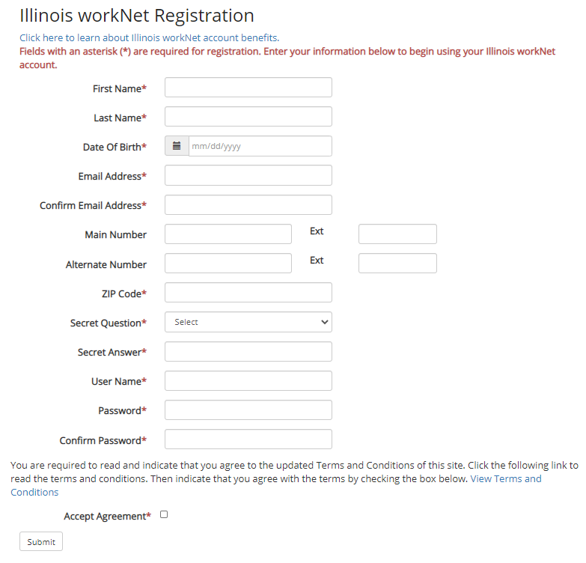

1. Create an Illinois workNet account
Go to IllinoisworkNet.com
At the top of the page click
the Sign Up icon
Fill out the entry form
Follow instructions in the
confirmation email

Slide 6
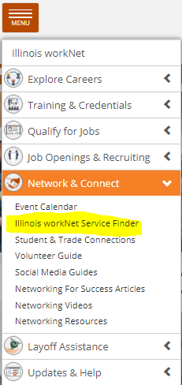
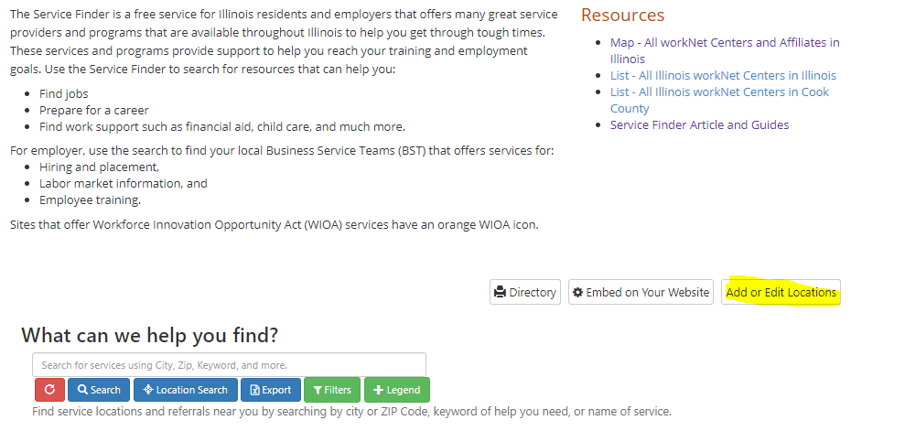
2. Add your site to the service finder
Before you can officially become a partner, your
organization must be listed in the Service Finder.
You must log into your account and submit your
organization to be approved as a partner location.
For more information about how to do this, see
the Service Finder article (linked on page).

Slide 7
3. Send your request to info@illinoisworknet.com
After submitting your site to the Service Finder, send an email to
info@illinoisworknet.com with the following information:
A reason for the email; for example, "I would like to request an
Illinois workNet partner account.“
Your name as it appears in your Illinois workNet account.
The name of your organization as it appears in the Service
Finder.
Your organization's address and work phone number.
We will review your request, confirm your information is accurate,
and provide you with a partner account.

Slide 8
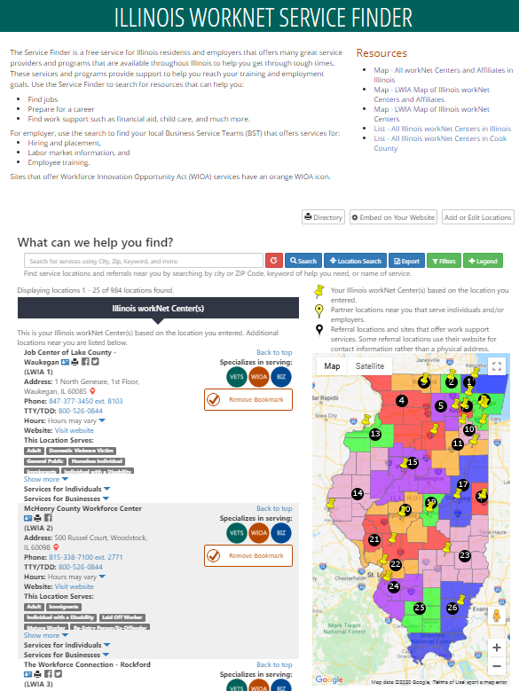
Illinois workNet service finder
Job Seekers come here to look for resources that help with finding jobs, preparing for a career, and work support such as financial aid, childcare, and more.

Slide 9
Illinois workNet service finder
Employers can use this to find Business Service Teams that offer services such as hiring and placement, LMI, and employee training.

Slide 10
Illinois workNet service finder
Both job seekers and businesses may contact your center by using the Service Finder search and seeing your contact information.
If they have questions you or someone in your office are unable to answer, you can also use the search to see if there’s another location you can refer them to.

Slide 11
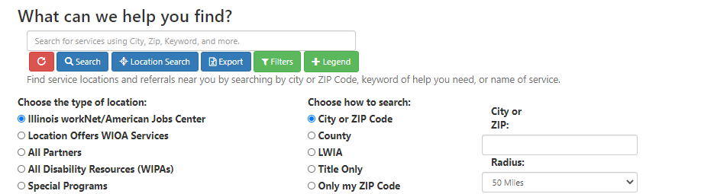
Illinois workNet service finder: search Filters

Slide 12
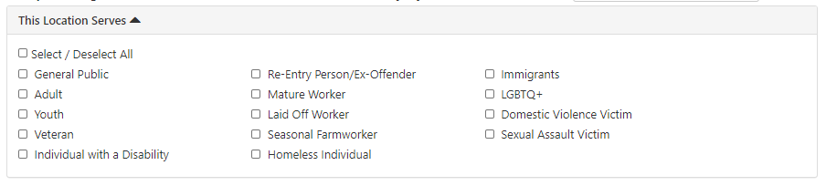
Illinois workNet service finder: search Filters

Slide 13
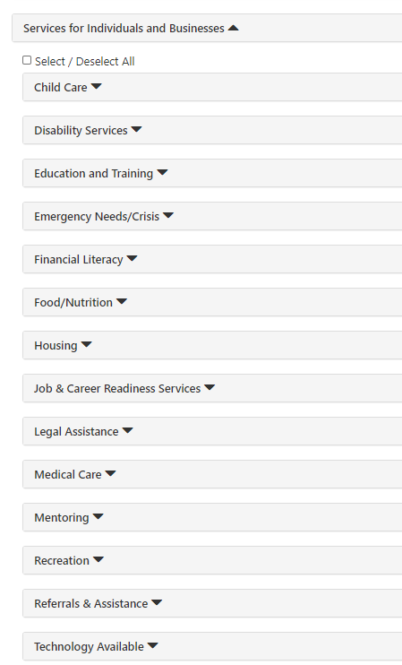
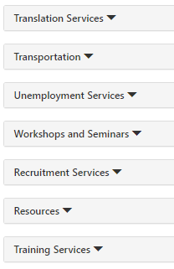
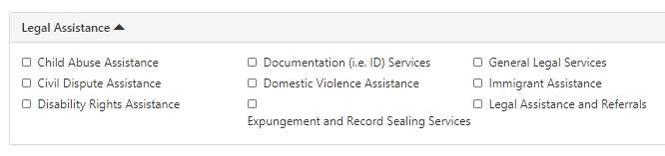
Illinois workNet service finder: search Filters

Slide 14
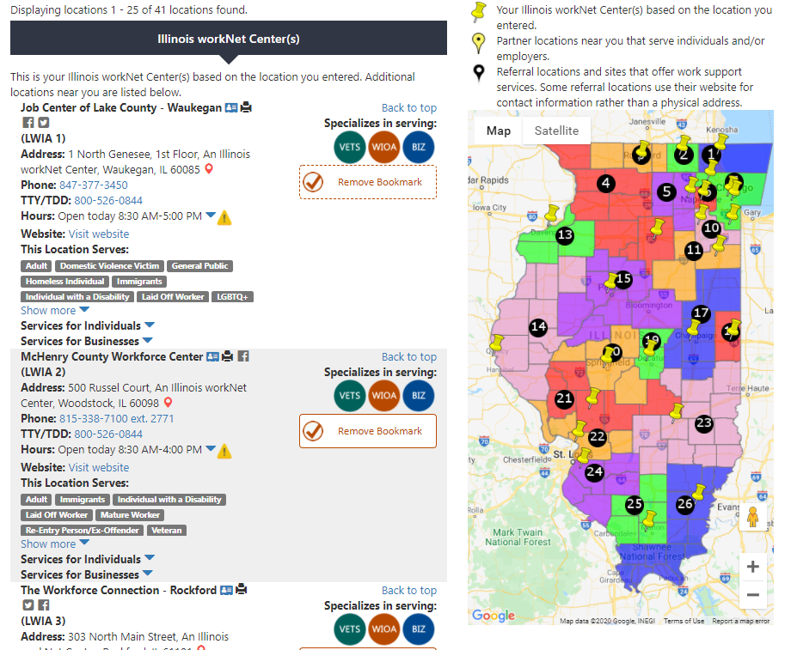
Search results

Slide 15
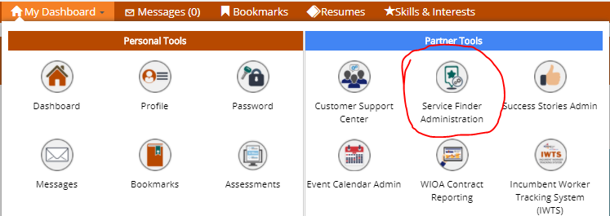
Managing site information
Once your site is approved, the designated primary and secondary contacts (if applicable) can manage service or referral information at any time.
We understand that accurate information is important, so we will send out an automatic email notice every six months to make sure the information is accurate.
To access the Service Finder administration area:
Login to your Illinois workNet partner account.
Select My Dashboard and then select Service Finder Administration under the Partner Tools section.
On the Dashboard, you will have a list of Partner sites that you have added to the Service Finder. Select the Edit button next to the site to make any updates.

Slide 16









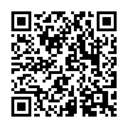
follow us!
Subscribe to our Newsfeed or check us out on Social Media
HOME: https://www.illinoisworknet.com/
EMAIL: info@illinoisworknet.com
MORE INFO: www.illinoisworknet.com/ExploreCareers
Facebook
Twitter
Youtube
linkedin
Linkedin group
Pinterest

