Slide 1
March 5, 2020
WIOA RAPID RESPONSE WEBINAR Workforce Services for Dislocated Workers
for
One Point Logistics, Inc.

Slide 2

Presenter
Kathleen Brannigan
Chicago Cook Workforce Partnership
Business Relations Specialist

Slide 3













About The Partnership
Created in 2012, The Chicago Cook Workforce Partnership (The Partnership) is an umbrella organization operating the public workforce system in the City of Chicago and Cook County. The Partnership combines federal and philanthropic resources to broaden the reach and impact of workforce development services for both employers and job seekers.
As the largest workforce development system in the nation, The Partnership has helped place more than 60,000 individuals in employment, collaborated with more than 2,000 employers and administers more than $200 million in federal and philanthropic funds. The Partnership’s network of 53 community-based organizations, 10 American Job Centers, and sector-driven workforce centers serve 132 municipalities.
Focusing on the region’s labor market, The Partnership provides training, business services, career coaching and data analysis, in the following high-growth and high-demand industries:
    Business and Professional Services
    Healthcare
    Retail, Culinary, and Hospitality
    Information Technology
For more information about The Partnership, visit workforceboard.org call 312.603.0200, follow us on social media @ChiCookWorks, or Subscribe to In the Works, The Partnership’s monthly eNewsletter.
    Manufacturing
    Transportation, Distribution, and Logistics
    Construction

Slide 4
Our Motivation
Vision
  Every person has the opportunity to build a career; every business has the talent to grow and compete in a global economy.
Mission
  To create, promote, and effectively manage a network of workforce development organizations that:
  Designs innovative solutions to address business needs, and,
  Prepares individuals for, and connects them to, career opportunities

Slide 5






System Overview
Data and Analytics
Sector Strategies
Job Postings
Recruitment
Candidate Assessment
Employee Upskilling
Career Pathways
Talent Pipeline
Career Coaching
Individual Employment Plan
Training
Job Search
Job Seeker
Employer
Training Provider
Business Services Team
Chicago Cook Workforce Partnership
Career Coach

Slide 6
Region’s Labor Market
    Business and Professional Services
    Healthcare
    Retail, Culinary, and Hospitality
    Information Technology
    Manufacturing
    Transportation, Distribution, and Logistics
    Construction

Slide 7
Rapid Response Services
Rapid Response is Laid Off Worker Services
Provide information & available resources & programming for WIOA Dislocated Workers administered under the Cook County public workforce system – Local Workforce Innovation Area 7 (LWIA) or ‘The Partnership’.
To support affected workers who are facing an employment layoff at no fault of their own with employment services, programs, and resources that will prepare and support them in their re-employment efforts including and opportunity to train/re-train in sector & demand driven occupational training.

Slide 8
What is a Dislocated Worker?
Dislocated Workers are individuals who:
Have received notice of layoff, have been laid off, due to company closure or re-organization resulting in a reduction in force or mass layoff.
Rapid Response services are set into action by receipt of the WARN Notice.
WIOA Dislocated Worker funding serves these layoff affected workers in their employment transition through workforce development programs & services.

Slide 9
What is WIOA?
Workforce Innovation & Opportunity Act - WIOA
Laid Off Worker programs & services for Dislocated Workers are made available through federal funding from the US Department of Labor.
WIOA funds the public workforce system throughout the USA through the American Job Center system.
WIOA funding provides re-employment preparation assistance, job placement support/assistance, and opportunity for occupational training leading to improved skill attainment and workforce marketability.
AT NO COST TO YOU! Tax Dollar funded program.

Slide 10
Get Started through WIOA
How can WIOA help & your next step:
WIOA dislocated worker program provides career services & resources, workforce readiness & training services for Laid Off Workers through the American Job Center system and public workforce system
In Cook County – the public workforce system consists of ten (10) American Job Centers located in the City of Chicago and suburban Cook County along with a network of expert workforce development organizations that are regionally located throughout Chicagoland
Call the nearest, most convenient American Job Center nearest you and register for a Dislocated Worker Orientation session (held weekly, varies by Center). Bring your Company separation letter which validates your layoff & other required documents

Slide 11
Career Success through WIOA
Mock Interview Preparation
Hire First On-The-Job Training Incentive programs
Business Service Teams that make connections to Employers and JOBS
Employment & Career Success
Career Resources & Workshops
Job Search Services
Job Placement Services
Access to Labor Market Data
One-on-One Career Coaching
Individual Employment Plan & Goals
Train in Demand Sector driven occupations
Resource Centers that can serve as your Work Office.
Use of Computers, Internet, Printers and more –at no cost.
Workforce-Job Readiness Workshops
Professional Resume Writing Assistance
Social Media Workshops
Career Coach & Job Search Assistance
Occupational Training Opportunities
*Healthcare *IT *Manufacturing
*Transportation & Logistics
*Hospitality, Retail
*Business & Professional Services
*Construction

Slide 12

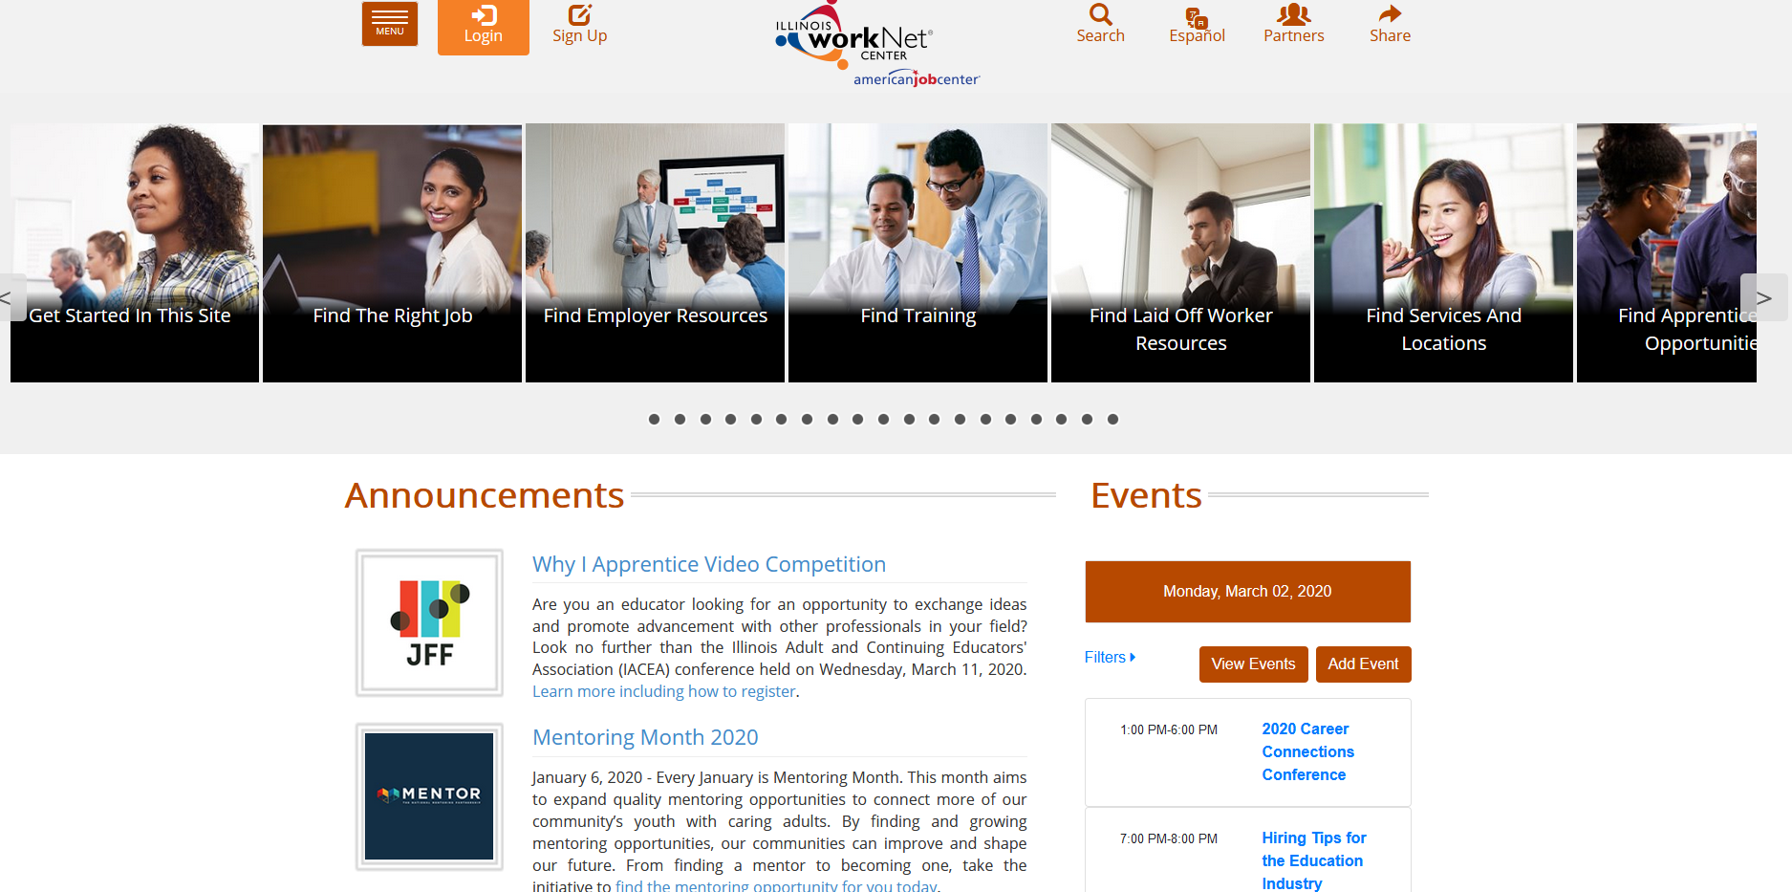
Illinoisworknet.com
Follow the Laid Off Worker Icon
www.illinoisworknet.com
Illinoisworknet.com is an online, 24/7 informational workforce development website that helps individuals plan and move forward in their job search & careers. It can also direct you to find the State of IL Health Insurance exchange or other support services

Slide 13
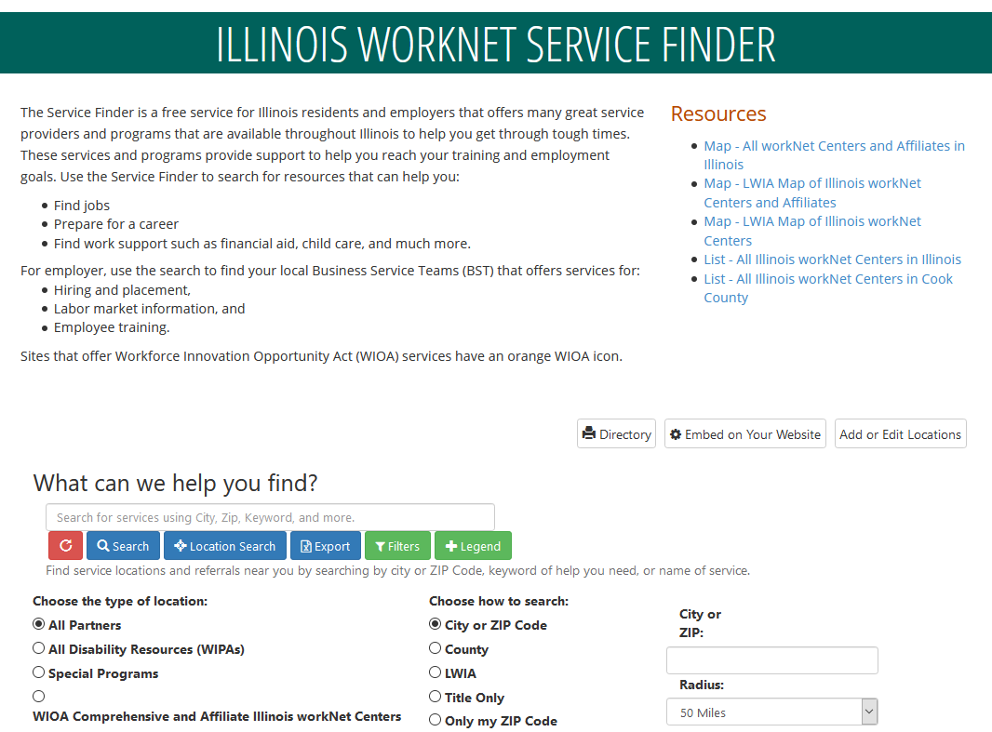
Illinoisworknet.com
www.illinoisworknet.com
Search for a Cook County American Job Center nearest you. You can filter/narrow your search by Zip Code, County, Keyword Search: Laid Off Worker Services

Slide 14
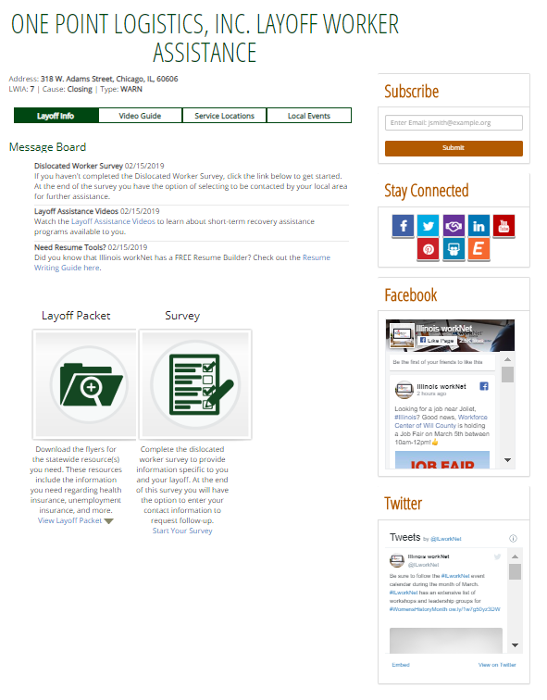
Illinoisworknet.com
Company Specific Layoff Page
www.illinoisworknet.com/opl

Slide 15
Connect with the
Chicago Cook Workforce Partnership
For more information about The Partnership, visit workforceboard.org, call 312.603.0200, follow us on social media @ChiCookWorks, or Subscribe to In the Works, The Partnership’s monthly eNewsletter.

