Slide 1
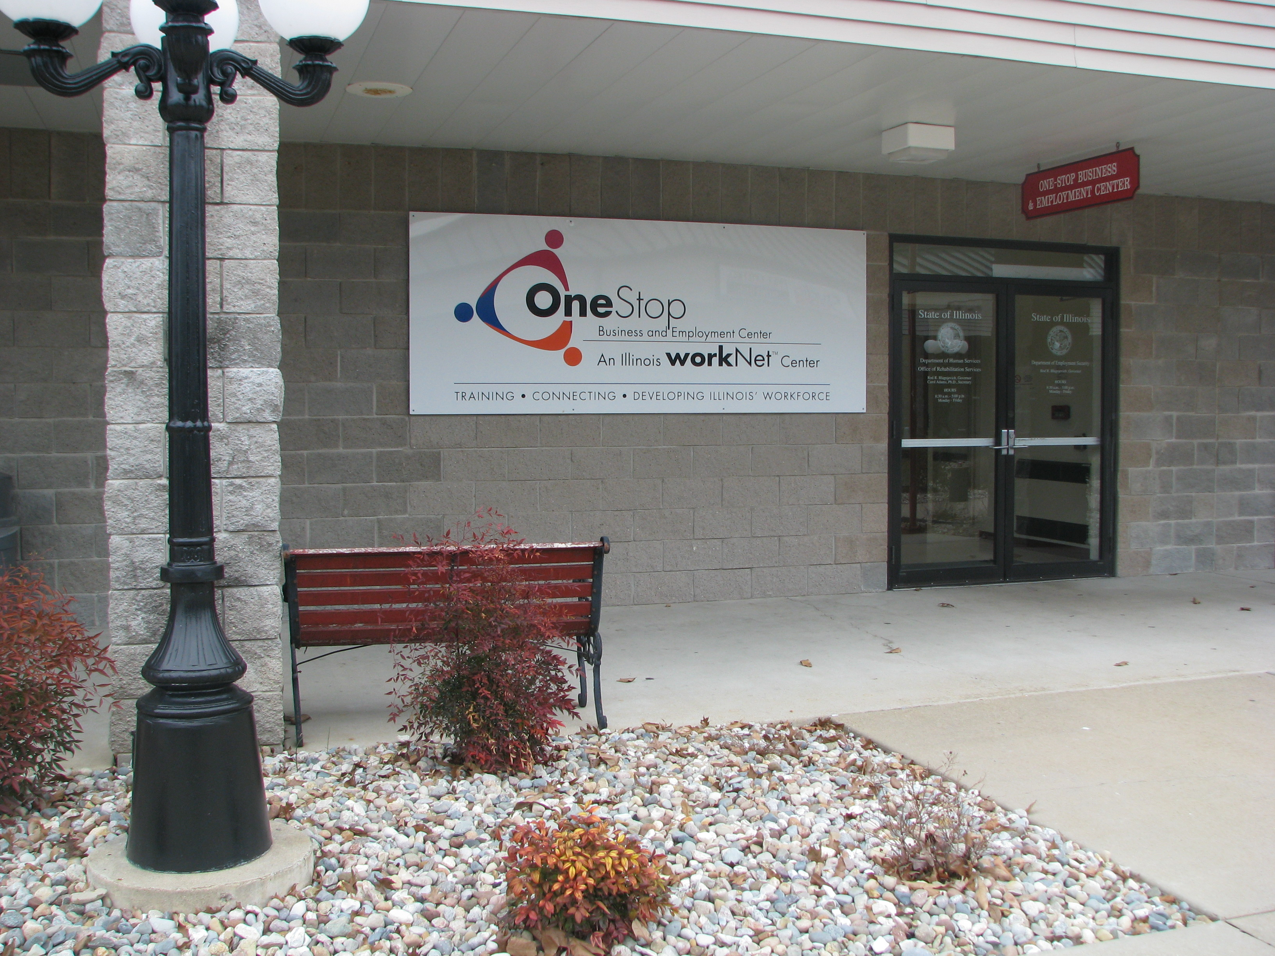
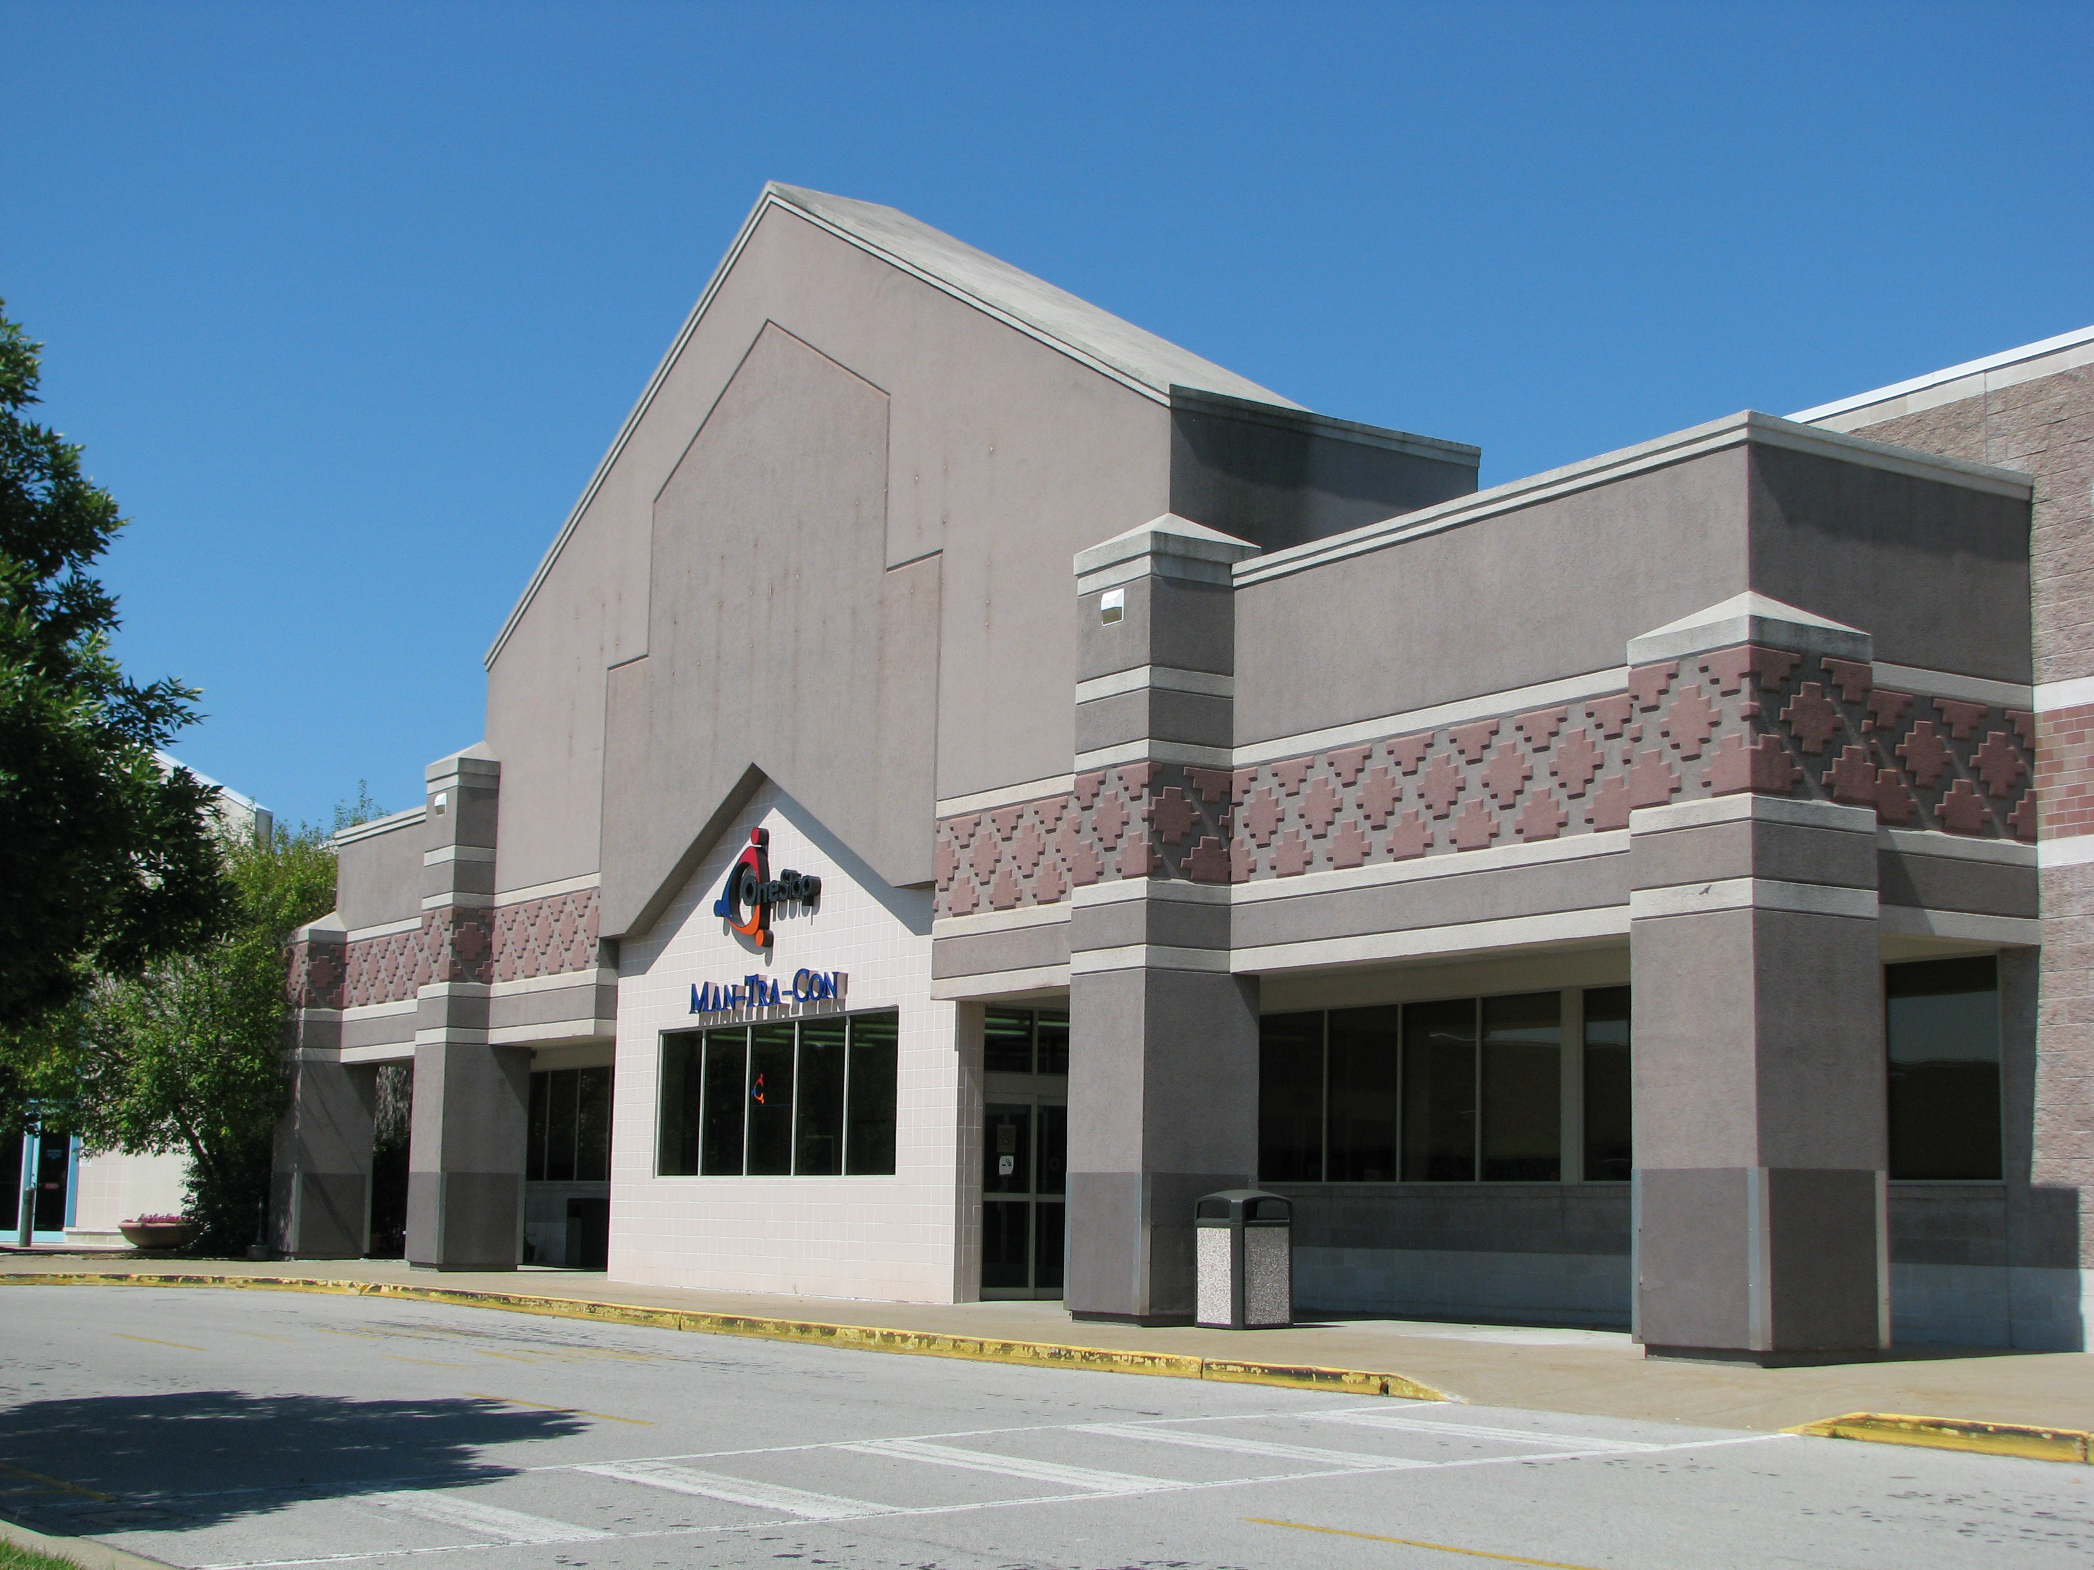
Overview of WIOA Services for
Dislocated Workers
618/998-0970
www.mantracon.org
333 Potomac Blvd., Suite E
Mt. Vernon, Illinois 62864
3000 W. DeYoung
Marion, Illinois 62959

Slide 2
Man-Tra-Con can help you find new employment and our services are provided at “no cost” to you!
Job Search Assistance
Resume preparation
Provide Job Leads
Prepare for Interviews
Navigate on-line Job Applications
Make Employer Connections

Slide 3
Man-Tra-Con can help you with learning new skills or with training for a new career.
Work Based Learning & Education
Work Experience – designed to help an individual learn new skills to transition into permanent, full-time employment. Participants earn wages & gain experience while looking for permanent employment.
On-The-Job Training (OJT) – provides wage reimbursement to an employer while a new employee is learning a job.
Apprenticeships – a combination of on-the-job training (paid work) and technical instruction leading to a degree or credential from the Department of Labor.

Slide 4
Man-Tra-Con can help you with learning new skills or with training for a new career.
Work Based Learning & Education, continued
Educational Assistance for Certificate or Degree Programs – scholarships for training in a new career. WIOA scholarships cover all costs associated with an occupational training: tuition/fees, books, tools & supplies, uniforms, mileage reimbursement, childcare costs.

Slide 5
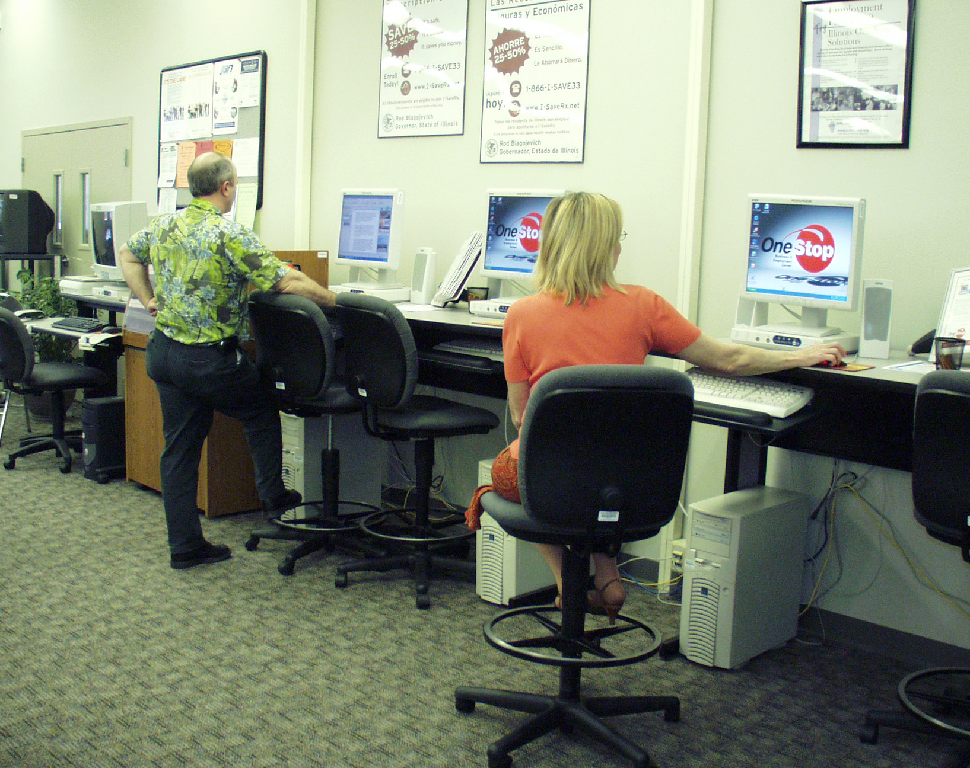
Man-Tra-Con is a partner with the
American Job Center Resource Rooms
Our RESOURCE ROOMS offer the following tools to help you reach your career goals.
Computers — with unlimited Internet access
Fax, phone, scanner, copier
Connections — to other valued community resources
NO APPOINTMENT IS NECESSARY TO USE THE RESOURCE ROOM. If you require initial information on how to use these tools, please ask our staff for help. Resource rooms are located at our offices in Marion and Mt. Vernon—available Monday through Friday, from 8:30 a.m. to 4:30 p.m.

Slide 6
THANK YOU… for taking time to watch this webinar.
We want to hear from you. Please call or visit one of our offices or checkout our website.
Marion:
3000 W. DeYoung
North side of Illinois Centre Mall – in between Dillard’s & Pirate Pete’s
Mt. Vernon:
333 W. Potomac
Rend Lake Marketplace
Phone: 618/998-0970 (for both locations)
Website: www.mantracon.org
YOUR success story can begin NOW!

