Slide 1
Local Workforce Innovation Area Realignment Statewide Update
9/12/18

Slide 2
Webinar Agenda
  Workforce Planning Areas
  WIOA Planning Regulations
  Realignment Considerations

Slide 3
Local Workforce Innovation Areas
Under the Workforce Innovation and Opportunity Act (WIOA), the Governor has the responsibility to designate Local Workforce Innovation Areas (LWIAs).
  LWIAs are composed of one or more counties that provide workforce development services
  Illinois currently has twenty-two LWIAs

Slide 4
LWIA Designation
The Governor must designate LWIAs that are:
  Consistent with labor market areas in the State;
  Consistent with regional economic development areas in the State; and
  Have available the Federal and non-Federal resources necessary to effectively administer activities under WIOA.

Slide 5
Labor Market Areas
A Labor Market Area is an economically integrated geographic area within which individuals can reside and find employment within a reasonable distance or can readily change employment without changing their place of residence.
Information such as metropolitan statistical areas (MSA), and workforce commuting patterns provide a snapshot of the labor market.

Slide 6
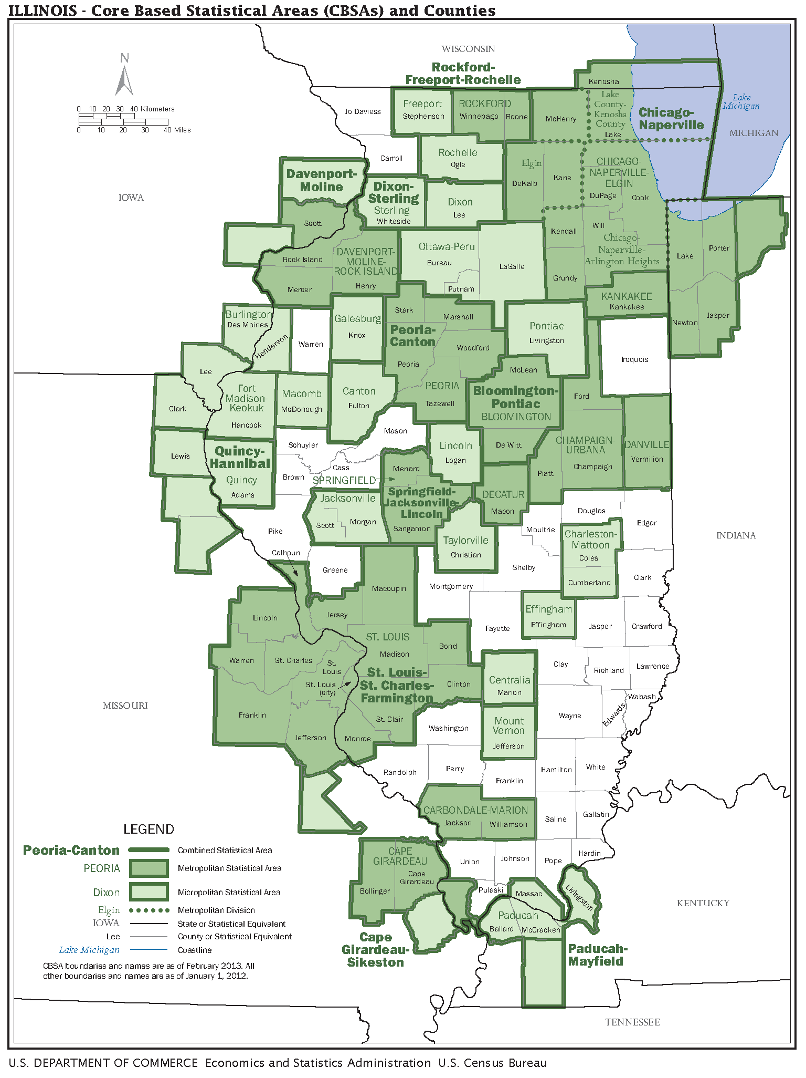
Metropolitan Statistical Areas

Slide 7
WIOA Planning Regions
The Governor must also designate Planning Regions that are consistent with labor market areas in the State; and consistent with regional economic development areas in the State.

Slide 8
Illinois’ WIOA
Planning Regions
Based on the requirements that WIOA planning regions must be consistent with labor market areas and regional economic development areas, the State concluded that Illinois’ WIOA planning regions should coincide with Illinois’ existing Economic Development Regions (EDRs).

Slide 9
Illinois Economic Development Regions
Illinois’ Economic Development Regions were determined based on the following factors:
Workforce: Demographics, Labor Force, Commuting Patterns
Geography: Metropolitan Statistical Areas (MSAs)
Business & Industry: Employers & Major Industries

Slide 10
Data-Driven Policy
In its description of the principles of WIOA in Federal Regulations, the DOL states that:
  “Success in accomplishing the purposes of WIOA at the State, local, and regional levels, will be determined by labor market, and related data driven policy and strategic decisions.”

Slide 11
State of Illinois Strategies
Below are the state’s strategies to achieve our vision and goals. They consist of six major strategies, and each directly underpins Illinois’ commitment to engage and support all parts of our workforce, education, and economic development systems
Coordinate Demand-Driven Strategic Planning at the State and Regional Levels
Support Employer-Driven Regional Sector Initiatives
Provide Career Pathways for Economic Advancement
Coordinate and Enhance Career Services and Case Management
Expand Employer and Job Seeker Access to Labor Market Information
Improve Public-Private Data Infrastructure

Slide 12
LWIA Realignment
WIOA Planning Regulations

Slide 13
WIOA Planning Regions
In accordance with WIOA Section 106(a)(2), a single local area may not be split across two planning regions
Local areas must be contiguous in order to be a planning region and effectively align economic and workforce development activities and resources.” 20 CFR 679.210

Slide 14
Monitoring Finding
In 2017 the US Department of Labor issued a Finding that Illinois’ Regional Planning / LWIA map is not in compliance with the aforementioned requirement. Illinois was directed to: “identify a regional structure that does not result in any single local area being split between two or more regions”.

Slide 15
Potential Impacts
The Realignment process was included as part of Illinois’ Plan submission in March, 2018. Also, in order to address the finding and begin the corrective action process, Illinois had to complete the consultation process by July 1, 2018. The plan was approved at the end of June, 2018.
Without an approved plan, Illinois could have been subject to sanctions including the withholding of formula funding for Titles I & III. Illinois’ applications for non-formula funding opportunities could have also been impacted.

Slide 16
Initial Consultation Meetings
Five Local Workforce Innovation Areas in Illinois are split across State Planning regions including: Ogle (LWIA 4), Livingston (LWIA 11), DeWitt (LWIA 19) , Jersey and Calhoun (LWIA 21), and Douglas (LWIA 23).
Illinois re-reviewed data and began the consultation process with the impacted Counties and Local Workforce Areas. This webinar represents that next phase of the consultation process.

Slide 17
Illinois Waiver Request
July 2018: The USDOL approved a waiver from the State of Nebraska regarding LWIA regional realignment requirement.
August 2018: The Illinois Workforce Innovation Board and State Agency Partners directed the State Team to request a waiver of the LWIA regional realignment requirement.
September 2018: Illinois Waiver Request has been posted for public comment prior to its submission to USDOL.

Slide 18
Waiver Requirements
Illinois waiver still needs to be submitted and approved by the US Department of Labor
US Department of Labor has advised that there are no guarantees that the waiver would be “renewed” beyond 2020.
If Illinois’ waiver is approved, Chief Elected Officials may be provided with the flexibility to retain the current regional / LWIA boundaries based on the consideration listed below:
  The counties and local workforce areas that are in multiple regions will need to agree to actively participate in the regional planning process of both regions.
  The CEOs must verify that they have reviewed the data / realignment options and have agreed to the LWIA configuration (retaining the current boundaries or realigning counties).
  The LWIA / Counties that do not realign must agree to work with the state in 2020 if this waiver is not renewed. LWIAs could be required to complete the regional planning process in 2020 AND in 2021 if the waiver is not renewed.

Slide 19
LWIA Realignment
Realignment Considerations

Slide 20
LWIA Realignment
The WIOA regulations “encourages States confronted with (the realignment) issue to reevaluate whether the local areas in question are consistent with labor market areas and with regional economic development areas in the State. If these criteria are not met, the State should consider how best to recast local areas for the purposes of subsequent designation and regional integration.”

Slide 21
Realignment Considerations
The Reconfiguration of a Local Workforce Innovation Area is a significant project that can take 9 to 24 months to complete.
Chief Elected Officials will need to work with the Local Workforce Innovation Board, Program Administrators, and other stakeholders to develop a transition plan that documents the following considerations:
  LWIA Governance & Planning
  Fiscal Management
  Service Delivery
  Performance & Reporting
  Other Local Considerations

Slide 22
Governance and Planning
Chief Elected Officials agreement(s)
Chief Elected Officials / Local Workforce Innovation Board Agreement
Chief Elected Officials / Grant Recipient / Fiscal Agent Agreement
Regional and Local Workforce Plan
Memorandum of Understanding

Slide 23
WIOA Title I Funding

Slide 24
WIOA Title I Formula Grants
(PY16-PY18)
 | PY'16 | PY'17 | PY'18 |  | PY'16 | PY'17 | PY'18 |  | PY'16 | PY'17 | PY'18 |  | PY'16 | PY'17 | PY'18
 | Adult | Adult | Adult |  | DW | DW | DW |  | Youth | Youth | Youth |  | Total | Total | Total
 | Allocations | Allocations | Allocations |  | Allocations | Allocations | Allocations |  | Allocation | Allocation | Allocation |  | Allocations | Allocations | Allocations
LWIA 1 | 1,326,864 | 1,625,811 | 1,537,041 |  | 1,497,643 | 1,558,510 | 2,105,402 |  | 1,363,309 | 1,669,961 | 1,618,824 |  | $4,187,816 | $4,854,282 | $5,261,267
LWIA 2 | 567,423 | 593,860 | 526,984 |  | 691,490 | 712,416 | 662,164 |  | 578,658 | 604,961 | 535,189 |  | $1,837,571 | $1,911,237 | $1,724,337
LWIA 3 | 1,173,569 | 1,418,716 | 1,499,087 |  | 1,481,736 | 1,858,639 | 1,990,780 |  | 1,212,473 | 1,469,096 | 1,541,948 |  | $3,867,778 | $4,746,451 | $5,031,815
LWIA 4 | 829,769 | 1,019,375 | 913,616 |  | 1,373,973 | 1,696,765 | 1,389,959 |  | 844,221 | 1,041,405 | 908,234 |  | $3,047,963 | $3,757,545 | $3,211,809
LWIA 5 | 1,567,153 | 1,853,812 | 1,673,333 |  | 1,642,406 | 2,172,492 | 1,811,700 |  | 1,804,802 | 2,127,074 | 1,898,620 |  | $5,014,361 | $6,153,378 | $5,383,653
LWIA 6 | 1,472,240 | 1,561,547 | 1,376,148 |  | 2,331,712 | 2,152,997 | 2,057,528 |  | 1,600,941 | 1,698,394 | 1,491,165 |  | $5,404,893 | $5,412,938 | $4,924,841
LWIA 7 | 15,330,752 | 16,374,445 | 16,044,835 |  | 14,992,951 | 17,712,553 | 17,365,872 |  | 15,740,116 | 16,778,774 | 16,532,089 |  | $46,063,819 | $50,865,772 | $49,942,796
LWIA 10 | 1,642,465 | 1,679,212 | 1,621,151 |  | 2,258,026 | 2,607,279 | 2,275,360 |  | 1,736,848 | 1,774,341 | 1,676,645 |  | $5,637,339 | $6,060,832 | $5,573,156
LWIA 11 | 576,218 | 670,531 | 624,281 |  | 820,918 | 997,924 | 845,198 |  | 597,664 | 696,179 | 634,228 |  | $1,994,800 | $2,364,634 | $2,103,707
LWIA 13 | 536,429 | 675,406 | 625,685 |  | 925,295 | 1,020,002 | 885,182 |  | 549,760 | 695,214 | 675,526 |  | $2,011,484 | $2,451,322 | $1,931,458
LWIA 14 | 528,268 | 672,165 | 541,480 |  | 686,791 | 991,541 | 754,255 |  | 626,361 | 787,616 | 635,723 |  | $1,841,420 | $6,944,046 | $6,529,213
LWIA 15 | 1,388,788 | 1,808,032 | 1,762,827 |  | 2,528,855 | 2,938,931 | 2,666,196 |  | 1,720,385 | 2,197,083 | 2,100,190 |  | $5,638,028 | $6,944,046 | $6,529,213
LWIA 17 | 543,738 | 680,628 | 651,620 |  | 508,421 | 682,643 | 548,009 |  | 949,554 | 1,141,282 | 1,123,503 |  | $2,001,713 | $2,504,553 | $2,323,132
LWIA 18 | 252,085 | 312,321 | 306,973 |  | 338,022 | 432,750 | 408,491 |  | 273,105 | 337,885 | 306,568 |  | $863,212 | $1,082,956 | $1,022,032
LWIA 19 | 362,916 | 434,319 | 409,652 |  | 575,594 | 637,234 | 551,772 |  | 396,422 | 473,739 | 428,523 |  | $1,334,932 | $1,545,292 | $1,389,947
LWIA 20 | 687,749 | 820,894 | 768,287 |  | 876,429 | 1,141,468 | 911,153 |  | 665,468 | 799,066 | 814,729 |  | $2,229,646 | $2,761,428 | $2,494,169
LWIA 21 | 466,900 | 561,378 | 464,633 |  | 584,316 | 755,432 | 605,150 |  | 500,186 | 601,232 | 495,883 |  | $1,551,402 | $1,918,042 | $1,565,666
LWIA 22 | 680,691 | 835,440 | 713,634 |  | 551,407 | 1,163,777 | 758,070 |  | 767,014 | 937,140 | 766,863 |  | $1,999,112 | $2,936,357 | $2,238,567
LWIA 23 | 739,085 | 923,822 | 824,486 |  | 1,164,844 | 1,463,563 | 1,188,790 |  | 875,900 | 1,083,769 | 881,502 |  | $2,779,829 | $3,471,154 | $2,894,778
LWIA 24 | 987,365 | 1,133,183 | 979,498 |  | 1,106,510 | 1,404,915 | 1,160,041 |  | 975,570 | 1,121,540 | 945,462 |  | $3,069,445 | $3,659,638 | $3,085,001
LWIA 25 | 699,600 | 864,564 | 754,257 |  | 752,211 | 1,014,327 | 840,586 |  | 783,921 | 964,533 | 829,018 |  | $2,235,732 | $2,843,424 | $2,423,861
LWIA 26 | 468,371 | 629,295 | 579,113 |  | 564,037 | 951,575 | 676,369 |  | 440,294 | 604,575 | 551,492 |  | $1,472,702 | $2,185,445 | $1,806,974
TOTAL | $32,828,438 | $37,148,756 | $35,198,621 |  | $38,253,587 | $46,067,733 | $42,458,027 |  | $35,002,972 | $39,604,859 | $37,391,924 |  | $106,084,997 | $122,821,348 | $115,048,572

Slide 25
Estimated Title I Fiscal
Impact on Counties
COUNTY | LOCAL AREA | CURRENT ALIGNMENT | PROPOSED ALIGNMENT | CHANGE
Ogle | LWIA 4 to LWIA 3 | $ 587,580 | $ 604,828 | $ 17,248
Livingston | LWIA 11 to LWIA 15 | $ 422,285 | $ 417,651 | $ (4,634)
Dewitt | LWIA 19 to LWIA 15 | $ 163,588 | $ 163,570 | $ (18)
Douglas | LWIA 23 to LWIA 17 | $ 167,085 | $ 169,874 | $ 2,789
Calhoun | LWIA 21 to LWIA 22 | $ 49,901 | $ 49,677 | $ (224)
Jersey | LWIA 21 to LWIA 22 | $ 218,336 | $ 217,219 | $ (1,117)

Slide 26
Estimated Title I Funding Shifts from Realignment

Slide 27
Service Delivery
Provide information regarding the transfer of functions including case management responsibilities to new LWIA (as applicable).
Include time to review and reconcile participant files and records (program and fiscal) for active participants (as applicable).
Plan for transitioning service providers, case managers and other IWDS staff from former Title 1 operator / grant recipient to new entity (as applicable).
Review and update policies, procedures, and processes impacting the delivery of participant services including the training and supportive service policies.
Update the regional and local plans to describe how services will be delivered.

Slide 28
WIOA Title I Service Levels
(PY13-PY17)

Slide 29
WIOA Title I Participants in Training (PY13-PY17)

Slide 30
Performance Management & Reporting
The State will provide technical assistance with the transfer of participant files and records for active participants (as applicable).
The State will work with the impacted LWIA’s to help manage the potential WIOA performance impacts.
The State will work with the impacted LWIA’s to assist in any transfers of training providers.
Additional guidance will be provided regarding the development of the 2020 Regional and Local Plans.

Slide 31
Next Steps & Timeline
October-November 2018: The State Team will coordinate individual meetings and provide information to assist the Chief Elected Official and local workforce stakeholders in making the regional alignment decisions.
November 30, 2018: The State will require a decision from the impacted Chief Elected Officials and Local Workforce Areas regarding the realignment of the impacted counties.
December 2018 - Ongoing: The State Team will provide significant technical assistance including on-site trainings, sample documents, program and fiscal management assistance to the LWIAs that move forward with the realignment process.

Slide 32
2020 Planning Process
April 2019 - March 2020: The regions and local workforce areas will develop the 2020 Regional and Local workforce plans. The impacted local workforce areas will finalize the transition plans for the impacted counties
April – June 2020: The Local Workforce Areas will execute the transition plan with an effective date of July 1, 2020

Slide 33
Resources
  PROJECT WEBSITE:
  https://www.illinoisworknet.com/WIOA/RegPlanning/Pages/LWIA-Realignment.aspx
  PROJECT CONTACT:
  Deb Waldrop
  Senior Workforce Consultant
  Email: Deb.Waldrop@Illinoisworknet.com
  Phone: 618-922-5456

Slide 34
Questions and Discussion

