Slide 1





Rapid Response Workshop:
MacMurray College Jacksonville

Slide 2



Agenda of Speakers
Martha McDermott
martha.mcdermott@illinois.gov
(312) 550-4225
Mike Sherer (Executive Director)
michael.sherer@west-central.org
(217) 854-9642 x 1235
Patti Sellers
patti.sellers@west-central.org
(217) 243-5846
Connie Pitts
connie.pitts@west-central.org
(217) 243-5846
Monica Heard
monica.heard@illinois.gov
(217) 524-7856

Slide 3
Our goal is to help you get back to work!
Workforce Innovation & Opportunity Act
“WIOA”
WIOA services are free to you due to the closure of MacMurray College
WIOA is a federally funded program, paid for through your tax dollars
Access services anywhere in the United States
DuPage County, Illinois
locations

Slide 4
Dislocated Workers
Dislocated Workers are individuals who:
Have been laid off, or terminated, or have received notice of layoff or termination due to a plant closure or mass layoff,
Are unemployed through no fault of their own, are eligible for or have exhausted their unemployment compensation and are unlikely to return to their previous occupation or industry,
Were self-employed (including farmers, and ranchers) and are unemployed as a result of general economic conditions in their community, or
Are displaced homemakers or those who have been dependent on another’s salary but are now without.

Slide 5
Dislocated Worker Program
Services available to dislocated workers, including job search assistance as well as training services, are available in Illinois workNet® American Job Centers throughout Illinois. Accessing these services can help you upgrade your current skills to get a better job or provide support as you look for other employment.
Available Services:
• Career Services
• Training Services
• Work-Based Learning
Eligible applicants must be:
Authorized to work in the U.S.,
At least 18 years old, &
Registered in Selective Service, if male

Slide 6
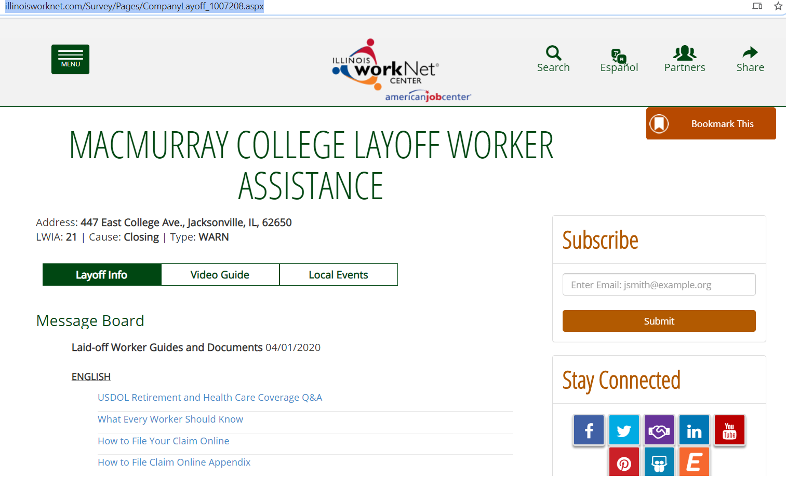
MacMurray College Layoff Assistance Resources
A company specific page has been created for MacMurray College workers to view information on local events, services, and resources available to help them navigate through this time.
Also on the layoff page is a Survey for those interested in receiving benefits from the WIOA program for dislocated workers.

Slide 7
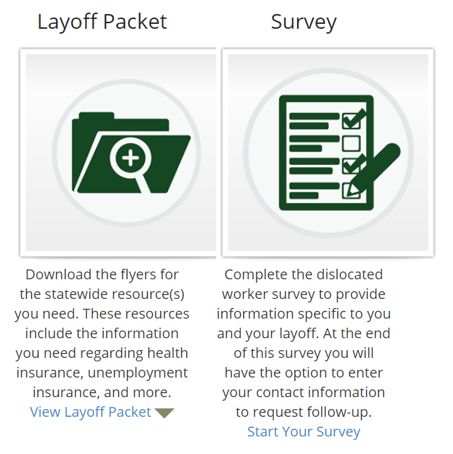
Key Resources
Survey for dislocated workers is an excellent starting point to express interest in benefits provided through WIOA and introduce yourself to a local workforce area representative.
  WIOA benefits include:
  Training or certification programs
  Post-secondary education
  Help finding a new job or starting a business
  Assistance to complete unemployment claims
Layoff Packet includes resources for individuals experiencing a layoff to serve as a self-serving guide through the process.
  Layoff Packet includes:
  Dislocated Workers Flyer
  Dislocated Worker Program Overview
  Employment Resources for Job Seekers

Slide 8

West Central Development Council
Patti Sellers
patti.sellers@west-central.org
(217) 243-5846
Connie Pitts
connie.pitts@west-central.org
(217) 243-5846
5 Job Centers in the West Central Region
Macoupin County Job Center - Carlinville
Montgomery County Job Center - Litchfield
Morgan/Scott Job Center - Jacksonville*
Shelby County Job Center - Shelbyville
Greene County Job Center - Carrollton
Visit www.west-central.org for detailed information on these centers.

Slide 9
West Central Development Council
LWIA 21 Services
814 W. State
Jacksonville
On The Job Training (OJT)
Resource Room
Mock Interviewing
Resume Writing
Individual Assistance
Locating Jobs

Slide 10
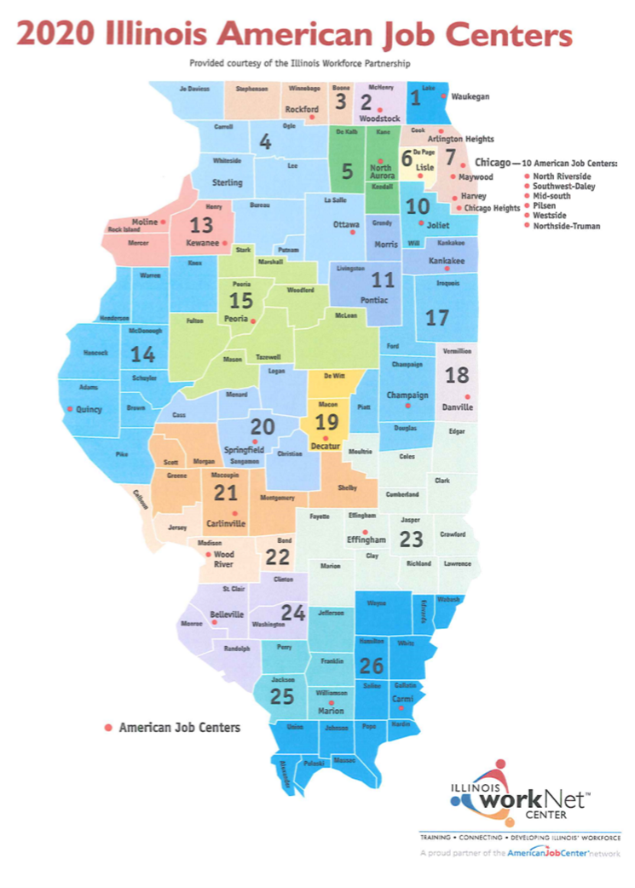
22 American Job Centers across the State of Illinois.
These centers provide resources and assistance to individuals and employers during transitional periods of employment.
MacMurray College in Jacksonville is designated to LWIA 21 – Carlinville location. However, affected workers of MacMurray can utilize services at any American Job Center in Illinois, or across the United States.
American Job Centers of Illinois

Slide 11
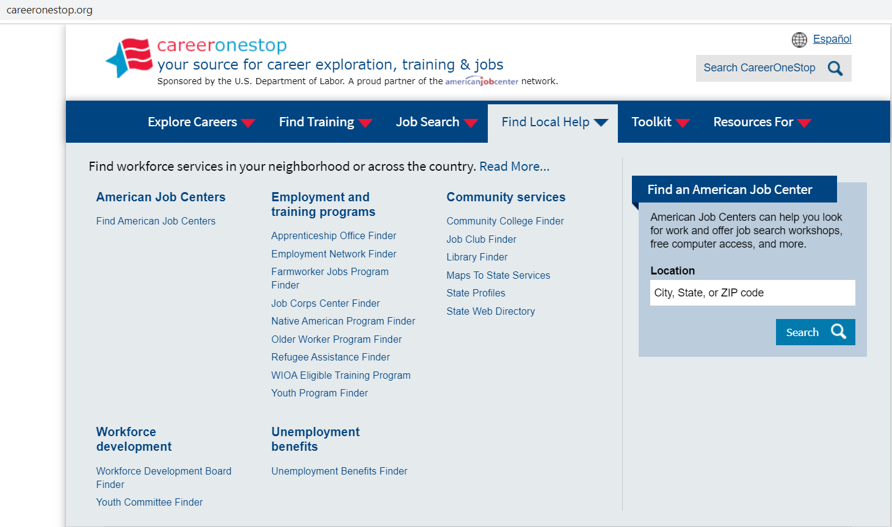
Search American Job Centers Nearby
www.careeronestop.org provides a directory of the nearest American Job Center nationwide.
To find the closest location, simply search by City, State or Zip Code.

Slide 12
U.S. Department of Labor - Employee Benefits Security Administration
Retirement & Health Care Coverage answers for dislocated workers
Visit us at www.dol.gov/agencies/ebsa
Call us at (866) 444-3272
Contact us electronically at www.askebsa.dol.gov

Slide 13

COBRA
Allows you to continue on your former employer’s group health plan for up to 18 months following a job loss
Up to 29 months if you (or your beneficiary) are deemed disabled by SSA
You pay the full cost of the insurance plus a 2% administration fee
There is a formal election process to get onto COBRA
The election notice must be sent to you within 44 days of coverage loss
You have 60 days to elect the COBRA
You have 45 days to make your first payment from the date of election
COBRA coverage is retroactive to date coverage was terminated
Outstanding claims and out of pocket expenses will be paid or reimbursed

Slide 14
HIPAA Special Enrollment
Allows enrollment in a spouse’s employer’s plan (or a parent’s employer’s plan if you are under age 26) when you lose health coverage based upon a job loss
Your spouse (or parent) must request special enrollment from his or her employer’s plan within 30 days of losing coverage
Coverage becomes effective the first day of the following month
HIPAA does not provide a special enrollment right when an employer stops paying towards COBRA based upon a severance agreement

Slide 15
Affordable Care Act (ACA)
Health Insurance Marketplace
You have up to 60 days after your insurance ends to enroll in a plan after your job loss
Unlike COBRA, the coverage is not retroactive
Enroll by the 15th of the month for the coverage to begin the 1st of the following month
The marketplace will also determine whether you qualify for Medicaid
The marketplace may allow enrollment when an employer stops paying towards COBRA based upon a severance agreement

Slide 16
Retirement Benefits Options
401(k) Plan
Take a distribution
    There is 20% automatic tax withholding and a 10% penalty if you are younger than 59 ½
    A distribution may also affect your unemployment benefits
Roll the account into another employer plan or your own IRA
    There are no tax consequences with a rollover
Leave the account with your former employer
    Make sure the plan has your current mailing address and email address
    You should receive information from the plan annually

Slide 17
Upcoming Web Sessions – Health Care Coverage and Retirement Benefits after Employment
Attend one of these virtual information sessions on Dislocated Workers rights under COBRA, special enrollment rights, and your rights as a participant of an employer sponsored retirement plan.
April 29, 2020 at 2:00 pm Central Time
JOIN WEBEX MEETING https://dol.webex.com/dol/j.php?MTID=md46bf17e26917e005a5d7152f932e18c
Meeting number: 615 260 613
Meeting password: pPZPurk@327
JOIN BY PHONE
Call-in number: 1-517-244-5430
Call-in toll-free number: 1-866-616-0010
Attendee access code: 403 114 6#
April 30, 2020 at 9:00 am Central Time
JOIN WEBEX MEETING https://dol.webex.com/dol/j.php?MTID=m7af29c7ad548faff7a1e39675e8b92be
Meeting number: 615 131 400
Meeting password: YMpXRum2*63
JOIN BY PHONE
Call-in number: 1-517-244-5430
Call-in toll-free number: 1-866-616-0010
Attendee access code: 403 114 6#

Slide 18


Health Insurance Contact Information
https://getcovered.illinois.gov/
review, compare and enroll in an ACA Marketplace health plan
https://widget.getcoveredamerica.org/?original=/IL/
free enrollment assistance
Calvin Green
Illinois Department of Insurance
877- 527-9431
Healthcare.gov
800-318-2596

Slide 19




Questions?

