Slide 1
2023 LWIB Recertification & LWACS Updates
Michael Baker - Illinois Department of Commerce
Marcus Lathan – SIUC Center for Workforce Development

Slide 2
Agenda
2023 LWIB Recertification
LWACS System Updates
Updated Process Printable Appointment / Reappointment Form
Streamlined Data Entry
New Feature Document Library
Live Walk-Through

Slide 3
2023 LWIB Recertification Process
Enter Member Info for ALL New & Active Members
Upload Signed Forms & Documents
State Review
Notification of Approval or Corrective Action

Slide 4
2023 LWIB Recertification Process
Members
Recertify (Update Every Member)
Reappoint
Forms
Appt./Reappt.
Nomination (if required)
Documents
LWIB Bylaws
CEO Agreement
New
Composition Summary
Bus. Members
Accessibility
CEO/LWIB Agreement
Change employer / contact info
Mark Departing Members

Slide 5
2023 LWIB Recertification Process
Following information due October 1, 2023
Appointment / Reappointment Forms (All new and ongoing LWIB members)
Updated Composition Summary Form
LWIB Bylaws – upload most recent version
CEO Agreements – upload most recent version
CEO/LWIB Agreements (where they exist) – upload
Narrative-Business members relevant to employment opportunities
Accessibility Statement

Slide 6
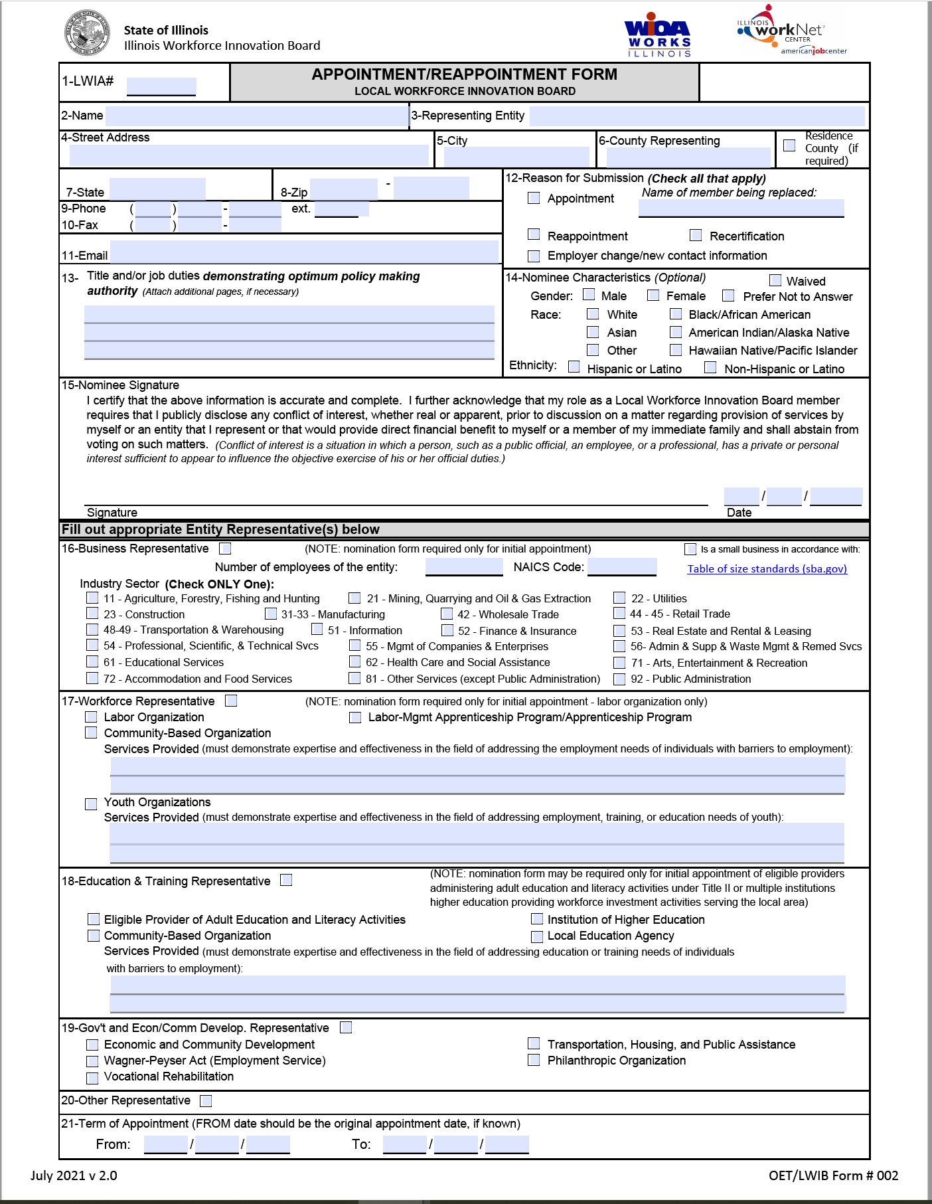
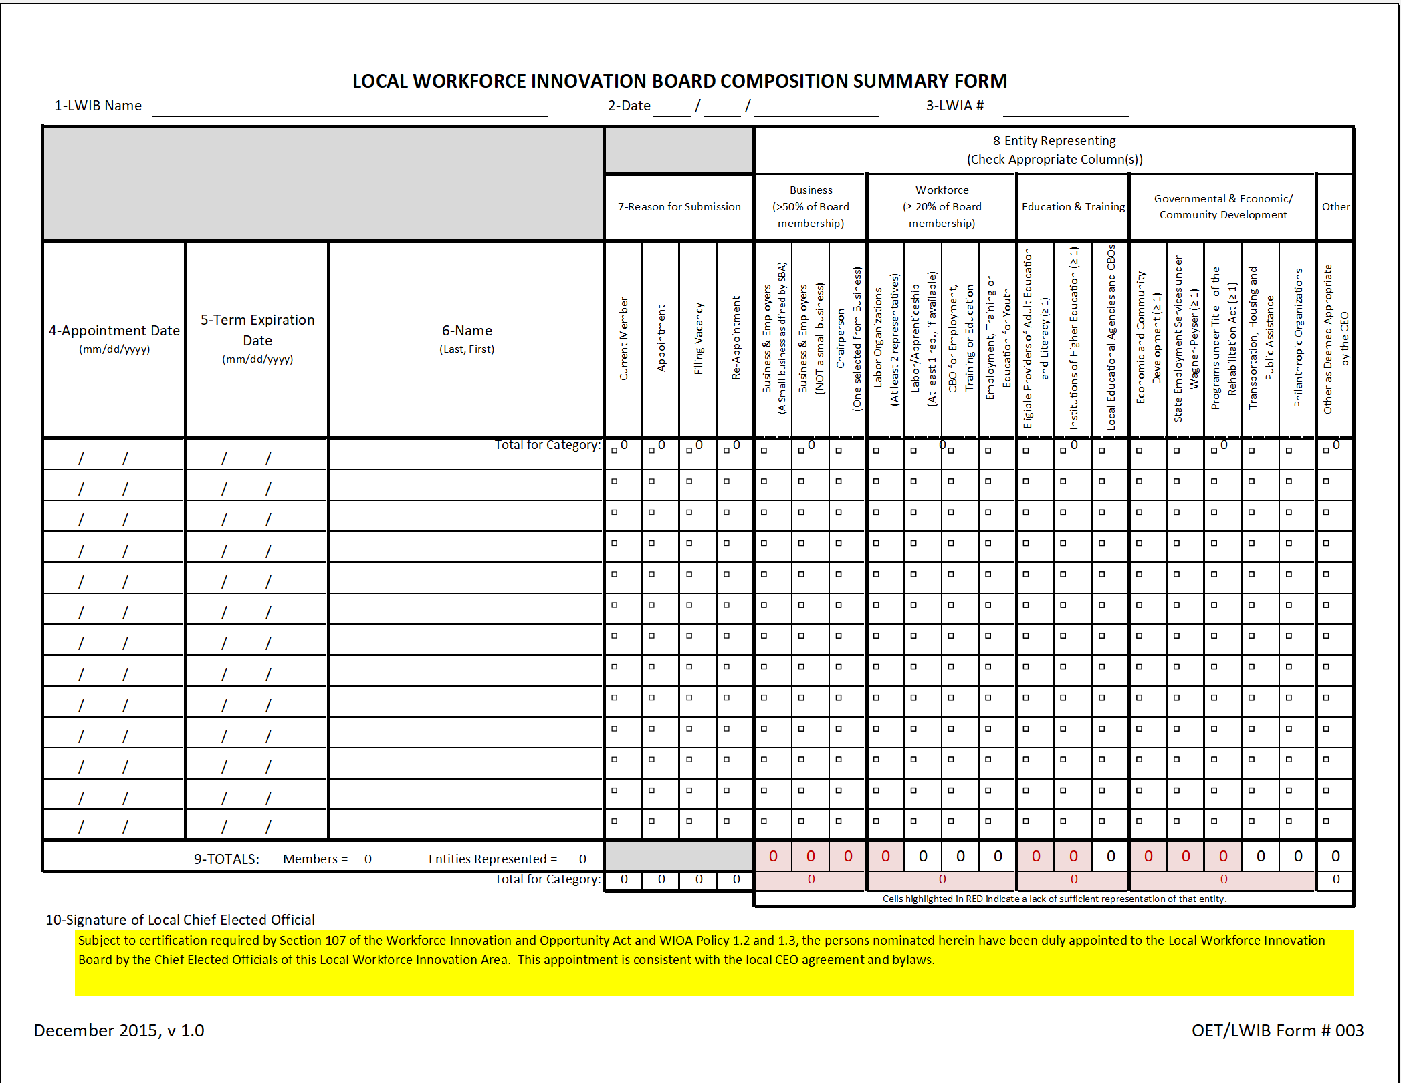
2023 LWIB Member Updates
Continue transition to more automated process
Reduce errors where information across forms did not align
Reduce errors where information on form did not align with information entered into LWACS

Slide 7
Appointment / Reappointment Form
1
2
3
4
Enter Appointment Form info into LWACS for new & active members
Generate printable form
Obtain signature and upload signed form into LWACS member record
Remember to update any departing members in LWACS
New Process for 2023 System creates form based on member info

Slide 8
Composition Summary Form
System creates form based on member information
1
2
3
Generate printable form
Obtain CEO signature
Upload signed form

Slide 9
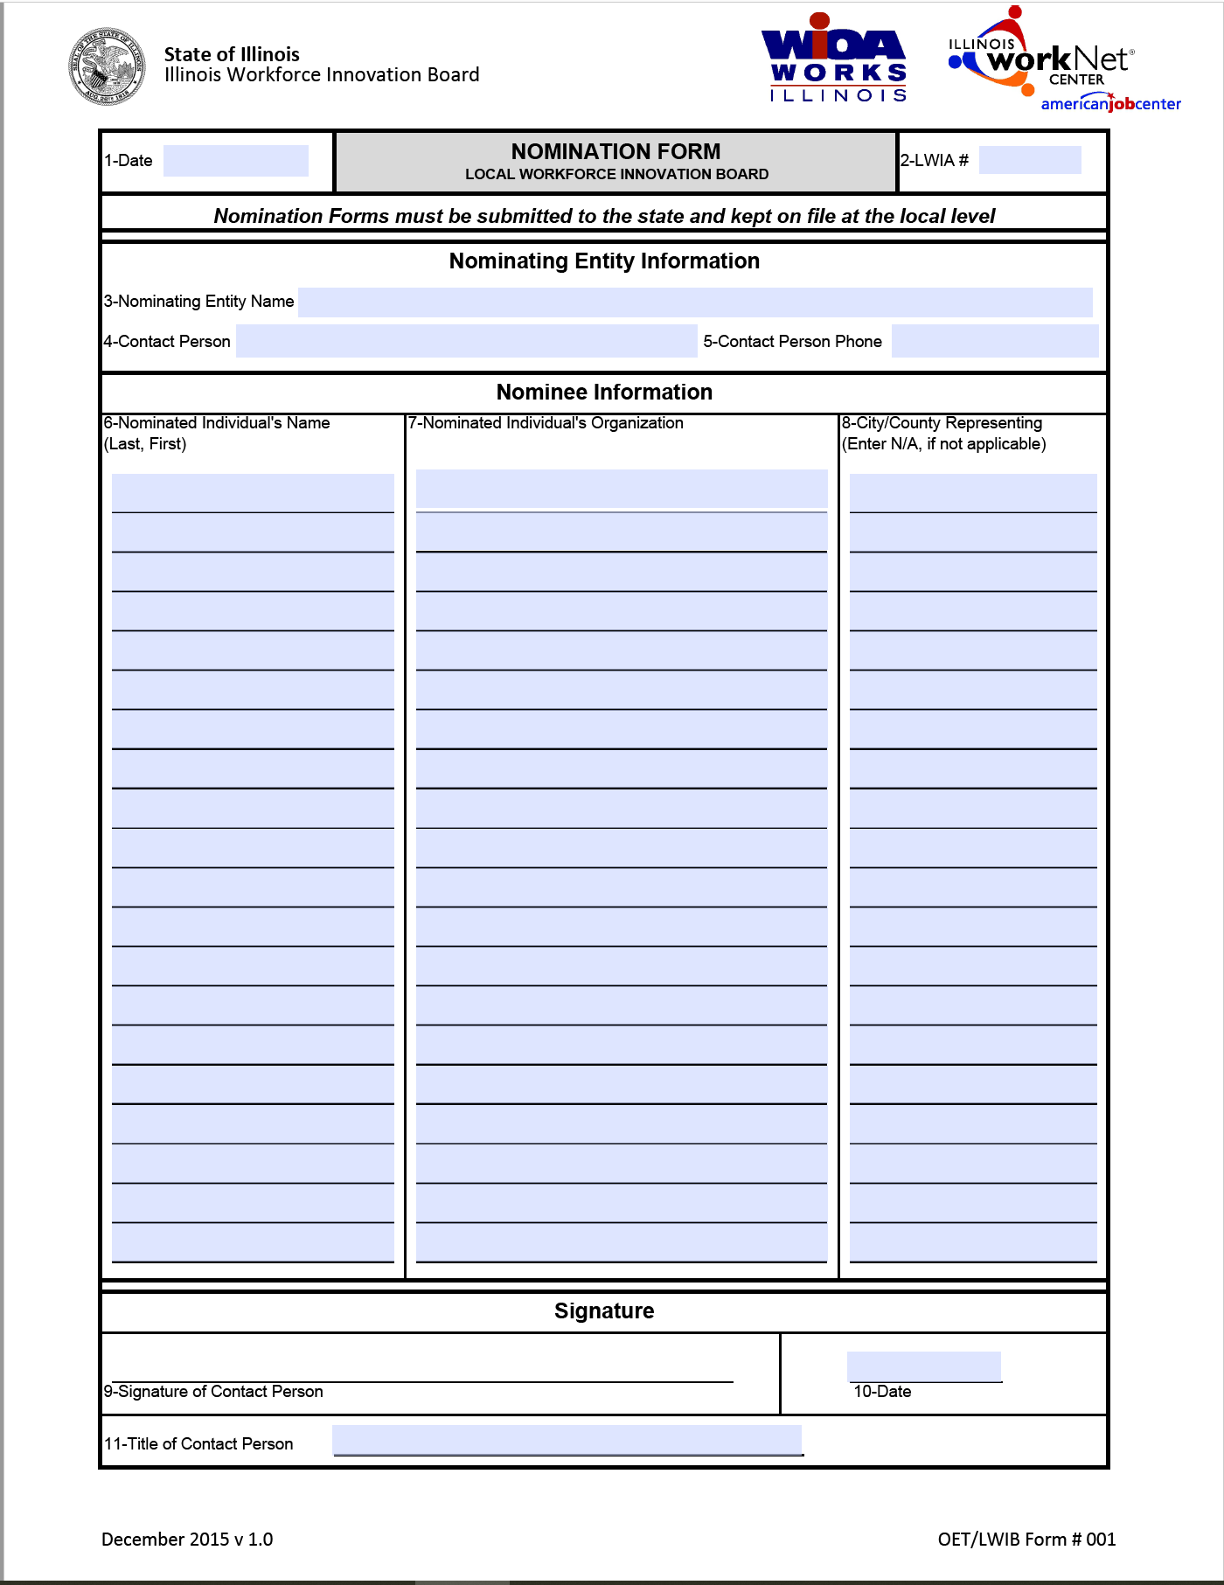
Nomination Form
1
2
Download from Illinois workNet ePolicy site This is the only form not generated by LWACS
Upload signed forms into LWACS in the member record

Slide 10
Upload to Document Library
LWIB Bylaws CEO Agreement CEO/LWIB Agreement
Business Member Narrative
Accessibility Statement

Slide 11
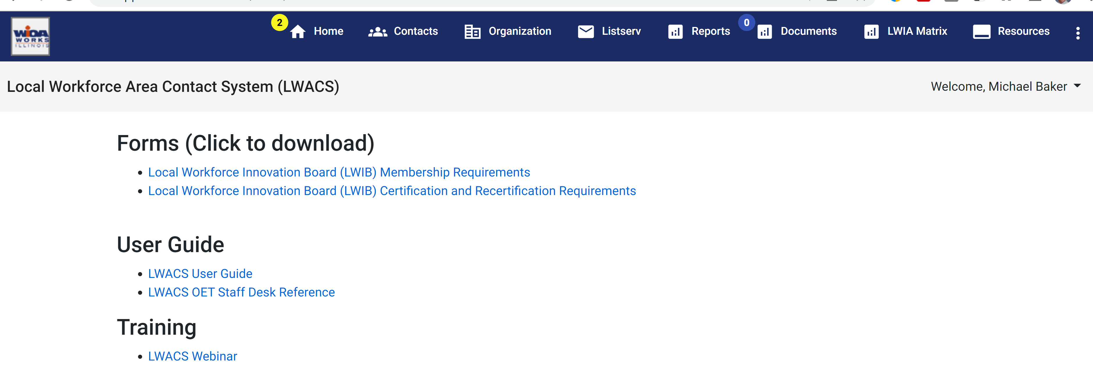
Resources
Direct Links to ePolicy
Instructions
Recorded Training

