Slide 1



Program Implementation
& Reporting System
Illinois workNet® is sponsored by the Department of Commerce and Economic Opportunity. – June 2022

Slide 2
Agenda
Program Implementation
& Reporting System
Job Training & Economic Development (JTED)
System Overview
Demonstration
Next Steps
Identify Staff Access Needs
Sign up for Small Group Technical Assistance

Slide 3
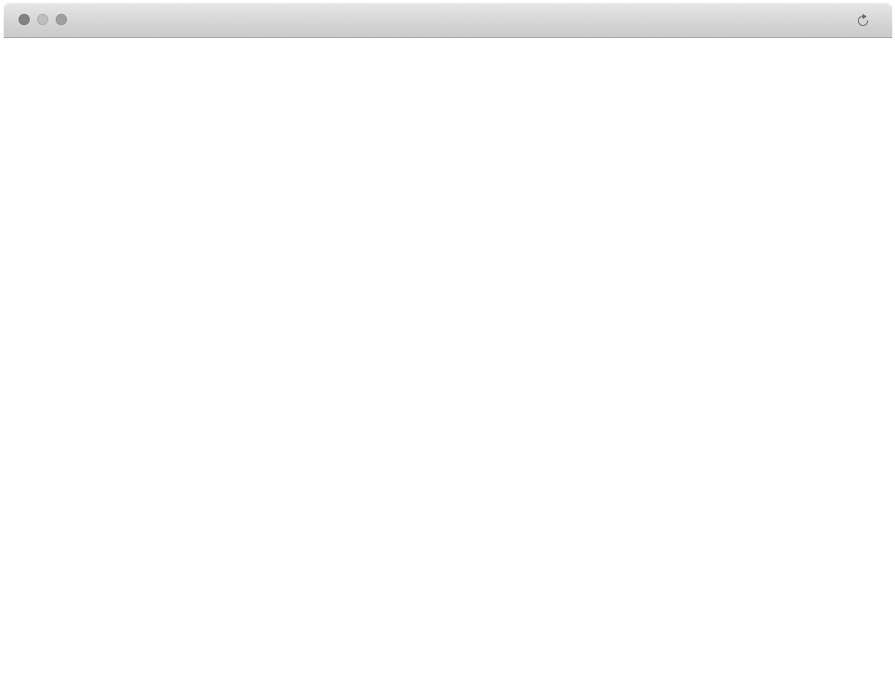




Job Training & Economic Development (JTED)
Workforce & Education Data
Federal
State
Individuals
Grantee Tools & Information
Online Application/ Initial Assessment
Eligibility & Enrollment
Local
Global Business Data
Partners
Communication & Case Note Tools
Case Management Tools
Referrals
LMI
Other
Apps
Engagement & Transparency Tools
Program Dashboards & Reporting
Participant Dashboard
Social Media
Employers
Illinois Workforce Integration System (IWIS )
● Role-Based Access  APIs  Cloud DB  Notifications & Alerts  Event, Log Monitoring  Responsive Design  Identity  Email Services  Search  Workflow 

Slide 4
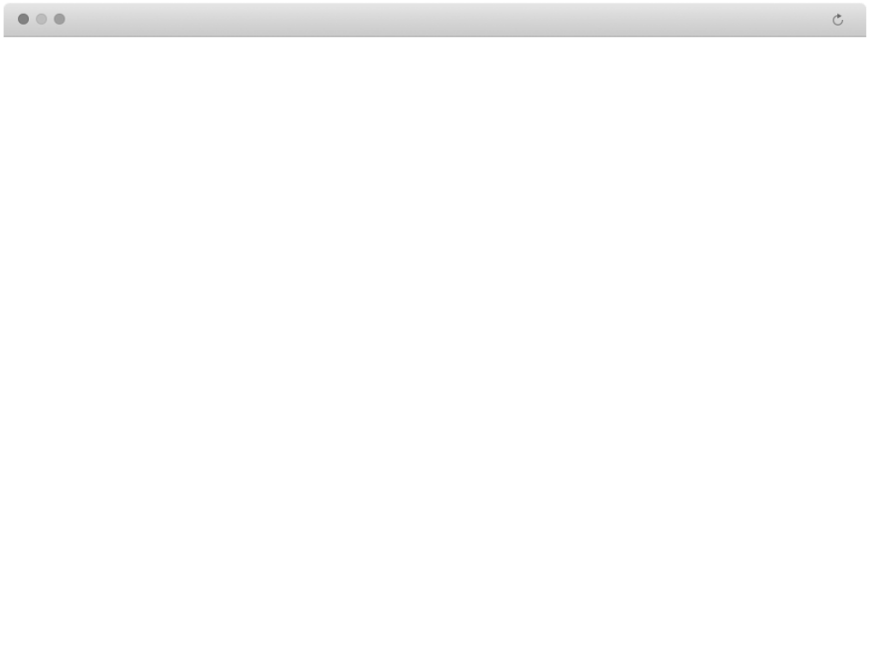
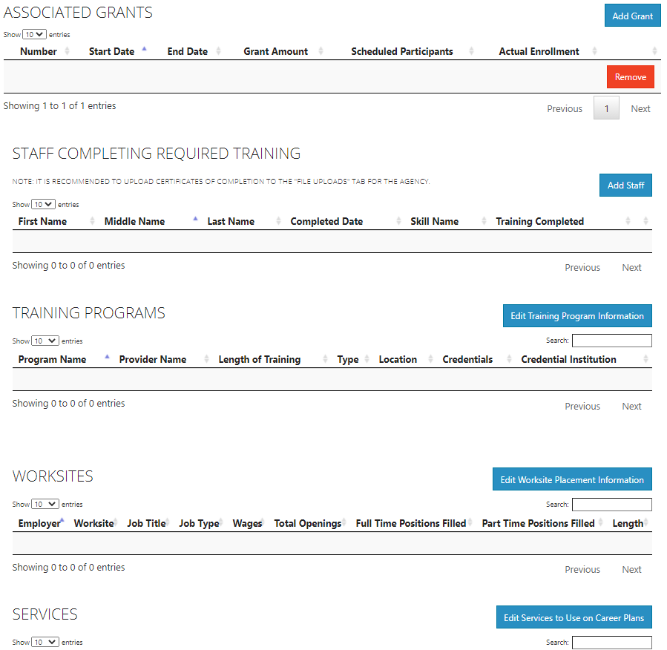
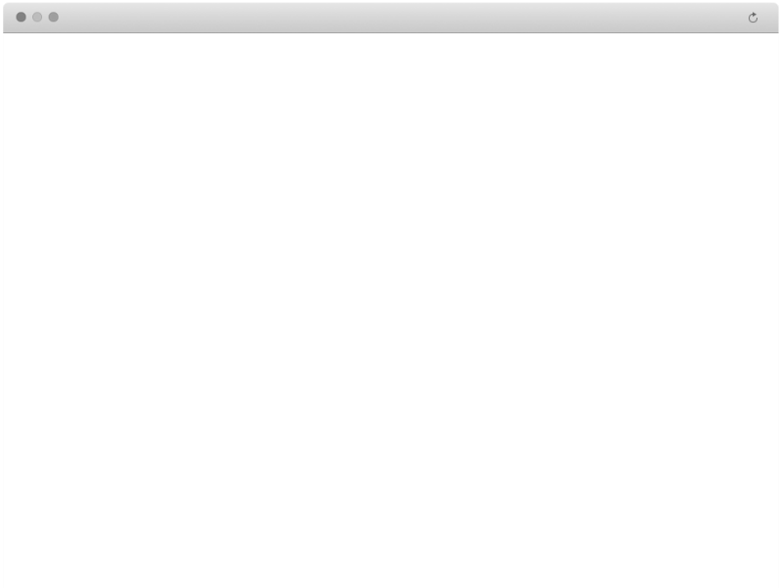
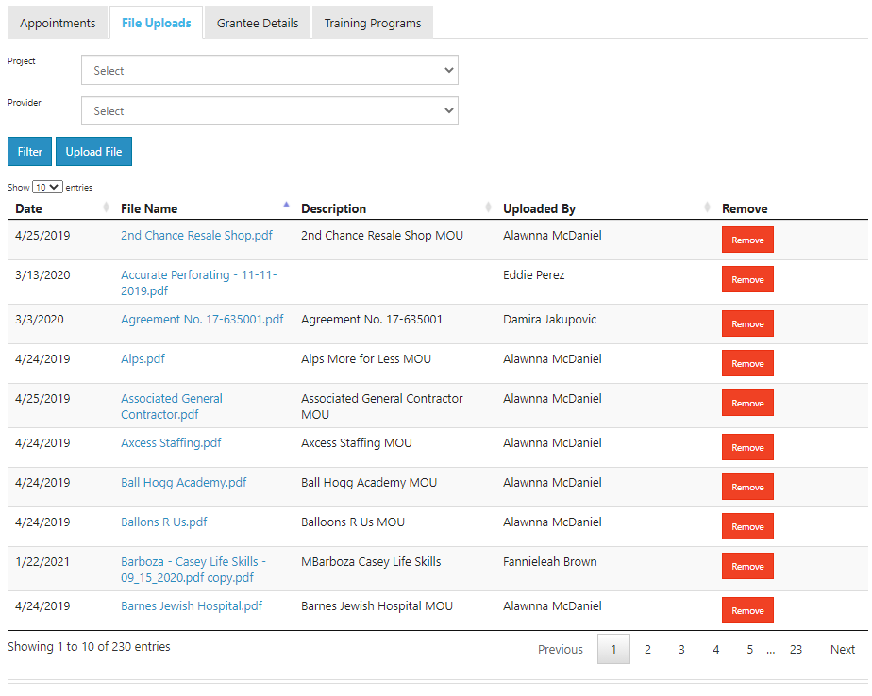
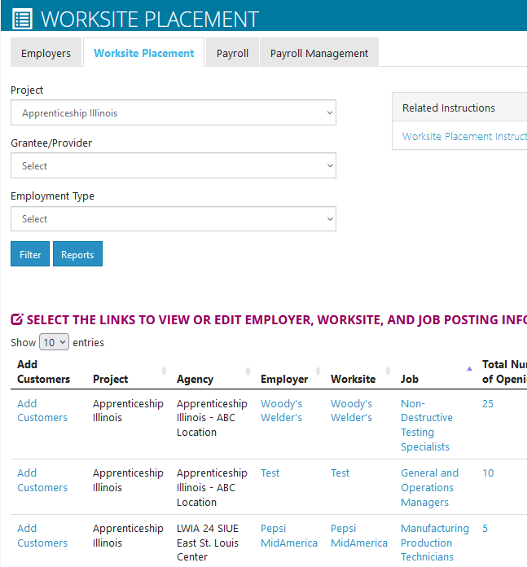
Grantee Set Up Tools
Provide program staff with grantee program management tools:
Grant information - Grant number start/end dates, grant amount, scheduled participants, actual enrollment, file upload.
Services – Customize service list based on the grant.
Training Programs – Training program information and related credentials.
Worksites– Employer, worksite, job title, wages, openings, full/part time positions filled, and more.

Slide 5
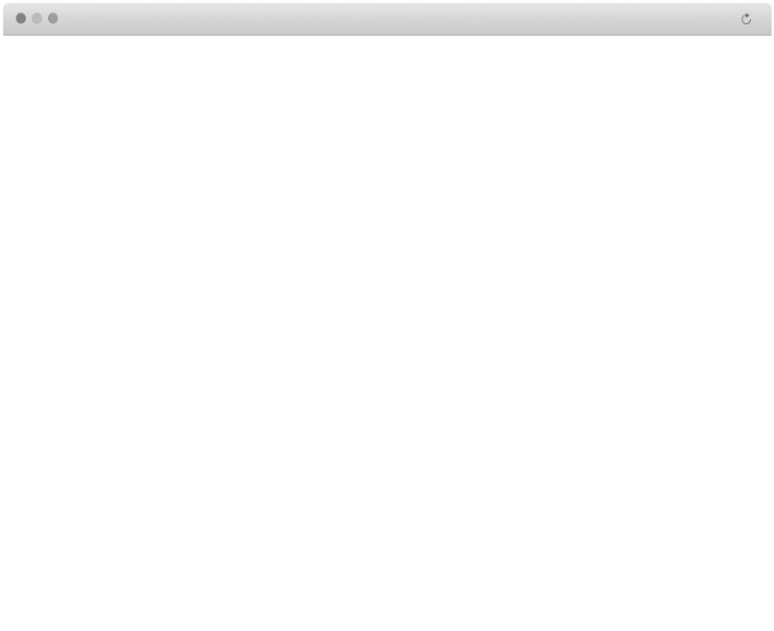
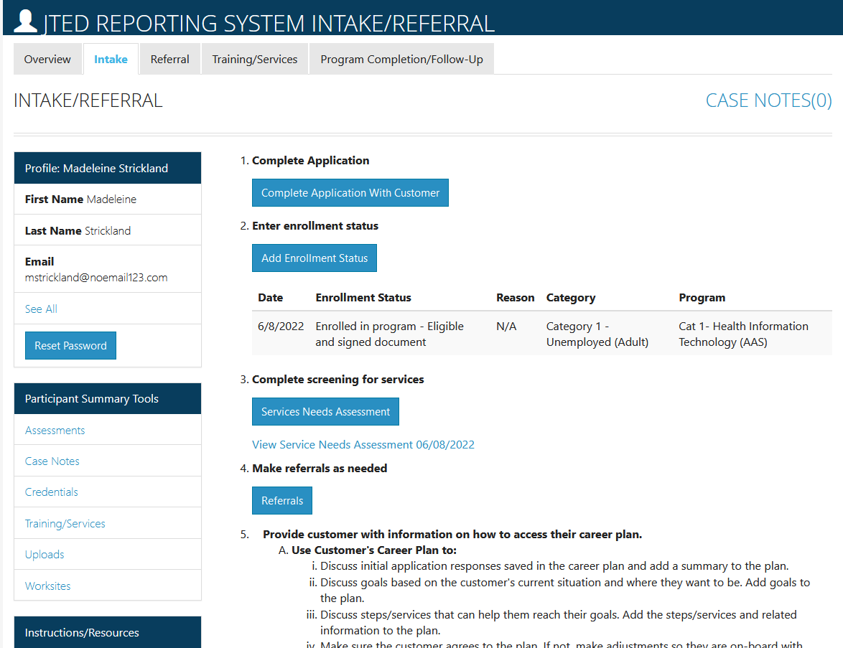
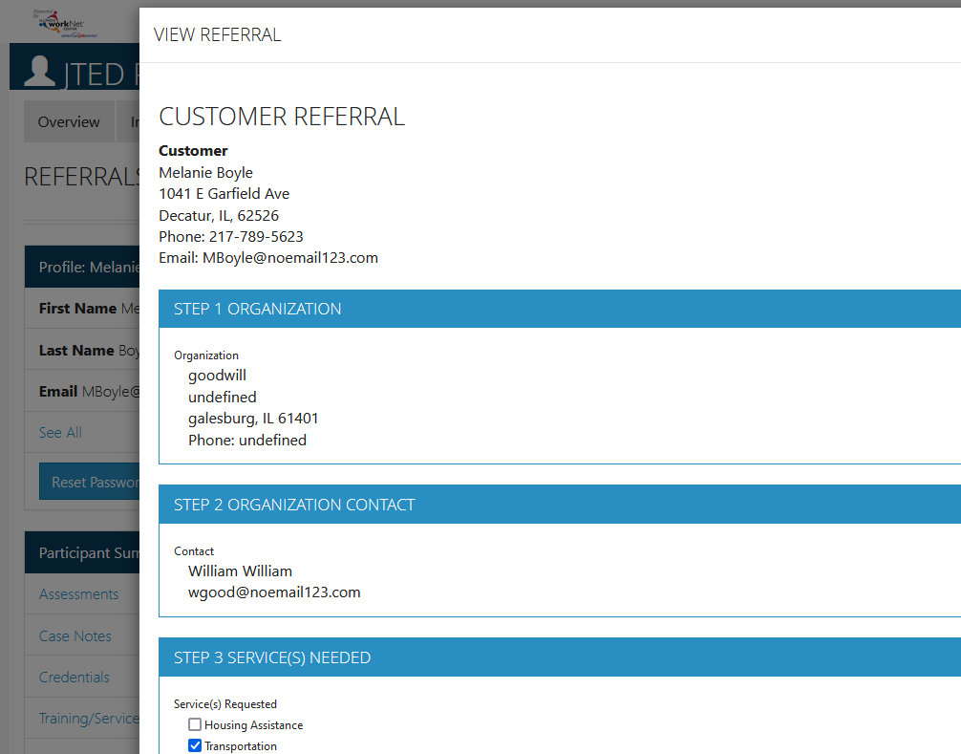
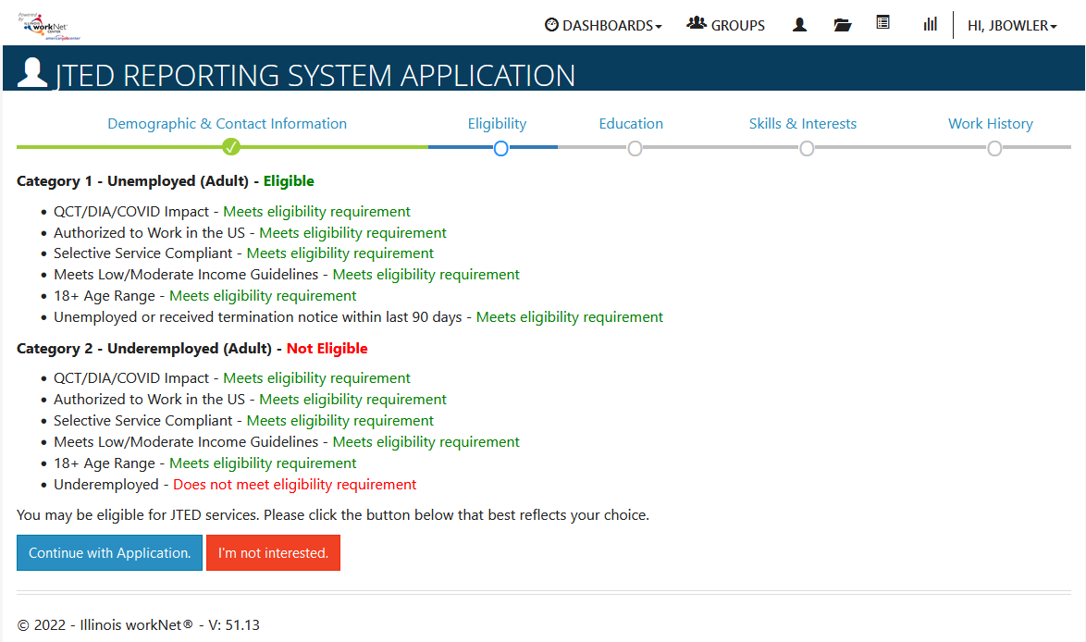
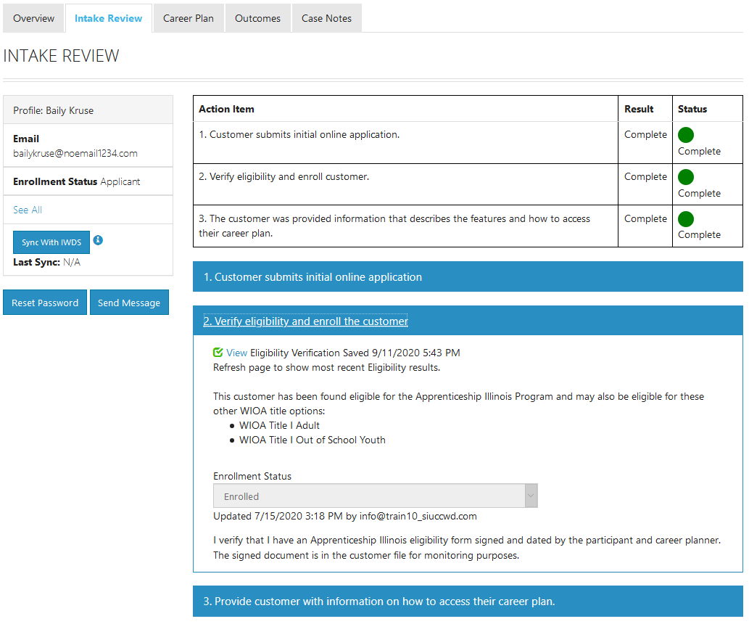
Intake
Provide Intermediaries with tools to:
Assess needs in order to reach training and employment goals using the online application/initial assessment.
Determine eligibility for JTED category 1, 2, 3, or 4.
Enroll in training and support services.
Refer for partner support services.

Slide 6
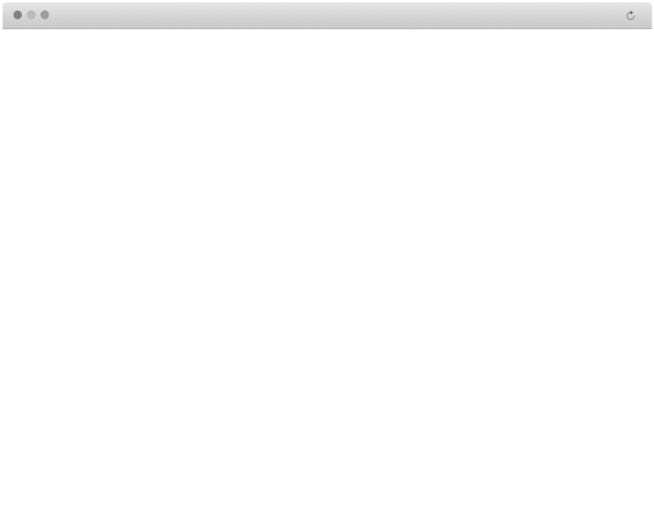
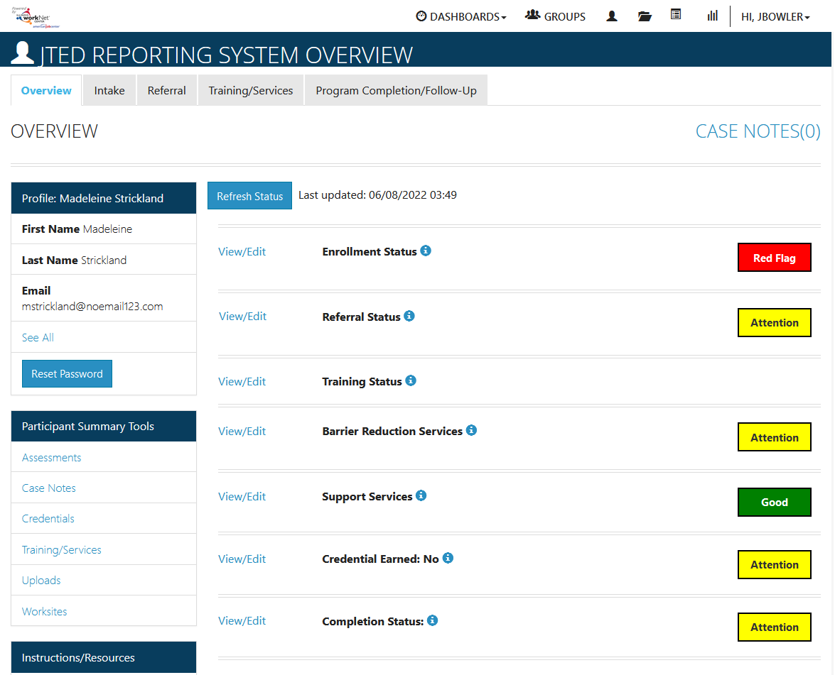
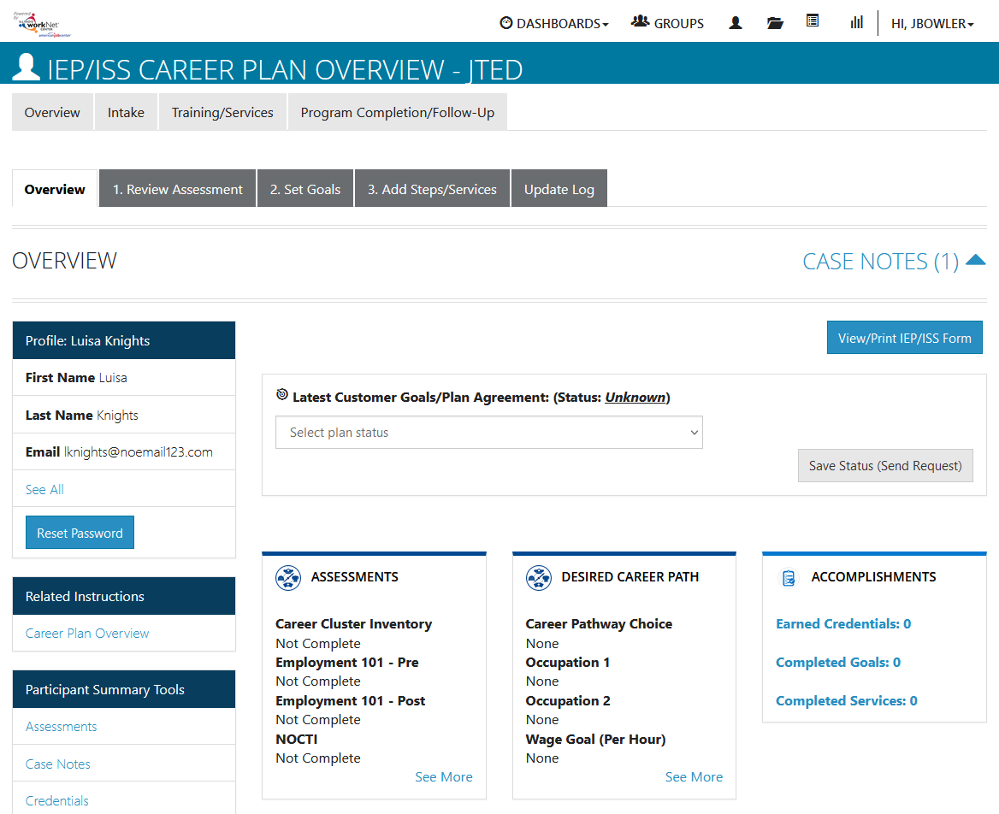
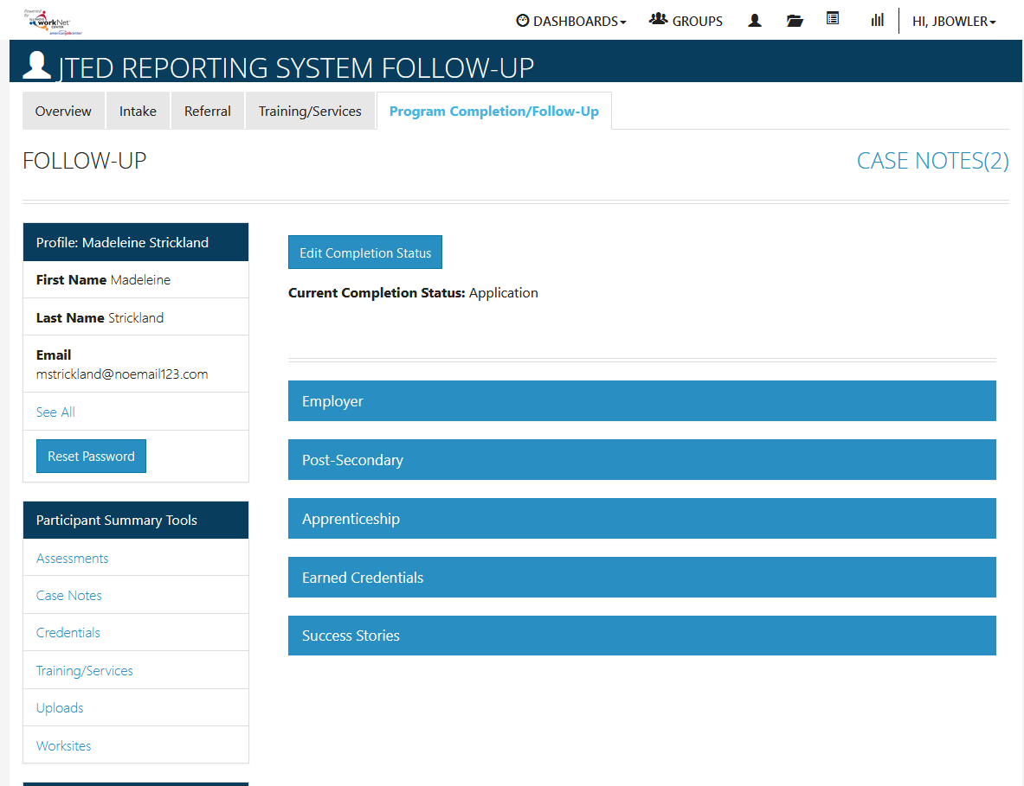
Case Management
Provide Intermediaries with tools to:
Develop a plan to reach training and employment goals.
Assign/update services, providers, and related information using the career plan builder.
Communicate using case note & message app.
Monitor progress, performance and outcome data.

Slide 7

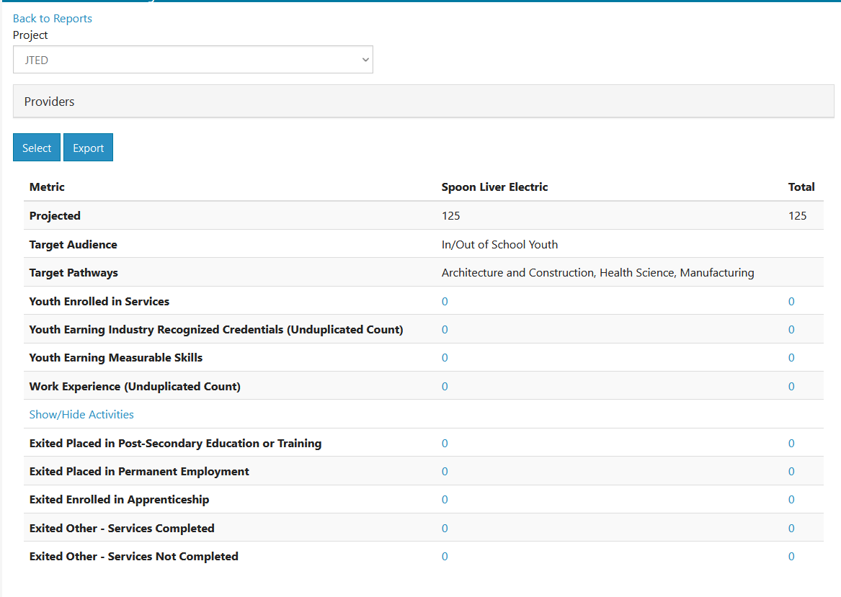
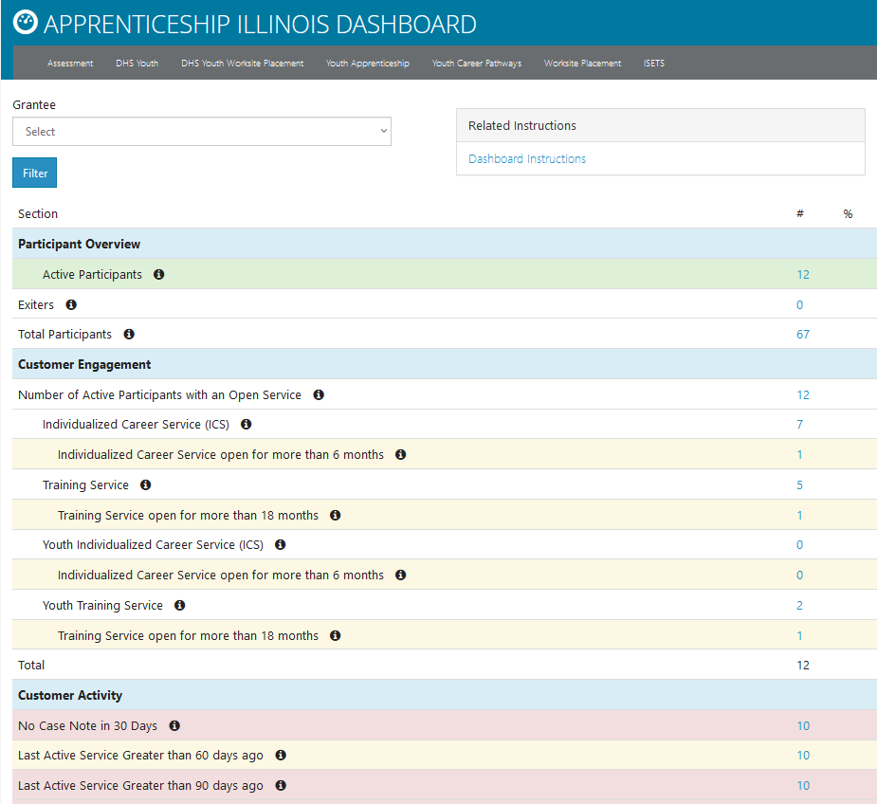
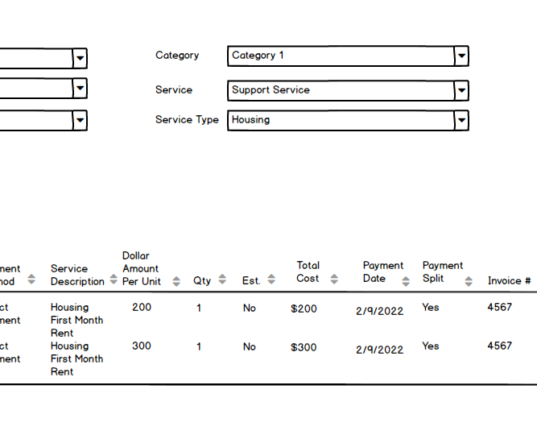
Program Dashboards & reporting
Provide Intermediaries & Navigators with tools to:
Dashboards & Tables to see a high-level view of program status and to access a filtered list of customers based on specific program criteria.
Reports to view aggregate participant cost, completion and employment outcomes.

Slide 8
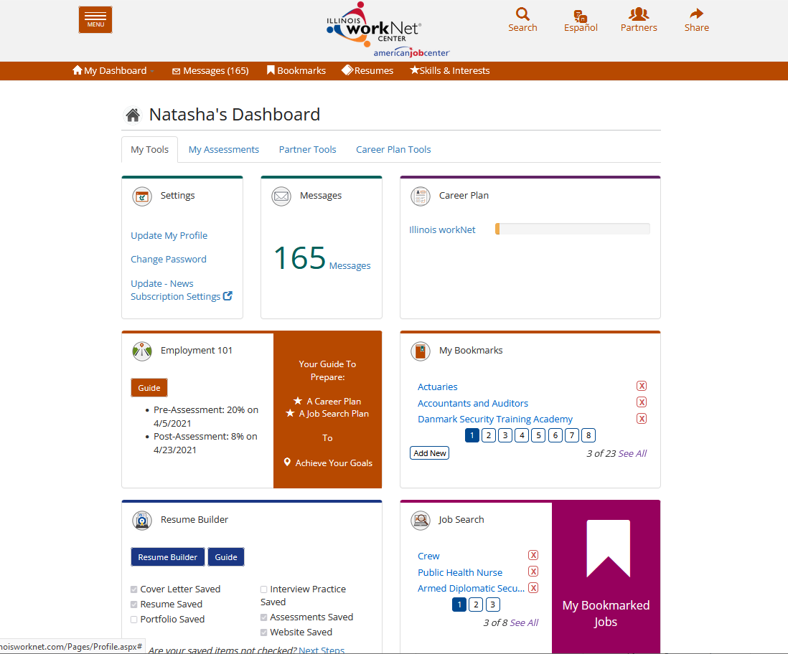
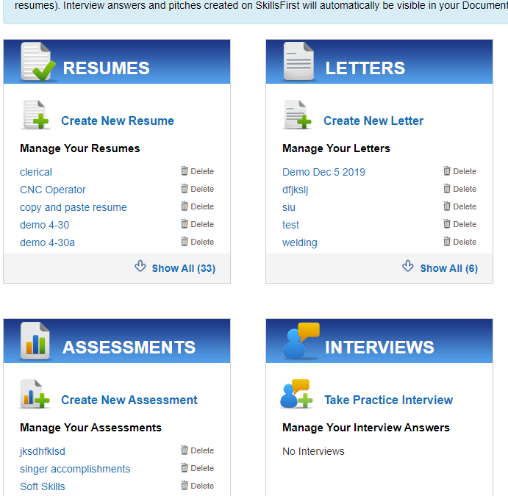
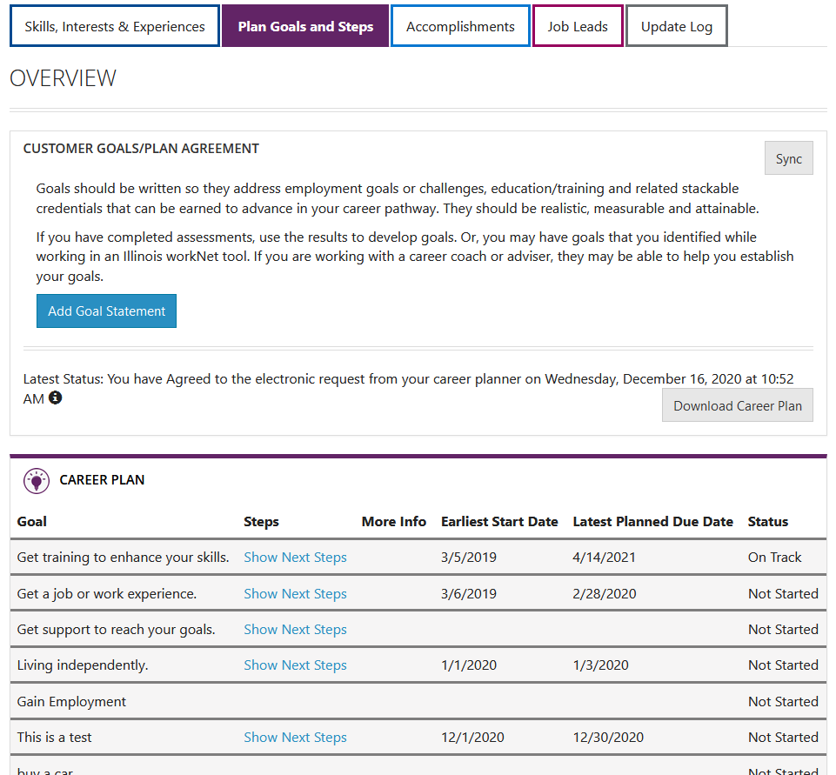
Other Participant tools
Participant Dashboard - Participants can access their personalize account information including career plan, messages, bookmarks, etc.
Resume Builder & Writing Guide - Includes resumes, letters, portfolios, and more.
Career Plan (participant view) - Includes resources building skills employers desire and is aligned to the Illinois Essential Employability Skills.
Employment 101 - Includes interactive tools and resource for exploring careers, exploring training, finding a job, and more.
Notes:
Customer can view their Apprenticeship Illinois Career plan by accessing the plan through their Dashboard.

Slide 9
Demonstration
System Tools
Notes:
Outline of Demonstration
Logging in as a Test Grantee for Category 1 and 2.
Highlight process for setting up an Illinois workNet account.
Highlight grantee details and training programs.
Navigate to the group
Demonstrate adding a customer
Complete application
Enroll customer
Complete Service Needs Assessment
Demonstrate Referral
Demonstrate Training/Services Career Plan Tool – open one service – close one service and demo completion
Review the program completion
Mention the Overview Page and Dashboard

Slide 10
Next Steps
Get Access: Create an Illinois workNet account and request access to the JTED Partner tools.
https://www.illinoisworknet.com/partners/Documents/Become%20a%20Partner%20-%20JTED.pdf
Sign up for Small Group Technical Assistance
https://docs.google.com/document/d/1YPjA40DPXv3AAqWfzaX8Wwc0inRAcHgR8z3FBB_PV7s/edit?usp=sharing

Slide 11
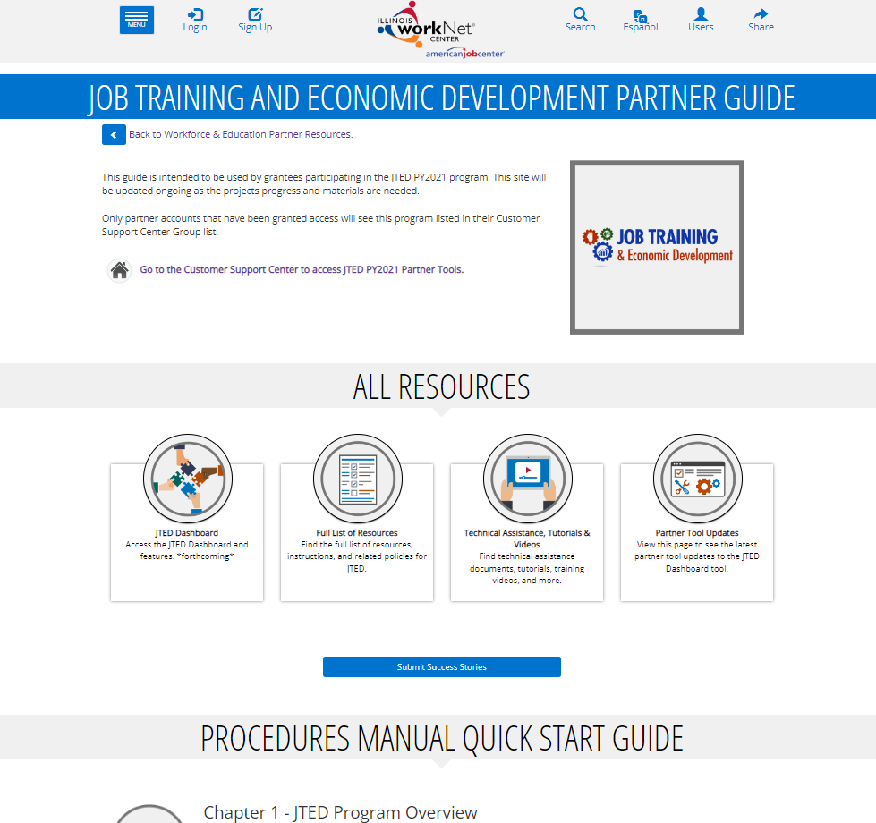
Partner Guide
https://www.illinoisworknet.com/partners/Pages/JTEDPartnerGuide.aspx

Slide 12









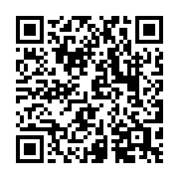
follow us!
Subscribe to our Newsfeed or check us out on Social Media
HOME: https://www.illinoisworknet.com/
EMAIL: info@illinoisworknet.com
MORE INFO: https://www.illinoisworknet.com/partners/Pages/Apprenticeship.aspx
Facebook
Twitter
Youtube
linkedin
Linkedin group
Pinterest
The Illinois workNet Center System, an American Job Center, is an equal opportunity employer/program. Auxiliary aids and services are available upon request to individuals with disabilities. All voice telephone numbers may be reached by persons using TTY/TDD equipment by calling TTY (800) 526-0844 or 711. This workforce product was funded by a grant awarded by the U.S. Department of Labor’s Employment and Training Administration. For more information, please refer to the footer at the bottom of www.illinoisworknet.com.

