Slide 1


Illinois workNet:
Widgets
www.illinoisworknet.com
Illinois workNet® is sponsored by the Department of Commerce and Economic Opportunity. – February 2022

Slide 2
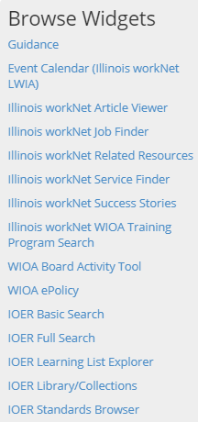
What is a Widget?
A widget is a stand-alone application that can be embedded into other websites.
Illinois workNet offers several widget options. All of the widgets are interactive making content seamless from other websites.
To use the widgets a short code snippet is copied and pasted into a websites source code/html. Setting up an Illinois workNet widget is easy and only takes a few minutes.

Slide 3
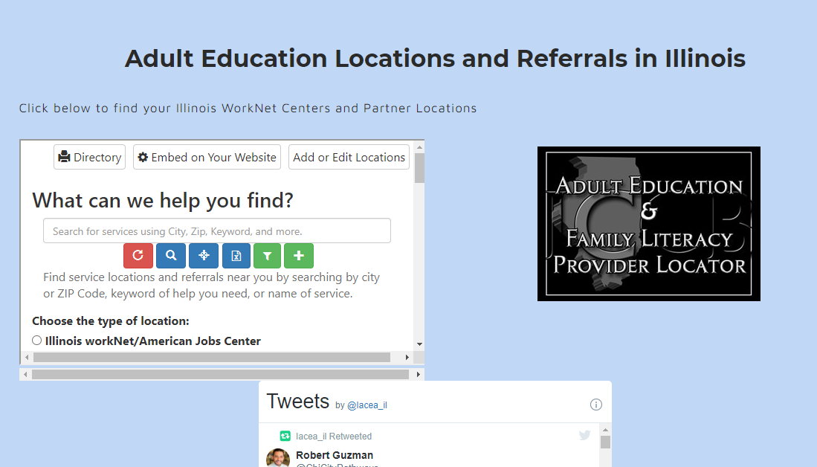
Let Us Do the WORK!
Illinois workNet widgets give you tools and resources to add to your website, while we maintain the functionality!
Any time we update a widget, it will automatically update on your website.
This example is IACEA using the Service Finder widget on their website for education locations and referrals.

Slide 4
Illinois workNet Widgets!
Anyone who has access to their website’s source code/html can add Illinois workNet widgets. Below are some examples of widgets but check the IOER widget page because new widgets might be available. https://www.illinoisworknet.com/widgets
Widget | Description
Event Calendar | The Illinois workNet Event Calendar shows events that have been added by our office, local partners, and other users that have events to share. Event examples include Job Fairs, WIOA Orientation, Job Search Workshops, Conferences, and more.
Article Viewer | The Illinois workNet Article Viewer will allow you to select from and view articles from Illinois workNet.
Illinois workNet JobFinder | The Illinois workNet JobFinder widget uses Indeed’s API to show jobs statewide and allows the user to search using keywords, location, job sector, position type, and much more!
Related Resources | Illinois workNet uses the Related Resources widget to pull in external resources that assist our users in accomplishing their employment and training goals. You can use this widget to display related resources from any library and collection within Illinois Open Educational Resources.
Service Finder | The Illinois workNet Service Finder provides users with a search to locate offices where staff are able to assist them in finding resources for their job search, career preparation, and referrals for work support such as financial aid, child care, and much more. These partner locations include Illinois workNet Centers, Community Based Organizations, State Agencies, and much more.
Success Stories | Illinois workNet Success Stories from WIOA and related programs are an amazing collection of testimonies to the value of State of Illinois programs and their positive impact on our communities. This widget allows you to embed relevant success stories on your website.
WIOA Training Program Search | The WIOA Training Program Search widget makes it easy to find WIOA-approved training programs and providers.
WIOA Board Activity Tool | Illinois workNet uses the WIOA Board Activity Tool to track members, events, and files for the Illinois Workforce Innovation Board (IWIB) and their sub-committees, task forces, etc.
WIOA e-Policy | Illinois workNet’s WIOA ePolicy tracking system reads like an e-book, allowing users to move through the policy one-by-one or navigate the table of contents. In addition, there is an A-Z view, Archive Only view, and print view to allow the user to print any or all of the policy in the system.

Slide 5
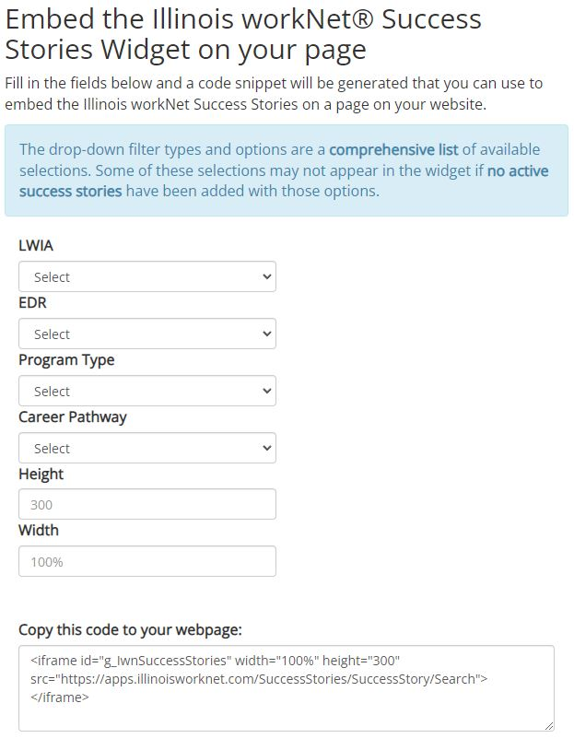
Widget Samples
Illinois workNet Success Stories
Display success stories from WIOA and related programs that have had a positive impact on your community.

Slide 6
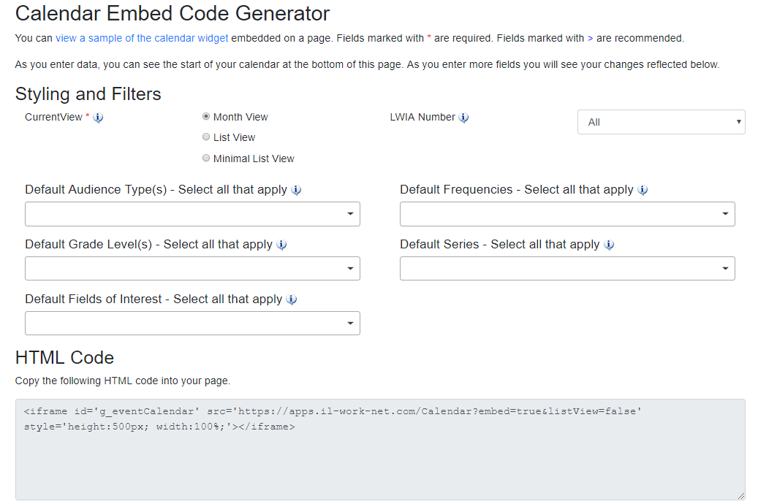
Widget Samples
Illinois workNet Event Calendar
Customize the calendar to match the look and feel of your website and fit the space you have.

Slide 7
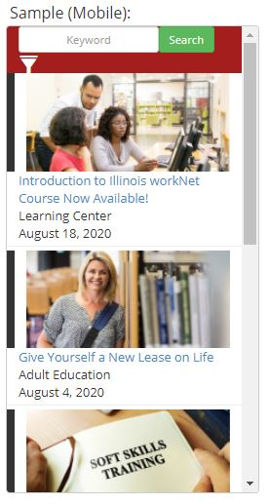
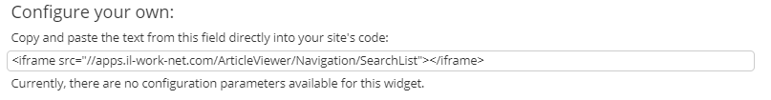
Widget Samples
Illinois workNet Article Viewer
Display articles that cover a wide variety of career, training, and employment topics.

Slide 8
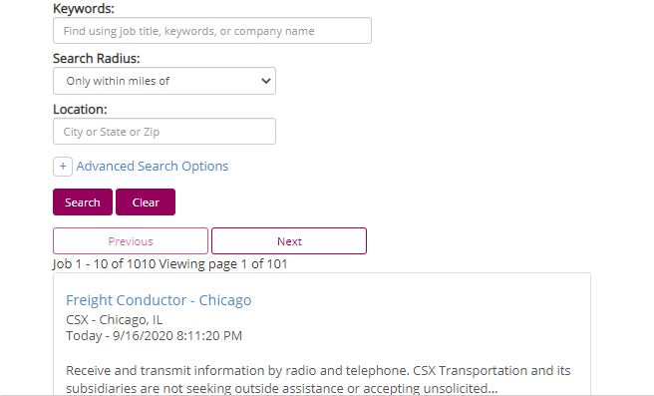
Widget Samples
Illinois workNet Job Finder
Add the Illinois workNet JobFinder to your website to allow customers to search for jobs near them that they can apply for.

Slide 9
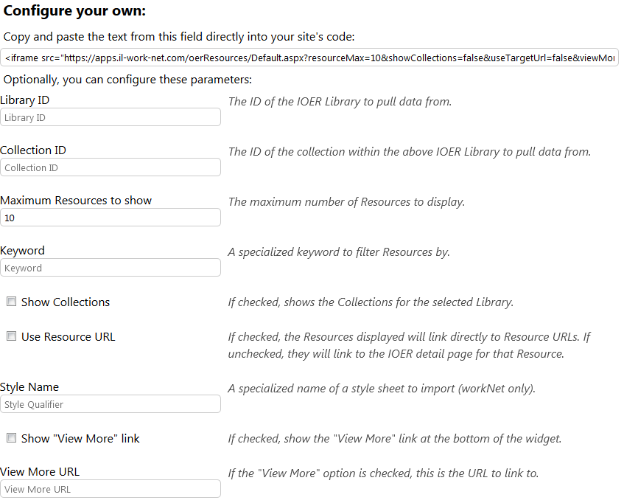
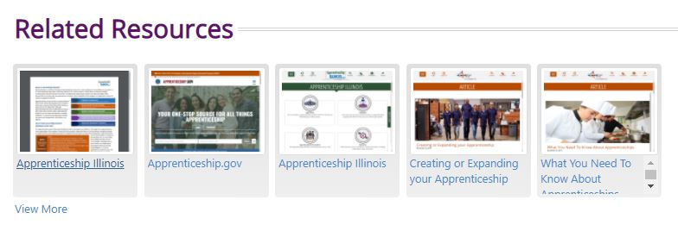
Widget Samples
Illinois workNet Related Resources
Add the Related Resources widget to provide external resources that can assist your customers in accomplishing their employment and training goals!

Slide 10
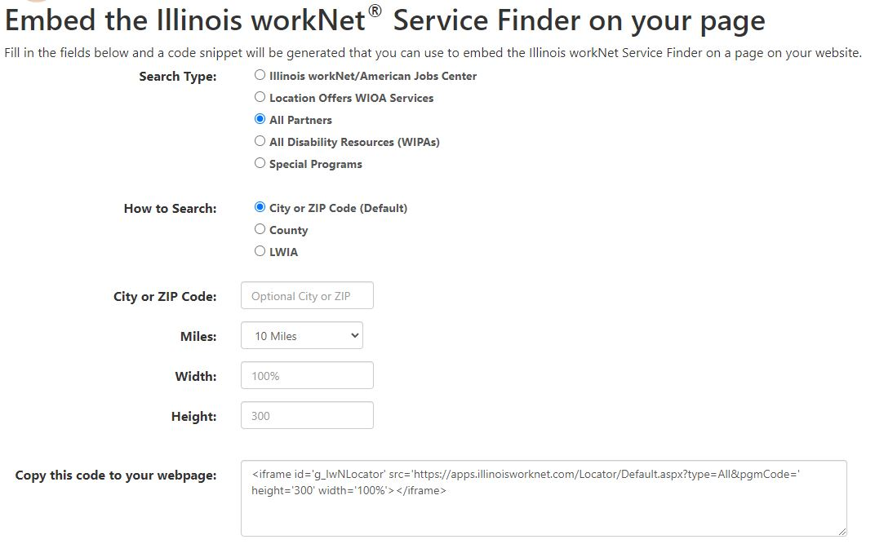
Widget Samples
Illinois workNet Service Finder
Add the Service Finder to your website to assist customers with locating organizations, schools, etc. that can provide in-person assistance.

Slide 11
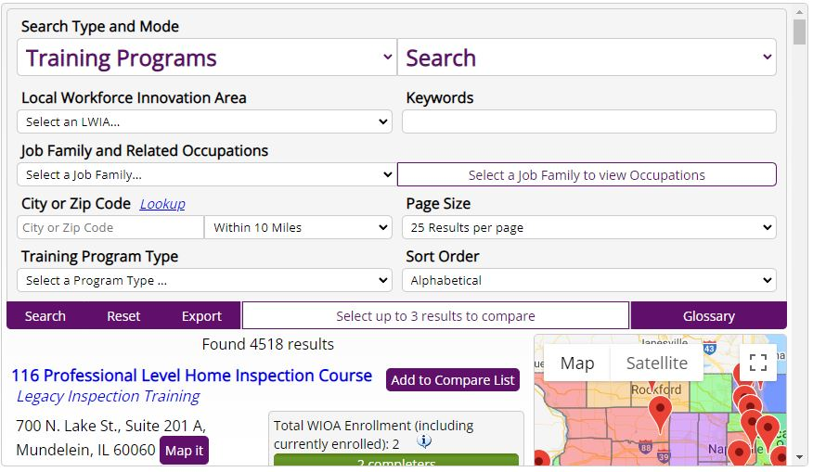
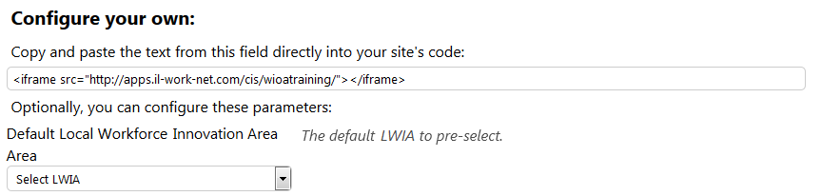
Widget Samples
Illinois workNet WIOA Training Program Search
Customize the WIOA Training Program Search to show WIOA Approved Programs and Providers in your Local Workforce Innovation Area (LWIA) or statewide!

Slide 12
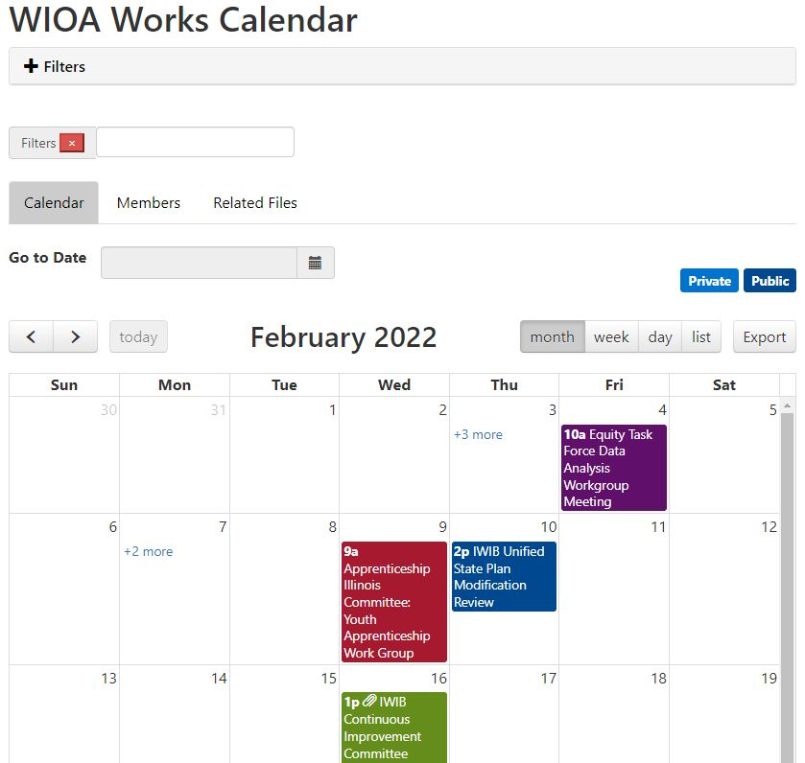
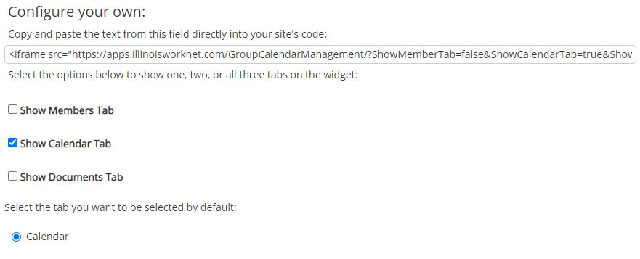
Widget Samples
WIOA Board Activity Tools
Customize the WIOA Board Activity Tool to show WIOA Members, Calendar events, and documents on your website. Easily identify which page to auto default to.

Slide 13
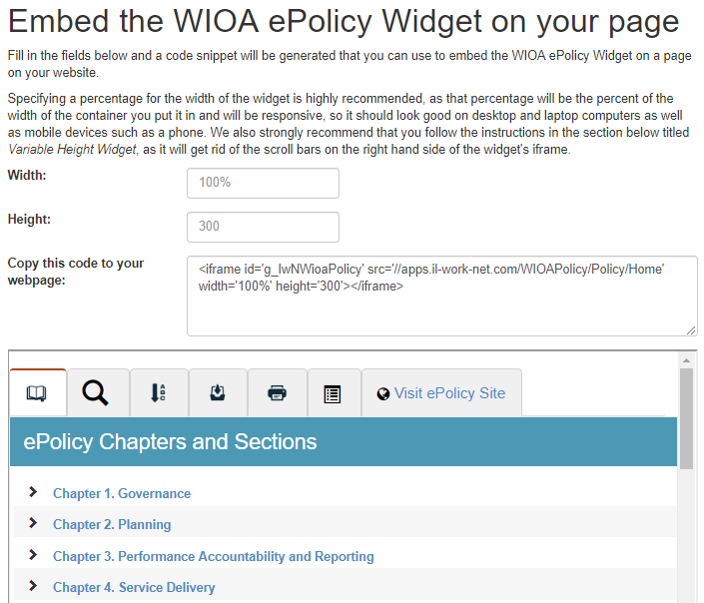
Widget Samples
WIOA e-Policy
Add Illinois WIOA e-Policy Manual to your website to help your users easily locate WIOA policy information; including notices, resources/references, documentation, helpful links, and contact information for each policy chapter and section.

Slide 14









follow us!
Subscribe to our Newsfeed or check us out on Social Media
HOME: https://www.illinoisworknet.com/
EMAIL: info@illinoisworknet.com
MORE INFO: https://www.illinoisworknet.com/Widgets
Facebook
Twitter
Youtube
linkedin
Linkedin group
Pinterest
The Illinois workNet Center System, an American Job Center, is an equal opportunity employer/program. Auxiliary aids and services are available upon request to individuals with disabilities. All voice telephone numbers on this website may be reached by persons using TTY/TDD equipment by calling TTY (800) 526-0844 or 711. This workforce product was funded by a grant awarded by the U.S. Department of Labor’s Employment and Training Administration. For more information, please refer to the footer at the bottom of any webpage at illinoisworknet.com – February 2022

