Slide 1
Web Portal System
www2.illinoisworknet.com
Overview and Update April 16, 2015

Slide 2
Topics
Illinois workNet® Background and Overview
Resources and Tools for Everybody
Partner Resources

Slide 3
Illinois workNet Background
Sponsored by DCEO Office of Employment and Training through WIA/WIOA funds, Illinois workNet® (IwN) has been evolving continually since launching in 2005-2006 as a result of recommendations from the Illinois Workforce Investment Board. Since, it’s inception, the IwN Web Portal System has continually evolved as a flexible infrastructure to support State of Illinois initiatives and priorities. The Web Portal System has always worked with and supported partnerships across state agencies and regionally across Local Workforce and Economic Development Areas.
State Agencies and Organizations:
Illinois Workforce Investment Board (IWIB)
Illinois Workforce Partnership (IWP)
Illinois Pathways STEM Learning Exchanges
Illinois Community College Board (ICCB)
Illinois Board of Higher Education (IBHE)
Illinois Department of Employment Security (IDES)
Illinois Department of Healthcare and Family Services (DHFS)
Illinois Department of Human Services (DHS)
Illinois State Board of Education (ISBE)
Illinois Student Assistance Commission (ISAC)

Slide 4
IwN Web Portal System
IwN ensures there is “no wrong door” to access state programs, provides 24-7, no-cost access to career, employment, and workforce development resources, services and tools to all citizens of our state.
It is built as a technology that is flexible to adapt to new programs as they occur and share data back and forth with the Illinois Workforce Development System (IWDS) and other systems. Web services are in place to share/integrate customer data between Illinois workNet and IWDS.
IWDS is State’s WIA/WIAO reporting system. This system is used by Local Workforce Investment Areas (LWIA) staff for case management and reporting of all local WIA/WIOA services.

Slide 5
IwN Purpose and Audience
Illinois workNet has always been the state’s workforce development portal. It is an open system available to anyone to use. It does not duplicate services; it identifies and fills service gaps and bridges existing services to connect individuals, employers and workforce and education partners to achieve their career, training and employment goals.
Employers
Youth (Middle School Up)
Adults
Dislocated Workers
Individuals with Disabilities
Veterans
Education and Workforce Partners
(state, regional, and community)

Slide 6
IwN Innovative Support - Examples
Employment & Training Program (DHS & DCEO)
Illinois Talent Pipeline
(DCEO)
Accelerated Training for Illinois Manufacturing
(ICCB, IDES, Manufacturing STEM Learning Exchange, & DCEO)
Workforce Data Quality Initiative (IBHE, ICCB, IDES, DHS, ISBE, ISAC, ILDS & DCEO)
Open Career & Educational Resources (ISBE, STEM Learning Exchanges, & DCEO)
Layoff Aversion & Assistance
(LWIAs & DCEO)
Job-Driven NEG (Information Technology, STEM Learning Exchanges, LWIAs & DCEO)
STEM Learning Exchanges/Career Pathways
(IDES, ISBE, ICCB, IBHE, ISAC, IDES & DCEO)
Summer Youth Employment Program (IDHS & DCEO)

Slide 7
IwN Advanced Technologies
The web portal system uses the most current technologies to support regional and state priorities and partnerships:
Presents a new streamlined look, feel and navigation.
Optimizes for smart phones, iPads, PCs, and more.
Gives more options to include a mobile app.
Provides more interactive and dynamic content.
Guides users to achieve their goals.
Personalizes with My Dashboard.
Simplifies niche content as articles with related materials, articles, and resources.
Hosts special programs.
Provides partners with guides and tools.
Offers widgets that any partner can easily embed on their website.
Integrates state agency, open source, and private sector apps and data through web services/APIs and single-sign-on.

Slide 8
IwN Develops Partnerships
IwN develops and supports the statewide system of Illinois workNet Centers (comprehensive one stops), state services, schools, community partners, and employers. Community partnership examples include:
Chicago Public Libraries
Other Public Libraries
Disability service organizations
Veteran’s service organizations
Social service organizations
Faith-based organizations
High Schools
Colleges
Any organization that as part of what they do help employers or individuals achieve career, training, and employment goals.
Employers and Work-based Learning
Planning and Preparation
Academic, Technical, and Soft Skill Training

Slide 9
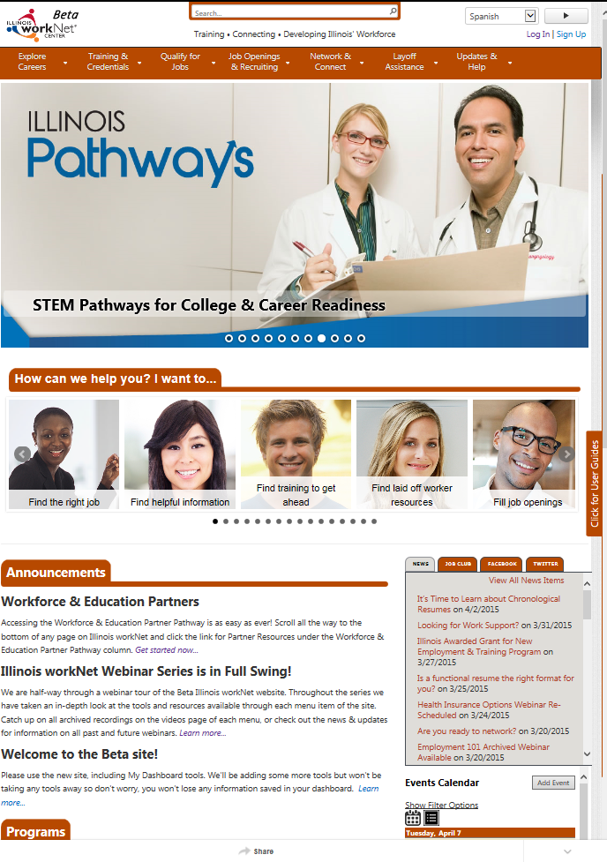
IwN Personalized Tools
http://www2.illinoisworknet.com
Adapts to devices ranging from smart phones, to iPads, to PCs.

Slide 10
Area | Icon | Resource and tools …
Explore Careers |  | To explore careers, their skills and interests, and to plan for their future or job/career transition.
Training & Credentials |  | Plan and participate in training opportunities and connect to financial support to become qualified in your career field.
Job Openings & Recruiting |  | Help job seekers get a job and to help employers recruit and hire.
Qualify for Jobs |  | Get real life experiences and understand employer expectations to become prepared to demonstrate how your experience, skills and credentials qualify you for a job.
Network & Connect |  | Reinforce connections to help you get into, and stay, in your chosen career field.
Layoff Assistance |  | Help individuals impacted by a layoff through job or career transition, as well as provide employers the legal requirements for reporting layoffs and resources to voluntarily help employees impacted.
Updates & Help |  | Additional guides and work support resources to help people meet their employment and training goals.

Slide 11
Explore Careers** | Training & Credentials** | Qualify for Jobs** | Job Openings & Recruitment** | Network & Connect** | Layoff Assistance** | Updates & Help**
Skills & Interests Surveys | Training Programs | Job Skills Guides | Illinois workNet JobFinder | Event Calendar | Company Layoff Search | News & Updates
Careers, Wages & Trends | Apprenticeship Opportunities | Digital Literacy Guides | Illinois JobLink | Illinois workNet Service Finder | Recovery Step Guide | Download & Print Materials
Employment 101 | Adult Education Opportunities | Prepare Your Resume | Featured Employers | Student & Trade Connections | Layoff Reporting & Services | disabilityworks
Planning Your Career | Employer-Based Training Programs | Marketing Your Skills | Start a Business | Social Media Guide | Layoff Assistance Videos | Veteran’s Guide
Career Exploration Videos | Credentials | Job Qualifications Videos | Recruiting & Hiring | Networking for Success | Layoff Assistance Resources | jobPrep Mobile App
Career Exploration Resources | Planning for Training | Job Qualifications Resources | Employer Hiring Credits | Networking Videos |  | Success Stories
 | Training & Financial Aid Videos |  | Employment & Hiring Planning | Networking Resources |  | FAQ
 | Training & Financial Aid Resources |  | Job Searching & Hiring Videos |  |  | Glossary
**User Guide are available from the home page and all main navigation pages. Additional topics will be added as content is developed. |  |  | Employment & Hiring Planning Resources |  |  | Managing Your Work Success Work Support Videos Work Support Resources

Slide 12
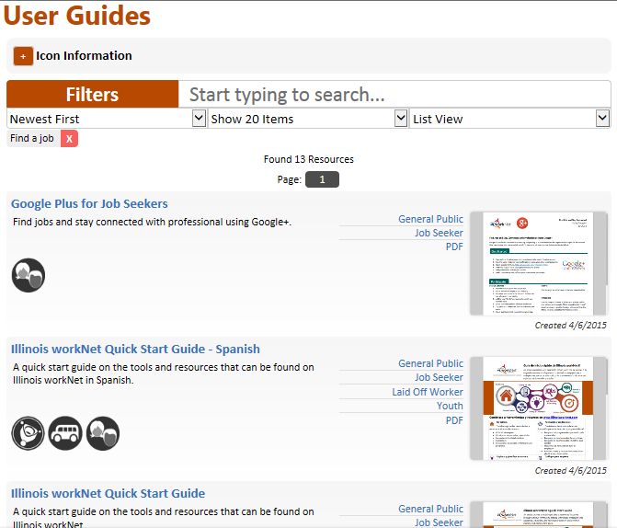
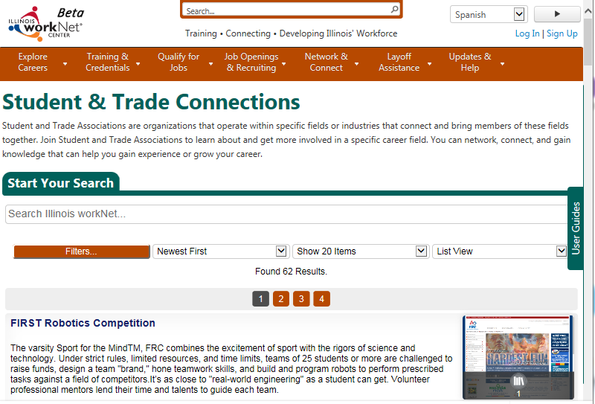
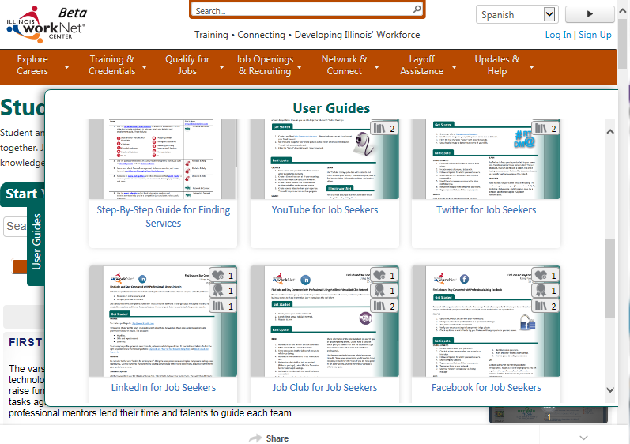
IwN Tour - Guidance
Look for Side Tabs.
Click or Swipe.
Closed
Open

Slide 13
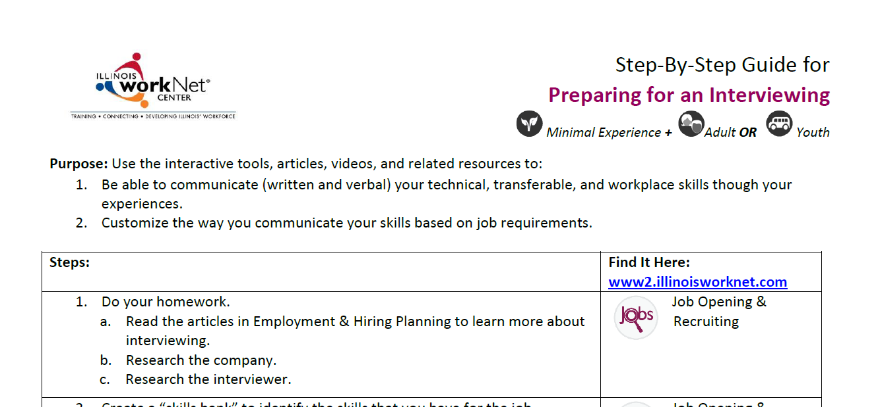
Simple User Guidance
(Example: One format that answers these questions.)
What is this?
Who is this for?
Why do this?
How do you do this?
Where do you find the resources?

Slide 14
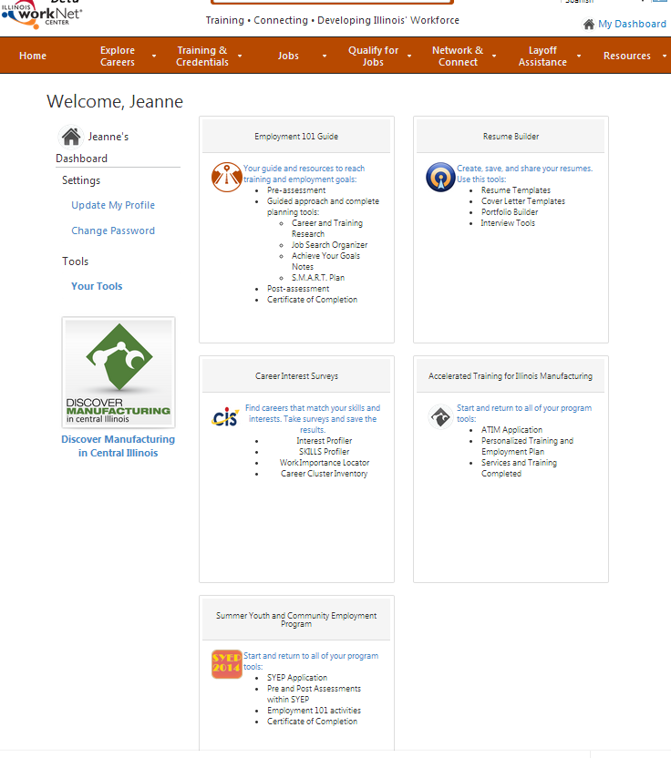
My Dashboard
Global tools available to everyone:
Employment 101 – Career, Training, and Job Search Plan, Assessment, and Certificate of Completion
Resume Builder
Career Interest Surveys
My Bookmarks
My Notes
Messages
Special program tools for applicants and enrolled participants – only seen by those who submit an application to participate or are enrolled in the program.
Partner Tools

Slide 15
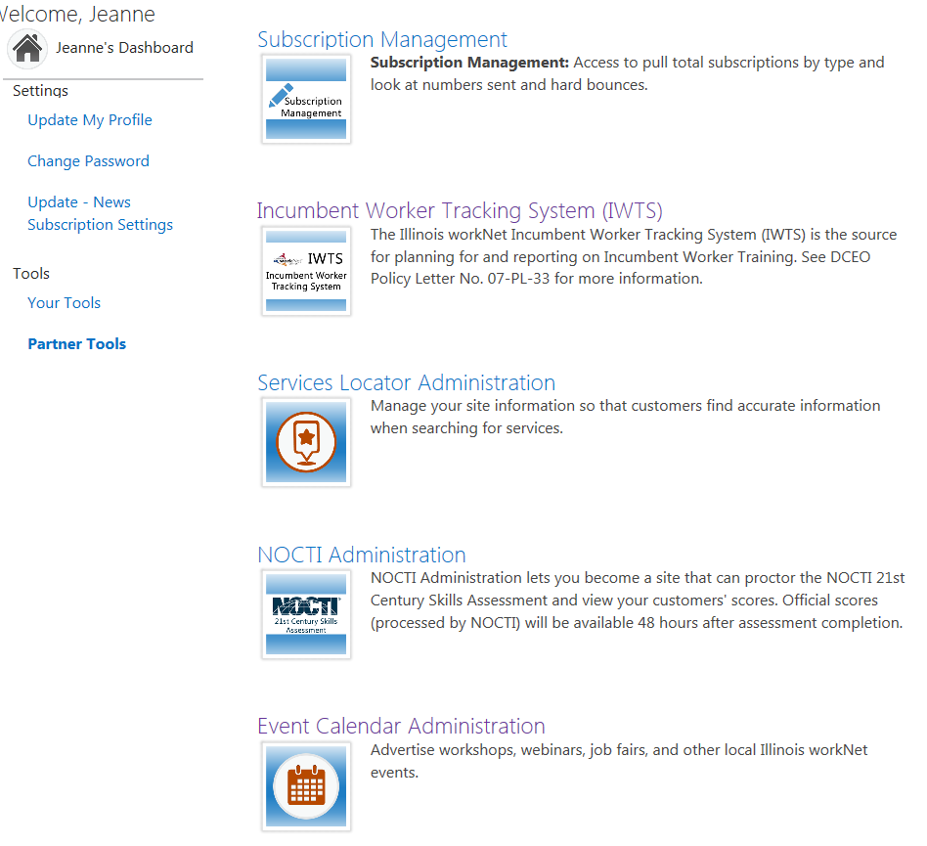
My Dashboard
Partner Tools:
Global - Available to LWIA and community partners based on staff roles:
Add/manage service and referral sites
Add/manage events
Add/manage success stories
Customer Groups
NOCTE 21st Century Skills Assessment
Observation Assessment
Worksite Evaluation
Career Interest Assessments
Special Projects – Available to LWIA and community partners based upon participation with special projects.

Slide 16
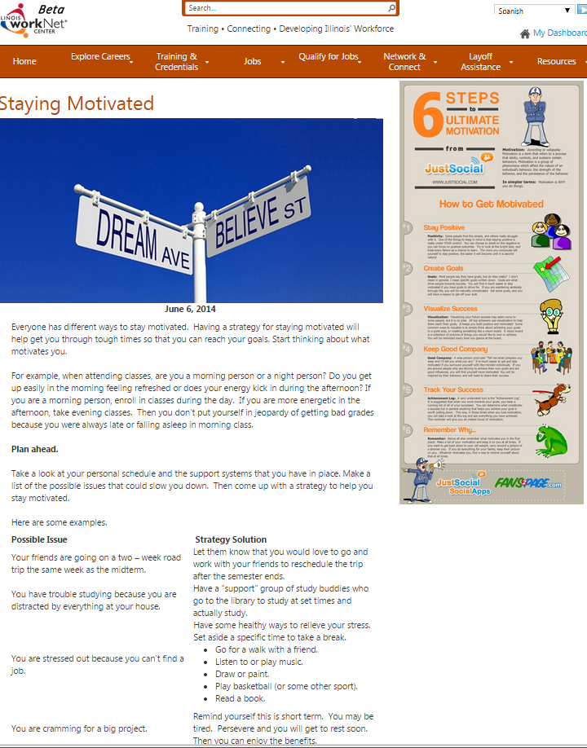
IwN Tour - Articles
Current Articles with:
Related materials
Related articles
Related resources

Slide 17
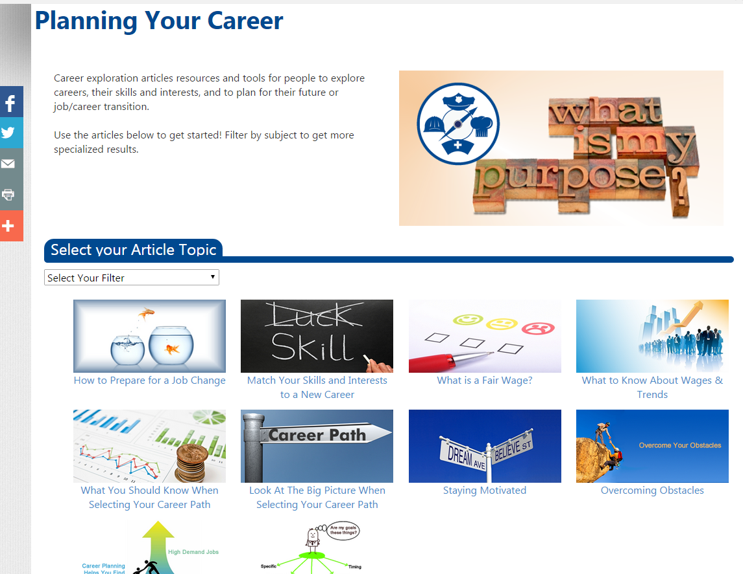
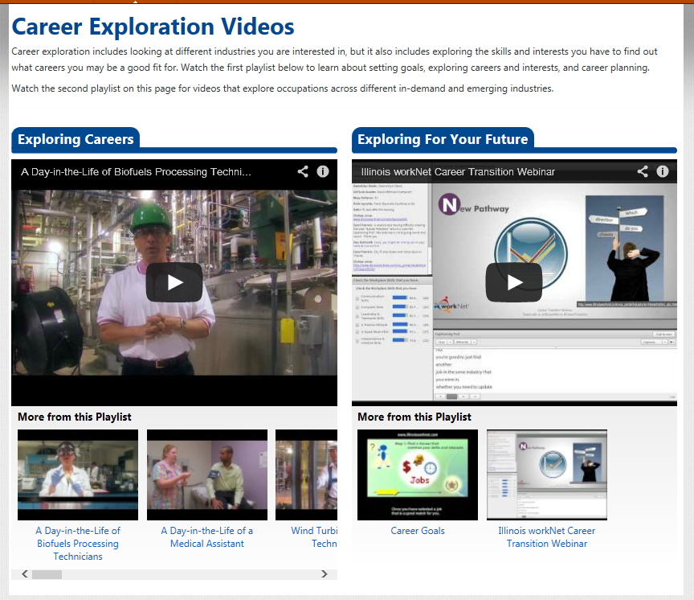
Explore Careers Examples
Interactive tools
Current articles with materials, related articles and resources
Videos

Slide 18
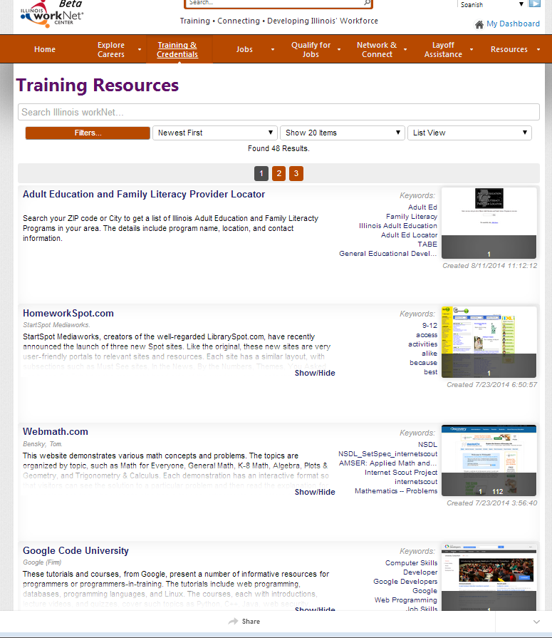
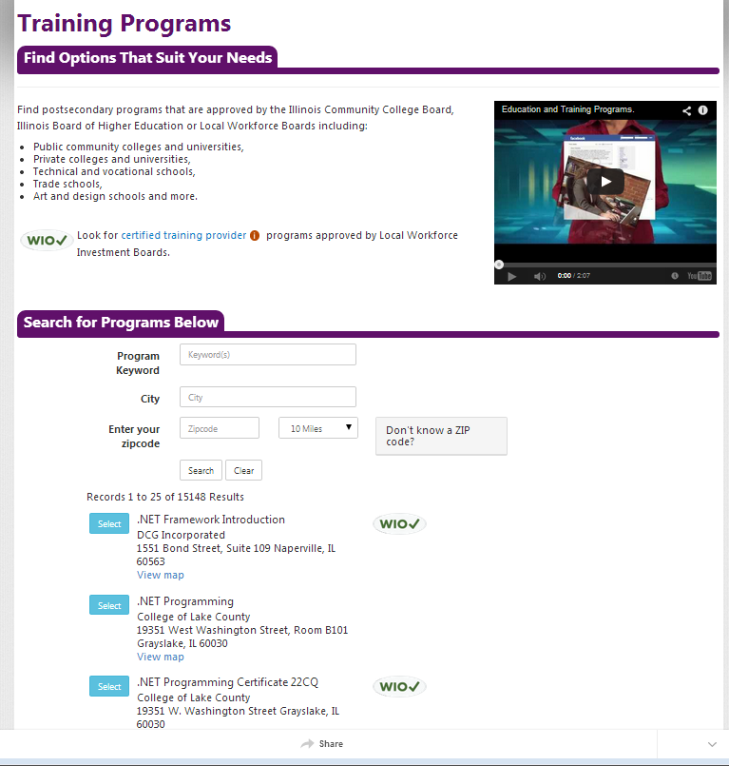
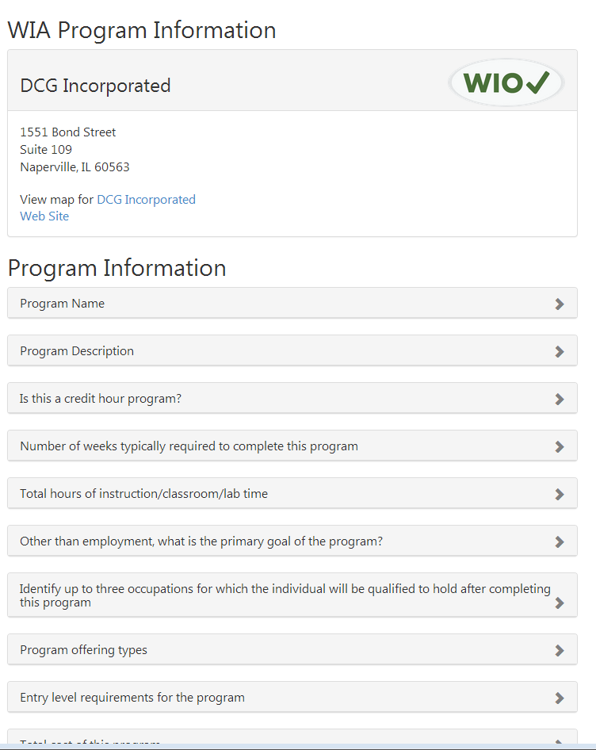
Training Program Examples
Postsecondary programs including WIOA approved
Resources to connect to training opportunities

Slide 19
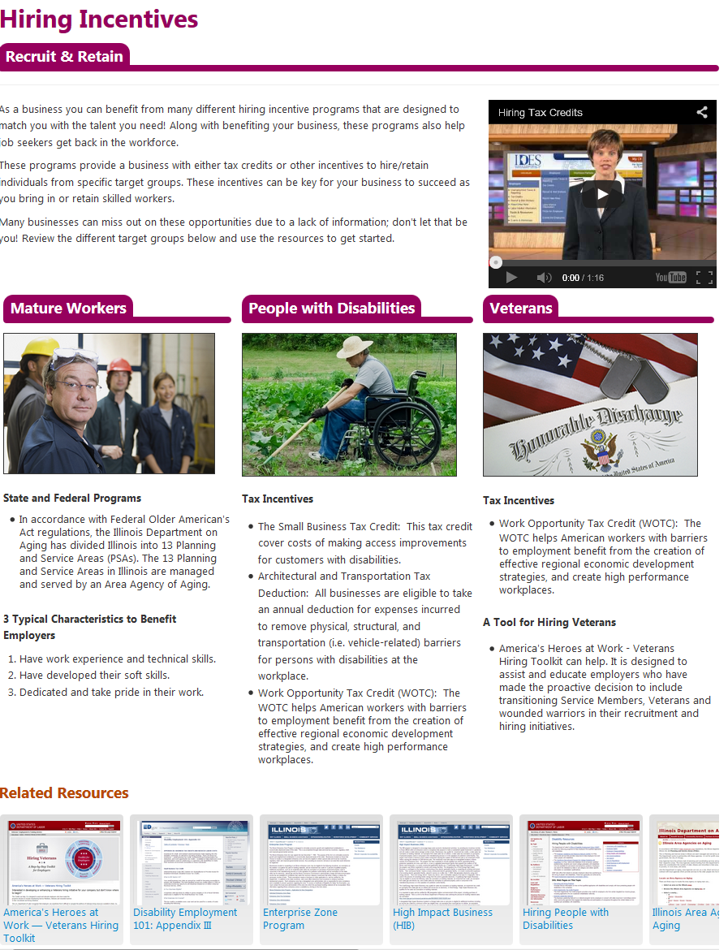
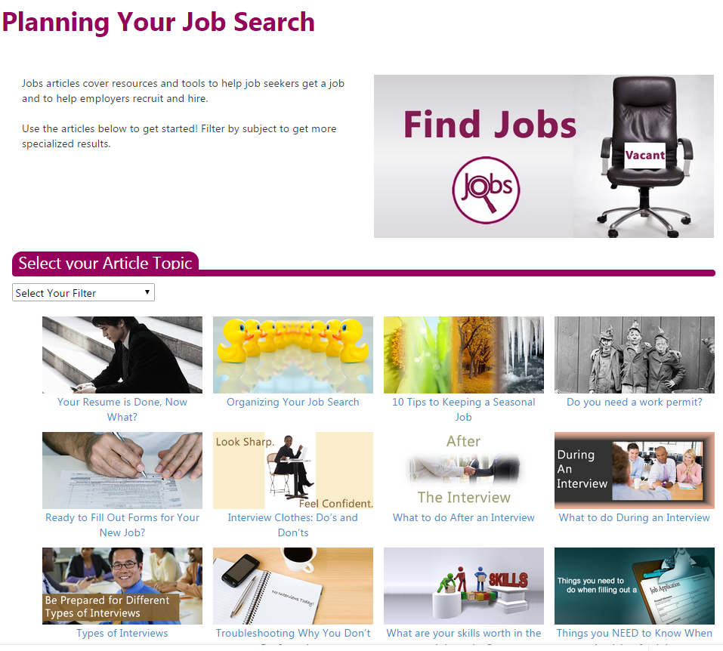
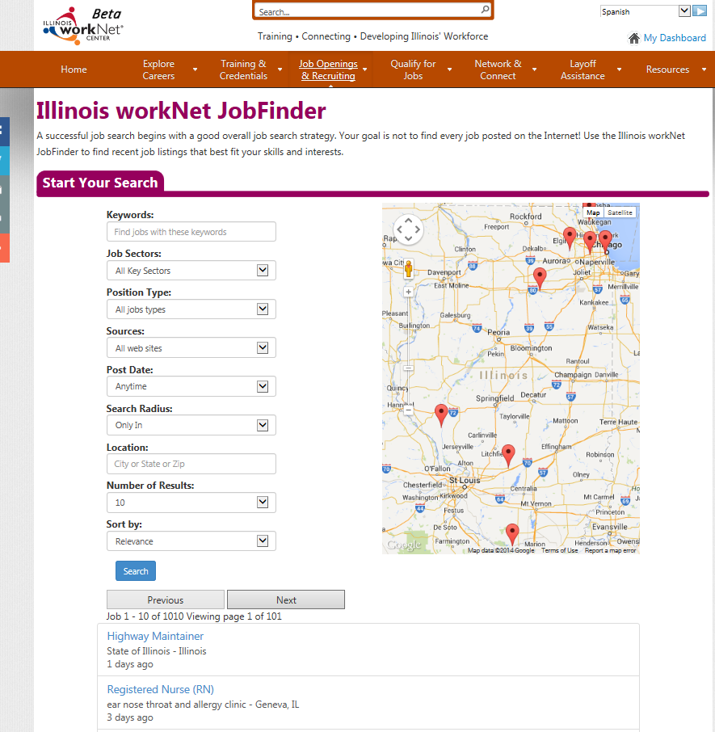
Jobs Examples
Connect to Job Opportunities
Hiring Incentives
Planning Assistance

Slide 20
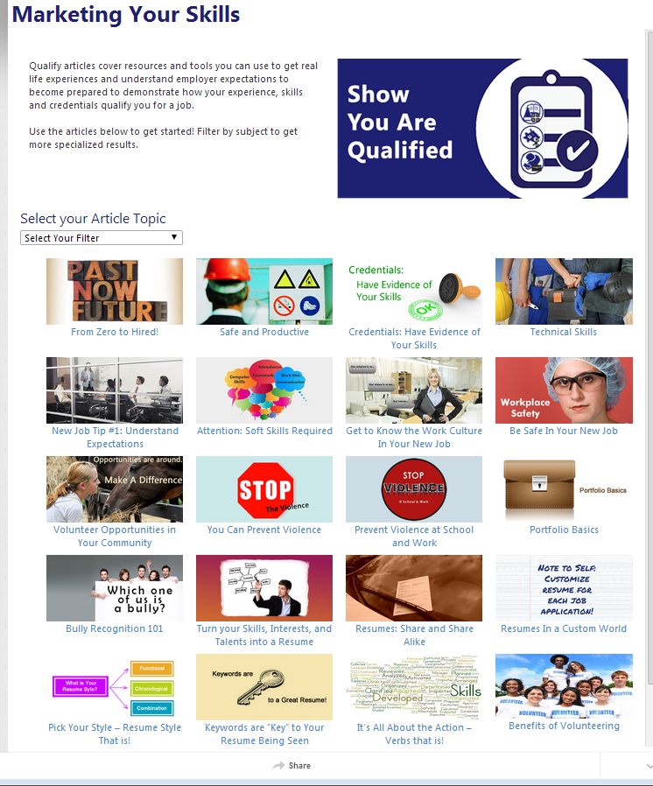
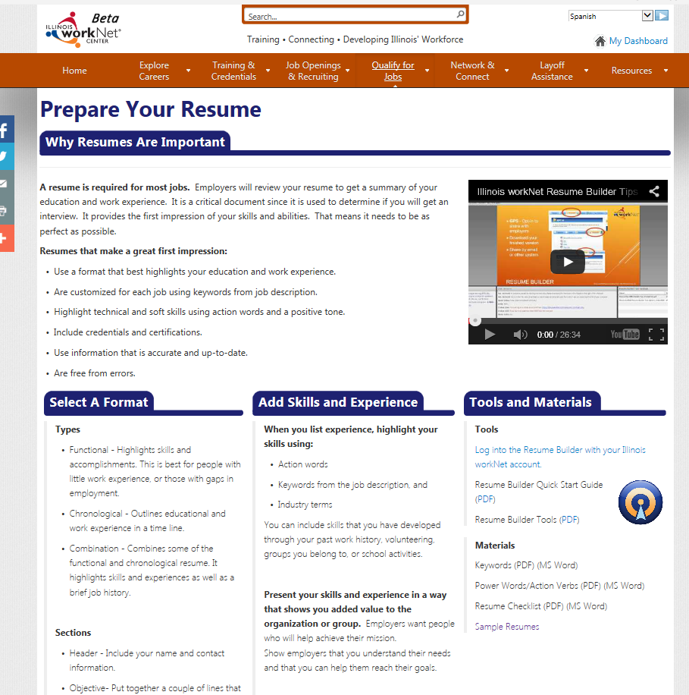
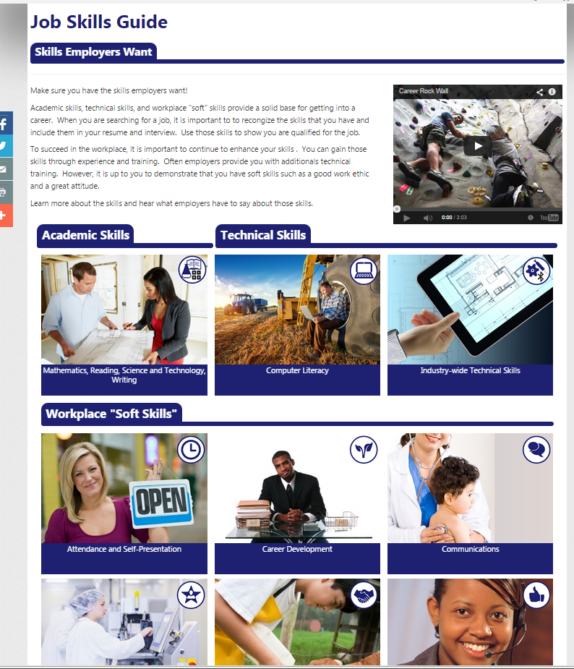
Qualify for Jobs Examples
Job Skills Guide
Prepare Your Resume
Marketing Your Skills

Slide 21
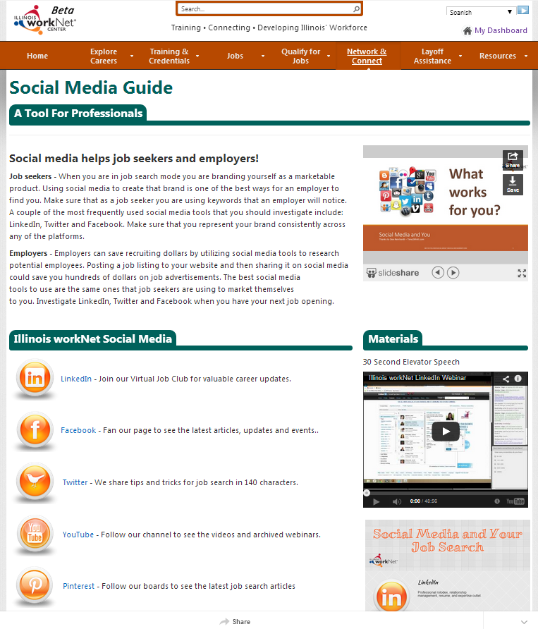
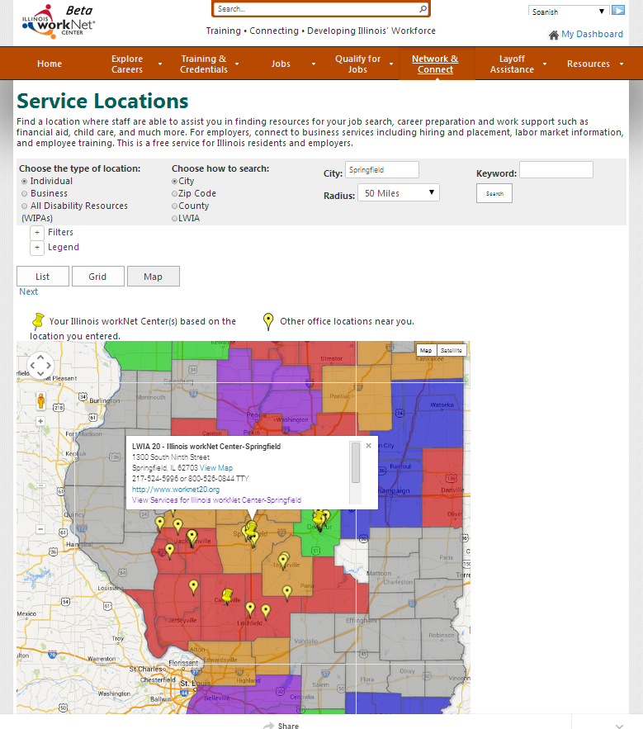
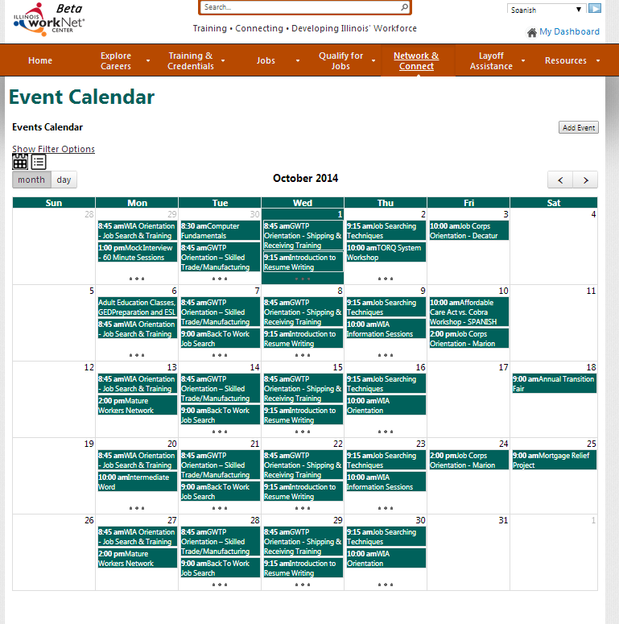
Network & Connect Examples
Event Calendar Widget
Service Locations
Social Media Guide

Slide 22
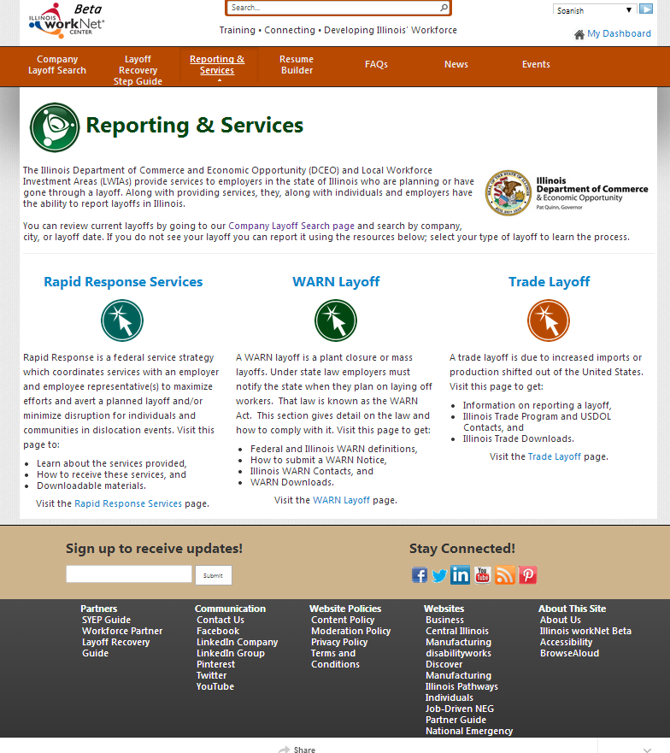
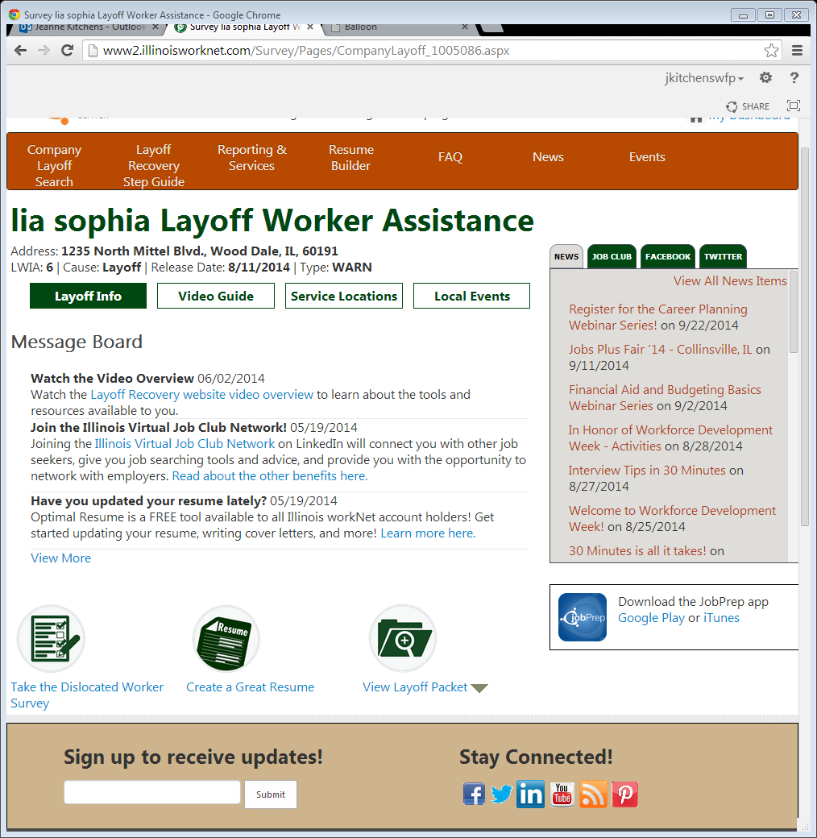
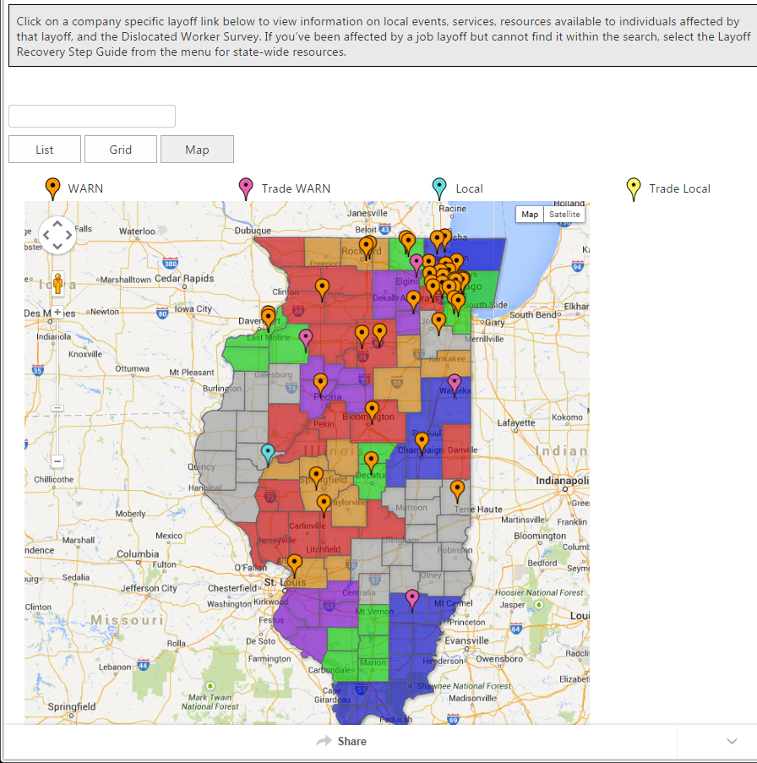
Layoff Assistance Examples
Company-Specific Layoff Assistance
Reporting and Services
Step Guides

Slide 23
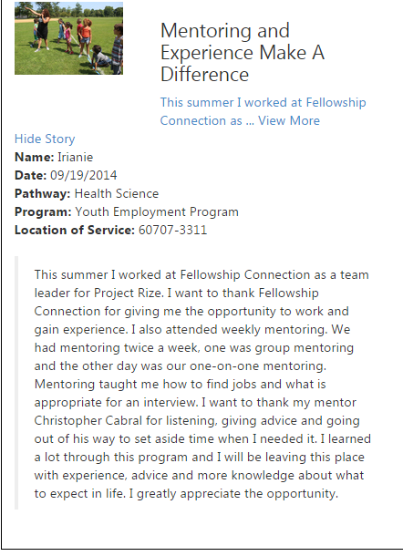
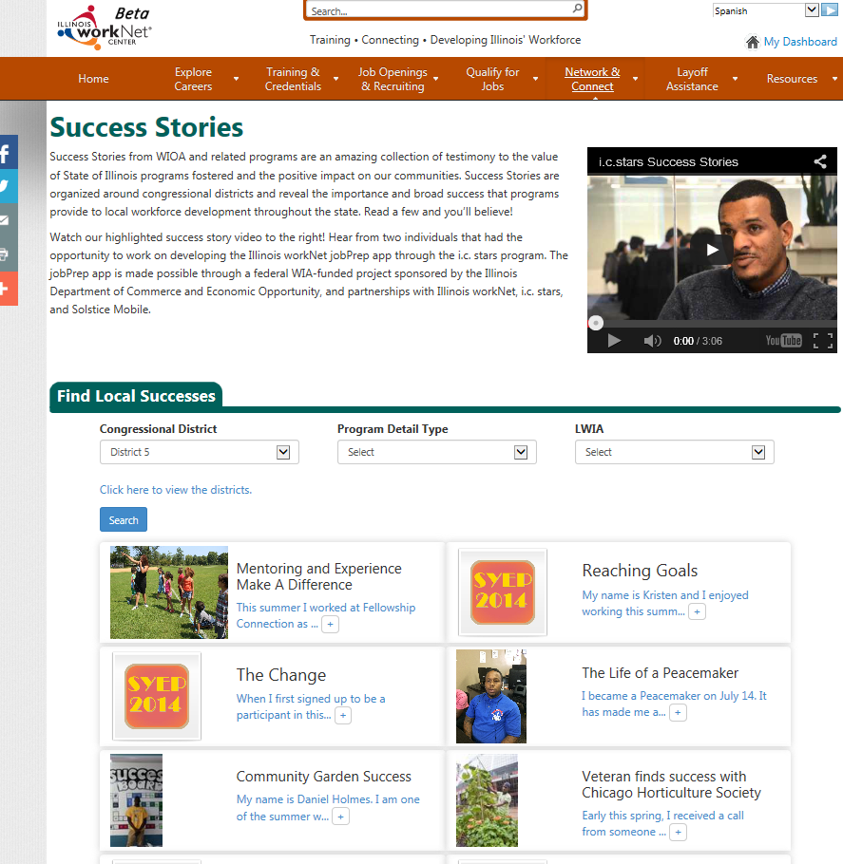
Success Stories Examples
Collect
Approve
Display

Slide 24
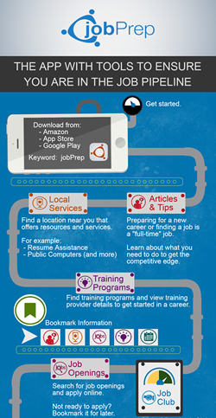
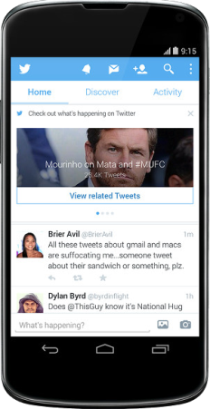
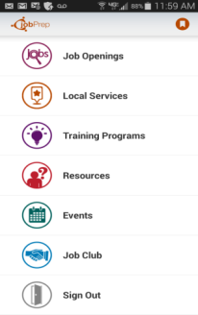
IwN jobPrep Mobile App
jobPrep app offers career preparation at your fingertips:
Get the competitive edge with articles & tips.
Learn how and where to get supportive services.
Connect to training programs for high demand jobs.
Join the virtual job club.
Find and apply for jobs.
Use the calendar to find local job fairs and workshops.
Available at iTunes, Google Play, and Amazon app stores for FREE use keyword “jobPrep”.
http://www2.illinoisworknet.com/UpdatesHelp/Pages/jobPrep.aspx

Slide 25
Partner Tools
Through Illinois workNet both WIOA-funded and other community partners can have accounts and use tools to facilitate and engage customers:
Dashboard to view customer groups, assign and see assessments and program information.
Add and manage information beneficial to the community:
Company-Specific Layoff Assistance Pages
Events
Featured Employers
News and Updates
Partner Page
Resources
Service Locations
Special Programs
Success Stories

Slide 26
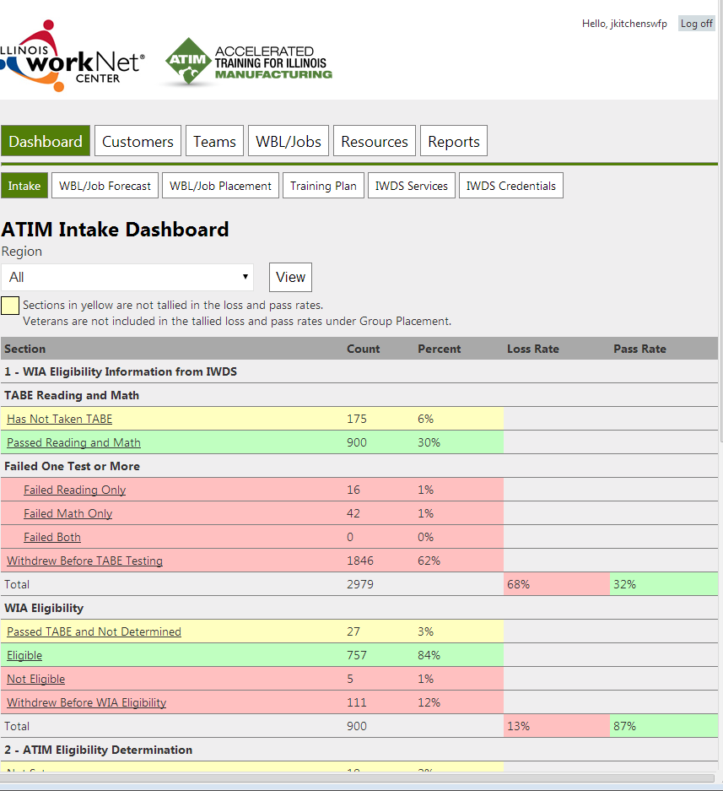
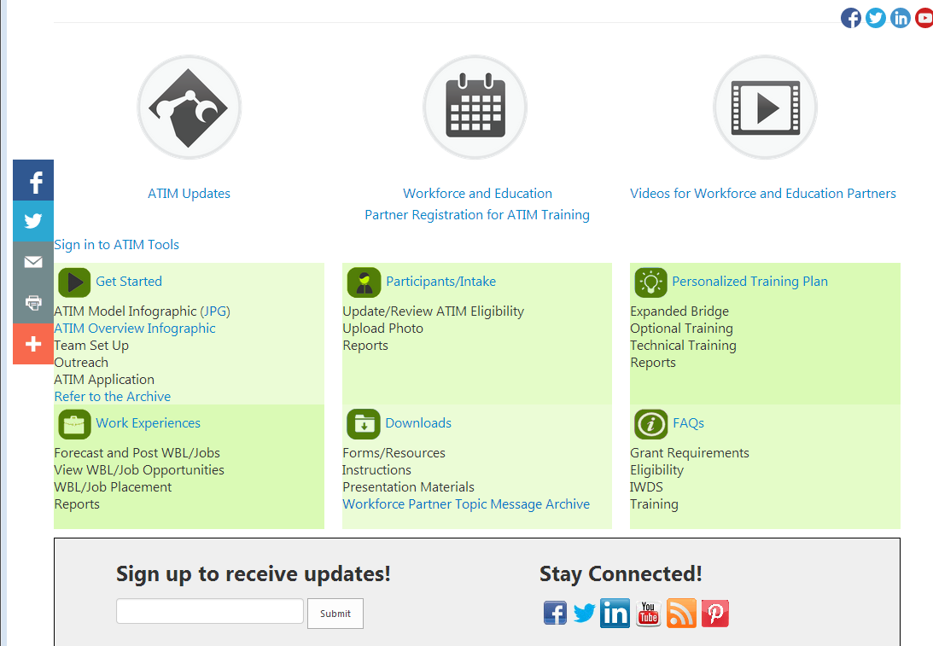
Partner Guides and Tools Examples
Data and tools at the office or on the go
Online guides
Live and archived webinars

Slide 27
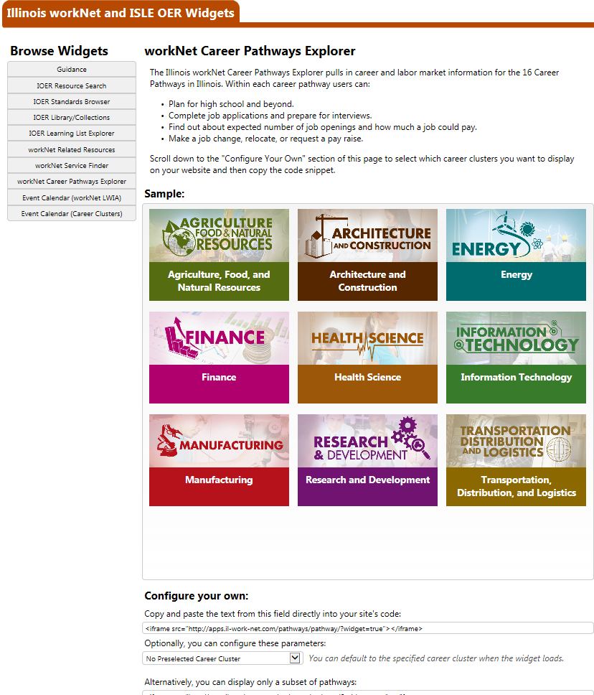
IwN and OER Widgets
Several widgets are available that, much like YouTube videos, with the copy/paste of a short code snippet puts nicely formatted, interactive apps on any website page. Any state agency or partner can put widgets on their websites:
IOER Resource Search
IOER Learning Standards Browser
IOER Libraries and Collections
IOER Learning List Explorer
IwN Related Resources
IwN Service Finder
IwN Career Pathways Explorer
IwN Event Calendar
Illinois Pathways (Career Clusters) Event Calendar
http://www2.illinoisworknet.com/widgets

Slide 28
Outreach/Marketing
Illinois workNet provides templates for outreach and marketing available to any partner:
Graphics and icons
Color palette
Updated flyer templates for local partners to customize (by filling in some of their services and local contact information):
Employers
Individuals
Youth
Veterans
Laid Off Workers
Workforce and Education Partners
General

Slide 29
Contact Information for Partners
Jeanne Kitchens
Associate Director
SIU Center for Workforce Development
2450 Foundation Drive, Suit 100
Springfield, Illinois 62703-5464

