Slide 1


Employment 101:
Tools to Reach Training
and Employment Goals
March 6, 2018
The Illinois workNet® Center System, an American Job Center, is an equal opportunity employer/program. Auxiliary aids and services are available upon request to individuals with disabilities. All voice telephone numbers may be reached by persons using TTY/TDD equipment by calling TTY (800) 526-0844 or 711. This workforce product was funded by a grant awarded by the U.S. Department of Labor’s Employment and Training Administration. For more information please refer to the footer at the bottom of any webpage at illinoisworknet.com.

Slide 2

Illinois workNet: Benefits for Career and technical education Students and Providers
Students can access resources and tools to help them explore careers, training, and the skills needed to reach their training and employment goals.
Providers have access to the same resources and tools. Plus, they have instructor guides and partner tools to recover passwords, view student assessments, plans, saved resumes, and more.
All of these resources are FREE.
You can type in a career of your interest in the search box.
It will then generate a list of jobs for you to view that match your search.

Slide 3
Employment 101: Tools to Career Goals
Employment 101
Demonstrate Student Tools
Supporting Classroom Resources
Live Polling Question & Discussion
Customer Support Center
Demonstrate Partner Tools
Live Polling Question & Discussion
Next Steps

Slide 4







Guidance & Personalized tools for students

Slide 5


Employment 101: Getting Started
Students need to have an Illinois workNet account.
Step one
Step two
Step Three
Go to www.illinoisworknet.com and sign up for an Illinois workNet account.
Verify your Illinois workNet account via email.
Go to My Dashboard and select Employment 101.

Slide 6
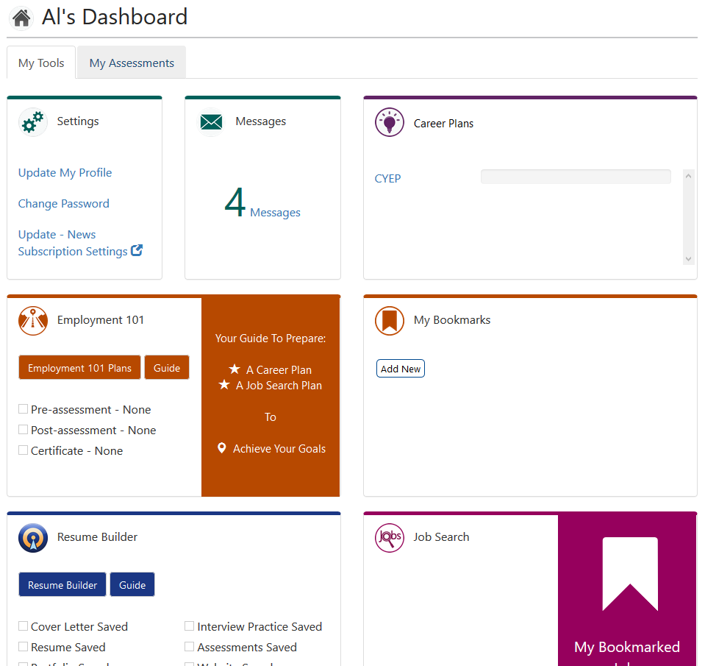
Employment 101: Getting Started
Available on their My Dashboard.

Slide 7
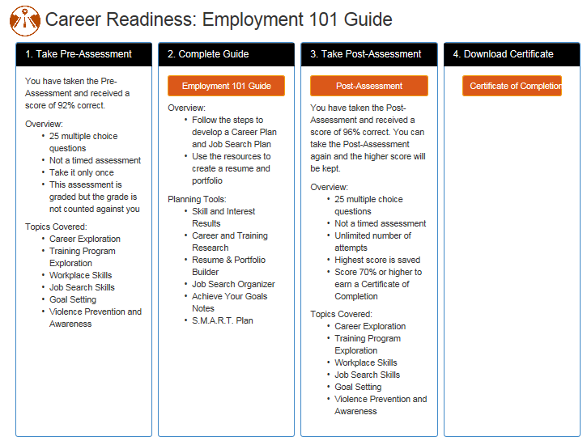
Employment 101: Step by step approach
…to develop a roadmap to reach career goals.
You can type in a career of your interest in the search box.
It will then generate a list of jobs for you to view that match your search.

Slide 8
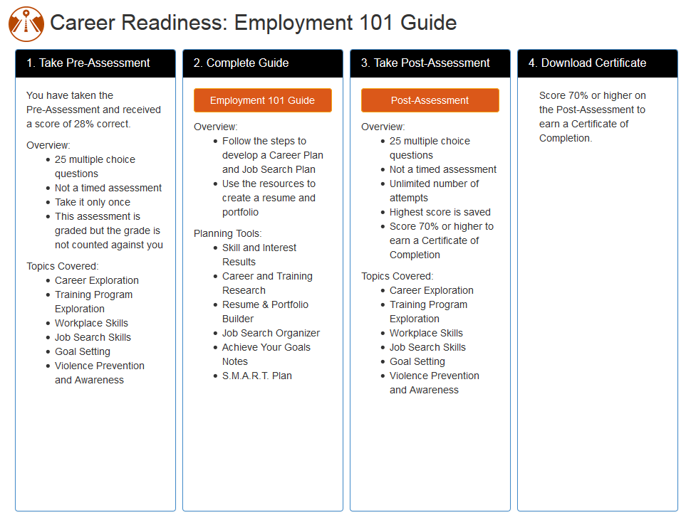
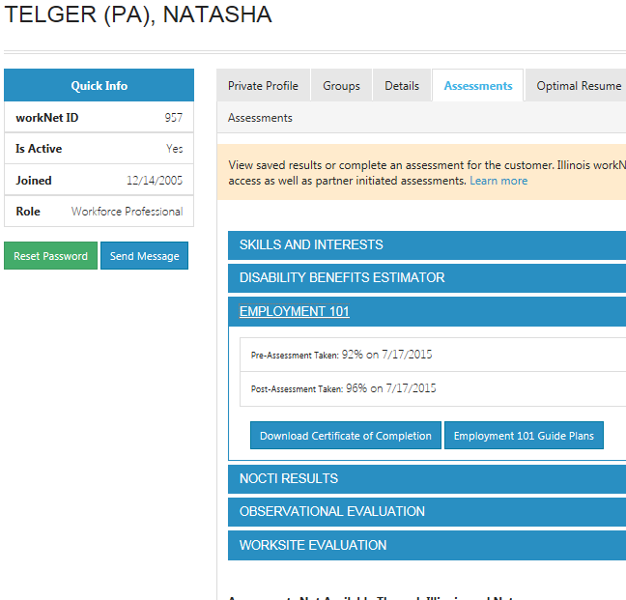
Employment 101: pre & Post Assessments
Students:
access Through their account.
Instructors:
view results in the Customer Support Center.

Slide 9

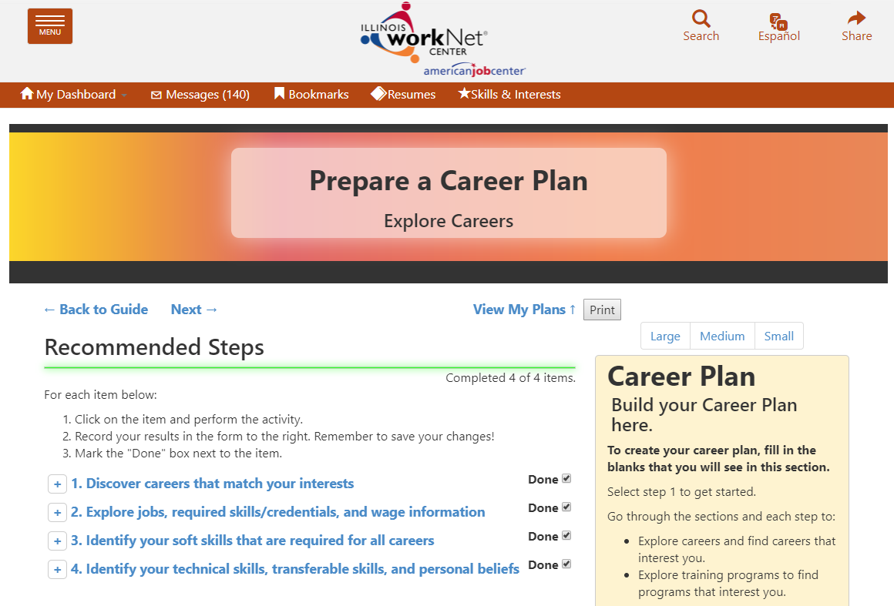

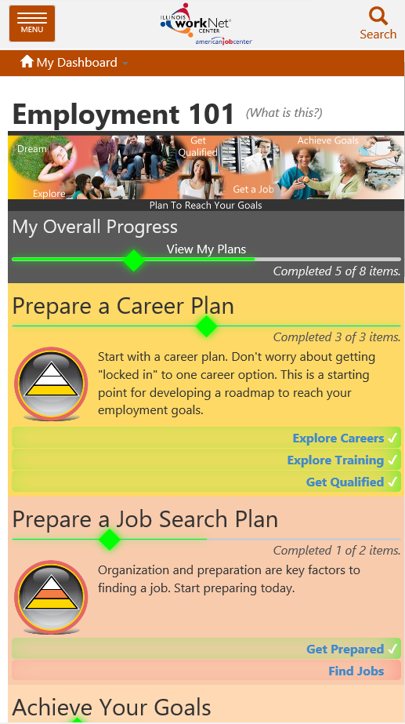
Employment 101: The guide
Instructor Guides Available:
Prepare a Career Plan
Prepare a Job Search Plan
STEPS WITH INTEGRATED RESOURCES:
Articles
Searches
Tools
Videos
Link to View Plans
SIDE BAR FOR:
Career Planning
Job Search Records
Goals and Notes

Slide 10
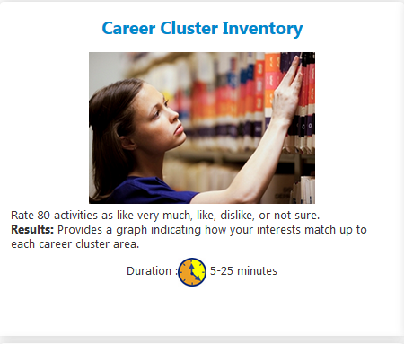
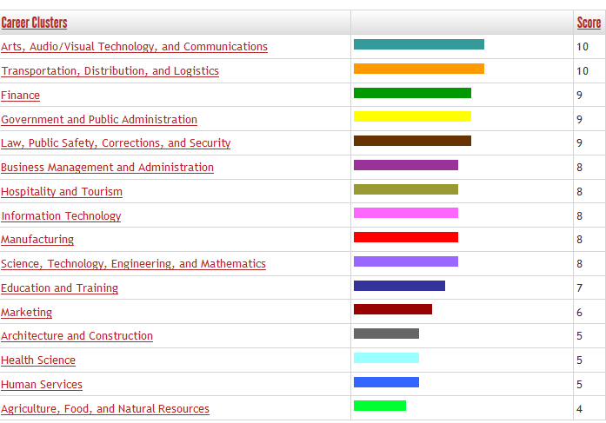
Employment 101: integrated Tools
Skills and Interest Survey
Students complete career cluster inventory.
Students and Instructors can view results
Source: Illinois Career Information System (CIS) brought to you by Illinois Department of Employment Security.

Slide 11

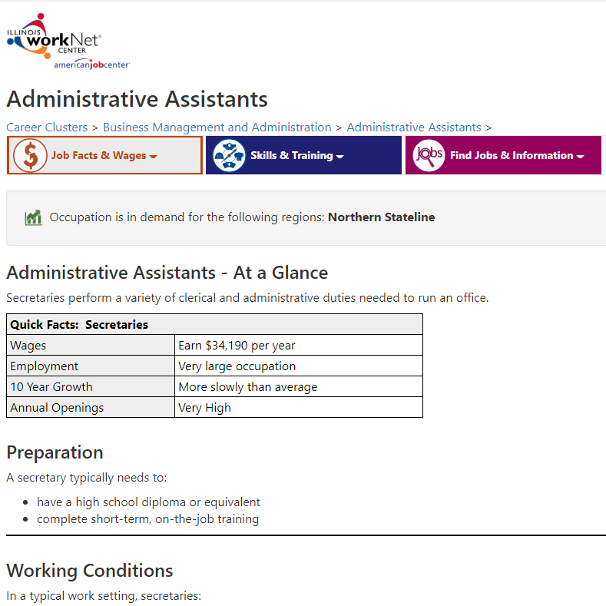
Employment 101: integrated Tools
Research Careers, Wages & Trends
Source: Illinois Career Information System (CIS) brought to you by Illinois Department of Employment Security.
Students
Explore Options In Career Pathways
Learn About Wages, Job Opportunities, Working Conditions, Required Skills & More
Learn About Required License/Certification and Training Programs

Slide 12
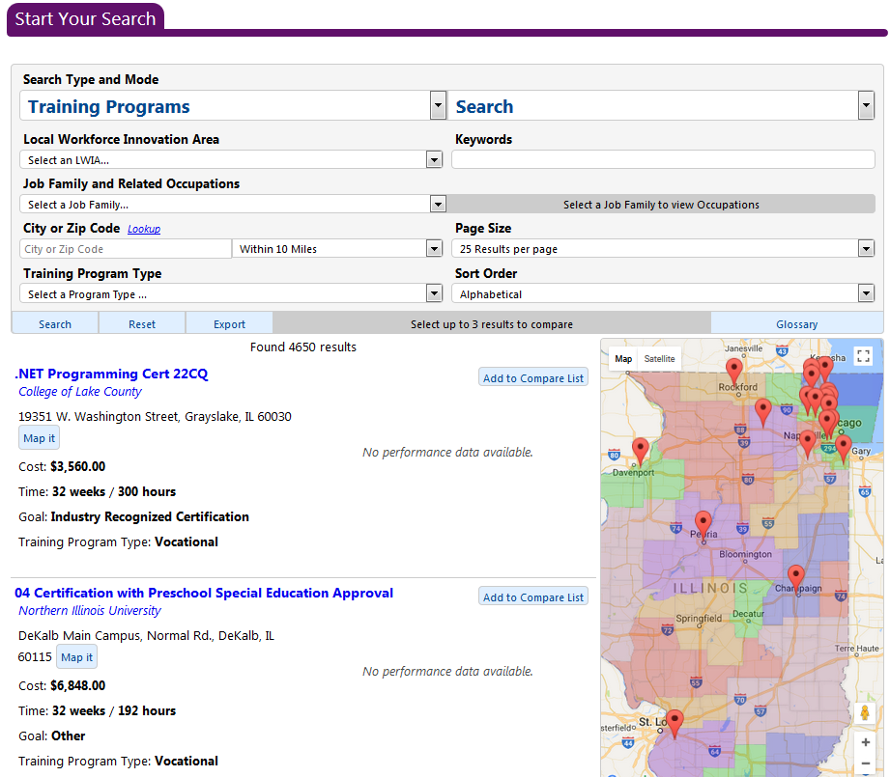
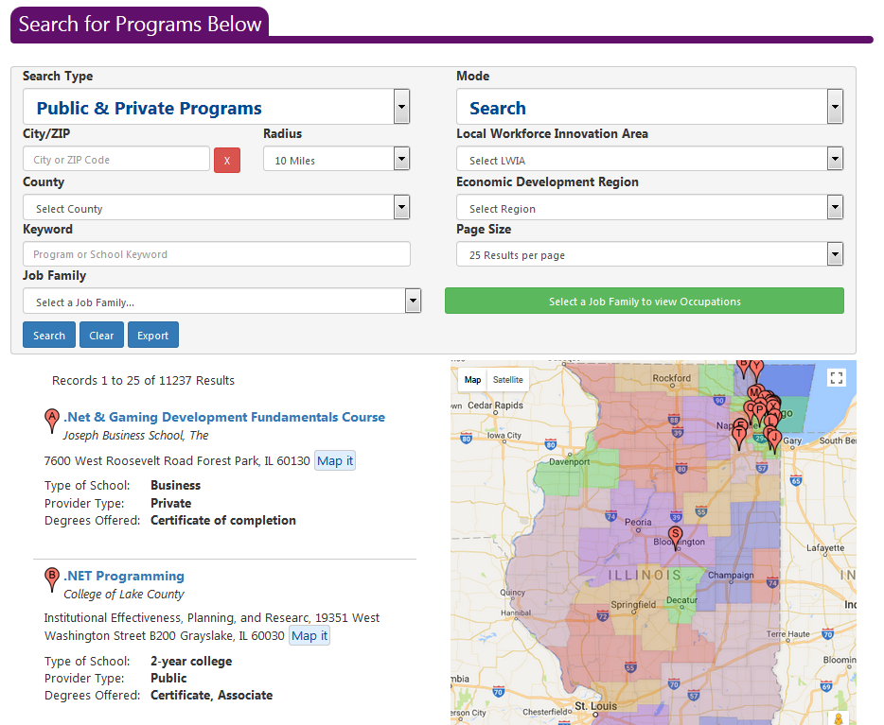
Employment 101: integrated Tools
Research Training
WIOA Approved Training Programs
PUBLIC & PRIVATE TRAINING PROGRAMS*
*Source: Illinois Career Information System (CIS) brought to you by Illinois Department of Employment Security.

Slide 13

Employment 101: integrated Tools
Guides
Job Skills Guide
Digital Literacy Guide
Resume Writing Guide
Social Media Guides

Slide 14
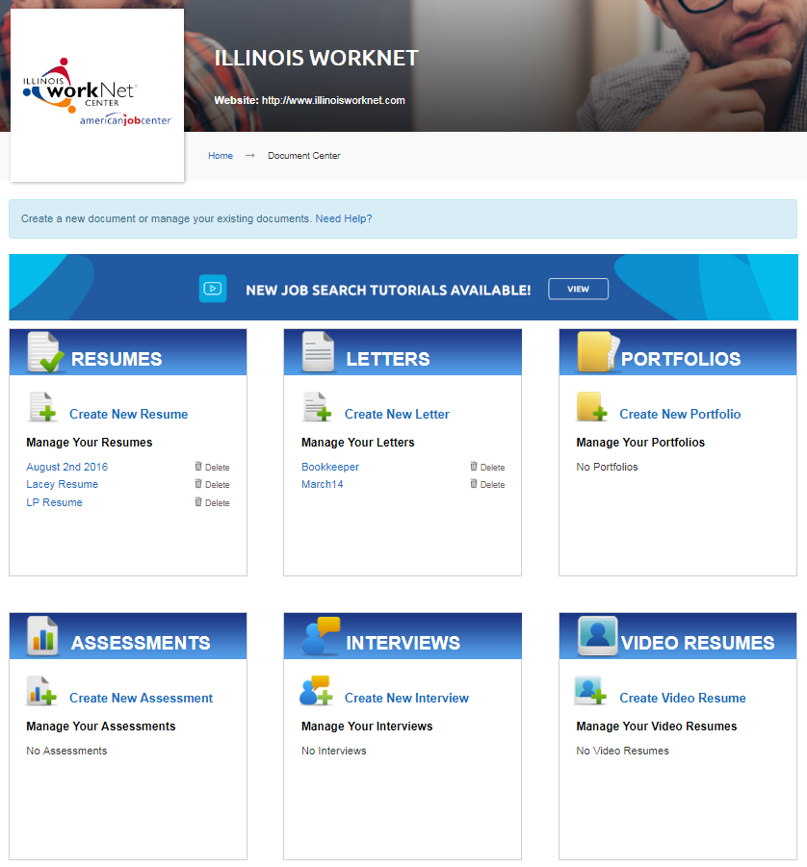
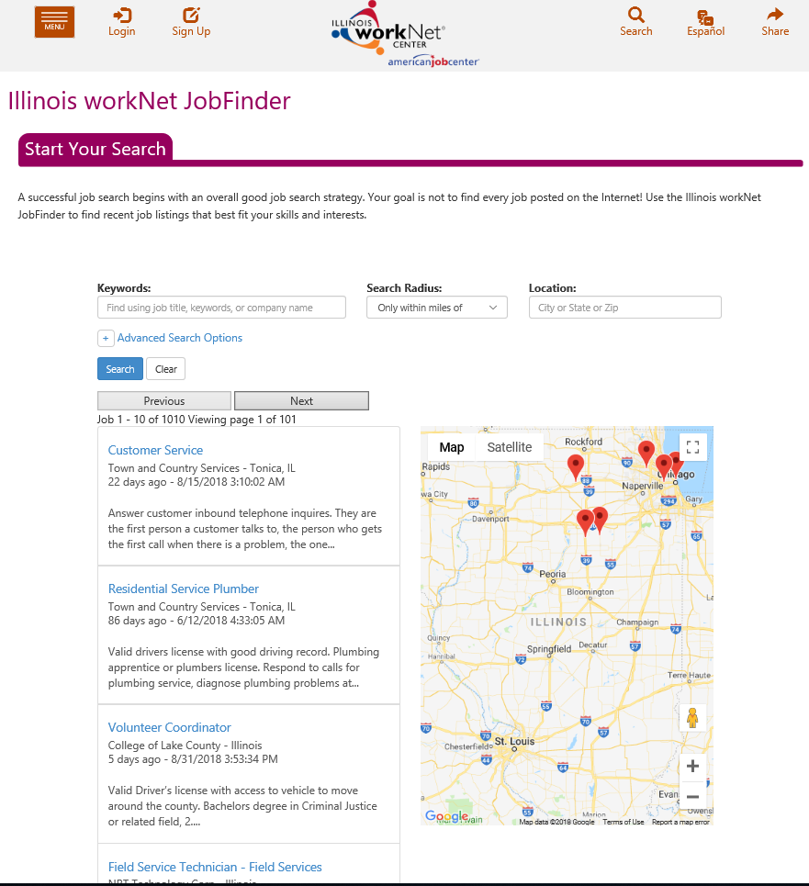
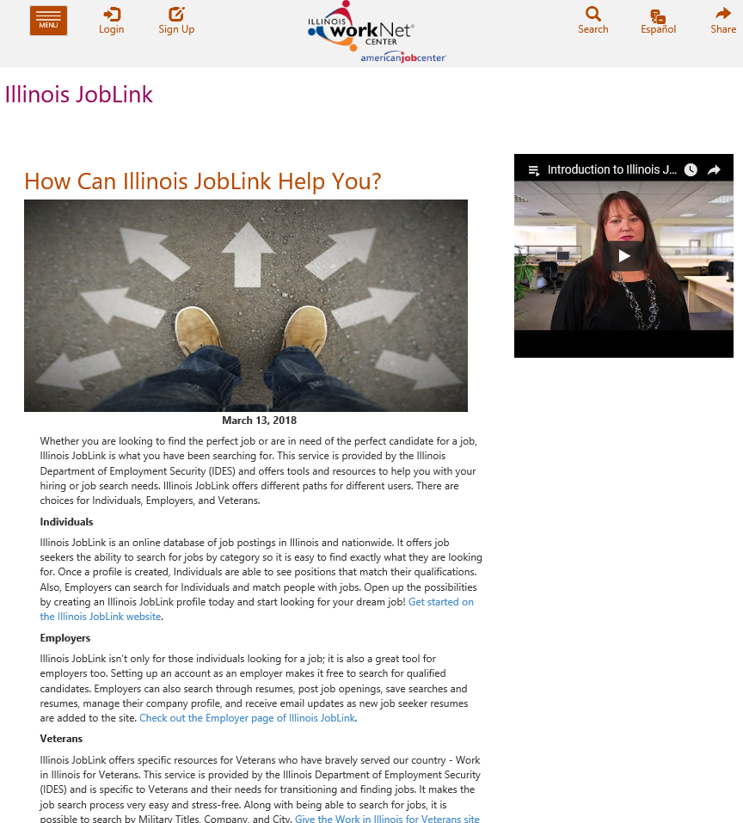
Employment 101: integrated Tools
Find Jobs
Resume Builder
JobFinder
Illinois JobLink

Slide 15

Employment 101: Certificate of Completion

Slide 16
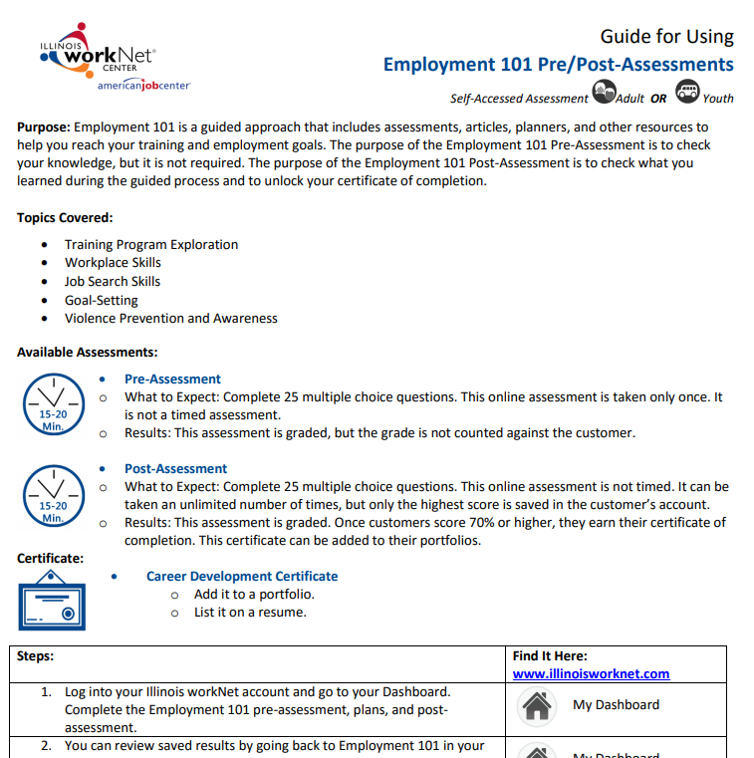

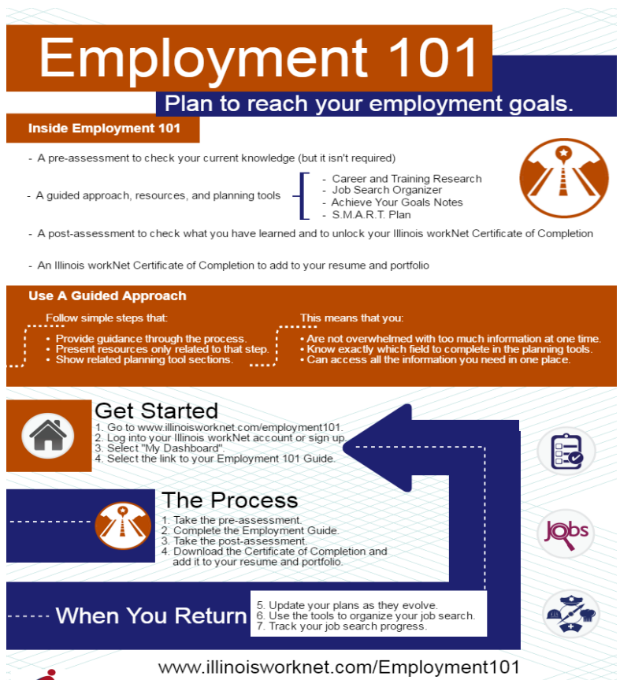
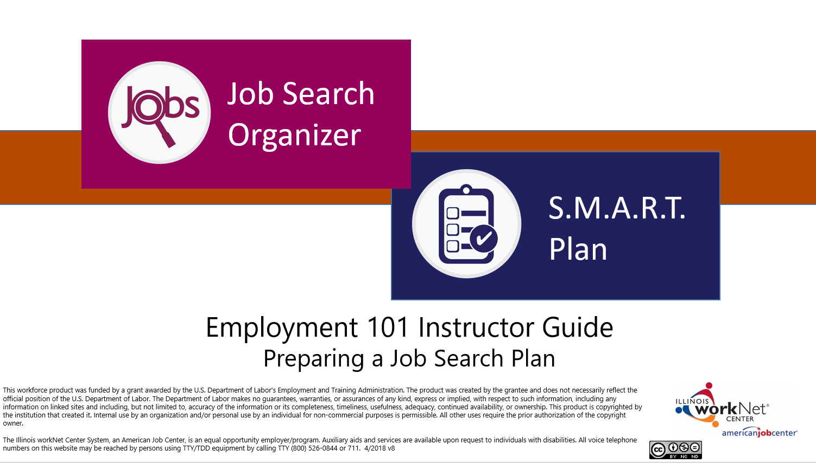
Employment 101: Supporting Resources
Guide for Using Employment 101 Customer Guide (PDF)
Employment 101 Overview for Customers (PDF)
Employment 101 - Career Plan Instructor Guide (PPT)
Employment 101 - Job Search Plan Instructor Guide (PPT)
https://www.illinoisworknet.com/partners/Pages/Assessments.aspx

Slide 17





Guidance & Personalized tools for Partners

Slide 18
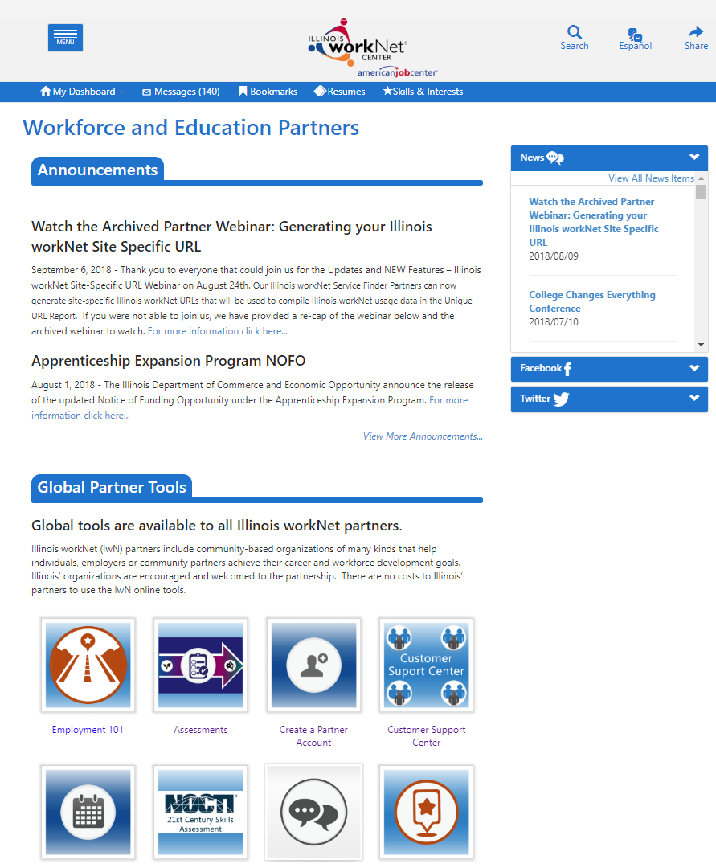
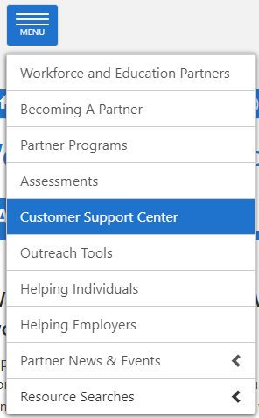
Partner Tools:
www.illinoisworknet.com/partners

Slide 19



Customer support center: Getting Started
Partners need to have an Illinois workNet partner account.
Step one
Step two
Step Three
Go to www.illinoisworknet.com and log into your Illinois workNet account.
Go to My Dashboard and select Partner Tools.
Invite students to join your Customer Support Center group.
When they accept the invitation, they are immediately added to your group.
https://www.illinoisworknet.com/partners/Pages/Customer-Support-Center.aspx

Slide 20

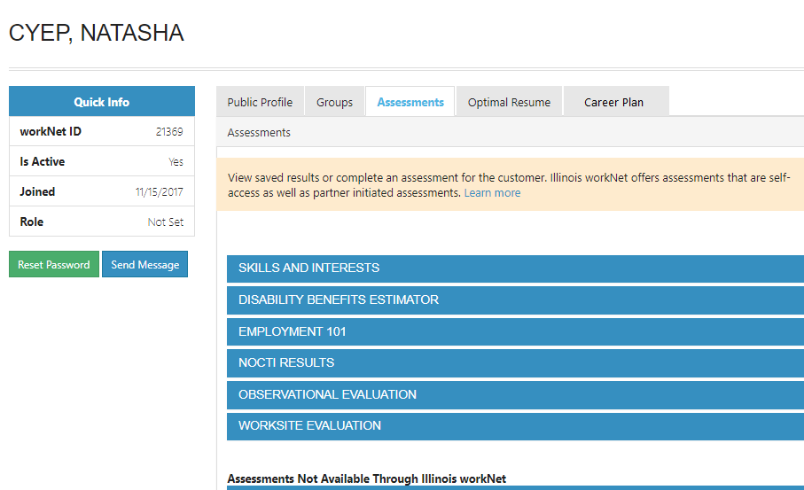
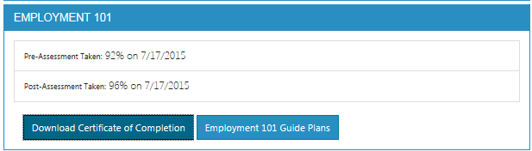
Customer Support Center: Partner Tools
View Student Employment 101 Results
Assessment Tab
View student skills and interest results.
View Employment 101 assessment results, plans, and certificate of completion.

Slide 21
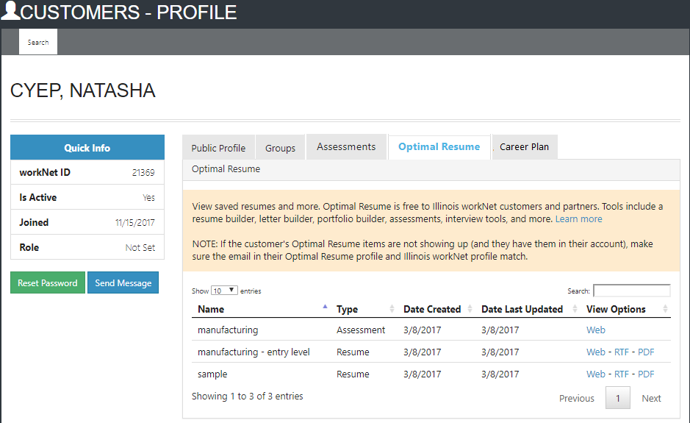
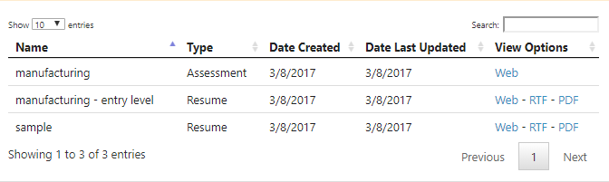
Customer Support Center: Partner Tools
View Student Employment 101 Results
Optimal resume Tab
View student saved resumes, cover letters, interview practice, assessments, and webpages.

Slide 22










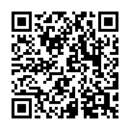
follow us!
Subscribe to our Newsfeed or check us out on Social Media
HOME: https://www.illinoisworknet.com/
EMAIL: info@illinoisworknet.com
MORE INFO: www.illinoisworknet.com/ExploreCareers
Facebook
Twitter
Youtube
linkedin
Linkedin group
Google+
Pinterest

