Slide 1
How the Illinois Department of Insurance Can Help You Find Health Insurance

Slide 2
Outline
Affordable Care Act (ACA) - Expanding Access to Coverage
ACA Marketplace: What is the Special Enrollment Period in Response to COVID-19?
SEP in Response to COVID-19 and the American Rescue Plan (ARP)
Get Covered Illinois - ACA Marketplace Enrollment
Uninsured Ombudsman Program

Slide 3
Affordable Care Act (ACA) - Expanding Access to Coverage

Slide 4
Expanding access to coverage
The Affordable Care Act (ACA) provides for affordable coverage through:
The ACA Health Insurance Marketplace
Private insurance – with financial assistance to help pay premiums, if you qualify
Medicaid expansion

Slide 5
ACA Marketplace health plans increase consumer protections:
Establishes 10 Essential Health Benefit categories
Provides coverage for people with pre-existing conditions
Eliminates annual and lifetime dollar limits
Caps maximum out-of-pocket costs

Slide 6
Essential Health Benefits
Ambulatory care
Emergency services
Hospitalization
Maternity and newborn care
Mental health and substance use disorder services
Prescription drugs
Rehabilitative disease management
Laboratory services
Preventive/wellness services and chronic disease management
Pediatric services, including oral and vision care
Notes:
Every individual and small-group policy sold since January 1, 2014 includes essential health benefits coverage.
There are multiple resources available to enroll in a health plan. Regardless of where you decide to enroll in a health plan, it is important to understand your coverage.

Slide 7
ACA Health Insurance Marketplace: What is the Special Enrollment Period (SEP) in Response to COVID-19?
Notes:
Get Covered Illinois is ACA partnership between Illinois and the federal Marketplace.

Slide 8
Special Enrollment Period (SEP) in Response to COVID-19
February 15, 2021 through August 15, 2021
The Biden-Harris administration opened the federal ACA Marketplace to help millions of people, including Illinoisans, who’ve lost job-based health coverage, experienced health issues due to COVID-19, or are uninsured for any reason.

Slide 9
How is this Special Enrollment Period (SEP) different?
Unlike other SEPs, the Special Enrollment Period (SEP) in Response to COVID-19 does not require additional documentation, beyond what is normally required to purchase and enroll in an ACA Marketplace health plan
Consumers do not need to provide proof of a qualifying life event, such as job loss, marriage or birth of a child, which is typically required for SEP eligibility

Slide 10
Who can get covered through the SEP in Response to COVID-19?
You can enroll if:
You live in the United States
You are a U.S. citizen or national
You are not incarcerated
You do not have health insurance through an employer, Medicare, Medicaid, Children’s Insurance Program (CHIP), or another source that provides qualifying health coverage
Notes:
Most people can shop for coverage in the Marketplace. To be eligible you must live in the state where your Marketplace is, you must be a citizen of the U.S. or be lawfully present in the U.S., and you must not currently be incarcerated.

Slide 11
When do I enroll and when does coverage begin?
Eligible Illinoisans who don’t have health insurance coverage or want to change their current ACA Marketplace health plan can purchase and enroll in a new plan now
through August 15, 2021
After you enroll, your coverage can start the next month
If you enroll on May 2nd, coverage can begin June 1st
Contact your new insurer for details

Slide 12
SEP in Response to COVID-19 and the American Rescue Plan (ARP)
Notes:
Get Covered Illinois is ACA partnership between Illinois and the federal Marketplace.

Slide 13
What is the American Rescue Plan (ARP) and how does it affect ACA Marketplace plans?
The ARP is a $1.9 trillion economic stimulus bill that includes
the expansion of financial assistance to help consumers pay for
ACA Marketplace health plans
If you qualify, you receive premium tax credits (PTCs) to help cover the cost of your monthly premium payments
PTCs are refundable credits which are sometimes called "subsidies“ or "discounts”

Slide 14
How are Premium Tax Credits (PTC) calculated under the ARP?
Under the ARP, you may be eligible for a temporary increase in premium tax credits (PTC) and pay no more than 8.5%
of your household income toward the cost of a benchmark
ACA Marketplace plan
Your household income must be at least 100 % but no more than 400 % of the federal poverty line for your family size

Slide 15
When do I get the Premium Tax Credits (PTCs)?
When you enroll in a new ACA Marketplace plan, you will find out if you qualify for premium tax credits
If you already have an ACA Marketplace plan and receive premium tax credits, you may receive additional tax credits
The premium tax credits are for plan years 2021 and 2022
To receive PTCs, you must buy health insurance directly through the ACA Marketplace (at getcoveredillinois.gov and healthcare.gov)

Slide 16
How does the ARP affect someone who lost their job and may be eligible for COBRA subsidies?
Under the ARP, federal subsidies may cover 100% of your monthly COBRA premium
You must be currently eligible for COBRA (lost job/reduction of hours in the last 18 months)
Employers are responsible for notifying eligible former employees about COBRA and providing information about open enrollment
Federal COBRA subsidies are for employers with 20 or more employees

Slide 17
When does the ARP financial assistance end?
Premium tax credits and other subsidies/savings under the American Rescue Plan are scheduled to end in 2022
Visit getcoveredillinois.gov for FAQs about the ARP

Slide 18
Get Covered Illinois ACA Marketplace Enrollment
Notes:
Get Covered Illinois is ACA partnership between Illinois and the federal Marketplace.

Slide 19
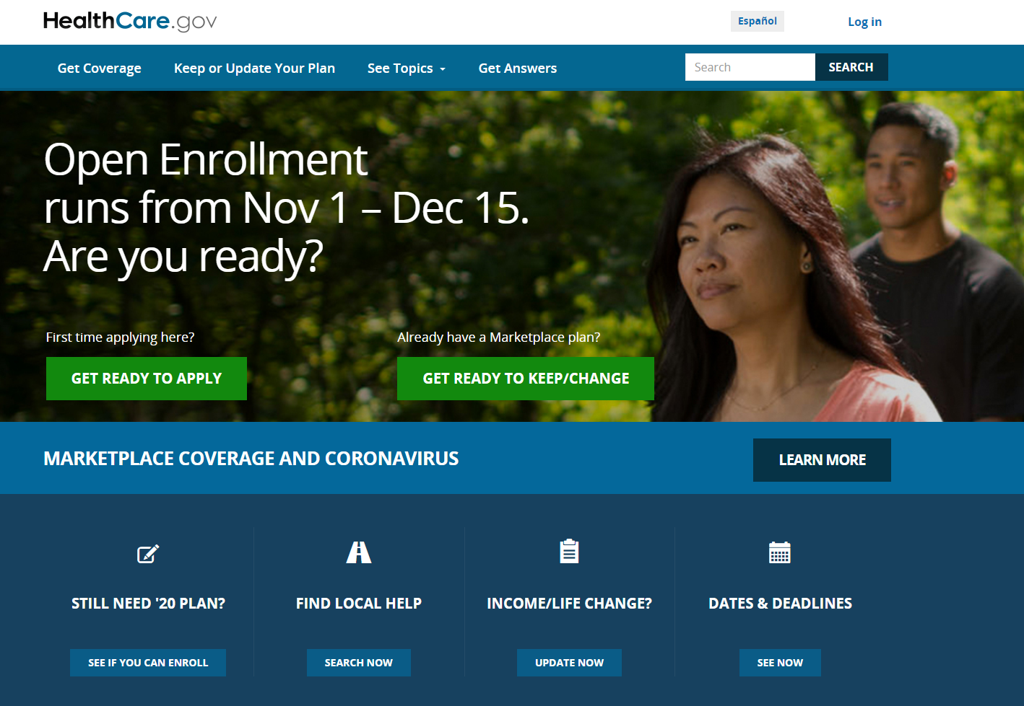
Enrolling in an ACA Marketplace health plan
Healthcare.gov
Federal website where you can compare plan prices/benefits and enroll
Every plan covers essential health benefits including doctor visits, preventive care, prescriptions drugs and hospitalization
You may qualify for financial help

Slide 20
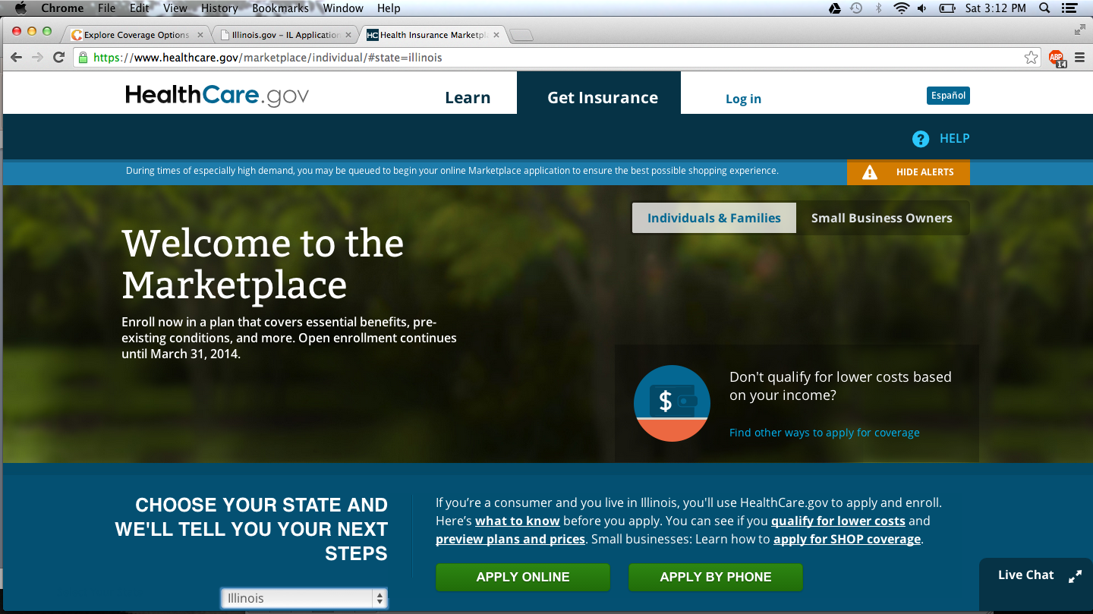
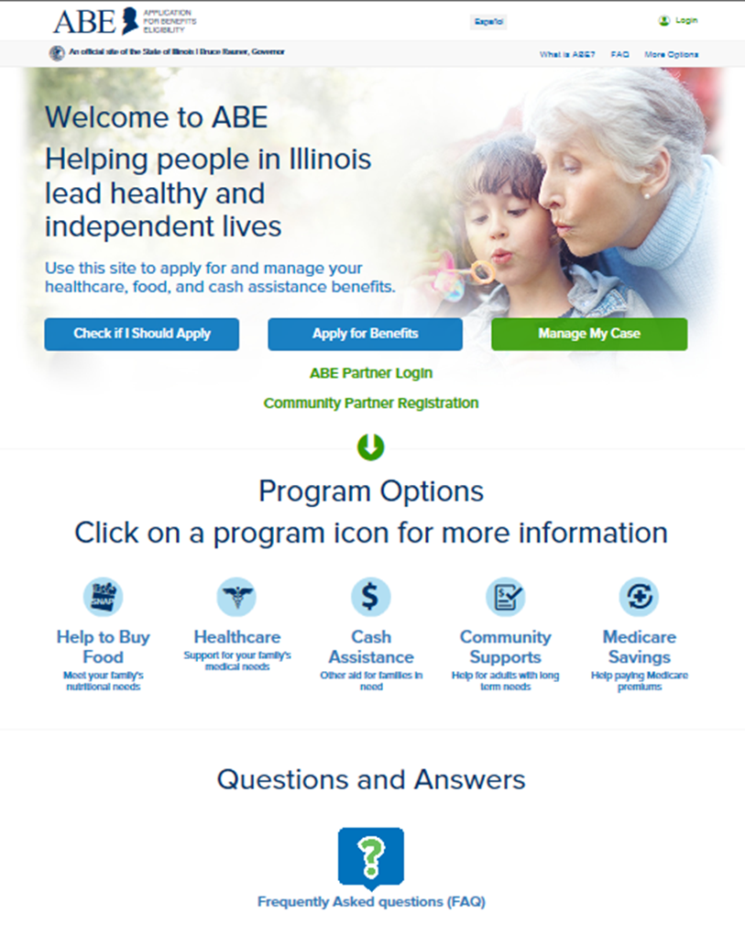
ACA Marketplace or Medicaid?
Answer 3 questions on getcoveredillinois.gov to help us direct you to the ACA Health Insurance Marketplace or to Medicaid
ACA Marketplace: Special Enrollment Period (SEP) in Response to COVID-19 - enroll now through August 15, 2021
You can apply for Medicaid at any time

Slide 21
Where do I find help to enroll?
Get Free Help
getcoveredillinois.gov
https://widget.getcoveredamerica.org/get-covered-illinois/
Notes:
Visit GetCoveredIllinois.gov, and go to the “Get Free Help” button on the main menu. You will be directed to a tool that allows you to type in your zip code and find a Certified Application Counselor in your local area. CAC’s, also known as Assisters, will not recommend a specific plan for you but they will answer any questions you have regarding the different plans available.

Slide 22
Who can help me enroll?
Local Assisters
Help educate you about the different types of plan coverage, answer questions and help you enroll
Can be found by entering your zip code on getcoveredillinois.gov
Navigators
Individuals or organizations trained to help you find and apply for health insurance through the ACA Marketplace or Medicaid

Slide 23
Uninsured Ombudsman Program
Notes:
Get Covered Illinois is ACA partnership between Illinois and the federal Marketplace.

Slide 24
The Uninsured Ombudsman Program assists consumers who:
Have no health insurance
Are about to lose health insurance
Cannot afford to purchase health insurance

Slide 25
The Uninsured Ombudsman Program can help you:
Explore available state and federal programs
Review coverage options and locate resources to help reduce your medical costs
Understand your continuation rights and responsibilities under your existing job-based health insurance

Slide 26
In addition to an ACA Marketplace health plan or Medicaid, consider:
COBRA continuation of your job-based health insurance plan under state and federal law
Contact your employer or the U.S. Department of Labor 866-444-3272 www.dol.gov/general/topic/health-plans/cobra
Joining your spouse/partner’s job-based health insurance plan

Slide 27
Health Insurance Resources
Websites
https://getcovered.illinois.gov/ - review, compare and enroll in an ACA Marketplace health plans
https://insurance.illinois.gov/ - Illinois Department of Insurance
https://abe.illinois.gov/abe/access/#program-options - Medicaid, other medical and human services programs
https://coronavirus.illinois.gov/s/ - latest information and resources about Coronavirus (COVID-19)
Phone Numbers
Healthcare.gov – the federal ACA Marketplace 800-318-2596
Get Covered Illinois 866-311-1119
IDOI - insurance questions and complaints 877-527-9431
IDOI - insurance claims appeals and external reviews 877-850-4740
Medicaid and other Medical Programs 800-843-6154
The Illinois Warm Line (Mental Health & Substance Abuse Assistance) 866-359-7953
Notes:
The following websites and phone numbers are helpful resources as you search for a new health insurance plan or if you have questions or insurance complaints. The Illinois Warm Line has also been added to this page as a resource for people seeking assistance with mental health and substance abuse challenges.

Slide 28
Additional programs managed by state and federal agencies
Hill-Burton Free Care Program - 800-638-0742 www.hrsa.gov
- Reduced fee services at certain health care facilities
Department of Specialized Care for Children - 800-322-3722 https://dscc.uic.edu/
- For families and children with special needs
Veterans Care - 877-483-8779 https://www.illinois.gov/hfs/Pages/default.aspx
- Medical, limited dental and vision coverage for an affordable monthly premium
Illinois Comprehensive Health Insurance Plan (ICHIP) 800-962-8384 http://www.chip.state.il.us/default.htm
- Applicants must qualify for coverage
Health Care Services for HIV - 800-243-2437 http://dph.illinois.gov/
Senior Health Insurance Plan (SHIP) 800-252-8966 https://www2.illinois.gov/aging/pages/default.aspx
- Assists Medicare eligible consumers
MEDICARE - 800-252-8966 www.medicare.gov
- Covers seniors 65 and older, the disabled under 65 and people with End-Stage Renal Disease
Notes:
The following websites and phone numbers are helpful resources as you search for a new health insurance plan or if you have questions or insurance complaints. The Illinois Warm Line has also been added to this page as a resource for people seeking assistance with mental health and substance abuse challenges.

