Slide 1

Workforce Grants 101:
An Overview of the Grant Submission Requirements under the Illinois Grant Accountability and Transparency Act
Illinois Department of Commerce and Economic Opportunity

Slide 2
Grant Life Cycle
Pre-Award
Award
Post- Award
This presentation will focus on the pre-award requirements of a workforce grant from the Illinois Department of Commerce and Economic Opportunity.

Slide 3
Program 2018 Funding Opportunities
Apprenticeship Expansion Program
  www.illinoisworknet.com/apprenticeshipnofo
Talent Pipeline Program
  www.illinoisworknet.com/TalentPipelineNOFO
Statewide Workforce Innovation Program
  www.illinoisworknet.com/WIOAInnovationNOFO

Slide 4
Illinois Grant Accountability and Transparency Act
The Grant Accountability and Transparency Act (GATA), 30 ILCS 708/1 et seq., is a State of Illinois law to:
Increase accountability and transparency in the use of grant funds
Reduce the administrative burden on both State agencies and grantees
Adoption of the federal grant guidance and regulations codified at 2 CFR Part 200 (Uniform Requirements)

Slide 5
Grantee Pre-Award Requirements that must be Completed Prior to Grant Award Execution
Grantee Registration
Grantee Pre-Qualification
Financial and Administrative Risk Assessment
  (ICQ – Internal Control Questionnaire)
Programmatic Risk Assessment
Mandatory Disclosures & Conflict of Interest Documents

Slide 6
GATA & Indirect Cost Rate System
Office of Management and Budget GATA Website: http://grants.illinois.gov
  Grantee Links Tab is the entry point for the GATA portal
    Authentication,
    Registration,
    Pre-qualification,
    Fiscal & Administrative Risk Assessment
  Centralized Indirect Cost Rate System will be used to elect the indirect cost rate option and, if necessary, complete the indirect cost rate negotiation process.
    Grantees that are not current users in the system will receive an invitation to the Centralized Indirect Cost Rate System once a Notice of State Award (NOSA) is generated by a State awarding agency

Slide 7
Grantee Registration
All Grantees must be registered with the State of Illinois using the Illinois.gov Authentication Portal. A personal or business email address is required to establish an account
Grantee Registration is completed by browsing to https://grants.illinois.gov/portal and associating your Illinois.gov account with your organization.
Completing the registration process triggers Grantee pre-qualification verifications

Slide 8

Grantee Pre-Qualification
Pre-Qualification includes verification of:
  Current DUNS number
  Current SAM.gov account
  Good Standing with Secretary of State
  Not on Federal Excluded Parties List
  Not on the Illinois Stop Payment List
  Not on the DHFS Provider Sanction List
  *Pre-qualification is dynamic and verifications
  are completed nightly.

Slide 9
Pre-Qualification Notification
If there are no issues, the GATA portal will send email to communicate “Qualified” status.
If there are issues, the GATA portal emails qualification issue(s)
  DUNS number is not current
  SAM CAGE Code is not current
  Not in Good Standing with Secretary of State
  On the Federal Excluded Parties List (cannot be remediated)

Slide 10
GATA Framework for Risk Assessment
Fiscal Risk Assessment (ICQ) is automated.
  The Grantee can access the ICQ from the grantee portal.
  The ICQ is completed on an annually basis by the Grantee
  The ICQ should be completed at the entity-wide level
  All state agencies will utilize the results of the ICQ
Programmatic Risk Assessment will be conducted by the awarding agency (DCEO) in the application process. It is unique to each NOFO and grant program and is typically completed if the proposal is recommended for funding.
Risk profiles will be determined based on the two risk assessments. Risk profile will determine grant specific conditions and monitoring.

Slide 11
Indirect Cost Rate Selection
Centralized Indirect Cost System
All grantees must select an Indirect Cost Rate option in a centralized indirect cost rate system.
An indirect cost rate is a device used for determining the appropriate amount of indirect costs each program should bear. An Indirect Cost Rate is the ratio between the total indirect expenses and some direct cost base.
Options available for a Grantee to receive an Indirect Cost Rate:
  Current Federal negotiated Indirect Cost Rate Agreement
  Negotiate a rate with the State of Illinois
  Elect to use the Federal 10%“de minimis” rate of Modified Total Direct Cost (MTDC)*
  Use a “restricted’ or “special” rate that is statutorily required within program rules
  Elect to decline any indirect cost rate
* Note that if a grantee organization has ever federal or a state-negotiated rate, they are ineligible for the de minimis rate.

Slide 12
Indirect Cost Rate Proposals & Elections
  Centralized Indirect Cost System can be accessed at http://grants.illinois.gov from the dropdown menu in the Grantee Links Tab. This site includes:
    FAQs
    Training Modules
    Forms and Indirect Cost Rate Templates
    Department of Labor Indirect Cost Rate Guide
  An indirect cost proposal or rate election must be initiated with the Centralized Indirect Cost Rate system upon notice of award. The indirect cost rate proposal or rate election must be completed no later than three (3) months after the effective date of the State award.
  Uniform Guidance (2 CFR 200) requires an annual submission of an indirect cost proposal or rate election. The Centralized Indirect Cost Rate system will be used for annual renewals. Annual submissions must be received within six months after the Grantee’s fiscal year end.

Slide 13
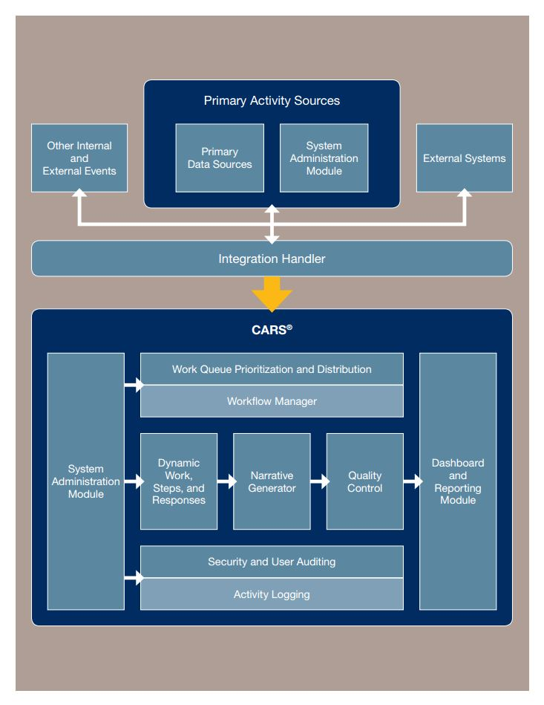
Who is Required to use the
Centralized Indirect Cost Rate System
Any organization that receives a grant from a State of Illinois grant making agency.
If a grantee organization has a federally negotiated rate, they are required to provide information through the indirect cost rate system.
If a grantee organization chooses to elect the 10% de minimis rate, they are required to make this election in the indirect cost rate system.
A grantee may volunteer to accept a lower indirect cost rate, but state agencies are not allowed to force or coerce a grantee to take a lower rate

Slide 14
Standard Application &
Grant Award Documents
Notice of Funding Opportunity (NOFO)
  Catalog of State Financial Assistance
  https://www.illinois.gov/sites/GATA/Grants/SitePages/CSFA.aspx
Uniform Application for State Grant Assistance
Uniform Budget Template
Notice of State Award

Slide 15
Notice of Funding Opportunity
Program Description
Program Requirement
Funding Information
Eligibility Information
Application Requirements & Submission Information
Applicant Review Information
Award Administration Information
State Awarding Agency Contact
Other Information

Slide 16
Typical Application Requirements
Executive Summary
Technical / Programmatic Proposal
  Applicant Capacity
  Documentation of Need
  Operational Plan
  Project Outcomes / Return on Investment
Implementation Plan & Schedule
Required Technical / Programmatic Forms and Exhibits
Resumes of Key Program Staff
Memorandum of Understanding and/or other Partnership Agreements
Budget Proposal

Slide 17
Applicant Capacity
Who are you?
What is your relationship to the target population?
What are your qualifications?
What other projects have you accomplished?
Who are your partners?
What are their qualifications?
Describe the organization.
Describe any similar projects undertaken.
Describe the qualifications of individuals responsible to carry out the project activities.
List any facilities, equipment, or resources available to the project and their sources.

Slide 18
Documentation of Need
What is the target population?
What are the needs/problems of the target population?
What are the causes of the identified needs/problems?
What documentation is there to support the existence of the identified needs/problems?
Statistical information to document the extent of the need/problem
  http://www.census.gov/
  http://www.bls.gov/home.htm
  https://www.illinoisreportcard.com/
Only identify the need/problem you intend to address
Describe the population affected by the need/problem

Slide 19
Operational Plan
What is your solution to the need/problem?
How will you approach the solution?
What is your plan of action to address the identified need/problem?
What are the steps you will take?
Who will do what?
How long will it take?
Explain the project goal and how it would meet the need or solve the problem identified.
List specific, measurable objectives that will allow the project to meet its goal.
State expected project outcomes and how they would benefit the target population.
State the planned activities, methodology, and timetable for accomplishing the planned activities.
Explain how the project will be managed.
Always tie the objectives back to the identified need/problem.

Slide 20
Return on Investment
What are the expected outcomes of the project? The measurements should be quantitative.
You need to show that your proposed project has the support of those it affects.
You need to show that you have considered the need/problem from many different angles.
You need to show that you have considered all available resources.
Will the project be evaluated? The evaluation should measure accomplishment of the stated project goals and objectives.
How will the project be continued after the grant expires?

Slide 21
Uniform Application for State Grant Assistance
Agency Information
  Funding Opportunity Information
  Instructions on How to Submit an Application
  Required Grant Information
Applicant Completed Section
  Applicant Information
  Contact Information
  Key Project Information (Location, Term, Amount)
  Fiscal Information
Certification

Slide 22
Uniform Budget Template - Overview
Uniform Budget Template for most State of Illinois Grants (modeled after the SF-524 Federal Budget template).
Basic Budget Line Item Definitions based on the Uniform Administrative Guidelines [Develop Budget Line Items Sheet].
General Requirements
  Allowable
  Reasonable
  Allocable

Slide 23
Allowable Costs § 200.403
Factors affecting allowability of costs:
Be necessary and reasonable for the performance of the Federal award and be allocable under the Federal Cost Principles.
Conform to any limitations or exclusions set forth in these principles or in the Federal award as to types or amount of cost items.
Be consistent with policies and procedures that apply uniformly to both federally-financed and other activities of the non-Federal entity.
Be accorded consistent treatment. A cost may not be assigned to a Federal award as a direct cost if any other cost incurred for the same purpose in like circumstances has been allocated to the Federal award as an indirect cost.
Be determined in accordance with generally accepted accounting principles (GAAP), except, for state and local governments and Indian tribes only, as otherwise provided for in this Part.
Not be included as a cost or used to meet cost sharing or matching requirements of any other federally financed program in either the current or a prior period.
Be adequately documented.

Slide 24
Reasonable Costs § 200.404
A cost is reasonable if, in its nature and amount, it does not exceed that which would be incurred by a prudent person under the circumstances prevailing at the time the decision was made to incur the cost. The question of reasonableness is particularly important when the non-Federal entity is predominantly federally-funded. In determining reasonableness of a given cost, consideration must be given to:
Whether the cost is of a type generally recognized as ordinary and necessary for the operation of the non- Federal entity or the proper and efficient performance of the Federal award.
The restraints or requirements imposed by such factors as: sound business practices; arm’s-length bargaining; Federal, state and other laws and regulations; and terms and conditions of the Federal award.
Market prices for comparable goods or services for the geographic area.
Whether the individuals concerned acted with prudence in the circumstances considering their responsibilities to the non-Federal entity, its employees, where applicable its students or membership, the public at large, and the Federal government.
Whether the non-Federal entity significantly deviates from its established practices and policies regarding the incurrence of costs, which may unjustifiably increase the Federal award’s cost.

Slide 25
Allocable Costs § 200.405
A cost is allocable to a particular Federal award or other cost objective if the goods or services involved are chargeable or assignable to that Federal award or cost objective in accordance with relative benefits received. This standard is met if the cost:
  Is incurred specifically for the Federal award;
  Benefits both the Federal award and other work of the non-Federal entity and can be distributed in proportions that may be approximated using reasonable methods; and
  Is necessary to the overall operation of the non-Federal entity and is assignable in part to the Federal award in accordance with the principles in this subpart.
All activities which benefit from the non-Federal entity’s indirect (F&A) cost, including unallowable activities and donated services by the non-Federal entity or third parties, will receive an appropriate allocation of indirect costs.

Slide 26
Type of Costs
Program
Direct
Indirect
Administration
Direct
Indirect
See: http://www.illinoisworknet.com/WIOA/Documents/SMART_Module3.pdf for more information.

Slide 27
Types of Costs
Direct costs: Costs that can be identified specifically with a particular final cost objective, such as a Federal award, or other internally or externally funded activity, or that can be directly assigned to such activities relatively easily with a high degree of accuracy. § 200.413
Indirect Costs (Facilities and Administration): Costs incurred for a common or joint purpose benefitting more than one cost objective, and not readily assignable to the cost objectives specifically benefitted, without effort disproportionate to the results achieved. § 200.456

Slide 28
Uniform Budget Template Outline
Instructions
Section A – Grant Funds
  Summary
  Indirect Cost Rate Information
Section B Match
  Cash
  In-Kind
  Leverage
Certification
FFATA Data Collection
Section C – Budget Worksheet & Narrative

Slide 29
Uniform Budget Template Section A: State of Illinois Funds
Includes funding that is provided by the state awarding agency regardless if the grant is state or Federally funded (federal pass-through funds).
The standard budget line item definitions are consistent with the Uniform Administrative Guidance.
The line items that are not applicable to the grant program are “grayed out”.
The Uniform Budget Template provides a space for Program-Specific line items.

Slide 30
Section A: Indirect Cost Selection
All grantees must complete the Indirect Cost Rate Form and select one of the following options:
Use the current Federally approved indirect cost rate as a result of being a direct grant recipient from a Federal awarding agency;
Negotiate a rate with the State of Illinois by first submitting an Indirect Cost Rate Proposal to the State of Illinois’ Centralized Indirect Cost Unit;
Use the Federal “de minimis” rate of 10% of modified total direct costs (MTDC);
Use a Restricted Rate designated by programmatic or statutory policy;
Choose not to request reimbursement of indirect costs.

Slide 31
Section B: Non-State of Illinois Funds: Matching Funds
For all Federal awards, any shared costs or matching funds and all contributions, including cash and third party in-kind contributions, must be accepted as part of the non-Federal entity’s cost sharing or matching when such contributions meet all of the following criteria:
Are verifiable from the non- Federal entity’s records;
Are not included as contributions for any other Federal award;
Are necessary and reasonable for accomplishment of project or program objectives;
Are allowable under Subpart E— Cost Principles of this Part;
Are not paid by the Federal government under another Federal award, except where the Federal statute authorizing a program specifically provides that Federal funds made available for such program can be applied to matching or cost sharing requirements of other Federal programs;
Are provided for in the approved budget when required by the Federal awarding agency; and
Conform to other provisions of this Part, as applicable.

Slide 32
Uniform Grant Agreement - Part I
Article I Award and Grantee Specific Information
Article II Required Representations
Article III Definitions
Article IV Payment
Article V Scope of Grant Activities/Purpose of Grant
Article VI Budget
Article VII Allowable Costs
Article VIII Required Certifications
Article IX Criminal Disclosure
Article X Unlawful Discrimination
Article XI Lobbying

Slide 33
Uniform Grant Agreement – Part I
Article XII Maintenance and Accessibility of Records; Monitoring
Article XIII Financial Reporting Requirements
Article XIV Performance Reporting Requirements
Article XV Audit Requirement
Article XVI Termination; Suspension
Article XVII Subcontracts/Sub-Grants
Article XVIII Notice of Change
Article XIX Reorganization and Board Membership
Article XX Agreements with other State Agencies
Article XXI Conflict of Interest
Article XXII Equipment or Property
Article XXIII Promotional Materials; Prior Notification
Article XXIV Insurance
Article XXV Lawsuits and Indemnification
Article XXVI Miscellaneous

Slide 34
Uniform Grant Agreement – Part I
Exhibit A – Project Description
Exhibit B – Deliverables or Milestones
Exhibit C – Payment
Exhibit D – Contact Information
Exhibit E – Performance Measures
Exhibit F – Performance Standard
Exhibit G – Specific Conditions

Slide 35
Uniform Grant Agreement
PART 2
Grantor Specific Terms
PART 3
Project Specific Terms

Slide 36

Grantee Resources
https://www.grants.Illinois.gov
http://www.illinoisworknet.com/GATA
https://www.illinoisworknet.com/wioastateplan
https://www.doleta.gov/grants/UniformGuidance.cfm
http://etasmarttraining.com/pdf/Single_Track_Region1.pdf
https://www.workforcegps.org/
http://www.naswa.org/
https://www.doleta.gov/

Slide 37
For More Information Contact
For More Information Contact
Charles Dooley
Charles.Dooley@Illinois.gov
John Barr
John.W.Barr@Illinois.gov
John Barr
John.W.Barr@Illinois.gov
Matthew Hillen
Matthew.Hillen@Illinois.gov

