Slide 1


Slide 2

Ron Johnson
State of Illinois
Dept of Commerce & Economic Opportunity
Susi Pihera
DuPage County Workforce Development Division
Scott Miller
U.S. Dept. of Labor
Employee Benefits Security
Administration
Fernando Reyna
Illinois Dept. of Employment Security

Slide 3
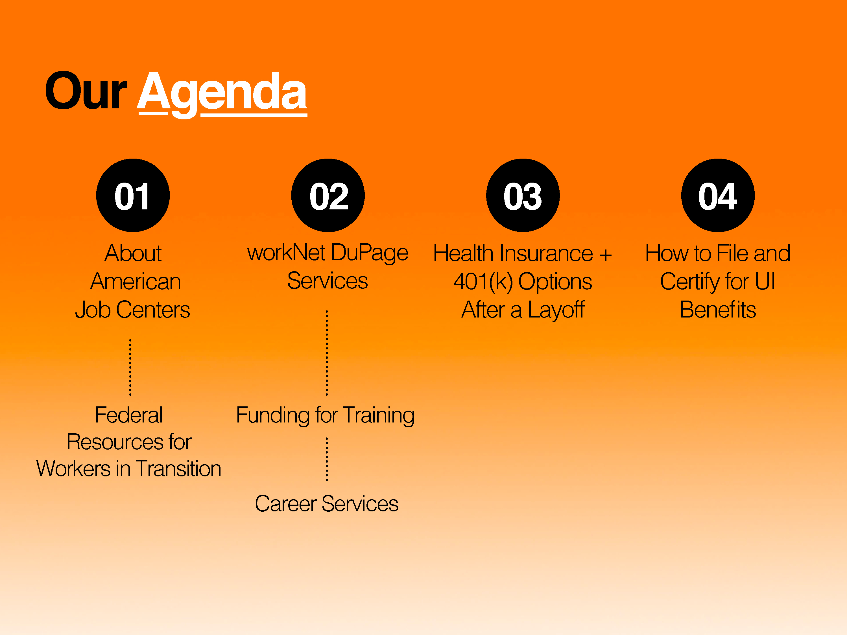

Slide 4


Slide 5

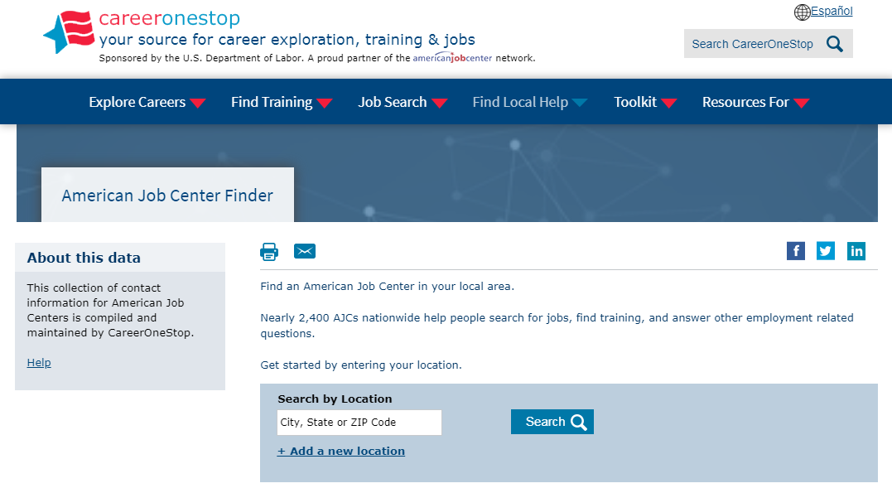

Slide 6


Slide 7
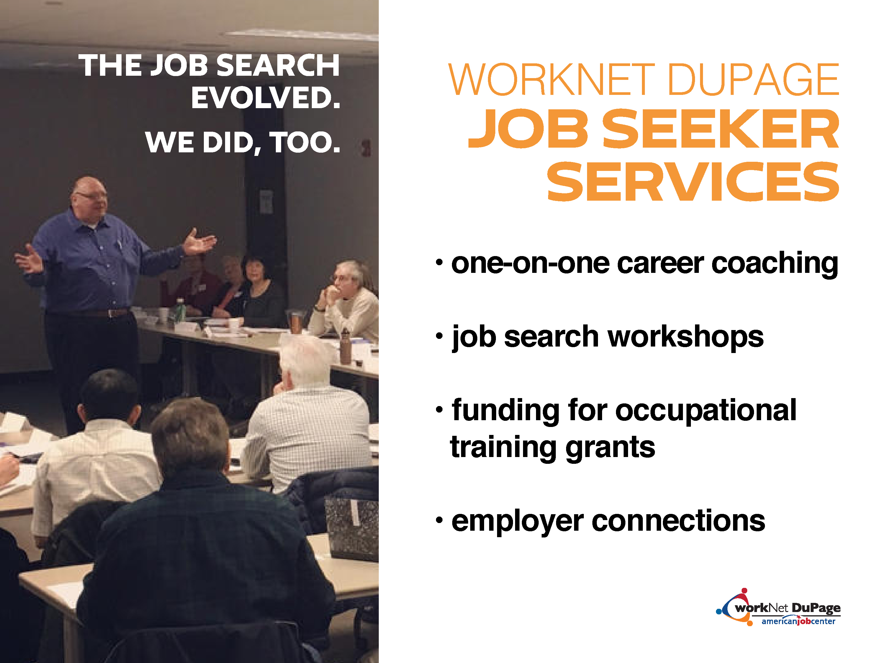

Slide 8
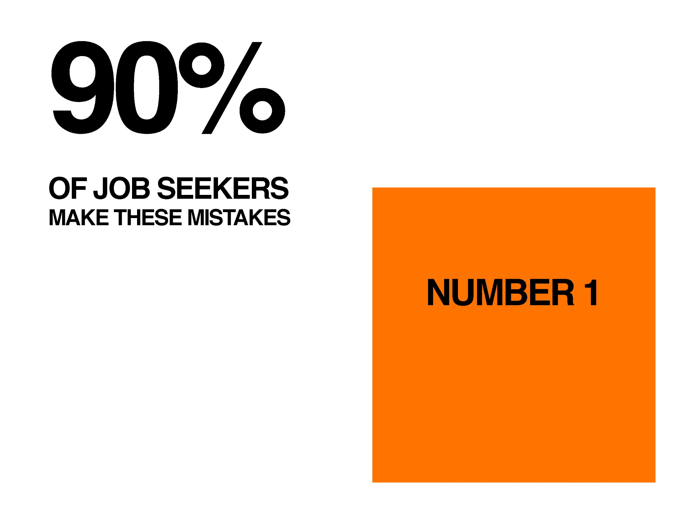

Slide 9
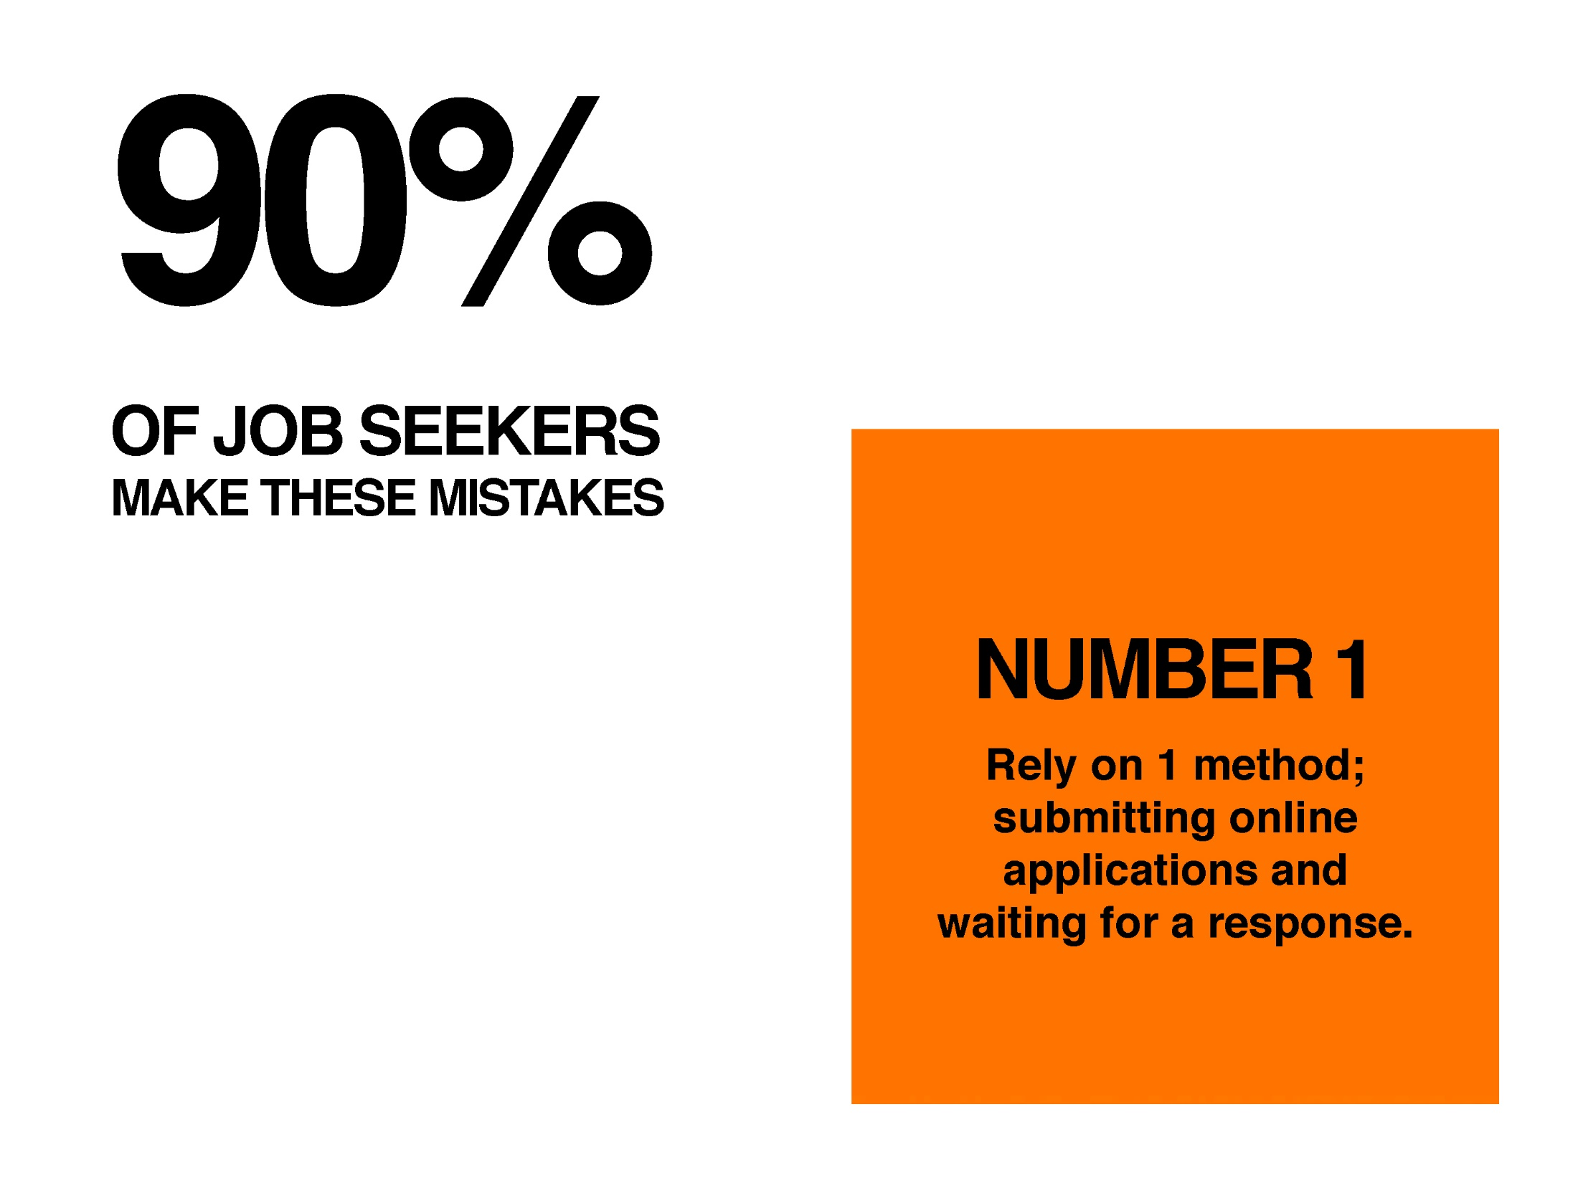

Slide 10
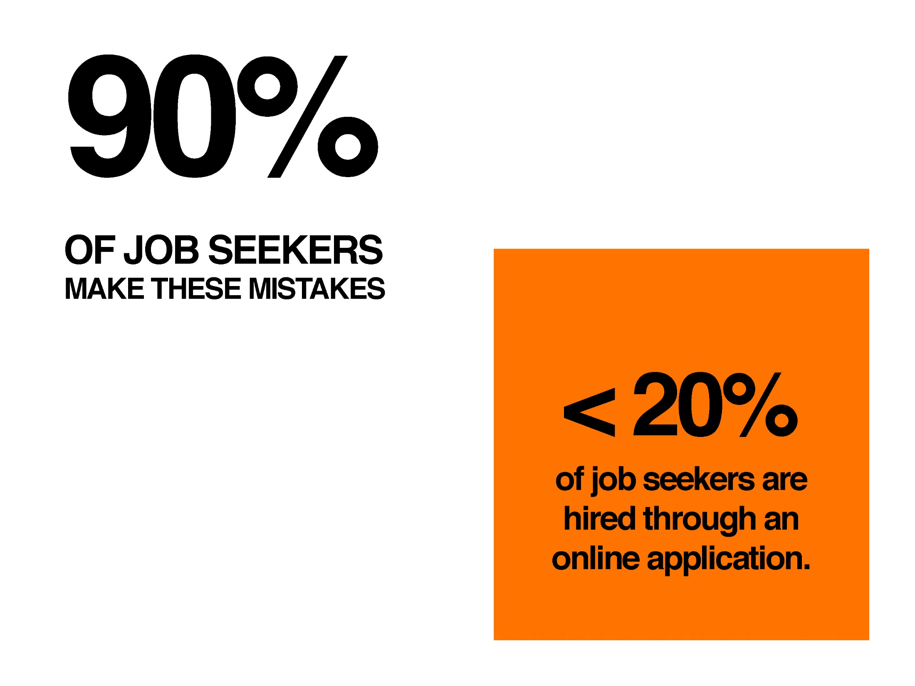

Slide 11


Slide 12


Slide 13
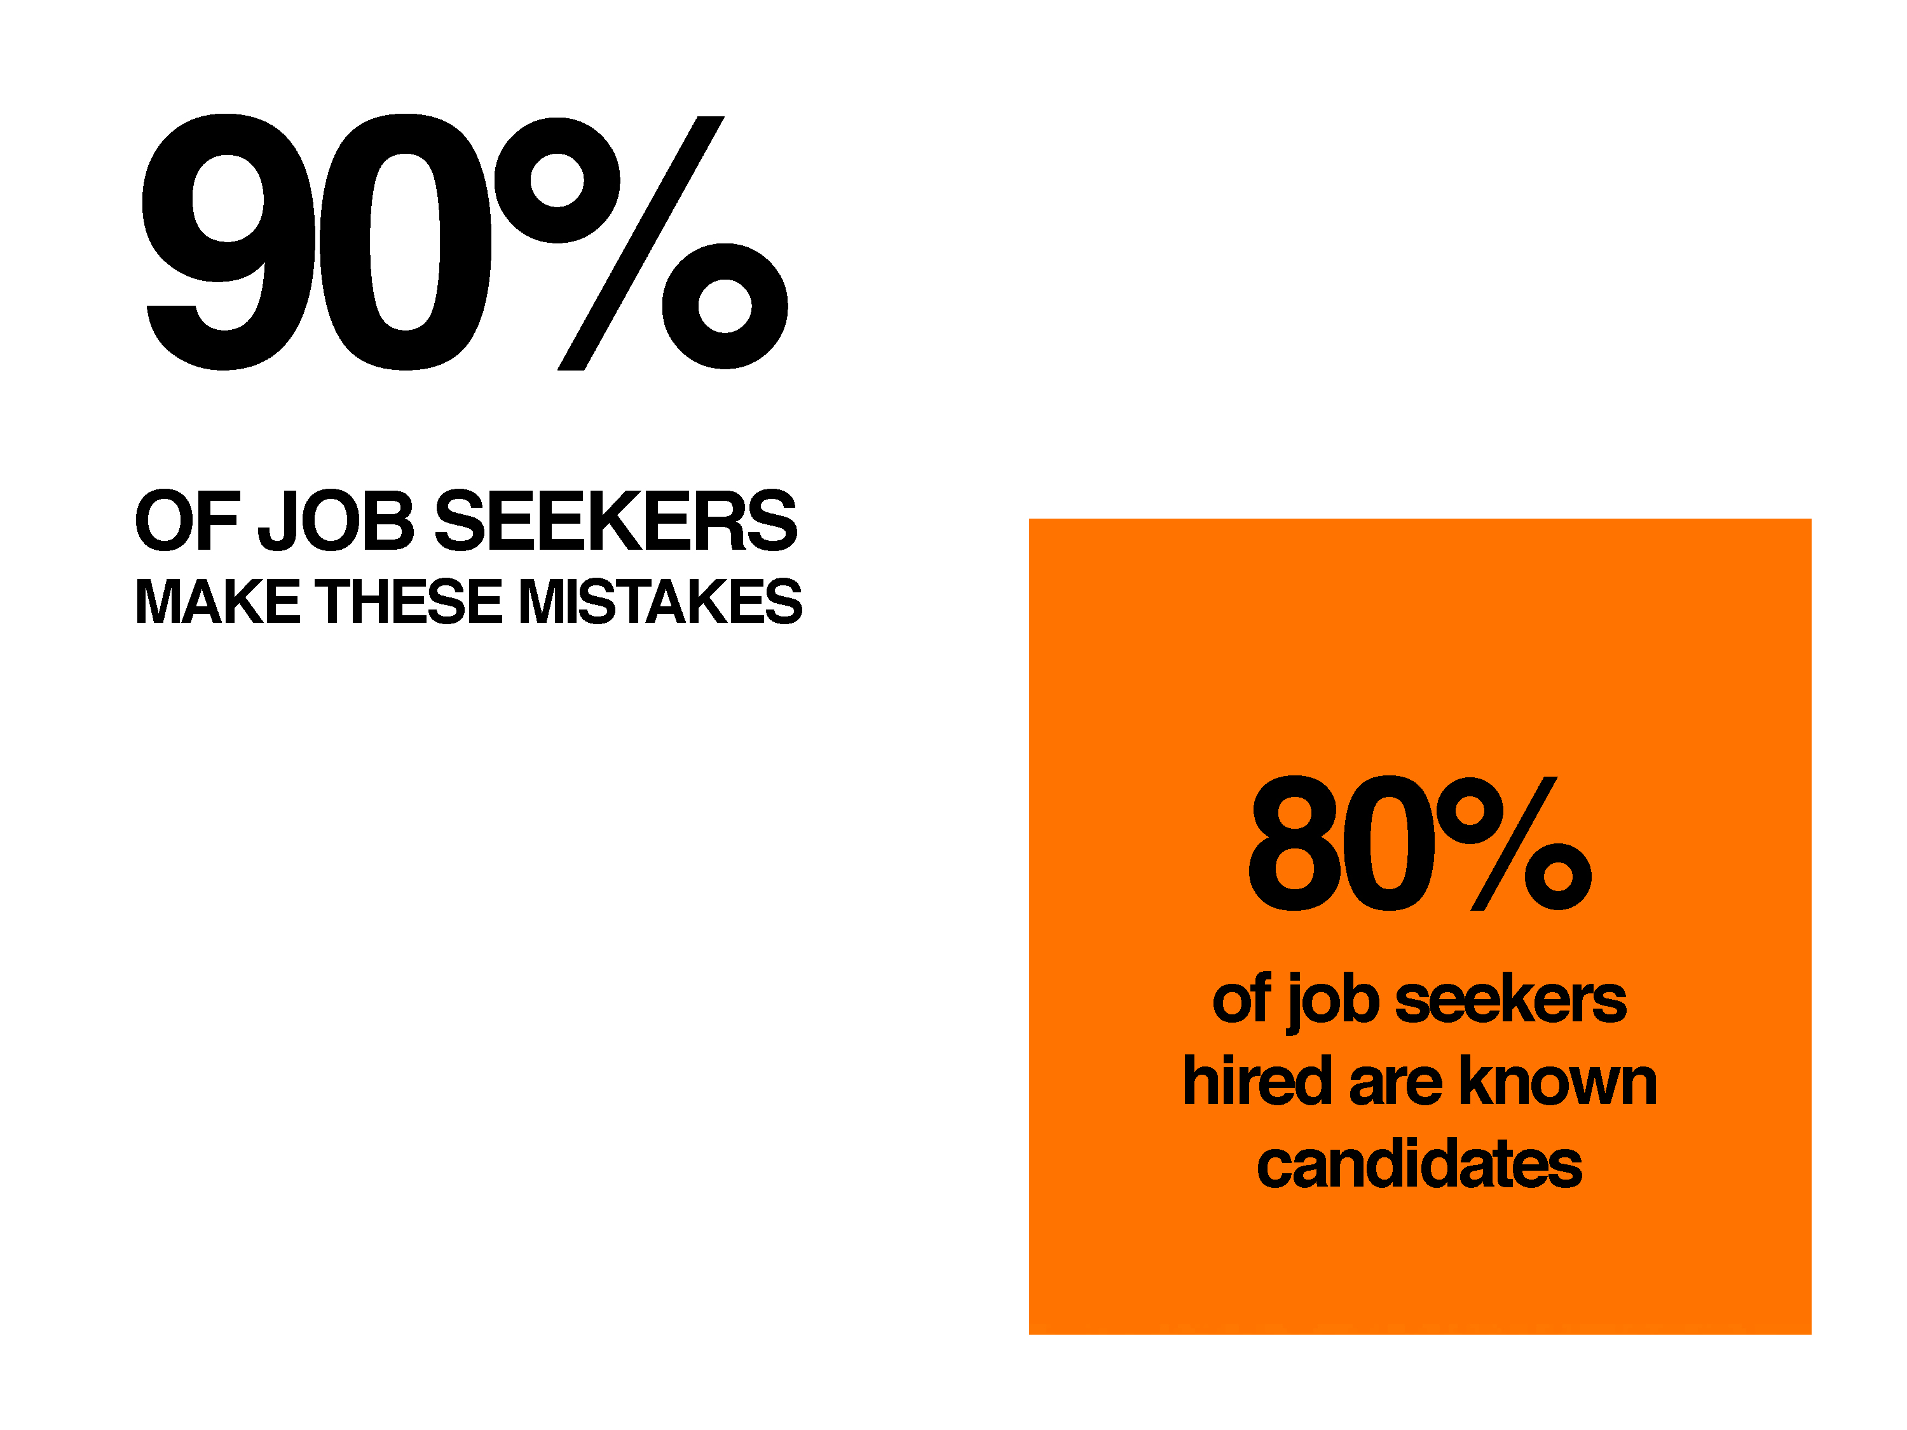

Slide 14


Slide 15


Slide 16
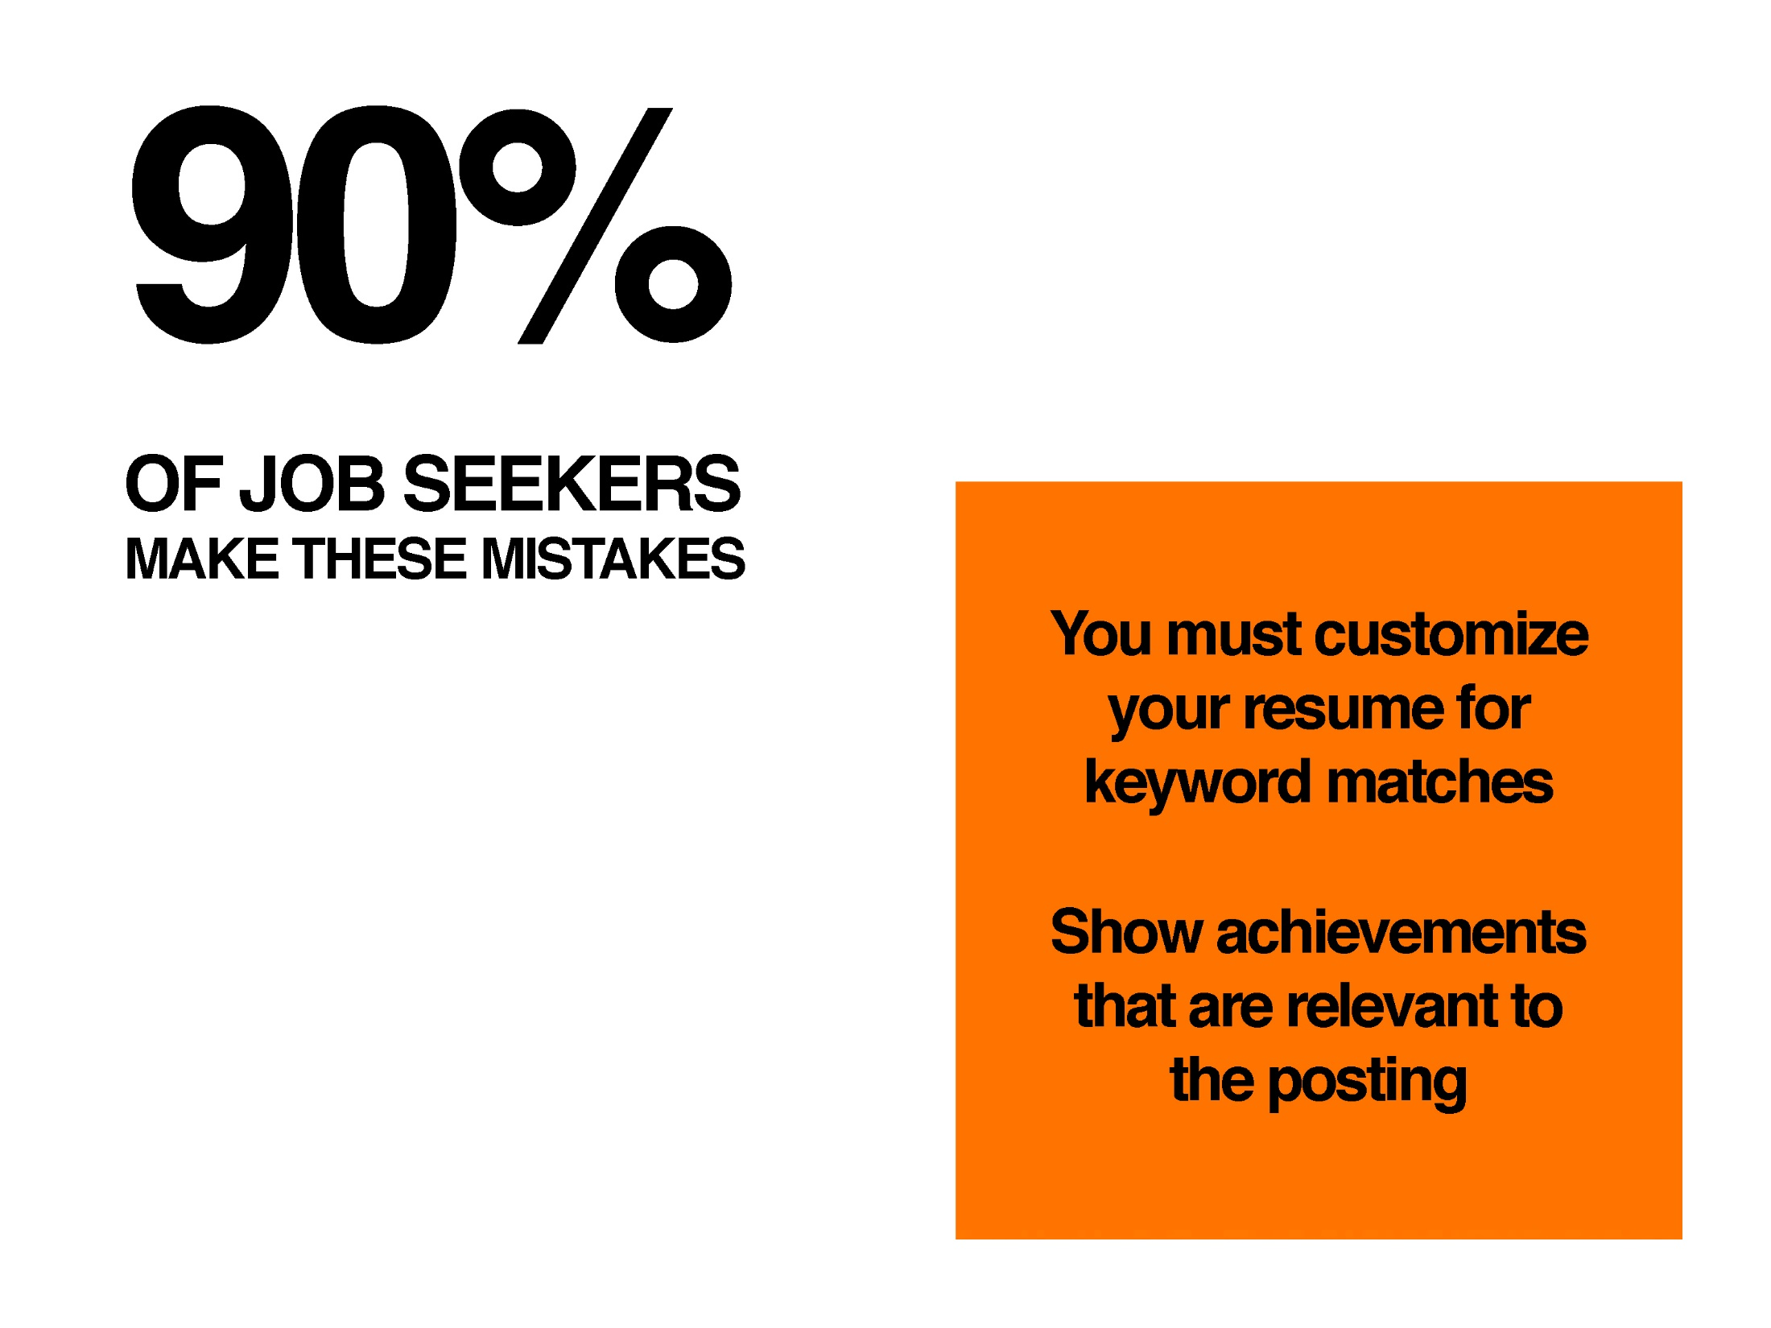

Slide 17


Slide 18


Slide 19
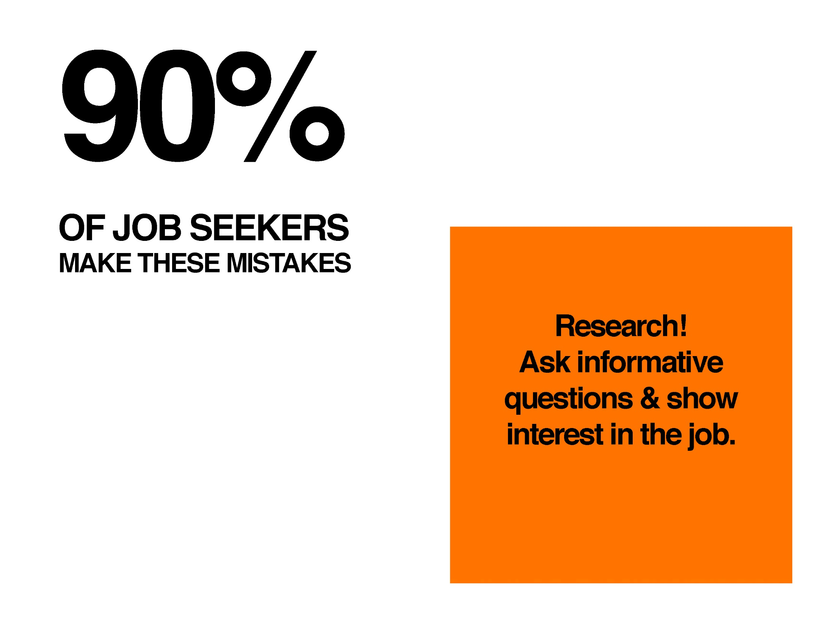

Slide 20


Slide 21


Slide 22
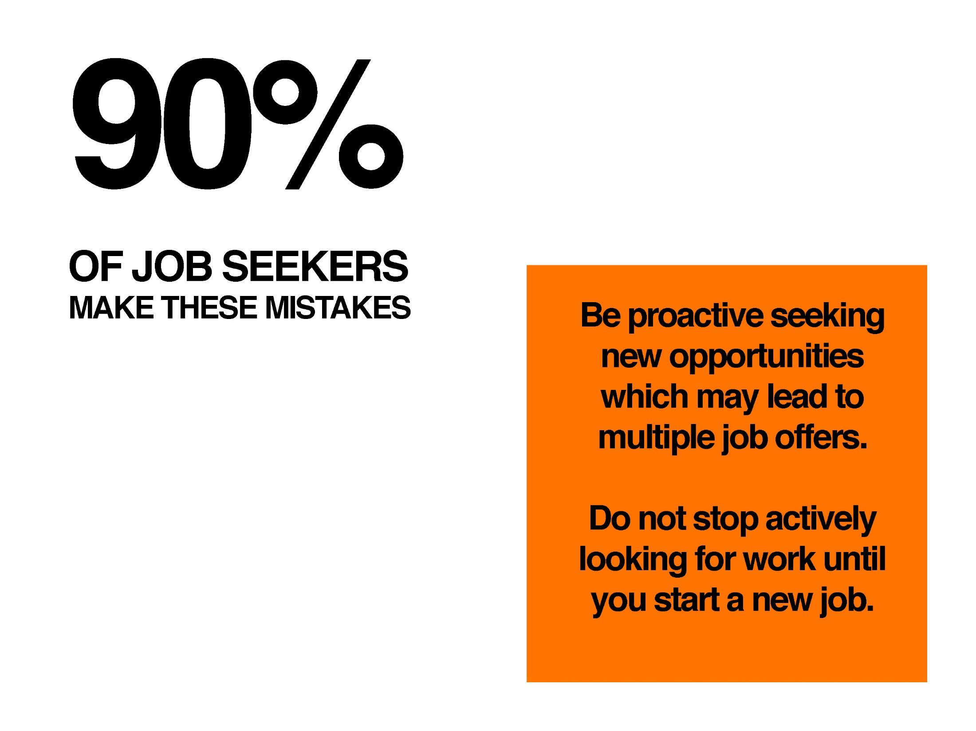

Slide 23
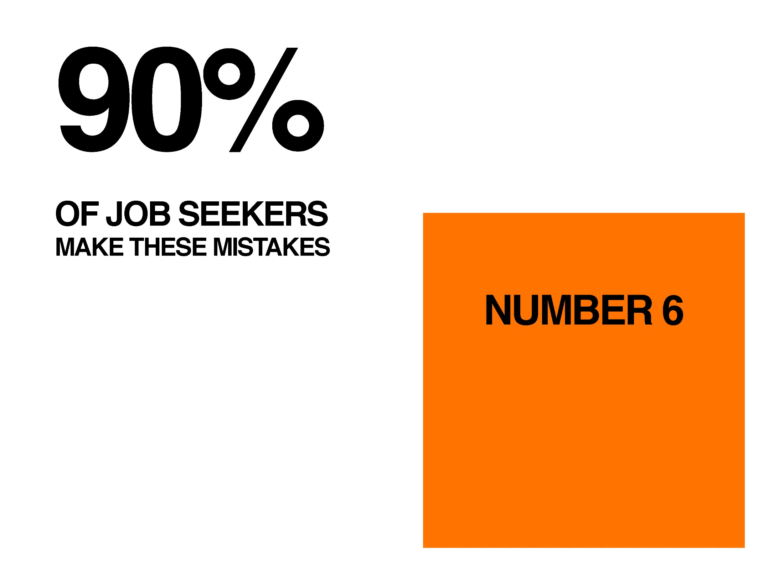

Slide 24


Slide 25
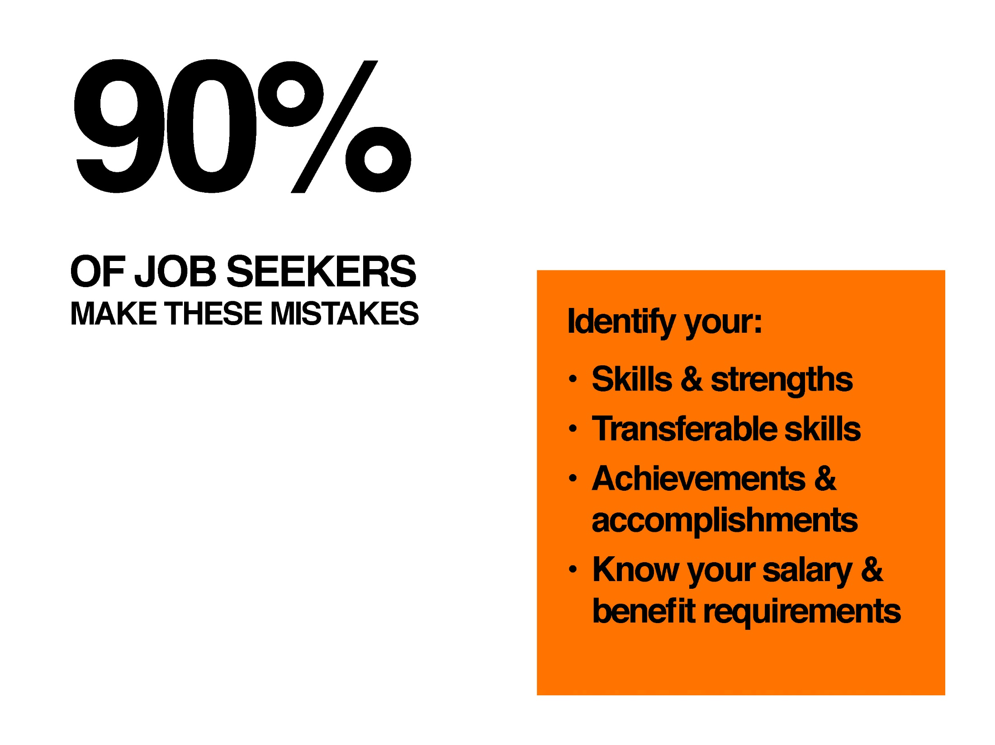

Slide 26
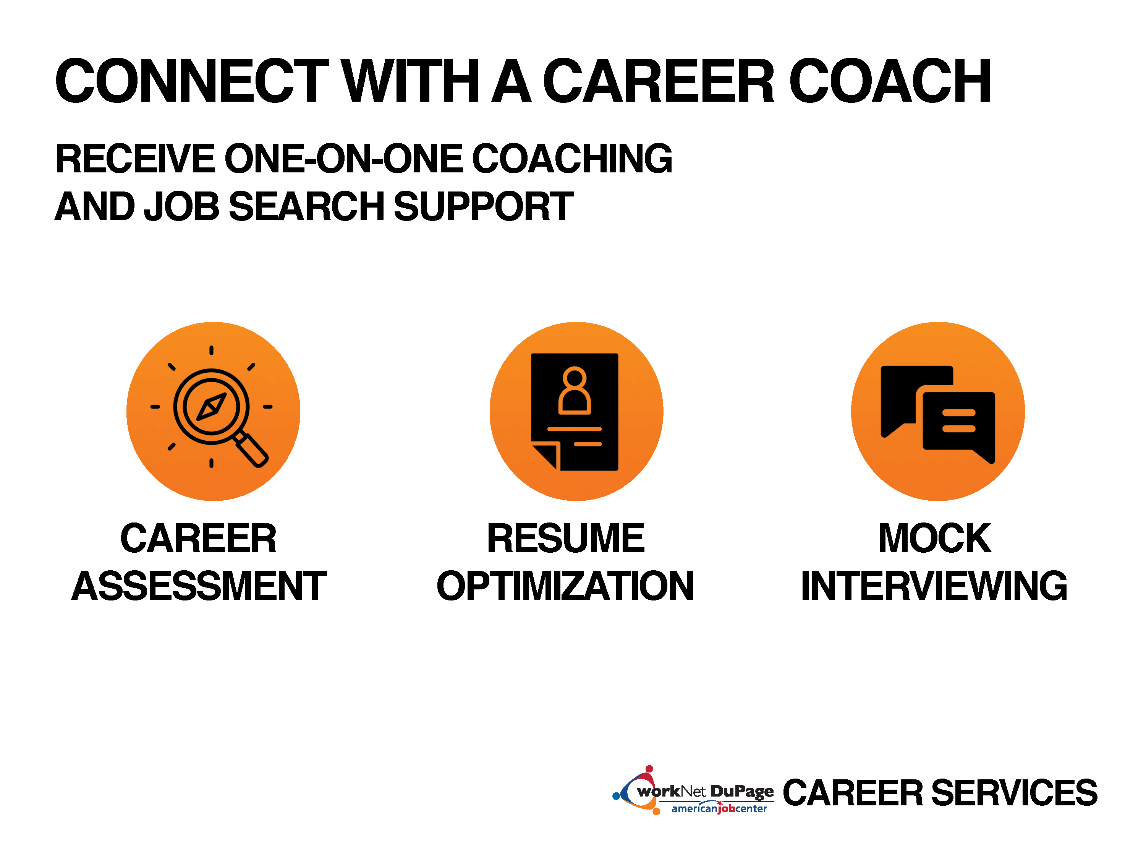

Slide 27
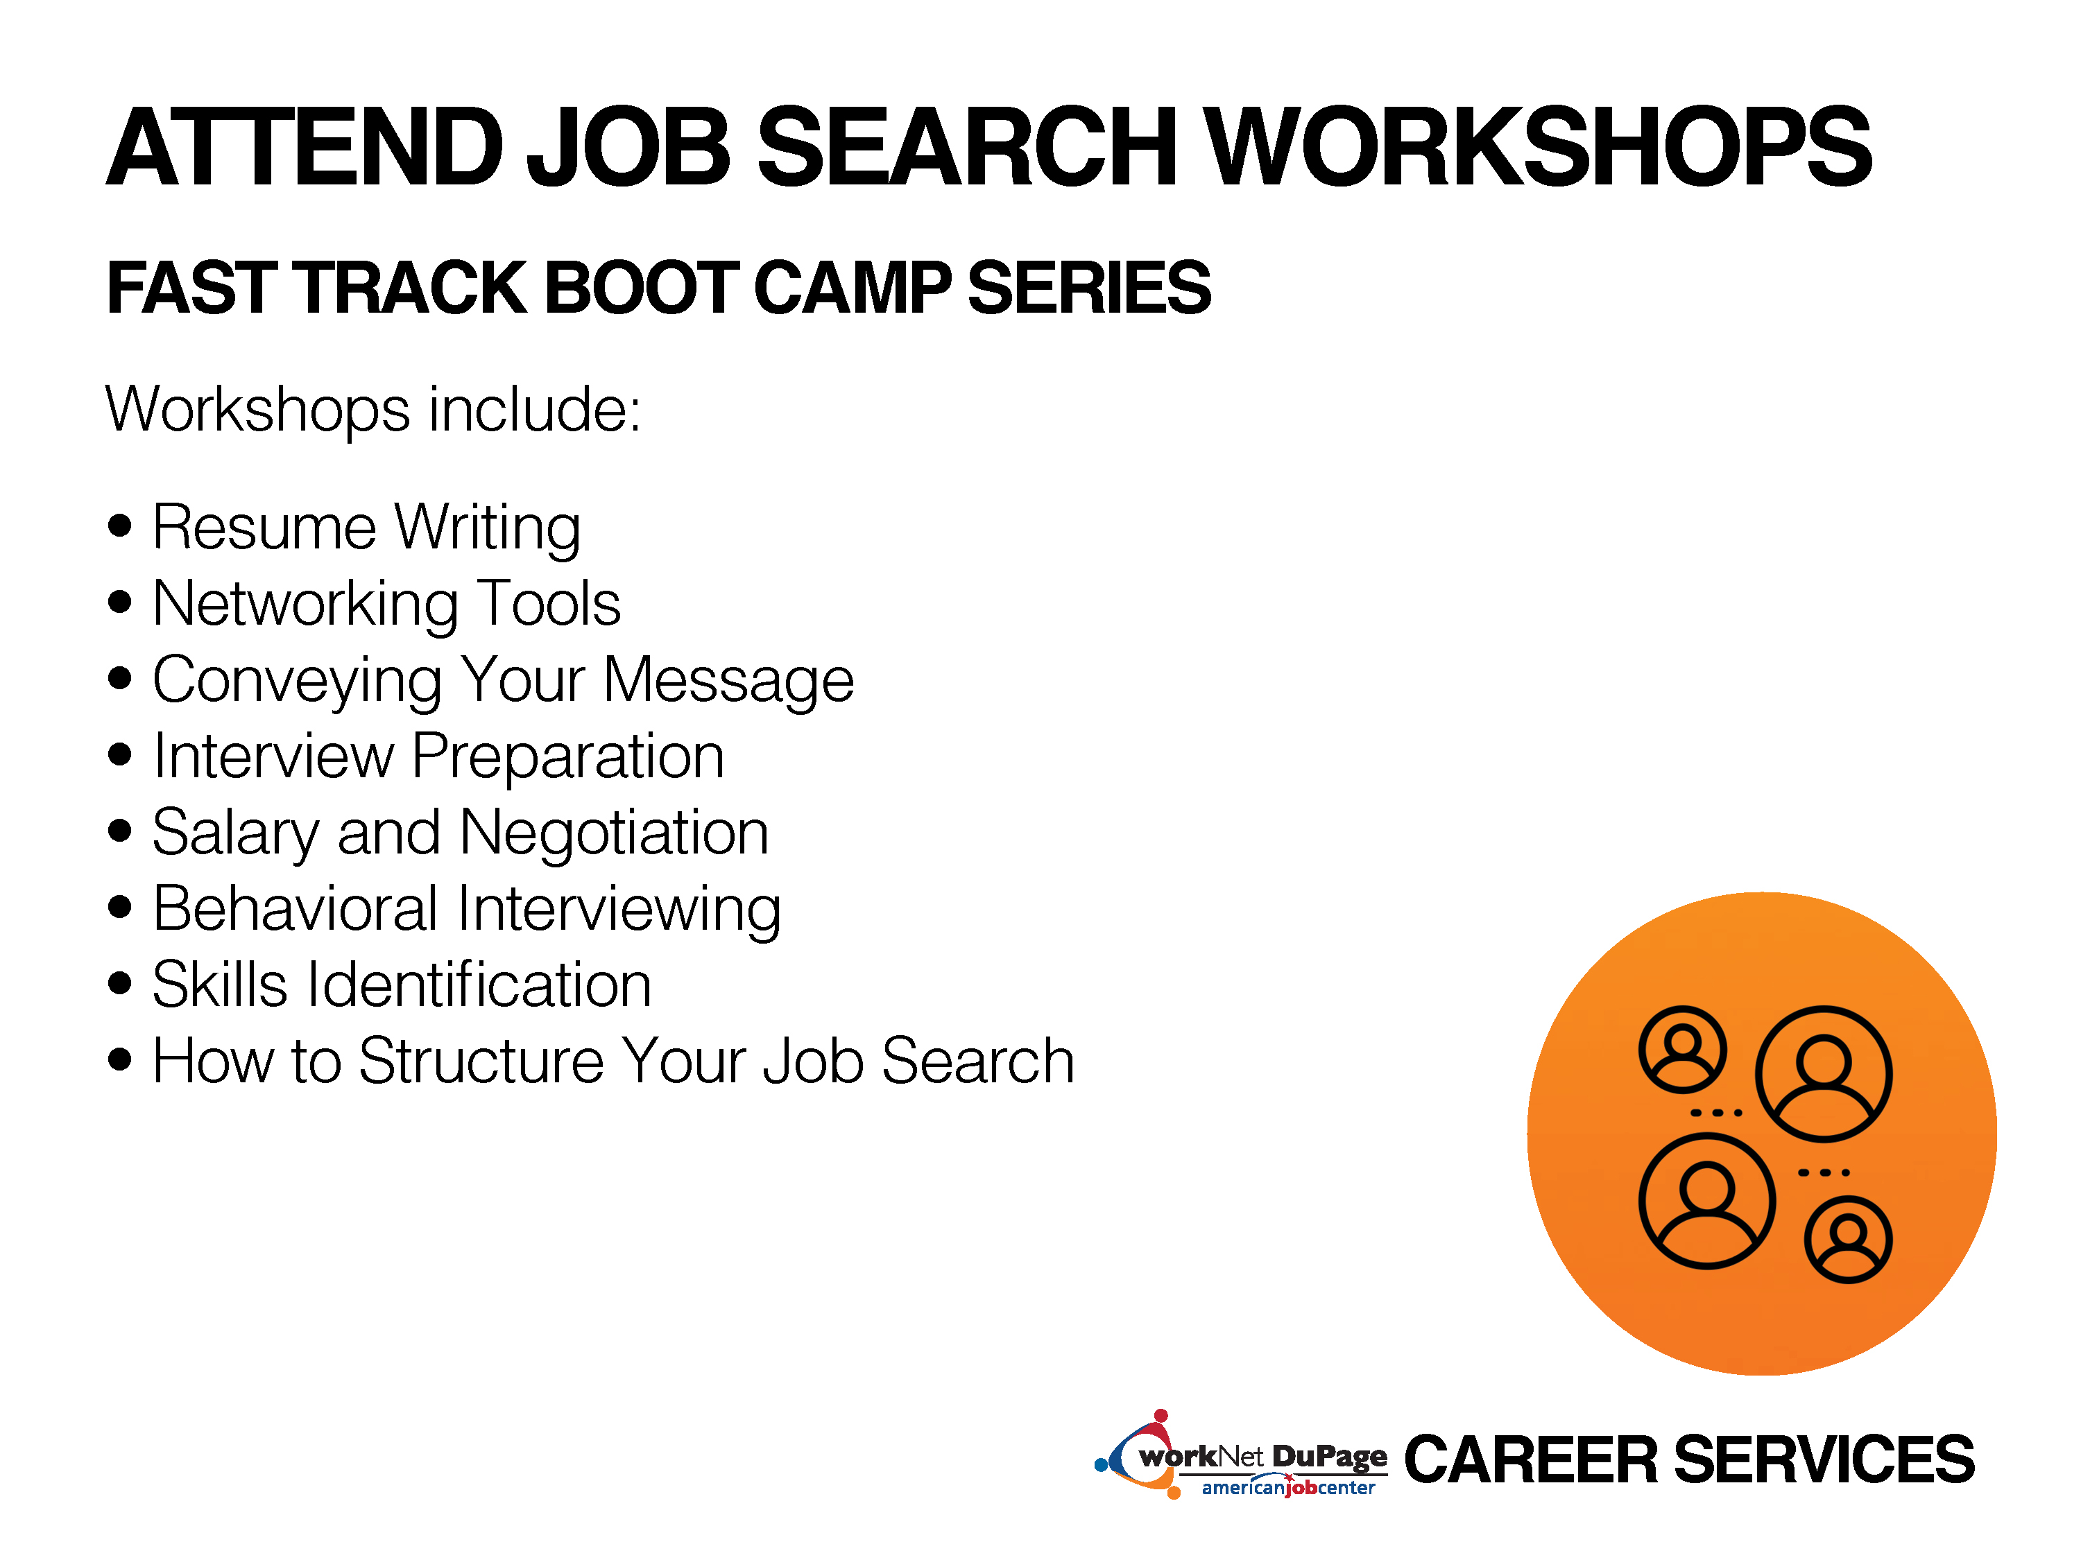

Slide 28


Slide 29


Slide 30
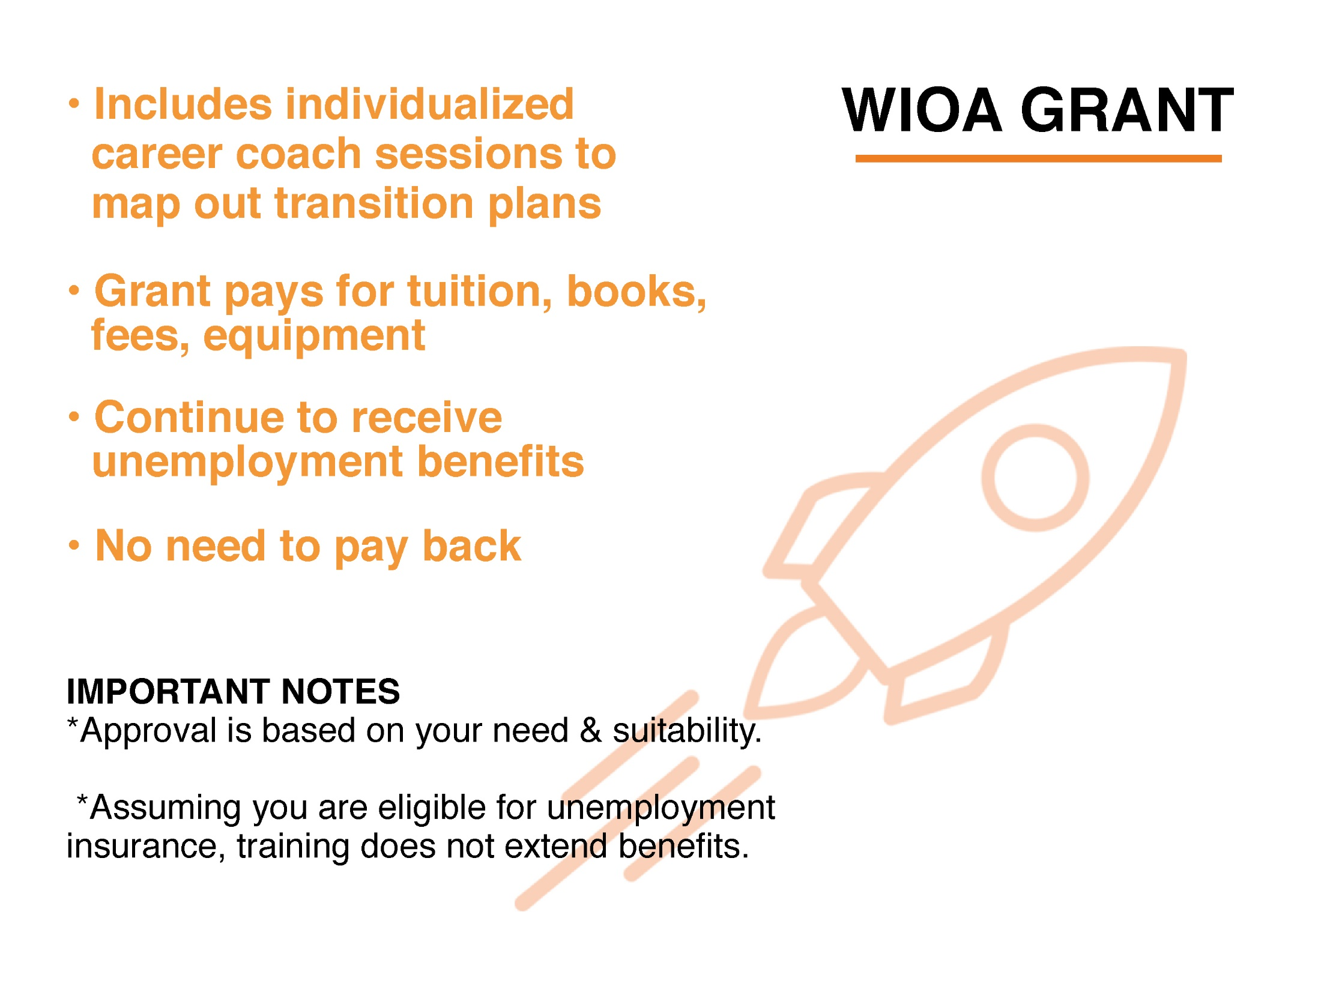

Slide 31


Slide 32


Slide 33


Slide 34


Slide 35


Slide 36
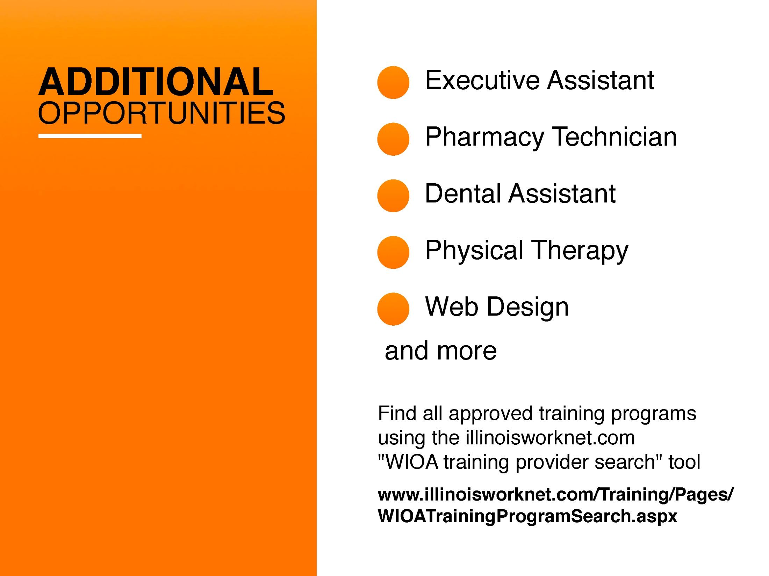

Slide 37


Slide 38


Slide 39
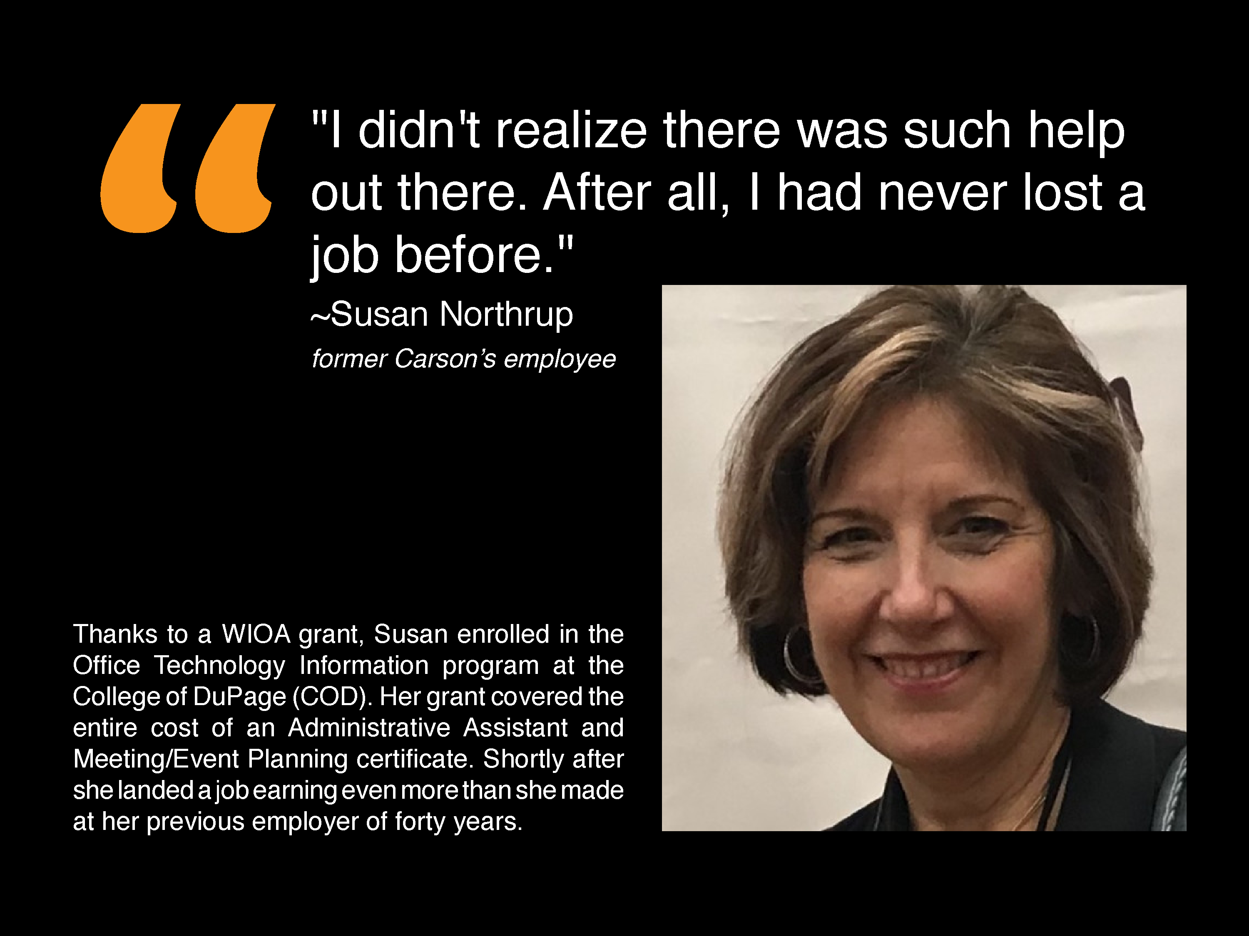

Slide 40
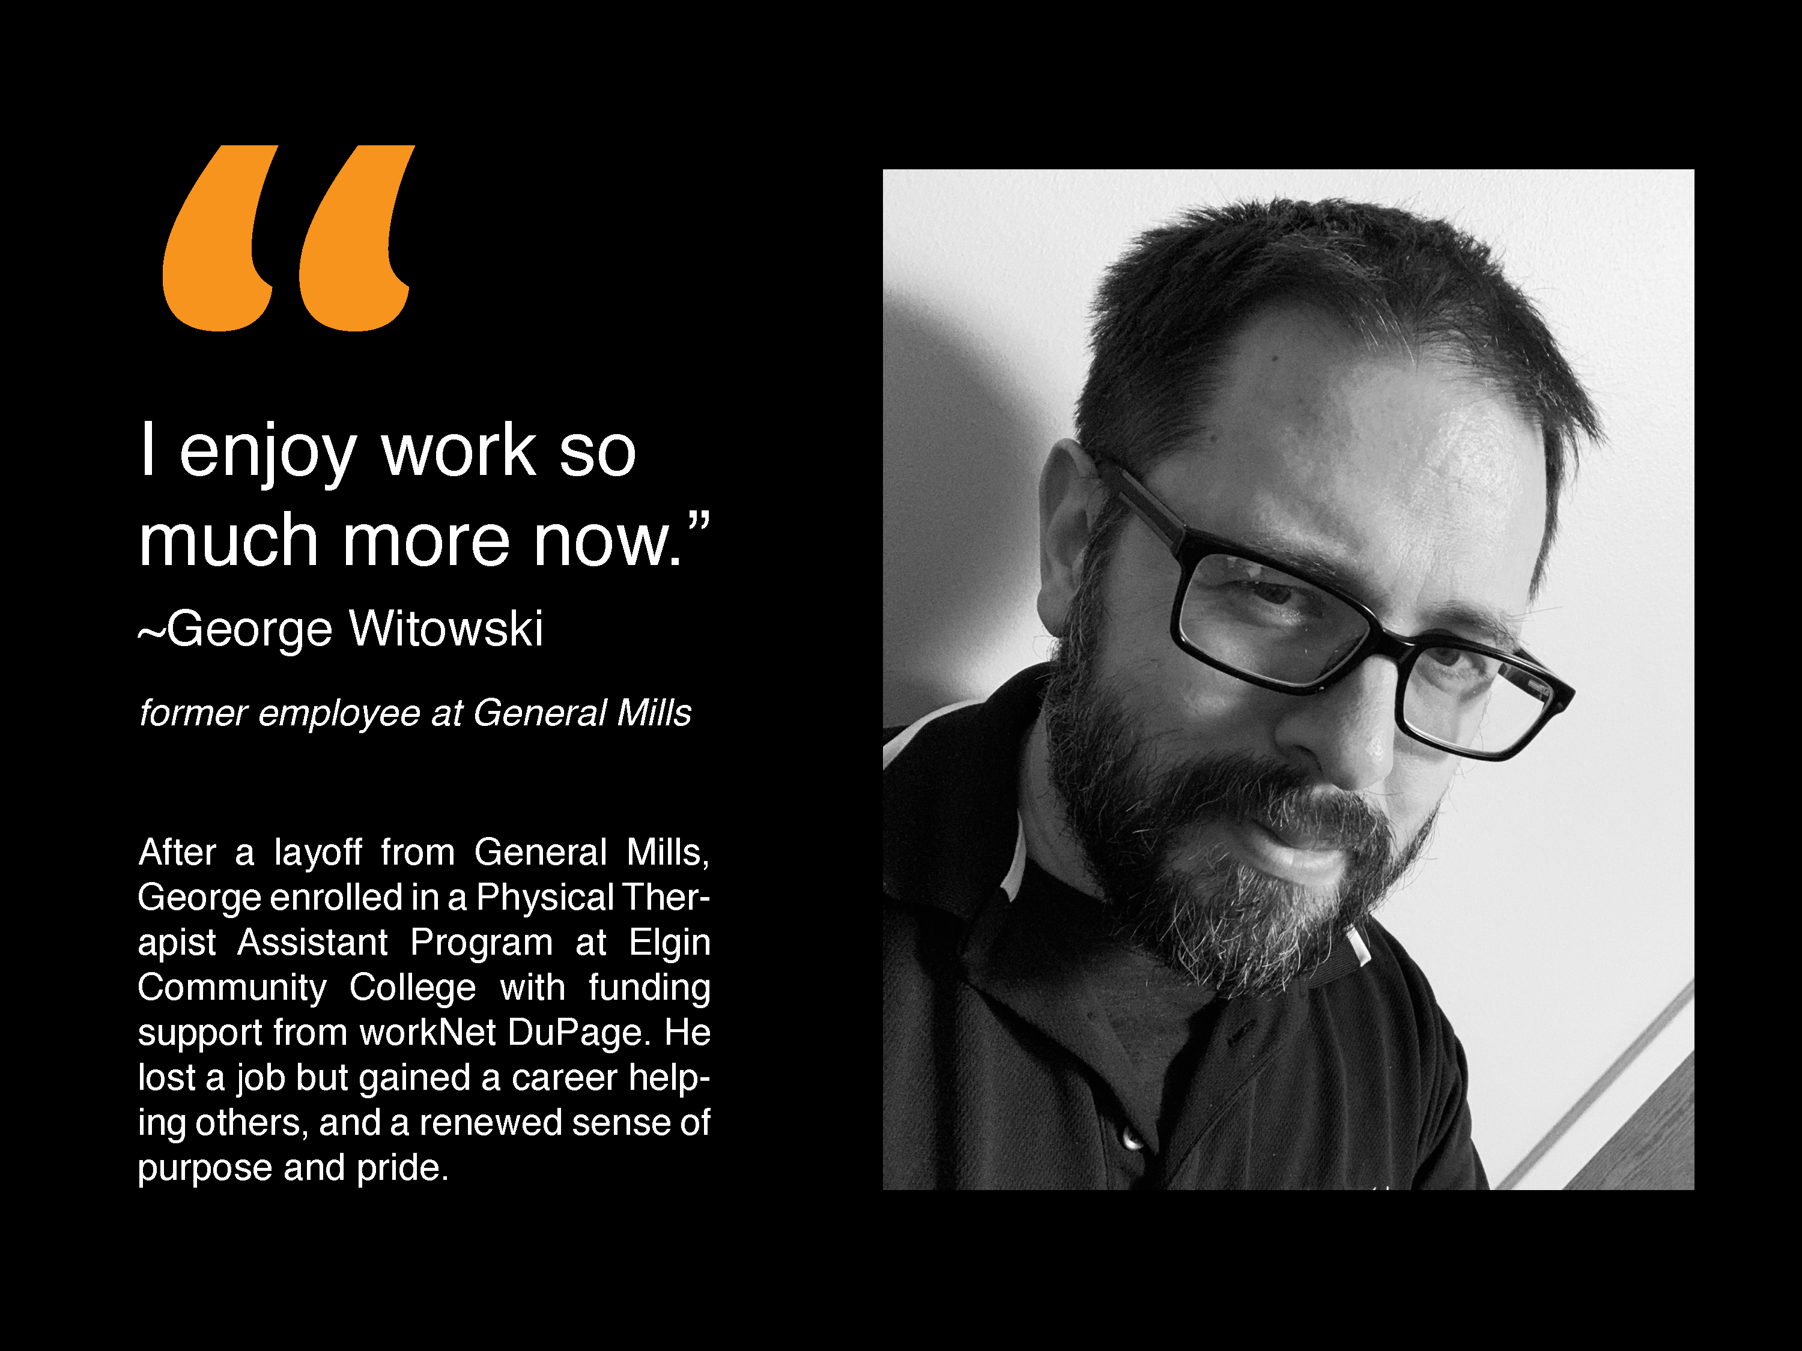

Slide 41


Slide 42
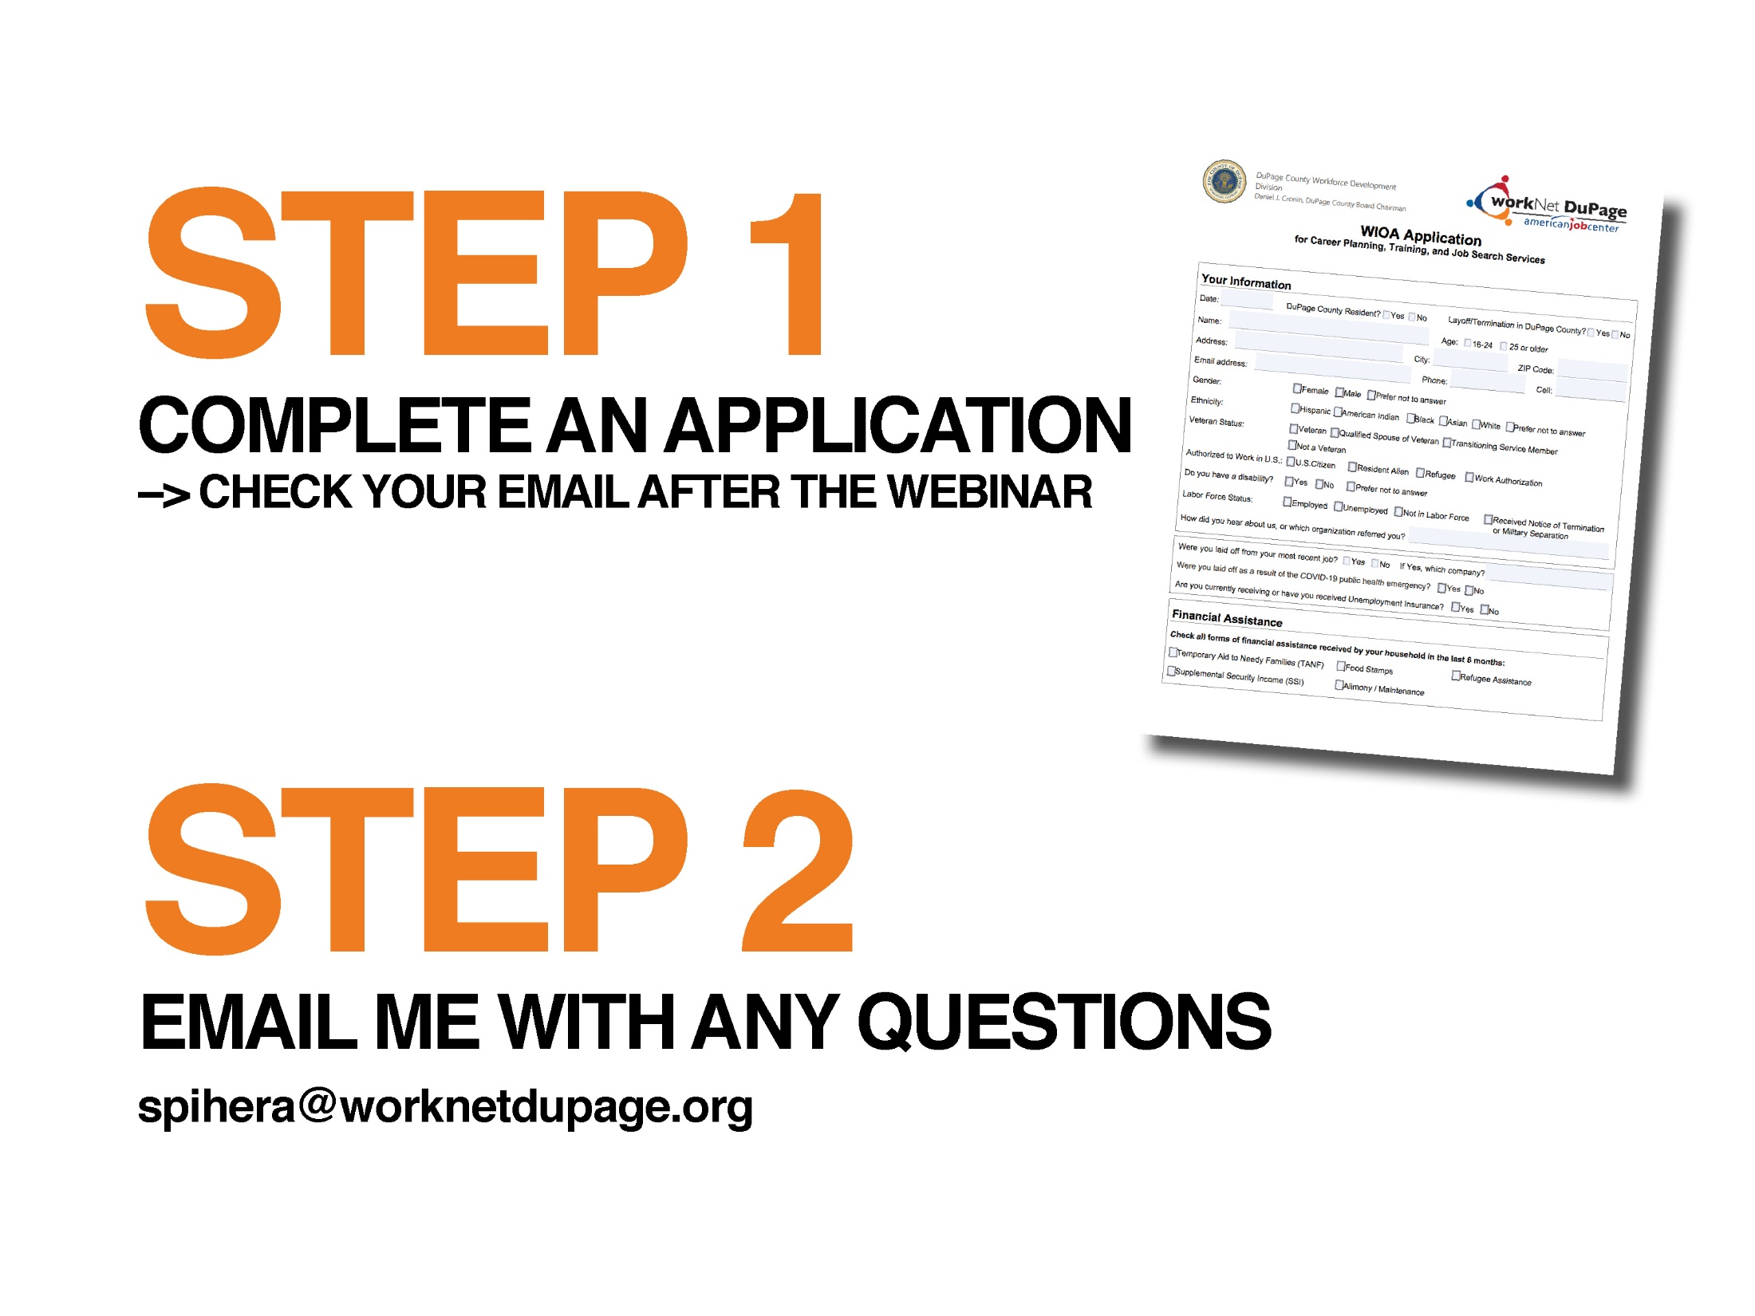

Slide 43


Slide 44


Slide 45

U.S. Department of Labor
Employee Benefits Security Administration
Retirement & Health Care Coverage…
Questions and Answers for Dislocated Workers
Visit us at www.dol.gov/agencies/ebsa
Call us at (866) 444-3272
Contact us electronically at www.askebsa.dol.gov

Slide 46
Allows you to continue on your former employer’s group health plan for up to 18 months following a job loss
You pay the full cost of the insurance plus a 2% administration fee
There is a formal election process to get onto COBRA
COBRA coverage is retroactive to date coverage was terminated
The election notice must be sent to you within 44 days of coverage loss
Outstanding claims and out of pocket expenses will be paid or reimbursed
Up to 29 months if you (or your beneficiary) are deemed disabled by SSA
You have 60 days to elect the COBRA
You have 45 days to make your first payment from the date of election

Slide 47




HIPAA Special Enrollment
Allows enrollment in a spouse’s employer’s plan (or a parent’s employer’s plan if you are under age 26) when you lose health coverage based upon a job loss
Your spouse (or parent) must request special enrollment from his or her employer’s plan within 30 days of losing coverage
Coverage becomes effective the first day of the following month
HIPAA does not provide a special enrollment right when an employer stops paying towards COBRA based upon a severance agreement

Slide 48



Affordable Care Act (ACA)
Health Insurance Marketplace
You can enroll in the marketplace up to 60 days before your insurance ends or within 60 days after your insurance ends
There are multiple coverage options available to you
The marketplace may allow enrollment when an employer stops paying towards COBRA based upon a severance agreement
The marketplace will also determine whether you qualify for Medicaid
Unlike COBRA, the coverage is not retroactive
Enroll by the 15th of the month for the coverage to begin the 1st of the following month

Slide 49

Affordable Care Act (ACA)
Health Insurance Marketplace
GET COVERED ILLINOIS - official health marketplace for Illinois
(866) 311-1119
www.getcoveredillinois.gov
ACCESS DUPAGE - DUPAGE COUNTY HEALTH DEPT.
Robin Lavender, ACA Navigator
630-221-7049
robin.lavender@dupagehealth.org
OUTSIDE OF ILLINOIS
Please call (800) 318-2596
www.healthcare.gov

Slide 50
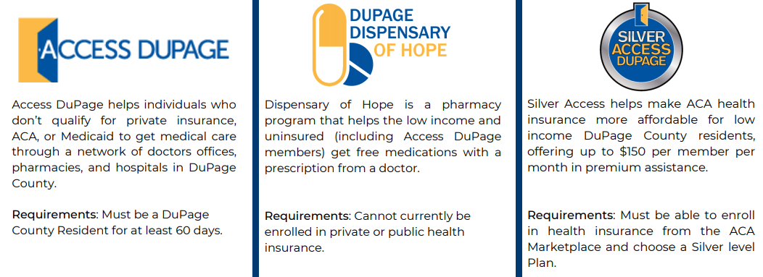

DuPage County Health Department Programs

Slide 51




What options do I have regarding my
retirement benefits?
401(k) Plan Options
Take
Roll
Leave
Take a distribution
  There is 20% automatic tax withholding and a 10% penalty if you are younger than 59 ½
  A distribution may also affect your unemployment benefits
Roll the account into another employer plan or your own IRA
  There are no tax consequences with a rollover
Leave the account with your former employer
  Make sure the plan has your current mailing address and email address
  You should receive information from the plan annually

Slide 52


J.B. Pritzker, Governor
How to file & certify for unemployment insurance benefits
Information on Illinois JobLink
www.ides.illinois.gov
IDES Call Center – 800-244-5631
Illinois Dept. of Employment Security
Notes:
Introduce yourself and give a brief description of how you can assist them.
Be sure that you have signed in; turn in the self assessment to receive credit for attendance.
Pass out: Employment Resources for Job Seekers Guide; any IJL account information you have reviewed such as incomplete demographics or resumes.
RESEA ONLY: At the end of this presentation sign up for the required Individual Employability appointment. This is only an introduction to the various services and resources offered at this One-stop. Please be prepared to take notes and write down dates for upcoming workshops, online resources, and job search tips.

Slide 53
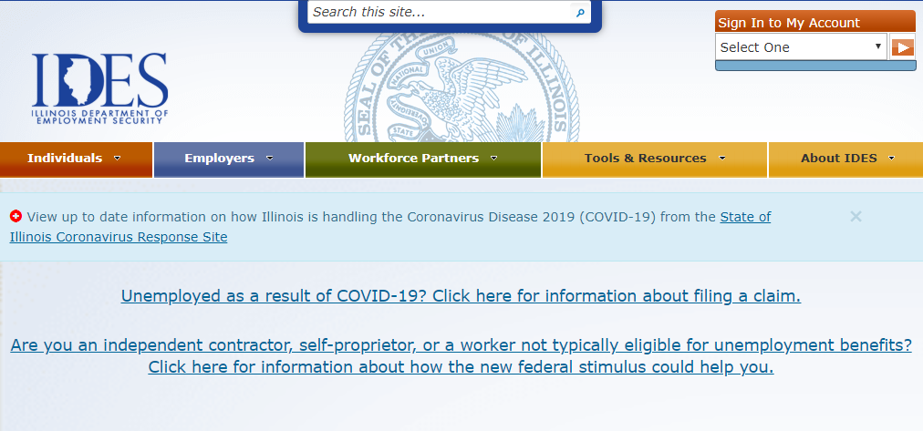
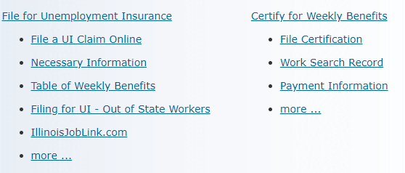
How to file your claim on-line
Important! Verify web address: www.IDES.Illinois.gov
Scroll to middle of page to locate
File a UI Claim Online link

Slide 54
Online Filing Schedule
Last names beginning with letters A-M will be Sundays, Tuesdays, or Thursdays.
Last names beginning with letters N-Z will be Mondays, Wednesday, Fridays.
Saturdays will be available for anyone to accommodate those who could not file during their allotted window.
Online filing and claims applications will be NOT be available every night from 8 p.m. to 10 p.m. for daily claims processing.

Slide 55
Call Center Filing Schedule
Last names beginning with letters A-M will be asked to call on Tuesdays and Thursdays between 7:30am – 6pm.
Last names beginning with letters N-Z will be asked to call on Mondays and Wednesdays between 7:30am – 6pm.
Fridays (7:30am – 6pm) will be available for anyone to accommodate those who could not file during their allotted window.

Slide 56
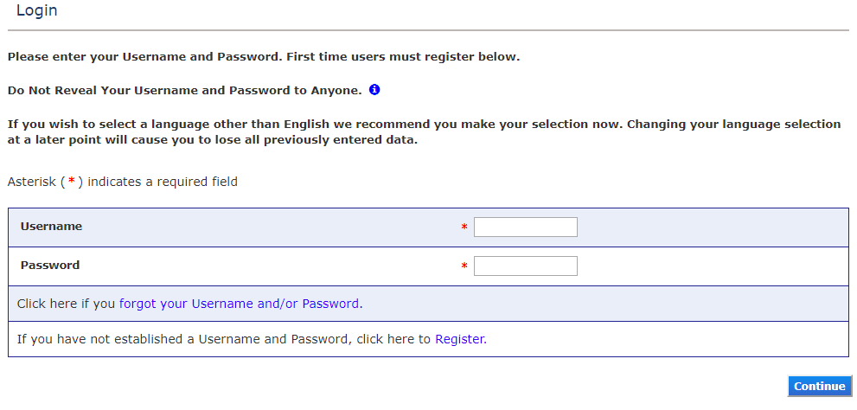
First Step – Login or Register
Previously registered; enter username & password.
First time registration; click register

Slide 57
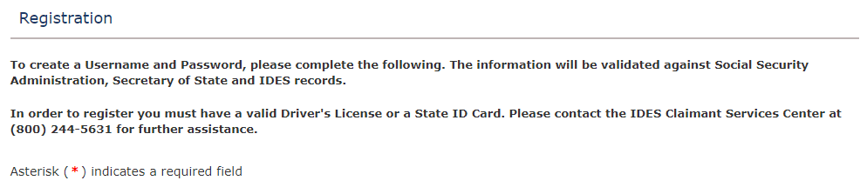
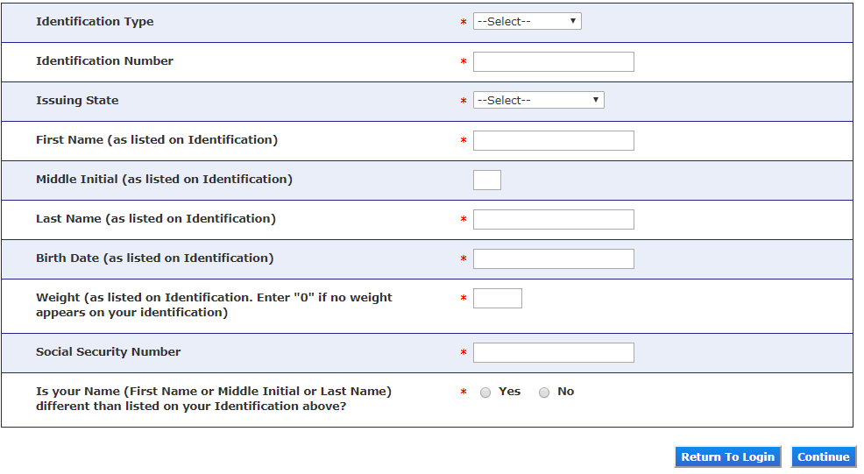
Verifying your identity
Driver’s License or State ID
Enter weight as listed on ID

Slide 58
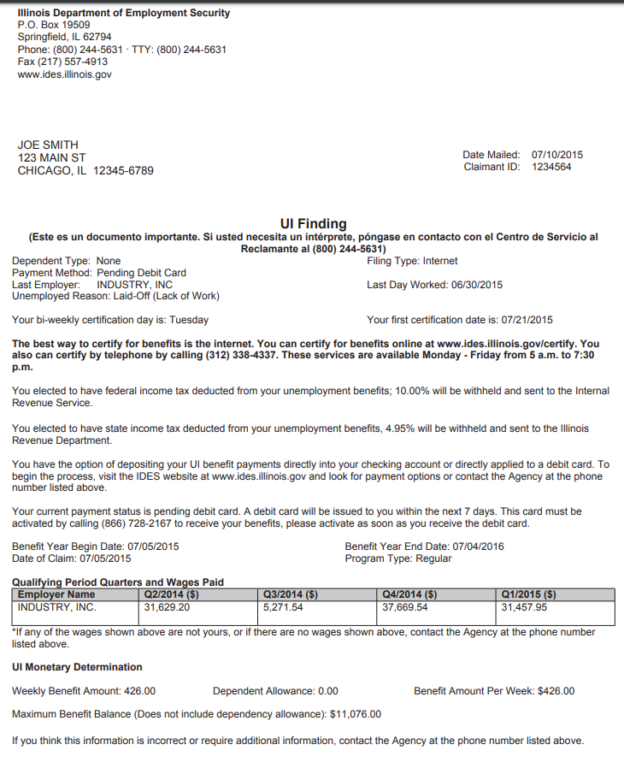
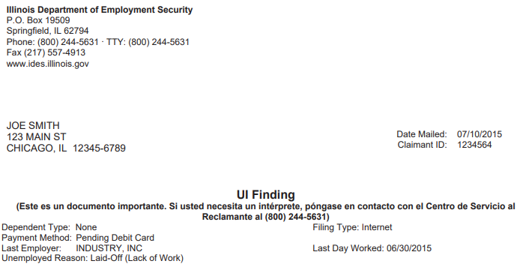
UI Finding Letter
UI Findings Letter should arrive U.S. Mail after you filed your claim
Claimant ID
IMPORTANT
See page 1 of “I filed my claim, what happens now” brochure

Slide 59
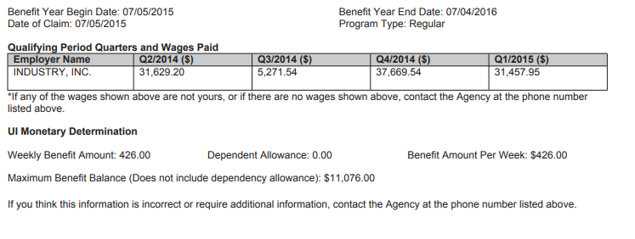
UI Benefit Year and
UI Monetary Determination
2020 MAXIMUM WEEKLY BENEFIT AMOUNTS:
$484.00 Single no dependents
$577.00 Non-working spouse as dependent
$669.00 With one or more child under 18
*As of January 5, 2020, these amounts are subject to change

Slide 60
Federal Stimulus Package Unemployment Benefits
Federal Pandemic Unemployment Compensation (FPUC)
The $600 federal increase is now available! Those claimants certifying beginning April 6 will see the additional supplemental income applied to their weekly benefit amount.
This increase is available through the week ending July 25, 2020.

Slide 61
Federal Stimulus Package Unemployment Benefits
Pandemic Unemployment Assistance (PUA)
​
PUA provides up to 39 weeks of federally funded unemployment benefits to individuals not typically eligible for unemployment benefits, including independent contractors and sole-proprietors who have become unemployed as a direct result of COVID-19
Eligibility for PUA will not be determined until the individuals apply via the new PUA system, and IDES anticipates the new system will be in place sometime in the near future. Check the IDES website for updates. ​

Slide 62
Federal Stimulus Package Unemployment Benefits
Pandemic Emergency Unemployment Compensation (PEUC)
PEUC provides up to 13 additional weeks of federally funded unemployment benefits for individuals who have exhausted regular unemployment benefits.
IDES received USDOL guidelines on April 10 and expects the program can be implemented through the current IDES computer system the week of April 20, 2020.

Slide 63
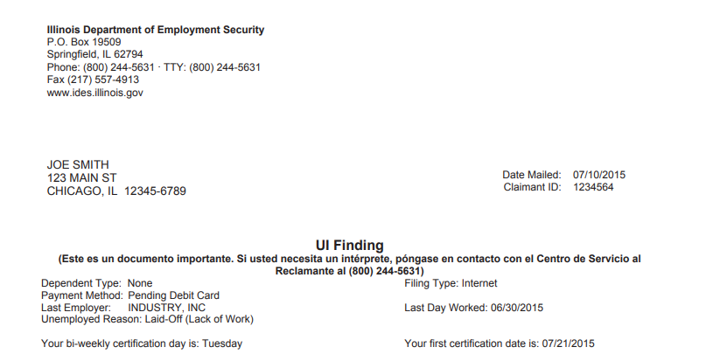
Certification day and first certification date

Slide 64
To receive benefits you must certify
Certify every 2 weeks
  See UI Finding Letter for certification day & first certification date.
Be Able, Available and Actively searching for work to receive unemployment insurance benefits.
Review and prepare the answers before you certify to ensure quick, accurate certification.
Download “I Filed My Claim What Happens Now” from the IDES website to view certification questions.

Slide 65
Certify On-line at www.IDES.Illinois.gov
Scroll to middle of page to locate
File Certification

Slide 66
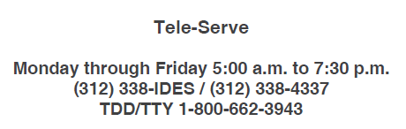
Certify via the telephone
1. Have you received or will you receive holiday pay during the period of Sunday through Saturday (week 1 beginning date through week 2
ending date)?
  • If yes, enter the gross amount of your holiday pay (before deductions) for each week.
2. Did you work during the period of Sunday (week 1 beginning date) through Saturday (week 2 ending date)?
  • If yes, enter the total amount of earnings (before deductions) for each week.
3. Has your dependency status changed during this certification period?
4. Were you able and available to work each day during your normal work week?
  • If no, enter the number of days you were unavailable for work in each of the weeks.
5. Did you actively look for work for the week of Sunday (week 1 beginning date) through Saturday (week 2 ending date)?
6. Are you receiving or have you applied for primary Social Security benefits?
7. Other than Social Security, are you receiving or have you applied fora retirement or disability pension?
  • If yes, has the amount changed?
8. Did you attend school or receive training?
  • If yes, did you attend all scheduled training courses?
  • If no, enter the number of days that you did not attend class.
9. Do you have a current workers’ compensation claim or do you expect to receive workers’ compensation for a temporary disability?
10. Has your phone number changed?
  • If yes, enter your new ten-digit telephone number.
11. Has your mailing address changed?

Slide 67
How Earnings Affect Your UI Benefits
If you earn less than half of your weekly benefit amount (WBA), you will receive your full WBA
If you earn more than half of your WBA, there will be a dollar-for-dollar deduction from your WBA
If you earn an amount equal to or more than your WBA, your claim will be closed
For example: Your WBA is $400
 | Earn less | Earn more | Earn 100%
 | than 50% | than 50% | or more
WBA
Earnings
WBA
$400
$190
$400
$400
$210
**$390
$400
$400+
$0
**dollar-for-dollar deduction from your WBA

Slide 68
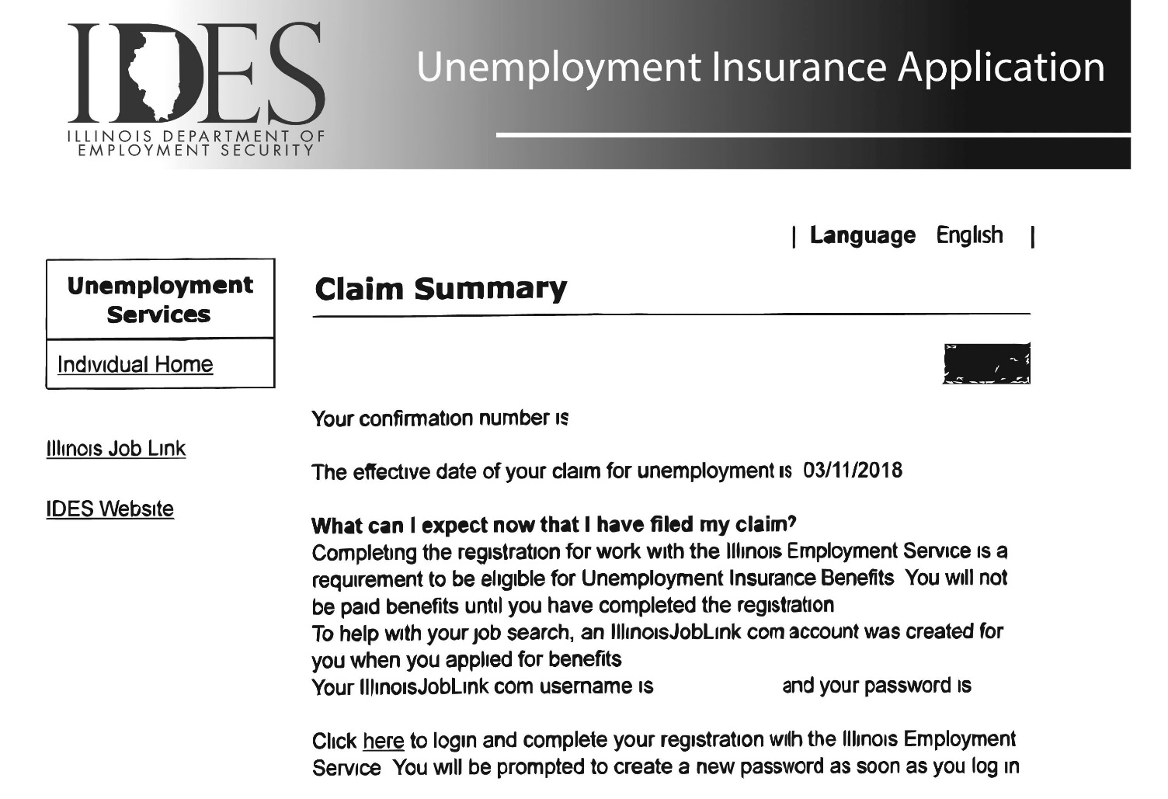
Important
Print/save YOUR
Claim Summary page
Claim Summary Page

Slide 69
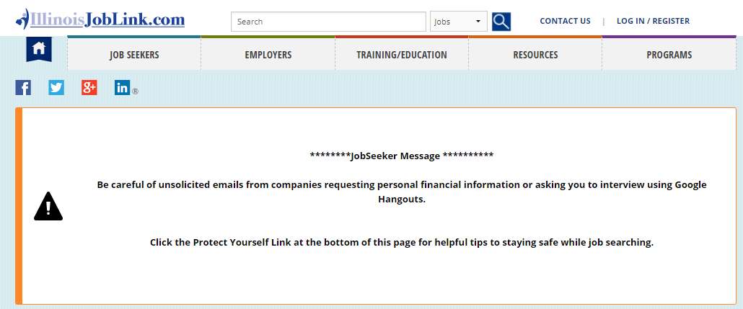

Employment Service Registration
www.IllinoisJobLink.com
Your benefits will not be paid until
your registration is complete.
LOG IN/REGISTER

Slide 70
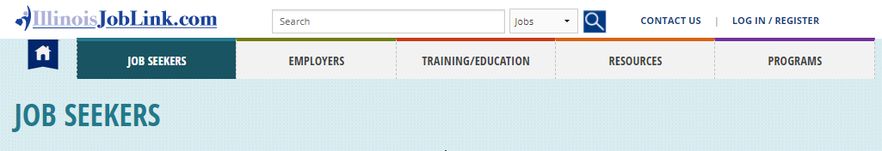
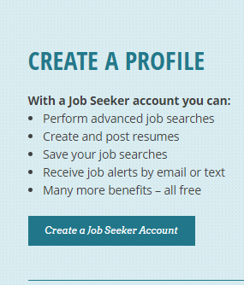
Illinois JobLink
To complete your
required registration for
Illinois JobLink
start by creating a profile

Slide 71
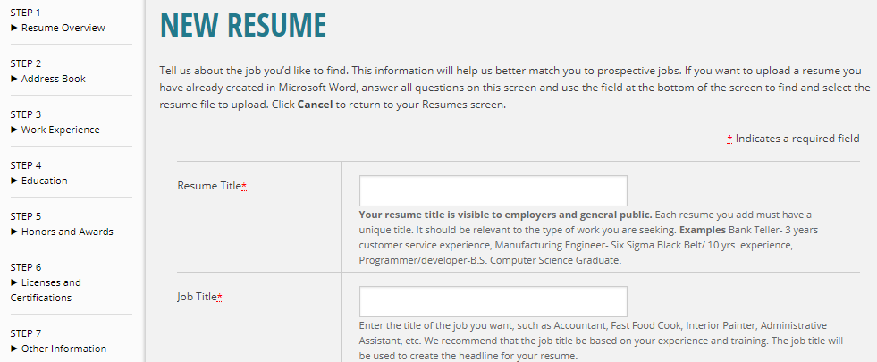
Illinois JobLink - Resume
Enter job title for position you’re seeking
You must create or upload at least one resume.
Upload/create multiple resumes for different types of positions you’re seeking!

Slide 72

Searching for a Job!
You must be:
Able
Available
Actively searching for work to receive unemployment insurance benefits.

Slide 73
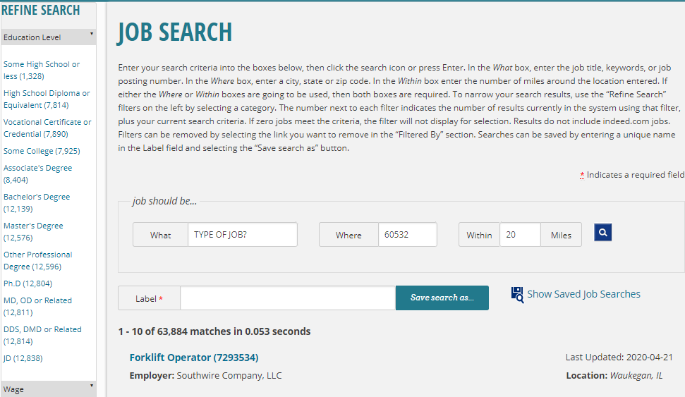
Search for Jobs
Click to view job posting

Slide 74
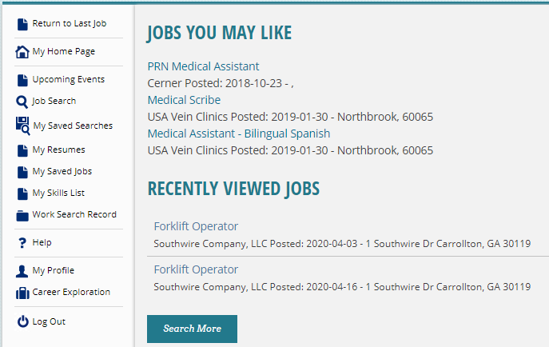
View your Illinois JobLink Work Search Record

Slide 75
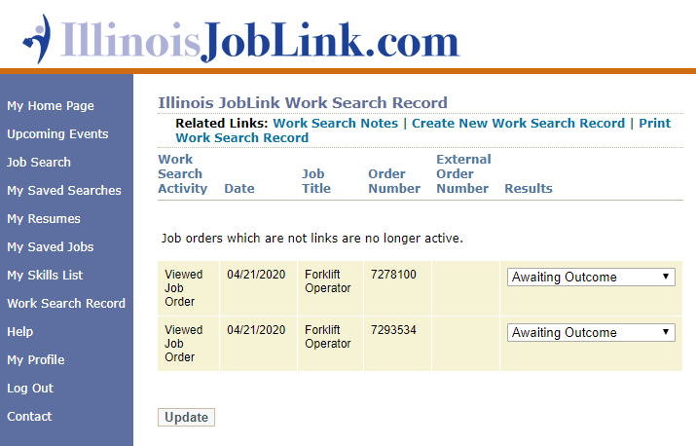
Work searches
are autogenerated

Slide 76
Record work search activity for jobs outside of Illinois JobLink
Click Here

Slide 77
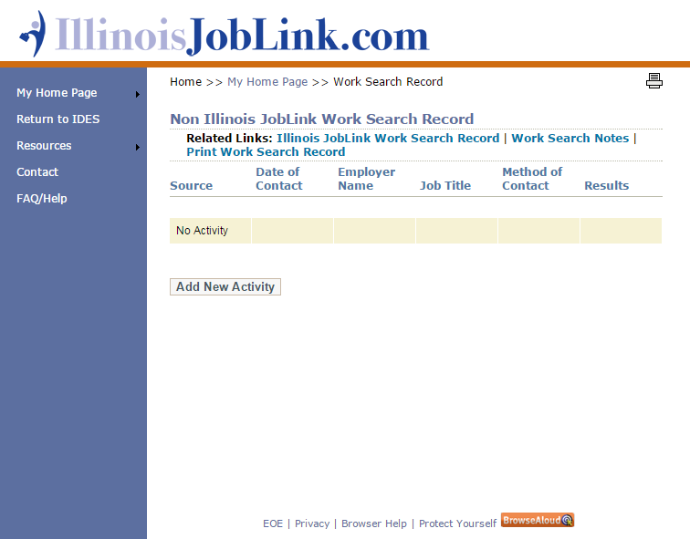
Click Here

Slide 78
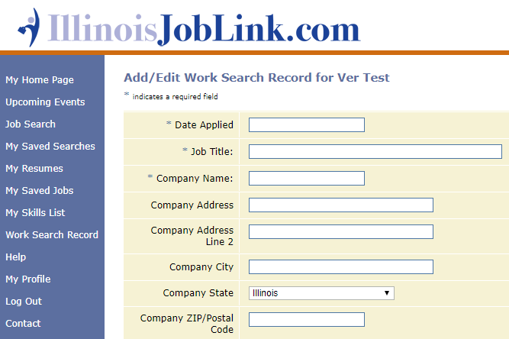

Create New Work Search Record
Record
your work search activity for jobs outside of Illinois JobLink
Date viewed
Complete the required fields
Notes:
Tell audience to pull out the creating a work search handout. Use handout to explain.

Slide 79
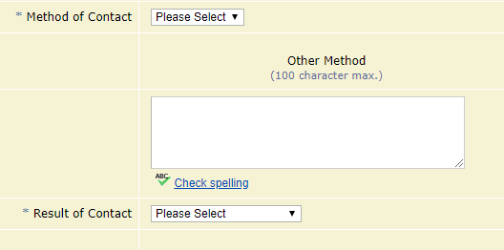

Create New Work Search Record Continued
Select from drop down menu
Select from drop down menu
Be sure to SAVE!
Complete the required fields
Notes:
Tell audience to pull out the creating a work search handout. Use handout to explain.

Slide 80
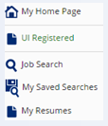
How do I know my Illinois JobLink registration is complete?
Verify UI Registered
is GREEN
.

Slide 81
Questions?
workNet DuPage; for questions about WIOA services, training grants & job search services
Susi Pihera
630-955-2041 or spihera@worknetdupage.org
www.worknetdupage.org
Illinois Dept. of Employment Security; for questions about Unemployment Insurance Benefits
www.ides.Illinois.gov or Call Center: 1-800-244-5631
Access DuPage -DuPage County Health Department
Robin Lavender 630-221-7049 or robin.lavender@dupagehealth.org
www.accessdupage.org
U.S. DOL Employee Benefits Security Administration
Scott Miller
312-353-4035 or www.askebsa.dol

