Slide 1
Trade adjustment assistance program
(Taa)

Slide 2
National Able Network Welcomes You!
Introductory Session on
Trade Adjustment Assistance Program (TAA)
Please silence your cell phones

Slide 3
About National Able Network
Our MISSION
To help make careers happen. Each client receives personalized career supports that integrate career coaching, specialized training, and direct connections to the job market.
Our Vision
To use our expertise to empower people to improve their lives by providing the means to self-sufficiency through sustainable employment, and career and life advancement.

Slide 4
Career Coaches: Training & Employment Specialists
Career Pathway Discussions
Training Application Management
Individualized Support
Individual Employment Plan
Resume Review
Personal Branding
Effective Networking
Employment Targets
Job Search Work Team
Becoming a Known Candidate
Exclusive Job Leads
Hiring Events
Job Referrals
Internal Networking Events
97% of clients recommend the program
to those in need of similar services.
81% of clients gain employment
with the program.
Our clients experience a 20 percent average increase in earnings.

Slide 5
JumpStart! Workshops
Our JumpStart Workshops incorporate leading edge curriculum on what’s going on in the job market today.
Participants get jobs 32% faster!
National Able Network
My Skills, My Goals: The Targeted Job Search
The Ultimate Guide to Resumes
LinkedIn: Maximize Your Professional Potential
Interview Success: All the Answers
Introduction to Social Media
Introduction to Networking
Financial Wellness While Seeking
Employment
Exceptional Customer Service
Jobscan

Slide 6
Career Training Assistance
CAREER TRAINING TUITION ASSISTANCE:
Types of Training Available
Prevocational: GED, ESL, ABE
Vocational: Training that is offered at a reasonable cost and is proven likely to result in reemployment within a reasonable time frame and at a livable wage.
General Guidelines
Maximum number of training weeks is 130.
Reasonable cost for training is usually $20,000 or below.
All training participants must have an Occupational Goal.
All vocational training must end with the attainment of an industry recognized credential.
In order to learn more about your career training options and apply for training, attendance to our Training Guidance Workshop is required.

Slide 7
You are here today…
Start a New Career Path
Trade Adjustment Assistance Program (TAA)

Slide 8
You may find yourself…
READY FOR A NEW CAREER OR EXPAND ON CURRENT SKILLS!
LOOKING FOR A JOB!
ALREADY EMPLOYED!

Slide 9
Benefits Rights and Obligations (BRO)
BRO Page 1
What is TAARA?
The Trade Adjustment Assistance Reauthorization Act is a federal program that provides services to workers who have lost or may lose their jobs as a result of foreign trade of goods or services.

Slide 10
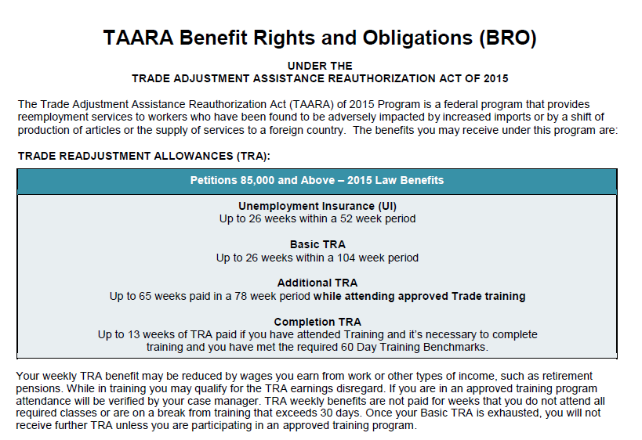
BRO: TRA Allowances

Slide 11
BRO: The Seven Conditions
BRO Page 3
Training Application Criteria
An application must be submitted to the State for approval, with your help, to demonstrate that training requests meet all 7 Conditions.

Slide 12
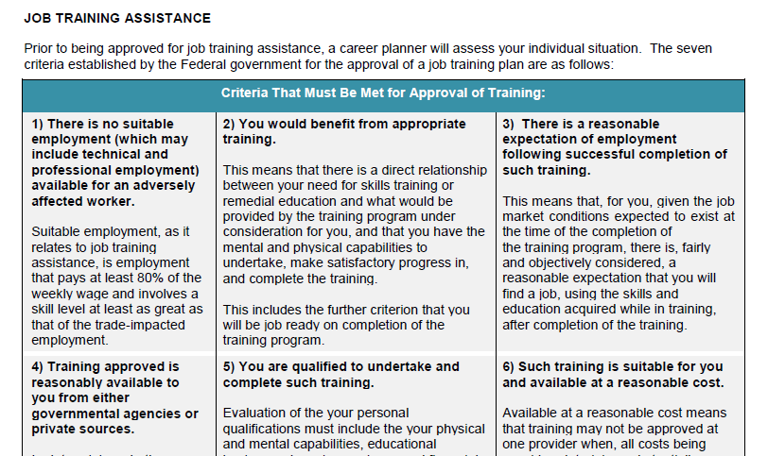
BRO: #1 No Suitable Employment

Slide 13
BRO: #2 Benefit From Training

Slide 14
BRO: #3 Expectation of Employment

Slide 15
BRO: #4 Reasonably Available to You

Slide 16
BRO: #5 Qualified to Undertake and Complete

Slide 17
BRO: #6 Suitable and at Reasonable Cost

Slide 18
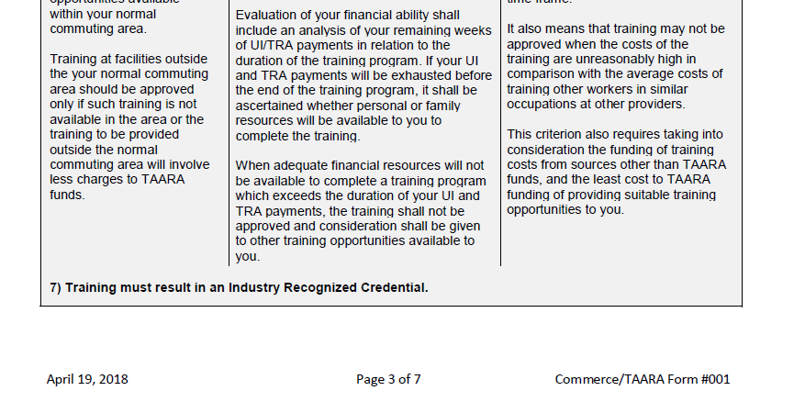
BRO: #7 Industry Recognized Credential

Slide 19
BRO: Successful Training Participation
BRO Page 4
Benchmarks: successful training participation
Timely proof of attendance every 2 weeks
Proof of satisfactory progress every 60 days
Choices made before and during training will impact your participation and benefits in TAA Program.

Slide 20
Benefits Rights and Obligations (BRO)
BRO Page 5
Reemployment Trade Adjustment Assistance (RTAA)
Workers who are 50 years old or better may be eligible to receive wage subsidies if reemployed at a lower wage.

Slide 21
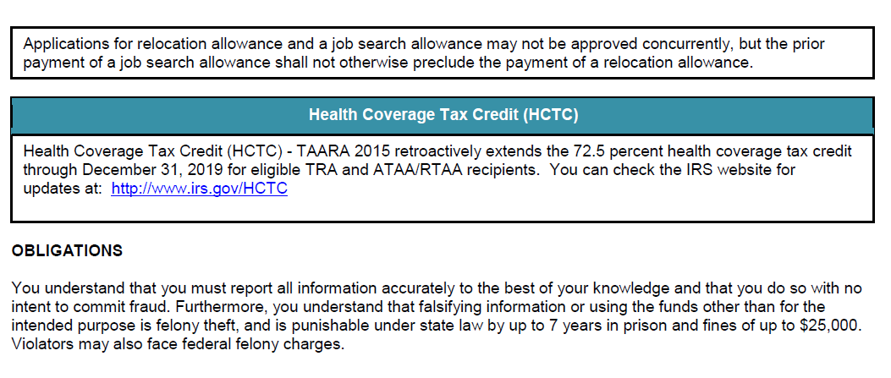
Benefits Rights and Obligations (BRO)
Health Coverage Tax Credit (HCTC)

Slide 22
Next Steps!
Submit DocuSign Intake Packet I
Submit Eligibility Documents & DocuSign Intake Packet II
Review Training Application Components
Submit Training Application

Slide 23
Next Steps: 1
1. Complete Preliminary Application
2. Complete Dislocated Worker Survey
3. BRO Signature Page
4. Grievance Procedure
Submit DocuSign Intake Packet I
Instructions sent via email
All completed forms to taaeligibility@nationalable.org

Slide 24
Next Steps: 2
Valid State ID or Drivers License
Proof of Current Address (if not current on ID/DL)
Lay-off Letter
Last Check Stub
Social Security Card
US Birth Certificate, Current US Passport, Naturalization Certificate or Valid Resident Card
Selective Service Compliance (if applicable)
Resume
High School Diploma/College Diploma
Submit DocuSign Intake Packet I
Submit Eligibility Documents & DocuSign Intake Packet II
Email documents to taa@nationalable.org
Intake Packet II will be sent and submitted via DocuSign

Slide 25
Next Steps: 3
1. Standard Application
2. IEP
3. TRA Form #055
Submit DocuSign Intake Packet I
Submit Eligibility Documents & DocuSign Intake Packet II
Review Training Application Components

Slide 26
Next Steps: 4
Submit DocuSign Intake Packet I
Submit Eligibility Documents & DocuSign Intake Packet II
Review Training Application Components
Submit Training Application
Know your deadlines!

Slide 27
Your Responsibility
Be accountable for Your Own Training Participation
Commit to your training plan
Attend classes and submit timely documentation
Actively communicate with your Career Coach
Participate in Workshops and Events
Check Your Email Regularly
Be Responsive to Opportunities

Slide 28
Specialized Services
We offer additional specialized programs and services that are tailored to your needs. You will receive assistance from our team to match you with the resources that best meet your needs.
For education and GED support
Services are exclusively for military and veterans
For individuals who are interested in training for information technology careers
For individuals age 55 or better who are entering the workplace

Slide 29
Funders
Our services are available to you at no cost through the support of our dedicated funding partners, including:
Trade Adjustment Assistance funding from the Illinois Department of Commerce and Economic Opportunity
Workforce Innovation and Opportunity Act funding from the Chicago-Cook Workforce Partnership
Private community foundations

Slide 30
Do you have any…
“ Thoughts!”
“Questions”
“ Concerns”
“ Not Interested”
“Unsure”

