Slide 1
Get Ready! College and Career Ready!
Presenters:
Troy McMillan – Illinois Department of Employment Security
Dee Reinhardt – Illinois workNet
www.ides.Illinois.gov
www.illinoisworknet.com
July 19, 2018 - College Changes Everything Conference, Tinley Park, IL

Slide 2
Resources from Illinois Department of Employment Security -IDES
To help your students identify and reach their career, education, and employment goals.

Slide 3
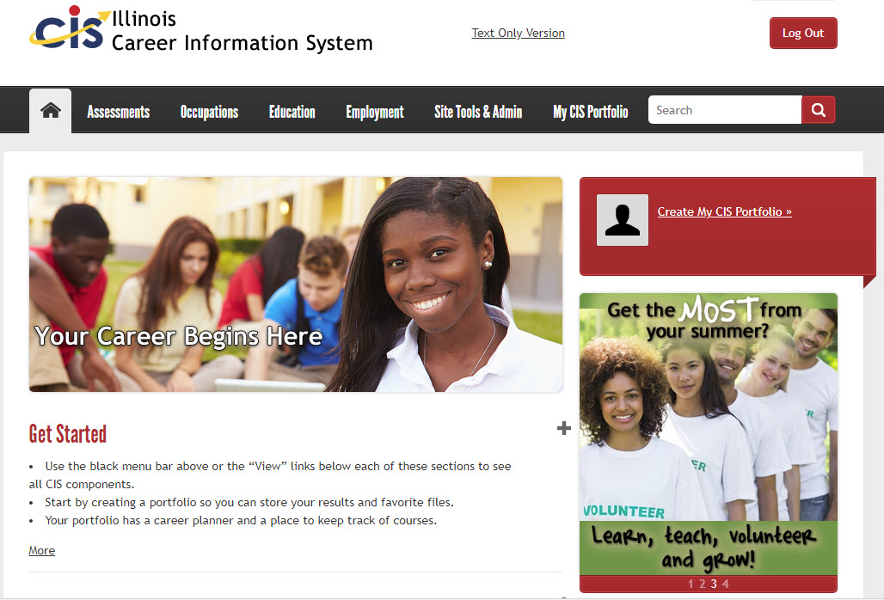
Career Information
Learn about occupations, wages, employment outlook and more
Find educational programs and training opportunities
Link to resources designed for students, job seekers, and career changers
Explore lifestyle choices using Reality Check

Slide 4
Career Information
Who am I? What is important to me?

Slide 5
Career Information
Learning about Occupations

Slide 6
Career Information
Finding Education and Training Options

Slide 7
Let’s Get Started
& Meet Dave

Slide 8
More IDES Resources
For Additional Career Information – http://www.ides.illinois.gov/lmi/Pages/Career_Information.aspx
For Labor Market Statistics - https://illinois.virtuallmi.com
For Labor Market and Career Information Publications - http://www.ides.illinois.gov/lmi/Pages/Labor_Market_and_Career_Information_Publications.aspx
For Employer Services Special Programs - http://www.ides.illinois.gov/Pages/ES_Special_Programs.aspx
For Illinois JobLink - http://www.ides.illinois.gov/Pages/Workforce_IllinoisJobLink.aspx

Slide 9
Resources from Illinois workNet
To help your students identify and reach their career, education, and employment goals.

Slide 10
Illinois workNet®
Benefits for Adult Education Students and Providers:
Students can access resources and tools to help them explore careers, training, and the skills needed to reach their training and employment goals.
Providers have access to the same resources and tools. Plus, they have instructor guides and partner tools to recover passwords, view student assessments, plans, saved resumes, and more.
All of these resources are FREE.

Slide 11
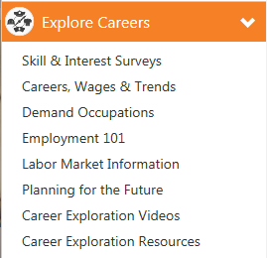
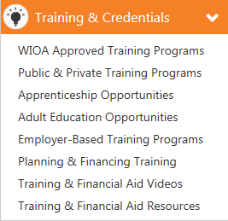
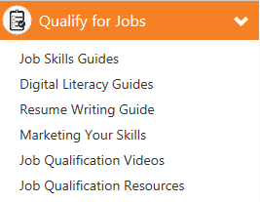
Individual Resources and Tools to Prepare a Career Plan
Connect to online and in-person resources, tools and programs.

Slide 12
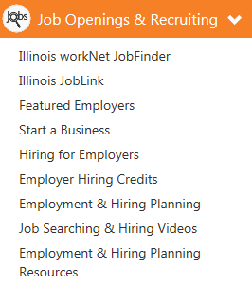
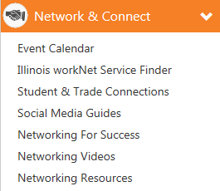
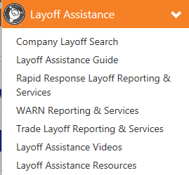
Individual Resources and Tools to Find Jobs

Slide 13
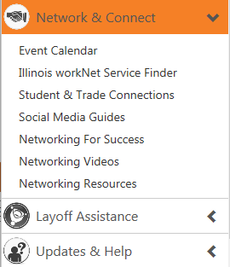
Individual Resources and Tools to:
Find Support Services
Manage Your Work Success

Slide 14
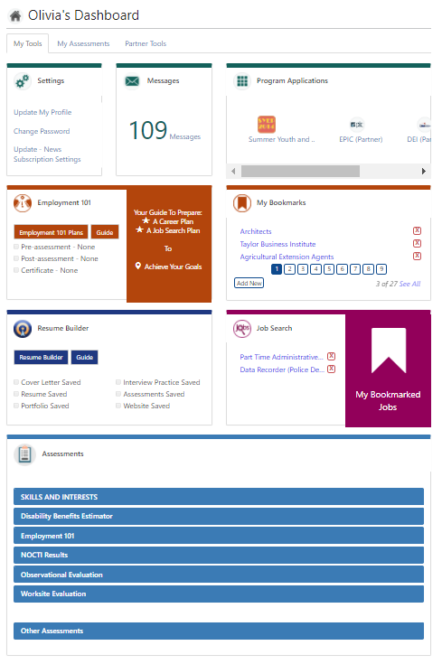
Personalized Student Tools
Illinois workNet offers a variety of personalization tools in My Dashboard.
This is an area where the adult education student can have one place to:
Access their Employment 101 guide.
Track their career and job search plans.
Get messages.
Access their resume and portfolio.
View assessment results.

Slide 15
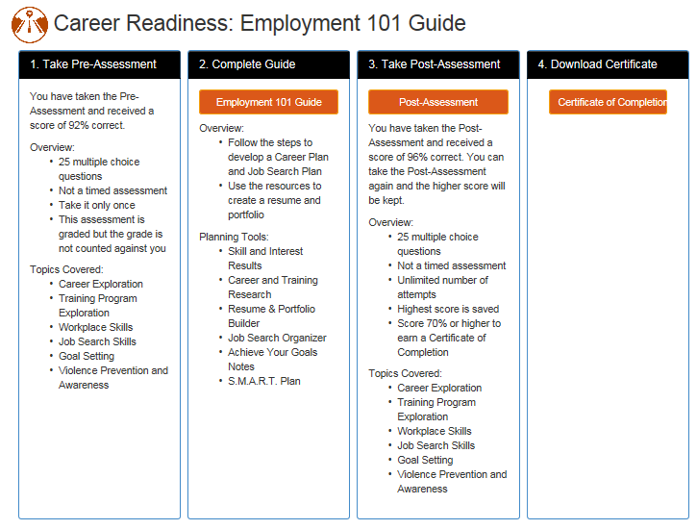
Employment 101 is a self-guided, step-by-step approach your students can go through online.

Slide 16
Employment 101 Demonstration
http://www.illinoisworknet.com

Slide 17
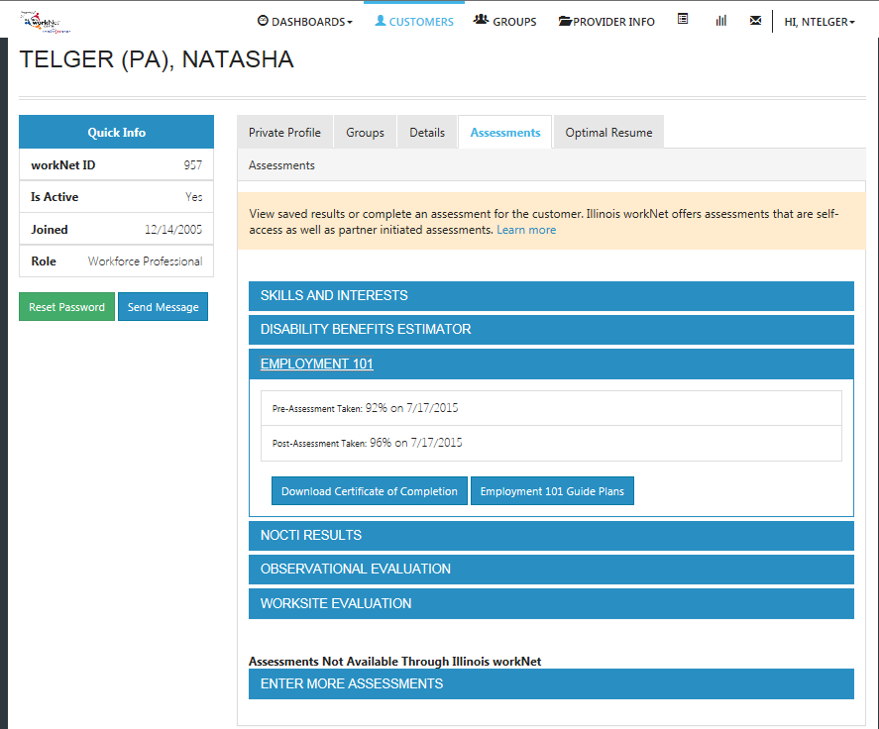
Employment 101: Pre & Post-Assessments
Instructor can view results in the Customer Support Center.
Student can access the Pre/Post Assessments in their account.

Slide 18
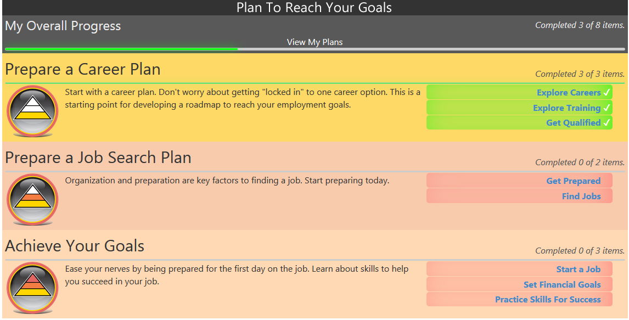
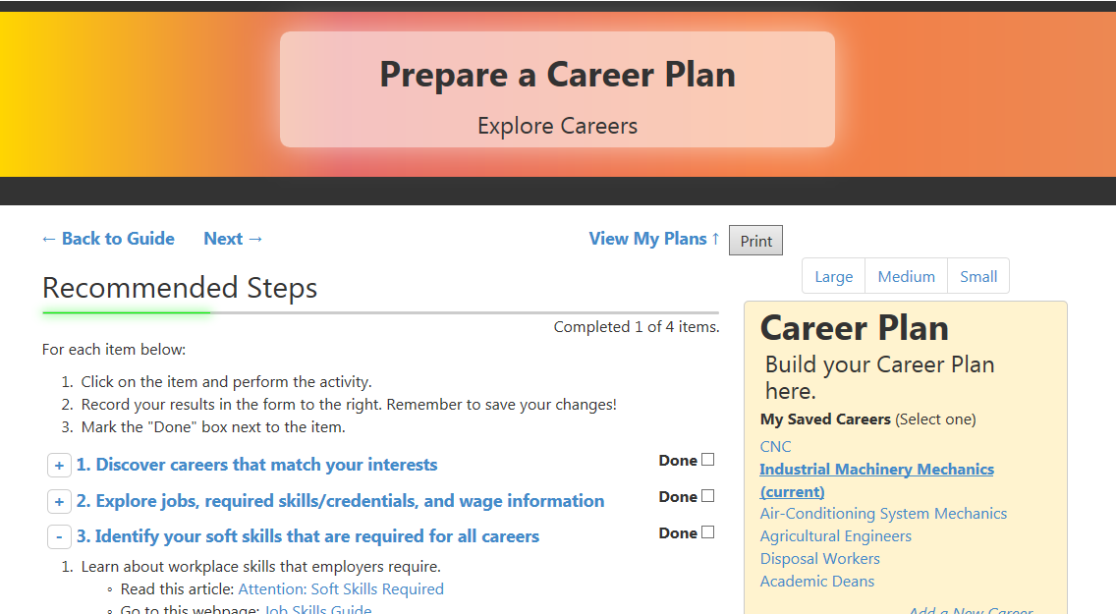
Employment 101: The Guide
Instructor Guides Available:
Prepare a Career Plan
Prepare a Job Search Plan
Steps with Integrated Illinois workNet Resources:
Articles
Searches
Tools
Videos
Side Bar for:
Career Planning
Job Search Records
Goals and Notes
Link to View My Plans:
Career and Training Research
Job Search
Goals

Slide 19
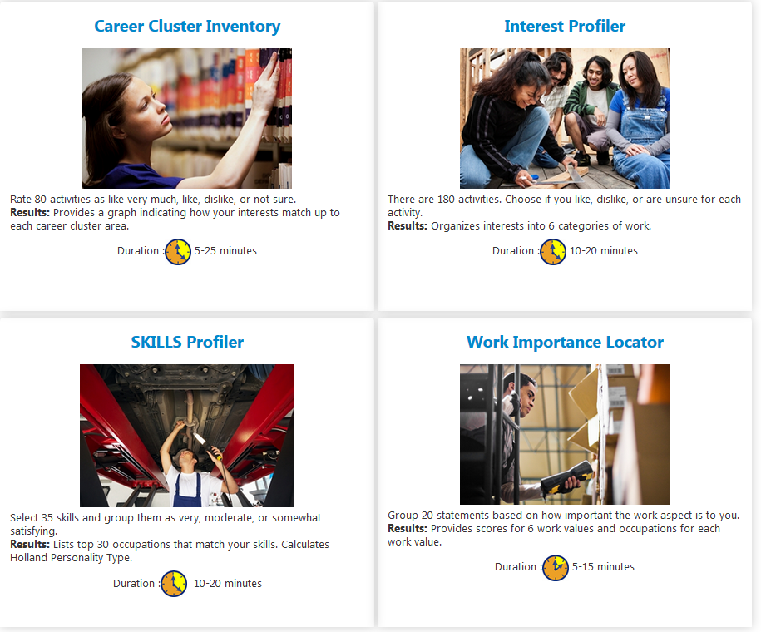
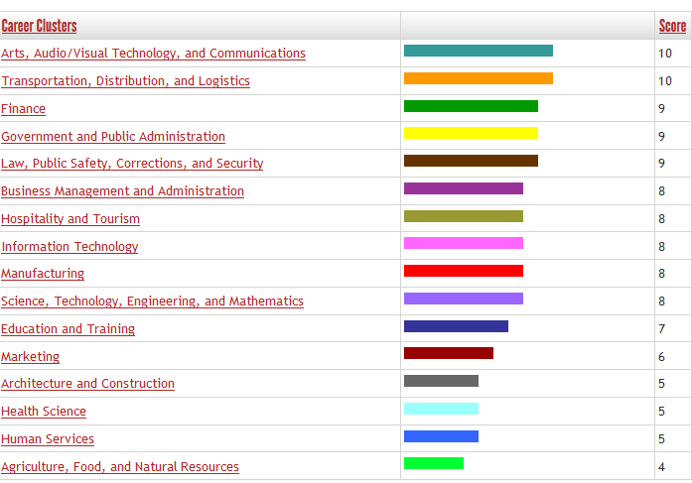
Employment 101 Integrated Tools: Skills and Interest Surveys
Source: Illinois Career Information System (CIS) brought to you by Illinois Department of Employment Security.

Slide 20
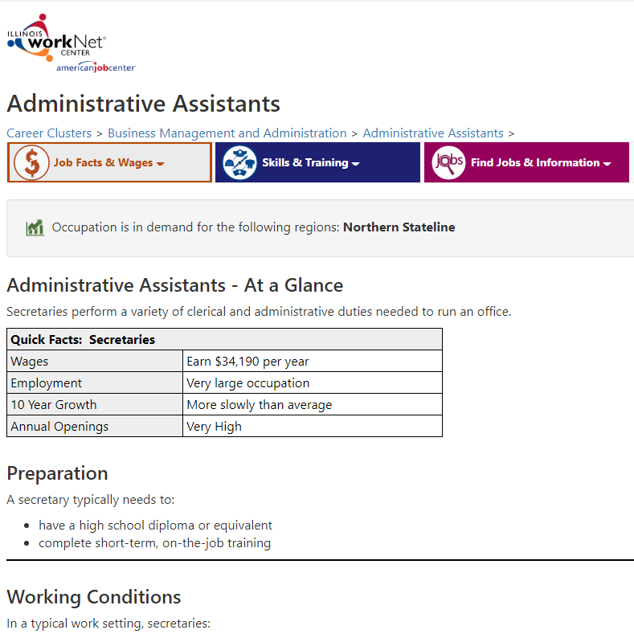
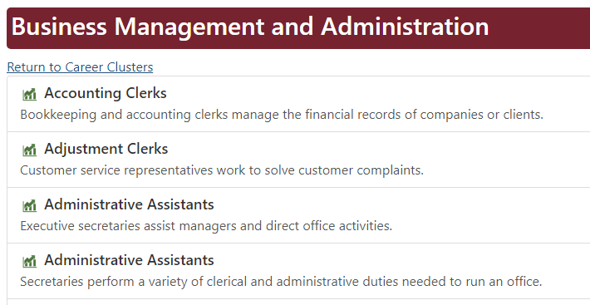
Employment 101 Integrated Tools: Research Careers, Wages & Trends
Source: Illinois Career Information System (CIS) brought to you by Illinois Department of Employment Security.

Slide 21
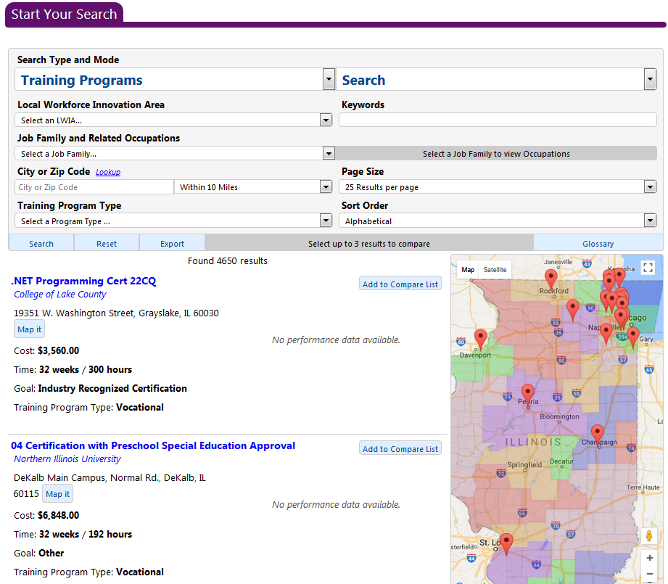
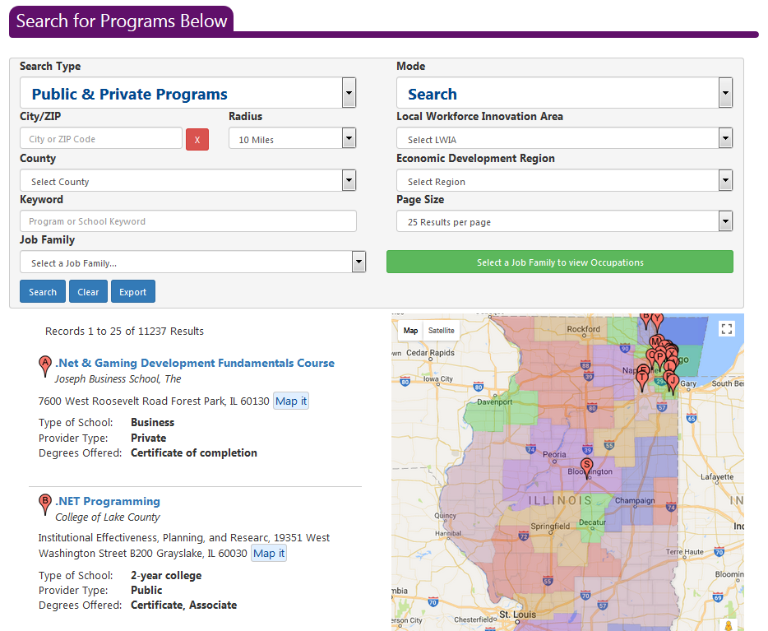
Employment 101 Integrated Tools: Research Training
WIOA Approved Training Programs
Public & Private Training Programs*
*Source: Illinois Career Information System (CIS) brought to you by Illinois Department of Employment Security.

Slide 22
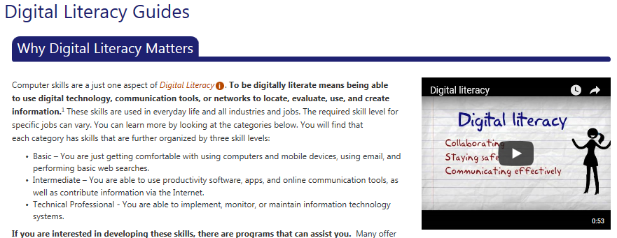
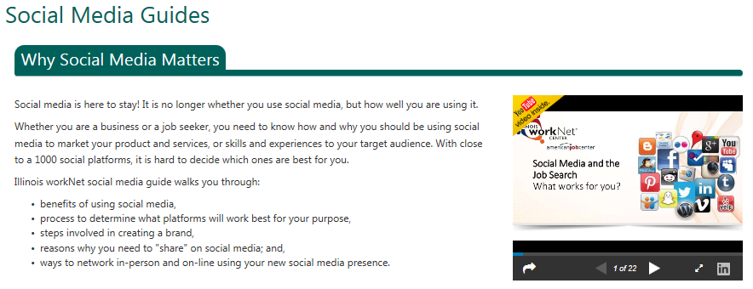
Employment 101 Integrated Tools: Guides

Slide 23
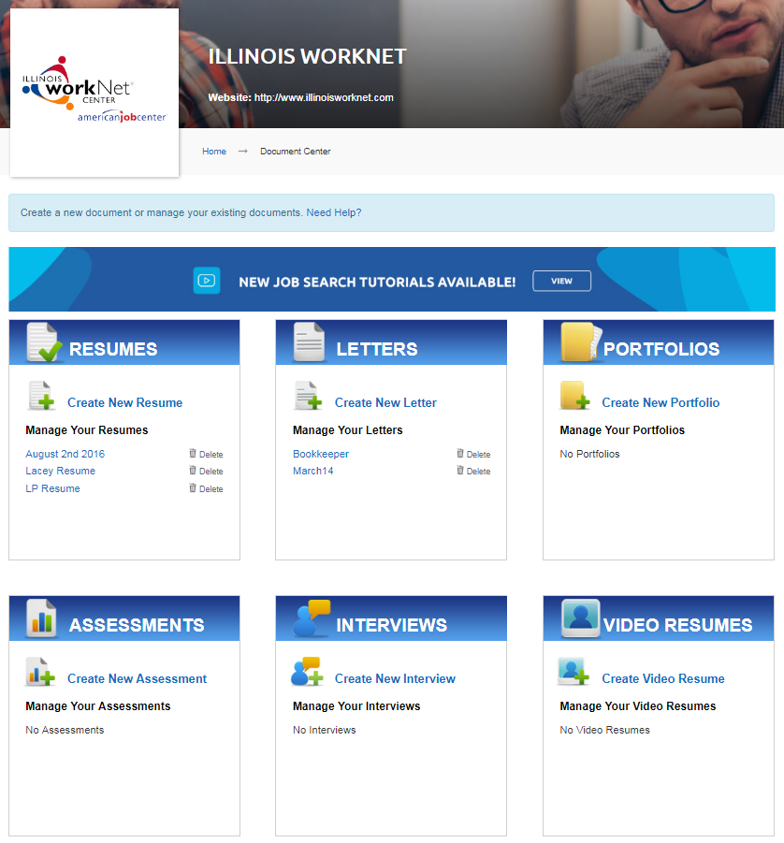
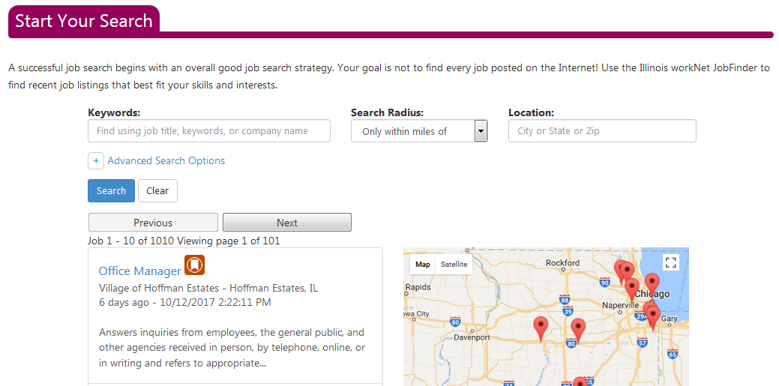
Employment 101 Integrated Tools: Find Jobs
Resume Builder
JobFinder
Illinois JobLink

Slide 24
Employment 101: Certificate of Completion

Slide 25
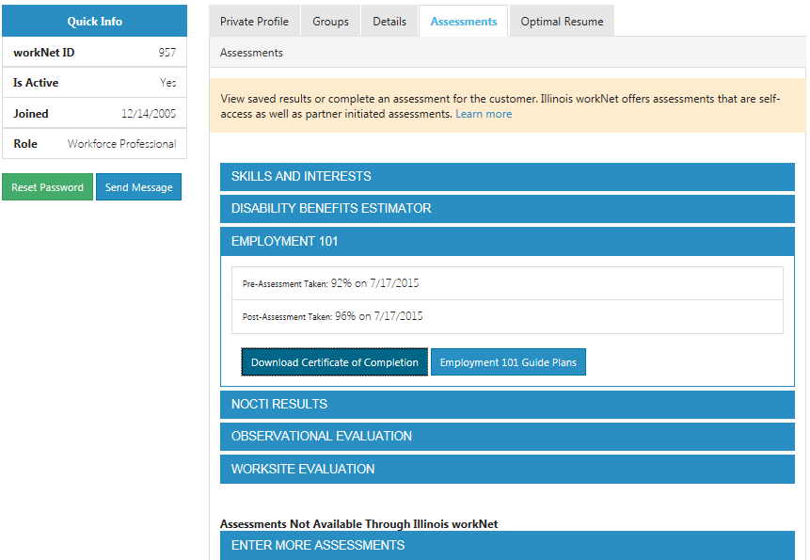
Customer Support Center
Benefits:
View student assessment results.
View Employment 101 plans.
Complete essential job skill evaluations.
Observational Evaluation
Worksite Placement
Help students recover or update their passwords.
Send messages to your student.
View their saved resumes and portfolios.
https://www.illinoisworknet.com/partners/Pages/Customer-Support-Center.aspx

Slide 26
More Tools for Partners
Partner Resources - http://www.illinoisworknet.com/partners
Customer Support Center - http://www.illinoisworknet.com/partners/Pages/Customer-Support-Center.aspx
Assessments - http://www.illinoisworknet.com/partners/Pages/Assessments.aspx
Outreach Tools - https://www.illinoisworknet.com/partners/Pages/outreachtools.aspx

Slide 28
Visit: www.illinoisworknet.com
Email: info@illinoisworknet.com
Monday – Friday
8:00 A.M. – 4:30 P.M.
Visit: www.ides.Illinois.gov
Email: des.cis@Illinois.gov
Call: 877-566-6230
Monday – Friday
8:30 A.M. – 5:00 P.M.
Emails are checked and responded to each business day.
This workforce product was funded by a grant awarded by the U.S. Department of Labor's Employment and Training Administration. The product was created by the grantee and does not necessarily reflect the official position of the U.S. Department of Labor. The Department of Labor makes no guarantees, warranties, or assurances of any kind, express or implied, with respect to such information, including any information on linked sites and including, but not limited to, accuracy of the information or its completeness, timeliness, usefulness, adequacy, continued availability, or ownership. This product is copyrighted by the institution that created it. Internal use by an organization and/or personal use by an individual for non-commercial purposes is permissible. All other uses require the prior authorization of the copyright owner.
The Illinois workNet Center System, an American Job Center, is an equal opportunity employer/program. Auxiliary aids and services are available upon request to individuals with disabilities. All voice telephone numbers on this website may be reached by persons using TTY/TDD equipment by calling TTY (800) 526-0844 or 711.
This workforce product was funded, wholly or in part, by a grant awarded by the U.S. Department of Labor's Employment and Training Administration. The product was created by the recipient and does not necessarily reflect the official position of the U.S. Department of Labor. The Department of Labor makes no guarantees, warranties, or assurances of any kind, express or implied, with respect to such information, including any information on linked sites and including, but not limited to, accuracy of the information or its completeness, timeliness, usefulness, adequacy, continued availability, or ownership. This product is copyrighted by the institution that created it. Internal use by an organization and/or personal use by an individual for non-commercial purposes is permissible. All other uses require the prior authorization of the copyright owner."
IDES is an equal opportunity employer and complies with all state and federal nondiscrimination laws in the administration of its programs. Auxiliary aids and services are available upon request to individuals with disabilities. The IDES Equal Employment Opportunity (EEO) Officer is responsible for compliance and can be reached at (312) 793-9290 or (888) 340-1007 TTY.

