Slide 1
Business Services Overview

Slide 2
Topics
Illinois workNet® Background
Business Services Overview
Using Illinois workNet to Achieve Training and Employment Goals

Slide 3
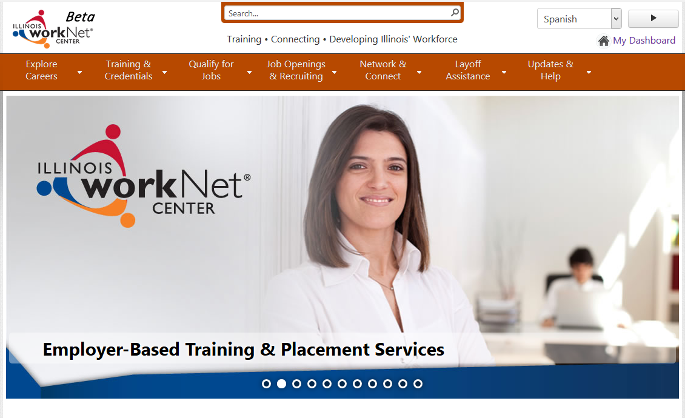
Illinois workNet Background
Illinois workNet is our state’s workforce development portal:

Slide 4
Benefits for Everyone
Benefits for individuals, businesses, and workforce professionals:
Dynamic/Real Time – Trained state and local content managers located throughout Illinois publish content to the portal.
Web Services – Seamless access to databases and tools, including occupational and labor market information, resume builder, self-assessments, and job postings.
Accessible – Supports assistive technologies and meets Illinois Information Technology Accessibility Act.
Partnerships – Promotes networking organizations offering public access to computers and a variety of community services.

Slide 5
Benefits for Everyone
Benefits for individuals, businesses, and workforce professionals:
Guidance – Step-by-step guidance on how to use the online resources is provided throughout the portal.
Glossary – As an education tool, the glossary provides definitions.
Personalized Account Resources – Users can save notes, links, and activities.
Frequently Asked Questions (FAQ’s) – FAQ’s are posted on the website.
Training – Online courses, webinars, and in-person training opportunities are available at no cost to staff with all partner organizations.

Slide 6
Community of Users
Individuals
Community
Explore Occupations and utilize job searching on our JobFinder powered by Indeed.
Find Training Programs and Services in your local area.
Businesses
Portal and Centers
Workforce
Professionals
Work with local Business Service Teams to: Recruit, Train, and Develop skills.
Workforce Professionals provides Trainings, Recruiting, and offer Laid-Off Worker Assistance.

Slide 7
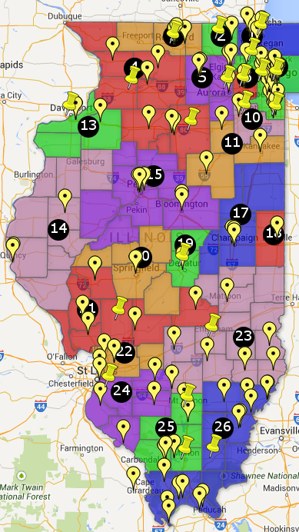
Promotes Network of Partnerships
Local Partners:
Provide public access to Illinois workNet and public content throughout the site.
Offer a variety of workforce related services to the community.
Have staff that access the Partners Resources to use guidance and resources.
Use customizable marketing materials available for download from Illinois workNet.
Use training webinars offered by Illinois workNet.
Locations in Illinois serving
employers
Notes:
Map – all workNet sites, all libraries, all ASM CBOs

Slide 8
Individuals & Business
Services available for Individuals or Business:
Review Career, Wages and Trends information
Connect to training and education programs
Review Job Skills Guide, Digital Literacy and Training Programs
Use the Featured Employers listings
Check Recruiting and Hiring resources
Review Employer Hiring Credits
Explore Events, Networking and Association suggestions
Participate in business development training and webinars

Slide 9
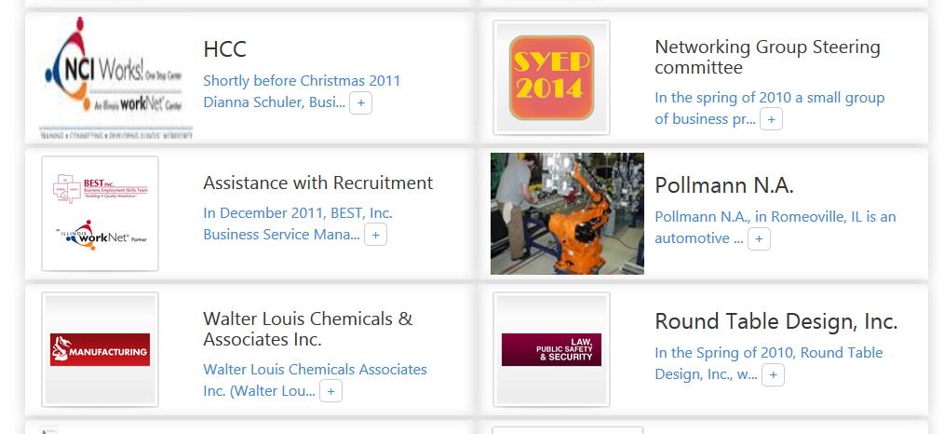
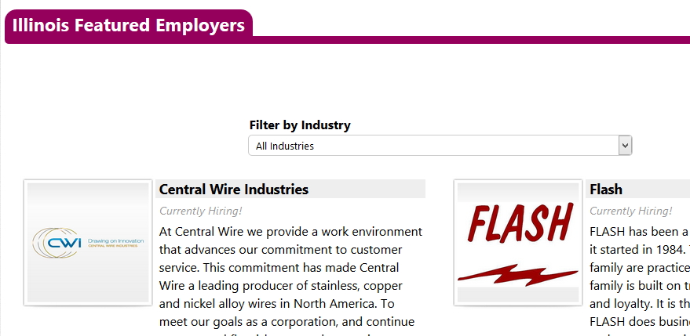
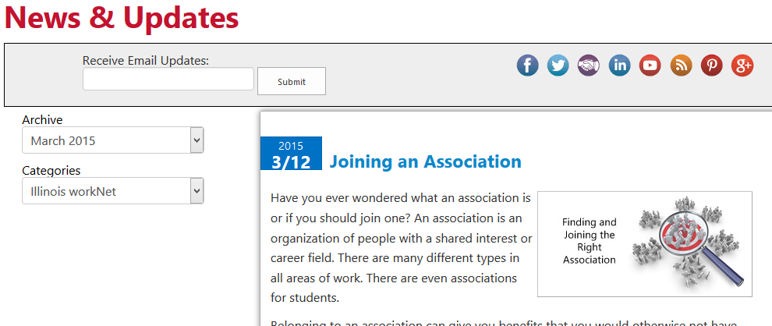
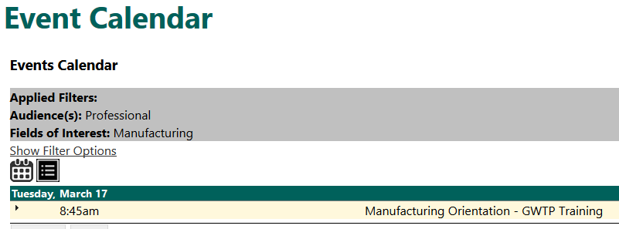
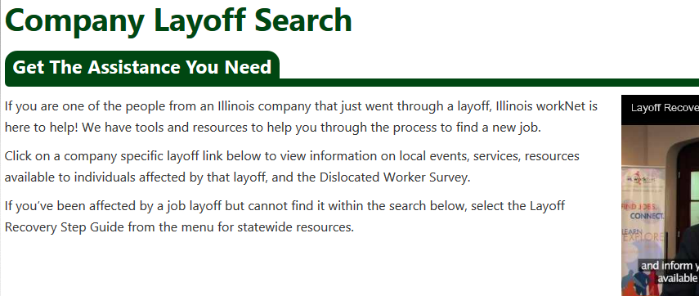
Local Content
Local content from businesses and workforce partners published by anyone with an Illinois workNet account:
Featured Employers
News and Updates
Hiring events, workshops and interview opportunities
Community resources
Laid off workers assistance
Success Stories and more….

Slide 10
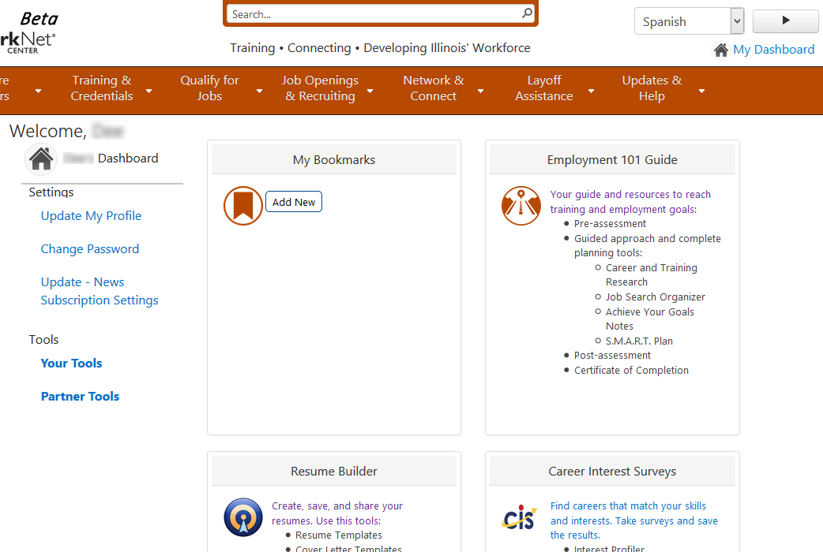
My Dashboard
Registered Users Can Access:
Employment 101 Guide
Resume Builder
Career Interest Surveys
Special Programs
Bookmarked pages

Slide 11
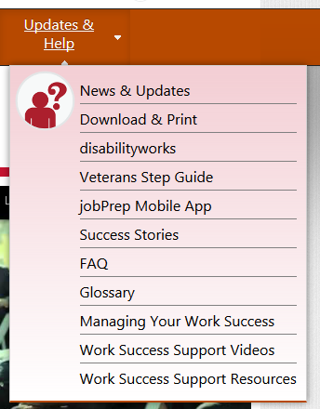
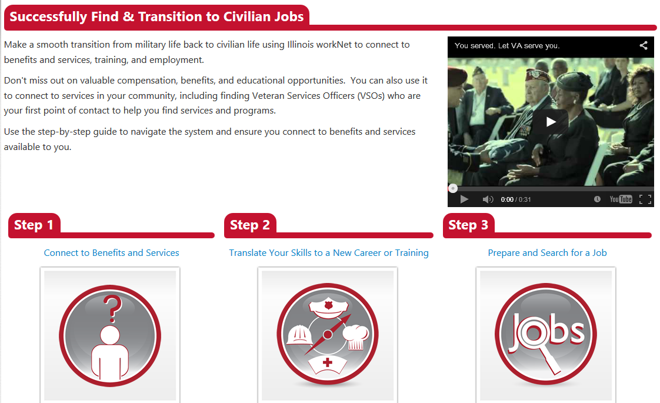
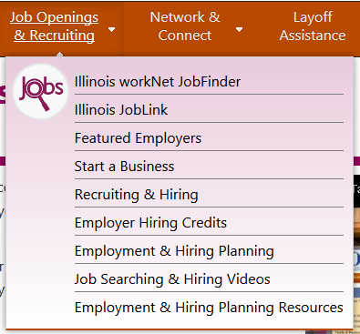
Veteran’s Priority of Service

Slide 12
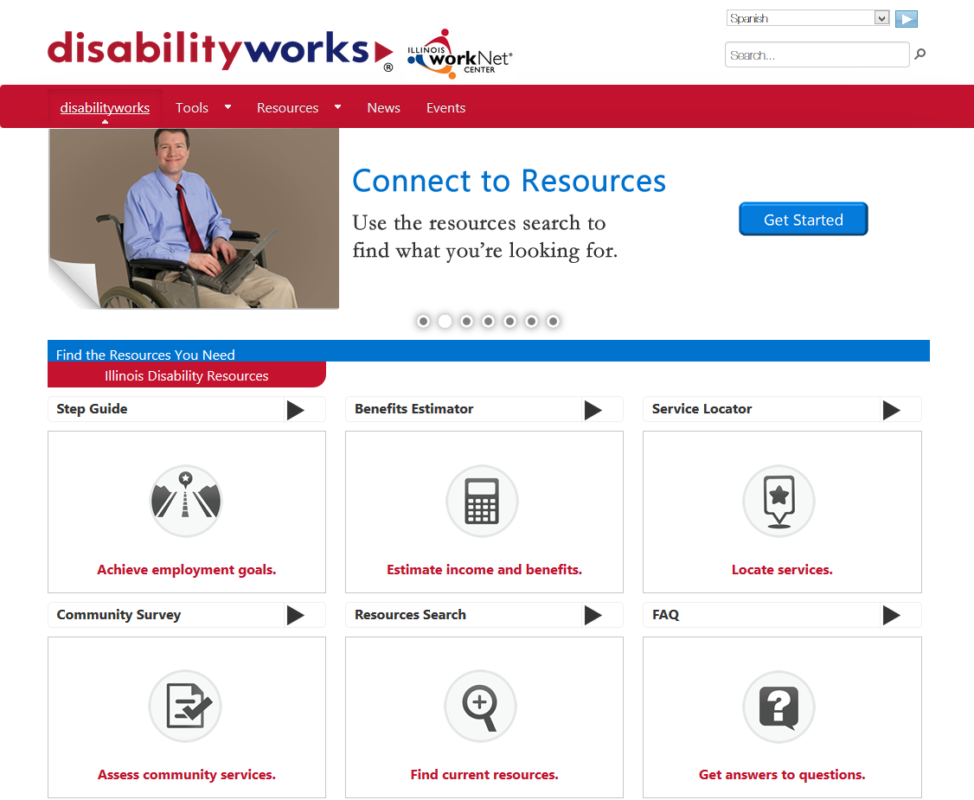
Disability Resources
Illinois workNet users guide provide resources for:
Work incentive planning assistance
Disability benefits information
Rights and Advocacy
Transitional Youth Programs
Nearby locations offering services using the Service Locator
Hiring Credits
http://www.disabilityworks.org
Notes:
They do serve youth with developmental disabilities.

Slide 13
Business Services Overview

Slide 14
Business Services Team
Business Services Team Members have core knowledge in functions necessary to meet business needs:
Benefits of Illinois workNet
Awareness and application of local, state, and federal business resources
Knowledge of business demands and expectations
The ability to create solutions for common business needs

Slide 15
Recruiting Resources
Illinois workNet provides options for no-cost job recruiting tools available which helps businesses:
Locate workplace assessments, labor market and economic snapshots.
Explore recruiting options including:
Illinois JobLink
Illinois Career Pathways
Resume GPS
Understanding Social Media
Locate and advertise information pertaining events such as job fairs hiring events and local area news.

Slide 16
Hiring Credits
Hiring Credits Are Available For Businesses Who Employ:
Mature Workers
Persons with Disabilities
Veterans
Re-Entry
Youth

Slide 17
Training Programs
Often, businesses or their employees will want to search for local education and training programs. Illinois workNet provides multiple methods for conducting such searches.
In addition to helping businesses locate training provided by Illinois colleges and universities, Illinois workNet provides resources for businesses to help their employees find other types of training providers and resources such as:
Locating WIOA Certified Training Providers
Customized Training Opportunities
Incumbent Worker Training (IWT)
Program locations for the Job Training and Economic Development (JTED)
Locate on-the-job training resources for businesses
Refer businesses to local and statewide information related to education and training programs

Slide 18
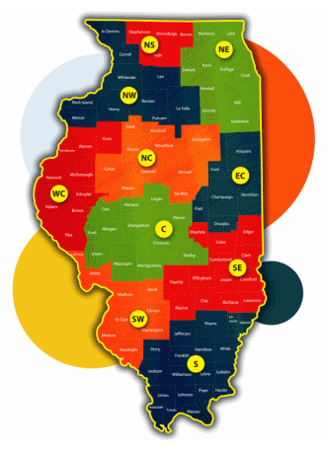
Start or Expand a Business
Rather than sifting through numerous websites and resources, Illinois workNet has made business development simple. We provide access to all the various business development websites and resources all in one place. Finding capital or locating free online business education and training courses is now available.
The business development unit provides an overview of resources available through Illinois workNet and tools for easily locating Small Business Development Centers (SBDCs).
Labor Market Information (LMI) is available and can be downloaded to use in presentations.

Slide 19
Laid Off Worker Assistance
Illinois workNet offers a set of online tools to help Laid Off Workers:
Find a Location Near You where staff are able to assist you in finding resources for your job search, career preparation, and work support such as financial aid, child care and much more.
Connect to Benefits and Services and learn how to file for unemployment insurance online, and develop a Financial Management Plan.
Connect to Education and Training opportunities and explore jobs, including details such as wages and trends and required skills.
Organize yourself, prepare for your job search, know your interest and achieve your goal

Slide 20
Workforce Partner Accounts
Illinois workNet Account Benefits:
Access your Dashboard to participate in programs to which you are associated like ATIM or SYEP.
Announcements to ensure you always have up-to-date information.
Events – Add a hiring event or job fair, or a learning event you are hosting.
Success Stories – have you been working with a program or individual referred to you by an Illinois workNet program? Share your Success Story with other readers.
Featured Employers – add your Illinois company information to our Featured Employers Section. You don’t even have to be hiring!
Site Administration tools to manage Illinois workNet programs, your user account information, online training registration, and much more.

Slide 21
Quick Facts
Program Year 2014 Web Traffic:
18,188,608 page views
626,921 unique visitors
49,832 views per day on average
Illinois workNet's monthly subscribers:
Illinois workNet 122,627
Illinois Pathways 33,993
Workforce & Education Partners 2,278
Special Programs 1739
Active Illinois workNet User Accounts:
451,181 Individual Accounts
5005 Workforce Professional Accounts
3773 Business Accounts

Slide 22
Recent Statewide Programs

Slide 23
Summer Youth Employment
Pre and Post-Assessment, Activities, and Participant Tracking For Skills Development:
Model state-wide program for other states
Served more than 2717 youth in 2014
Over 591 Employers participated in 2014 (DCEO)

Slide 24
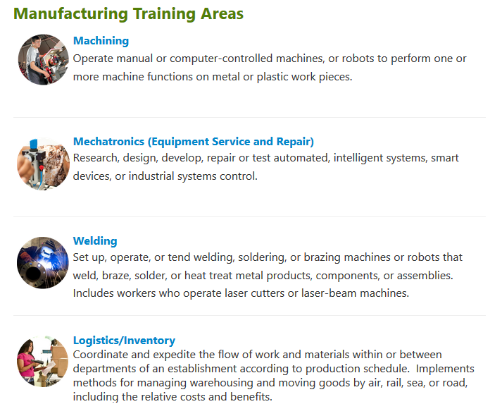
Accelerated Training for Illinois Manufacturing - ATIM
Developed online tools, activities, and participant tracking for the ATIM program:
Model state-wide program for other states
Served more than 3600 adults
Over 50 Employers with 183 forecasted openings participated in 2014/15
http://ilworknetmanufacturing.com/ATIM/Pages/default.aspx

Slide 25
Using Illinois workNet to Achieve Training & Employment Goals

Slide 26
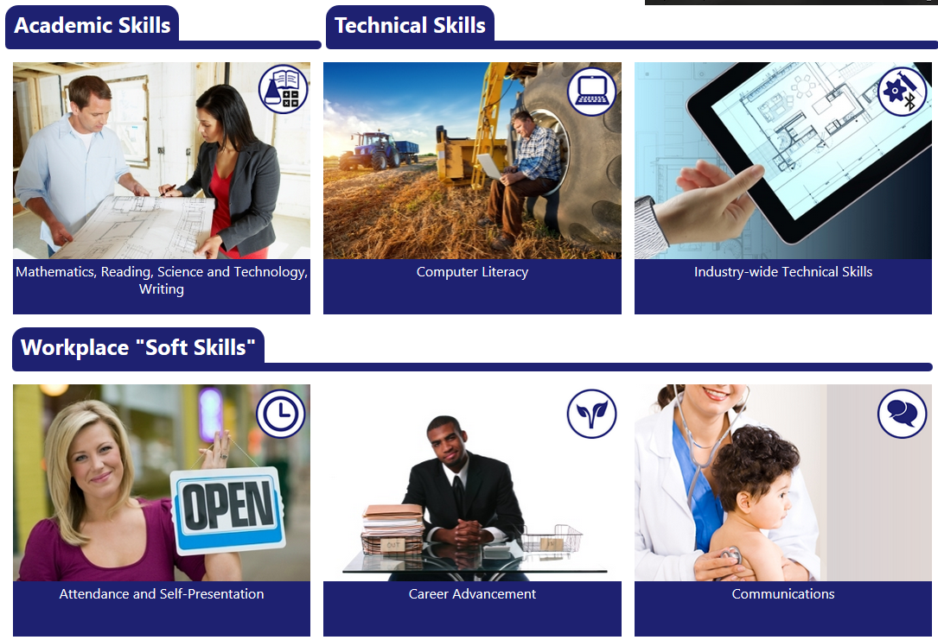
Job Skills Guide
Share the Job Skills Guide:
Guidance to achieve employment goals are:
Find resources to help acquire Academic Skills
Review Technical Skills Information
Learn skills that every employer wants

Slide 27
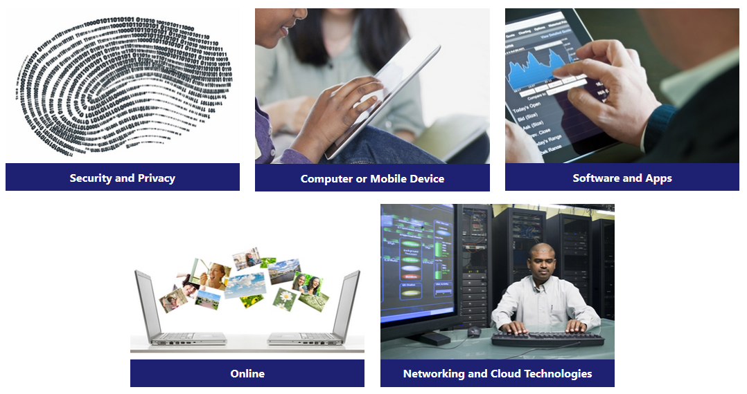
Digital Literacy Guides
Why Digital Literacy Matters:
Completing the computer skills self survey, connecting to online courses and local training
will enhance computer skills and knowledge
Digital Literacy is the ability to use information and communication technologies to find, evaluate, create, and communicate information, requiring both cognitive and technical skills.

Slide 28
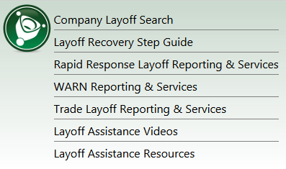
Laid Off Worker Assistance
Laid Off Worker Assistance Includes:
Pathway and guidance to achieve training and employment goals
Find resources to help get dislocated workers back to work
Specific Layoff Information for various companies
Skills enhancement that can open new employment opportunities

Slide 29
Contact Information
Business Services Representative—Illinois workNet
Representative Name
Street Address City, State Zip-code Email: youraddress@yourwebsite Phone: xxx-xxx-xxxx ext. xxxx
General Information: info@illinoisworknet.com
Find Illinois workNet On:

