Slide 1
Networking Essentials
What to do Before, During and After a Networking event

Slide 2
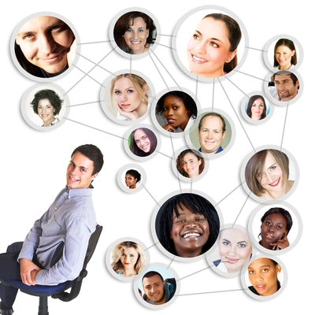
What are we talking about
Optimism
Before event
During event
After event
Follow-up
On-going communication

Slide 3
Optimism
When you joined a group like a chamber of commerce or other networking group did you expect that the phones were going to ring non-stop?
When you attend an event, do you expect phone calls from people to whom you hand your card?
Do you expect to close business with each of those people to whom you gave your card?
Realistic
vs.
Unrealistic

Slide 4
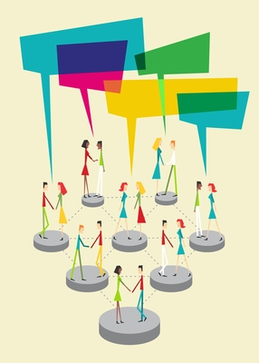
Before the Event
What type of event is it?
  Business After Hours
  Networking luncheon
  Meet-up
What are your expectations?
  Set a goal
  Introduce or re-introduce
Do you need to research before you attend?
  Who is the contact you need to meet?
  Is this a company with which you might do business?
Notes:
Handouts to have
Event types
Upcoming calendar
Point to registration on the website.

Slide 5
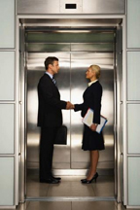
Techniques
Refine your elevator speech
Brush up on your current events
Reload your business cards
Practice not sounding like a perpetual sales pitch
Have a “get-to-know-you” question
Have name badge in your purse or pocket
Know who your 1st priority
Types of groups – Chambers, LeTip, BNI, Leads, Associations
Notes:
Who can help you with your elevator pitch
Who can print business cards
Who can make name tags

Slide 6
Examples
Who do I need to meet?
Where could I meet them?
Don’t judge a book by it’s cover!
Don’t be afraid to network with what you perceive as your competition.
Examples
Notes:
I am your back-up …….

Slide 7
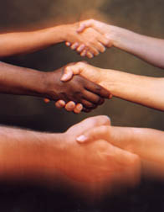
At the Event - Introductions
Nametags
  Which side do you wear it
Shake Hands
  How to shake a hand
  Make eye contact
  Repeat the person’s name
Business Cards
  Do you exchange immediately
  Do you wait to be asked
  Do you wait until you are parting

Slide 8
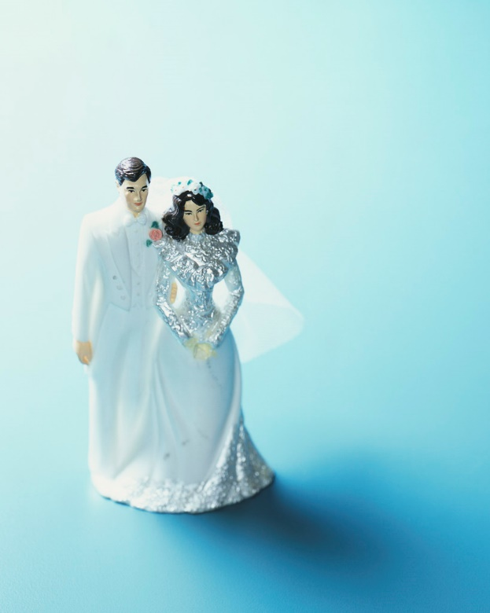
At the Event - Conversations
Conversation
  How long do you chat
  What topics do you cover
  How much do you share
Start the Relationship
  Ask the “right” questions
  Find a commonality or a talking point
Next Step
  Make an introduction to someone they might need to meet at the event
  To whom could you refer them
  #1 priority list - Schedule a follow-up?
Notes:
Light and breezy or do you get married on the first date
Example of a right question based on your target market
Do you own your own business?
Go around the room and determine a “right question”

Slide 9
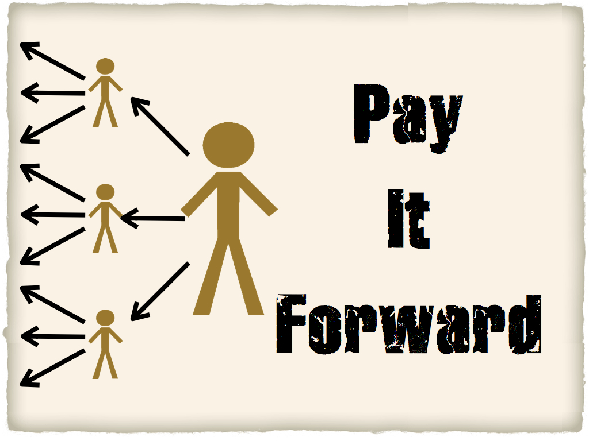
At the Event - Techniques
Business Cards
Exit Strategy
Make Introductions
Style
Notes:
What do you do with your business cards to “remember”
How do you break away without being rude?
How do you make a proper introduction?
Talk styles of networking – Dee find the list from NEAN
BumbleBee -come into the group, stop say HI, what I do, what do you do, great, move on to the next person get enough business cards to wallpaper a room in my house
WallFlower - Stands off to the side never joining, runs away if someone approaches them, continuously dodging other networkers. Other networkers need to provide humor as wallflower leaves. Wallflower needs to speak about being panicked about talking to people. Things like running for their life. Oh no this is not good for me. Why can't they just ignore me. Etc...
Quick Draw - Set a card at every place on the table or go around to all tables just giving out cardspulls out his card like a magic trick with the card between his pointer and middle finger making a gun motion with his thumb. Says "Hey, feeling lucky? you want my card don't ya!“
Touchy Feely (Cuddley Bear)Big hugs no matter what, rubbing arms, holding onto someone, invading personal space
Take a Breath already - Fast talker, overflowing with informationI
Wear 18 Different Hats - Combining with fast talker. How else to get it all out. :)
Center of Attention- jump up on the bar - I'M HERE, let the party begin!!
Agent 009 - Talks to you but never tells you what they do
The Clique - a small group is talking, a new person approaches and they all turn their back and tighten up the circle
Brochures Extraordinare - The person walks in says hello - OH I don't have a business card, but I have a flyer for that and opens up a carry on suitcase with folders of flyers. Pulls out a brochure that is 4 pages taped together in length.
Department Store - Answer to every question is more offerings. Weaves every discussion point into more offerings Straight person asks normal question; DS response is only lists of products (lots and lots and lots of products)

Slide 10
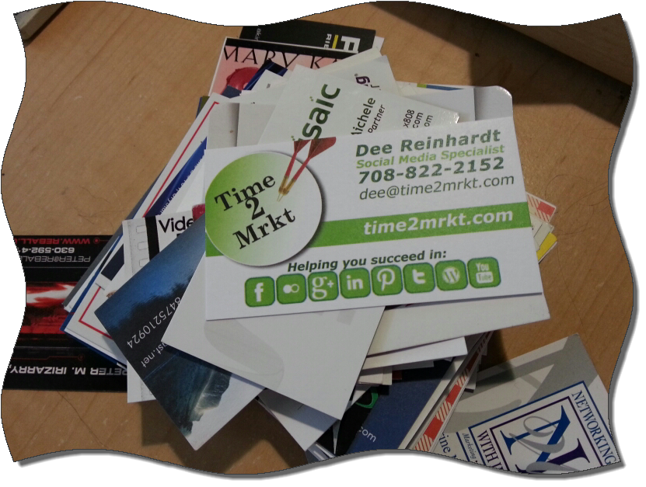
After the Event
Business Cards
  In a box
  Scanning
  Rubber Banded together
Database
  Add to a CRM
  Invite to LinkedIn or other social media
Follow-up Emails
  Pleasantries
  Schedule a time to meet
  Invite to follow your social media/e-news letters
Keep your promise!
Notes:
App to scan cards – world card
Neat receipts

Slide 11
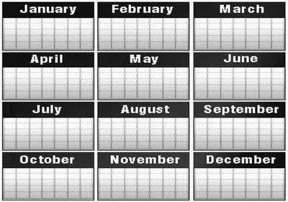
After the Event - Techniques
Template for a follow-up email or phone call
Schedule a date
Connecting on social networks
CRM – Contact Resource Management
Follow-up plan for days, week, month, quarterly
Notes:
Template – do what you say
Schedule a date – do you have specifics, do you talk by phone
It’s not about who you know, its about who they know.
SM – LinkedIn, Facebook, Twitter, G+
WHAT tools – ACT, Salesforce, Excel, box, Outlook

Slide 12
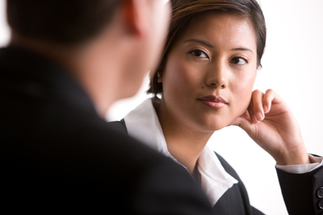
At the Appointment
How long is a good follow-up appointment
Bring brochures/take-aways
Mutually discuss
  Ideal clients / referrals
  Trigger phrase
Listen
Note your follow-up – maintain your integrity
Don’t forget the ASK!
Notes:
Find Tom Gosche form

Slide 13
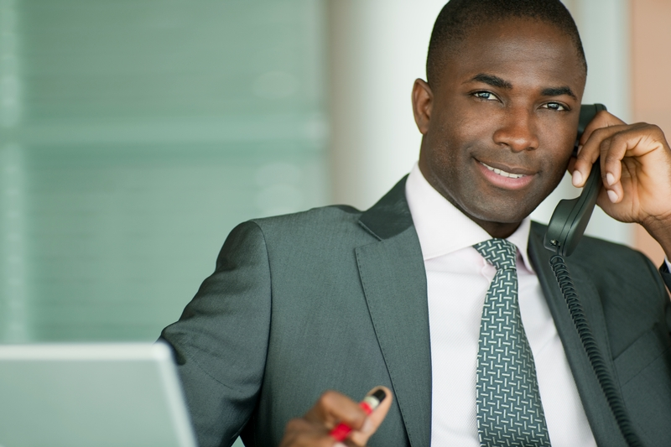
After the Appointment
Make the referrals
Stay in contact on a regularly defined time period
Do what you say; and, Say what you do!

Slide 14











Thank you for joining us!
Connect and Network with Illinois workNet here:
Check more networking information on Illinois workNet at:
www.illinoisworknet.com/socialmedia
info@illinoisworknet.com

