Slide 1
WIOA Title I PY’2020/2020 Local Performance Goals Negotiations
August 20, 2020

Slide 2
Olivia G. Miller
Training and Development Specialist
Center for Workforce Development - WED
Southern Illinois University

Slide 3
State Performance Team
Patti Schnoor
Technology and Performance Manager
Office of Employment and Training - OET
Illinois Department of Commerce and Economic Opportunity
Mark Burgess
Performance Measures, Manager
Office of Employment and Training - OET
Illinois Department of Commerce and Economic Opportunity
Paula Barry
Reporting and Performance
Office of Employment and Training - OET
Illinois Department of Commerce and Economic Opportunity

Slide 4
State Negotiations Team Consultants
Brian Richard
Assistant Director, Workforce Development
Center for Governmental Studies - CGS
Northern Illinois University
Andy Blanke
Research Analyst
Center for Governmental Studies - CGS
Northern Illinois University

Slide 5
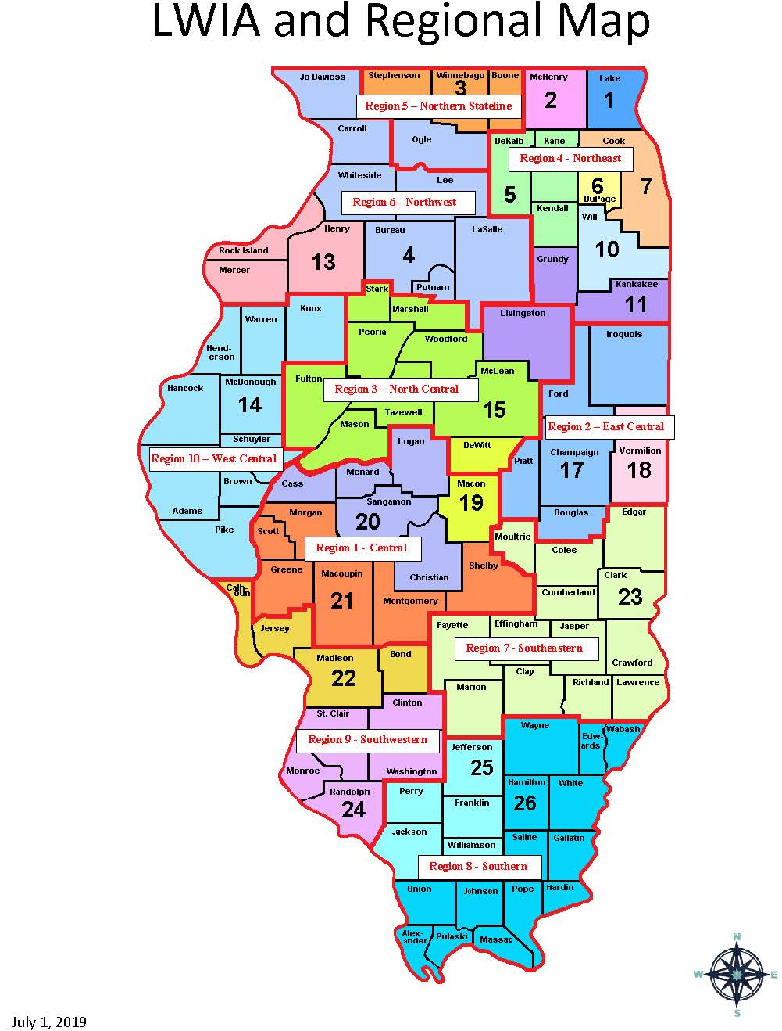

Slide 6
What Role Do You Have in the LWIA?
Local Workforce Innovation Area
LWIB Chairperson
LWIB Member
Chief Elected Official
WIOA Title I Administrator
LWIB Staff
Other

Slide 7
Local Negotiations Timeline
Local Negotiation Teams
Negotiation Process
Local Negotiation Tool
Scheduling Negotiations
Open Comments and Questions
Future Performance and Accountability Dashboard

Slide 8
Negotiation Timeline
What has Already Occurred?
May 19, 2020 - USDOL and State of Illinois Negotiations with Titles I and III
May 26, 2020 – State of Illinois received official USDOL Notification of Negotiated Levels of Performance
June 25, 2020 – Title I Performance Unit provided update to Illinois Workforce Partnership on Title I Negotiated Levels of Performance, Timeline and Process
July 23, 2020 – DRAFT Process presented to IWP Performance Task Force for discussion and comments
August 3, 2020 – WIOA Notice 20-NOT-01 Issued on Local PY’2020/2021 Performance Goals Negotiations (Change 1 to be issued)
August 18, 2020 – WIOA Title I Local Negotiation Tool distributed

Slide 9
Negotiation Timeline
What Comes Next?
August 28, 2020 – Local Negotiation Team submits proposed levels of performance goals for consideration by State, Negotiation Calls are scheduled upon receipt
August 28 – September 4, 2020 – State and Local areas prepare for negotiation calls
September 7 – 25, 2020 – Local Negotiation Calls are held, as necessary
September 30, 2020 – State submits Local negotiated levels to USDOL
October 7, 2020 – State issues official Local Performance Goals letters
October 16, 2020 – Local Plans are updated to reflect negotiated performance goals
Notes:
These will need adjusted based on approval of Illinois’ extension of the deadline for negotiations.

Slide 10
Preparing for Negotiations
Negotiated levels of performance released in WIOA Notice 20-NOT-01 (August 3, 2020)
Consider four Negotiation Factors in preparation for negotiations
Compare performance across LWIAs
Utilize the Statistical Adjustment Model Estimates (2nd Quarter Measures)
Promote continuous improvement and ensure optimal return on investment: tool to use LWIB PY’17 and PY’18 Outcomes rank.
Assist State in meeting its goals

Slide 11
Local Performance Goals Proposal
Submit PY 2020/2021 Proposed Levels of Performance to OET
Attachment G: Performance Goal Proposal Form
Due August 28, 2020
Include supporting data and rationale with form to support the local proposals
Historical data and information
Past performance outcomes
Data and information should be verifiable and replicable

Slide 12
20-NOT-01 Attachment G: Proposed Levels of Performance Form
Establish Local Negotiation Teams of up to five members who will participate in the Formal Negotiations
Consider LWIB Chair, LWIB Members, CEOs, WIOA Title I Administrator, LWIB Staff
Identify a single Primary Contact to represent the Team in submitting Attachment G, scheduling a date and time for negotiation call and coordinating all team members in participating on the call
At least one team member must be able to agree on final goals during the call
Additional individuals may assist in planning and preparation of proposed goals and negotiation call
Final Negotiated Levels of Performance will be submitted to the LWIB Chairperson and CEO(s) finalizing the process

Slide 13
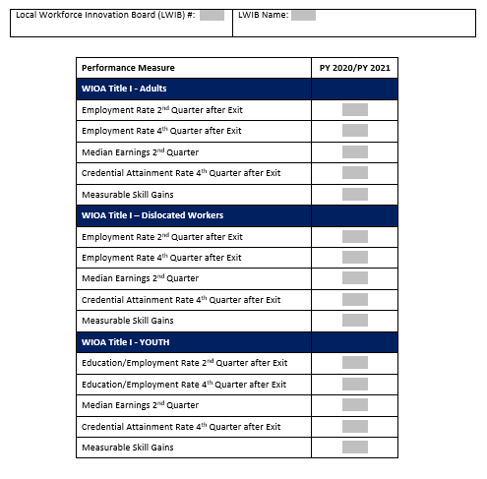
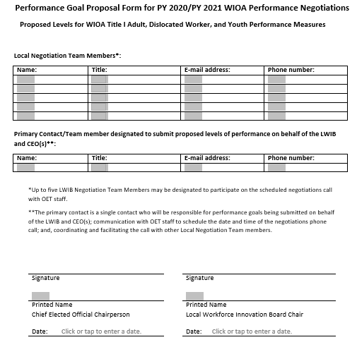
Proposed Levels of Performance Form

Slide 14
Additional Data and Information
Bureau of Labor Statistics data
Expected economic conditions and participant characteristics
Populations being served in area
Training enrollment and completion rates
Local management information and data
Local Workforce Innovation Board policies and procedures
Local Plans, MOUs, and other formal local agreements
Local Plan/MOU page on Illinois workNet
Service delivery strategies

Slide 15
COVID-19 Pandemic
Impacts on outcomes may be significant but are UNDETERMINED.
The State and LWIBs will not negotiate performance levels on assumptions made based on the potential impact of the COVID-19 Pandemic.
DOL will carefully look at the SAM to see how it will adjust for the COVID-19 impact.
Once DOL has the facts and the data, they will accurately measure what the impact are and account for them appropriately.

Slide 16
PY 2020/2021 Performance Negotiations: Determining Success or Failure
PY 20/21 Negotiations are unprecedented
First time all 15 WIOA Performance Indicators are being negotiated. No baseline measures this round
End of PY 2020: Success or Failure of the “2nd Quarter Measures” will be determined
End of PY 2022: Success or Failure of the “4th Quarter Measures” can be determined
WIOA Notice 20-NOT-01 Attachment E: Performance Failure Phase in for Incentives and Sanctions

Slide 17
Illinois Title I Adult Negotiated Levels
Adult | PY 2020 | PY 2021
Employment Rate 2nd Quarter after Exit | 77.0% | 77.0%
Employment Rate 4th Quarter after Exit | 75.5% | 75.5%
Median Earnings 2nd Quarter after Exit | $6,500 | $6,500
Credential Attainment within 4 Quarters after Exit | 70.0% | 70.0%
Measurable Skill Gains | 39.0% | 39.0%

Slide 18
Illinois Title I DW Negotiated Levels
Dislocated Worker | PY 2020 | PY 2021
Employment Rate 2nd Quarter after Exit | 81.0% | 81.0%
Employment Rate 4th Quarter after Exit | 81.0% | 81.0%
Median Earnings 2nd Quarter after Exit | $9,600 | $9,600
Credential Attainment within 4 Quarters after Exit | 71.0% | 71.0%
Measurable Skill Gains | 43.5% | 43.5%

Slide 19
Illinois Title I Youth Negotiated Levels
Youth | PY 2020 | PY 2021
Employment/Education Rate 2nd Quarter after Exit | 73.5% | 73.5%
Employment/Education Rate 4th Quarter after Exit | 73.0% | 73.0%
Median Earnings 2nd Quarter after Exit | $3,275 | $3,275
Credential Attainment within 4 Quarters after Exit | 65.0% | 65.0%
Measurable Skill Gains | 31.0% | 31.0%

Slide 20
Statistical Adjustment Model
Level the playing field by accounting for variation in characteristics of the participants being served
Account for the differences in economies participants are being served in
Appropriately adjust performance goals for local areas serving hard-to-serve populations and/or in economies facing more difficult labor market conditions.
Objectively quantifies how and to what extent, each of these factors affect program performance outcomes
Negotiate now, targets change later

Slide 21
Local WIOA Performance Negotiation Tool
ALPHA VERSION, NOT TO BE CITED
This data tool was designed to facilitate performance negotiations in implementation of the Workforce Innovation and Opportunity Act in Illinois. It includes information for comparing the unemployment situation and industry employment composition of each Local Workforce Innovation Area over time, as well as the results of the Statistical Adjustment Model provided by the U.S. Department of Labor for Illinois.
For questions about the data tool please contact Andy Blanke at ablanke1@niu.edu.

Slide 22
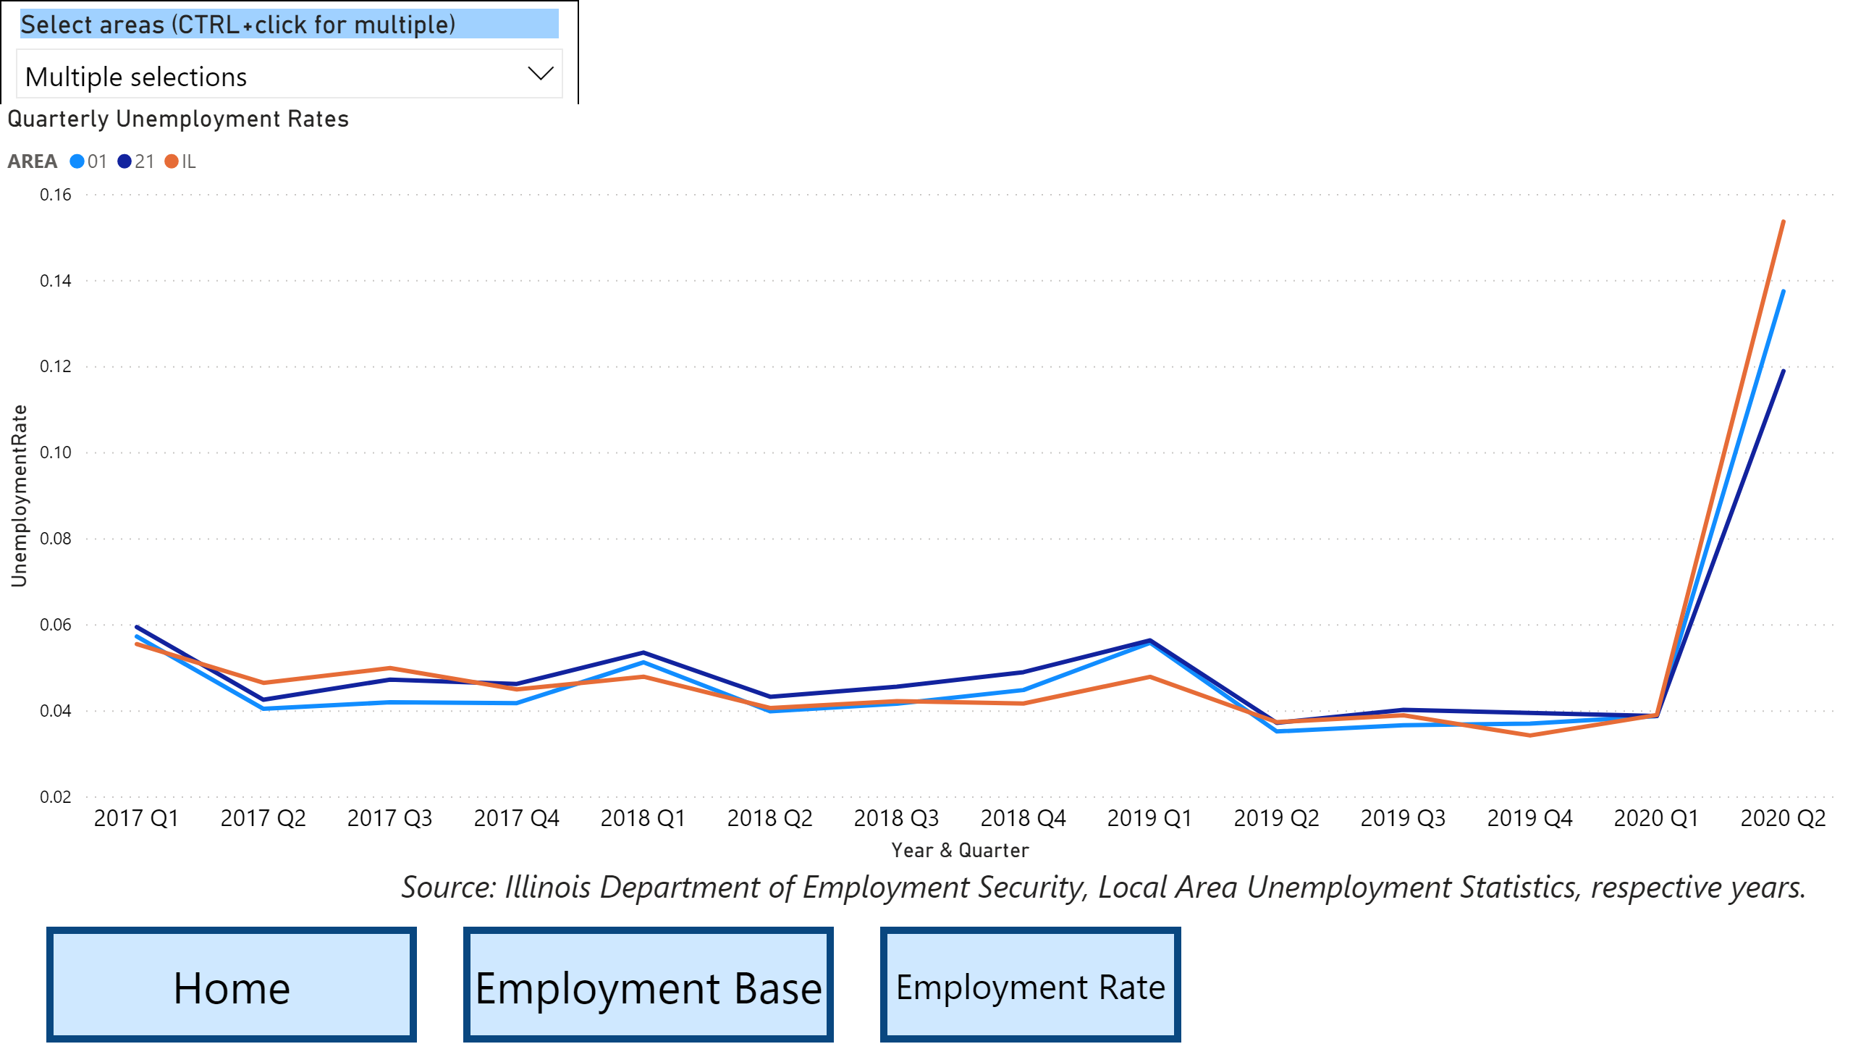
Local WIOA Performance Negotiation Tool

Slide 23
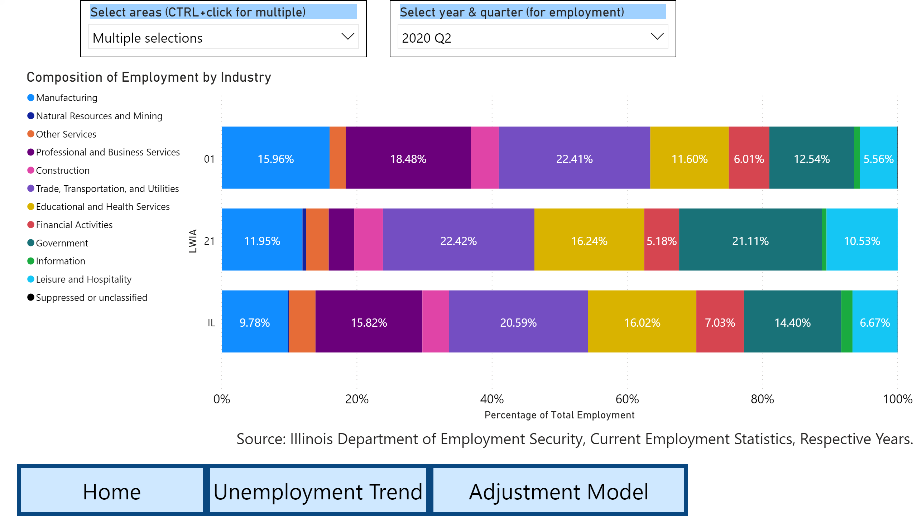
Local WIOA Performance Negotiation Tool

Slide 24
Local WIOA Performance Negotiation Tool
This model is for demonstration purposes only. Placeholder values are used and they do not reflect the actual conditions in Local Workforce Innovation Areas.

Slide 25
Economic Data Resources
Bureau of Labor Statistics
Local Area Unemployment Statistics
Quarterly Census of Employment and Wages
U.S. Census Bureau
Guide to State and Local Workforce Data
Center for Economic Studies (CES)

Slide 26
Negotiation References
WIOA Policy 3.2 General Requirements for Negotiation of Performance Goals
WIOA Notice 20-NOT-01 Local Performance Goals Negotiations
WIOA Policy WIOA Section 116(c)
WIOA: Final Rule Section 677 Subpart C published at Federal Register Vol. 81, No. 161
TEGL No. 10-16, Change 1, Performance Accountability Guidance
TEGL No. 09-17, Negotiating Performance Goals
TEGL No. 11-19, Negotiations and Sanctions Guidance
WIOA Wednesday: Using the Statistical Adjustment Model for Negotiating WIOA Performance Levels
“WIOA Performance Indicators – Definitions and Training Timing Chart
A Methodology for Statistical Adjustment under the Workforce Innovation and Opportunity Act (WIOA)

Slide 27
Illinois Performance Accountability and Transparency System (IPATS) Objectives

Slide 28
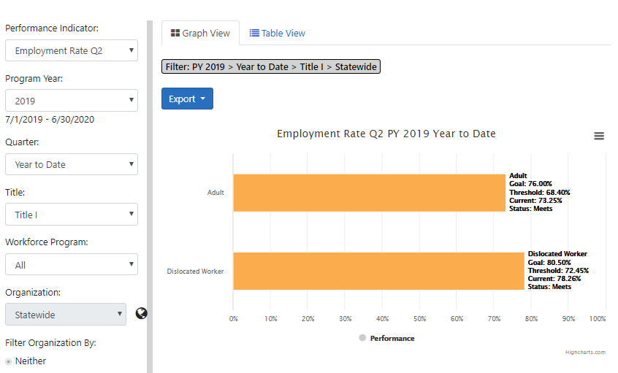
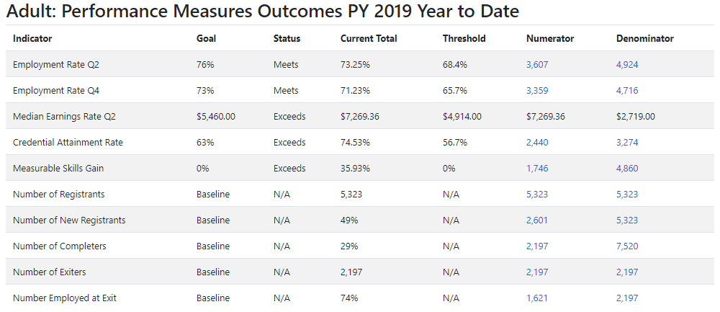
Performance Accountability Statewide
WIOA Key Performance Indicator Outcomes:
Employment Rate 2nd Quarter after Exit
Employment Rate 4th Quarter after Exit
Median Earnings 2nd Quarter after Exit
Credential Attainment
Measurable Skills Gain
Effectiveness in Serving Employers

Slide 29
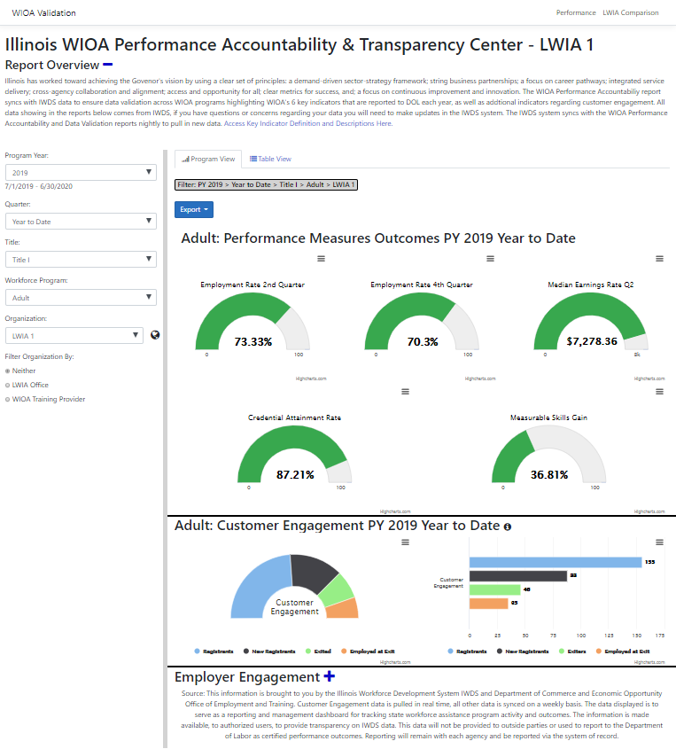
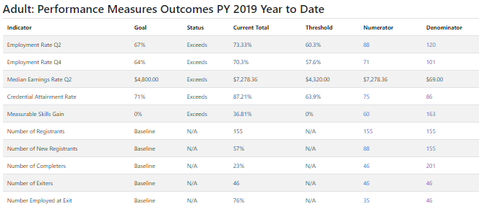
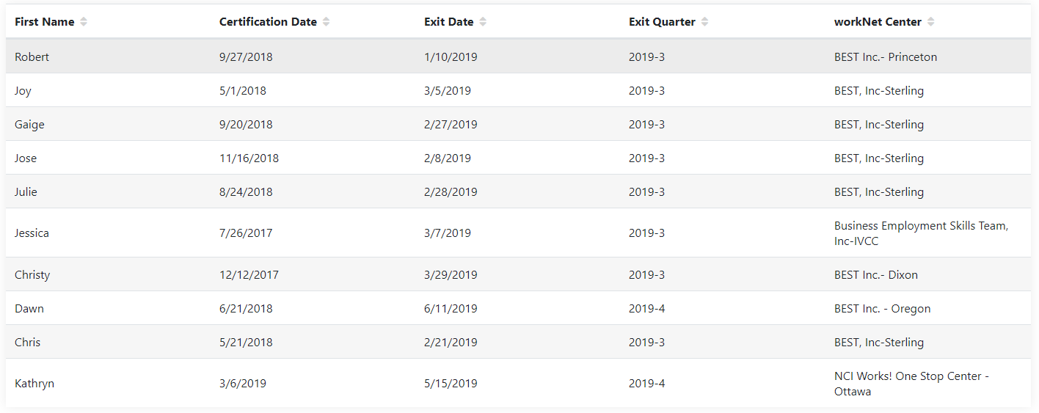
Performance Accountability by LWIA
Drill down to individual participant info from the LWIA detail dashboards.
Counts are linked to customer lists.

Slide 31
Mark Burgess
Performance Measures Manager
Office of Employment and Training
Illinois Department of Commerce and Economic Opportunity
Mark.a.burgess@Illinois.gov
(c) 217.970.0061

