Slide 1
Local Workforce Area Contact System (LWACS)
Spring 2025 System Updates
Illinois workNet® is sponsored by the Department of Commerce and Economic Opportunity. – April 2025

Slide 2
Agenda
Housekeeping
Background for Changes
Demonstration
ListServ email distribution list updates
Composition Summary form updates
LWIB updates
Resource Updates
Partner Guide Instruction updates
Next Steps
Q & A session

Slide 3
Housekeeping
LWACS updates are presented by:
Heather Lawrence – Business Analyst, Illinois workNet
Markee Waldron – Programmer, Illinois workNet
Mike Baker - Planning Unit Manager, Office of Employment & Training
Lora Dhom – Policy Manager, Office of Employment & Training
Mute/Raise Hand
When you joined the webinar today, you joined muted. Please stay muted until the Q&A session. During that session, you may unmute yourself and ask questions.
This webinar is being recorded and will be posted to the Partner Training Materials & Videos section on the LWACS partner page by the end of the day.

Slide 4
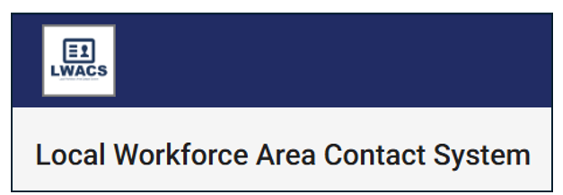
Background for Changes
The intent is to streamline, eliminate inefficiencies, and improve user friendliness.
The policy has been updated to reflect the changes in the system.
All changes discussed and demonstrated today are live in the LWACS system.

Slide 5
Demonstration

Slide 6
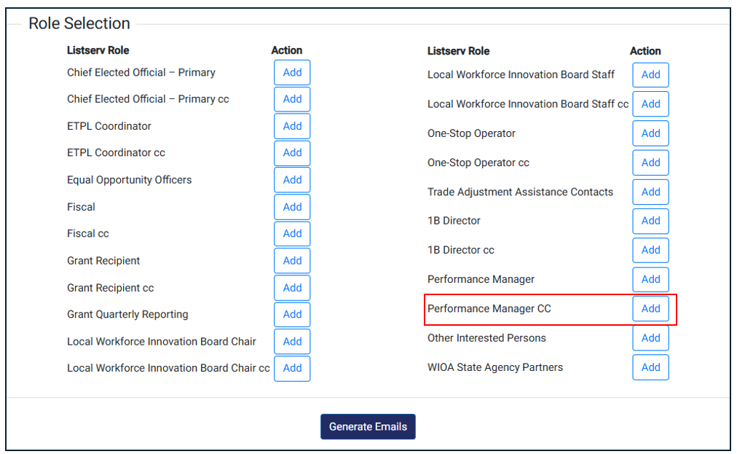
ListServ email distribution
Added Performance Manager cc to the email distribution list
Departed and/or deleted records no longer show up in the e-mail distribution list

Slide 7
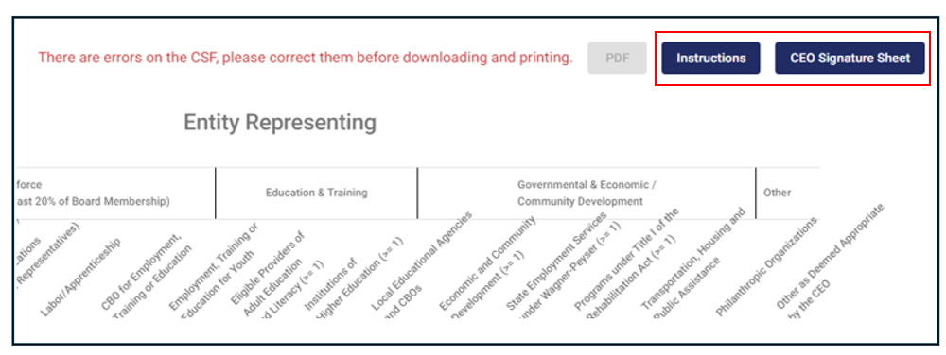
Composition Summary Form
An error message has been added to display at the top and the bottom of the form if there are errors. The PDF button is not available if the form has errors and needs to be fixed.
Instructions and CEO Signature Sheet have been added.

Slide 8
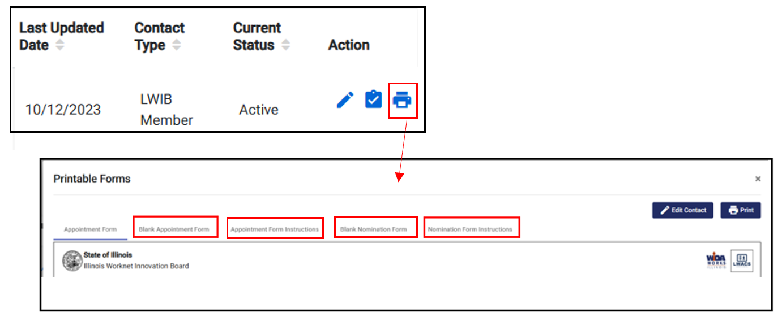
LWIB Member – Forms & Instructions
Added a printable blank Appointment form
Added printable Appointment Form instructions
Added a printable blank Nomination form
Added printable Nomination form directions
It is no longer required to upload a Nomination or Appointment/Reappointment form for an LWIB member. You can stop uploading them immediately.

Slide 9
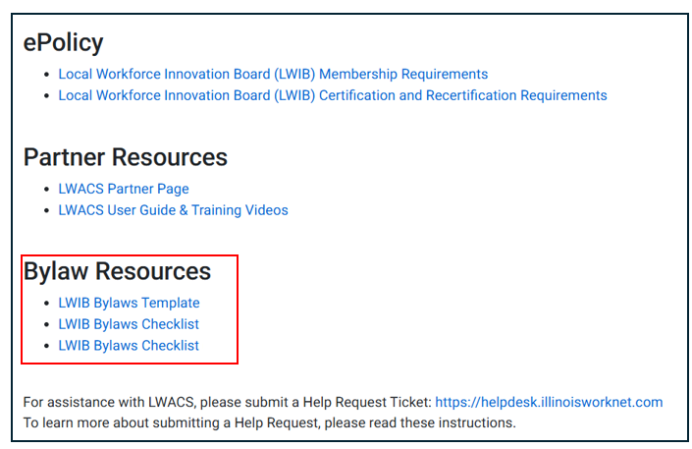
Bylaw Resources
Added a Bylaw section to the Resources
Added LWIB Bylaws Template
Added LWIB Bylaws Checklist
Added LWIB Bylaws Checklist (Fillable PDF)

Slide 10
LWACS Partner Guide
UPDATED Contact Management instructions
UPDATED Documents & Reports instructions
UPDATED LWIA Matrix & Listserv instructions

Slide 11
These changes are live in the system.
Next Steps
Reminder this is a board recertification year.
The list of required documentation per policies 1.2 CEO Functions and Agreements and 1.6 Local Workforce Innovation Board Functions and Policies. (For the official verbiage, consult the policy in the LWACS resources.)
Chief Elected Official (CEO) Agreement*
LWIB Bylaws*
CEO/LWIB Agreement*
A narrative demonstrating how the business members provide employment opportunities.
Statement of Accessibility
*Only if changes have been made

Slide 12
Question & Answer

