Slide 1


Future Energy Jobs Act: Multi-Cultural Jobs Program
Notice of Funding Opportunity
Overview of the Grant Submission and Pre-Award Requirements
Illinois Department of Commerce and Economic Opportunity

Slide 2
Agenda
  Welcome / Overview
  Program Authorization and Objectives
  Program Design
  Technical Grant Requirements
  Questions will be posted with responses after the session.

Slide 3

Program Authorization / Legislation
The purpose of the Future Energy Jobs Act (FEJA) is to stimulate job growth in the clean energy economy with investments in energy efficiency and renewable energy. FEJA includes three Workforce Development Programs:
  Solar Pipeline Training Program
  Craft Apprenticeship Program
  Multi-Cultural Job Training Program
The administration of the programs authorized under the FEJA were assigned to the Illinois Department of Commerce in 2022 by the Climate and Equitable Jobs Act [see Public Act 102-662].
Notes:
PRESENTER: SHANNON ?

Slide 4
Program Objectives / Goals
The objective of this NOFO is to set forth the requirements for the Future Energy Jobs Act Multi-Cultural Jobs Program authorized under 220 ILCS 5/16-108.12(a)(3).
Through this NOFO, the Department will fund proposals offered by community-based, diversity-focused organizations that strive to provide participants with development, economic or career-related opportunities within the clean energy sector. If feasible, Commerce anticipates providing funding for services through this NOFO in the Economic Development Regions (EDRs) that are environmental justice communities.
The goal of this NOFO is to provide training for clean energy related occupations for diverse low-income, or economically disadvantaged populations.

Slide 5

Support of Clean Energy Industry
Clean energy jobs in 2020 accounted for 2.2% of total U.S. employment or more than one in every 50 American workers. Clean energy workers now account for 19% of all construction jobs, more than 5% of jobs in wholesale trade and more than 4% of all manufacturing jobs.
Illinois Clean energy jobs surged nearly 7 percent in the second half of 2020 to employ more than 115,00 Illinoisans across the state, according to the sixth annual Clean Jobs America report from E2. Despite dropping clean energy jobs overall in 2020 due to the pandemic-fueled economic crisis, Illinois’ ranking among states actually improved as the state now has the most clean energy jobs in the Midwest and fifth most nationwide.

Slide 6
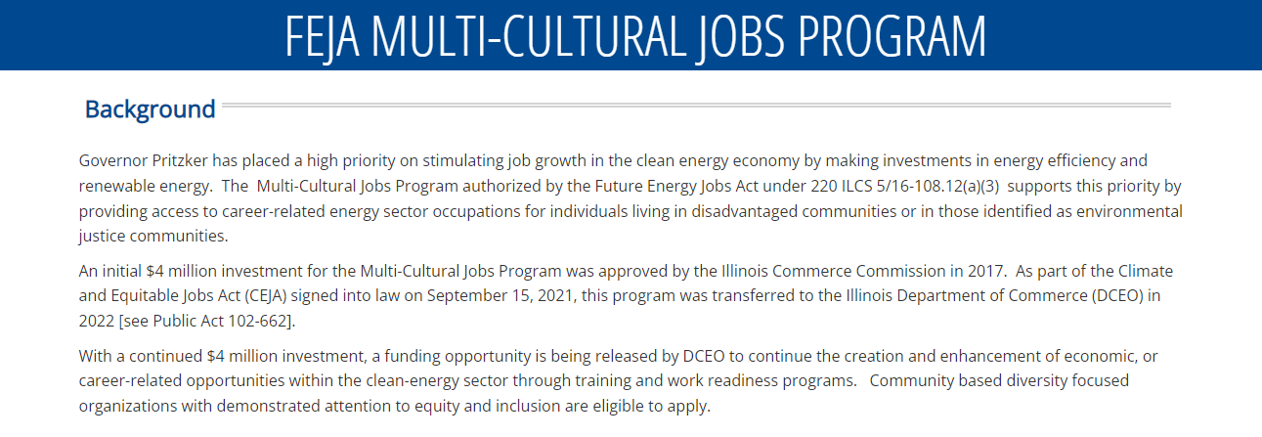
Multi-Cultural Jobs Program NOFO Website
https://www.illinoisworknet.com/fejamulitculturaljobsnofo2022
.

Slide 7

Program Foundations
The Multi-Cultural Jobs Program
Provides an opportunity to provide innovative, employer-driven training approaches that pair education and occupational training with work-based learning to individuals in need of self-sustaining employment.
Assists in the development of a workforce with the requisite knowledge, skills, training, experience, and competence to work in the clean energy sector.
Identifies partnership opportunities within training programs to maximize the societal benefits of the funds provided pursuant to Section 16-108.12(a)(3) of the Public Utilities Act.

Slide 8
Program Foundations
Commerce will seek innovative service delivery proposals for programs from diversity-focused community organizations that have a record of successfully delivering job training to
    women,
    people of color,
    persons with a record, former foster care recipients, and
    other jobseekers with specific barriers to employment.
Selected grantees will recruit, train, and place participants in clean energy related occupations throughout the State of Illinois

Slide 9

Eligible Applicants
One grant will be funded for each of the following diversity-focused community organizations that have a record of successfully delivering job training. Applicants must choose only one of the six listed below to apply to even if applicant’s organization may fall into more than one category *.
CATEGORY A: Community-based civil rights and human services not-for-profit organization that provides economic development, human capital, and education program services.
CATEGORY B: Not-for-profit organization that is also an educational institution that offers training programs approved by the Illinois State Board of Education and United States Department of Education with the goal of providing workforce initiatives leading to economic independence.
CATEGORY C: Not-for-profit organization dedicated to developing the educational and leadership capacity of minority youth through the operation of schools, youth leadership clubs and youth development centers
Note: Only entities that meet one of the categories identified in A – F above and properly operating in accordance with Federal, State, and local law, in the state of Illinois may submit a proposal for consideration.

Slide 10
Eligible Applicants
CATEGORY D: Not-for-profit organization dedicated to providing equal access to opportunities in the construction industry that offer training programs that include Occupational Safety and Health Administration 10 and 30 certifications, Environmental Protection Agency Renovation, Repair and Painting Certification, and Leadership in Energy and Environmental Design Accredited Green Associate Exam preparation courses.
CATEGORY E: Non-profit organization that has a proven record of successfully implementing utility industry training programs, with expertise in creating programs that strengthen the economics of communities including technical training workshops and economic development through community and financial partners.
CATEGORY F: Non-profit organization that provides family services, housing education, job and career education opportunities that have successfully partnered with the electric industry on job training.
Note: Only entities that meet one of the categories identified in A – F above and properly operating in accordance with Federal, State, and local law, in the state of Illinois may submit a proposal for consideration.

Slide 11

Program Design
Energy career pathway training to targeted populations and communities.
Equitable statewide access to quality training, jobs, and economic opportunities
Full Spectrum of Services
  Outreach and recruitment
  Employer Engagement
  Career Planning, including:
    Comprehensive Assessment
    Individual Employment Plan
  Training

Slide 12

Program Design: Training
Programs must lead to industry-recognized or post-secondary credentials and align with the customer's choice for a career pathway.
Training identified must be consistent with the comprehensive assessment and IEP
Providing career pathways education and work-based learning assist in accelerating an individual's career advancement.
Training should include a balance of job readiness, or soft-skills training, and technical, hands-on training.
Notes:
Training
Training services are critical to the employment success of many individuals. Programs must lead to industry-recognized or post-secondary credentials and align with the customer's choice for a career pathway. Specifically, the training identified must be consistent with the comprehensive assessment and IEP.
Providing career pathways through education and work-based learning assist in accelerating an individual's career advancement. Training should include a balance of job readiness, or soft-skills training, and technical, hands-on training. Applicants should consider including in their program design the following types of training:
Occupational skills training, training for nontraditional employment – Prepares participants for careers that are traditionally non-academic and directly related to a specific trade, occupation or vocational skills leading to proficiency in performing actual tasks and technical functions required by certain occupational fields at entry, intermediate, or advanced levels.
Skill upgrading and retraining – Training is provided to assist with upgrading the skills and/or retraining the participants. Courses that provide an occupational changing type of instruction to prepare person(s) for entrance into a new occupation through instruction in new and different skills demanded by technological changes. Training will result in the workers’ acquisition of transferable skills or an industry-recognized certification or credential.
Entrepreneurial training – Prepares entrepreneurs to either start a small business or expand an existing business, usually through the development of a business plan.
Job readiness training -- Includes job seeking and interviewing skills, understanding employer expectations, and enhancing a customer’s capacity to move toward self-sufficiency.
Adult education and literacy activities - Includes activities of English language acquisition and integrated education and training programs, provided concurrently or in combination with services provided in any of the services listed above or as part of work-based learning.

Slide 13
Program Design: Training Types
Occupational skills training
Skill upgrading and retraining
Entrepreneurial training
Job readiness training
Adult education and literacy activities
Work-Based Learning / Training
  Apprenticeship
  Work experiences or internships
    Transitional jobs
    On the Job Training (OJT)
    Customized Training.
    Incumbent Worker Training.
Notes:
Work-Based Learning / Work-Based Training
Work-based learning provides more opportunities for workers to earn income while gaining critical job skills. The following work-based learning services are allowed under this grant:
Pre-apprenticeship is a program designed to prepare individuals to enter and succeed in a registered apprenticeship program, which includes:
Training and curriculum that aligns with the skill needs of employers in the economy of the State or region;
Access to educational and career counseling, and other supportive services and/or barrier reduction funding;
Hands-on, learning activities connected to education and training activities, such as exploring career options and understanding how skills acquired through coursework can be applied to a future career;
Opportunities to attain at least one industry-recognized credential; and
A partnership with one or more registered apprenticeship programs that assists in placing individuals who complete the pre-apprenticeship into a registered apprenticeship program
Apprenticeship is an employer-driven, “earn while you learn” model that combines on-the-job training (OJT) with job-related instruction in curricula tied to the attainment of industry-recognized skills standards. Workers benefit from apprenticeships by receiving a skills-based education that prepares them for good-paying jobs. Apprenticeship programs help employers recruit, build, and retain a highly skilled workforce. Funds may be used to pay for the technical training and on-the-job training cost of workers as well as provide supportive services to participants that help them succeed in apprenticeship programs.
Work experiences or internships are planned, structured learning experiences that take place in a workplace for a limited period. Work experiences or internships may be paid or unpaid, as appropriate, and consistent with other laws, such as the Fair Labor Standards Act (29 U.S.C. 201). Work experiences or internships may be within the private for-profit sector, the non-profit sector, or the public sector. For youth, work experiences may also include:
Transitional jobs are time-limited, wage-paid work experiences that are subsidized up to 100 percent. These jobs can be in the public, private, or nonprofit sectors. Transitional jobs provide individuals with work experience and an opportunity to develop important workplace skills within the context of an employee-employer relationship, in which the program provider generally acts as the employer, and with an opportunity to develop important workplace skills.
On the Job Training (OJT) provides up to a 75% reimbursement to employers toward the wages paid to the OJT trainee. The reimbursement helpscompensate for the costs associated with skills upgrade training for newly hired employees and the lost production of current employees providing the training (including management staff). OJT training can assist employers who are looking to expand their businesses and who need additional staff trained with specialized skills..
Customized Training is designed to meet the specific requirements of an employer or group of employers with the commitment that the business or businesses employ an individual(s) upon successful completion of the training.
Incumbent Worker Training for employers with 250 or less employees. Employee trainees must meet the definitions of under-employed or have received notices of termination or lay-off. IW is designed to meet the needs of an employer or group of employers to retain a skilled workforce or avert layoffs The training help employees obtain the skills necessary to retain employment, such as increasing the skill levels of employees so they can be promoted within the company and create backfill opportunities for new or less-skilled employees. Incumbent Worker training can be used to either: Help avert potential layoffs of employees; or Help an individual who is working part-time but desires full-time employment, who is working in employment not commensurate with the individual's demonstrated level of educational and/or skill achievement, who is an employed low-income individual, or who is employed but their current earnings are not sufficient compared to their previous job’s earnings from their previous employment.

Slide 14
Highlight of Program Activities and Outcomes (refer to NOFO for complete list)
Program Outcomes
Number of individuals:
enrolled in and completing program, and, as applicable, number of individuals:
obtaining industry-linked credential(s), certification or license
placed in post-secondary education
placed and number completing a Pre-Apprenticeship,
placed and number completing a Registered Apprenticeship, or
placed and number completing on-the-job trainings
placed and number completing a paid work experience or internship
placed in unsubsidized employment
retained in unsubsidized employment for 6 and 12 months
Notes:
Number of individuals enrolled in and completing program
Number of individuals obtaining industry-linked credential(s), certification or license
Number of individuals placed in post-secondary education
Number of individuals placed and number completing a Pre-Apprenticeship,
Number of individuals placed and number completing a Registered Apprenticeship, or
Number of individuals placed and number completing on-the-job trainings
Number of individuals placed and number completing a paid work experience or internship
Number of individuals placed in unsubsidized employment
Number of individuals retained in unsubsidized employment for 6 and 12 months

Slide 15

Target Populations
To align with the FEJA priority of ensuring equitable statewide access to quality training, jobs, and economic opportunities across the clean energy sector, applicants should prioritize serving:
  Individuals who face barriers to employment such as low educational attainment, low levels of literacy, language barriers, etc.
  Persons with prior involvement with the criminal legal system
  Graduates of or currently enrolled in the foster care system
  Individuals from Environmental Justice Communities (see https://www.illinoissfa.com/environmental-justice-communities/)
  Displaced Energy Workers (as defined by Public Act 102-662)

Slide 16
State Workforce Goals
This funding opportunity is available to public and private organizations that meet the requirements outlined in this NOFO.
Strong proposals will demonstrate a solid understanding of the state’s overarching workforce strategies and goals.
Combined federal and state resources mean greater flexibility in
apprenticeship expansion
There are several resources identified in the NOFO as background information, including synopses of and links to:
  State Unified Plan,
  IWIB Apprenticeship Committee, and
  Governor’s Action Agenda
  FEJA and CEJA

Slide 17
Diversity, Equity & Inclusion
Applicants are required to address diversity, equity, and inclusion (DEI)
changes in recruitment practices
intentional and inclusive marketing (including using images of women and people of color)
addressing discrimination within programs and at workplaces
offering supports that boost retention and completion, such as childcare, transportation, and career counseling
Notes:
the proposal application and articulate why and how this can be cost efficient and an effective solution for both the employer and community.

Slide 18
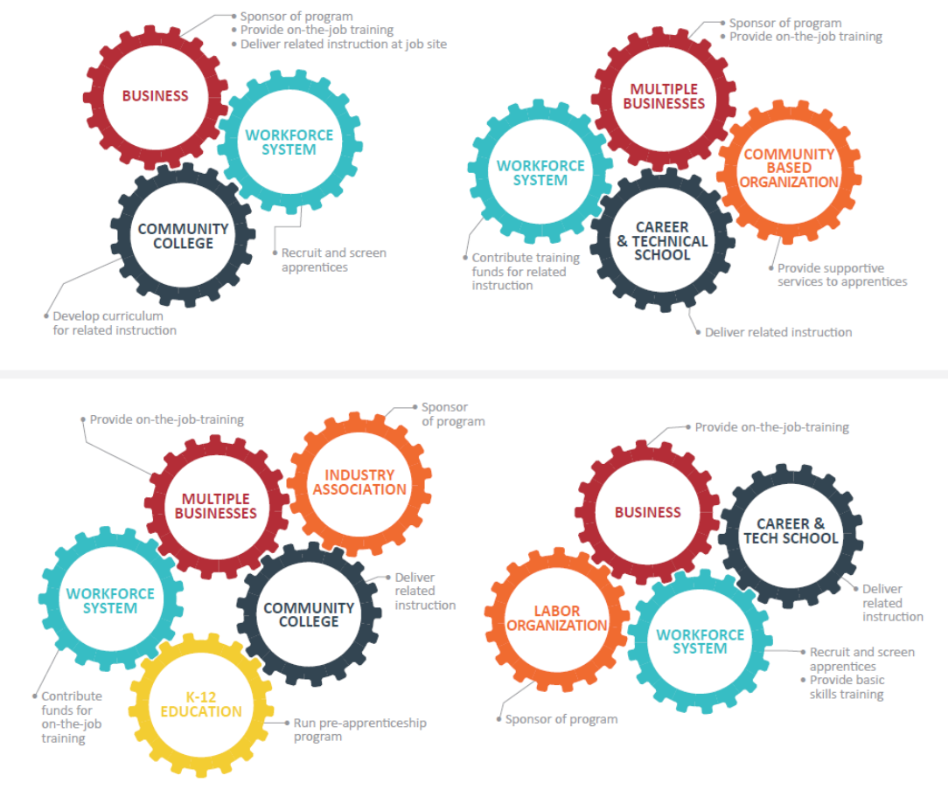
Importance of Partnerships
The Development of partnerships should result in the following goals:
To connect with businesses that need this training for their workforce
To connect with organizations that can facilitate or provide skill upgrade training to these workers
  Industry & Business Associations
  Community Colleges
  Public-Private Partners
  Local Workforce Agencies
  High School Districts
  Unions
  Chambers of Commerce
  Community Based Organizations
  Other needed partners

Slide 19
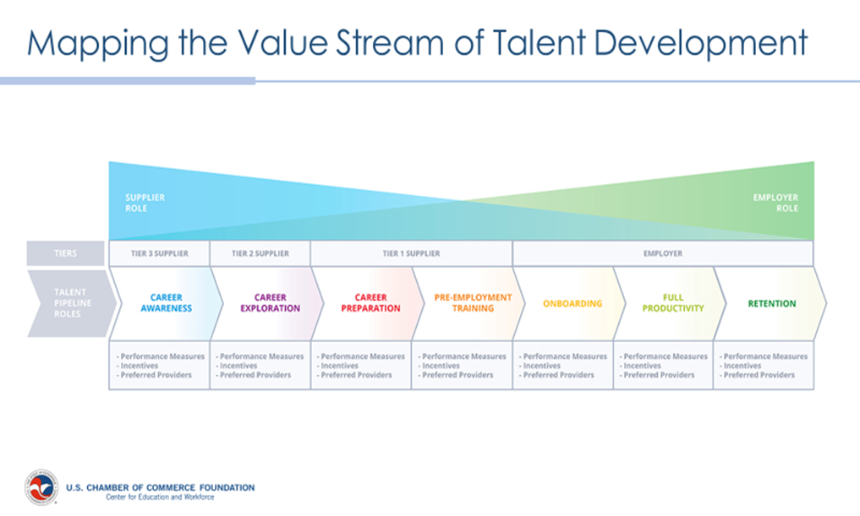
A Way to Address Skill Gaps:
Talent Pipeline Management

Slide 20
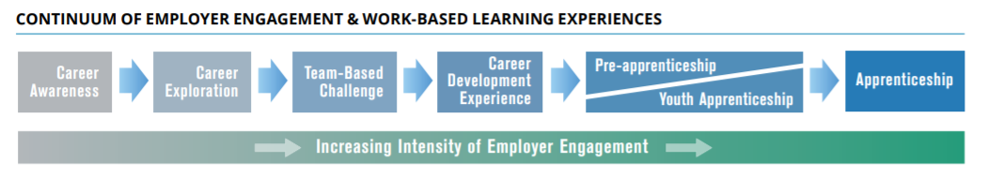
Career Pathways: Industry Skill Needs
A combination of rigorous and high-quality education, training, and other services that aligns both vertically and horizontally across Secondary Education, Adult Education, Workforce Training and Development, Career and Technical Education, and Postsecondary Education systems, pathways, and programs.

Slide 21
Application Components
Executive Summary
Project Narrative
  Organization Capacity
  Documentation of Need
  Project Plan
  Budget / Cost Effectiveness
Project Implementation Plan
Outcome Summary
Uniform Grant Application
Uniform Budget
Budget Narrative
Conflict of Interest Disclosure
Diversity, Equity & Inclusion Plan
Resumes of Program Staff
Partnership Agreement(s)

Slide 22
Application Submission Requirements
Application Format Requirements:
  Applications must be formatted to an 8 1/2 x 11-inch page size, using 11-point type and at 100% magnification.
  Tables may be used to present information with a 10-point type.
  The program narrative must be typed single-spaced, with 1-inch margins on all sides.
  The entire application must be sequentially page numbered (hand-written page numbers are acceptable). Items included in the attachments are NOT included in the page limitations.
  The Department reserves the right to request additional information from applicants to evaluate applications.
Application Submission: Application materials must be submitted via electronic form at: https://app.smartsheet.com/b/form/445cd5920ba14d63a4bb7ab19be21108.
Application Due Date: Applications are due at 5PM on June 15, 2022

Slide 23
Application Review Information
Applicants must demonstrate that they meet all the requirements outlined in the Notice of Funding Opportunity.
The following criteria will be used to evaluate applications:
  Applicant Capacity (20%)
  Documentation of Need and Opportunity (30%)
  Quality of Project Plan (40%)
  Budget Narrative (10%)

Slide 24

Grant Award Information
It is anticipated that the Department will make one award under this NOFO for up to $4 million.
CATEGORY A: $1,000,000 .
CATEGORY B: $500,000
CATEGORY C: $500,000
CATEGORY D: $1,000,000
CATEGORY E: $500,000
CATEGORY F: $500,000
It is anticipated that the award will be made before August 15, 2022.
The grant term/performance period is determined on a project-specific basis, It is anticipated that this grant will be awarded for 24 months with one 12- month renewal option.
Notes:
Program Funding: It is anticipated that the Department will make one award in the following amounts for each of the NOFO categories listed in Section A, above, for a total of $4 million. Applicants may only submit one application and are required to select only one category..
CATEGORY A: $1,000,000 .
CATEGORY B: $500,000
CATEGORY C: $500,000
CATEGORY D: $1,000,000
CATEGORY E: $500,000
CATEGORY F: $500,000

Slide 25
Grant Life Cycle
Pre-Award
Award
Post- Award
The next several slides will focus on the pre-award requirements of a workforce grant from the Illinois Department of Commerce and Economic Opportunity.
Notes:
BEGINNING OF JOSH’S PART ☺

Slide 26
Illinois Grant Accountability and Transparency Act
The Grant Accountability and Transparency Act (GATA), 30 ILCS 708/1 et seq., is a State of Illinois law to:
Increase accountability and transparency in the use of grant funds
Reduce the administrative burden on both State agencies and grantees
Adoption of the federal grant guidance and regulations codified at 2 CFR Part 200 (Uniform Requirements)
Notes:
JOSH

Slide 27
Grantee Pre-Award Requirements that must be Completed Prior to Grant Award Execution
Grantee Registration
Grantee Pre-Qualification
Financial and Administrative Risk Assessment
  (ICQ – Internal Control Questionnaire)
Programmatic Risk Assessment
Mandatory Disclosures & Conflict of Interest Documents

Slide 28
GATA & Indirect Cost Rate System
Office of Management and Budget GATA Website: http://grants.illinois.gov
Grantee Links Tab is the entry point for the GATA portal
  Authentication,
  Registration,
  Pre-qualification,
  Fiscal & Administrative Risk Assessment
Centralized Indirect Cost Rate System will be used to elect the indirect cost rate option and, if necessary, complete the indirect cost rate negotiation process.
  Grantees that are not current users in the system will receive an invitation to the Centralized Indirect Cost Rate System once a Notice of State Award (NOSA) is generated by a State awarding agency

Slide 29
Grantee Registration
All Grantees must be registered with the State of Illinois using the Illinois.gov Authentication Portal. A personal or business email address is required to establish an account
Grantee Registration is completed by browsing to https://grants.illinois.gov/portal and associating your Illinois.gov account with your organization.
Completing the registration process triggers Grantee pre-qualification verifications

Slide 30

Grantee Pre-Qualification
Pre-Qualification includes verification of:
  Valid Unique Entity Identifier number
  Current SAM.gov account
  Good Standing with Secretary of State
  Not on Federal Excluded Parties List
  Not on the Illinois Stop Payment List
  Not on the DHFS Provider Sanction List
  *Pre-qualification is dynamic and verifications
  are completed nightly.

Slide 31

Pre-Qualification Notification
If there are no issues, the GATA portal will send email to communicate “Qualified” status.
If there are issues, the GATA portal emails qualification issue(s)
  DUNS number is not current
  SAM CAGE Code is not current
  Not in Good Standing with Secretary of State
  On the Federal Excluded Parties List (cannot be remediated)

Slide 32
GATA Framework for Risk Assessment
Fiscal Risk Assessment (ICQ) is automated.
  The Grantee can access the ICQ from the grantee portal.
  The ICQ is completed on an annually basis by the Grantee
  The ICQ should be completed at the entity-wide level
  All state agencies will utilize the results of the ICQ
Programmatic Risk Assessment will be conducted by the awarding agency (DCEO) in the application process. It is unique to each NOFO and grant program and is typically completed if the proposal is recommended for funding.
Risk profiles will be determined based on the two risk assessments. Risk profile will determine grant specific conditions and monitoring.

Slide 33
Indirect Cost Rate Selection
Centralized Indirect Cost System
All grantees must select an Indirect Cost Rate option in a centralized indirect cost rate system.
An indirect cost rate is a device used for determining the appropriate amount of indirect costs each program should bear. An Indirect Cost Rate is the ratio between the total indirect expenses and some direct cost base.
Options available for a Grantee to receive an Indirect Cost Rate:
  Current Federal negotiated Indirect Cost Rate Agreement
  Negotiate a rate with the State of Illinois
  Elect to use the Federal 10%“de minimis” rate of Modified Total Direct Cost (MTDC)*
  Elect to decline any indirect cost rate
  * Note that if a grantee organization has ever federal or a state-negotiated rate, they are ineligible for the de minimis rate.

Slide 34
Indirect Cost Rate Proposals & Elections
Centralized Indirect Cost System can be accessed at http://grants.illinois.gov from the dropdown menu in the Grantee Links Tab. This site includes:
  FAQs
  Training Modules
  Forms and Indirect Cost Rate Templates
  Department of Labor Indirect Cost Rate Guide
An indirect cost proposal or rate election must be initiated with the Centralized Indirect Cost Rate system upon notice of award. The indirect cost rate proposal or rate election must be completed no later than three (3) months after the effective date of the State award.
Uniform Guidance (2 CFR 200) requires an annual submission of an indirect cost proposal or rate election. The Centralized Indirect Cost Rate system will be used for annual renewals. Annual submissions must be received within six months after the Grantee’s fiscal year end.

Slide 35
Standard Application & Grant Award Documents
Notice of Funding Opportunity (NOFO)
  Catalog of State Financial Assistance
  https://www.illinois.gov/sites/GATA/Grants/SitePages/CSFA.aspx
Uniform Application for State Grant Assistance
Uniform Budget Template
Notice of State Award

Slide 36
Applicant Capacity
Who are you?
What is your relationship to the target population?
What are your qualifications?
What other projects have you accomplished?
Who are your partners?
What are their qualifications?
Describe the organization.
Describe any similar projects undertaken.
Describe the qualifications of individuals responsible to carry out the project activities.
List any facilities, equipment, or resources available to the project and their sources.
Notes:
JOSH THROW OVER TO KENIS TO DO

Slide 37
Documentation of Need
What is the target population?
What are the needs/problems of the target population?
What are the causes of the identified needs/problems?
What documentation is there to support the existence of the identified needs/problems?
Statistical information to document the extent of the need/problem
  http://www.census.gov/
  http://www.bls.gov/home.htm
  https://www.illinoisreportcard.com/
Only identify the need/problem you intend to address
Describe the population affected by the need/problem
Notes:
KENIS

Slide 38
Operational Plan
What is your solution to the need/problem? How will you approach the solution?
What is your plan of action to address the identified need/problem?
What are the steps you will take? Who will do what? How long will it take?
Explain the project goal and how it would meet the need or solve the problem identified.
List specific, measurable objectives that will allow the project to meet its goal.
State expected project outcomes and how they would benefit the target population.
State the planned activities, methodology, and timetable for accomplishing the planned activities.
Explain how the project will be managed.
Always tie the objectives back to the identified need/problem.
Notes:
KENIS

Slide 39
Return on Investment
What are the expected outcomes of the project? The measurements should be quantitative.
You need to show that your proposed project has the support of those it affects.
You need to show that you have considered the need/problem from many different angles.
You need to show that you have considered all available resources.
Will the project be evaluated? The evaluation should measure accomplishment of the stated project goals and objectives.
How will the project be continued after the grant expires?
Notes:
KENIS

Slide 40
Uniform Application for State Grant Assistance
Agency Information
  Funding Opportunity Information
  Instructions on How to Submit an Application
  Required Grant Information
Applicant Completed Section
  Applicant Information
  Contact Information
  Key Project Information (Location, Term, Amount)
  Fiscal Information
Certification
Notes:
JOSH?

Slide 41
Uniform Budget Template - Overview
Uniform Budget Template for most State of Illinois Grants (modeled after the SF-524 Federal Budget template).
Basic Budget Line Item Definitions based on the Uniform Administrative Guidelines [Develop Budget Line Items Sheet].
General Requirements
  Allowable
  Reasonable
  Allocable
Notes:
PRESENTER: JOSH

Slide 42
Allowable Costs § 200.403
Factors affecting allowability of costs:
Be necessary and reasonable for the performance of the Federal award and be allocable under the Federal Cost Principles.
Conform to any limitations or exclusions set forth in these principles or in the Federal award as to types or amount of cost items.
Be consistent with policies and procedures that apply uniformly to both federally-financed and other activities of the non-Federal entity.
Be accorded consistent treatment. A cost may not be assigned to a Federal award as a direct cost if any other cost incurred for the same purpose in like circumstances has been allocated to the Federal award as an indirect cost.
Be determined in accordance with generally accepted accounting principles (GAAP), except, for state and local governments and Indian tribes only, as otherwise provided for in this Part.
Not be included as a cost or used to meet cost sharing or matching requirements of any other federally financed program in either the current or a prior period.
Be adequately documented.

Slide 43
Reasonable Costs § 200.404
A cost is reasonable if, in its nature and amount, it does not exceed that which would be incurred by a prudent person under the circumstances prevailing at the time the decision was made to incur the cost. The question of reasonableness is particularly important when the non-Federal entity is predominantly federally-funded. In determining reasonableness of a given cost, consideration must be given to:
Whether the cost is of a type generally recognized as ordinary and necessary for the operation of the non- Federal entity or the proper and efficient performance of the Federal award.
The restraints or requirements imposed by such factors as: sound business practices; arm’s-length bargaining; Federal, state and other laws and regulations; and terms and conditions of the Federal award.
Market prices for comparable goods or services for the geographic area.
Whether the individuals concerned acted with prudence in the circumstances considering their responsibilities to the non-Federal entity, its employees, where applicable its students or membership, the public at large, and the Federal government.
Whether the non-Federal entity significantly deviates from its established practices and policies regarding the incurrence of costs, which may unjustifiably increase the Federal award’s cost.

Slide 44
Allocable Costs § 200.405
A cost is allocable to a particular Federal award or other cost objective if the goods or services involved are chargeable or assignable to that Federal award or cost objective in accordance with relative benefits received. This standard is met if the cost:
  Is incurred specifically for the Federal award;
  Benefits both the Federal award and other work of the non-Federal entity and can be distributed in proportions that may be approximated using reasonable methods; and
  Is necessary to the overall operation of the non-Federal entity and is assignable in part to the Federal award in accordance with the principles in this subpart.
All activities which benefit from the non-Federal entity’s indirect (F&A) cost, including unallowable activities and donated services by the non-Federal entity or third parties, will receive an appropriate allocation of indirect costs.

Slide 45
Types of Costs
Direct costs: Costs that can be identified specifically with a particular final cost objective, such as a Federal award, or other internally or externally funded activity, or that can be directly assigned to such activities relatively easily with a high degree of accuracy. § 200.413
Indirect Costs (Facilities and Administration): Costs incurred for a common or joint purpose benefitting more than one cost objective, and not readily assignable to the cost objectives specifically benefitted, without effort disproportionate to the results achieved. § 200.456

Slide 46

Uniform Budget Template Outline
Section A – Grant Funds
  Summary
  Indirect Cost Rate Information
Section B Match
  Cash
  In-Kind
  Leverage
Certification
FFATA Data Collection
Section C – Budget Worksheet & Narrative

Slide 47
Uniform Budget Template Section A: State of Illinois Funds
Includes funding that is provided by the state awarding agency regardless if the grant is state or Federally funded (federal pass-through funds).
The standard budget line item definitions are consistent with the Uniform Administrative Guidance.
The line items that are not applicable to the grant program are “grayed out”.
The Uniform Budget Template provides a space for Program-Specific line items.

Slide 48
Section A: Indirect Cost Selection
All grantees must complete the Indirect Cost Rate Form and select one of the following options:
Use the current Federally approved indirect cost rate as a result of being a direct grant recipient from a Federal awarding agency;
Negotiate a rate with the State of Illinois by first submitting an Indirect Cost Rate Proposal to the State of Illinois’ Centralized Indirect Cost Unit;
Use the Federal “de minimis” rate of 10% of modified total direct costs (MTDC);
Use a Restricted Rate designated by programmatic or statutory policy;
Choose not to request reimbursement of indirect costs.

Slide 49
Section B: Non-State of Illinois Funds: Matching Funds
For all Federal awards, any shared costs or matching funds and all contributions, including cash and third party in-kind contributions, must be accepted as part of the non-Federal entity’s cost sharing or matching when such contributions meet all of the following criteria:
Are verifiable from the non- Federal entity’s records;
Are not included as contributions for any other Federal award;
Are necessary and reasonable for accomplishment of project or program objectives;
Are allowable under Subpart E— Cost Principles of this Part;
Are not paid by the Federal government under another Federal award, except where the Federal statute authorizing a program specifically provides that Federal funds made available for such program can be applied to matching or cost sharing requirements of other Federal programs;
Are provided for in the approved budget when required by the Federal awarding agency; and
Conform to other provisions of this Part, as applicable.

Slide 50
Uniform Grant Agreement - Part I
Article I Award and Grantee Specific Information
Article II Required Representations
Article III Definitions
Article IV Payment
Article V Scope of Grant Activities/Purpose of Grant
Article VI Budget
Article VII Allowable Costs
Article VIII Required Certifications
Article IX Criminal Disclosure
Article X Unlawful Discrimination
Article XI Lobbying
Article XII Maintenance and Accessibility of Records; Monitoring

Slide 51
Uniform Grant Agreement – Part I
Article XIII Financial Reporting Requirements
Article XIV Performance Reporting Requirements
Article XV Audit Requirement
Article XVI Termination; Suspension
Article XVII Subcontracts/Sub-Grants
Article XVIII Notice of Change
Article XIX Reorganization and Board Membership
Article XX Agreements with other State Agencies
Article XXI Conflict of Interest
Article XXII Equipment or Property
Article XXIII Promotional Materials; Prior Notification
Article XXIV Insurance
Article XXV Lawsuits and Indemnification
Article XXVI Miscellaneous

Slide 52

Uniform Grant Agreement – Part I
Exhibit A – Project Description
Exhibit B – Deliverables or Milestones
Exhibit C – Payment
Exhibit D – Contact Information
Exhibit E – Performance Measures
Exhibit F – Performance Standard
Exhibit G – Specific Conditions

Slide 53

Grantee Resources
https://www2.illinois.gov/sites/GATA/Pages/default.aspx
https://www2.illinois.gov/sites/GATA/Grantee/Pages/default.aspx
https://grants.illinois.gov/portal/
https://www2.illinois.gov/sites/GATA/Grantee/Pages/GranteePortalFAQ.aspx
https://www2.illinois.gov/sites/GATA/Grantee/CentralizedIndirectCostSystem/Pages/default.aspx
https://www2.illinois.gov/sites/GATA/Pages/ResourceLibrary.aspx
https://www.illinoisworknet.com/wioastateplan
http://www.naswa.org/

Slide 54
Submit questions regarding this NOFO via email to: Kenis.Williams@illinoisworknet.com
Questions and responses will be posted to the Illinois workNet page
Questions and Answers

