Slide 1

2018 Illinois Apprenticeship Expansion Program Notice of Funding Opportunity
Overview of the Grant Submission and Pre-Award Requirements
Illinois Department of Commerce and Economic Opportunity

Slide 2
Agenda
Illinois Apprenticeship Expansion Program
Patrick Campbell
Pre-Award & Submission Requirements
John Barr

Slide 3

Program Purpose
Illinois recognizes apprenticeships are a proven work-based learning strategy connecting individuals to a career pathway. Although a solid foundation is in place, Illinois recognizes more resources are required to meet the goal of expanding Registered Apprenticeships 25% by 2020.
The purpose of this NOFO is to request proposals from eligible organizations capable of implementing the apprenticeship expansion priorities of Illinois’ Unified State Plan and the Illinois Apprenticeship Committee the support of Apprenticeship Intermediaries and Regional Apprenticeship Navigators.

Slide 4
Registered Apprenticeship Industries - 2017
Active Registered Apprentices: 15,507* Active Registered Programs: 431
*According to the US Department of Labor RAPIDS System

Slide 5
Registered Apprenticeship Locations
70% of Illinois’ Registered Apprentices are located in Cook and DuPage counties

Slide 6
Apprenticeship Expansion
Activities & Outcomes
Number of new registered apprentices
Number of individuals (including targeted populations) that will be provided with apprenticeship‐related services
Number of new and/or expanded registered apprenticeship programs
Number of partners in underutilized areas that receive apprenticeship expansion support
Number of businesses engaged, outreach events & number of targeted attendees
Number of apprenticeship sponsors receiving support
Number of industry sector partnerships supported and developed
Use of innovative, collaborative models/practices to create and sustain Apprenticeship programs

Slide 7
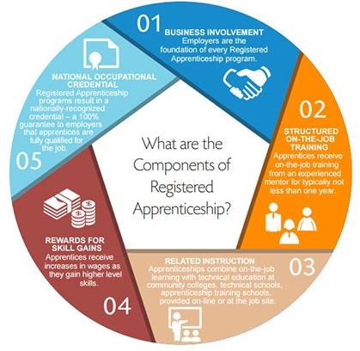
What is Apprenticeship?

Slide 8
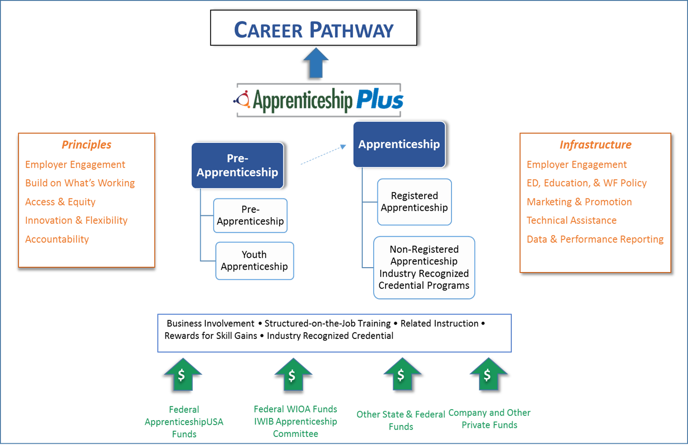
Illinois Apprenticeship Plus Framework

Slide 9
Career Pathway Elements
Aligns with the skill needs of industries in the economy of the State or regional economy involved;
Prepares an individual to be successful in any of a full range of secondary or postsecondary education options, including apprenticeships registered under the National Apprenticeship Act;
Includes counseling to support an individual in achieving the individual’s education and career goals;
Includes, as appropriate, education offered concurrently with and in the same context as workforce preparation activities and training for a specific occupation or occupational cluster;
Organizes education, training, and other services to meet the needs of an individual in a manner that accelerates the educational and career advancement of the individual to the extent practicable;
Enables an individual to attain a secondary school diploma or its recognized equivalent, and at least one recognized postsecondary credential;
Helps an individual enter or advance within a specific occupation or occupational cluster.

Slide 10
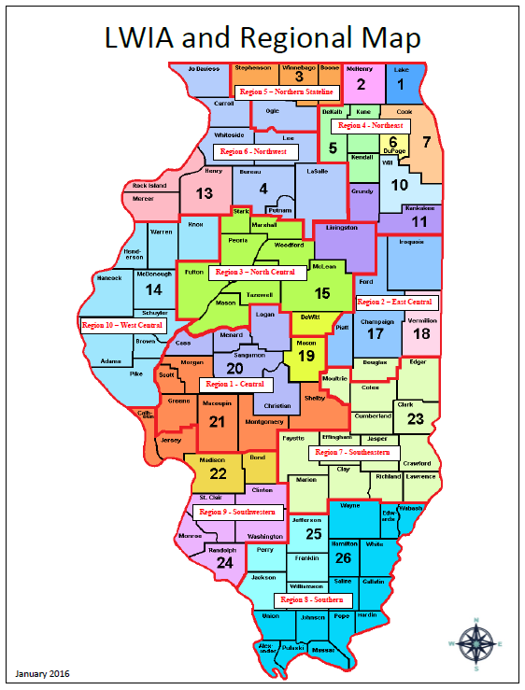
Coordination with Regional Workforce Plans
The Department of Commerce will consider projects from LWAs and regions throughout the state. The goal is to fund 2-3 projects in northern Illinois, 1-2 projects in central Illinois, and 1-2 projects in southern Illinois.
Applicants must identify the workforce / economic development region and administer the pilot programs within the context of the State, Regional, and Local workforce development plans.
The WIOA Regional and Local Plans may be viewed at: www.illinoisworknet.com/WIOA/RegPlanning/Pages/Plans_MOUs_Dashboard.aspx
Applicants must work with the State, Regional, and Local WIOA partners to implement the project in coordination with WIOA. Illinois workforce and economic development regions are depicted in the map on this page.

Slide 11
Regional Apprenticeship Navigators
Regional Apprenticeship Navigators will implement a targeted approach to business engagement within Illinois’ economic development regions focused on the targeted strategies.
Regional Apprenticeship Navigators build capacity by developing and strengthening the knowledge, skills, abilities, processes, and resources that businesses, educational institutions, local workforce areas, and community partners need to create new or expand existing apprenticeship programs.
Apprenticeship Navigators will develop sector and regional partnerships between interested parties with the common goal of growing the talent pipeline.
Navigators should build relationships with regional employers and ease the access to apprenticeship for business and employees as the lead outreach and technical expert in their assigned geographic region.

Slide 12
Regional Apprenticeship Navigators
A major role of the Apprenticeship Navigator is to establish and build partnerships in the region(s), which includes the following stakeholders:
  Education – High Schools, Community Colleges, Training Providers
  Employers and Associations
  Public Entities and CBOs
  Others
Understand the employers’ needs (demand) and the educational programs and other services available (supply). Working with each requires understanding how the pieces fit for apprenticeship.

Slide 13
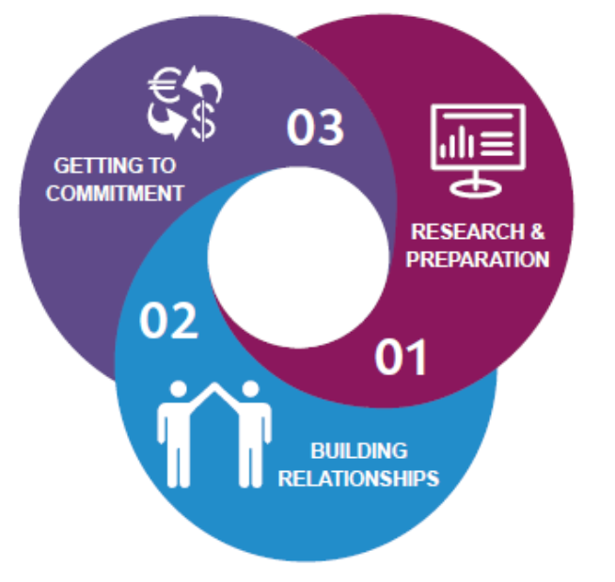
Regional Apprenticeship Navigator Characteristics
  Knowledgeable about apprenticeships and workforce development/solutions
  Successful and experienced in business engagement
  Fosters the development of partnerships, get people to the starting line, “holds their hand” guiding them through the process
  The Apprenticeship Point of Contact for the region
  Ingenious, Accountable, Well Prepared, Highly Engaged, Goal Oriented, Relationship Driven, Salespeople
  Can be Chambers of Commerce, Local Workforce Areas, Associations/Coalitions, Service Providers, Community Based Organizations, Technical Colleges, other Entities

Slide 14
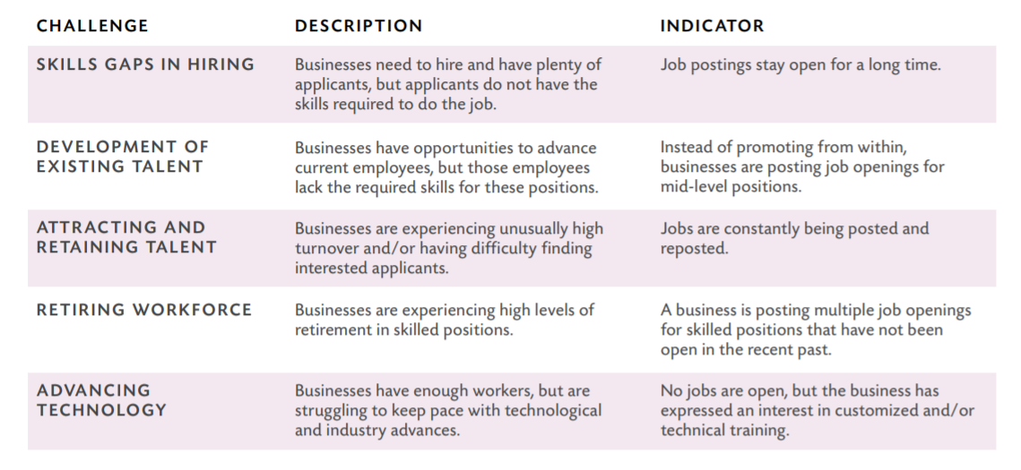
Navigators Understand Workforce Challenges

Slide 15
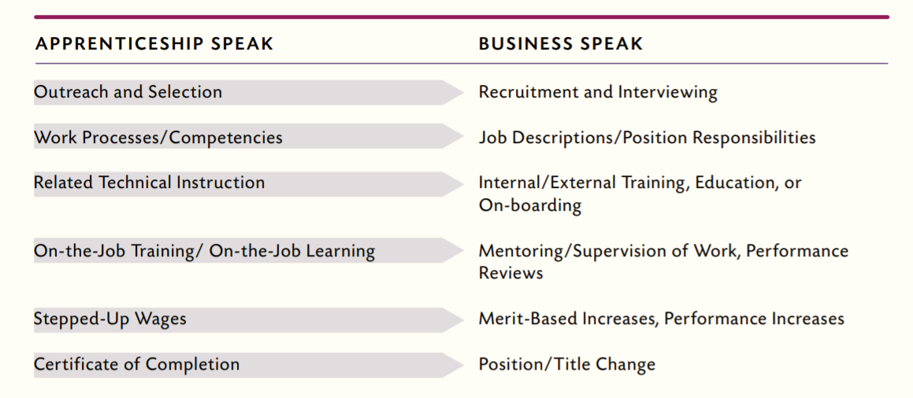
Navigators Speak the Language of Businesses

Slide 16
Regional Apprenticeship Navigators
Increase the number of apprentices and programs within the region
Demystify the process & decrease the amount of time to start a program
Support development of innovative programs and practices
Use regional data to support employers with workforce needs and identify new solutions
Increase access and diversity for targeted populations
Leverage existing resources
Create collaborative partnerships
Educate/create awareness among all stakeholders
Actively Engage Local Business
Use Labor Market Data to Drive Decisions
Tap Innovative Funding Sources
Embrace Evaluation

Slide 17
The “Sales” role of the Navigator
Don’t assume that everyone will understand the need for the program.
Provide context and details for your proposal to build understanding of the apprenticeship approach.
Don’t leave room for surprises, debunk the myths and connect the dots.
Meet with your stakeholders and understand their issues.
Leverage appropriate resources and determine which elements of an apprenticeship program are needed to be in place.
Don’t give up.
If the answer is no, understand the rationale, make adjustments and try again.

Slide 18
Capacity Building Activities and Outcomes
Activities & Funding
  Number of new businesses engaged
  Number of sponsors that receive apprenticeship expansion support
  Number of partners from underutilized area that receive apprenticeship support
  Number of outreach events & attendees
  Number of industry sector partnerships supported and developed
  Amount of matching / leveraged funds
Outcomes
  Number of new registered apprenticeship programs
  Number of registered apprenticeship programs expanded
  Number of new pre-apprenticeship programs established
  Number of pre-apprenticeship programs expanded

Slide 19
Apprenticeship Intermediary
An organization that can help broker local, regional, and national workforce solutions by, among other things, helping job seekers find jobs and employers find workers; convening employers and community partners to determine workforce trends; and assisting in blending customized services and seed funding to grow the demand for new apprenticeship programs.
Examples of apprenticeship intermediaries include industry associations, Institutions of Higher Education, CBOs, chambers of commerce, local workforce areas, and community service organizations. Industry Intermediaries usually specialize in a specific sector, but some may possess expertise that cuts across more than one market.

Slide 20
Role of Apprenticeship Intermediaries
Intermediaries often serve as the Sponsor of the apprenticeship program and the activities include, but are not limited to:
Supporting the registration of new programs with the USDOL Office of Apprenticeship
Sharing or utilizing resources from community colleges or other organizations for process acceleration that help stakeholders rapidly embrace programs; this includes sharing curricula and standards
Aggregating the needs of small employers within an industry
Identifying “champions” and “coaches” for apprentices, employers, and faculty
Providing informational sessions on available or soon-to-be available programs

Slide 21
Role of Apprenticeship Intermediaries
Targeting underrepresented population(s) and creating a plan for outreach, wraparound supports and accommodations
Managing Registered Apprenticeship Programs
Developing the program design and coordinating the program activities including the recruitment, assessment, case management, related technical training, work-based training, supportive service and placement of participants
Facilitating the participation of employers and other partners
Supporting the development and expansion of apprenticeship program in “non-traditional” industries, employers and occupations.
Identifying funding and resources to support demonstration projects

Slide 22
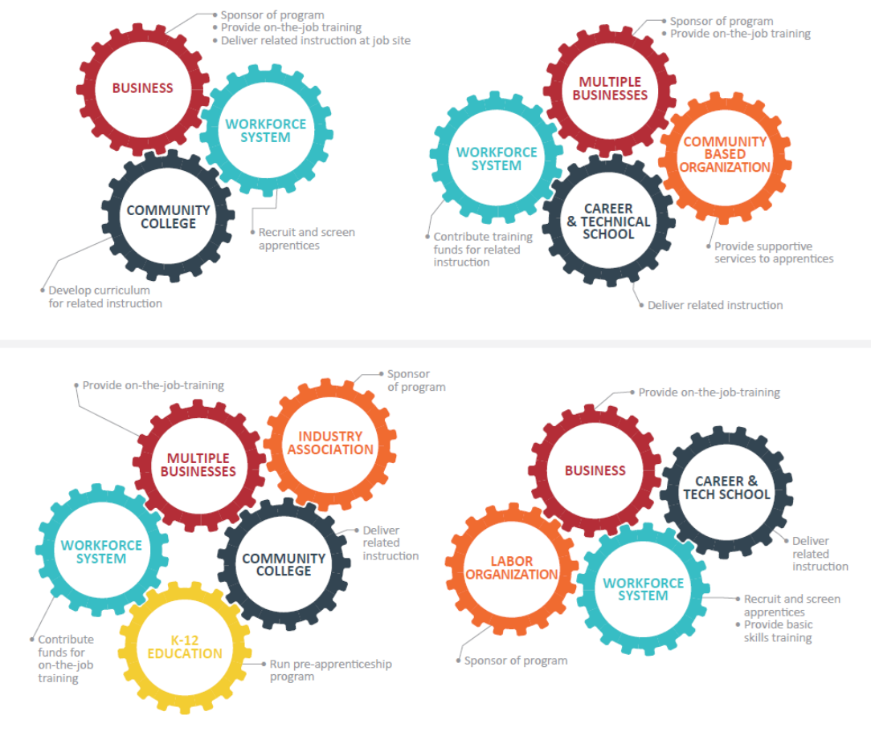
Importance of Partnerships
The Development of partnerships should result in the following goals:
To connect with businesses that need this training for their workforce
To connect with organizations that can facilitate or provide skill upgrade training to these workers
  Industry & Business Associations
  Community Colleges
  Public-Private Partners
  Local Workforce Agencies

Slide 23
MOU
“Musts”
Recruitment
Eligibility Determination
Enrollment
IWDS Entry
Case Management
Performance Requirements
Reporting
Follow-up

Slide 24
  Projects that provide services directly to participants are expected to meet the WIOA performance measures of the LWIA in which they are partnering.
  Negotiated performance measures unique to each local area are applicable to all participants served under this NOFO are listed in Appendix D.
  In instances where the Grantee is not an LWIA, WIOA performance measures and targets for the grant will be determined at the State level.
WIOA
Performance

Slide 25

Priority Populations Projects
Grant funds may be used to help develop strategies for effectively serving individuals with barriers to employment and for coordinating programs and services among workforce partners.
Projects must be focused on serving the targeted populations identified in Illinois’ Unified Workforce Plan.
Projects that serve individuals must meet the WIOA
Eligibility, Reporting & Performance Requirements

Slide 26
Targeted Industries and Occupations
  Applications will be accepted that target a specific industry(ies) that aligns with the state and/or regional workforce plan.
    State of Illinois Unified Workforce Plan
    https://www.illinoisworknet.com/wioastateplan
    WIOA Regional/Local Plans by Economic Development Region
    https://www.illinoisworknet.com/WIOA/RegPlanning/Pages/Plans_MOUs_Dashboard.aspx
  Industries targeted are based on an analysis of the labor market information.

Slide 27
Reporting Requirements Training Type
Incumbent Workers
IL Workforce Tracking System
Workers
Training Information
Outcomes
Monthly Cost Reporting
WIOA Participants
IL Workforce Development System
Eligibility & Services Provided
Case notes
Outcomes
Quarterly Reports
Monthly Cost Reporting
Quarterly Reports
Illinois workNet Portal
Youth Pathways Program

Slide 28
Demonstration Projects Serving Individuals Under this Grant
Services
  On the Job Training
  Related Training & Instruction
  Supportive Services
  Other
Funding
  Registered Apprentices
  Pre-Apprentices
  Matching / Leveraged Funds
Outcomes
  Number of Registered Apprentices
  Number of Pre-Apprentices
  Number of Pre-Apprentices that transition to Registered Apprentices

Slide 29
Application Options
Please note that organizations may submit a single proposal under this NOFO:
  As an Intermediary creating or expanding Registered Apprenticeship or pre-apprenticeship pilot programs
  As a Regional Apprenticeship Navigator promoting and building capacity with various organizations to expand apprenticeship programs or
  Serving in both the Intermediary and Regional Navigator roles in creating or expanding registered apprenticeships or pre-apprenticeships pilot programs and providing regional assistance as a regional navigator

Slide 30
Additional Funding Opportunities
“SUSTAINABILTIY”
Federal Apprenticeship USA Funds
Federal Workforce Innovation and Opportunity
Other State and Federal Funds
Company and other Private Funds

Slide 31
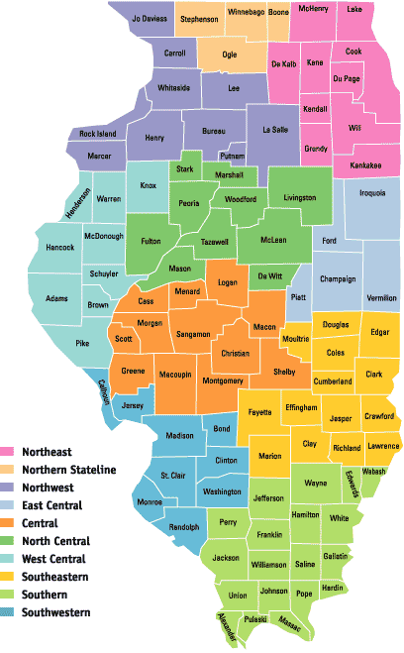
Statewide Workforce Innovation Program www.illinoisworknet.com/WIOAInnovationNOFO
Grass Roots Innovation: Looking for good ideas:
Regional and local workforce practitioners have incredible potential to spur innovation because they can most easily see what needs fixed. Does your team ever ask, “Why hasn’t anyone tried…?”.
Do you have the desire to improve your community’s pool of skilled workers and employment opportunities?
Do you believe your ideas could make a difference for businesses and workers?
Our goal is to identify and test promising practices, from incremental adjustments to sea-change approaches in:
    Sector Partnership Projects
    Innovative Workforce Pilot and Research Projects
    Priority Population Projects
    Statewide Technical Assistance

Slide 32

Illinois Talent Pipeline Program www.illinoisworknet.com/TalentPipelineNOFO
Looking to maintain a pipeline of hirable talent for your business?
Looking to hire new employees and train them your way? On-the-Job Training assists with the costs of training new employees. The employer agrees to hire, train and retain an individual who successfully completes the training. Illinois will match qualified applicants with job openings and refer them to you (you hire or not hire as you normally would). As the employer, you may be reimbursed an amount for training costs that is up to 75% of the new employee’s wages during the training period.

Slide 33

Illinois Talent Pipeline Program www.illinoisworknet.com/TalentPipelineNOFO
Thinking your business may be at-risk and in need of an investment in training employees to meet demands of changing technology or work environment, such as new production machines?
Incumbent Worker Training can help a business mitigate “at risk” factors such as declining sales, supply chain issues, adverse industry or market trends, changes in management philosophy or business ownership by providing training to current employees who may not have all the necessary in-demand skills. As the employer, you can be reimbursed up to 90% of Incumbent Worker training costs. In so doing, you can avoid the high cost of re-hiring.
Good fit for your business? Let’s see: Does your business operate year-round? Are employees paid an hourly wage or salary equal to or more than minimum wage? As employer, do you want an opportunity to train employees your way and realize the benefits of investing in employees? We at the Illinois Department of Commerce would like to listen to how your business can benefit from Illinois Talent Pipeline workforce training grants.

Slide 34
Bidders’ Conferences/Workshops
Chicago, IL – August 14, 2018, 10:00 am – 3:00 pm
Bilandic Building, 160 N LaSalle St, Chicago, IL 60601
Register here: https://grantworkshopchicago.eventbrite.com
Naperville, IL – August 15, 2018, 10:00 am – 3:00 pm
NIU Naperville, 1120 E Diehl Rd, Naperville, IL 60563
Register here: https://grantworkshopnaperville.eventbrite.com
Marion, IL – August 21, 2018, 10:00 am – 3:00 pm
State Regional Office Building, 2309 West Main Street, Marion
Register here: https://grantworkshopmarion.eventbrite.com
Collinsville, IL – August 22, 2018, 10:00 am – 3:00 pm
Illinois State Police, 1102 Eastport Plaza, Collinsville, IL 62234
Register here: https://grantworkshopcollinsville.eventbrite.com
Springfield, IL – August 23, 2018, 10:00 am – 3:00 pm
Lincoln Land Community College, Montgomery Hall
2450 Foundation Drive, Suite 100 Springfield, IL 62703
Register here: https://grantworkshopspringfield.eventbrite.com
Rockford, IL – August 29, 2018, 10:00 am – 3:00 pm
Regional Design Center, 315 North Main Street, Rockford 61101
Register here: https://grantworkshoprockford.eventbrite.com

Slide 35
Apprenticeship Tools & Resources
US Department of Labor Workforce GPS:
https://apprenticeshipusa.workforcegps.org/
US Department of Labor Apprenticeship Playbook:
https://www.doleta.gov/oa/federalresources/playbook.pdf
High Level Apprenticeship Partner Roles Infographic:
https://www.dol.gov/apprenticeship/docs/Partner_Roles_Infographic_20150616.pdf
Illinois workNet: www.illinoisworknet.com/apprenticeshipplus

Slide 36
Apprenticeship Tools & Resources: Sponsors & Business Outreach
USDOL Interactive Map of Sponsor Programs: https://oa.doleta.gov/bat.cfm
USDOL Marketing to Apprenticeship Sponsors: https://apprenticeshipusa.workforcegps.org/resources/2017/03/13/10/27/Apprenticeship-Sponsors-as-Eligible-Training-Providers
USDOL Business Outreach Guides & Fact Sheets:
  https://apprenticeshipusa.workforcegps.org/resources/2017/02/02/10/12/Marketing-Outreach-to-Business-on-Apprenticeship
  https://www.dol.gov/apprenticeship/toolkit/docs/RA-Employer-Fact-Sheet.pdf
  https://www.doleta.gov/oa/employers/apprenticeship_toolkit.pdf
USDOL Industry Focused Flyers:
https://www.dol.gov/apprenticeship/pdf/ATR-AdvancedManufacturing.pdf
https://www.dol.gov/apprenticeship/pdf/ATR-Healthcare.pdf
https://www.dol.gov/apprenticeship/pdf/ATR-Transportation.pdf
https://www.dol.gov/apprenticeship/pdf/ATR-SkillTrades.pdf
https://www.dol.gov/apprenticeship/pdf/FinancialSector.pdf

Slide 37
Apprenticeship Tools & Resources: Workforce Professionals
US Department of Labor Interactive Training Modules: https://www.dol.gov/apprenticeship/toolkit/learn.htm
US Department of Labor Apprenticeship Tools & Templates: https://www.dol.gov/apprenticeship/toolkit/implement.htm
US Department of Labor Guide to Expand Apprenticeship to Under Represented Populations: https://apprenticeshipusa.workforcegps.org/resources/2017/02/28/12/33/Expanding-Apprenticeship-to-Under-Represented-Populations
US Department of Labor Quick Facts Resources:
Customer Flow: https://www.dol.gov/apprenticeship/toolkit/docs/Desk-Aid-Customer-Flow.pdf
Use of Funds: https://www.dol.gov/apprenticeship/toolkit/docs/Desk-Aid-Use-of-Funds.pdf
Performance: https://www.dol.gov/apprenticeship/toolkit/docs/Desk-Aid-Performance.pdf

Slide 38
Application Requirements
  Uniform Application Form
  Executive Summary
  Technical Proposal
    Applicant Capacity
    Documentation of Need
    Specific Project Requirements and Considerations
    Project Plan
  Resumes of Key Program Staff
  Memorandum of Understanding
  Budget Proposal

Slide 39
Application Review Information
Applicants must demonstrate that they meet all of the requirements outlined in the Notice of Funding Opportunity.
The following criteria will be used to evaluate applications:
  Applicant Capacity (20%)
  Documentation of Need (25%)
  Project Quality and Integration (30%)
  Cost Effectiveness/Return on Investment (25%)

Slide 40
Application Timeline
APPLICATION TIMELINE
Grant Information Workshops | August
Applications Due | September 17, 2018
Grant Negotiation | October/November
Grant Award (Anticipated) | December

Slide 41
Grant Submission Details
Applications must be received via email no later than 5:00 p.m. on September 17, 2018 to grantapplication@illinoisworknet.com including:
  Uniform Application Form
  Executive Summary
  Technical Proposal
  Resumes of Program Staff
  Partnership Agreement and/or MOUs
  Budget Proposal
Applications must be formatted on 8 1/2 x 11‐inch paper using 11‐point type and at 100% magnification. Tables may be used to present information with a 10‐point type.
The Technical Proposal is limited to 12-18 pages.

Slide 42
Freedom of Information / NOFO Questions
Applications are subject to disclosure in response to requests received under provisions of the Freedom of Information Act (5 ILCS 140/1 et seq.). Information that could reasonably be considered to be proprietary, privileged, or confidential commercial or financial information should be identified as such in the application.
Questions regarding the grant opportunity can be sent to: Patrick.Campbell@Illinois.gov
The program webpage includes a question and answer document for all applicants to view. http://www.illinoisworknet.com/apprenticeshipnofo

Slide 43

Grantee Resources
https://www.grants.Illinois.gov
http://www.illinoisworknet.com/GATA
https://www.illinoisworknet.com/ApprenticeshipPlus
https://apps.il-work-net.com/WIOAPolicy/Policy/Home
https://www.illinoisworknet.com/wioastateplan
https://www.doleta.gov/grants/UniformGuidance.cfm
http://etasmarttraining.com/pdf/Single_Track_Region1.pdf
https://www.workforcegps.org/
http://www.naswa.org/
https://www.doleta.gov/

Slide 44
For More Information Contact
For More Information Contact
Apprenticeship Expansion – Patrick Campbell
Patrick.Campbell@Illinois.gov
GATA / Program Administration – John Barr
John.W.Barr@Illinois.gov
Charles Dooley
Charles.Dooley@Illinois.gov
John Barr
John.W.Barr@Illinois.gov
Matthew Hillen
Matthew.Hillen@Illinois.gov

