Slide 1


APIL Lunch n’ Learn – LWIA 10

Slide 2

Will County Workforce System
Comprehensive One-Stop Job Center
Partners onsite/nearby include:
Workforce Services Division of Will County (WIOA Title 1)
Illinois Department of Employment Security (Title 3)
Illinois Department of Human Services – DRS (Title 4)
Adult Education (Title 2) and Youth Services
Veterans Assistance Commission
Will County Center for Community Concerns (CDBG, SCSEP)
Services available in person or online:
Resource Room
Job Search Assistance
Resume Assistance
Workshops/Seminars
Career Planning
Career Scholarships/Training Assistance
Employer Spotlights/Business Services
will.works

Slide 3
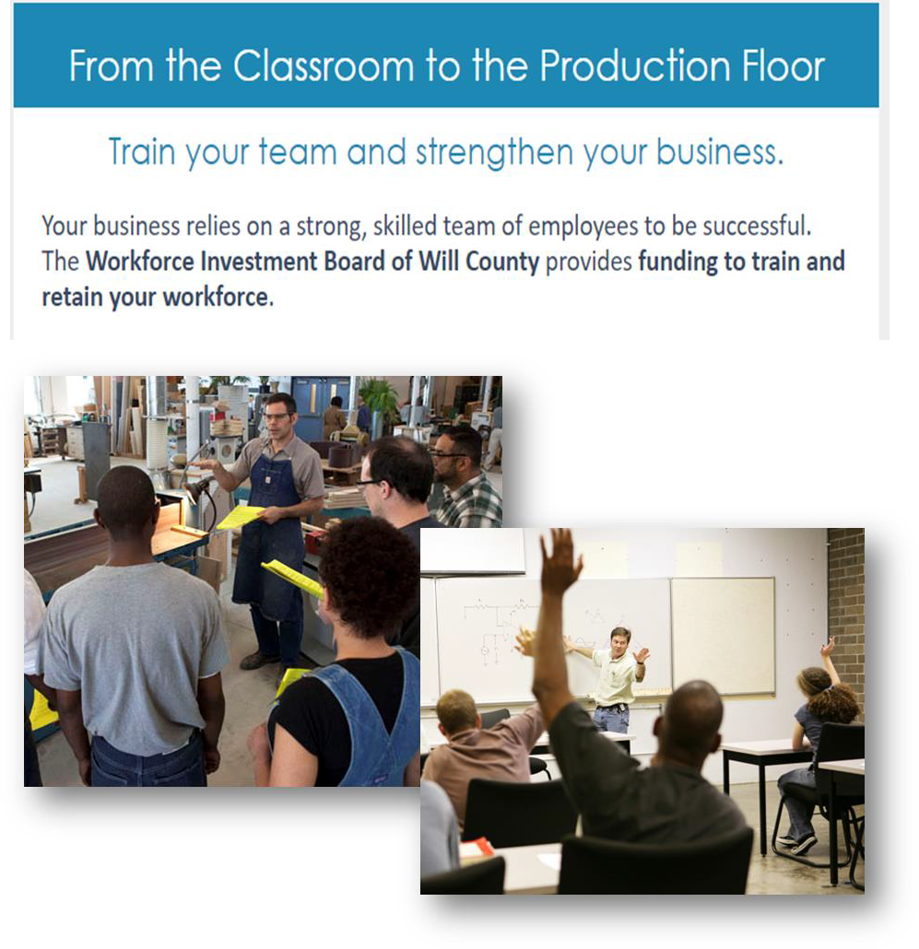

Customized Services
Customized Wage/Industry Reports
Employee Training Grants
Opportunities to upskill current
workforce
Customized to fit employers needs
On-the-Job Training, Apprenticeships and
Internship Programs
  Tailored based on employer needs
  Staff works with company and employee/intern throughout the process

Slide 4
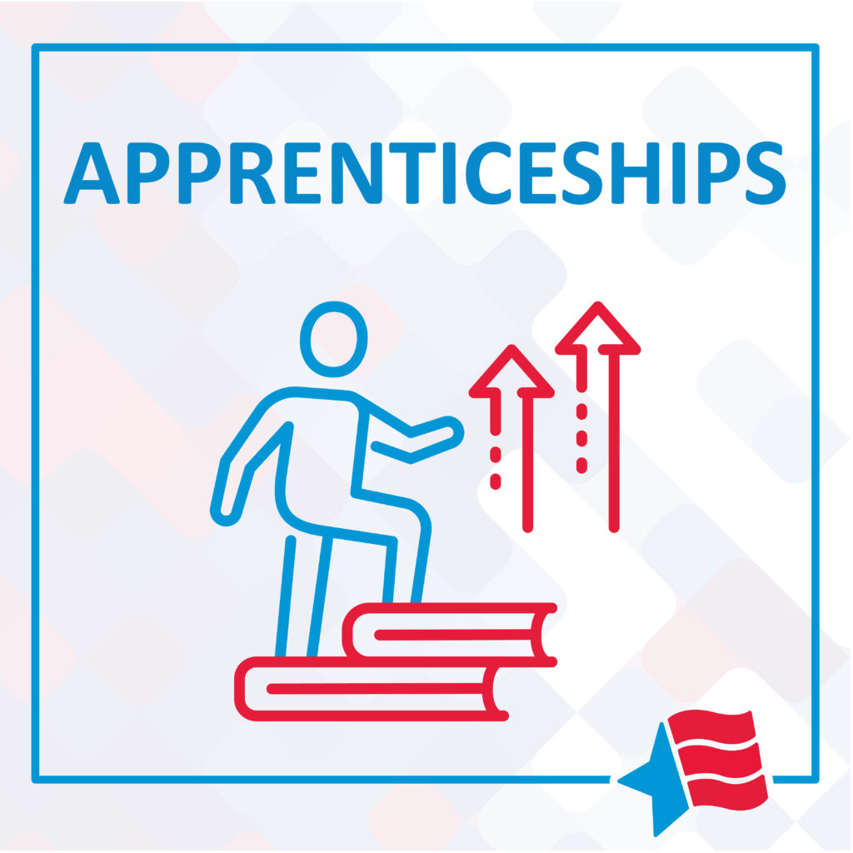

Challenges
Staff Changes
Business buy-in
Communication throughout buildout
Uncertainty of it being the right fit for a company
Apprentice recruitment

Slide 5
Making Connections – Increasing Awareness

Slide 6
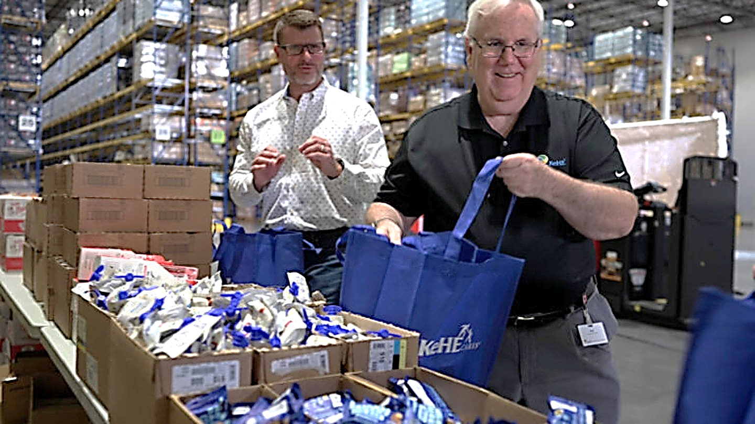


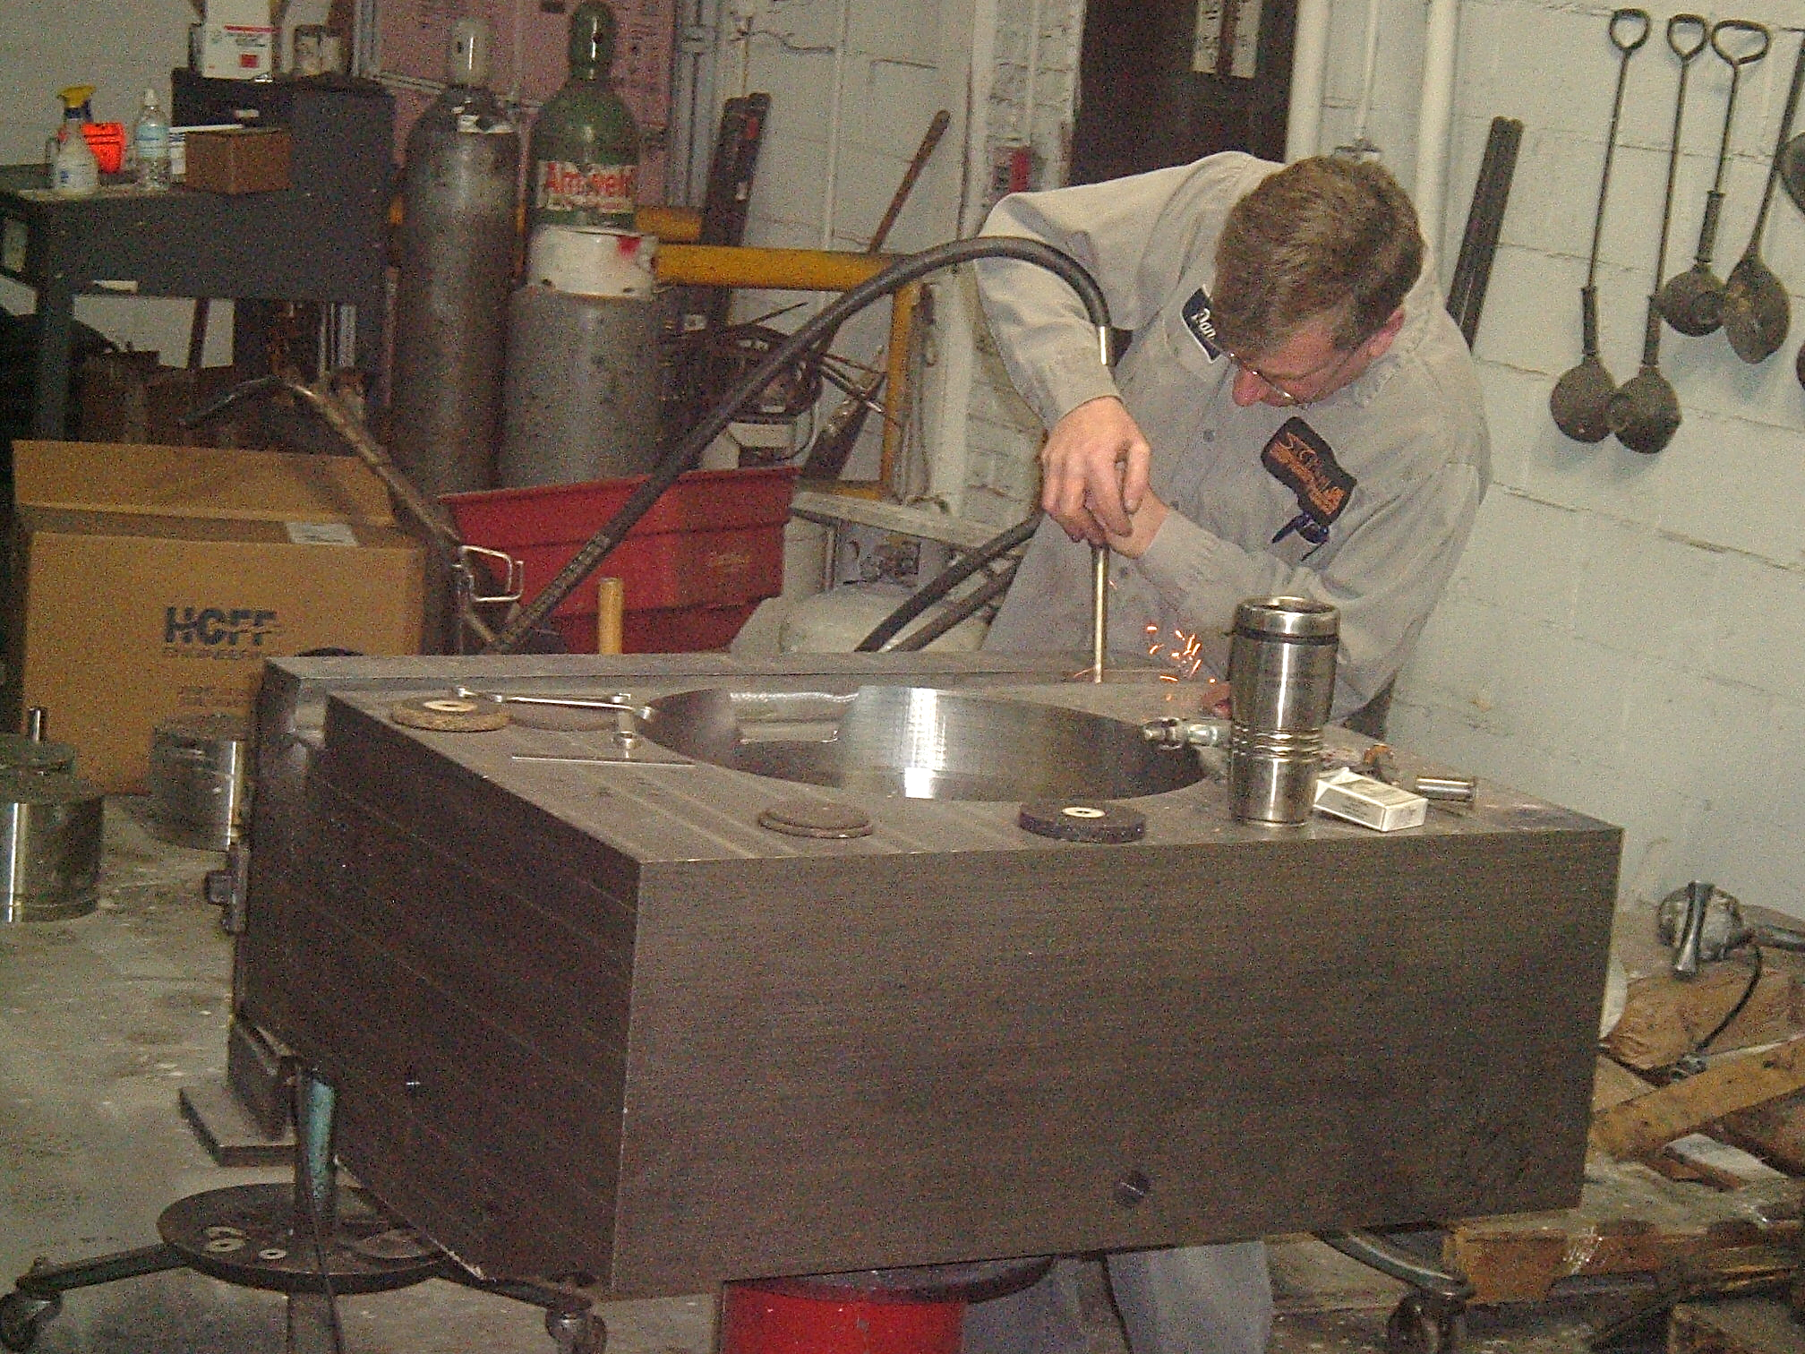
Making an Impact – Engaging Employers
Partnership with DRS
Started as a chance for disability employment
Now they have 3 registered apprenticeship occupations
H&H DIE MFG
Referral from partners at CED
One of their managers went through a program years ago, wanted to model a new one for their current employees.

Slide 7

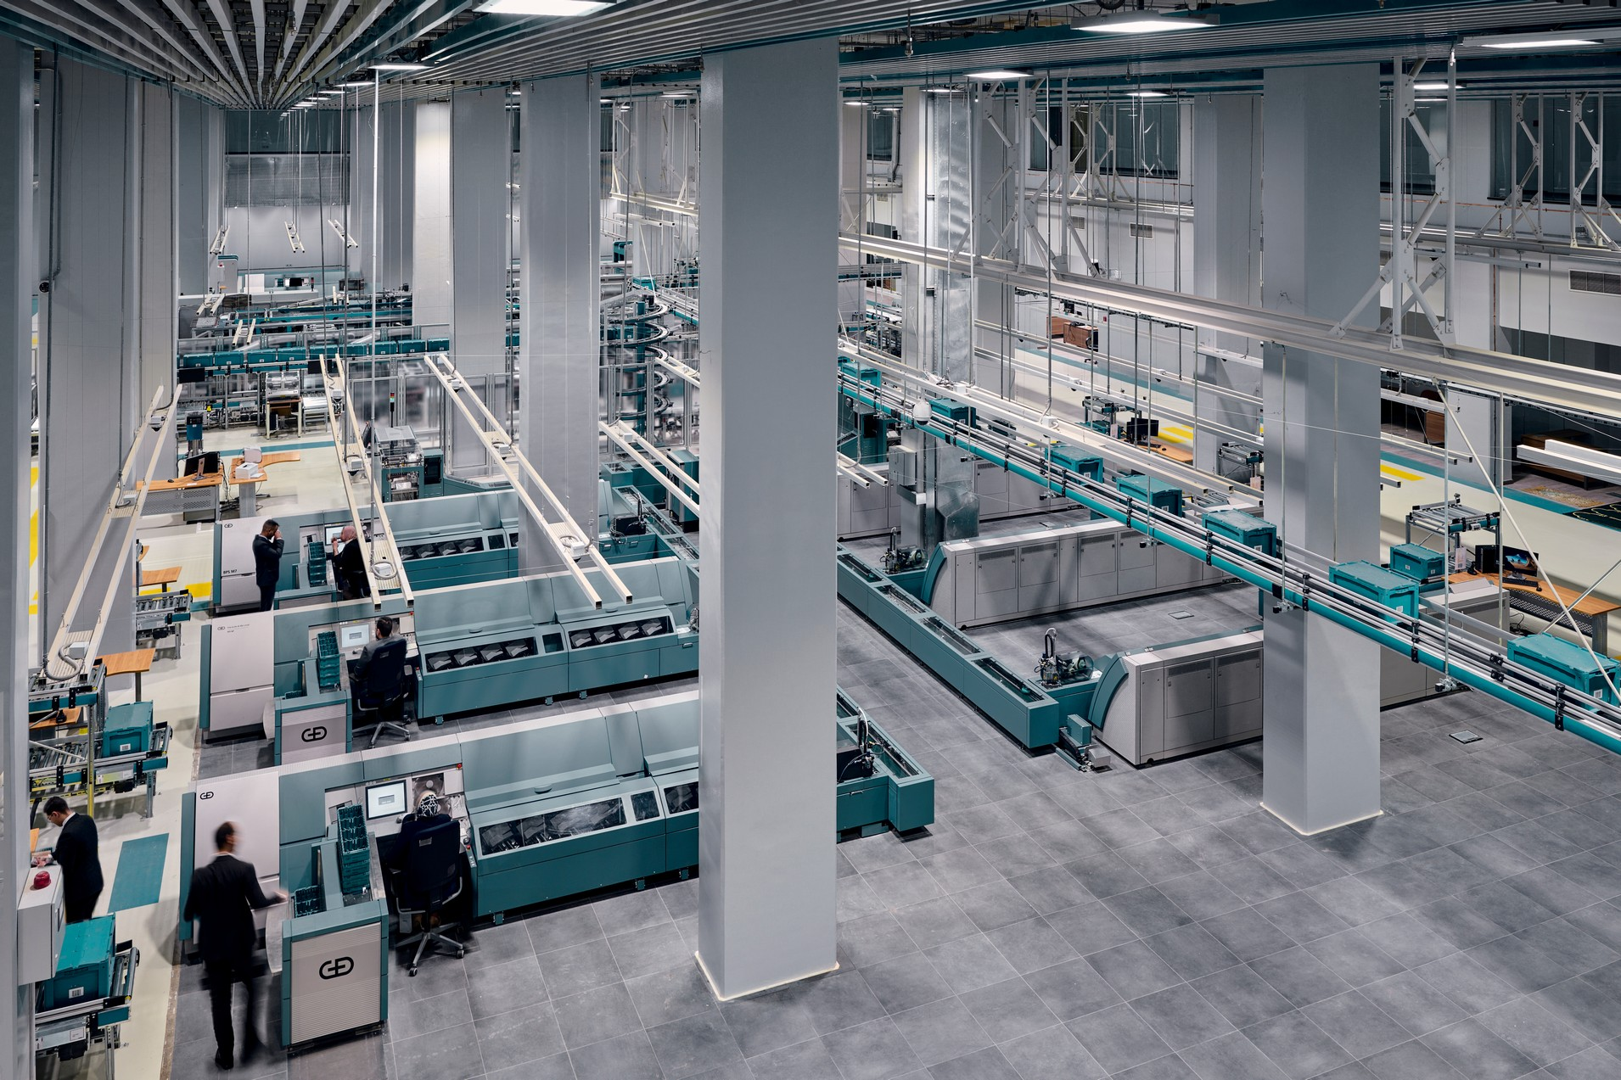

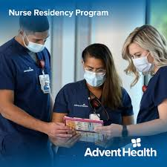
Making an Impact – Engaging Employers
Started as IWT project
  Regular check-ins lead us to create training into RAP
Plans to expand throughout various roles in the org
Started as IWT
Innovative program – modeling doctors residency but for nurses
Plans to expand this RAP across all AdventHealth Hospitals in IL (4)

Slide 8




New Programs on the Horizon
Pace Suburban Bus – Deisel Mechanic
Hopewell Academy – Gen Ed / Special Ed Teacher
NFI Industries – Deisel Mechanic & CDL Driver
Allied Valve – Engine Lathe Operator

Slide 9
Lessons Learned
One size doesn’t fit all – every business has different needs and procedures
Flexibility – being available to answer questions or respond to concerns can make the difference in a company truly buying in
Have clear ROI – companies want data!
Connections – your network is huge. Establishing relationships with community partners greatly expands your outreach

