Slide 1


Read Before You Proceed:
Instructions for Use & Legal Compliance
Legal Accessibility Requirements: 508 Compliance
Only use tables when standard content delivery is insufficient, and never merge table cells.
Do not use screenshots or images of text items. All text must be editable and not blur when the screen is zoomed in.
Avoid using “Smart Art” or the “Design Ideas” tool.
Do not repurpose slide title boxes for any other use.
Do not use multiple spaces, empty paragraphs, or strings of tabs to visually adjust your content, as every such repeated character must then be manually stripped from all slides before posting. Instead:
  Use soft returns to bump content to the next line in lieu of spaces (Shift + Enter)
  Manage paragraph spacing and tabs in the “Paragraph” panel.
Every image or visual element used must either have alternative “alt” text applied or be marked as “decorative.”
  Alt text translates visual information into verbal information, which is read aloud in screen readers, while items marked “decorative” are skipped.
  This step is required to deliver the full message provided by any graphics.
  The person who laid out the content should also provide
  that alternate information to ensure their
  message stays intact.
Learn about the new innovative features!
Please watch this webcast
before using this template.
https://vimeo.com/370983870/2afa9e8306
(Ctrl + Click to open link)
Duration: 6 minutes

Slide 2
Why Apprenticeship? Employer Partners and Apprenticeship Programs
Presented By:
Office of Workforce Investment, Division of Strategic Investments

Slide 3

Today’s Moderator
Cheryl Martin
  Program Manager
    Division of Strategic Investments
    Employment and Training Administration

Slide 4

Today’s Panel Moderator: Office of Apprenticeship
Michael Qualter
  Deputy Administrator
    Office of Apprenticeship

Slide 5

Today’s Speakers
Will Mounts
  Vice President and Board Member
OMICO Plastics, Inc.

Slide 6
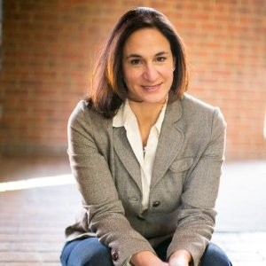
Today’s Speakers
Heather Terenzio
  CEO and Co-Founder
Techtonic

Slide 7
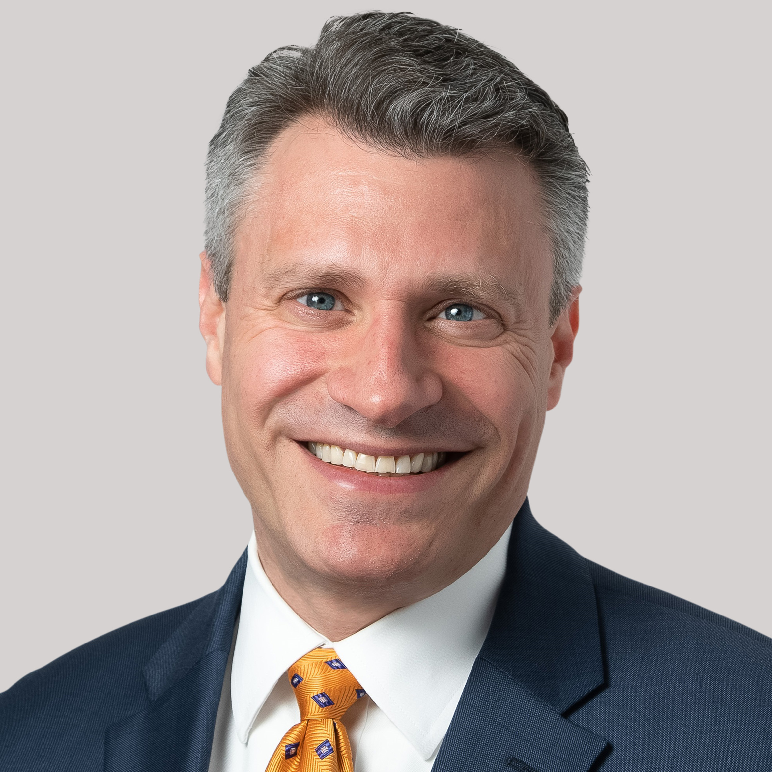
Today’s Speakers
Brent Weil
  Vice President, Workforce Development
Argentum

Slide 8
Discussion Questions
There are many workforce development approaches… Can you give us some insight into why this business decision was made? Specifically, why apprenticeship?

Slide 9
Discussion Questions
Every program has a recipe for success and there are certainly cross cutting success factors. What are the key factors that contributed to the successful launch of your apprenticeship program?

Slide 10
Discussion Questions
COVID has required all of us to innovate rapidly. What are some of the innovations you’ve put in place to respond to the pandemic?

Slide 11
Discussion Questions
When talking to other employers and partners, what are the key benefits you emphasize/highlight about Apprenticeships? How have you calculated the Return on Investment (ROI) for your organization, whether formally or informally?

Slide 12

Argentum: Return on Investment
Trilogy Health Services
Commonwealth Senior Living
Retention for Registered Apprentices: 80%
Retention for All Other Nurse Aides: 51%
→ Raised total retention rate to 58% nationwide
Cost of turnover $4,400 per employee

Slide 13
OMICO Plastics: Return on Investment
Developed a calculator for GOFAME which shows that:
  Even if a sponsoring company lost their student after the program ended, they would come out ahead a minimum of $7,142 over 2 years compared to hiring “off the street” (conservative estimate)
  OMICO Plastics came out $20,000 ahead per year, or $40,228 for the program
However, apprentice retention for GOFAME companies has been high – 78-80%
Return of Investment Calculator Variables include:

Slide 14
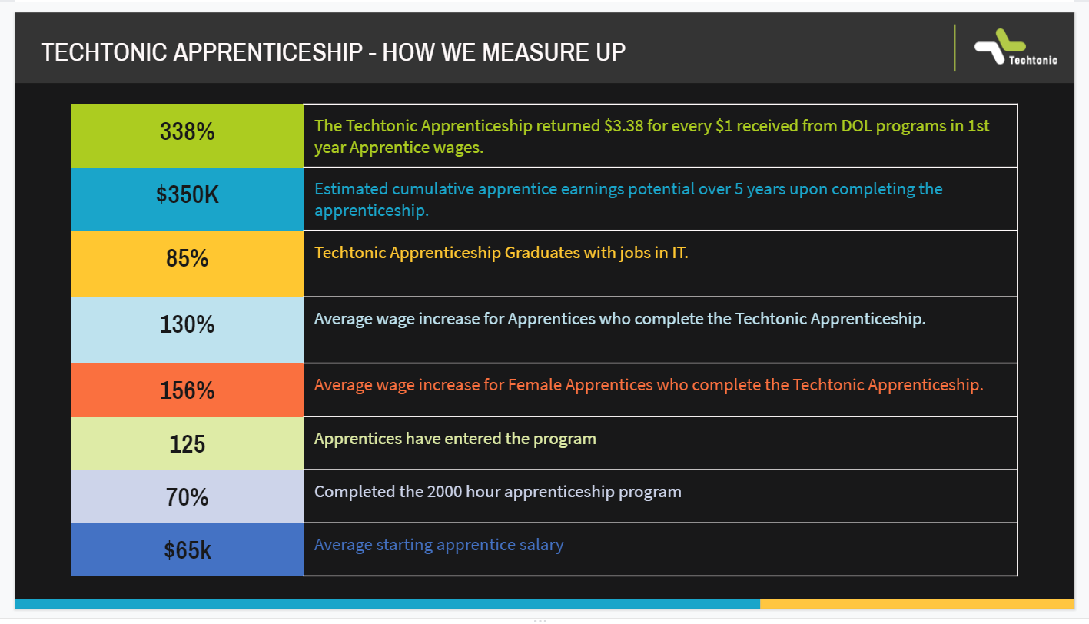
Techtonic: Return on Investment

Slide 15
Discussion Questions
What type of messages and engagement strategies seem to be resonating most with your employer peers right now, particularly in light of challenges created by COVID19? And what kind of positive feedback are you hearing from employers who are trying apprenticeship for the first time?

Slide 16
Thank you!

