Slide 1
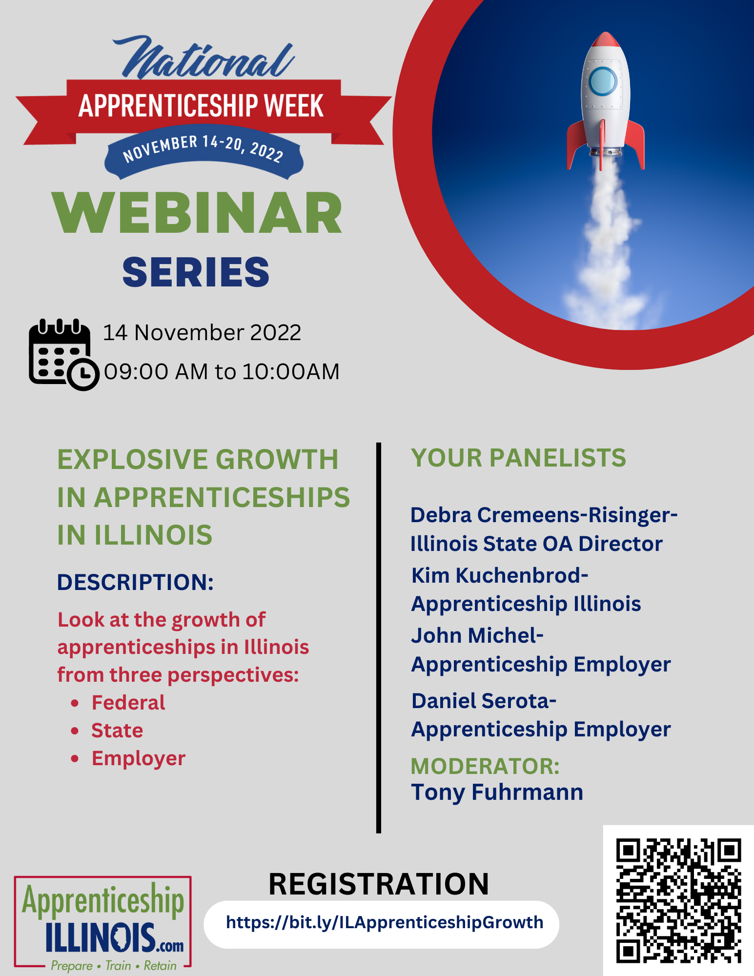
A couple of housekeeping items before we get started with today’s webinar:
All attendees are muted. You have the ability to mute or unmute yourselves.
However, we ask that you remain muted unless you are speaking to reduce background noise.
We invite you to post any questions in the chat and they will be addressed.
The session will be recorded and posted to the NAW2022 website: https://bit.ly/NAWAPIL2022
This session will use the Live Transcript feature to provide closed captioning.

Slide 2
Question:
Please give us a little background of your experiences with apprenticeship programs.

Slide 3
Question:
Each of you have a different perspective, when you hear “explosive growth of apprenticeships in Illinois”, what does it mean to you?

Slide 4
Question:
How do you see apprenticeship programs continuing to grow and be an important part of meeting employer needs for a skilled, trained workforce?

Slide 5
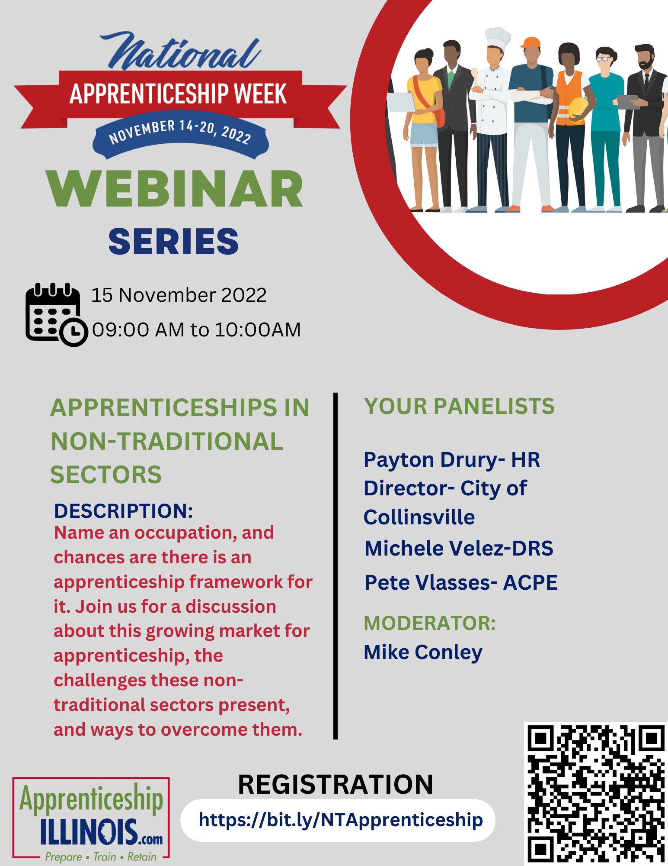
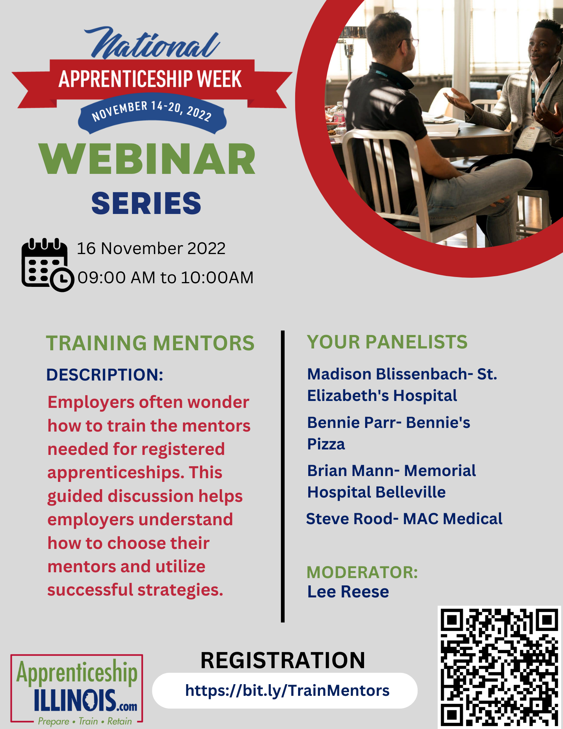
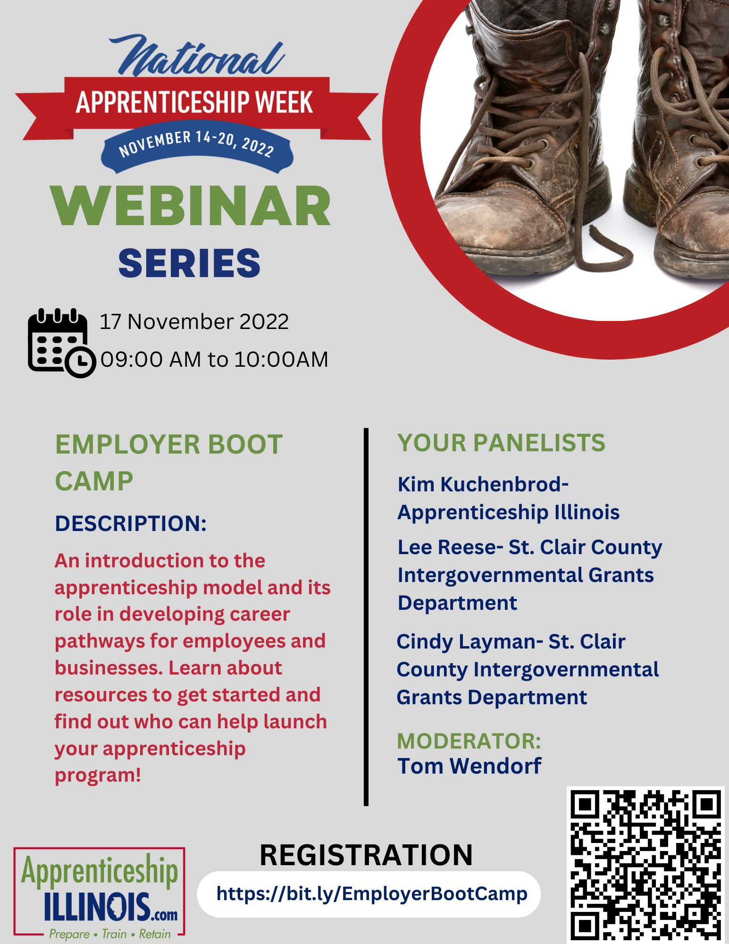
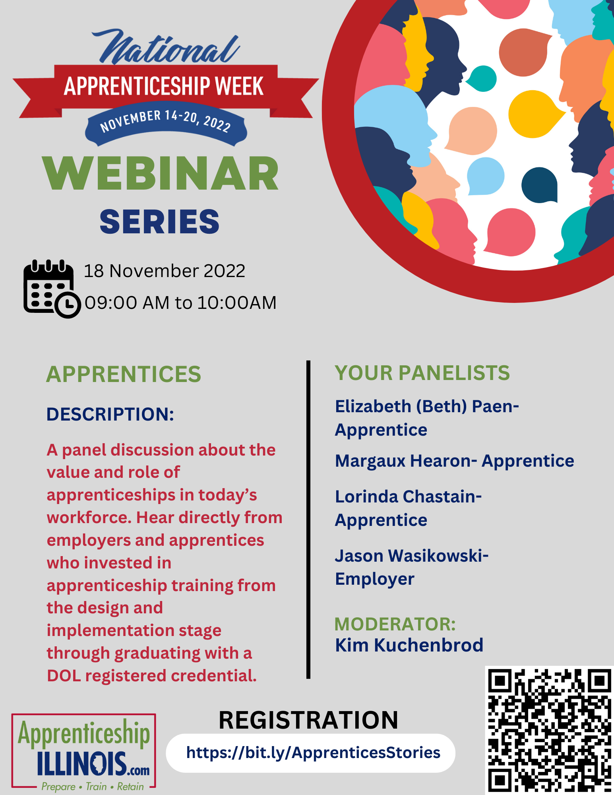
Don’t miss the next four webinars!

