Slide 1



Thinking local: Working with Chambers
& Regional Economic development
10/15/24
Nate Carlson, TA program director

Slide 2
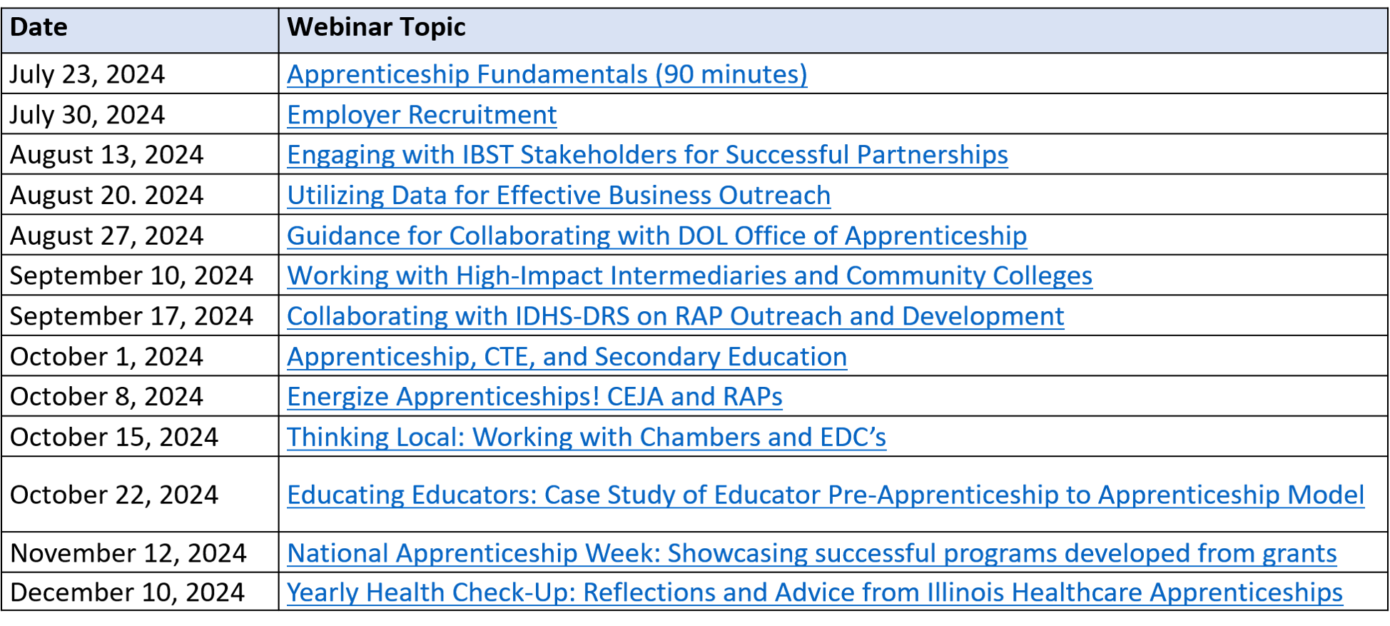
lunch & learn webinar series Dates

Slide 3

About the presenter:
Nate Carlson
State Mentor & Technical Assistance Program Director for Apprenticeship Illinois
Previously: Apprenticeship Specialist for LWIA 23, Digital Literacy and Communication Instructor at Eastern Illinois University.
Email: ncarlson@niu.edu

Slide 4
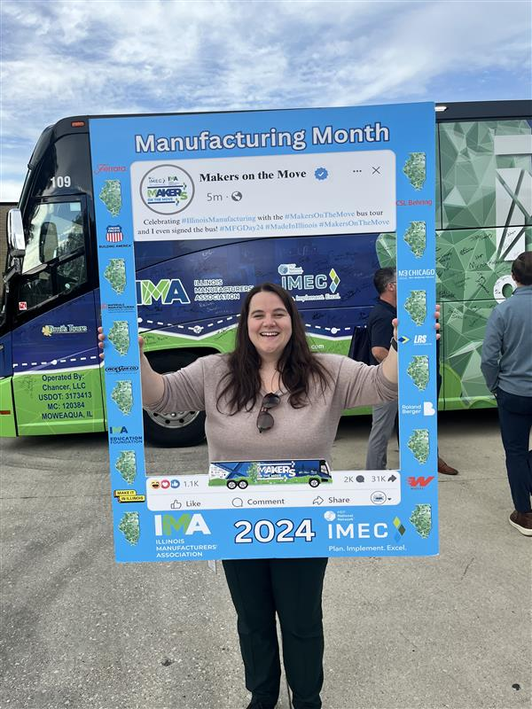
About the presenter:
Renee Wott
Senior Northeast Regional Economic Development Manager at the Illinois Department of Commerce and Economic Opportunity

Slide 5

Time for a
brief poll

Slide 6

About apprenticeship Illinois:
Our Regional Specialists will…
  Conduct in-person and virtual apprenticeship outreach through events and employer consultations
  Receive and pursue referrals received to the Apprenticeship Illinois website
  Work with employers to fully develop and register their apprenticeship programs from start to finish
  Connect employers to intermediary partners and other applicable services

Slide 7
Learning Objectives
We will understand the role of chambers and EDCs in our local workforce ecosystem.
We will identify the benefits of strong partnerships with local economic development organizations.
We will brainstorm strategies for effective collaboration with local and regional economic development entities.
We will anticipate and overcome potential challenges in working with local EDCs and chambers.

Slide 8
What are Chambers of commerce?
A Chamber of Commerce is a localized, not-for-profit business networking and lobbying organization which primarily derives revenue from member dues.
This means…
  Chambers must offer a value add to their local businesses to be successful, viable entities.
  Chambers are well-connected to businesses in their communities who are actively interested in networking and growth opportunities.
  Chambers and their staff are trusted in the local business community and have an existing rapport with their members.

Slide 9
Chambers of commerce stats
  A 2022 survey by the Association of Chamber of Commerce Executives (ACCE) found that the average chamber…
  employs ~4.5 staff members
  earns 43% of revenue from member dues
  maintains 600 member accounts
  retains members at a rate of 89% per year
  Invests $150,000 in community impact funding

Slide 10
Benefits of partnering with chambers
  Chambers have an existing infrastructure for sharing valuable information with their members
  Highly-involved chamber members are early adopters interested in staying current on innovative opportunities
  When brought on board apprenticeship champions, chambers can function as a high-powered referral system with significant potential for lead generation!
  Chambers have the organizational ethos and reputation that LWIAs and local government sometimes lack amongst members of the business community

Slide 11
Opportunities for chamber partnerships:
  Networking through casual events (After Hours/Golf Scrambles social events) or informal presentations (Lunch & Learns/Chamber Breakfasts)
  Formal joint outreach events (Symposiums, Business Roundtables, Business Services Expo, Publications)
  Mutual Social Media promotion on Facebook, LinkedIn, Instagram, etc.
  Collaboration on TPM Employer Sector Partnership facilitation
  Integrated Business Services Team Meetings
  1:1 Referrals/Consultations to Members

Slide 12
Potential Barriers to partnership
  Communication; make sure you are speaking the same “language” as your chamber partners!
  Perception of Red Tape/Bureaucracy; as with employers, overemphasize a streamlined process in all your engagements with chambers
  Lack of Awareness; if your local chambers don’t know the services you offer or the benefits presented by apprenticeship, why should their members?
  Lack of Trust; leverage existing business champions and success stories when available– if not, put in the time and energy to build a relationship!

Slide 13

Open for Business
Illinois’ 2024 Economic Growth Plan

Slide 14
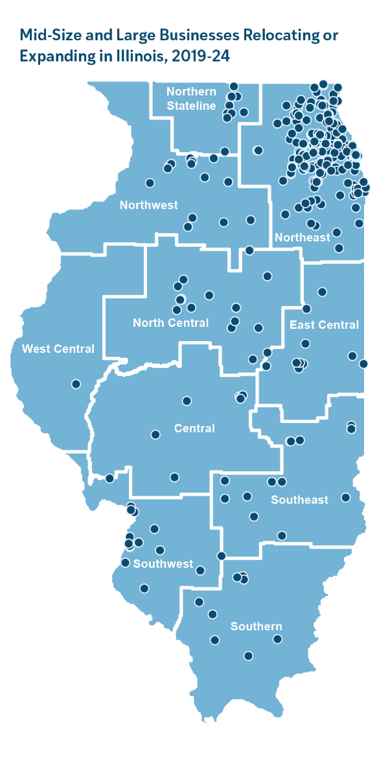
Illinois on the Rise
Mid-Size and Large Businesses Relocating or Expanding in Illinois, 2019 - 24
Illinois GDP eclipsed $1 trillion in 2022 and continues to rise
Illinois is home to more than 30
Fortune 500 companies
Chicagoland ranked first in the nation among metro regions for corporate investment in 2023
Illinois ranked second in the nation for corporate expansions and relocations in 2023
Illinois ranked in the top six in the nation for education, infrastructure, technology and innovation and access to capital by CNBC in 2024
Illinois ranked in the top five states for college readiness by
U.S. News & World Report in 2024

Slide 15




2024 Economic Growth Plan Goals
In this Five-Year Economic Growth Plan, Illinois outlines a roadmap to attract record-level investments, create jobs and support communities over the next five years while laying the foundation for economic growth for generations to come.
Focus on High Growth Sectors and Continue Overall Business Climate Improvements
Advance Comprehensive Economic Development Efforts for Business Growth and Attraction
Promote Equitable Growth by Empowering Workers, Entrepreneurs and Communities
Build Out the New Clean Energy Economy

Slide 16








Business Development Strategy
Customized Job training
Site Readiness
Strengthening and Leveraging Unified Economic Development Partnerships
Build Out the New Clean Energy Economy
Building upon Competitive incentives
Marketing

Slide 17

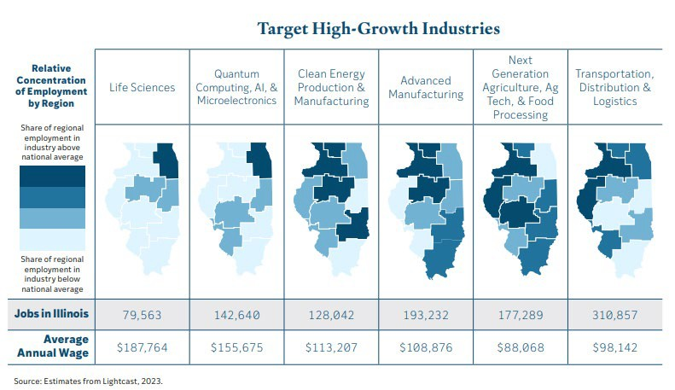







Growth Industries
LIFE SCIENCES
QUANTUM COMPUTING, AI, & MICROELECTRONICS
CLEAN ENERGY PRODUCTION & MANUFACTURING
ADVANCED MANUFACTURING
NEXT GENERATION AGRICULTURE, AG TECH, & FOOD PROCESSING
TRANSPORTATION, DISTRIBUTION, & LOGISTICS

Slide 18



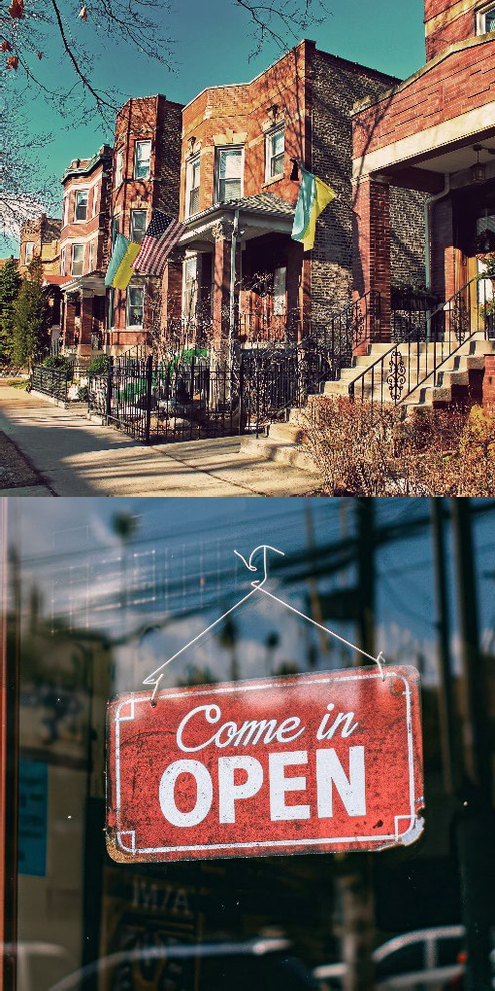




Building Resilient & Growing Communities
Education for Careers
Access to Child Care
Promote and Provide Investments in Underserved Communities
Supporting Entrepreneurs
Boosting Quality Jobs
Increasing Grant Accessibility

Slide 19

State of Illinois
Business Development Programs
2024

Slide 20

Illinois Tax Incentive Programs

Slide 21
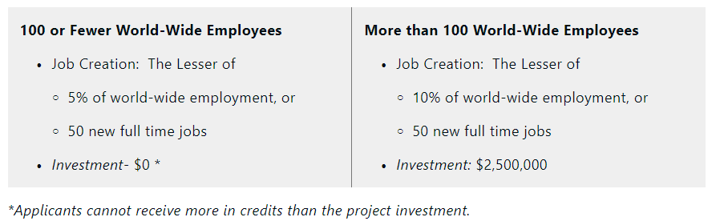
EDGE (Economic Development for Growing Economies)
Provides a tax credit equal to 50% of the new full-time employees’ payroll withholding tax and 25% withholding credits for retained jobs for 10 years to companies creating new jobs and making a qualifying capital investment.
For projects located in underserved areas, companies receive credits equal to 75% of the new full-time employees’ payroll withholding and 50% withholding credits for retained jobs.
For startups*, companies established less than 5 years before the filing of an application and that have never had any Illinois income tax liability are eligible to retain the payroll withholdings with an approved project.

Slide 22

REV (Reimaging Energy and Vehicles)
Income tax withholding is retained instead of being turned over to the state for a credit
  Up to 100 percent income tax withholding for new or retained employees
  Up to 75 percent income tax credit equivalent to construction wages
Tax credits covering up to 25 percent of employee training costs
Tax credit equal to 0.5 percent of qualified property investments
Blue Collar Job Act (BCJA) Benefits
Tier 1:
Invest in at least $2.5M and at least 50 new jobs (or 10% of WWE) in 4 years
20 year benefits (10 year plus renewal)
Tier 2:
Invest in at least $1.5B and at least 500 new jobs in 5 years
30 year benefits (15 year plus renewal)

Slide 23

Blue Collar Jobs Act
The tax credits are based on the wages paid to construction workers employed on eligible projects and may receive up to 75 percent income tax withholding credits for construction workers.
To be eligible, a company must be located in an Enterprise Zone (EZ) or a River Edge Redevelopment Zone (RERZ), designated a High Impact Business (HIB), or have an agreement under the Economic Development for a Growing Economy (EDGE) Program.
Manufacturing Machinery and Equiptment (MME) Exemption
Provides company with sales and use tax exemption all tangible personal property that is used or consumed by a purchaser in a manufacturing facility
The state also expanded the definition of production related tangible personal property to include supplies and consumables used in a manufacturing facility including fuels, coolants, solvents, oils, lubricants, and adhesives, hand tools, protective apparel, and fire and safety equipment used or consumed within a manufacturing facility.
Investment Tax Credit
Provides 0.5% tax credit on the total capital investment on a project located in an Enterprise Zone

Slide 24
Illinois Programs for Start Ups

Slide 25

EDGE for Start Ups
EDGE, the Economic Development for a Growing Economy, is a tax credit incentive program designed to encourage startups to invest, create, and retain jobs in Illinois. Businesses must be incorporated 10 years ago or less, not yet turning a profit, and ready to hire full time W2 employees to be eligible.
INVENT Illinois
The Illinois Innovation Venture Fund is a direct equity investment program funded through the U.S. Department of the Treasury State Small Business Credit Initiative (SSBCI).
The funds are expected to provide small businesses with the resources they need to sustainably grow and thrive, and to improve access to capital for traditionally underserved entrepreneurs.
Angel Investment Tax Credit
This program encourages investment in innovative, early-stage companies to help obtain the working capital needed to further the growth of their company in Illinois.
Investors in companies that are certified as Qualified New Business Ventures (QNBVs) can receive a state tax credit equal to 25% of their investment (up to $2 million).
Investors in companies that are designated Set-Aside QNBVs can receive a tax credit equal to 35% of their investment (up to $2 million).

Slide 26
Illinois Workforce Programs

Slide 27

Employer Training Investment Credit
The ETIP program is a competitive matching grant awarded to companies that provide job training to Illinois residents. The job training may be provided to both new employees and incumbent workers. The training should be a direct result of a permanent expansion, location, or retention activity. ETIP will cover up to 50% of training costs.
Apprenticeship Program
Under this program, employers are allowed a tax credit for qualified educational expenses associated with training and upskilling apprentices. Employers are eligible for a credit of up to $3,500 per apprentice against the taxes imposed by subsections (a) and (b) of Section 201 of the Illinois Income Tax Act.
This credit may be enhanced by an additional credit of up to $1,500 for each apprentice if (1) the apprentice resides in an underserved area or (2) the employer’s principal place of business is located in an underserved area. The credit is applicable to expenses such as tuition, books, and lab fees.

Slide 28
Illinois Loan Programs

Slide 29

Advantage Illinois Participate Loan Program (PLP)
The PLP offsets the risk by DCEO participating (sharing) in a portion of the loan with the Lender. There are no costs or fees to the lender or borrower. The DCEO buyout creates a lower blended rate for the borrower.
Eligible loans can be used to finance the following: equipment, real estate (must be 51% or more occupied by the business), working capital, inventory, leasehold improvements, and accounts receivable.
Advantage Illinois Loan Guarantee Program (LGP)
The LGP offsets the risk by DCEO insuring partial repayment to the Lender in case of loan default. There are origination and ongoing costs and fees to utilize the program that may affect the Lender and/or Borrower. There is no rate adjustment as we are not purchasing any portion out.
Cannabis Social Equity Loan Program
This program is an unwavering commitment to equity as the state works to ensure that entrepreneurs that have been adversely impacted by the war on drugs have a space in the growing cannabis industry.
Direct Forgivable Loans are fully financed by the State of Illinois. We offer a significant grace period, low interest rates, and full principal forgiveness upon receiving proof of eligible expenses.
Interest Rates are 4% after an 18-month grace period of no required payments and 0% interest; applicants can also pursue forgiveness prior to any interest accruing. The loan principal is 100% forgivable upon providing documentation for eligible business expense

Slide 30
Illinois International Trade Programs

Slide 31

Illinois’ State Trade and Export Program (ISTEP)
The ISTEP program provides Illinois' small businesses with both financial and technical assistance to increase their exports.
The program includes 5 options for Illinois' companies to grow their export sales: Group Trade Missions (GTM), Individual Foreign Market Sales Missions (IFMSM), and Product Compliance (PC), Website Localization (WL), and Ex-Im Bank: Export Credit Insurance (ECI).
APEX Accelerator Program
This program funds centers around the state to provide guidance for government contracting success. These centers assist Illinois businesses with all their government contracting needs whether federal, state, or local.
Foreign Trade Zones
Available to companies located in specific areas, foreign and domestic merchandise may be admitted into Zones without being subject to formal Customs entry procedures, the payment of Customs duties or federal excise taxes.

Slide 32
Illinois Grant Programs

Slide 33
Invest in Illinois
Newly created $400M closing fund that will provide discretionary grant assistance for a large project with significant job creation, retention, and capital investment.
Prime Sites Capital Grant Program
Grants assists companies with large-scale investment projects that commit to significant job creation.
Eligibility: Must have an EDGE/HIB and commit to hiring 50 new jobs and $40M in investment OR hire 100 new jobs and make $20M in investment
Grants will range from $250,000 to $10 million, up to $5,000 a job, with a 1:1 match.
Illinois Department of Transportation – Economic Development Program (IDOT-EDP)
A local government may apply for funding up to $2,000,000 for roadway improvements or construction necessary for access to industrial, manufacturing or distribution companies.
Grant funding can be up to $30,000 for every full-time job created and $10,000 for every full-time job retained.
Federal Grant Support Program
Grants assists Illinois-based businesses and organizations seeking federal grants that align with the State's economic development objectives.
DCEO may provide a 1:1 cash matching grant for capital and non-capital expenses up to $2,000,000, with prioritization based on awards that require a federal match and the number of awards an institution may have already received in the same fiscal year under this program.
Regional Site Readiness Program – Capital and Planning (Closes 10/21/2024)
The Regional Site Readiness Program aims to better prepare sites for industrial development in all 10 Economic Development Regions in the state.
The intended outcome for this grant is for communities and landowners to have better prepared industrial sites in their community to attract future investment and job creation.
The grant program has funds for Capital Ready sites as well as Planning activities for sites.

Slide 34
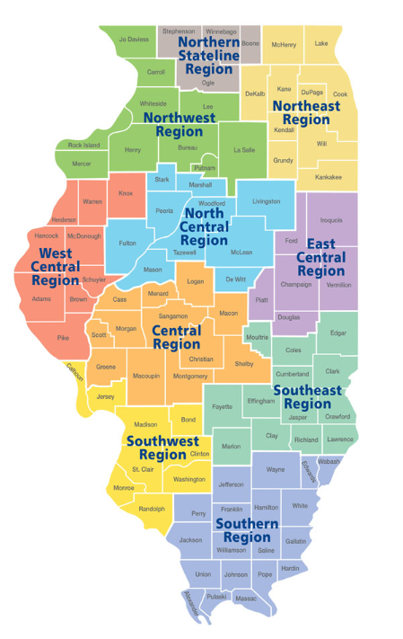
Contact information
Renee Wott, MPA
Senior Northeast Regional Manager
312.305.1892
Renee.Wott@Illinois.gov

Slide 35
Contact us:
  Nate Carlson ncarlson@niu.edu
  Jennifer Foil jfoil@niu.edu
  Jordan Johnson jtjohns@ilstu.edu

