Slide 1
Registered Apprenticeship: Business Services Coordinator
Dr. Justin Arnold and Taylor Black
Apprenticeship Illinois Summit 2025

Slide 2
Overview
Introduction
Learning Outcomes
Background
Investigation
Program Standards
Work-based Learning
Related Instruction
RAP Launch
Summary
Q & A

Slide 3
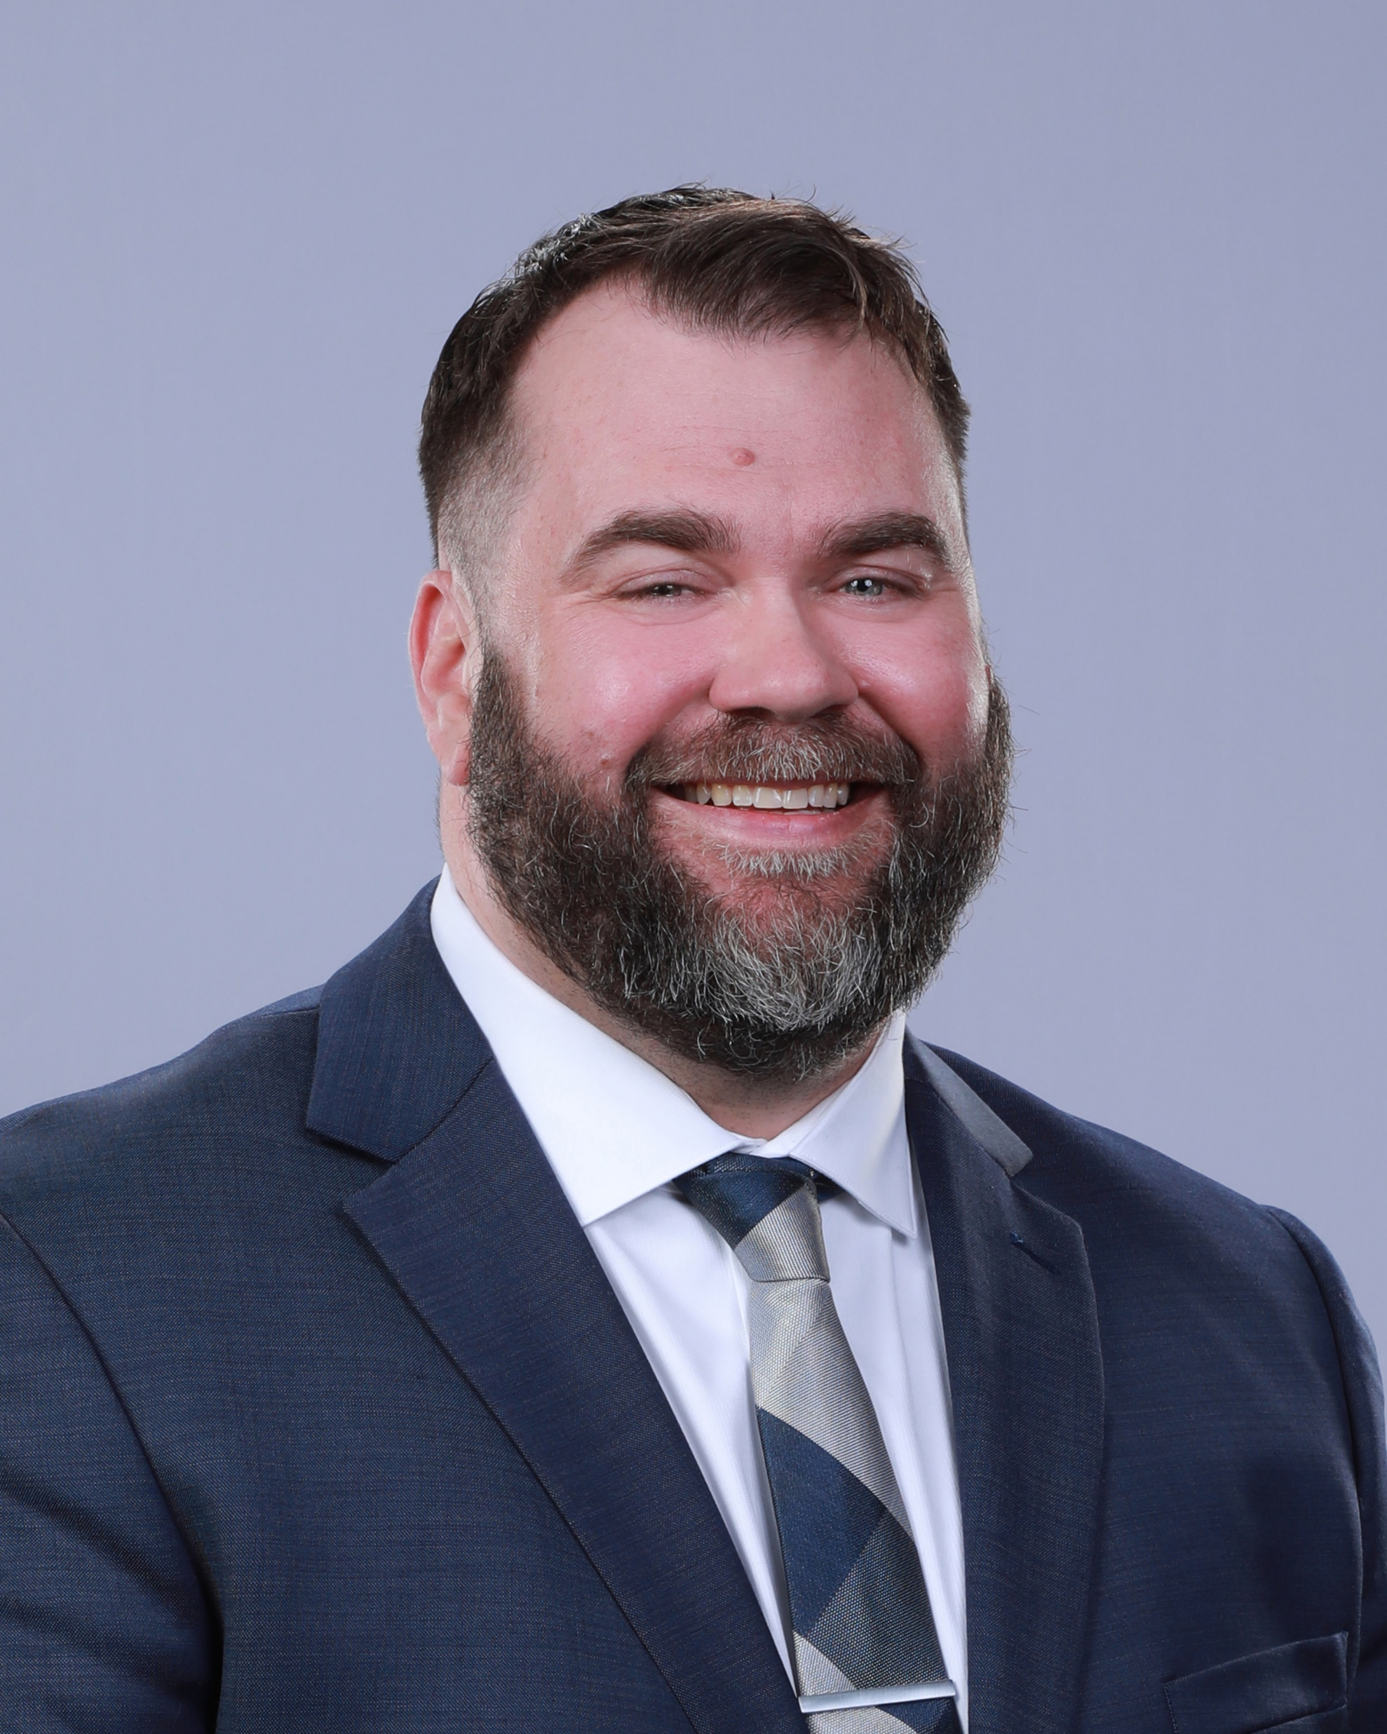
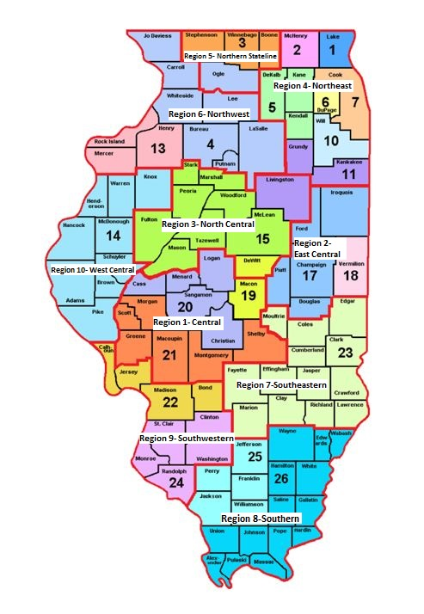
Introduction
Dr. Justin Arnold
East Central Illinois Workforce Board
Illinois Workforce Partnership

Slide 4

Introduction
Taylor Black
Apprenticeship Specialist
Business Services Coordinator (WIOA)
Apprentice

Slide 5

Introduction
Apprenticeship Illinois
Five-year Strategy for RAP Expansion
Regional Specialists + Local Business Teams
Apprenticeship Ambassadors
Apprenticeship Committee (IWIB)

Slide 6
Learning Outcomes
How a USDOL-approved "business services coordinator" registered apprenticeship can be used to develop incumbent workers in workforce development.
A description of the mentoring, work-based learning, and related instruction involved with our apprenticeship.
Q&A with both the employer and employee involved with the registered apprenticeship.

Slide 7
Background
Our workforce area’s hiring needs: administrative support, staff who can provide direct services and handle a caseload, middle-managers (“coordinators”)
The local labor pool: unfamiliar with our profession, lack skills and knowledge for both office work and community development, lack of relevant credentials
University students and graduates, “customer service” across industries, and workers in other industries looking for an office environment and first shift hours

Slide 8
Background
Reflecting on our own challenges
Isn’t this what every other employer deals with everyday?
Don’t we tell them not to expect a ready-made professional but to upskill incumbent workers and backfill entry-level positions?
How could we take our own advice?

Slide 9
Background
Did I have an incumbent worker that had been around for some time and demonstrated positive work traits (trustworthy, problem-solving, coachable, etc.)?
Did I have an incumbent worker who wanted and needed further education, and who wanted to invest in become a professional and find a career path?
Did I have an incumbent worker who, if given the opportunity to take on new work tasks and training, could rise to the challenge?
Yes.

Slide 10
Synergy
I had a staff member who wanted to think about continuing their education.
I wanted to support him.
We decided to investigate doing a RAP together.
Our first step was to investigate and make a plan.

Slide 11
Investigation
Could we pay for related instruction and books, fees, etc.?
Would I need to enroll him as a client, or would it be like regular PD?
Could we support the integration of the RTI into the workday?
Talked with our state workforce agency. Negotiated.

Slide 12
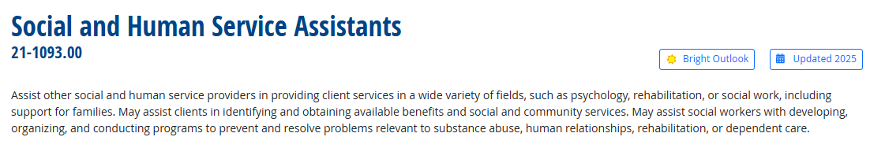
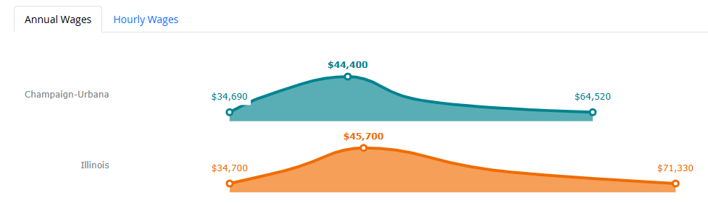
Investigation

Slide 13
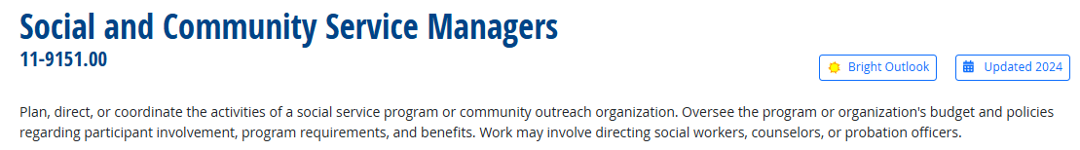
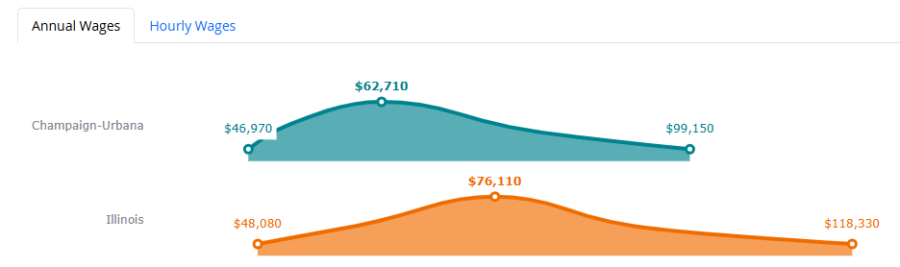
Investigation

Slide 14
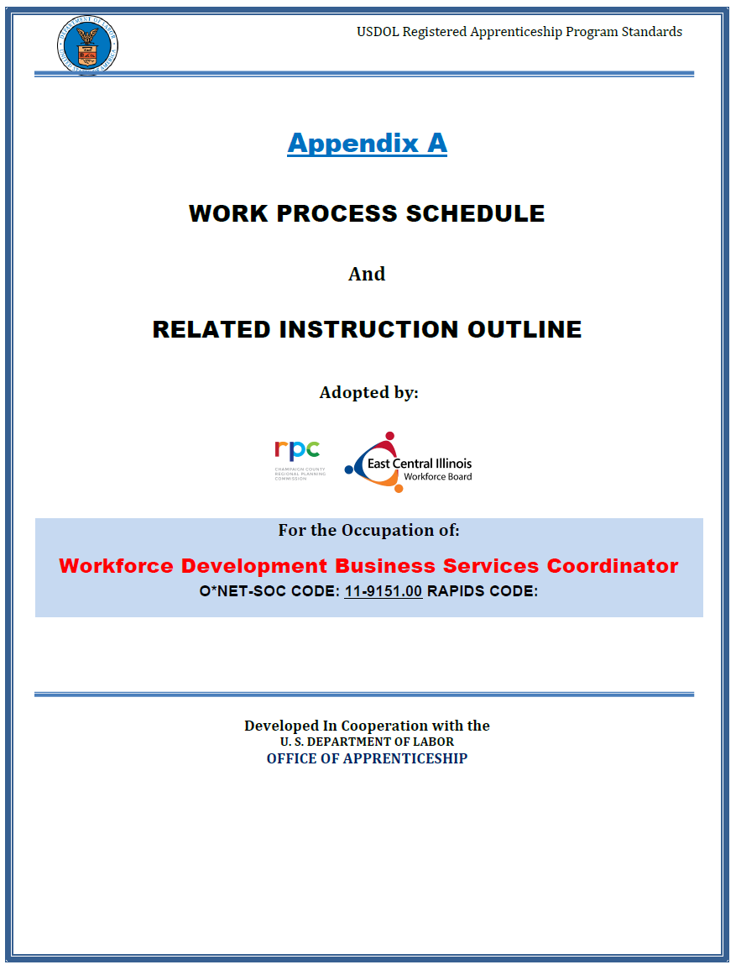
Program Standards
Working with USDOL
Program Standards (Appendix A)
Approach
Term
Ratio
Wages
Work Process Schedule
Competencies
Related Technical Instruction (RTI) Outline

Slide 15
Program Standards
Competencies
Program and operations management
Financial and resource management
Community and stakeholder engagement
Compliance and policy implementation
Leadership and staff development
Strategic program and operations oversight

Slide 16
Program Standards
Bachelor of Science, Business Management
Why? Required for the work and required for future promotion in our field (other organizations).
Related Technical Instruction (576 Hours)
Business Fundamentals
Principles of Management, Financial Accounting, Microeconomics, etc.
Core Business Concepts
Organizational Behavior, Marketing Principles, Business Law, etc.
Advanced Business Practices
Human Resources Management, Operations Management, Community and Stakeholder Engagement, etc.
Strategic and Leadership Focus
Business Policy and Decision-making, Leadership and Organizational Change, Advanced Project Management, etc.

Slide 17
Work-based Learning
Grant Management Experience
$170,000 Apprenticeship grant – Full cycle responsibility
Grant application writing
Project timelines & budget
Quarterly reporting to Apprenticeship Illinois
Fiscal management coordination
Program integrity maintenance

Slide 18
Work-based Learning
Integrate Business Services Team (IBST) Leadership
Public Relations
Coordination
Project Management
Stakeholder Engagement

Slide 19
Work-based Learning
Full-Cycle Hiring Process
Business Services Specialist position – Current project
Job description development
Structured interview design
Candidate evaluation (ongoing)
Future onboarding management

Slide 20
Related Instruction
Fundamentals for Success in Business
Foundation Coursework Competencies
Course planning
Common ethical issues
Organizational function and values
Effective communication
Emotional intelligence
Leadership and influence

Slide 21
Related Instruction
Organizational Behavior
Core Business Concepts Module
Team Development – multi-agency collaboration
Leadership Theories – Diverse stakeholder management
Motivation & Performance – Staff & partner engagement
Change Management – Policy & economic adaptation

Slide 22
Related Instruction
Business Communication
Advanced Professional Communication Skills
Strategic Messaging – Goal-aligned communication
Professional Writing – Grant applications & policy documents
Presentation Techniques – Diverse audience engagement
Cross-Cultural Communication – Regional diversity management

Slide 23
RAP Launch
Having employer and local workforce board sign-off
Both employer and employer signed a contract with submitted standards
Thinking about how to mentor and supervise
Provide a safe environment with high expectations and teachable moments
Paying for school and starting RTI
Quarterly RAPIDS reports on competency achievement

Slide 24
Summary
Background
Investigation
Program Standards
Work-based Learning
Related Instruction
RAP Launch

Slide 25
Q & A
Questions?

Slide 26
Registered Apprenticeship: Business Services Coordinator
Dr. Justin Arnold and Taylor Black
Apprenticeship Illinois Summit 2025

