Slide 1
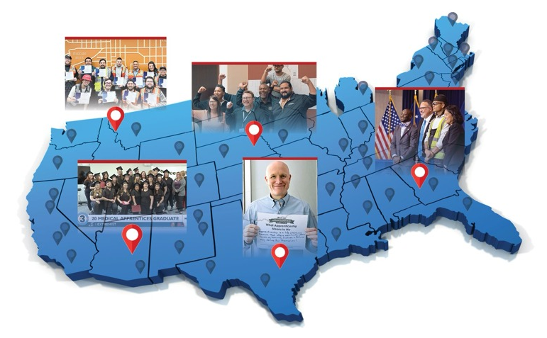
THE 10th ANNUAL
NATIONAL APPRENTICESHIP WEEK (NAW)
NOVEMBER 17-23, 2024
NAW is a nationwide celebration that brings together employers, industry associations, labor organizations, community-based organizations, workforce partners, education providers, and government leaders
to demonstrate their support for Registered Apprenticeship.

Slide 2

National Apprenticeship
Week
10th Anniversary
The theme for NAW 2024 is “National Apprenticeship Week 2024: Celebrating 10 Years of Engagement, Expansion, and Innovation.” This theme reflects the transformative power of Registered Apprenticeship and its ability to bring together key national, regional, state, and local stakeholders across the country to meet critical workforce needs.
Notes:
Jeff

Slide 3

A DECADE OF GROWTH AND DIVERSIFICATION!
Since its inception in 2014, NAW has helped broaden public awareness of Registered Apprenticeship. The dedicated efforts of these partners working to expand the National Apprenticeship System has led to the following accomplishments over the past 9 years:
Over 2.4 million new Registered Apprentices representing over 90% growth
23,729 new Registered Apprenticeship programs
Increased percentages of active apprentices from underrepresented populations, including
  225% more women
  97.5% more people representing communities of color
  126.9% more young people ages 16 through 24
  3,825% more individuals with disabilities
  42% more veterans

Slide 4

DAILY THEMES
Monday, November 18
Youth and Young People Apprenticeship Day
Tuesday, November 19
Registered Apprenticeship in New and Emerging Industries and Around the Globe
Wednesday, November 20
Expanding Registered Apprenticeship to Underserved Populations
Thursday, November 21
Women in Apprenticeship
Friday, November 22
Federal Apprenticeship and Veterans in Apprenticeship

Slide 5
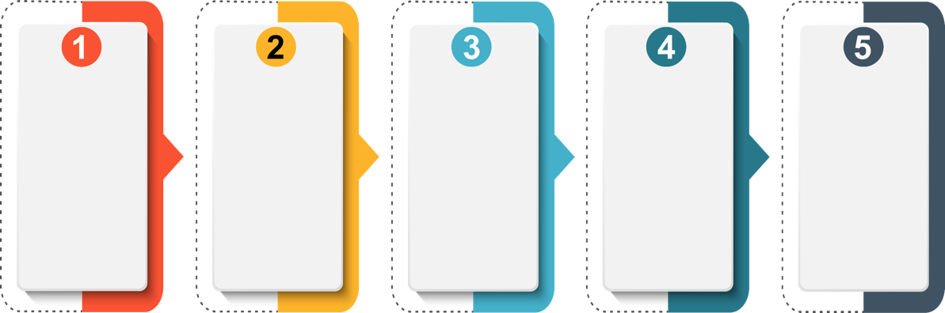
HERE’S HOW YOU CAN GET INVOLVED
Spread
The Word
Find An Event
Near You
Host
An Event
Submit Proclamations
Share Your Event Highlights
Share information about NAW and encourage your stakeholders to get involved.
Use our
interactive
NAW map
to find an event near you to participate in.
Help plan and promote NAW events, and
don’t forget to submit details
on the
NAW website.
Connect with local and state government, industry and educators
and encourage them to support National Apprenticeship Week.
Share photos, videos, blogs and more
on social media with hashtags
#NAW2024 and
#ApprenticeshipUSA.

Slide 6

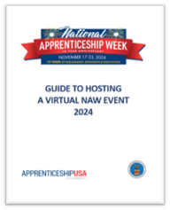
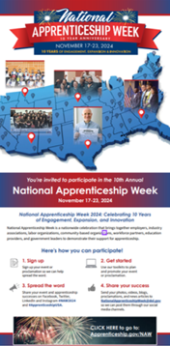
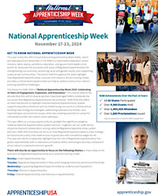
NAW RESOURCES
The NAW Resources page provides materials to help you plan, promote and enhance your NAW events and proclamations. There you will find:
NAW Logo
Factsheet
Planning & Promotional Toolkits
Guide to Hosting a Virtual Event
NAW Promotional Flyers & Mailer
Proclamation Templates
Social Media Tip Sheet
Other Resources?
Notes:
Jeff

Slide 7




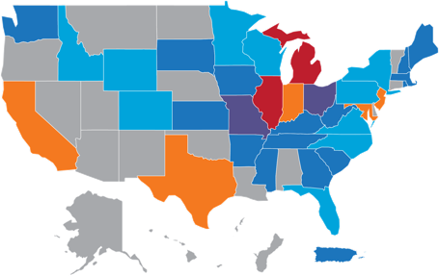

NATIONAL APPRENTICESHIP WEEK
2023 By the Numbers
1,845 Activities
472 Proclamations
1,373 Events
The 10th Annual National Apprenticeship Week (NAW) will take place from
November 17-23, 2024!
The theme of this year's celebration is "National Apprenticeship Week: 10 years of Engagement Expansion, and Innovation."
NAW is a nationwide celebration that brings together business leaders, career seekers, labor, educational institutions, and other critical partners to demonstrate their support for apprenticeship.
Get involved by hosting or attending an event or signing and submitting a proclamation!
Events Across the U.S. States and Territories
States/Territories: All NAW Events
1-10
11-20
21-30
31-50
51-100
101+
Visit www.apprenticeship.gov/NAW for resources!

Slide 8
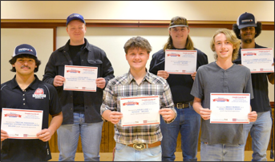
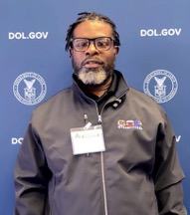
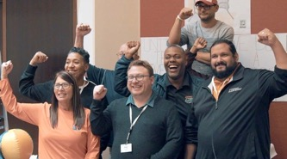
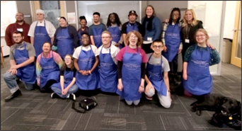
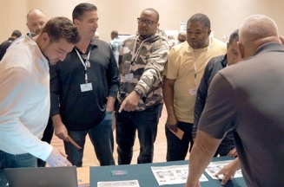
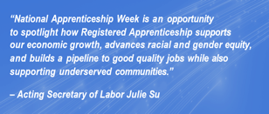
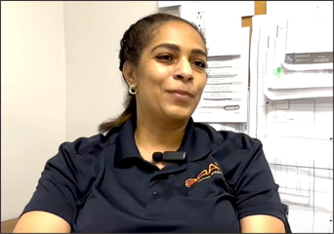
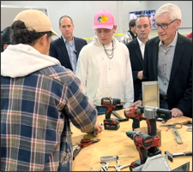
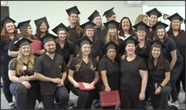
NAW 2023 HIGHLIGHTS FROM THE FIELD
Notes:
Nicole
The announcement of the introduction of new national guideline standards for the role of Project Management Specialist at IPC International, aimed at enhancing the talent pipeline in electrical contracting management. Our organization is among the pioneering entities in the nation to implement Registered Apprenticeship programs, specifically designed to assist young adults with disabilities as they transition into full-time employment opportunities.
Google acknowledged the value of apprenticeship programs by publishing a blog post titled "Advancing AI Skills Through the Apprenticeship Model." In the post, it emphasized that "apprenticeships are essential for addressing skills gaps and facilitating entry for workers into AI-driven and high-demand professions." Similarly, Amazon and Apprenti organized a successful event to honor the accomplishments of recent graduates from apprenticeship programs in cloud technology, mechatronics, and robotics. The Virtual + Amazon Hubs event, in partnership with the Global Apprenticeship Alliance, aimed to raise awareness of the benefits of apprenticeships.
Various sponsors and intermediaries shared numerous resources on how to create pathways as well as recruit and retain individuals from underserved populations including those with disabilities.
There were several events focused on women's experiences in registered apprenticeship. These included discussions on the transformative impact of apprenticeship on their lives, the return on investment that creates additional pathways for growth within the workplace, and a presentation highlighting registered apprenticeship as a strategic approach to addressing workforce challenges, particularly in the healthcare sector.
A new HBCU program was launched to create a new pathway to public service.
Many veteran events were held to bring awareness to employers on transitioning veterans to the workforce, effectively building a pipeline of military, and veteran talent and holding a statewide hiring event with more than 20,000 employers!

Slide 9

10 YEARS OF NAW ENGAGEMENT
All 50
U.S. states participate
9,960+
events held nationwide
1.4 million
event
attendees
1,825
proclamations
made
Notes:
Sasha

