Slide 1

Lunch & Learn LWIA 22/24
Bonnie Forker, Regional Apprenticeship Navigator
EDR 9 serving: Bond, Calhoun, Clinton, Jersey, Madison, Monroe, Randolph, St. Clair, Washington Counties
Partnering region: Madison County Employment and Training LWIA 22—awesome partners!
ATR: Bruce Hallam—he rocks!

Slide 2
About myself: Over 30 years of Workforce Development experience working with employers and job seekers who were incarcerated, coming out of incarceration, students and adults with disabilities, and youth in high school, adults and dislocated workers.
In the past I have been a job coach, a job developer, workshop facilitator, career planner, business rep and Business Service Team manager at two previous agencies.
In my current position I am a part of LWIA 24’s Business Services Team (1 of 2 people), Business Lead over our EDR 9 regional Business Services Team, Co-chair of our NEXUS Employers group, Vice President of our local Transition Planning Committee, WIOA Career Planner/case manager for On-the-Job Training participants. And part of our Rapid Response team.
I cover 9 counties in the Metro East Area:
Bond, Calhoun, Clinton, Jersey, Madison, Monroe, Randolph, St. Clair, and Washington Counties. We are located about 30 miles East of St. Louis City and most of our counties are rural. We are regional Business Services Team partners with St. Louis City, St. Louis County, Jeff/Frank, and St. Charles Counties for multiple regional events assisting employers and job seekers with barriers as part of our NEXUS employer group.

Slide 3

Let’s talk about Apprenticeships!

Slide 4
First the positives:
I am lucky to be able to work with a great group of Workforce Professionals that neighbors up to our region—big shout out to Madison County Employment and Training LWIA 22 and Bruce Hallam!
LWIA 22 has great apprenticeship projects through the Apprenticeship Hub Grant, West Star Aviation and apprenticeships for students with disabilities.

Slide 5
LWIA 22 Apprenticeships Continued
The Madison County Employment and Training apprenticeship program started in January 2022 and has grown to work with four high schools and five employers. (Thanks to Kayla Boesing for supplying the updates)!

Slide 6
Gateway Apprenticeship Hub- Becca Ryan, Abby Helms & Tony Fuhrmann
Madison County Employment & Training – LWIA 22
Funding is sourced from the U.S. Department of Labor’s Apprenticeship Building America program. Madison County Employment and Training was a recipient of this grant starting in the fall of 2022 and founded the Gateway Apprenticeship Hub. The Hub aims to create a varied and skilled workforce in the St. Louis region and southern Illinois, including 18 Illinois counties and 5 Missouri counties.
Goal of 750 apprentices by June 2026
Funding is available for pre-apprenticeships and employer incentives for apprenticeships within the education, healthcare or bioscience industries
Major project successes:
First teacher apprenticeship program in the state of Illinois – McKendree University
Over 420 apprentices registered since January 2023
77% of apprentices are female
60% of apprentices are Black/African-American
Numerous state and national presentations given to showcase models and provide technical assistance

Slide 7
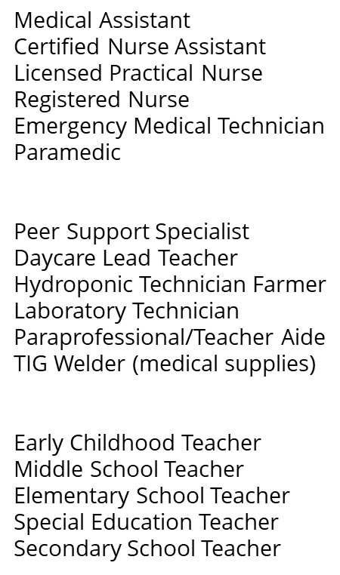
Programs Available Include:

Slide 8
LWIA 24 Apprenticeships
(RYA) Midwest Career Source Vocational School (INTR) Healthcare Industry:
**Midwest Career Source is a private vocational school. MCS provides adult students for an evolving workplace, the opportunity to pursue career choices and to develop a variety of technical and workplace skills to transition into employment in preparation for life-long learning. They strive to go above and beyond for their students no matter the challenge. Over the past 10 years, their staff have helped more than 600 students improve their study habits, comprehension, and test-taking skills. Their tutors are available to assist with not only passing their assessments but also address test anxiety and how to improve study habits for future testing in the future.
As a result, these students have earned better test scores and grades, and grown in self-esteem and confidence. MCS prepares students to earn a national certification through Pre-apprenticeship/job shadowing opportunities. Their Healthcare Pre-Apprenticeship model introduces students to the healthcare industry to determine their interest in the field. The program is focused on preparing individuals for entry into the healthcare careers that include Certified Nurse Assistant, Phlebotomist, Psychiatric Technician and Clinical Medical Assistant through job shadowing/internships.
In the pre-apprenticeship and apprenticeship model, students are provided mentoring, counseling with an on-site psychologist (to address any trauma related issues that may be a barrier to employment), staff also assist with addressing transportation and childcare barriers as well. MCS provides resources and referrals to agencies who would be able to assist with limiting or eliminating those barriers. Students are placed at local hospitals, clinics, and assisted living facilities for their employment and hands on training.
**https://www.midwestcareersource.com/about

Slide 9
LWIA 24 apprenticeship continued
For More Information Contact
**MAC Medical, Inc. is a local, family-owned company and an industry leader in manufacturing high-quality stainless steel and laminate healthcare equipment. Utilizing state-of-the-art equipment including a 3D CAD solid modeling system, fully automated fabrication line, and a team of highly skilled craftsmen and women, MAC Medical produces American made equipment that is built to last and unparalleled in the marketplace.
MAC Medical’s Apprenticeship Program is designed for the next generation of Tradesmen/Tradeswomen. Get on-the-job training and learn a valuable trade while getting paid. Presently, TIG Welder Apprenticeship are available-- apprentices are recruited from local High Schools, local colleges and our EDR 9 referrals. We are educating them on branching out into more apprenticeships, but they have new HR staff, and they want them to fully understand the process before starting another apprenticeship position. We have assisted with WIOA funded Incumbent Worker funding and On-the-Job Training reimbursements plus special regional grants are being written for further assistance.
**https://macmedical.com/apprenticeship-program/ for video an in-depth information about their Tig Welding apprenticeship
Charles Dooley
Charles.Dooley@Illinois.gov
John Barr
John.W.Barr@Illinois.gov
Matthew Hillen
Matthew.Hillen@Illinois.gov

Slide 10
Take aways from my experience
Employer buy in
Employer resistance
Employers like the idea of having a formal training program to help recruit good talent.
Employers appreciate the assistance to recruit and refer apprentices to their company.
Employers like the assistance and consultation services provided at no cost.
Employers don’t want to have DOL rules to implement a formal training program.
They don’t like the eligibility criteria and hoops that job seekers have to go through to get any funding to assist with hiring/training. (WIOA)
Employers don’t like the government involvement and paperwork even when the ATR and Apprenticeship Specialists help reduce most of it.
They don’t like the mandatory classroom training—we explain that it is easier and they are probably already doing most of it—but they don’t like it being mandatory and monitored in anyway.

Slide 11
Contact information
Bonita (Bonnie) Forker
Regional Apprenticeship Navigator, EDR 9
Business Services Team- St. Clair County IGD
19 Public Square, STE 200
Belleville, IL 62220
CELL: 618-631-5091 (text & voice) OFFICE: 618-825-3270
EMAIL: bonita.forker@co.st-clair.il.us
Rebecca (Becca) Ryan LWIA 22
Apprenticeship Grant Manager
Gateway Apprenticeship Hub
Madison County Employment & Training Department
101 East Edwardsville Road, Wood River, Illinois 62095-1332
Office (618)296-4456
Cell (309)265-8265
rrryan@madisoncountyil.gov
Abby Helms, Madison County LWIA 22
Gateway Apprenticeship Hub
Madison County Employment & Training Department
101 East Edwardsville Road, Wood River, Illinois 62095-1332
Office (618)296-4992
Cell (309)433-4859
amhelms@madisoncountyil.gov
ATR: Bruce A. L. Hallam
Apprenticeship & Training Representative
Employment and Training Administration (ETA)
Office of Apprenticeship
U.S. Department of Labor
Hallam.Bruce.AL@dol.gov
217-693-8991
Questions????

