Slide 1
Regional showcase: LWIA #25
May 20, 2025
Apprenticeship specialist | Man-tra-con

Slide 2
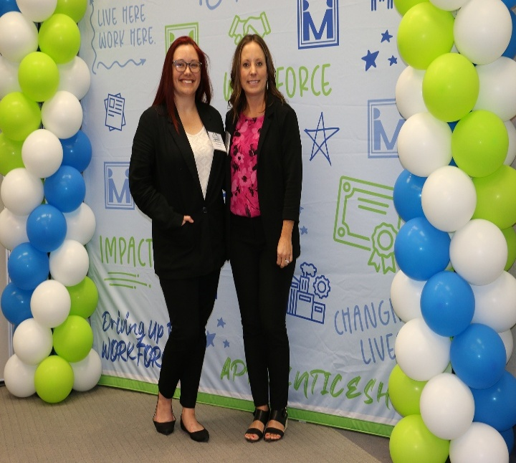
introduction
Emily Perks — Employer Services Manager, Man-Tra-Con
Abby Russell — Employer Services Coordinator, Man-Tra-Con
LWIA 25 consist of Franklin, Jefferson, Williamson, Jackson and Perry counties in Southern Illinois and is overseen by the Southern Illinois Workforce Development Board. Man-Tra-Con is the administrative entity with regards to all Title I-B activities
Man-Tra-Con is a private not-for-profit, 501(c)3 Charitable, community-based organization
Our mission is to provide area businesses with a qualified workforce and help job seekers reach their career or employment goals and we have been providing those services to Southern Illinois since 1979
The majority of Man-Tra-Con’s funding is from the Workforce Innovations and Opportunity Act (WIOA). However, the agency administers several other projects including Apprenticeship Expansion (Navigator) and Intermediary.
Abby Russell (left) and Emily Perks attend the 2024 Workforce Summit held at John A. Logan College.

Slide 3
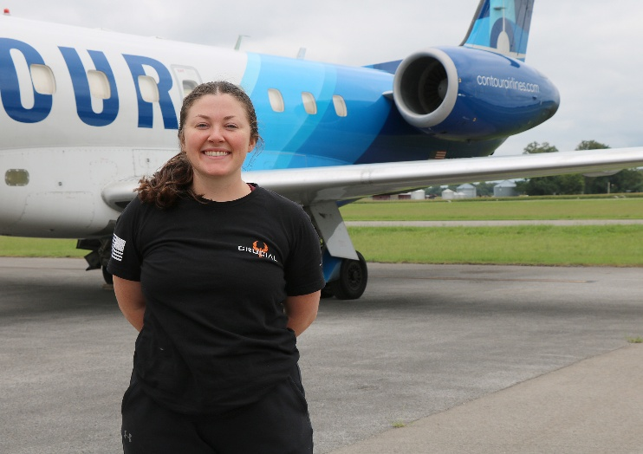
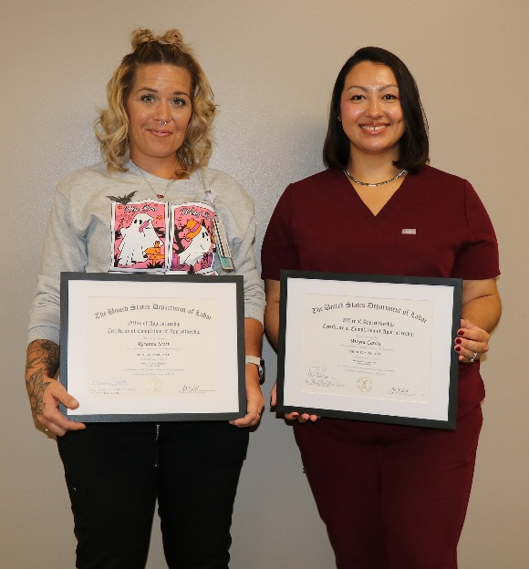
Programs in progress
Developed or expanded programs:
Pepsi — CDL
Liberty Village — LPN
D&D Electric
Programs in the works:
Deaconess/John A. Logan College — RN
John A. Logan/Southern Illinois Healthcare — Surgery Technician
Pre-apprenticeship: Liberty Village — LPN
Rend Lake College/Magnum Steel — Welding
Additional Apprenticeship Data:
Shawnee Health — 38 apprentices, including 10 Medical Assistants and 4 Dental Assistants
Pepsi MidAmerica — 7 CDL Drivers and 7 Industrial Truck Mechanics
Crucial MRO — 6 Airframe and Powerplant Mechanics
Shawnee Communications — 2 Telecommunications Technicians, and 1 Underground Utility Installer
To date, 35 apprenticeships have been completed.

Slide 4
Collaborations & Partnerships In action
Integrated Business Services Teams — Rend Lake College, John A. Logan College, Chambers of Commerce,
SI NOW, DCEO, IDHS-DRS, IDES,
& referrals
Jefferson County Development Corporation — Manufacturing Day
Unions — Expanded this year
Regional Office of Education — Career Days and tours
Illinois Manufacturing Association (IMA)
Illinois Manufacturing Excellence Center (IMEC)
Southern Illinois Now

Slide 5
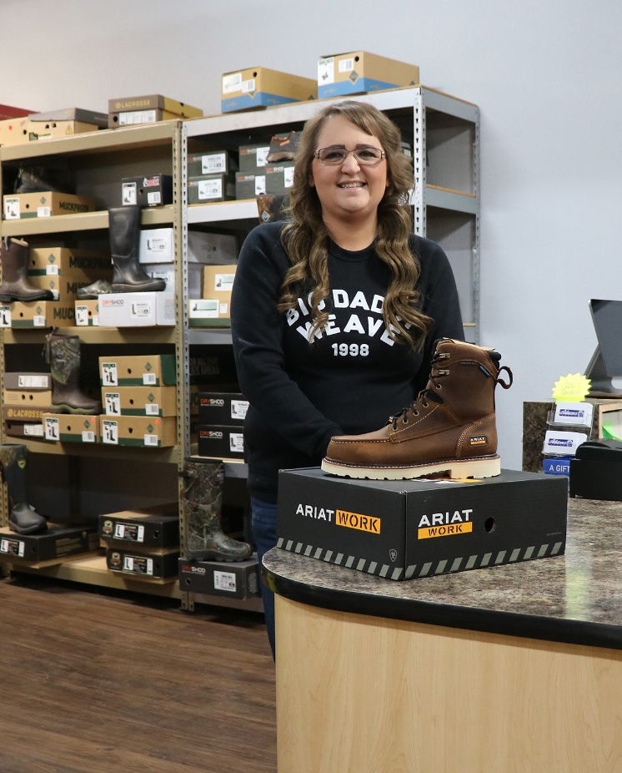
Funding innovations
Here are several ways we’ve used Apprenticeship Illinois grant funds and/or WIOA formula funding to support apprenticeship programs:
Support Services — boots, tools, uniforms
Curriculum Reimbursement — for an expansion
On-the-Job Training
Technical Assistance
Collaboration — Connecting employers and working with training providers

Slide 6
Occupations/Employer Partners/Unions
City of Carbondale — Police Officer
Crucial MRO – Aviation Mechanic
Donelson Concrete — Construction Craft Laborer
Family Foot & Ankle — Medical Assistant
Prysmian — Maintenance
Liberty Village of Marion — LPN
Pepsi MidAmerica — Diesel Mechanic, CDL
Shawnee Health — Community Health Worker, Dental Assistant, Medical Assistant
SIH Medical Group — Medical Assistant
D&D Electric — Electrician
318 Local Union

Slide 7
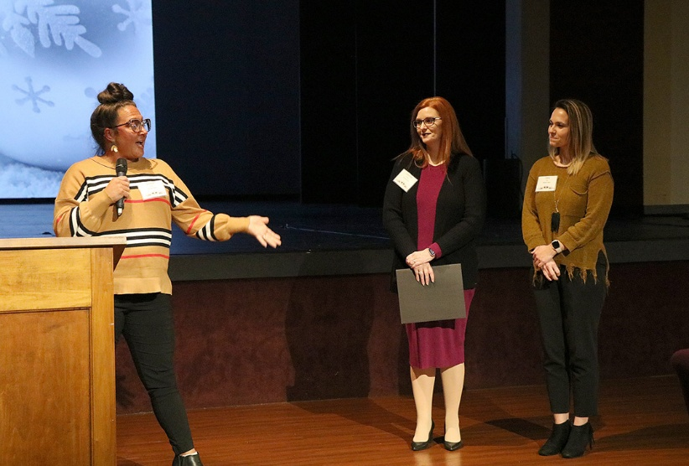
APPRENTICESHIP Success
SHAWNEE HEALTH: Statewide Business Leadership Award Winner!
Through apprenticeships, “grow your own”
programs, and the assistance of local partners, Shawnee Health has successfully enhanced and stabilized its workforce while contributing to the economic viability of the local workforce, as well
as expanded access to care for its community.
Results to Date: 18 current completers and 10 active total in Community Health Worker, Dental Assistant
and Medical Assistant positions.

Slide 8
APPRENTICESHIP Success
Training Opportunities Lead to Success
Pepsi MidAmerica, Crisp Container, and Man-Tra-Con
Strengthen CDL Apprenticeship Partnership
Pepsi MidAmerica and Crisp Container continue to enjoy a strong and
positive working relationship with Man-Tra-Con Corporation, collaborating to develop and enhance their CDL Driving Program. Through the implementation
and execution of the CDL Apprenticeship program, this partnership has been instrumental in providing meaningful and effective training tools for employees entering the trucking industry.
As part of this ongoing commitment to workforce development, Crisp Container
is proud to welcome four new CDL apprentices to the program: Daniel Lucas,
Baxter Cather, Jonathan White, and Braden Freeman. These individuals will
receive hands-on experience, professional training and the skills needed to become licensed commercial drivers.
At Crisp Container, we recognize the importance of investing in the next
generation of drivers. By working closely with Man-Tra-Con, we ensure that our apprentices receive the support and guidance necessary to succeed in their careers. We look forward to seeing Daniel, Baxter, Jonathan, and Braden grow in their roles and contribute to the continued success of our team. Welcome aboard!

Slide 9
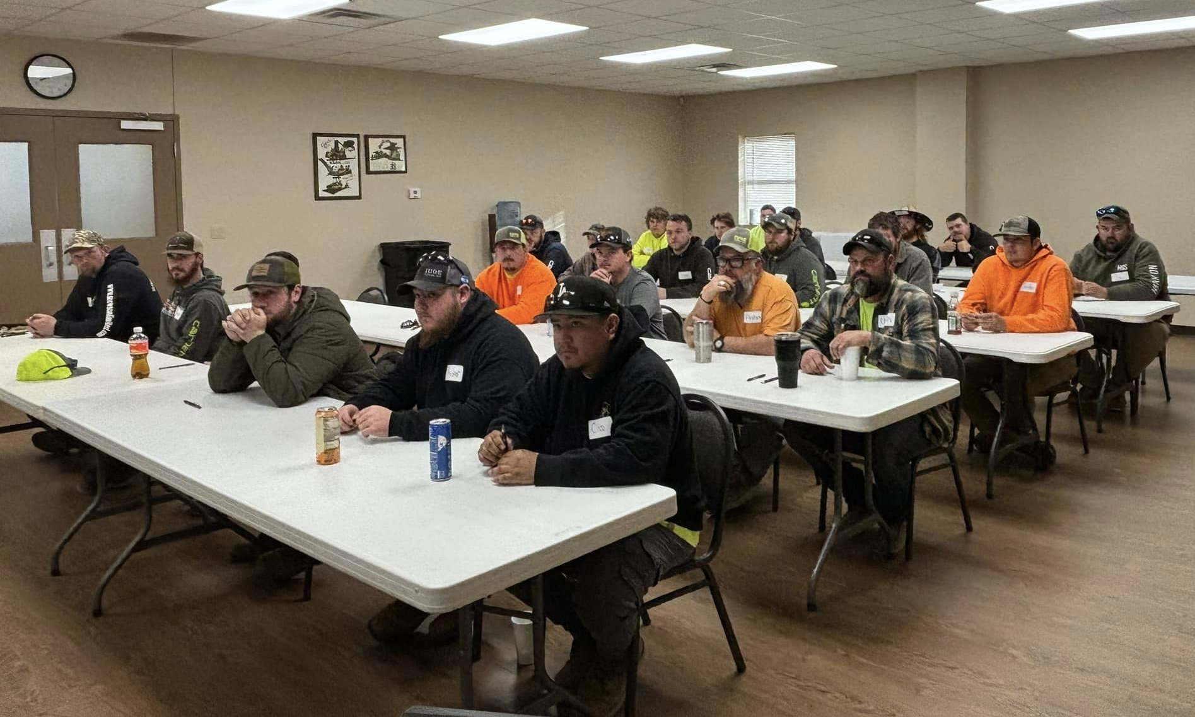
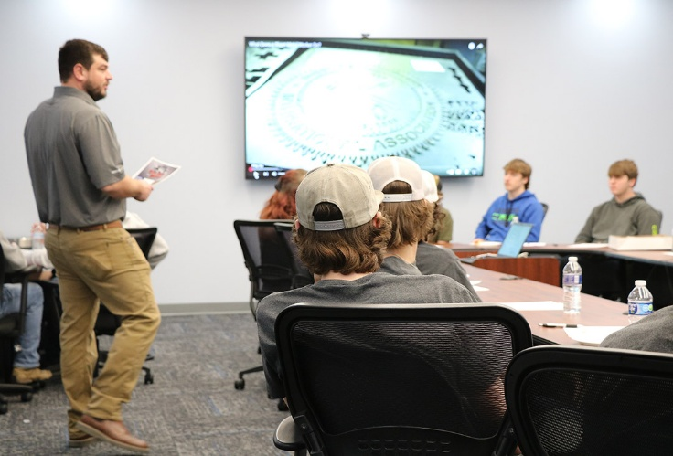
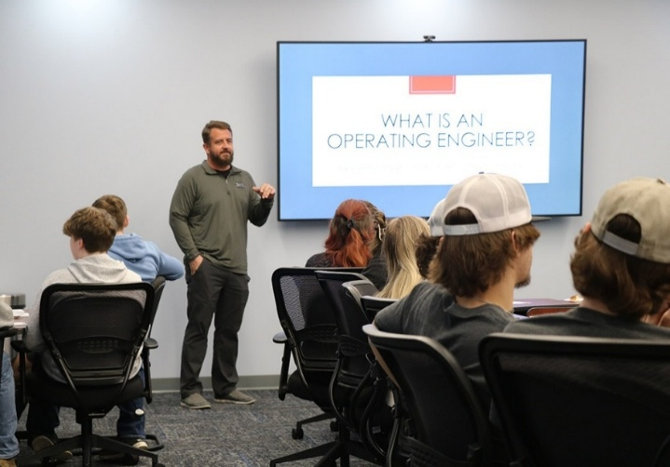
Union Day —
Local High Schools
Students from Marion High School, Thompsonville High School, and West Frankfort High School attended a Union Day event at the American Job Center in Marion.
Approximately 50 high school students listened to presentations from Man-Tra-Con staff and local union representatives. Students were able to learn about potential training and employment opportunities at
each union.

Slide 10
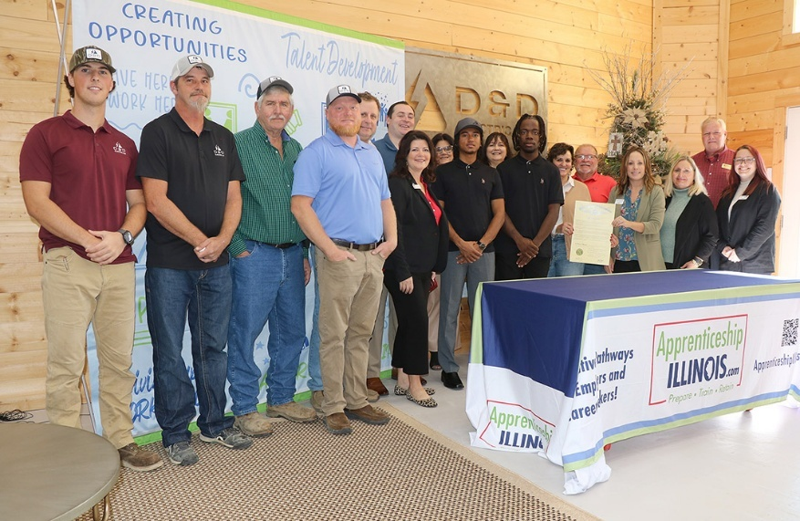
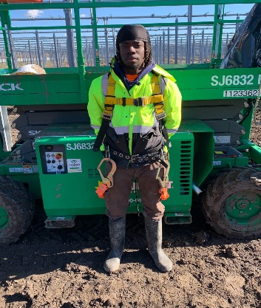
APPRENTICESHIP Success
Domarion finds full-time employment with assistance
from Apprenticeship Program and QUEST grant funding.
In July 2024, Domarion enrolled in the Apprenticeship Program with D & D Electric, LLC, in Harrisburg, Illinois. Domarion appreciated the assistance he received, and has this to say about the Apprenticeship Program, "It is a great opportunity. Stick with it and you'll get more job opportunities and won't be so replaceable. Apprenticeship makes you more valuable to your employer.”
Representatives from the State of Illinois, Apprenticeship Illinois, and Man-Tra-Con Corporation held a State Proclamation and Apprenticeship Program signing event on November 19, 2024, to celebrate the 10th anniversary of National Apprenticeship Week.
D & D Apprentice
Kevin Robinson (left)
was recently named Apprenticeship Ambassador for the
2025 program year.
We have helped over 20 apprentices with Support Services.

Slide 11
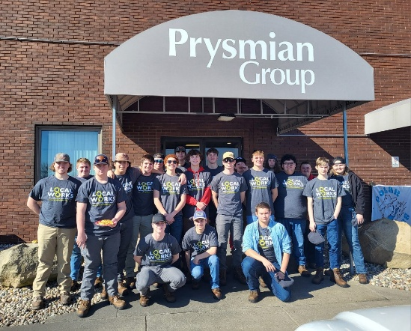
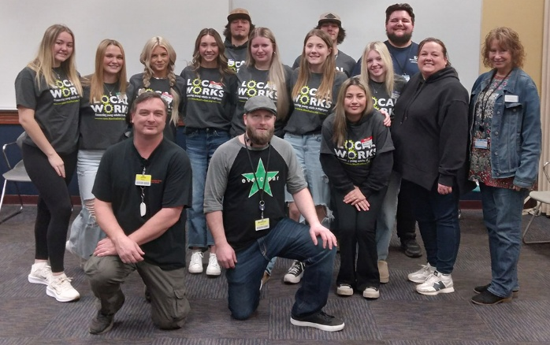
High School tours
Benton HS toured the Jolt plant in Benton
Du Quoin HS & Pinckneyville HS toured the Prysmian plant in Du Quoin
Marion HS toured the Aisin plant in Marion
West Frankfort HS toured Continental Tire & Walgreens Distribution Center in Mt. Vernon

Slide 12
Contact us
We would love to connect with you…
LWIA 25 Team
Emily Perks — emilyperks@mantracon.org
Abby Russell — abbyrussell@mantracon.org
Apprenticeship Illinois Team
Nate Carlson — ncarlson@niu.edu
Jordan Johnson — jtjohns@ilstu.edu
Jennifer Foil, Ph.D. — jfoil@niu.edu

