Slide 1



Regional showcase: LWIA #10
10/8/2025
John Hall| Will county investment board

Slide 2

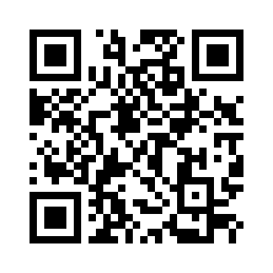
About the presenter:
John Hall – Business Services Supervisor & Will County Apprenticeship Specialist
E-mail: john.hall@willcountyillinois.com
Phone: (815) 724-1546

Slide 3
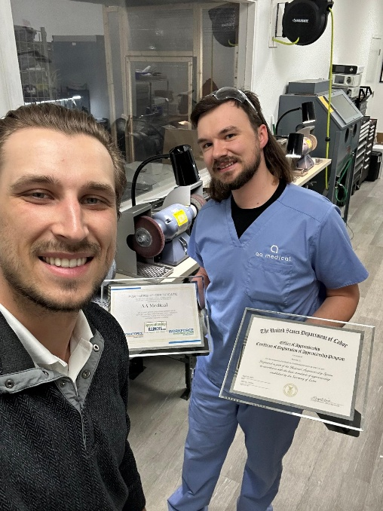
Why apprenticeship?
The Employer Case for Apprenticeship
The Basic Reasons:
Address workforce gaps and skills shortages
Provide “earn while you learn” opportunities
Build a sustainable talent pipeline
The Reasons Businesses Want to Hear:
They WORK!
They save you money
They strengthen your reputation
Tax benefits & access to incentives

Slide 4
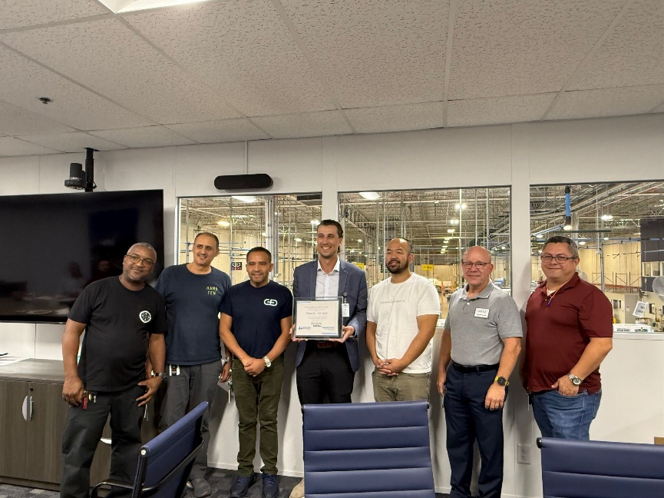
Partnerships In action:
In LWIA 10, we work with…
Local education providers
Will County Center for Economic Development
Training Providers/Intermediaries
Dept. of Labor – ATRs!!!
Notes:
Local education providers
Governor’s State University, Joliet Junior College, St. Francis University, Local High School Districts
Will County Center for Economic Development
Training Providers/Intermediaries
Illinois Manufacturing Excellence Center
Calumet Area Industrial Commission
Dept. of Labor – ATRs!!!

Slide 5
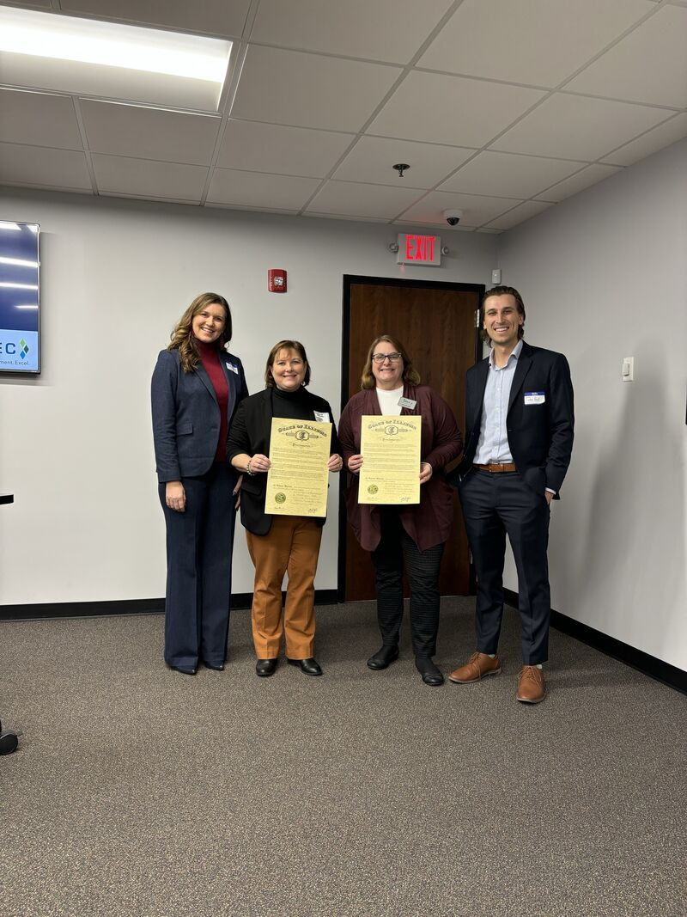
Local context: Will county
Large, diverse workforce
4th most populous county in IL
#1 county in IL for job creation over last 5 years (~17,900 jobs created over last 5 yrs)
Key Industries
Healthcare, Manufacturing, Logistics, IT
Local Challenges
Skill mismatches
Retention Issues
Employer hesitancy

Slide 6

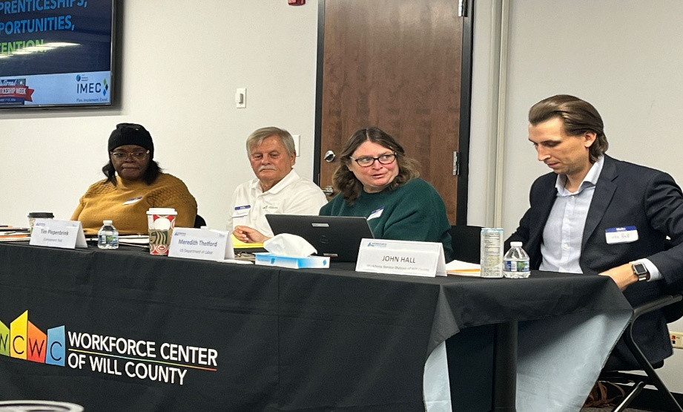
Strategies: Employer engagement
Use data and local context to your advantage!
Business Services Teams
Apprenticeship Framework
Employer Driven
Speak Their Language!
Notes:
Business Services Teams
Serve as consultants
Apprenticeship Framework
Should be framed as a SOLUTION for employers, rather than just an option
Employer Driven
Company knows their pain points – it’s our job to listen and build programs to combat them
Get them to drive the conversation!
Speak Their Language!
Data, ROI, etc.

Slide 7
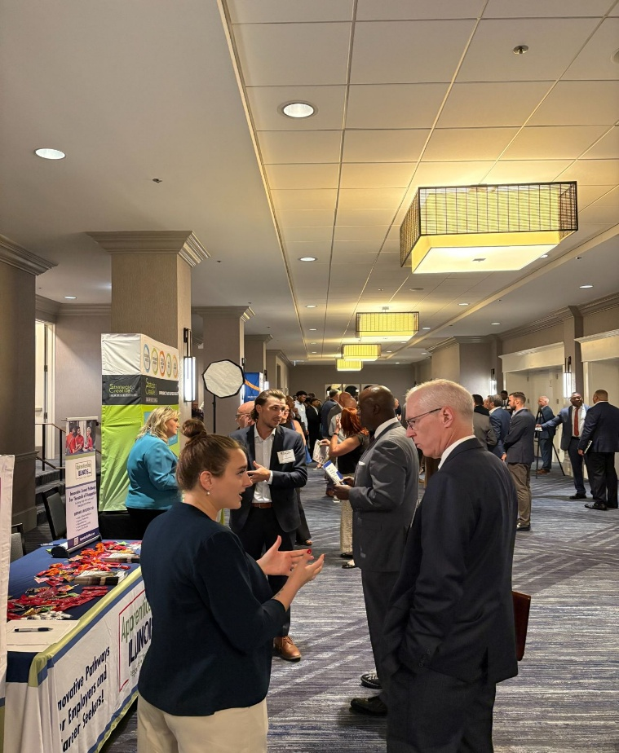
Implementation & Support
We are the experts!
We’re the government and we’re here to help……… lol
Registration
Coordination
Ongoing assistance

Slide 8
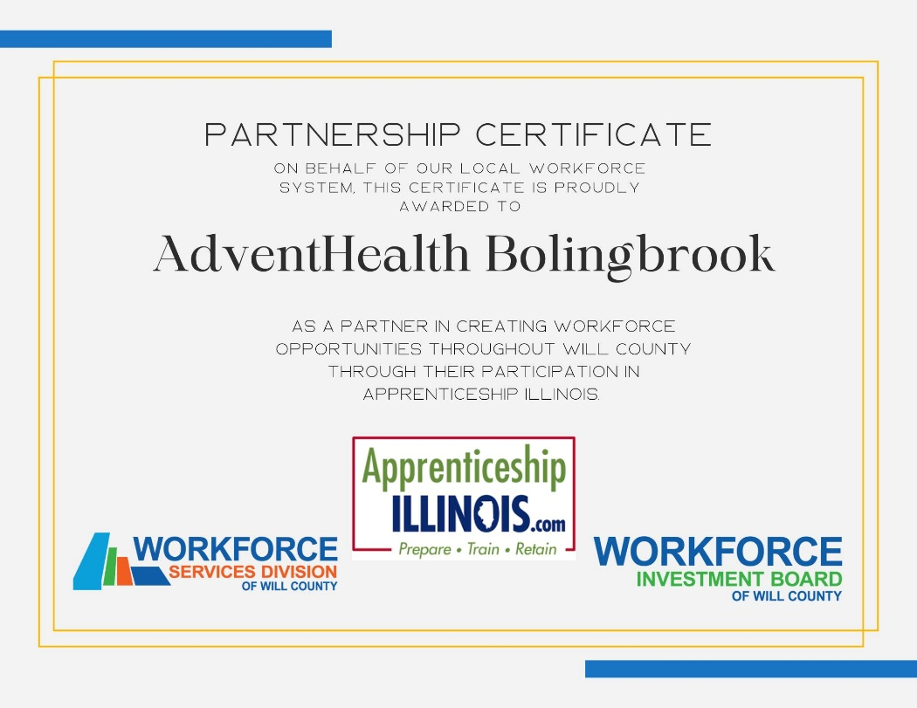
Funding innovations:
Here are some ways we’ve used Apprenticeship Illinois grant funds or WIOA formula funding to support apprenticeship…
Apprentice Stipends
Tuition Coverage

Slide 9

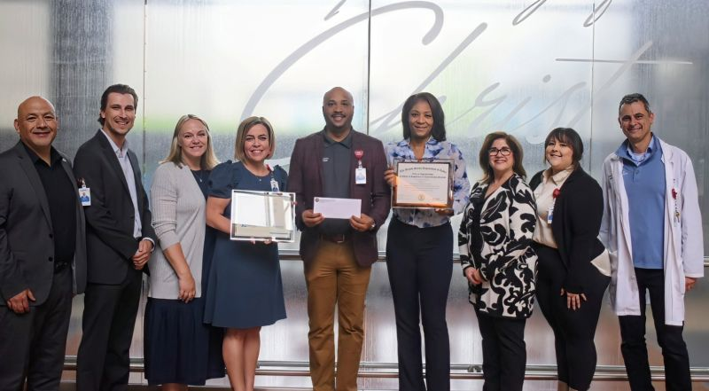
Apprenticeship in action: Adventhealth Bolingbrook Case study
Notes:
Started as IWT
Looped in ATRs
Reshaped the way they saw the training
Maintain communication – hospitals are busy
Be patient (pun intended)
Communicate and follow up every step of the way
Celebrate them!
Involve the community, CEOs, etc.
Partnership – this framework was adopted across other adventhealth hospitals

Slide 10

Lessons learned
Employer hesitancy and upfront time commitments
Registration and compliance complexities
Ongoing communication
TRUST!!!!
Notes:
Must recognize that these business owners poured their life and savings into building a company. They aren’t all going to be all-in right off the bat in adding a completely new function of their operations due to a government initiative
We must do all the government BS. Once they get a single whiff of the paperwork, DOL reporting/registration, they will become hesitant. We must handle these aspects and let them run the program.
Stay in touch. Take visits, go to apprentice journeyworker graduations, check in, ask how things are going. This is what builds familiarity and trust.

Slide 11



Looking ahead…
Expanding into emerging industries
Growing outreach through events
Employer collaboratives
Aligning with future workforce funding opportunities

Slide 12
Discussion / Q&A
Employers – How have apprenticeships impacted your business?
Education & Training Providers – What gaps do you see between classroom learning and workplace readiness?
Everyone – How can we make apprenticeships more visible and appealing to young people?

Slide 13
Let’s connect and share ideas!
John Hall – Business Services Supervisor & Will County Apprenticeship Specialist
E-mail: john.hall@willcountyillinois.com
Phone: (815) 724-1546

