Slide 1
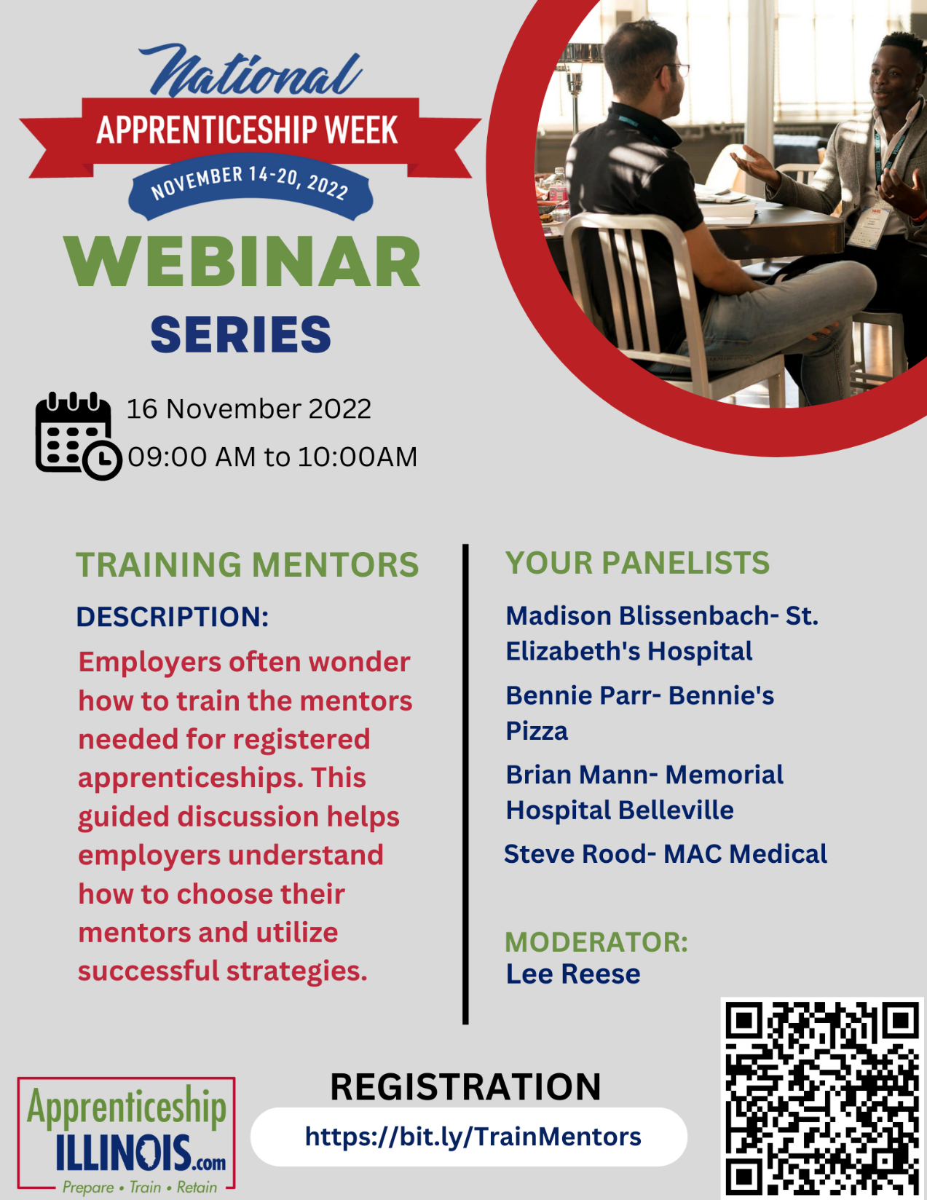
A couple of housekeeping items before we get started with today’s webinar:
All attendees are muted. You have the ability to mute or unmute yourselves.
However, we ask that you remain muted unless you are speaking to reduce background noise.
We invite you to post any questions in the chat and they will be addressed.
The session will be recorded and posted to the NAW2022 website: https://bit.ly/NAWAPIL2022
This session will use the Live Transcript feature to provide closed captioning.

Slide 2
Welcome by EDR 9
Apprenticeship Mentor Training Webinar
National Apprenticeship Week 2022.
November 16th, 2022

Slide 3
Question:
How did you start your relationship with your apprentice?

Slide 4
Question:
Did you feel more productive as a result of being a mentor?

Slide 5
Question:
What do you wish you had known before becoming a mentor?

Slide 6
Question:
Has communication and/or generational difference been difficult?

Slide 7
Question:
What did you have to improve to be a good mentor?

Slide 8
Question:
Would an online mentor training be of value?

Slide 9
Question:
What skills does a mentor need to be successful?

Slide 10
Mentor Presenters
St. Elizabeth’s Hospital| Madison Blissenbach| Madisonannblissenbach@gmail.com
Bennie’s Pizza| Bennie Parr |parrbennie@yahoo.com
Memorial Hospital Belleville| Brian Mann |Brian.Mann@bjc.org
MAC Medical| Steve Rood |srood@macmedical.com

Slide 11
Webinar Facilitator
Lee Reese
Workforce Development Program Coordinator
St. Clair County Intergovernmental Grants Department
Workforce Development Group
19 Public Square, Suite 200
Belleville, IL 62220
Office: 618-825-3259
Cell: 618-971-1348
Email: lee.reese@co.st-clair.il.us

Slide 12
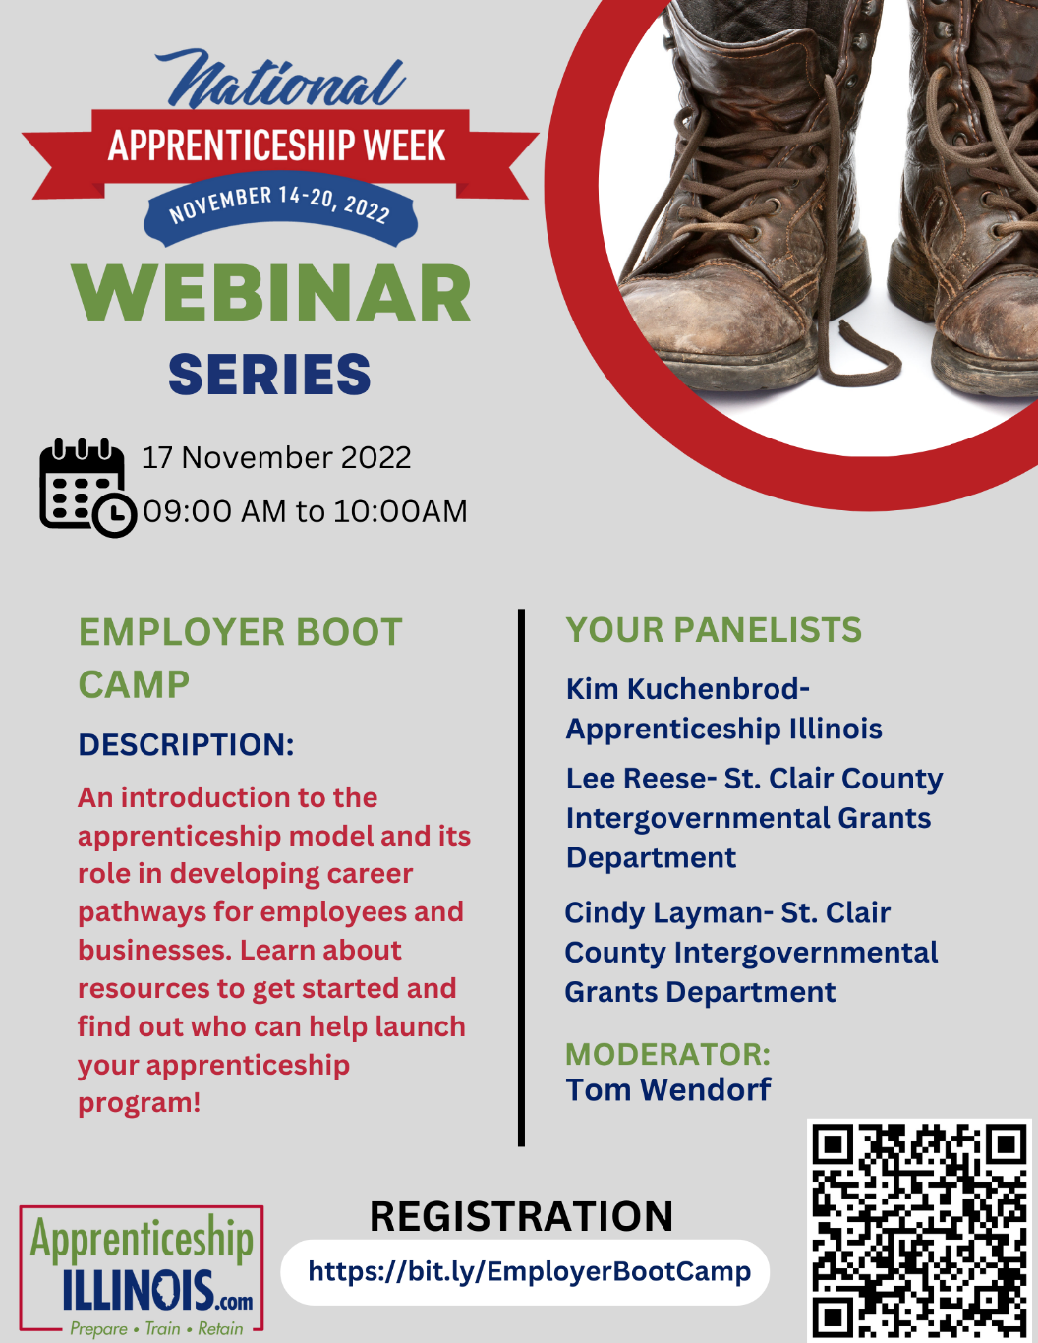
Don’t miss the next two webinars!

