Slide 1
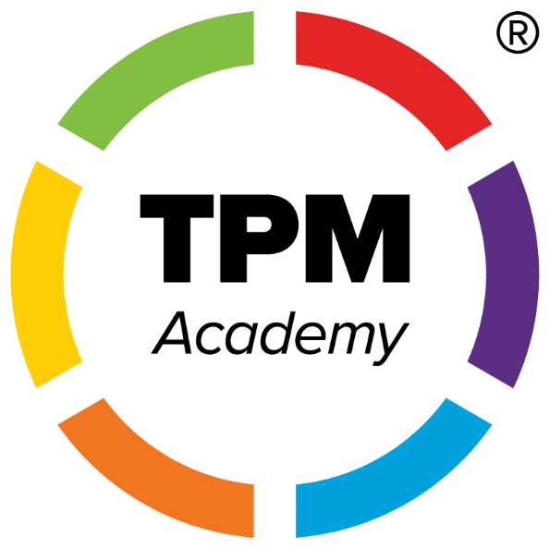
Building Illinois’ Skilled Workforce With Talent Pipeline Management and Work-Based Learning Strategies
Presented by: Kim Kuchenbrod, CWDP
TPM Faculty/Fellow – USCCF
Talent Pipeline Manager – NIU/DCEO
Notes:
Good morning,
Quick introduction, if needed.
Employers and training providers serve as critical stakeholders in the success and influence of apprenticeship programs.
This webinar will delve into the alignment of Work-Based Learning (WBL) opportunities with the Talent Pipeline Management (TPM) framework, aiming to establish a sustainable talent pipeline. This approach ensures the fulfillment of both immediate and long-term workforce needs for employers while supporting the professional growth of employees.

Slide 2
Introduction
What is Talent Pipeline Management (TPM)?
A demand-driven workforce strategy aligning education and training with employer needs.
What is Work-Based Learning (WBL)?
A hands-on approach integrating academic learning with real-world work experiences.

Slide 3
Illinois' TPM Overview
Key Features:
Assessing Workforce Needs
Building Partnerships
Designing Aligned Training
Impact:
Improved job placement rates.
Enhanced alignment of training programs with industry demands.
Notes:
At its core, the Talent Pipeline Management (TPM) framework emphasizes:
Assessing Workforce Needs: Gathering insights from employers to identify both current and emerging skill gaps.
Building Partnerships: Establishing strong collaborations with educational institutions, training providers, and community organizations to support workforce development.
Designing Aligned Training: Creating tailored training programs that address specific employer requirements, ensuring that learning directly translates into workplace readiness.
When executed effectively, these strategies lead to a win-win: organizations gain a skilled workforce, and individuals achieve meaningful career growth.

Slide 4
Key Characteristics and Components
Shared Goals
Successful partnerships thrive when all stakeholders align on common objectives, creating a unified vision for the future.
Active Participation
Active involvement from all stakeholders is crucial, fostering engagement and investment in the partnership's success.
Effective Communication
Clear and open communication channels ensure all parties stay informed and engaged, minimizing misunderstandings.
Focus on Workforce Needs
Partnerships should prioritize the needs of the workforce, ensuring training and job placement services meet industry demands.
Notes:
Successful industry sector partnerships often share key characteristics: shared goals, active participation from stakeholders, effective communication, and a focus on workforce needs. Components may include training programs, mentorship opportunities, and job placement services.

Slide 5
Work-Base Learning (WBL) in Illinois
Definition:
Sustained interactions with industry professionals in real or simulated workplace settings.
Examples in Illinois:
Apprenticeships, pre-apprenticeships, youth apprenticeships, internships, and co-op programs, incumbent work training.
Benefits:
Bridges the gap between classroom learning and career readiness.
Notes:
Work-Based Learning (WBL) programs have a significant impact on students by bridging the gap between classroom learning and career readiness. These programs provide sustained interactions with industry professionals in real or simulated workplace settings, such as apprenticeships, pre-apprenticeships, youth apprenticeships, internships, and co-op programs.
The benefits of WBL programs include helping students earn industry credentials, develop technical and interpersonal skills, and transition into the labor market. High-quality WBL experiences prepare students for the workforce by providing hands-on experience and practical knowledge that align with industry demands.
Share impact story of Georgetown math student.

Slide 6
The Relationship Between TPM and WBL
How They Compliment Each Other:
TPM identifies workforce needs through industry sector partnerships; WBL prepares students to meet those needs.
Both emphasize collaboration between employers and educators.
Shared Goals:
Building a skilled, adaptable workforce.
Enhancing economic growth and job stability.
Notes:
The relationship between Talent Pipeline Management (TPM) and Work-Based Learning (WBL) is complementary and synergistic. TPM identifies workforce needs through industry sector partnerships, while WBL prepares students to meet those needs. Both emphasize collaboration between employers and educators, aiming to build a skilled, adaptable workforce and enhance economic growth and job stability.
Together, TPM and WBL create a unified approach to workforce development, ensuring that training programs are aligned with industry demands and that students are well-prepared for the labor market.

Slide 7
Case Studies
Example 1: Vermilion County TPM Pilot
Mapped flows of qualified workers from high-school CTE programs to community colleges to local employers.
Focused on healthcare and advanced manufacturing sectors.
Example 2: Apprenticeship Illinois
Expanded WBL opportunities through partnerships with local businesses.

Slide 8
Talent Pipeline Management (TPM)
Illinois TPM Pilot Outcomes:
In Vermilion County, 67% of community college graduates tracked through the TPM pilot were employed in any sector two years post-graduation.
61% were employed in healthcare.
Training Programs:
Illinois' TPM Co/Lab Academy provides professional development for workforce teams. (~90 participants)
Enhances data collection and sector partnerships and participants earn industry recognized credential.
Apprenticeship IL
20,965 apprentices
455 programs
~1,700 employers
How can we make a larger impact through industry-led partnerships?

Slide 9
Work-Based Learning (WBL)
National Trends:
82% of U.S. states track some data on WBL programs.
Only 22% disaggregate this data to identify gaps in access and participation.
Student Outcomes:
High-quality WBL experiences help students earn industry credentials.
Develop technical and interpersonal skills.
Transition into the labor market.
State Initiatives:
Massachusetts tracks skill gains through its Career Ready database.
Documents job placements, wages earned, and student reflections on WBL experiences.
Michigan Race to Talent Initiative

Slide 10
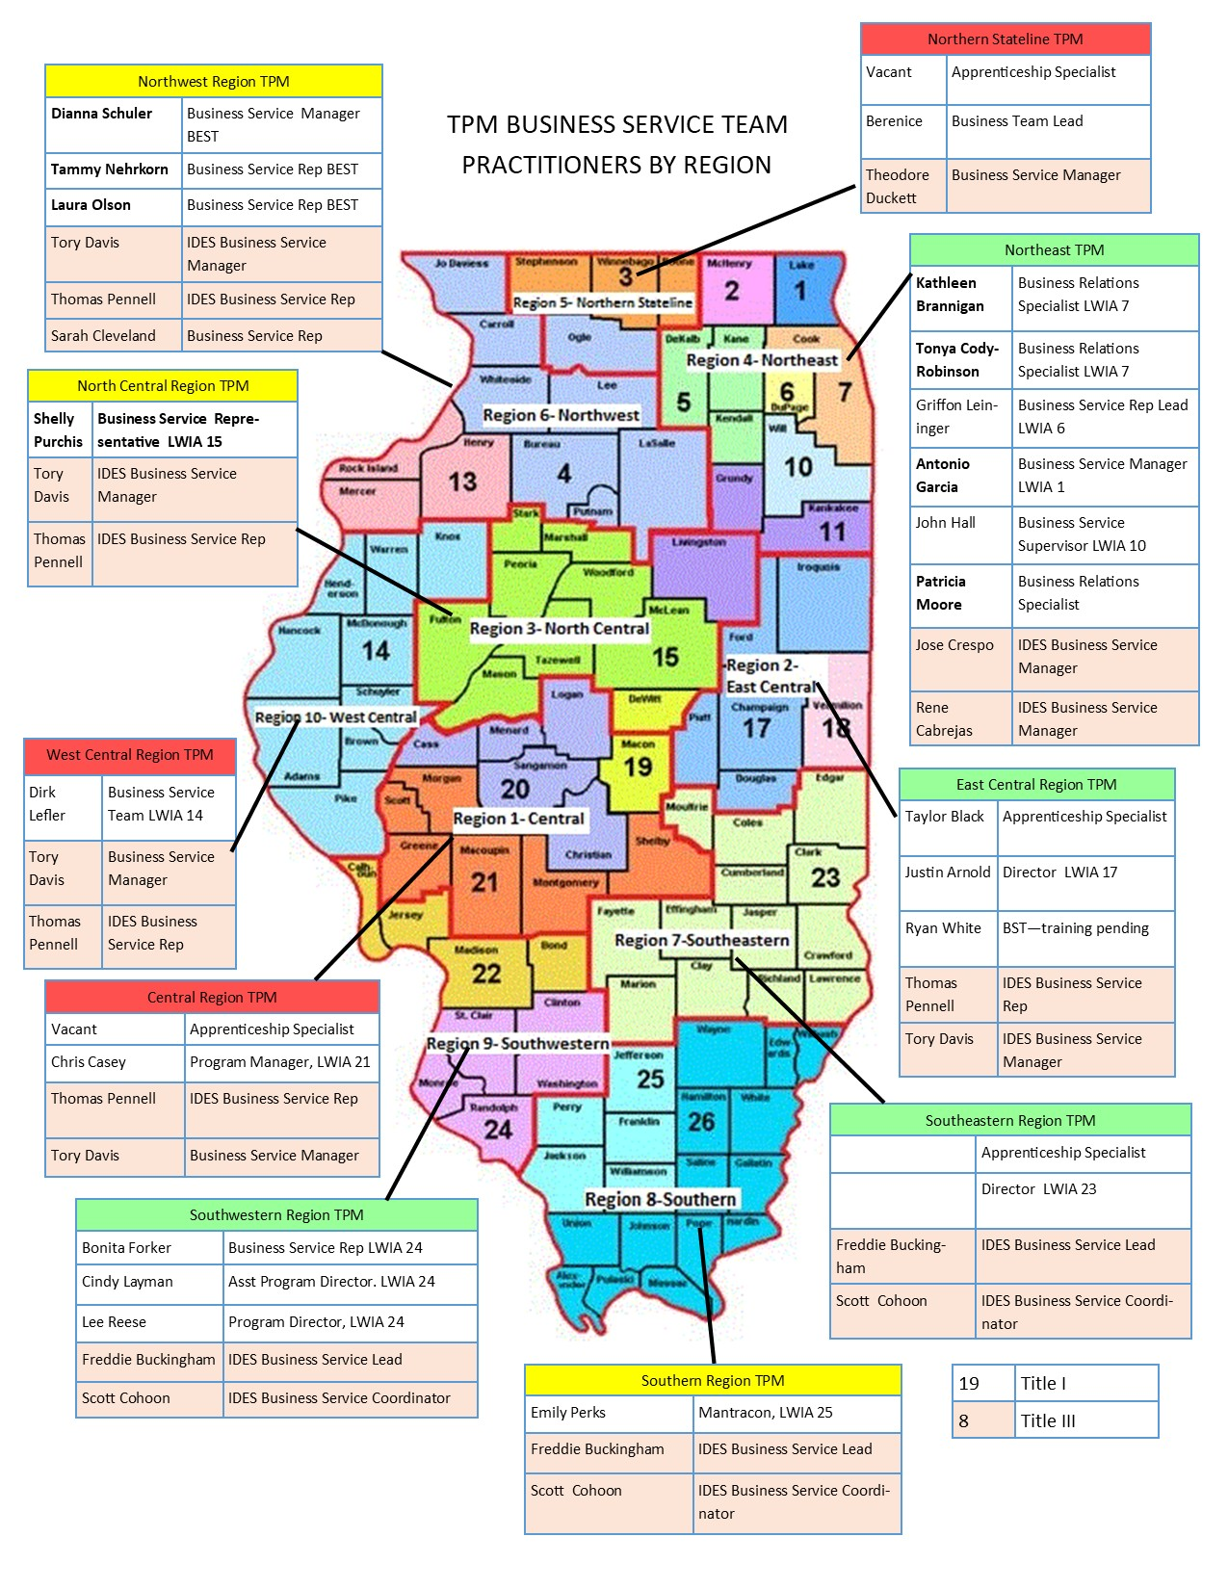
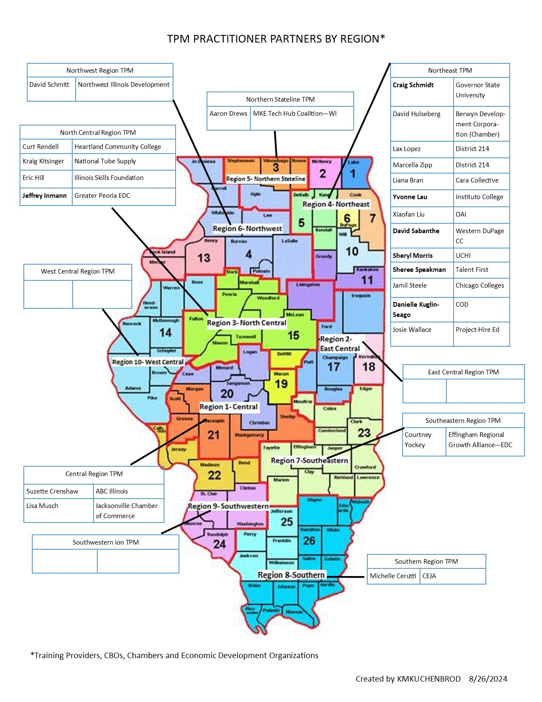

Slide 11
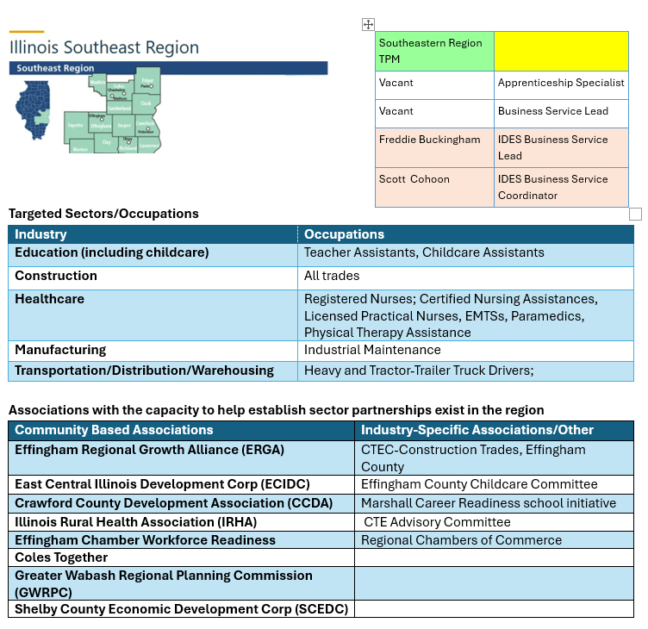
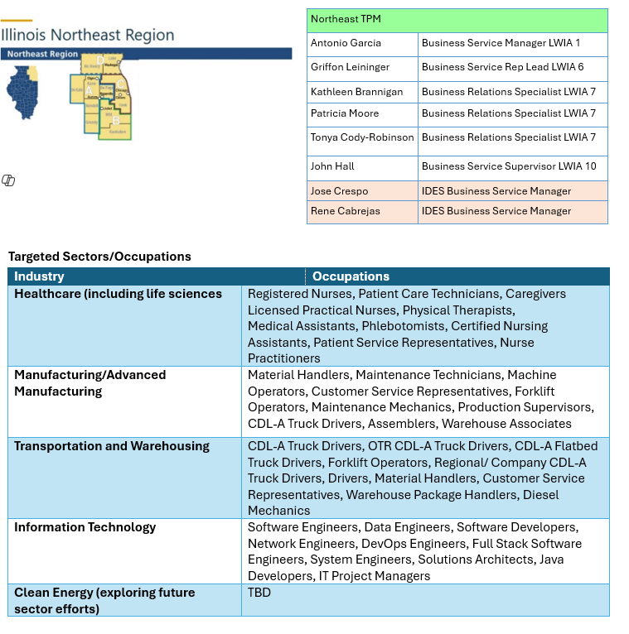
Illinois Regional Focus

Slide 12
Challenges and Opportunities
Challenges:
Aligning diverse stakeholder priorities.
Ensuring equitable access to WBL opportunities.
Opportunities:
Leveraging federal and state funding.
Scaling successful pilot programs statewide.
Notes:
all stakeholders align on common objectives, creating a unified vision for the future. This involves active participation from all stakeholders, fostering engagement and investment in the partnership's success. Clear and open communication channels ensure all parties stay informed and engaged, minimizing misunderstandings. By prioritizing the needs of the workforce, partnerships ensure that training and job placement services meet industry demands

Slide 13
Benefits of Implementing TPM and WBL
Workforce Skill Alignment
TPM ensures better alignment of workforce skills with the specific needs of employers, enhancing productivity and efficiency.
Reduced Recruitment Costs
By increasing employee engagement and retention, TPM helps in significantly reducing recruitment costs associated with turnover.
Improved Employee Retention
Implementing TPM leads to higher employee satisfaction, thereby improving retention rates and creating a more stable workforce.
Notes:
Implementing TPM offers numerous benefits, including better alignment of workforce skills with employer needs, reduced recruitment costs, and improved employee retention rates, ultimately leading to a more engaged workforce.

Slide 14
KPIs for Industry Sector Partnerships and TPM
Recruitment Time
Measuring recruitment time helps assess the efficiency of the hiring process in partnerships.
Employee Retention Rates
Tracking employee retention rates provides insight into job satisfaction and partnership success.
Training Completion Rates
Training completion rates indicate how effectively skill development is being implemented within partnerships.
Workforce Skill Assessments
Conducting workforce skill assessments is crucial for understanding capability gaps and training needs.
Notes:
Effectively demonstrating ROI to stakeholders involves presenting data. Clear and compelling evidence of success is essential for gaining ongoing support. Key performance indicators (KPIs) for measuring success in sector partnerships and TPM may include metrics related to recruitment time, employee retention rates, training completion rates, and workforce skill assessments.

Slide 15
Tracking and Analyzing Workforce Data
Importance of Tracking Data
Regular tracking of workforce data provides insights into partnership effectiveness and helps identify areas for improvement.
Data-Driven Decision Making
Employing a data-driven approach allows employers to make informed decisions that enhance workforce efficiency and performance.
Continuous Improvement
Analyzing workforce data promotes continuous improvement in operations, ensuring better outcomes for employers and employees alike.
Notes:
Employers should regularly track and analyze workforce data to gain insights into the effectiveness of their partnerships and TPM efforts. This data-driven approach enables continuous improvement and informed decision-making.

Slide 16
Conclusion
Key Takeaways:
TPM and WBL are essential for workforce development in Illinois.
Collaboration and innovation are key to success.
Call to Action:
Engage with local TPM and WBL initiatives to support workforce growth.
Continue the development of industry sector collaboratives to address talent needs
Apply WBL opportunities and track ROI
Notes:
In conclusion, implementing Talent Pipeline Management (TPM) and Work-Based Learning (WBL) strategies in Illinois presents both challenges and opportunities.
While aligning diverse stakeholder priorities and ensuring equitable access to WBL opportunities can be challenging, leveraging federal and state funding and scaling successful pilot programs statewide offer significant opportunities for a strong workforce ecosystem.
By focusing on collaboration and innovation, Illinois can build a skilled, adaptable workforce that meets industry demands and supports economic growth

Slide 17
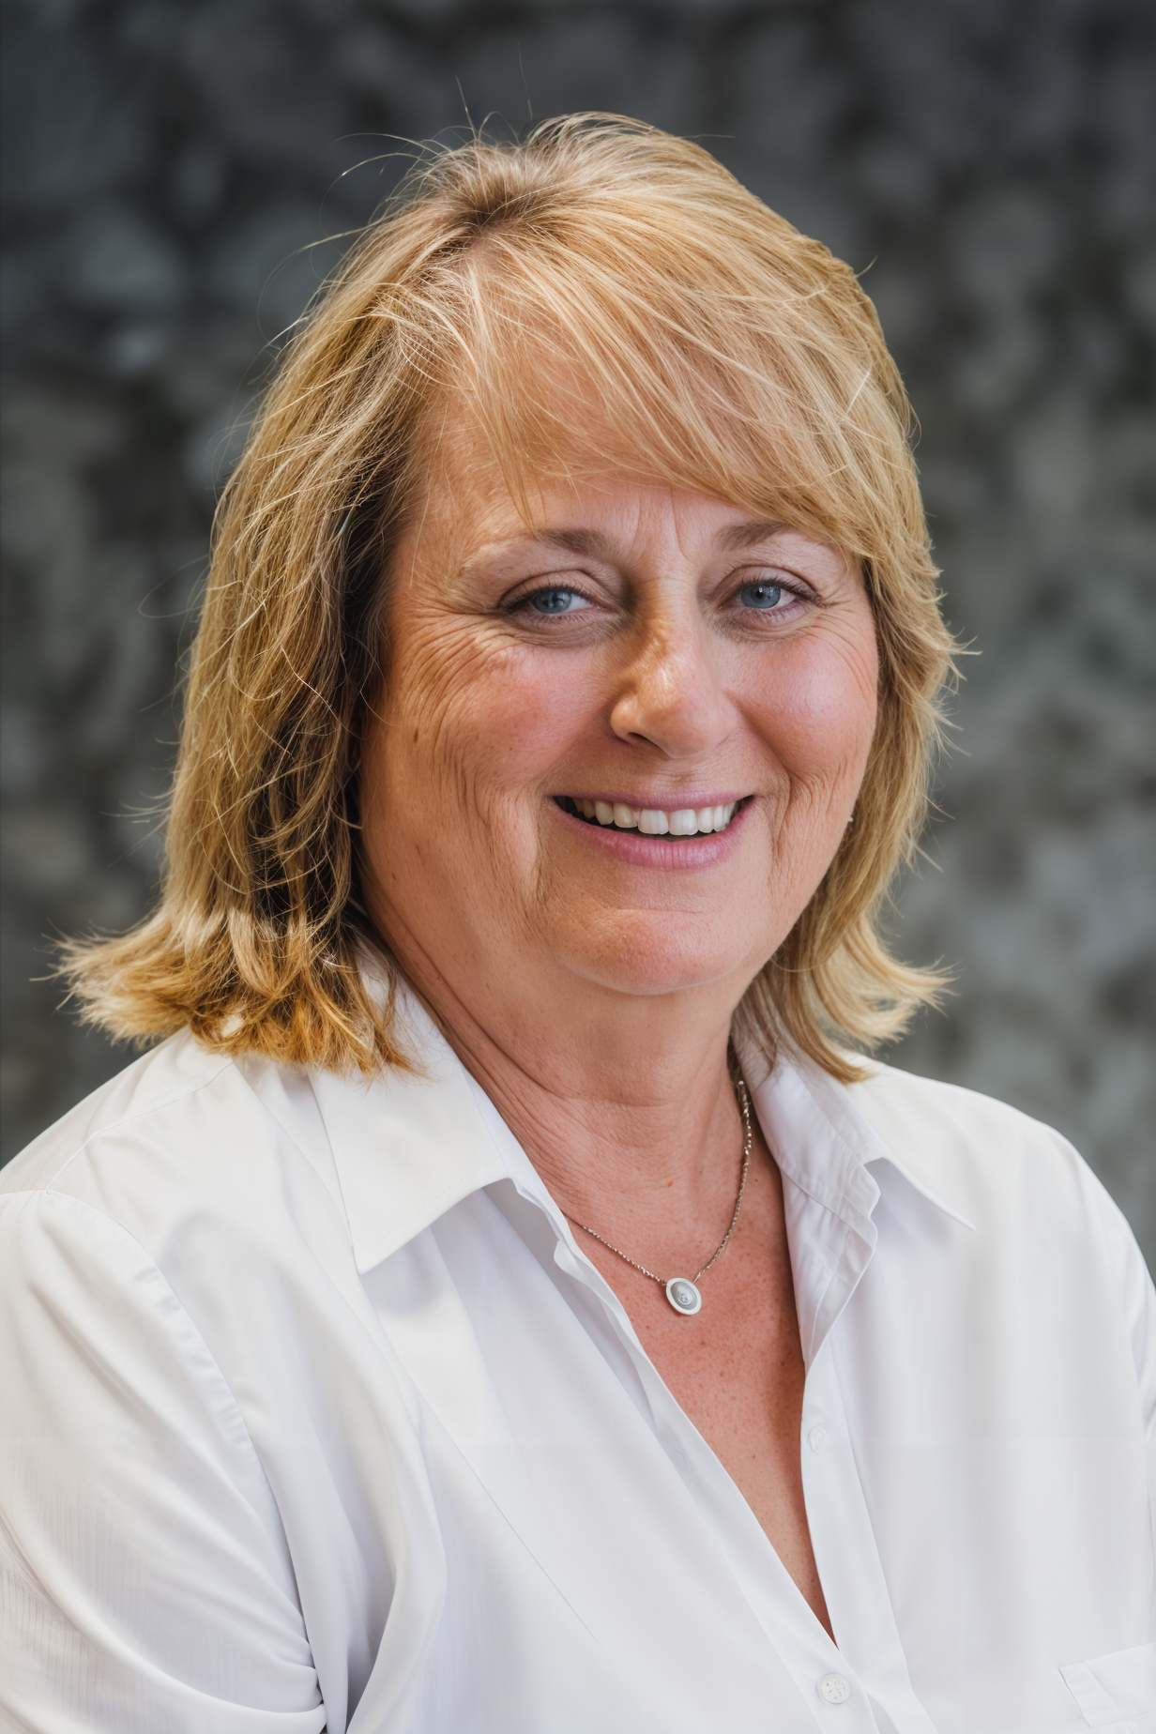
THANK YOU!
Kim Kuchenbrod, CWDP Talent Pipeline Management
Email: kmkuch1@ilstu.edu
Cell: 217-439-2555
Linkedin.com/in/kim-kuchenbrod

