Slide 1
REFLECTIONS AND ADVICE FROM Health CARE APPRENTICESHIP
TUESDAY, December 10, 2024
Kamy Vail RN BSN, Clay County Hospital Clinical Nurse Educator
Alani Frederick, DNP, RN, PCCN, CNE, Dean of Health Professions,
Illinois Eastern Community Colleges

Slide 2
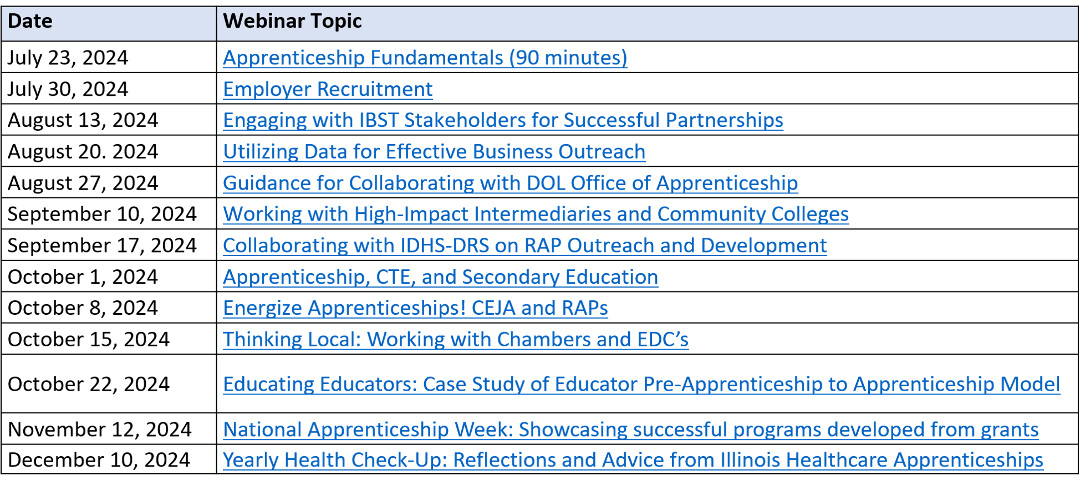
lunch & learn webinar series Dates

Slide 3
About the presenter: Kamy Vail, RN BSN
Kamy Vail is an esteemed Clinical Nurse Educator at Clay County Hospital, bringing a wealth of knowledge and experience to her role. A graduate of MacMurray College, Kamy earned her Bachelor of Science in Nursing (BSN) in 2007 and has since dedicated 17 years to the nursing profession. For the past seven years, Kamy has been an integral part of Clay County Hospital, where she oversees all employee education, ensuring that staff members are well-equipped with the latest healthcare practices and knowledge.
In addition to her primary responsibilities, Kamy plays a vital role in the local community by teaching health occupations at Clay County High Schools, nurturing the next generation of healthcare professionals. Her expertise extends to the Diabetes Education Department, where she assists in data collection and quality improvement of the program and assisting with educating patients on effective diabetes management. Kamy also serves as the wound care consulting nurse, providing specialized care and guidance in the treatment of complex wounds.
Moreover, Kamy oversees the Nursing Apprenticeship program at the hospital, fostering a supportive learning environment for aspiring nurses to gain hands-on experience under her expert mentorship. Her dedication to education and patient care highlights her commitment to advancing healthcare standards and improving patient outcomes.
Email: kamy.vail@claycountyhospital.org

Slide 4
About the presenter:
Alani Frederick, DNP, RN, PCCN, CNE
Dr. Alani Frederick serves as the Dean of Health Professions for Illinois Eastern Community Colleges, overseeing the education of over 150 Nursing students annually, along with several other Allied Health programs.
She earned her Doctorate in Nursing from Northern Kentucky University and holds specialty certifications in Progressive Care Nursing and Nursing Education.
With experience in both hospital education and academia, Dr. Frederick has been a dedicated leader at IECC for the past three years. She continues to practice as an ER Nurse and believes that contributing to the growth of future healthcare professionals is both an honor and a privilege.
Email: Fredericka@iecc.edu

Slide 5
Time for a
brief poll

Slide 6
About apprenticeship Illinois:
Our Regional Specialists will…
Conduct in-person and virtual apprenticeship outreach through events and employer consultations
Receive and pursue referrals received to the Apprenticeship Illinois website
Work with employers to fully develop and register their apprenticeship programs from start to finish
Connect employers to intermediary partners and other applicable services

Slide 7
Learning Objectives
Explain the rationale, planning and collaborative efforts behind establishing the RN Apprenticeship Program
Provide an overview of how the Clay County RN Apprenticeship is structured and launched
Discuss the current status and impact of the RN Apprenticeship Program progress

Slide 8
General information about Apprenticeships and Current models
The U.S. Department of Labor (DOL) defines an apprenticeship as a combination of paid on-the-job training and classroom instruction that prepares workers for skilled careers.
RN Apprenticeship can fall under 2 models
1- Academic Lead Partnership (Alabama Model)
2- Industry Lead Partnership (Indiana Model)

Slide 9
about Clay County Hospital
Clay County Hospital, located in the heart of Flora, Illinois, is a cornerstone of healthcare in the community, dedicated to enhancing the accessibility and quality of medical services. As a 20-bed critical access hospital, it plays a vital role in offering essential healthcare services to the residents of Flora and surrounding areas. In addition to its inpatient services and outpatient hospital services, Clay County Hospital operates three medical clinics and an on-campus pharmacy, all developed to increase access to healthcare and eliminate barriers that patients might face.
The hospital's mission is clear and unwavering: Clay County Hospital is committed to providing the highest quality of patient-centered healthcare to the community. This mission is not only reflected in the care provided but also in the hospital's strategic focus on employee development. By investing in their workforce and fostering a culture of "growing their own" employees, Clay County Hospital emphasizes the importance of nurturing talent from within, ensuring that staff are well-equipped to meet the diverse needs of their patients.
Clay County Hospital exhibits this by sponsoring the health occupations program for the local high schools and by the development of Illinois's first Department of Labor registered RN Apprenticeship program.

Slide 10
about Iecc Nursing
Illinois Eastern Community Colleges (IECC)
Located in Southeastern Illinois, spanning 3,000 square miles
Serves all or parts of 12 counties, primarily rural communities.
Includes four colleges:
Olney Central College (OCC) – Olney, IL
Wabash Valley College (WVC) – Mt. Carmel, IL
Lincoln Trail College (LTC) – Robinson, IL
Frontier Community College (FCC) – Fairfield, IL
Nursing Program Highlights:
ADN program began at OCC in 1969.
Expanded to LTC and WVC in 1975, FCC in 1978.
ACEN accredited
Award an AAS with 72 Credit Hours
4, 10 Credit Hour Courses (Integrated Curriculum)

Slide 11
Original Idea and Brainstorming behind the Program
The healthcare industry continues to change over the years and one the greatest hurdles that facilities are facing is the nursing shortage. Nursing positions were becoming increasingly harder to fill prior to covid and then the pandemic multiplied that struggle many times over.
Challenges We are Facing with Registered Nurse Staffing
Increase in the number of the patients
According to People Element there are currently more Americans over the age of 65 now than any other time in history and this population is expected to by 75% by the year 2030
Increase in demands of the patients
The increase in the number of older patients has a direct correlation with the number of patients with chronic disease such as HTN, CHF, COPD, Diabetes, etc
Increase in the number of nurses leaving the bedside and the nursing profession all together
Covid Burnout
Higher wages being offered by traveling contracts and huge sign on bonuses
Small rural community with a limited number of nurses to pull from and we are in competition with bigger facilities close by.

Slide 12
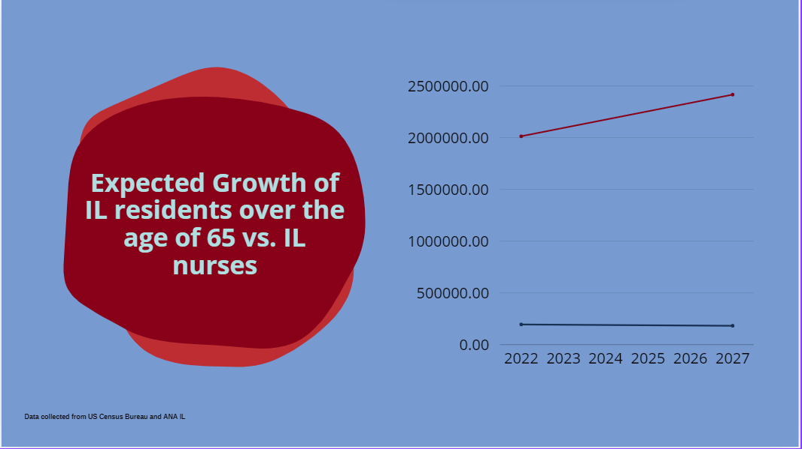
The shortage is not getting better

Slide 13
Original Idea and Brainstorming behind the Program
We had to get creative and develop a new talent pipeline strategy.
The idea of the nursing apprenticeship program was brought up in a meeting for the health occupations program which Clay County Hospital is sponsoring for local high schools.
We needed a way to grow our own nurses to help combat the nursing shortage and the other challenges we are facing
Communications were set up between Clay County Hospital, IECC and Apprenticeship IL to discuss what the apprenticeship would entail and how it would work among the agencies.
Clay County Hospital partnered with the Department of Labor and IECC to develop the first registered nursing apprenticeship program in the State of Illinois.

Slide 14
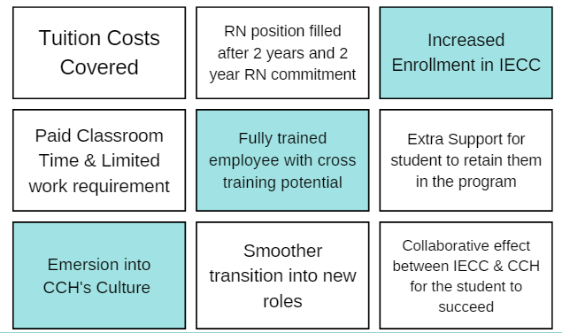
Win/Win/Win Opportunity

Slide 15
Timeline of Elements completed
Contact: Local college and obtain agreement & apprenticeship IL rep.
Obtain approval from DOL
Interview and choose the right apprentice
Continued support for the apprentice and monitoring of progress
Develop the idea and obtain administrative support
Develop desired competency requirements for the apprentice & complete required paperwork
Determine how to market the apprenticeship

Slide 16
Final Program Structure
Applicants
Must be accepted into an IECC Nursing Program beginning Fall 2023
Must have IL CNA Certification
Complete application process
Top 2 applicants chosen for the program
Apprentice
Work 1-12 hour shift per week
Maintain CCH Standards of performance
Maintain C average in College Courses
Complete 4-year total apprenticeship program
Hospital
Pay cost of tuition, fees and books for the nursing program from the time they begin the apprenticeship program.
Pay for hours in the NURSING classroom
Ensure that the apprentice obtains 144 hours of education annually
Nursing program will satisfy these requirements the first 2 years
In house on the job training to satisfy the additional two years of requirements
Ensure that the Apprentice is moving along the competency forms and mastering their skills
Communicate with the Department of Labor to ensure that the apprentice is being supported, and all requirements are being met

Slide 17
Approval Process
Clay County Hospital
Approval from hospital administration
Completed all paperwork with the help of our apprenticeship navigator all department of labor paperwork was completed and sent in for approval.
Partnership agreement was established with Illinois Eastern Community Colleges
IECC Nursing
Conversation with State Board of Nursing
Consideration for Accreditor (ACEN)

Slide 18
Program Launch

Slide 19
Update of program after year 1
Clay County Hospital:
Our first cohort completed their first year of nursing school and completed the LPN course and are currently working as LPN.
The apprentices have great attitudes and are exemplarily employees. By investing in them , they have become “owners” in the organization.
Quotes from first cohort apprentices:
“The apprenticeship has been a game-changer for me, helping to reduce the stress of balancing work and study and allowing me to focus on reaching my goal. Without this opportunity, the journey would have been far more challenging…”
“This program has given me more resources [than] I could ever imagine not only to help me succeed in school, but also become the best nurse I can be”
IECC:
Students are invested in their education
Student perform well in clinical and skills above peers

Slide 20
year two Update
Clay County Hospital:
Our first cohort are in their second year of nursing school, working as LPN. This has helped fill holes in nursing openings at the hospital.
The second cohort has is in their first year of nursing school. Working as CNAs at the hospital.
This has improved our staffing by 2 part time LPNs and 2 part time CNAs
The apprentices are reliable and accountable employees who show up for work and do their very best and provide quality compassionate care to our patients.
IECC:
Students are accountable peers
Remain invested in schooling
Interest during admission process

Slide 21
Plans for the future
Clay County Hospital:
The hospital plans to continue with the RN apprenticeship program by bringing on 2 apprentices every year while there is a need for nursing staff.
Year 3 will result even more improved staffing:
2 full time RNs, 2 part time LPNs, 2 part time CNAs
Year 4 staffing :
4 full time RNs, 2 part time LPNs, 2 part time CNAs
The idea behind the program is that the apprentices will choose to stay on as full-time employees after completing the apprenticeship program.
IECC:
Anticipate the Apprenticeship will increase interest in the Nursing Program
Stronger students can assist in retention and pass rates

Slide 22
Lessons learned
Clay County Hospital:
Develop clear lines of communication between departments involved
Our program is set up as a Medical surgical nursing program, but education also oversees the program
Define internal roles:
who will complete administrative task such as payroll, hour monitoring, ensuring mentor check-in, etc.
Ensure that you find resources in your area that can help support and bolster the program
Be a continual beacon of support for your apprentices and check in to see if their needs have changed
Ex: Additional study help, additional time to study, and accommodating shifts
IECC:
Marketing the program
Taking the leap

Slide 23
Contact us:
Kamy Vail kamy.vail@claycountyhospital.org
Alani Frederick Fredericka@iecc.edu
Jennifer Foil jfoil@niu.edu
Jordan Johnson jtjohns@ilstu.edu

