Slide 1

Registered Apprenticeships in Illinois
2025 Apprenticeship Illinois Bootcamp
October 9, 2025

Slide 2

Partner with state agencies and education, workforce, and economic development stakeholders to develop and improve workforce development programs, policies, and systems
Team - Advanced degrees in Human Capital Development, Economic Development, Higher Education Administration, Community Development, Public Administration, Communications, Social Work, Economics, and Systems Engineering
Diverse lived experience includes:
Poverty
Race and gender bias
Immigration
First generation college attendance
    Workforce program participation
    Entrepreneurship
    Military service
    Neurodivergent

Slide 3
Today’s Goals
Understand what we can (and cannot) learn from RAPIDS data
Be better consumers of data
How to use data to guide apprenticeship expansion

Slide 4
9+ Years IWIB WBLA Committee
 | 2016 | 2017 | 2018 | 2019 | 2020 | 2021 | 2022 | 2023 | 2024 | 2025*
Active Apprentices | 14,160 | 14,920 | 16,356 | 17,711 | 17,502 | 17,543 | 19,388 | 20,668 | 21,934 | 22,800
New Apprentices | 5,167 | 5,132 | 6,226 | 6,477 | 4,688 | 6,301 | 8,264 | 8,692 | 9,058 | 8,024
Construction Trades | 3,819 | 3,783 | 4,594 | 4,794 | 3,417 | 4,331 | 5,565 | 6,114 | 5,815 | 5,362
% Construction | 74% | 74% | 74% | 74% | 73% | 69% | 67% | 70% | 64% | 67%
All Other | 1,348 | 1,349 | 1,632 | 1,683 | 1,271 | 1,970 | 2,699 | 2,578 | 3,243 | 2,662
% All Other | 26% | 26% | 26% | 26% | 27% | 31% | 33% | 30% | 36% | 33%

Slide 5
New Apprenticeship Programs

Slide 6
Apprentices by Occupation Group
 | Active Apprentices |  | New Apprentices 2024
Construction | 17,107 | 75% | 5,815 | 64%
Installation, Maint, and Repair | 2,684 | 12% | 936 | 10%
Production | 712 | 3% | 371 | 4%
Transportation and Material Moving Occs | 242 | 1% | 271 | 3%
Architecture and Engineering Occupations | 191 | 1% | 113 | 1%
Computer and Math | 182 | 1% | 155 | 2%
Healthcare Support | 181 | 1% | 213 | 2%
Protective Service Occupations | 136 | 1% | 113 | 1%
All Other | 1,365 | 6% | 1,071 | 12%
Total | 22,800 |  | 9,058

Slide 7
New Occupation Programs Since 2016

Slide 8
Apprenticeship Illinois Grantees since 2016
Apprenticeship Illinois Specialists and Intermediaries have supported nearly 2,400 new apprentices.

Slide 9
Apprenticeship Illinois Grantees since 2016
 | New Apprentices
Construction | 40.3%
Installation, Maint, and Repair | 16.2%
Production | 10.9%
Healthcare Support | 10.7%
Food Preparation and Serving | 8.0%
Computer and Math | 3.0%
Healthcare Practitioners and Technical | 2.4%
Transportation and Material Moving | 2.1%
All Other | 6.5%

Slide 10
High Potential Occupations
Occupation | New Programs Since 2016 | New Apprentices since 2020 | Avg. Annual Openings | 55+ | Median Hourly Earnings
Industrial Machinery Mechanics | 43 | 485 | 1,048 | 3,299 | $32.01
Machinists | 33 | 138 | 1,657 | 6,346 | $27.22
Maintenance and Repair Workers | 27 | 576 | 7,087 | 25,826 | $26.03
Heavy Truck Drivers | 21 | 1,285 | 9,723 | 27,095 | $28.40
Computer User Support Specialists | 15 | 168 | 1,909 | 4,722 | $27.19
Registered Nurses | 10 | 126 | 8,441 | 37,337 | $41.52
Notes:
Using labor market data

Slide 11
Potential Low-Quality Apprenticeships
Occupation | New Programs Since 2016 | New Apprentices since 2020 | Avg. Annual Openings | 55+ | Median Hourly Earnings
Nursing Assistants | 25 | 543 | 9,872 | 13,981 | $ 21.50
Information Security Analysts | 18 | 161 | 433 | 850 | $ 54.87
Cooks, Restaurant | 18 | 421 | 10,747 | 11,701 | $ 17.58
Agricultural Equipment Operators | 15 | 108 | 500 | 663 | $ 19.10
Maids and Housekeeping Cleaners | 8 | 146 | 6,779 | 14,842 | $ 16.64

Slide 12
Apprentice Demographics
 | All New Apprentices 2024 | New Apprentices in Construction | New Apprentices in Non-Construction | Illinois Workers
Hispanic | 21% | 25% | 15% | 17%
Black | 15% | 11% | 23% | 13%
White | 54% | 60% | 43% | 62%
All Other | 9% | 4% | 19% | 8%
Female | 14% | 6% | 28% | 50%

Slide 13
Apprentice Illinois Grantee Demographics
 | All New Apprentices 2024 | New Apprentices in Construction | New Apprentices in Non-Construction | Illinois Workers
Hispanic | 14% | 6% | 19% | 17%
Black | 22% | 15% | 26% | 13%
White | 57% | 75% | 46% | 62%
All Other | 7% | 5% | 9% | 8%
Female | 24% | 9% | 34% | 50%

Slide 14
Demographic Trends

Slide 15
Successful Completion Rates

Slide 16
Program Structure
More than 85% of Apprentices are enrolled in Multi-employer programs under a collective bargaining agreement (CBA)

Slide 17
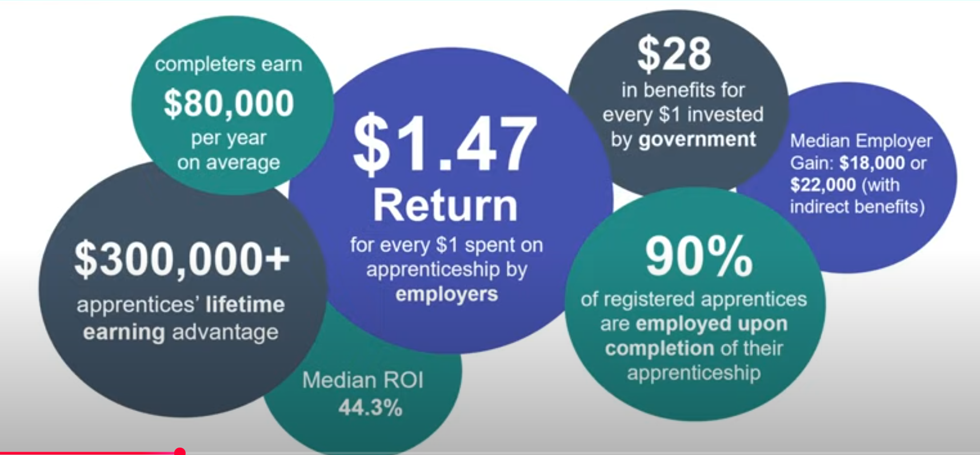
Sexy Data

Slide 18
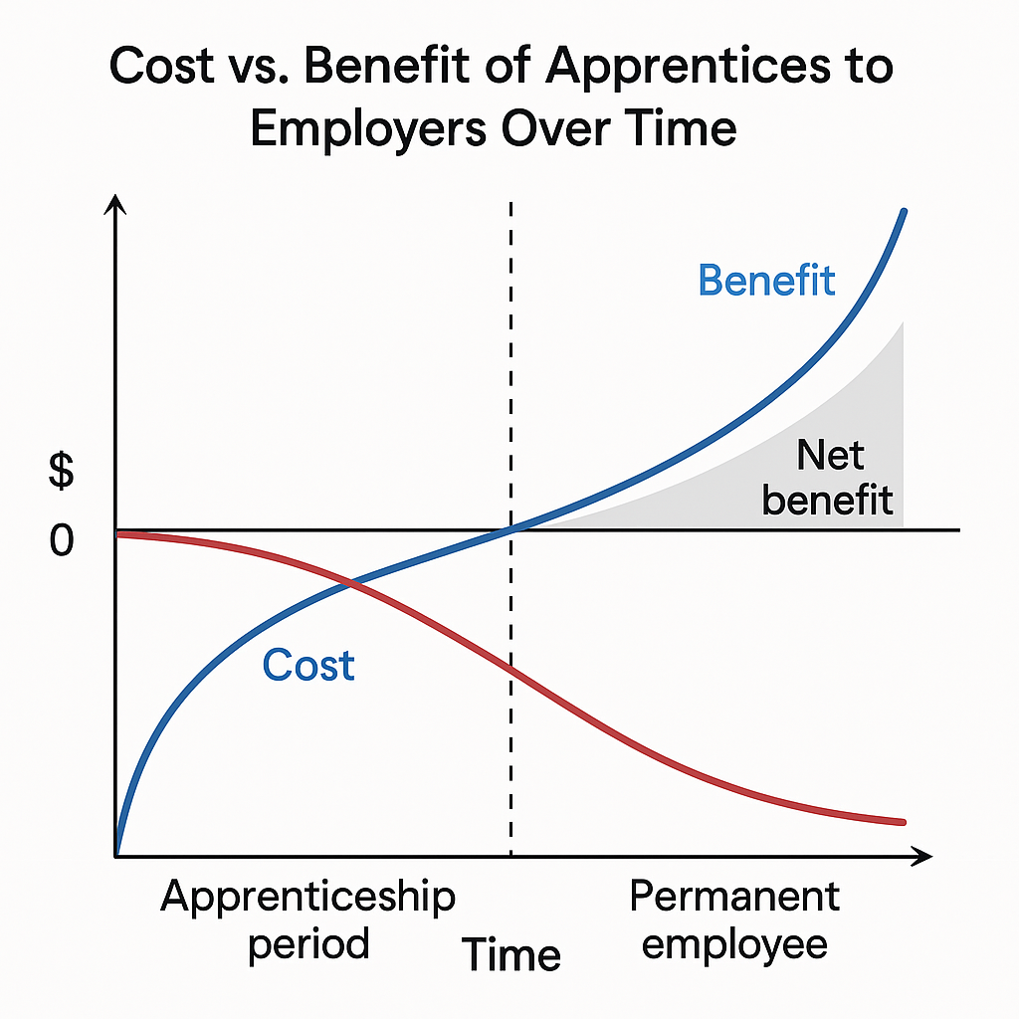
Return on Investment
Early in apprenticeship costs are greater than benefits
As apprentice gains skills and experience, benefits become greater than cost

Slide 19
Average Exit Wages
Occupation Group | Average Exit Wage
Construction | $ 33.95
Installation, Maint, and Repair | $ 31.51
Computer and Math | $ 26.65
Healthcare Practitioners | $ 23.92
Architecture and Engineering | $ 23.68
Production | $ 22.73
Protective Service Occupations | $ 21.97
Food Preparation and Serving Related | $ 23.16
Healthcare Support | $ 16.92
Transportation and Material Moving | $ 15.38

Slide 20
Brian Richard brichard@niu.edu
Jennifer Foil jfoil@niu.edu

