Slide 1
Engaging IBST Partners
August 2024
Dr. Justin arnold
East central Illinois workforce board

Slide 2
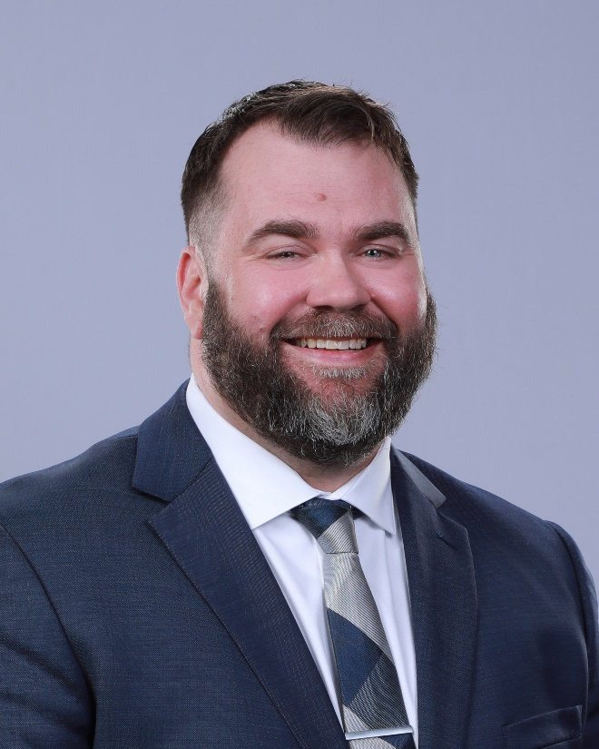
Dr. Justin Arnold, Executive Director

Slide 4
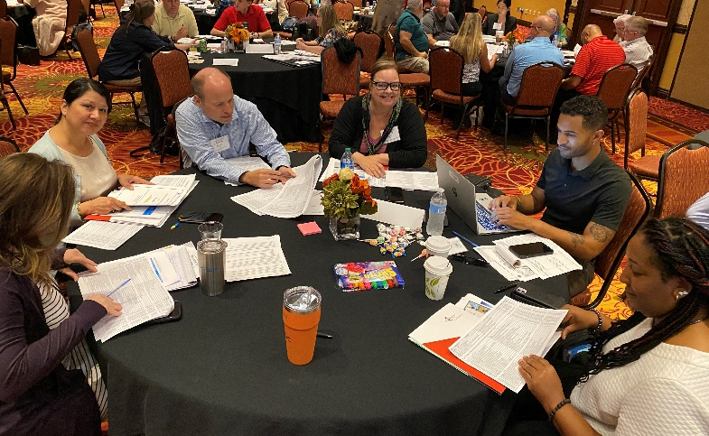
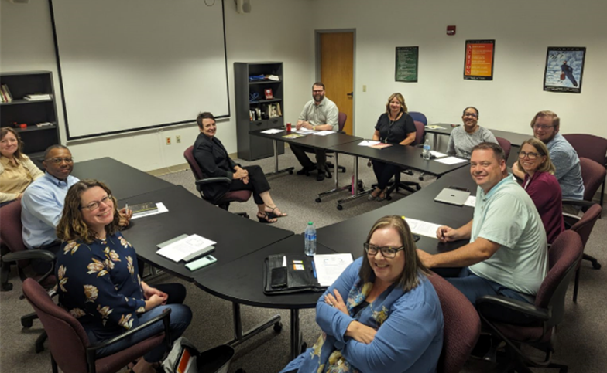
Apprenticeship Illinois Bootcamp (August 2023)
East Central Illinois Business Team (June 2024)

Slide 5
Learning Objectives
Using a shared framework
Facilitating planned change
Launching a local brand

Slide 6
Learning Objective 1:
Using a Shared Framework

Slide 7
using a shared framework
Different Perspectives
Geography
Places and built environments
Buildings, neighborhoods, cities, counties, districts
Organization
Different types of organizations with different missions
Different organizational structures and decision-making authority

Slide 8
using a shared framework
Reference Points
Daily Lives
Differences in how we deliver services to employers and how we think about interacting with other entities
Not everyone is used to thinking about a regional ecology and systems
Public Opinion
Knowing about the hot button issues and popular topics but not sure about how to do the work or what the work is

Slide 9
using a shared framework
Illinois Unified Plan
Core Partners
Workforce development, adult education and family literacy, employment services, and vocational rehab
Other Partners
Career and technical education, human services, education, economic development, business-serving
State Goals
Example of excellence in its approach to collaboration and customer service

Slide 10
using a shared framework
Illinois Workforce Board
Policymaking
“Through structured committees and task forces, IWIB representatives from private/public partner programs offer policy recommendations to strengthen Illinois' workforce system. All policies developed or commented upon include input from partners and the general public.”
Framework for Integrated Business Services
15-page document approved in 2017 that highlights how local areas can form and support local business services teams (Lee Reese)

Slide 11
using a shared framework
Apprenticeship Illinois
Local Workforce Areas
Invest in apprenticeship expansion through local areas by leveraging the existing infrastructure and plans
Apprenticeship Specialist
A subject-matter expert who would provide technical assistance and connect the local area to broader initiatives
Integrated Business Services Teams
An intentional attempt to integrate business services at the local level to better serve business customers

Slide 12
Learning Objective 2:
Facilitating Planned Change

Slide 13
Facilitating planned change
Investing in Relationships
Illinois Bootcamp 2023
Attended Apprenticeship Illinois Bootcamp with partners. Offered to pay for hotel, milage, food.
Monthly Meetings – “Planning Committee”
Set monthly meetings with the team.
Had an agenda.
Invited others.
Moved the site to visit other partners.
Followed-up with summary emails.

Slide 14
Facilitating planned change

Slide 15
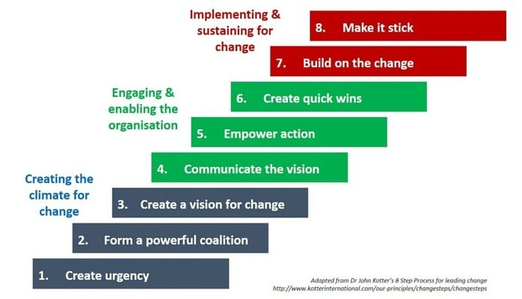
Facilitating planned change

Slide 16
Facilitating planned change
Kotter’s Leading Change
Create Urgency
Want people to feel like what they are doing is important and they aren’t wasting their time.
Form a Powerful Coalition
Can’t do it on your own. Need people who are excited, support, and bring others.

Slide 17
Facilitating planned change
Kotter’s Leading Change
Create a Vision for Change
Reviewed the State of Illinois’ Framework for IBST and thought about foundational elements and structural components.
Communicate the Vision
The foundational elements and structural components were our vision. Talked through them. Listened. Adjusted.

Slide 18
Facilitating planned change
Kotter’s Leading Change
Empower Action
Helping people at the table know they are contributing and can make decisions.
Had a team member present on “leading from the ground up.”
Create Quick Wins
Where we are now with a soft-launch: business visit form, quality referrals, shared visits, public events / promotion.

Slide 19
Facilitating planned change
Kotter’s Leading Change
Build on the Change
Easy to lose momentum if it gets too difficult and there are no wins.
Here is where people who have been silent or privately not buy-in will begin to share their concerns.
Make it Stick
Making change part of our regular work and normal environment.
This is difficult and requires ease of implementation, thinking about thinking, and the formation of new habits.

Slide 20
Learning Objective 3:
Launching a Local Brand

Slide 21
Launching a local brand

Slide 22
Launching a local brand
Becoming a Member
Who?
Workforce development, education, and economic development entities that provide services to businesses in our economic development region.
Why?
To network with partners and make it easier to provide services to businesses and sectors.

Slide 23
Launching a local brand
Expectations
Buy-in
Structural components, foundational elements, and shared commitments of the planning committee.
New Member Orientation + Team Charter
Created an orientation so that new members could quickly get up to speed and on the same page.
Created a “team charter” that outlined our vision, mission, goals, and structure.

Slide 24
Launching a local brand
Referrals
Individuals
We already make referrals of job seekers across entities. That referral system has a place for notes and a dashboard to monitor status and response times.
Businesses
We are using the same referral system and adding a section for “business services.” We are teaching new partners how to use it.

Slide 25
Launching a local brand
Confidentiality
Employer Information
Addressing concerns about the privacy expectations and needs of employers.
Sharing Information
Agreeing to not speak publicly about employers with friends, family, or on social media.
Creating a waiver for employers to review and sign when we want to promote successful projects.

Slide 26
Launching a local brand
Annual Elections
Chair and Vice Chair
Having a chair and vice chair take responsibility for meetings and the team so it isn’t on one person.
Chair Duties
Meeting planning, agenda creation, meeting facilitation, follow-up, addressing group concerns, orientation.
Soft Launch
July – October
Figuring out without a lot of pressure.

Slide 27
Learning Objectives
Building a shared framework
Facilitating planned change
Launching a local brand

Slide 28
Contact us:
Dr. Justin Arnold jarnold@ccrpc.org
Jennifer Foil jfoil@niu.edu
Jordan Johnson jtjohns@ilstu.edu

Slide 29
Questions?

