Slide 1
Apprenticeship Illinois
Bootcamp
July 2021

Slide 2
Integrated Business Services Teams:
How to be effective
Dr. Justin Arnold

Slide 3
Covered in this session
Why Learning is Key to Effective Teams
Core Learning Capabilities:
Fostering Aspiration
Understanding Complexities
Reflective Conversation

Slide 4
These Integrated Business Services Teams can do so much for apprenticeships.

Slide 5
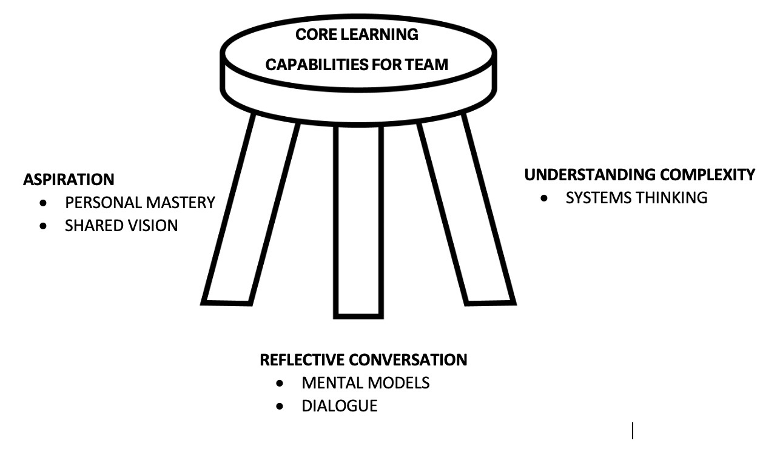
Effective teams
The Fifth Discipline by Peter Senge

Slide 6
FOSTERING Aspiration
“A hope or ambition of something achievable.” (Oxford Dictionary)
Motivation is linked to task performance, realistic goals, and helpful feedback (Locke).
Fostering aspiration through personal mastery and a shared vision.

Slide 7
Aspiration - Shared vision
Employers
Workers

Slide 8
ASPIRATION - Personal mastery
A sense of purpose.
Work with forces of change.
Deeply inquisitive.
Want to see reality accurately.
Feel connected.

Slide 9
Understanding COMPLEXITY
What “Understanding” Looks Like:
Explain
Interpret
Apply
Shift Perspective
Empathize
Self-assess
Understanding complexity through systems thinking.
Understanding by Design by McTighe and Wiggins

Slide 10
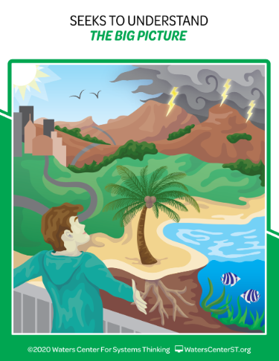
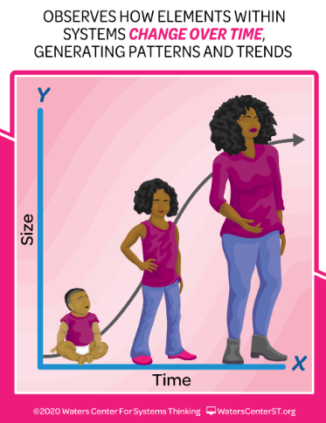
Understanding - Systems thinking
Habits of a Systems Thinker by The Waters Center

Slide 11
REFLECTIVE conversations
Assumptions are suspended, people are not defensive, and ideas flow.
Having reflective conversations by examining mentals models and engaging in dialogue.

Slide 12
Conversation - Mental models
Habits of a Systems Thinker by The Waters Center

Slide 13
Conversation - dialogue
Be available to explore concerns and listen to each other.
Share ideas to find common ground and identify realistic goals .
Realize conversation is taking place at different organizational levels and in the environment – noise.

Slide 14
Effective teams
The Fifth Discipline by Peter Senge

Slide 15
THANK YOU
Notes:
We can answer common questions

