Slide 1
Processes and Outcomes of a 14-Month Apprenticeship Learning Community: Toolkit Development and Practice Implications
Stuart Rumrill, Ph.D., LPC, CRC

Slide 2
Agenda
Overview of Our Apprenticeship Learning Community
Toolkit Development
Toolkit Overview
Toolkit Dissemination and Utilization
Next Steps

Slide 3
Apprenticeship Learning Community Sample of Recruitment Flyer – See Handout
Sign Up for the Apprenticeship Learning Community
Purpose
The purpose of the Apprenticeship Learning Community is to exchange ideas with professionals from around the country that promotes apprenticeship implementation and policy development. Participants will collaborate on the creation of an Apprenticeship Toolkit for use by state vocational rehabilitation agencies to include:
Apprenticeship infrastructure development including employer support and VR agency business services integration
Strategies for collaborating with State Offices of Apprenticeship
Apprenticeship grant funding opportunities
Resources and information to equip VR counselors with the tools to prepare VR customers for pre-apprenticeships and registered apprenticeships

Slide 4
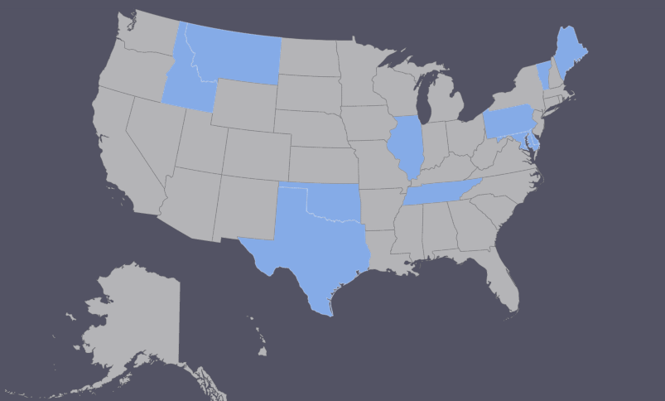
Apprenticeship Learning Community: Recruitment and Members
Subscribers/followers of VRTAC-QE and attendees of an Apprenticeship webinar received a flyer advertising the learning community
Applicants were asked for their name, email address, organization, and title
65 applicants; 12 members selected (2 later withdrew)
11 states represented
Titles/affiliations:
Apprenticeship Office at State Dept. of Labor and Workforce Development
Community-based service organization administrator
State VR administrator
Employer
Rehabilitation Counselor
Family member of a person with a disability
Department of Rehabilitation Services
OVR Bureau of Blindness and Visual Services
Addictions Recovery Center
Workforce Division for Blind and Visually Impaired
State VR counselor

Slide 5
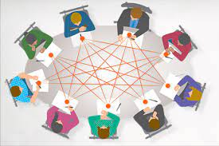
Apprenticeship Learning Community
What were the goals of this learning community?
Provide a tangible product
Provide a valuable experience
What was the product? – Apprenticeship “Toolkit”
For nationwide use by employers, VR staff, apprenticeship customers
What were the logistics of the learning community?
Meetings held over Zoom
Met 13 times as a large group over a 14-month period
Several smaller subgroup meetings as necessary- 11 total
Meetings lasted one hour
UIUC team members served as facilitators- sessions were owned by the membership

Slide 6
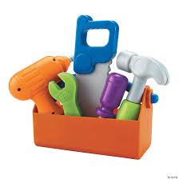
Apprenticeship Learning Community
Tell us more about the toolkit?
Three “problem areas” have been identified by group members
Lack of knowledge of apprenticeships
Issues with collaboration
Disability identification/
disclosure
“Apprenticeships: Key Information, Timeline of Events and Strategies for Enhanced Collaboration”
Basic knowledge of pre-apprenticeship and registered apprenticeship
Preparation of a VR customer for an Apprenticeship
Collaboration with VR, Office of Apprenticeship, and employers
Lead with ability and strengths & when and how to disclose disability

Slide 7
Toolkit Development
Members were split into three subgroups
Assigned based on preference/highest interest
Subgroups had 3-4 members led by one UIUC Facilitator
Each subgroup met 1-5 times
Section 1- FAQs- UIUC Facilitators (3 members/5 meetings)
Section 2- Preparing a Consumer for Apprenticeship (3 members/2 meetings; Bryan Austin Facilitated)
Section 3- Interagency Collaboration (4 members/3 meetings; Jim Knauf Facilitated)
Section 4- Disability Disclosure (3 members/1 meeting; Stuart Rumrill Facilitated)

Slide 8
Toolkit Overview

Slide 9
Toolkit Dissemination and Utilization
Final meeting (3/13/24) discussed dissemination and utilization plans
Some responses/ideas from LC members:
Share with new business service representative hires
Share with administrator
Share with other VR counselors and fellow staff
Share with high schools
Share with employment specialists
Present/discuss at annual statewide meeting
Share with state Rehabilitation Councils
Incorporate as part of trainings for employers, customers, and counselors
Personal use

Slide 10
Toolkit Sustainability
Some responses/ideas from LC members:
Meet again as a large group 6 months-1 year later
Start a panel; have conference meet-ups
Put the toolkit up on a website; post a link where people can give feedback
Present at CSAVR
Include in agency newsletters
Our ideas:
Meet once a year to update the toolkit and report on how toolkit has been implemented/used
Host feedback surveys wherever we post the toolkit online

Slide 11
Current Efforts/Next Steps
Partner with local workforce development boards to distribute the toolkit and incorporate it into their programs for supporting job seekers with disabilities
Create an online portal or platform where stakeholders can access the toolkit, complete interactive modules, and track their progress in using its resources.
Collaborate with disability advocacy organizations to promote the toolkit and ensure it reaches underrepresented groups and rural communities.
Develop a series of webinars or workshops to demonstrate how to use the toolkit, tailored to the specific needs of each stakeholder group (e.g., employers, counselors, job seekers).

Slide 12
Current Efforts/Next Steps
Pilot the toolkit with a small group of employers and vocational rehabilitation (VR counselors) to gather feedback and refine its content before wider distribution.
Work with state or federal apprenticeship officers to align the toolkit with existing apprenticeship frameworks and funding opportunities for people with disabilities.
Translate the toolkit into multiple languages or create accessible formats (e.g., html, braille, audio, large print), to ensure it reaches diverse audiences.
Other ideas?

Slide 13
Questions?

