Slide 1
Apprenticeship Illinois
Bootcamp

Slide 2
Consistent Messaging
Tony Fuhrmann
Tanner Crawford

Slide 3
Covered in this session
Background on Marketing Apprenticeship
Rebranding Tagline and Logo
ApprenticeshipIllinois.com
Social Media
National Apprenticeship Week

Slide 4
State-by-State Analysis of Apprenticeship Programs
Reviewed Apprenticeship websites for each state, and several within Illinois, and identified:
Websites
Apprenticeship Listings and Searches
Content Gaps
Outreach Resources/ Customizable Options
Social Media Sites to Emulate for Specific Audiences
FAQs
Apprenticeship Resources Currently on Illinois workNet
Notes:
Social Media Sites to Emulate for Outreach to Specific Audiences

Slide 5
Traits of Effective Apprenticeship Outreach Campaigns
Clean website with clear direction, helpful information, and resources:
Defines apprenticeship
What it includes
Why it’s helpful for jobseekers and employers
Search/listing of available opportunities on the site
Personal contact from Business Champions who have used apprenticeships
Social Media presence on multiple platforms
Resources and flyers:
Informational
Process driven
Checklists
Templates
Target different audiences
Variety in programs /targeted audiences
Notes:
A clean website with clear direction, helpful information, and resources for each of its topics as well as including guidance/links for action, i.e.
Social Media presence across multiple platforms
Resources and flyers:
Informational
Process driven
Checklists
Templates
Target different audiences that are standard and customizable with a consistent message

Slide 6
Initial Target: Employers
One-on-one interviews with employers of different
Sizes,
Industries, regions, and
Familiarity with apprenticeships
Completed to determine the knowledge of apprenticeship opportunities and perceived barriers.

Slide 7
Employer Feedback
Industries interviewed:
Insurance (10 employees)
Transportation (60 employees)
Healthcare (70,000 employees between 2 hospitals)
Learned: To prepare and train their current or future workforce -
Mostly hire internally and use OJT
Also incorporate other resources such as colleges, private training providers, and workforce development agencies.

Slide 8
EMPLOYER FEEDBACK CONT’D.
Important factors in developing training programs:
OJT and internal training
Seek out candidates with appropriate soft skills, diverse skills, and the ability to process information.
Businesses are finding:
Spent a lot of time and money on training
Turnover is high
ROI is not great.
Employers are open to alternatives, time permitting!

Slide 9
EMPLOYER FEEDBACK CONT’D.
How is the word “Apprenticeship” perceived?
Mix of answers- Trades, OJT with path to a result/job, someone helping another get into a profession
Companies are aware of apprenticeship programs, but are unfamiliar within their industry (insurance and healthcare)
Barriers to starting a program?
Cost
Time to learn or invest vs. competing priorities,
Lack of information regarding apprenticeship programs
Cannot guarantee job by the end of training,
Perception that it does not fit their business model.

Slide 10
EMPLOYER FEEDBACK CONT’D
What would help engage businesses in apprenticeship programs?
Time, information on the process, requirements, educational partners to assist.
Preferred the tagline “Prepare, Train, & Retain”
Proposed taglines included:
Prepare, Retain, and Profit
Prepare, Retain, and Grow
What marketing methods do they believe work best?
Personal contact, especially within their industry
Social media and targeted correspondence with links and directions for more information
Rebrand from Apprenticeship+ to Apprenticeship Illinois

Slide 11
Enhancement of Apprenticeship Illinois site.
Promotion through:
Outreach Materials for different audiences
Social Media, News, Announcements, Events, and Success Stories
Identify Apprentice Ambassadors and Business Champions
MOVING FORWARD

Slide 12
APPRENTICESHIP ILLINOIS URLS
These URLs direct to Apprenticeship website on Illinois workNet:
ApprenticeshipIllinois.com
ApprenticeshipIllinois.net
ApprenticeshipIllinois.org
ApprenticeshipIllinois.biz
ApprenticeshipIllinois.us
ApprenticeshipIllinois.guide
ApprenticeshipIL.com
ApprenticeshipIL.net
ApprenticeshipIL.org
ApprenticeshipIL.biz
ApprenticeshipIL.us
ApprenticeshipIL.guide

Slide 13
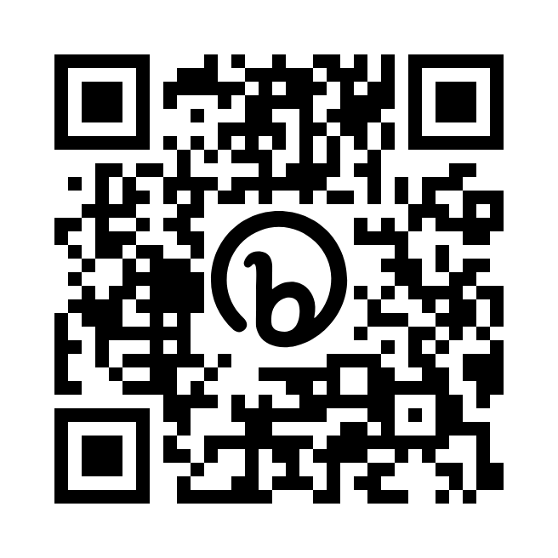
Apprenticeshipillinois.com
Scan this QR code to follow along
Notes:
According to the IL Career Pathways dictionary, WBL is defined as : learning that provides participants with work-based opportunities to practice and enhance the skills and knowledge gained in their program of study or industry training program, as well as to develop employability, and it includes an assessment and recognition of acquired knowledge and skills. Examples include: internships, service learning, paid work experience, on-the-job training, incumbent worker training, transitional jobs, and apprenticeships (do we want to add any of these to the PPT?
(WBL should be integrated with classroom learning to help participants draw connections between coursework and future careers.)

Slide 14
THE WEBSITE TODAY
From the homepage, there are several options:
Become an Apprentice
Information Center
Employer Information
Scroll Through the Page
National Apprenticeship Week Site
Notes:
Source—cte.ed.gov/wbltoolkit
This slide gives the framework of WBL and shows the 3 components of effective WBL programs
One- WBL is an instructional strategy that enhances classroom activity by connecting the work completed in the classroom to the experience to be had in the workplace. (These three images will offer more understanding of the WBL strategy, and how to engage employers, collect data, and scale effective programs—saying this is optional)
Two- in order to apply academic, technical and employability skills in a work setting, the WBL experience should be based on a comprehensive academic and employability skill requirements, and should also include in-depth hands-on experiences
Three—Participant should have mentors and these mentors should be trained on how to provide participants with industry-specific support general career and education guidance, personal and professional growth and a caring, emotional connection.
The mentors should support the participant by having the supervisors, instructors, etc. to promote participant engagement and to also monitor their progress and provide evaluations on the participant progress, AND mentors should allow participants to develop relationships with industry and community professionals

Slide 15
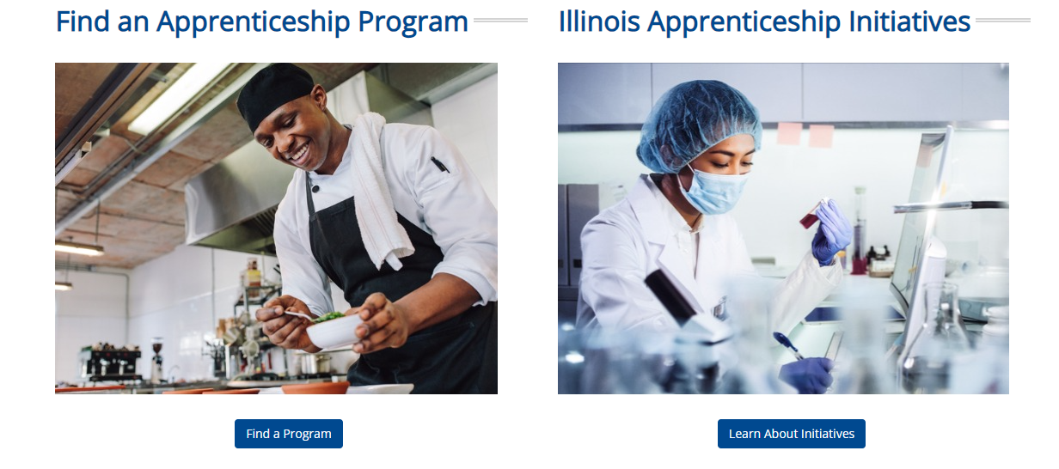
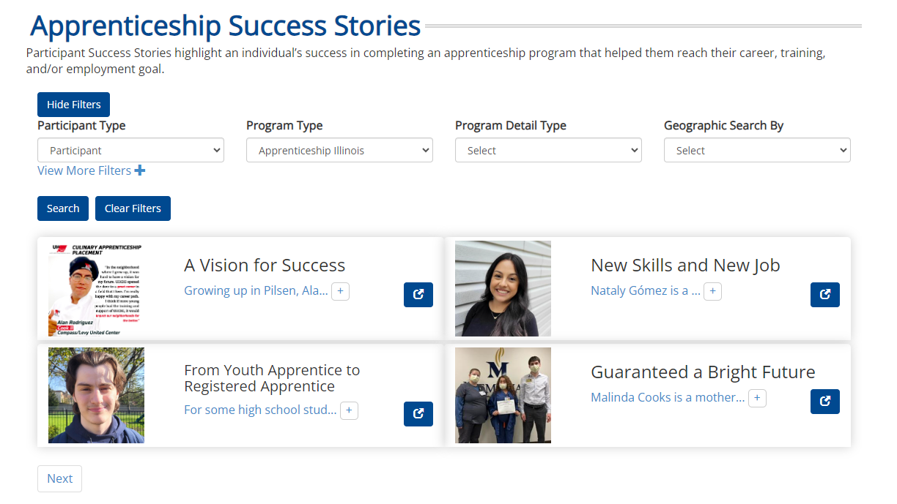
#1. Become an Apprentice
Find an apprenticeship program
Illinois Apprenticeship Initiatives
What is Apprenticeship?
Success Stories
And much more!

Slide 16
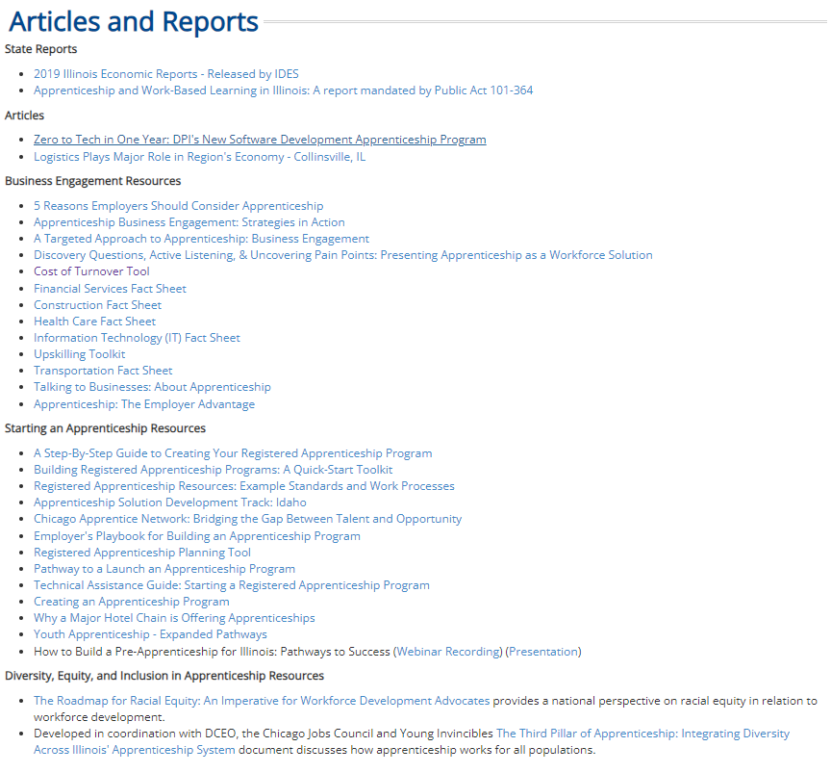
#2 Information Center
IWIB Apprenticeship Committee Monthly Bulletins
Helpful Articles, Reports, & Guides
Community Success Stories

Slide 17
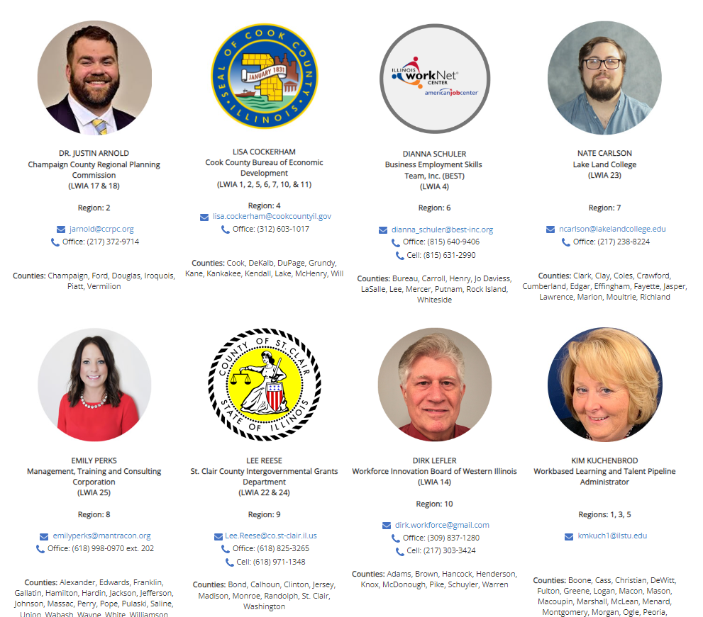
#3 Employer Information
Tax Credit Information
Apprenticeship Specialists
Employer Success Stories

Slide 18
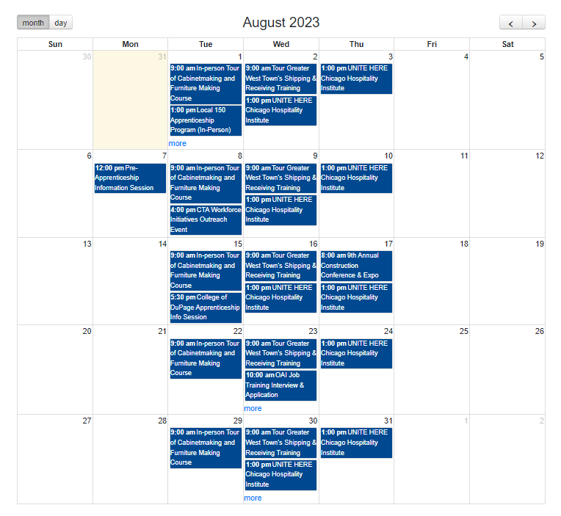
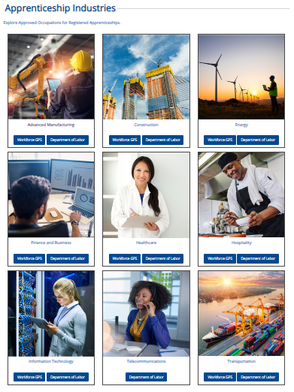
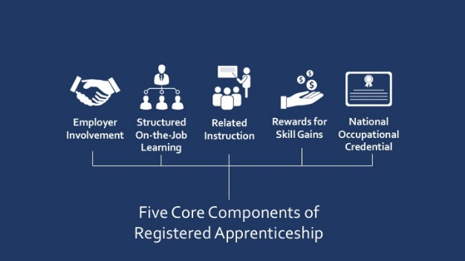
#4 HOME PAGE
What is an Apprenticeship?
Apprenticeship Industries
Apprenticeship Success Stories
Apprenticeship Event Calendar

Slide 19
#5 NATIONAL APPRENTICESHIP WEEK SITE
Social Media Toolkit
Proclamation Templates
Zoom Backgrounds
Proclamations
Apprenticeship Event Calendar

Slide 20
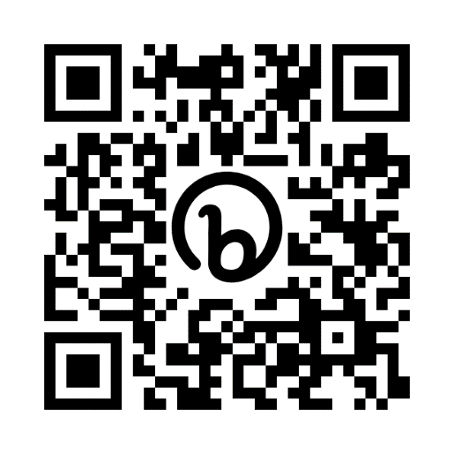
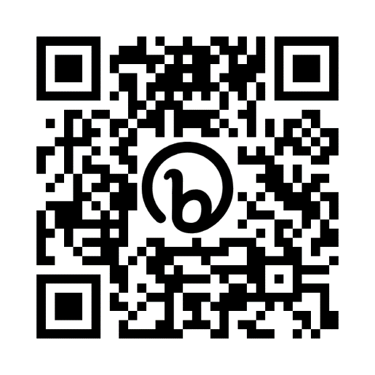
SOCIAL MEDIA- LINKEDIN AND FACEBOOK
LinkedIn
Followers: 1,176
New Followers last month: 36
LinkedIn = SM team’s focus. Grew exponentially - 0 followers to over 1,000 in just over a year.
Facebook
Followers: 339
New Followers last month: 30
Facebook is one of our oldest accounts. Looking for new accounts to connect with on this platform.

Slide 21
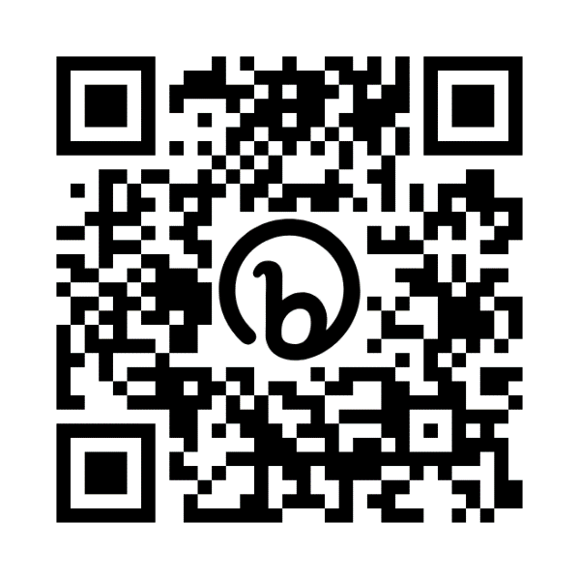
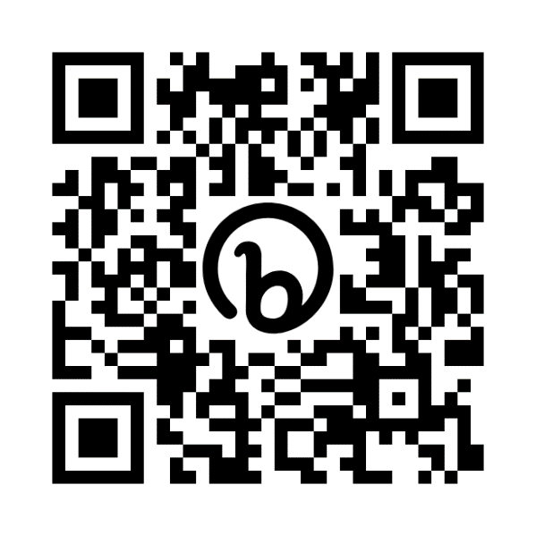
SOCIAL MEDIA- INSTAGRAM AND TWITTER/X
Instagram
Followers: 67
Instagram - newest account but is growing steadily.
Twitter/X
Followers: 42
Becomes more popular around NAW. Share our handle and help us grow!

Slide 22
SOCIAL MEDIA MESSAGING
Work hard to create & maintain consistent message.
Simple Message → Apprenticeship works!
Focus on how apprenticeship has worked, does work, or could work for a plethora of people.
Messaging strategy includes original posts, sharing other posts, and interacting with employers & jobseekers on all platforms.
Have idea for Apprenticeship Illinois social media accounts?
Send it to twcrawf@ilstu.edu. If it’s about apprenticeship, it fits the message.
We are constantly seeking out content, specifically content that highlights the value of apprenticeship.

Slide 23
SOCIAL MEDIA AND YOU
How can YOU contribute to spreading the word about Apprenticeship?
Like/follow each social media account
Send anything apprenticeship-related to the social media team
Share the posts that come from our official accounts
Tag Apprenticeship Illinois in posts/comments
Use the official hashtag #ApprenticeshipIL

Slide 24
NATIONAL APPRENTICESHIP WEEK
Proclamations
Events
Webinar Series
Add events to the Apprenticeship Illinois event calendar! →
Proclamation templates on the NAW 2023 website.
See below.
Tune in for the daily webinar series during National Apprenticeship Week. →

Slide 25
CONTINUOUS IMPROVEMENT OF APPRENTICESHIP ILLINOIS
Updating website
Cleaner and more user friendly
Adding Apprenticeship Specialist POC
Updating resources and toolkits
Let us know what you need
Social Media
Pilot campaign September – October
Targeting employers, driving to website
Employer Inquiries
Candace Dickerson manages and/or refers to appropriate regional POC

Slide 26
Notes:
We can answer common questions

