Slide 1



Recruiting Employers for Apprenticeship
July 30, 2024
Wendy Brors, American Institutes for Research

Slide 2
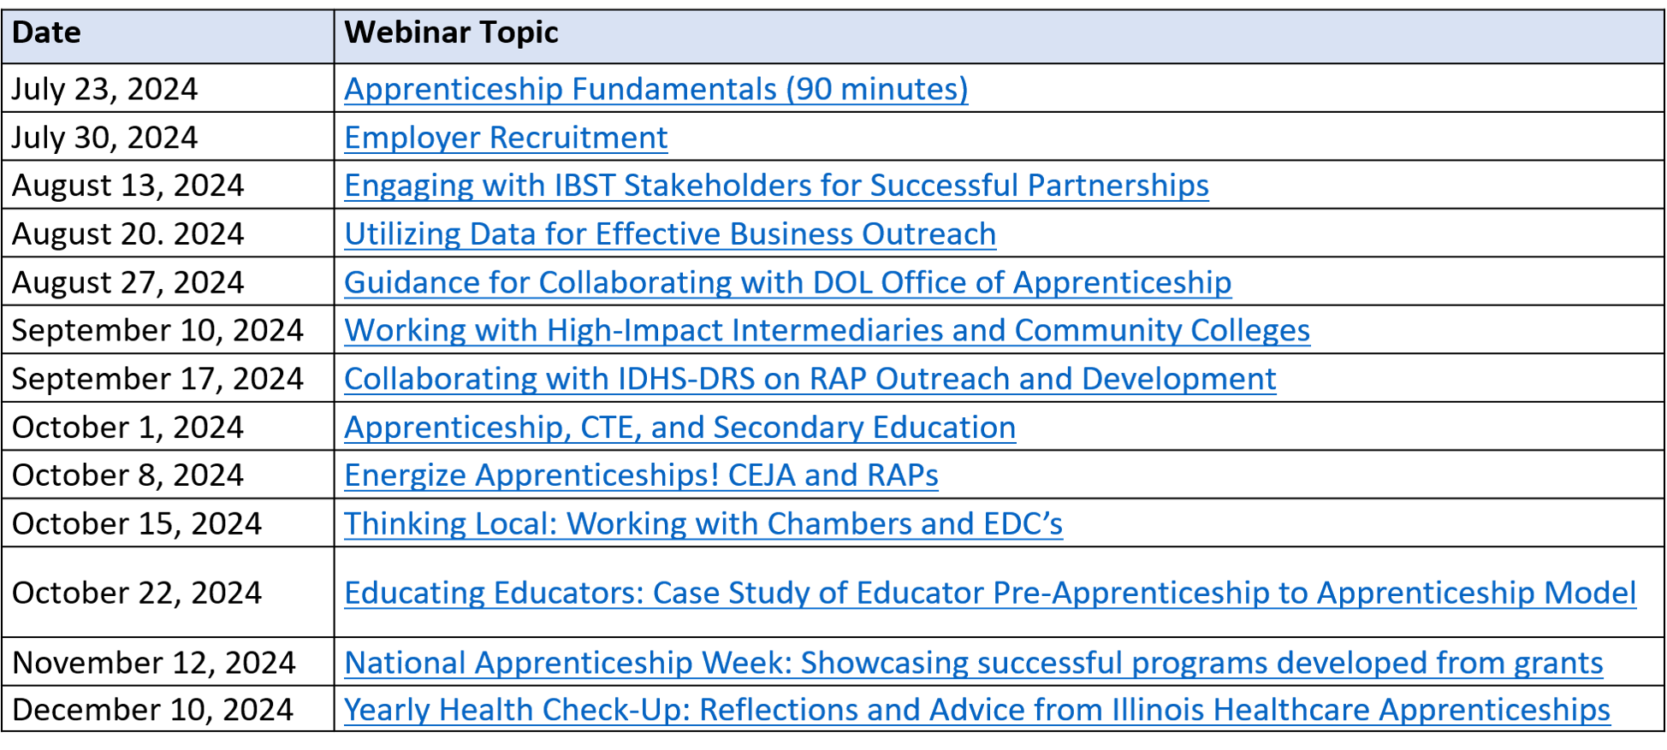
lunch & learn webinar series Dates

Slide 3

About the presenter:
Wendy Brors is a Senior Technical Assistance Consultant in the Workforce Development program area within the Human Services Division at the American Institutes for Research (AIR). https://www.air.org/experts/person/wendy-brors
The American Institutes for Research is providing collaborative technical assistance to Apprenticeship Illinois through a project that has been funded, either wholly or in part, with Federal funds from the Department of Labor, Employment & Training Administration under Contract number, 1605C2-20-C-0009, the contents of this publication do not necessarily reflect the views or policies of the Department of Labor, nor does mention of trade names, commercial products, or organizations imply endorsement of same by the U.S. Government."
Email: wbrors@air.org

Slide 4
Learning Objectives
Value from using Employer’s Journey framework
Tips for successful lead generation
Communications matter
No is rarely never, No is often not now

Slide 5

How are you going to advance your employer recruitment?
Notes:
Megan

Slide 6
Support the Employer’s Journey
A framework to meet employers where they are at in their decision journey.
STAGE | YOUR CLIENT (A Potential Employer Partner) | YOUR ACTIONS
AWARENESS | Becomes aware of pain: status quo loosens | Focus on problems and pain points. Be present where businesses are. Use big-picture industry-focused content in communications.
INTEREST | Gets interested in finding a solution; begins to discover trends, products, brands. | Discover their specific challenges empathetically. Explain apprenticeship as a solution. Educate and help prospects evaluate decision-making criteria. Use tools like self-assessments, webinars, events, reports, videos, individual meetings.
CONSIDERATION | Evaluates specific products and services; becomes willing to engage with technical assistance providers and experts. | Show the value offered and provide evidence of return on investment. Supply information like costs and benefits, case studies, similar programs.
DECISION | Commits to a specific solution; justifies reasons for investment. | Validate the client’s decision, onboard employer. Use training, fact sheets, user guides, toolkits.

Slide 7
Understand THE Employer’s Perspective
Workforce Planning
Supply analysis, also referred to as the "supply model" or "staffing assessment," involves an analysis of an organization's current labor supply.
Demand analysis, also referred to as the "demand model," includes a review of future business plans and objectives.
Gap analysis compares the differences in the supply and demand models and identifies skill surpluses and deficiencies.
Solution analysis focuses on how to address gaps in current staffing and future staffing needs through recruiting, training and development, contingent staffing, and outsourcing.
https://www.shrm.org/resourcesandtools/tools-and-samples/toolkits/pages/practicingworkforceplanning.aspx
Notes:
https://www.ibm.com/products/planning-analytics/workforce-planning?utm_content=SRCWW&p1=Search&p4=43700076098270078&p5=p&gclid=Cj0KCQjw7aqkBhDPARIsAKGa0oInvGr5wIGS9-nn4F9gD0LBdk8viKMOFh7JWM8h6tOExXcxQcmqZpoaAnKSEALw_wcB&gclsrc=aw.ds

Slide 8
Awareness
Our business needs more skilled workers
STAGE | YOUR CLIENT (A Potential Employer Partner) | YOUR ACTIONS
AWARENESS | Becomes aware of pain: status quo loosens | Focus on problems and pain points. Be present where businesses are. Use big-picture industry-focused content in communications.
INTEREST | Gets interested in finding a solution; begins to discover trends, products, brands. | Discover their specific challenges empathetically. Explain apprenticeship as a solution. Educate and help prospects evaluate decision-making criteria. Use tools like self-assessments, webinars, events, reports, videos, individual meetings.
CONSIDERATION | Evaluates specific products and services; becomes willing to engage with technical assistance providers and experts. | Show the value offered and provide evidence of return on investment. Supply information like costs and benefits, case studies, similar programs.
DECISION | Commits to a specific solution; justifies reasons for investment. | Validate the client’s decision, onboard employer. Use training, fact sheets, user guides, toolkits.

Slide 9
Marketing to drive inbound inquires
https://www.illinoisworknet.com/ApprenticeshipIL/Pages/Employers.aspx
Marketing Collateral
(web page, flyers, videos)
Thought leadership
(blog, social media, presenting at events)
Networking at events
On-demand Info Sessions

Slide 10
Interest
“What is apprenticeship and how could it help?”
STAGE | YOUR CLIENT (A Potential Employer Partner) | YOUR ACTIONS
AWARENESS | Becomes aware of pain: status quo loosens | Focus on problems and pain points. Be present where businesses are. Use big-picture industry-focused content in communications.
INTEREST | Gets interested in finding a solution; begins to discover trends, products, brands. | Discover their specific challenges empathetically. Explain apprenticeship as a solution. Educate and help prospects evaluate decision-making criteria. Use tools like self-assessments, webinars, events, reports, videos, individual meetings.
CONSIDERATION | Evaluates specific products and services; becomes willing to engage with technical assistance providers and experts. | Show the value offered and provide evidence of return on investment. Supply information like costs and benefits, case studies, similar programs.
DECISION | Commits to a specific solution; justifies reasons for investment. | Validate the client’s decision, onboard employer. Use training, fact sheets, user guides, toolkits.


Slide 11
Stimulate interest
Outbound lead generation
Understand your labor market
Build a target lists
Reach out to employers

Slide 12
Sales Outreach Statistics
Making decisions typically involves an internal project approval process
41.2% of salespeople said their phone is the most effective sales tool at their disposal.
19% of buyers want to connect with a salesperson during the awareness stage of their buying process — when they're first learning about the product.
60% want to connect with sales during the consideration stage — after they've researched the options and come up with a shortlist.
20% want to talk during the decision stage — once they're decided which product to buy.
Only 24% of sales emails are opened.
80% of sales require 5 follow-up calls, yet 44% of salespeople give up after one follow-up call.
Eight out of 10 prospects want to talk to sales reps via email over any other medium.
https://blog.hubspot.com/sales/b2b-outreach-strategy-for-startups

Slide 13
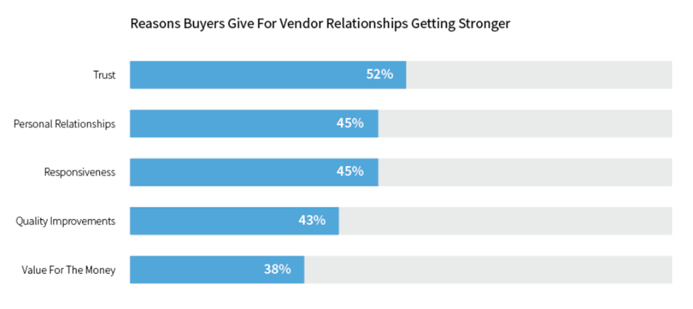

Build Mutually Beneficial Relationships
https://business.linkedin.com/marketing-solutions/success/lead-generation

Slide 14
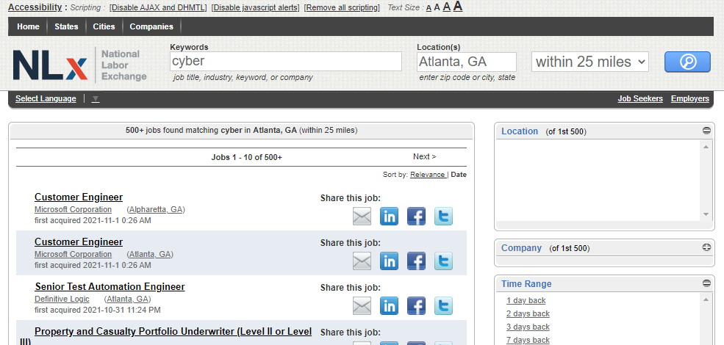
Build Your Target List
Finding employers to target
Create an ideal customer profile
Identify the personas you’ll likely speak to (HR, front-line manager, other)
Gather existing business lists your organization may have
Research to find other relevant business lists (eco devo organizations, co-working spaces, chambers of commerce, trade associations, sector partnerships, etc.)
Gather job posting data to see who is hiring for targeted occupation(s) (NLx)
Tap into other typically paid-for lists (Zoominfo; LinkedIn; D&B Hoovers Essentials; Uplead; Experian)
Attend events to network (Local events for businesses (industry councils/associations, chambers, eco dev, professional associations, meet ups)
Leverage social media networks
Notes:
https://usnlx.com/

Slide 15
Prepare Outreach Communication
A Guide to Cold Calling, https://hbr.org/2016/09/a-guide-to-cold-emailing
Review employer’s career page, their social media accounts
When crafting an email or script:
  Tailor the message to the recipient (show you’ve done your research)
  Validate yourself (explain who you know in common, or how you found them)
  Alleviate your audience’s pain or give them something they want
  Keep it short, easy, and actionable
  Be appreciative — and a little vulnerable
Summary content useful for writing compelling emails:
Vision and value proposition – one sentence!​
The problem for employers​
The solution for employers​
Top 3 benefits for employers​
Program specs – very high level​
Social proof, examples of employers​
Call to action
A Guide to Cold Calling, https://hbr.org/2016/09/a-guide-to-cold-emailing

Slide 16
Email Copy #1
Example
Employers throughout the United States are experiencing one of the greatest skills gaps in history. The global pandemic accelerated the future of work, and almost every employer is struggling to find qualified tech talent. In fact, CompTIA reports that 76% of IT decision-makers are experiencing critical skills gaps on their teams. That is a 145% increase since 2016.
WHY? Because they are all going to the same sources for talent, and it does not exist. Today, complex challenges confound an already difficult IT and cybersecurity jobs landscape.
WHAT TO DO? Organizations everywhere are realizing the risks and pitfalls involved in sticking with the status quo in terms of who they hire for tech, and how they hire for tech. Many know it's time to think bigger, think stronger, and think longer-term about tech talent development. Learn more about innovative solutions to fill tech roles in this Business Case and how you can develop skilled employees through apprenticeships.
There are real solutions to fill the hardest-to-fill tech roles, like help desk, cybersecurity support technician, data analysts and more, best of all you can speak with an expert, through an initiative funded by the United States Department of Labor Employment and Training Administration, book an initial consultation today!

Slide 17
Email Copy #2
Example
Are you experiencing hiring challenges for tech roles? You aren't alone; 3 out of every 4 employers tell us that they cannot fill tech roles. If you are willing to think differently about hiring, be innovative in your approach to upskilling existing staff, and want to get ahead of your competitors who are all fighting for the limited supply of talent. We can help.
If you are experiencing hiring challenges; and want to explore talent trends and solutions. Here are two resources that may be of interest to you, the <resource 1> and this Business Case for hiring and training differently.
Have you heard about registered apprenticeships but have your doubts? We can help you decide if it can be the right talent solution for you. Watch a short Informational Video (11m), read the Getting Started guide.
Don't waste another minute guessing or wondering if apprenticeship as a solution will work for you, book an initial consultation with one of our experts.

Slide 18
Value Propositions That Matter to Business
Examples
Diversity.
Retention.
Industry recognition.
Skills gap solution.
Apprenticeship gives organizations the chance to smartly diversify their teams and tap into new perspectives about new and existing business challenges. The X sector has been woefully under-diverse for years, and apprenticeship offers a sustainable way to improve workforce diversity.
94% of apprentices retain employment after their program ends, according to the Department of Labor. Retention boosts morale and, in equal measure, benefits the employer and the apprentice.
The world-class certification and knowledge apprentices unlock during an apprenticeship will be critical to helping them access high-demand jobs.
Apprenticeship is a quick and trusted way to help close the alarming skills gap facing the nation and to raise the collective tech IQ of teams.

Slide 19
“The first Conversation”
Empathize and inform
Notes:
Wendy

Slide 20
Potential employer needs
The business case
To build a more reliable talent pipeline and address a persistent skills gap
To provide employees with clearer internal career pathways
To contribute to our efforts to support their community inclusively and equitably
To support our shift to competency-based hiring and performance management
To upskill existing employees
For cost effective recruitment, hiring, and training
To develop future leaders through a proven mentorship method
To provide timely training in specific knowledge and skills that meet business needs and keeps pace with industry
To enhance program sustainability and success through an apprenticeship program

Slide 21
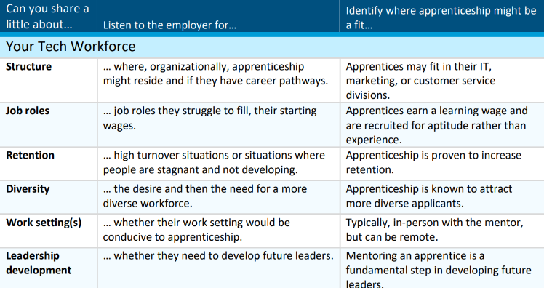
Practice listening

Slide 22
Explain your mission at a high level
Share information about apprenticeship to enable employers to decide options for engaging
Apprenticeship for reskilling/upskilling
Apprenticeship for new hires
Employers as sponsors and/or hiring partners
Connect employer to relevant next steps based on their needs

Slide 23
Use Business Speak
BUSINESS SPEAK
Recruitment & Interviewing
Job Descriptions/ Position Responsibilities
Internal/ External Training Education
Mentoring, Supervision of Work, Performance Management
Merit-Based Increases, Performance Increases
Position/ Title Change / Conversion to Full-Time
APPRENTICESHIP SPEAK
Outreach & Selection
Work Processes/Competencies
Related Technical Instruction
Mentored On the Job Learning (OJL)
Stepped-Up Wages or Progressive Wage Scale
Certificate of Completion

Slide 24
Be Prepared to Address Misconceptions
All apprenticeship programs take 4 years to complete.
Apprenticeships and internships are the same thing.
Apprenticeships are a way for companies to get low-cost labor.
Apprenticeships are only for the building and construction trades.
Apprenticeships are only for young staff or recruiting new staff. Current employees cannot participate in apprenticeship programs.
Apprenticeships cost too much for employers.
Only unions or large single employers can be “sponsors” or have apprenticeship standards.
Registering an apprenticeship program is too bureaucratic, extensive, and difficult.

Slide 25
consideration
“Is registered apprenticeship the right one for us to join?”
STAGE | YOUR CLIENT (A Potential Employer Partner) | YOUR ACTIONS
AWARENESS | Becomes aware of pain: status quo loosens | Focus on problems and pain points. Be present where businesses are. Use big-picture industry-focused content in communications.
INTEREST | Gets interested in finding a solution; begins to discover trends, products, brands. | Discover their specific challenges empathetically. Explain apprenticeship as a solution. Educate and help prospects evaluate decision-making criteria. Use tools like self-assessments, webinars, events, reports, videos, individual meetings.
CONSIDERATION | Evaluates specific products and services; becomes willing to engage with technical assistance providers and experts. | Show the value offered and provide evidence of return on investment. Supply information like costs and benefits, case studies, similar programs.
DECISION | Commits to a specific solution; justifies reasons for investment. | Validate the client’s decision, onboard employer. Use training, fact sheets, user guides, toolkits.



Slide 26
Share Details About Relevant Programs
How do I find local partners?
What is the cost to the employer? Are their funds available to offset costs?
What is the typical startup timeframe?
Do you help me prepare my mentors?
Is there flexibility with who provides the related instruction?
What are the reporting requirements?
What if an apprentice doesn’t work out?
May I customize the program to my business needs?

Slide 27
decision
“Yes, we have internal agreement and resources to do this, let’s get started!”
STAGE | YOUR CLIENT (A Potential Employer Partner) | YOUR ACTIONS
AWARENESS | Becomes aware of pain: status quo loosens | Focus on problems and pain points. Be present where businesses are. Use big-picture industry-focused content in communications.
INTEREST | Gets interested in finding a solution; begins to discover trends, products, brands. | Discover their specific challenges empathetically. Explain apprenticeship as a solution. Educate and help prospects evaluate decision-making criteria. Use tools like self-assessments, webinars, events, reports, videos, individual meetings.
CONSIDERATION | Evaluates specific products and services; becomes willing to engage with technical assistance providers and experts. | Show the value offered and provide evidence of return on investment. Supply information like costs and benefits, case studies, similar programs.
DECISION | Commits to a specific solution; justifies reasons for investment. | Validate the client’s decision, onboard employer. Use training, fact sheets, user guides, toolkits.




Slide 28
They’ve decided – now what?
Be responsive and follow-up
For “Yes” - follow the referral process (build your own program, hire through an intermediary)
For “No” – offer ways for them to stay engaged with apprenticeship such as:
Inform and invite them to sign up for the IL Apprenticeship Bulletin
Inform and invite to participate in NAW
Ask them if they’d like to contintue to deepen their knowledge about apprenticeship (refer to https://www.apprenticeship.gov/registered-apprenticeship-academy
Ask them if they’d like to be connected to an employer with active apprentices to learn more
Ask them if you can reach back out to them in 3 to 6 months to see if anything’s changed
Notes:
Nate

Slide 29

Always
Follow-up
Document

Slide 30

Questions?

Slide 31
How are you going to advance your employer recruitment?
Find business-member organizations to partner with
Deepen knowledge of potential employers and their open job roles or internal upskilling needs
Get organized to support employers through their decision journey
Create new or refresh existing collateral
Use business speak, embrace new messaging about apprenticeship as a talent solution
Other

Slide 32
Contact us:
  Jennifer Foil jfoil@niu.edu
  Nate Carlson NCarlson@NIU.edu

