Slide 1



Regional showcase: LWIA # 4
[January 21, 2025]
Apprenticeship specialist Dianna Schuler: BEST, Inc.

Slide 2

Welcome!
Time for a
brief poll
\

Slide 3

About apprenticeship Illinois:
Our Regional Apprenticeship Specialists will…
  DCEO's Top Priority: Apprenticeship Specialists create new apprenticeship programs, completing all the necessary registration paperwork on behalf of program sponsors to create a simple, streamlined process for employers!
  Conduct in-person and virtual apprenticeship outreach through events and employer consultations
  Receive and pursue referrals received to the Apprenticeship Illinois website
  Connect employers to intermediary partners and other applicable services
  Collaborate with Integrated Business Services Team for greater, collective impact

Slide 4
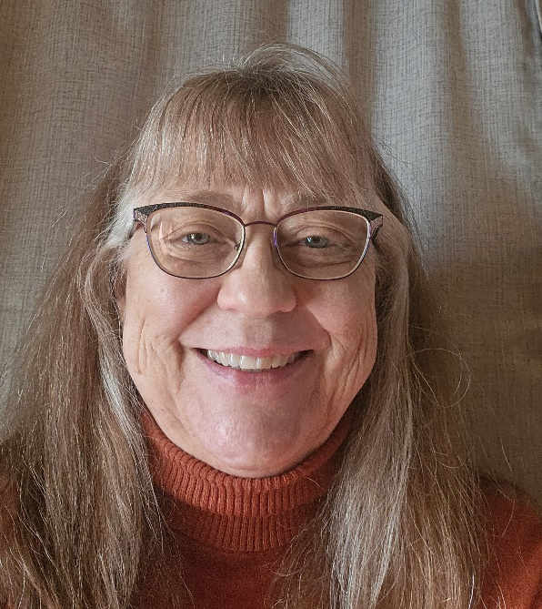
introduction
I got into workforce development in 1993 right out of graduate school. So I’ve been around for JTPA, Welfare to Work, WIA, WIOA, 3 navigator grants and whatever comes next. I am the Business Services Manager and current Navigator for our 8 county region in the Northcentral and Northwest corner of the state: La Salle, Putnam, Bureau, Ogle, Lee, Whiteside, Carroll, and Jo Daviess Counties. BEST, Inc. has been in existence since 1983 and we were original LWIA 12. In 2013 we consolidated with LWIA 4 and remained the administrative entity for the 8 counties. We cover roughly 5,500 square miles of rural Illinois.
Our region has seen a lot of change over the last 31 years. Many of our large manufacturing facilities have closed and our hospital system in at least 4 of our counties has been folded into the OSF family of healthcare. While we’ve seen a decline in the size of our manufacturing industries, manufacturing does remain one of our key industries as are agriculture, healthcare, and logistics.
We are comprised of 4 Regional Offices of Education and 2 Community College Districts. Because of the large geographic size of our area it can take up to 4 ½ hours to travel from the Southeast corner to the Northwest corner. Therefore, we have staff strategically located so that they can meet customers in the closer to where they live rather than traveling a large portion of their day to the Comprehensive One-Stop in Sterling.
E-mail: dianna_schuler@best-inc.org

Slide 5
Why apprenticeship?
The Employer Case for Apprenticeship
Let me start by saying I don’t do an elevator speech nor do I have a “pitch”. I believe in having a conversation with those companies we meet with and assessing what the issues are that a company is facing before suggesting a solution. That’s part of my 25 years experience with our Business Services Team and it has proven to work for us in our area. If a company identifies recruiting, hiring, skills development and retention to be one of the issues they are struggling with then I will begin sharing the benefits of a US DOL Registered Apprenticeship Program (RAP). Once they identify those issues, AND are open to considering an apprenticeship program, then I cover the following points with them.
Types of Programs: Time Based, Competency Based, Hybrid
Value:
1. Stepped-up wage system – can hire at lower wage while they can earn skills they need to perform job.
2. Increased retention rates – Don’t have to incur cost and lost productivity of rehiring and training for the same position
3. Repeatable, organized framework for recruitment hiring, onboarding, and advancing – Develop a hiring system & advancing that ensures consistency.
Benefits:
1. Build a pipeline of skilled workers
2. Gain workers with customized skills
3. Boost retention – 92% -96% rate in Illinois
4. Save money on wages
5. Make a positive return on investment - $1.47 for $1 spent
6. May be eligible for grant funds to offset the cost of training – Incumbent Worker Training

Slide 6
Meaningful Employer engagement
We take a Business Services approach to our employer outreach and engagement both one-on-one and in group events. Some of the events we have hosted ourselves and other we’ve partnered with the following entities to assess needs and provide information on RAPs.
Healthcare Summit in partnership with Illinois Valley Community College
Area Chambers of Commerce: Caffeinate and Connect, Leads Group, Business Improvement Workshops, reaching representatives from across private and public employers
Economic Development: Hosting business workshops also across all industries private and public
Our workforce board’s podcast series designed for both job seekers and area businesses
Sectors we’ve had success with past and current include:
Energy and Communications including 2 programs for broadband technicians
Manufacturing for CNC
Agri-business for fertilizer technicians
Elementary Education para-pro to teacher
And our very first program, before the consolidation of one of our healthcare providers into OSF we did Certified Medical Assistant

Slide 7
Programs in progress
Here are programs we’ve either developed in the past year and/or are working on …
    Borg Warner – Dixon CNC RAP signed July 2024 (PY24)
    LWIA Wide (8 Counties) – Expansion of Para- Pro to Teacher
      Conversations have been held with each Regional Office of Education and the Illinois State Board of Education to expand that started at Sterling Elementary fall 2024
      Upcoming meetings will include the ROE’s Statewide Director
      Looking for In-State Sponsors/Training Providers rather than relying solely on Bloomboard as the sponsor
      Target for completion is prior to Fall 2025 enrollment
      Jo-Daviess Transit – Jo Daviess County Dispatch RAP in initial talks on the development of a RAP
      LW Schneider – Princeton CNC RAP in initial talks

Slide 8
Collaborations & Partnerships In action
In LWIA #4, we work with ….
    Apprenticeship Effort:
      Area Chambers of Commerce
      Economic Development Entities
      Illinois Valley SHRM (hosting meeting 1/22/25)
      Community Colleges (Illinois Valley Community College and Sauk Valley Community College)
      4 Regional Offices of Education
      Illinois State Board of Education
      IDES
      All Other Business Service Efforts:
        Those listed above and the remaining publicly funded WIOA mandated/required partners

Slide 9
Funding innovations
Here are some ways we’ve used Apprenticeship Illinois grant funds and/or WIOA formula funding to support apprenticeship…
  We have utilized our Incumbent Worker Training funds a great deal to support area businesses with the training of their apprentices.
  Algeion in Princeton for their CNC apprentices
  Martin Engineering in Neponset for their CNC apprentices
  Carus Chemical in Peru for their Maintenance apprentices
  Jo Carroll Energy and Wolf Line Construction in Galena for their Broadband Technician apprentices (PY23 Apprenticeship Grant)
  Sterling Elementary in Sterling for their Para-Pro to Teacher apprentices (PY24)
  We will continue to offer WIOA IWT funds to area businesses that want to train apprentices either incumbents or new hires (waivers allowing)

Slide 10
Challenges faced
    The main challenge we’ve had to face is that for a great many of our businesses of scale the decision makers are not local. Getting decision makers that hardly ever step foot in a location in our area to be interested in taking part in a conversation about any workforce strategy often does not happen UNLESS you have a local ally within the company. Building relationships is always the first step.
    We continue to experience large layoffs and closures. Mostly in the manufacturing industry. Again, these tend to be companies where the decision makers are not local.
    For LWIA 4, one challenge we face is time. I wear many hats and have responsibilities outside of apprenticeship development. I am fortunate that we have staff that, although they don’t function in the navigator capacity, are out there speaking with groups and individual businesses about ALL Work Based Learning including apprenticeships and how WIOA funding could be of assistance in upskilling their current workforce or new hires (waiver allowing).

Slide 11
Effective approaches & Future Goals
  Effective Approaches
    BEING PATIENT! Not all programs happen quickly and sometime they cross grant/program years to build – LW Schneider has been 3 years in deciding how to set one up
    Focus on an actual need for example the teacher shortage
    Starting with those individuals you truly know and build the relationship of trust. These will be the individuals to offer you and RAPs an endorsement.
    Future Goals
      Primary goal is the expansion of the para-pro to teacher RAP
      Guiding Jo Daviess Transit through their process for a Dispatcher RAP
      Continue the conversation with LW Schneider for as long as it takes

Slide 12

\
Q&A
Feel free to unmute or drop your questions in the chat!

Slide 13
Contact us:
  LWIA #4 Team:
  Dianna Schuler dianna_schuler@best-inc.org
  APIL Team:
  Nate Carlson ncarlson@niu.edu
  Jordan Johnson jtjohns@ilstu.edu
  Jennifer Foil, Ph.D. jfoil@niu.edu

