Slide 1



Regional showcase: LWIA # 3
January 14, 2025
Apprenticeship specialist| The Workforce connection

Slide 2

Welcome!
Time for a
brief poll

Slide 3

About apprenticeship Illinois:
Our Regional Apprenticeship Specialists will…
  DCEO's Top Priority: Apprenticeship Specialists create new apprenticeship programs, completing all the necessary registration paperwork on behalf of program sponsors to create a simple, streamlined process for employers!
  Conduct in-person and virtual apprenticeship outreach through events and employer consultations
  Receive and pursue referrals received to the Apprenticeship Illinois website
  Connect employers to intermediary partners and other applicable services
  Collaborate with Integrated Business Services Team for greater, collective impact

Slide 4
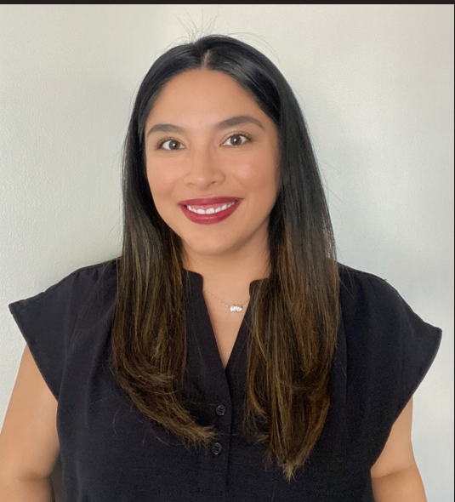


introduction
Your Presenters Today:
LWIA 3 Region: Winnebago, Boone and Stephenson Counties.
Berenice Jaquez – Apprenticeship Specialist
bjaquez@theworkforceconnection.org
Karyn McDonald – Elevate Program Manager
kmcdonald@theworkforceconnection.org

Slide 5
Why apprenticeship?
The Employer Case for Apprenticeship
Business Led – Training – Mentorship – Earn and Learn - Credentials
Employers build their own talent pipeline
Custom training that fits the employers needs
Development of existing talent
Access to incentives to apprenticeship support
Increased employee retention
Intentional succession planning
Unlocks opportunities for untapped talent

Slide 6
Meaningful Employer engagement
Initial Contact - Follow Up - Follow Through
  Business Team Events and Presentations
  Business Service Team Outreach and Cold Calls
  Job Fairs – Opportunities for Employers and Participants
  Community and Partner Referrals
  Business Team Specialist and Apprenticeship Specialist Collaboration
  Apprenticeship Specialist Follow Up – Workflow

Slide 7
Meaningful Employer engagement
Apprenticeship Specialist Guide to Follow Up
Task | Follow Up
1. Meet employer – review occupations, process and market information. | Initial Meeting/Contact
2. Provide sample Work Process Schedule (Job Description) and Related Training Instruction information | Follow Up meeting virtual or in person – Generally within 1 – 2 weeks.
3. Customize Work Process Schedule based on employer needs. | 1 week follow up. (Can be longer if more than one occupation)
4. Review RTI providers, hours and available programs | This can vary based on available programs – the key is always stating a follow up timeframe and modality (in person/virtual/phone call).
5. Review progressive wage schedule and provide labor market information | Generally shared and provided by employer via e-mail. 1-2 week follow up based on size of employer.
6. Once all the information is documented, send to employer for review and approval. | 1-2 week follow up by Apprenticeship Specialist
7. Submit packet to The Department of Labor (Appendix A) | Keep employer informed

Slide 8
Meaningful Employer engagement
Employer’s Apprenticeship Checklist
Roadmap to Building an Apprenticeship Program
Review Occupation and Job Description
Explorer training and credentials
Complete Work Process Schedule (Job skills and work-based learning breakdown of hours)
Choose training provider
Review wages and determine the progressive wage schedule for the apprenticeship
Final review and approval of documentation (Appendix A) (Employer)
Apprenticeship Specialist - Submits packet to The Department of Labor (Appendix A)

Slide 9
Collaborations & Partnerships In action
  LWIA 3 – Partnerships
  Rock River Tooling & Machining Association (RRVTMA)
  Community College – Rock Valley College
  IMEC
  Greater Rockford Area Chamber of Commerce
  Region 1 Planning Council
  Birth to Five
  Other LWIA’s
  Career Education Associates of North Central Illinois (CEANCI)
  Local School Districts

Slide 10
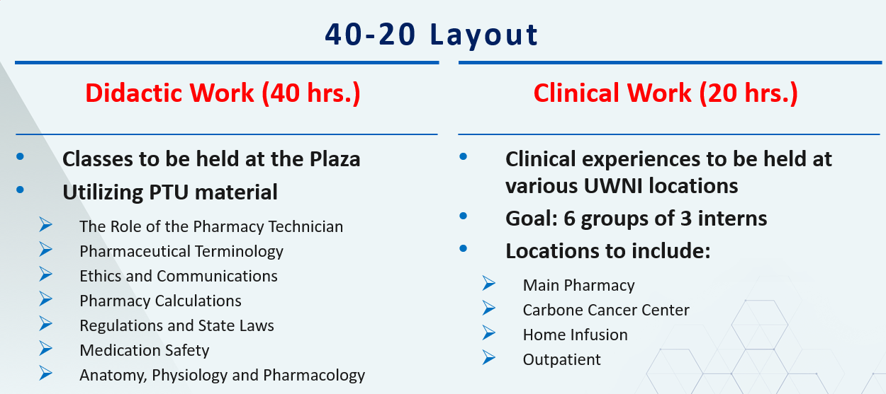
Collaborations & Partnerships In action
  SUCCESSFUL LWIA 3 PARTNERSHIPS…..
  UW Health and Harlem High School Collaboration with the Youth Service Team:
    Pharmacy Technician Program – How it Started….
    Framework, Enrollment, participant tracking and Successes……

Slide 11
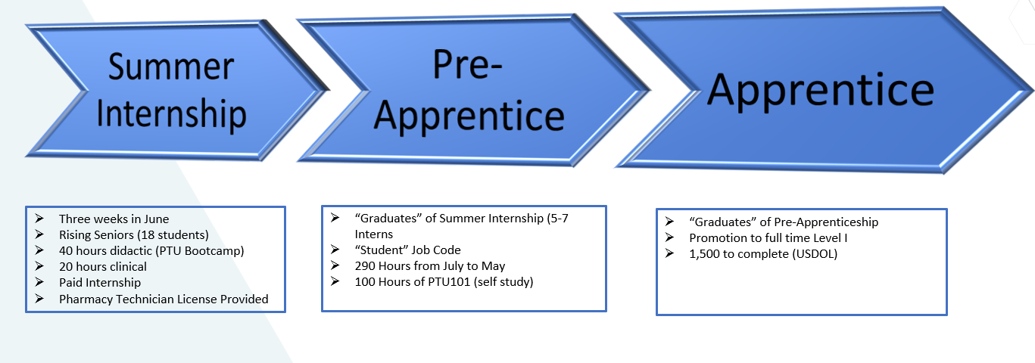
Collaborations & Partnerships In action
Program Overview

Slide 12
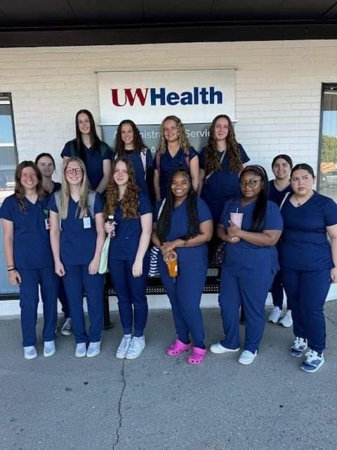
Collaborations & Partnerships In action
First Pharmacy Technician Cohort

Slide 13
Programs in progress
Here are programs we’ve either developed in the past year and/or are working on …
Developed or Expanded:
Adkins Energy – Electrician
Tad More Tailoring – Industrial Sewing
Awaken Foundation – Culinary
Divine Sol – Energy Consultant
Manufacturing
In the Works:
RAMP – Intermediary Development
Boone County – Firefighter Apprenticeship
Hand in Hand Early Childhood Center – Early Childhood Teacher
FHN – Health Service Occupations
Clean Energy Occupations for CEJA Programs

Slide 14
Funding innovations
Here are some ways we’ve used Apprenticeship Illinois grant funds and/or WIOA formula funding to support apprenticeships….
  Tuition Reimbursement for program expansion
  Curriculum Development Funding for new programs.
  Training Costs and Mentorship Cost Support
  On the Job Training Funds (OJT)
  Incumbent Worker Training Funds (IWT)
  Work Experience (WEX): Pre-Apprenticeship Support

Slide 15
Challenges faced
  Cost to Employers
  Time and effort commitment by employer to manage and support apprenticeship program and apprentice tracking
  Initially apprehension of DOL involvement

Slide 16
Effective approaches & Future Goals
GOALS
Continue to expand and collaborate with the business team for continued expansion and apprenticeship awareness
Continue efforts to expand and grow intermediary support
Enhance existing programs to establish a dedicated contact or reference point for those seeking apprenticeships

Slide 17

Q&A
Feel free to unmute or drop your questions in the chat!

Slide 18
Contact us:
  LWIA # 3 Team:
  Berenice Jaquez – Apprenticeship Specialist
  bjaquez@theworkforceconnection.org
  Karyn McDonald – Elevate Program Manager
  kmcdonald@theworkforceconnection.org
  Cassandra Potter – Careers Program Manager
  cpotter@theworkforceconnection.org
  APIL Team:
  Nate Carlson ncarlson@niu.edu
  Jordan Johnson jtjohns@ilstu.edu
  Jennifer Foil, Ph.D. jfoil@niu.edu

