Slide 1



Regional showcase: LWIA #17
February 18, 2025
Champaign County Regional Planning Commission

Slide 2

Welcome!
Time for a
brief poll
\

Slide 3

About apprenticeship Illinois:
Our Regional Apprenticeship Specialists will…
  DCEO's Top Priority: Apprenticeship Specialists create new apprenticeship programs, completing all the necessary registration paperwork on behalf of program sponsors to create a simple, streamlined process for employers!
  Conduct in-person and virtual apprenticeship outreach through events and employer consultations
  Receive and pursue referrals received to the Apprenticeship Illinois website
  Connect employers to intermediary partners and other applicable services
  Collaborate with Integrated Business Services Team for greater, collective impact

Slide 4
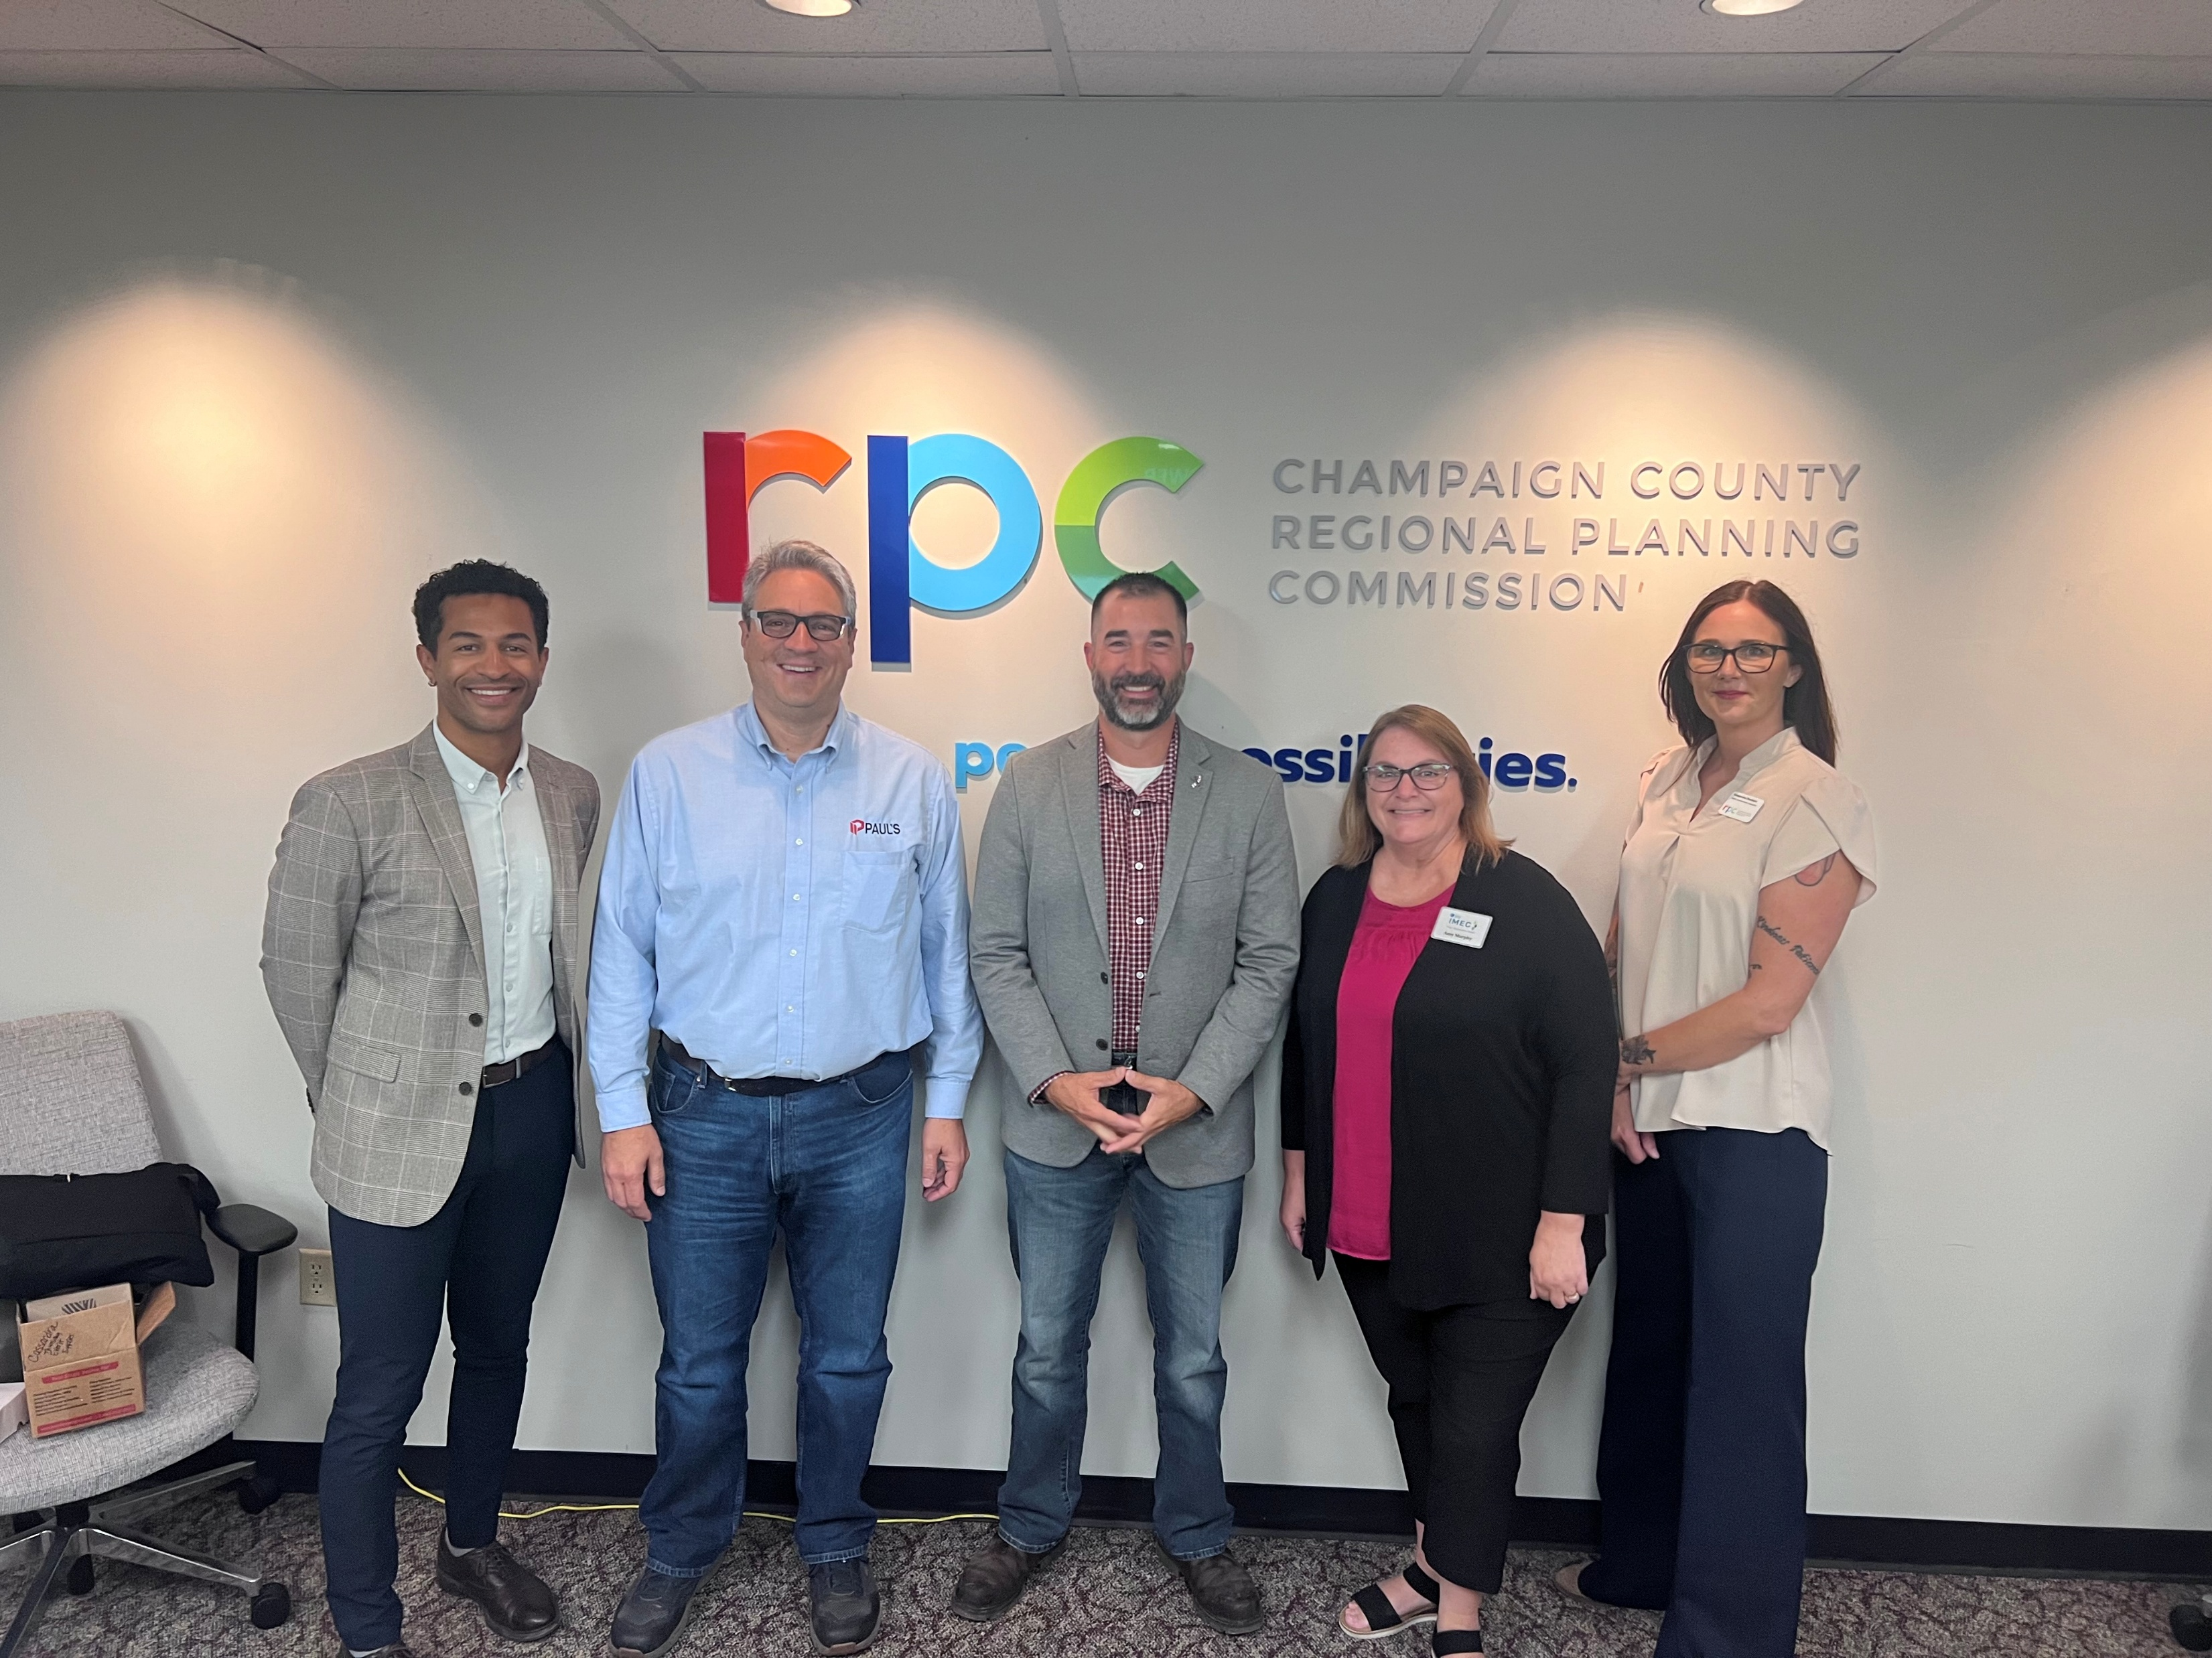
introduction
“About Me”
Business Services Coordinator (Apprenticeship Expansion, Title I investments, & CEJA initiatives)
Unrealized passion for Workforce Development & Education
Capacity Building
3 Community Colleges & 2 LWIAs
Vision
Build pathways to quality jobs
Create sustainable workforce pipelines
Challenges
Partner LWIA funding loss
Main college restructured to in-house apprenticeships
Pivot
- Hand-off approach to full-service
E-mail: tblack@ccrpc.org

Slide 5
Why apprenticeship?
The Employer Case for Apprenticeship
Initial Email Template
Subject: Reduce Training Costs & Build Your Workforce with Apprenticeship
Dear [Name],
I'm reaching out from Champaign County RPC regarding your company's workforce development needs. Companies in [industry] are seeing significant ROI through registered apprenticeship programs:
92% retention rate
$1.47 return for every $1 invested
40-50% reduction in training costs
We offer free program development and handle all registration paperwork. Would you have 15 minutes to discuss how apprenticeship could benefit [Company Name]?
Best regards,

Slide 6
Why apprenticeship?
The Employer Case for Apprenticeship
Follow-up Email Template
Subject: Following Up: Apprenticeship Resources for [Company Name]
Dear [Name],
Thank you for our conversation about apprenticeship opportunities. As discussed, here are the key benefits for [Company Name]:
[Customize based on conversation points]
I'll call next week to answer any questions. Meanwhile, here's a link to success stories from similar companies: [Link]
Best regards,

Slide 7
Why apprenticeship?
The Employer Case for Apprenticeship
Phone Script
Hello [Name], this is Taylor Black with Champaign County RPC. I'm calling because we're helping [industry] companies develop talent through registered apprenticeship programs.
Many employers in our area are facing workforce challenges - is this something you're experiencing as well? [Wait for response]
[If yes] We're currently offering free program development assistance and can handle all the paperwork. Would you be interested in learning how other companies have reduced training costs by up to 50% through apprenticeship?
[If interested] I'd love to schedule a brief meeting to discuss how this could work for your company. What works best for you?

Slide 8
Why apprenticeship?
The Employer Case for Apprenticeship
Walk-In Introduction
Hi, I'm Taylor Black with Champaign County RPC. We're visiting local employers to discuss workforce development through apprenticeship. Is your HR manager or operations director available?
[If available] Great! I'll be brief - we're helping companies in [industry] develop talent through registered apprenticeship. We handle all the paperwork and there's no cost for our assistance. Would you be interested in hearing how other local companies are using apprenticeship to build their workforce?
[If not available] No problem! Could I leave some information and get the best contact person's email? We'd love to share how other [industry] companies are reducing training costs through apprenticeship.

Slide 9
Meaningful Employer engagement
Weekly Engagement Strategy
Target & Approach
- 5 new employer contacts per week
- Focus on building lasting relationships
- Mix of cold calls, referrals, and walk-ins
Workflow Steps
1. Source identification:
- Local news/job boards
- Partner referrals (BST)
- Business walk-in visits
2. Contact schedule:
- Monday: Research & planning
- Tuesday-Thursday: Outreach
- Friday: Documentation

Slide 10
Meaningful Employer engagement
Weekly Engagement Strategy
Follow-up Process
1. Week 1:
- Initial Contact
- Benefits Sheet (Day 3)
- Phone Check-in (Day 5)
2. Week 2:
- Success stories email
- Final Call
3. Week 3
- Monthly contact list (If interested)
- Archive if uninterested
Target & Approach
- Basic excel tracking/Illinois Worknet
- Key fields: Company, contact, dates, interest level
- Monthly review of progress

Slide 11
Programs in progress
Program Impact Metrics
3 programs launched in past 8 months
6 new programs in development
Multiple pathways in industrial maintenance and manufacturing
Wage progression opportunities: $15.00 - $32.80 range
Mix of time-based and hybrid models
Looking Forward
Expanding industrial maintenance programs
Growing manufacturing sector partnerships
Developing advanced technology programs
Supporting rural workforce development

Slide 12
Programs in progress
Recently Approved Program (Last 8 months)
Manufacturing & Industrial
Kraft Heinz - Industrial Machinery Mechanic (Line Technician)
1-year hybrid program
Wage progression: $30.80 → $32.80
Status: Approved – 7 apprentices
Kuhn's Equipment - AG Equipment Technician
3-year time-based program
Wage progression: $16.00 → $27.50
Status: Approved – 3 apprentices
Darnall Printing (Automated Communications) - Print Binding and Finishing Specialist
4-year hybrid program
Wage progression: $15.00 → $26.00
Status: Approved – 1 apprentice

Slide 13
Programs in progress
Programs Under Development
Electrical & Industrial
Harris Companies
Multiple programs in development:
Electrician and Generator Maintenance (Industrial Maintenance Technician)
Machinist
Welding
Status: Initial development
Advanced Manufacturing
Flex-n-Gate (Danville)
Registering existing apprenticeship programs
New program development:
  Line Production Technician
  Robotics Automation
Status: Research & Design phase
8th Street Welding and Hydraulics
CNC Machinist
Welding apprenticeship
Status: Initial development

Slide 14
Collaborations & Partnerships In action
Core Educational Partnerships
Community College Network
Three Community Colleges (Parkland College, Danville Area Community College, Kankakee Community College)
  Curriculum Development Support
  RTI Delivery
  Resource Sharing for Program Development
Workforce Development Integration
Two Local Workforce Innovations Areas (LWIAs)
Intergration with American Job Centers (AJC)

Slide 15
Collaborations & Partnerships In action
Industry Sector Partnerships
Manufacturing & Industrial
Kraft Heinz
Flex-n-Gate
Advanced Filtration Systems, Inc. (AFSI)
Regional Tech Hub engagement
Agriculture & Equipment
Kuhn's Equipment
State-wide ag initiatives (Birkey's Farm Store)
Equipment dealer network (Associated Equipment Distributors)
Construction & Skills Trades
Harris Companies
8th Street Welding
Construction pre-apprenticeship programs

Slide 16
Collaborations & Partnerships In action
Core Partnerships
Business Services Integrations (BST)
Labor market information
Shared branding
Resource alignment
Rural Development
Network of four EDOs
Rural workforce initiatives
Sector strategy implementation
Business retention support
Future Growth Areas
Expanding rural partnerships
Strengthening Tech Hub collaborations
Developing new sector relationships
Building sustainable training partnerships

Slide 17
Funding innovations
Strategic Funding Utilization
SAEF Grant Implementation
Multi-year support (PY22-24)
Key components funded:
  Apprenticeship Specialist
  Business Team
  Direct Training support (Staff)
Rapid Response Success
PY22 Achievement
$188,077.28 funding secured
Supported Birkey's Farm Store cohort
11 apprentices maintained in program
Ensured program completion and employment

Slide 18
Funding innovations
State Supplemental Funding Impact
PY23 Highlights
CAT: $34,000
58 Supply Chain Management apprentices
Birkey's Farm Store: $81,000
8 Case New Holland apprentices
Kraft Heinz: $5,400
5 line tech apprentices
PY24
Kraft Heinz: $20,000 support
5 apprentices
RTI funding

Slide 19
Funding innovations
Incumbent Worker Training Innovation (IWT)
PY22-23 Programs
Volo Internet + Tech: $18,000
RTI support
AFSI: $3,000
RTI support
Case New Holland: $20,000
Tuition and books support
PY24
Kraft Heinz: $20,000
RTI support
Birkey's Farm Store: $20,000
Tuition & Books

Slide 20
Challenges faced
Initial Challenges
Loss of funding LWIA partner
Main college partner restructured to in-house apprenticeships
Solution
Transformed from hand-off model to full-service SME
Developed direct employer support system
Created more sustainable funding approaches
Lessons Learned
Adaptability is crucial
Direct employer relationships matter
Clear communication is essential
Regional collaboration key to success

Slide 21
Effective approaches & Future Goals
What's Working Well
Employer-Focus Approach
Concierge service model
Streamlined paperwork assistance
Flexible program design
Strong communication protocols
Strategic Sector Focus
Healthcare
Manufacturing
Ag-tech (with Tech Hub)
Rural development opportunities
Successful Program Elements
Focus on in-demand occupations
Integration with workforce investments
Strong RTI partnerships

Slide 22
Effective approaches & Future Goals
Future Goals
Regional Growth
Strengthen sector partnerships
Develop new industry connections
Build sustainable training pipelines
Program Development
Expand pre-apprenticeship opportunities
Increase youth engagement
Enhance career coaching integration
Partnership Enhancement
Deepen Tech Hub collaboration
Strengthen business team integration
Expand CEJA initiatives
Build more rural partnerships

Slide 23
Effective approaches & Future Goals
Future Goals
Innovation Focus
Creative funding solutions
Flexible program designs
Enhanced employer support
Expanded regional coverage
Success Metrics
Program completion rates
Employer satisfaction
Regional economic impact

Slide 24

\
Q&A
Feel free to unmute or drop your questions in the chat!

Slide 25
Contact us:
  LWIA # Team:
  APIL Team:
  Nate Carlson ncarlson@niu.edu
  Jordan Johnson jtjohns@ilstu.edu
  Jennifer Foil, Ph.D. jfoil@niu.edu

