Slide 1



Apprenticeship fundamentals
07/23/24
Nate Carlson, State Apprenticeship Mentor

Slide 2
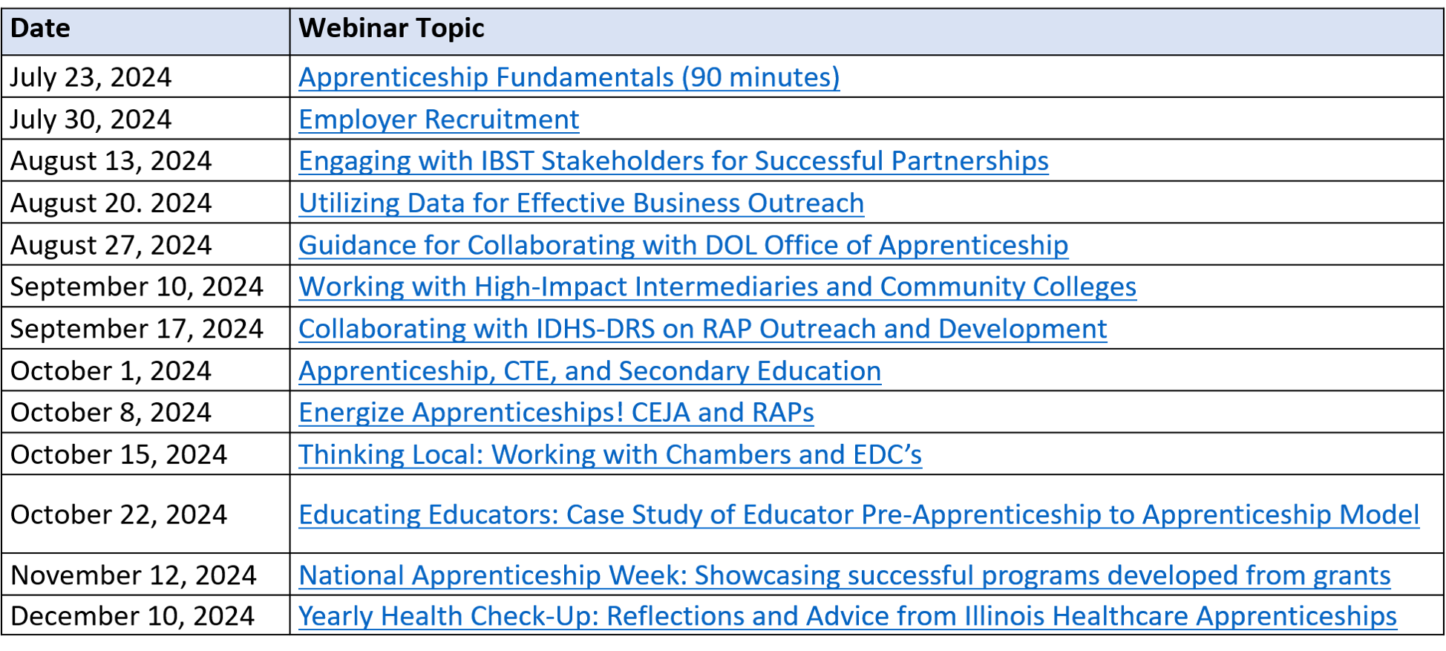
lunch & learn webinar series Dates

Slide 3

About the presenter:
Nate Carlson
State Mentor & Technical Assistance Program Director for Apprenticeship Illinois
Previously: Apprenticeship Specialist for LWIA 23, Digital Literacy and Communication Instructor at Eastern Illinois University.
Email: ncarlson@niu.edu

Slide 4

Time for a
brief poll

Slide 5
Learning Objectives
We will understand the seven components of the USDOL Registered Apprenticeship Program model.
We will be able to utilize the “3 C’s” model of apprenticeship outreach and development.
We will strategize on how to address employer misconceptions about registered apprenticeship.
We will identify key roles in the Illinois apprenticeship ecosystem.

Slide 6

Defining apprenticeship
Apprenticeships are NOT…
Unpaid Internships
Limited to the Trades/Construction
Limited to Young People/New Hires
A Delivery System for Corporate Welfare
A Magic Wand

Slide 7

Defining apprenticeship
Apprenticeships ARE…
Paid jobs, usually FT with benefits
Found in every sector
Open to workers of all ages/backgrounds
A life-changing career opportunity for participants that can revive communities and revitalize businesses

Slide 8
Defining apprenticeship
Most of all, apprenticeship is
AN INVESTMENT
in training and retaining skilled talent.

Slide 9
Defining apprenticeship
An apprenticeship which does not sufficiently train or has been designed in such a way that it will not retain skilled talent is functionally null and void.
It is our role to ensure that employers not only invest in registered apprenticeship, but that they make a worthwhile investment.

Slide 10

About apprenticeship Illinois:
Our Regional Specialists will…
  Conduct in-person and virtual apprenticeship outreach through events and employer consultations
  Receive and pursue referrals received to the Apprenticeship Illinois website
  Work with employers to fully develop and register their apprenticeship programs from start to finish
  Connect employers to intermediary partners and other applicable services

Slide 11







The Seven Components of
registered apprenticeship

Slide 12
1. Apprenticeships are...
business-driven.
What does this mean?
  Employers have final say on program design
  The Specialist role is about empowering program registration and ensuring program quality.
    Find opportunities to include employer input/customization
    Be honest when programs fall short; retention is important!

Slide 13
2. Apprenticeships are...
A paid job.
What does this mean?
  Apprentices earn a progressive wage schedule
  Apprentices earn a percentage of the journeyworker or experienced worker hourly rate.
  Wage reflects skill-gains in real time
  Wage Schedules are entirely customizable
  ONET data is useful for determining wage competitiveness

Slide 14
QUICK COMPARISON:
Both Wage Schedules below meet DOL requirements and end at the same wage, but which is more likely to incentivize retention?
Competencies Completed | Hourly Wage
0 (Program Start) | $15
60 (Completion) | $26
Competencies Completed | Hourly Wage
0-10 | $15
10-25 | $17
25-40 | $21
60 (Completion) | $26

Slide 15
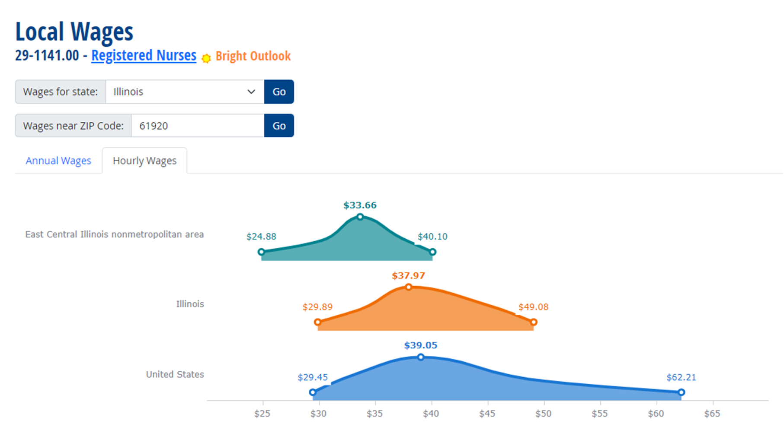
STAYING COMPETITIVE
The chart below from onetonline.org shows the median hourly wage for Registered Nurses in a specific region. We can use this data to ensure that programs we develop are competitive and likely to retain completers.

Slide 16
3. Apprenticeships include...
on-the-job mentorship.
What does this mean?
  Employers assign each apprentice an on-the-job mentor
  Apprentices may work alongside mentors or have regular check-ins/training sessions with them
  Mentors monitor apprentices’ progress through their program, signing off on competencies.
  Each program must establish a ratio of journeyworkers to apprentices

Slide 17
4. Apprenticeships include...
supplemental education.
What does this mean?
  Apprentices must receive at least 144 hours of classroom learning per year
  In most programs, this training is fully funded up-front by the employer
  Community Colleges and industry-recognized third parties are the most common RAP training providers
  Training can be front-loaded as necessary (CNA, CDL, etc.)

Slide 18
5. Apprenticeships facilitate...
diversity.
What does this mean?
  Programs are designed to reflect the communities in which they are located through strong non-discrimination, anti-harassment, and recruitment practices that ensure access, equity, and inclusion.
  Program Sponsors must work with their DOL ATR to develop an Affirmative Action Plan within two years of registration.

Slide 19
6. Apprenticeships ensure...
quality and safety.
What does this mean?
  Skill Competencies are standardized for each occupation to ensure quality of training outcomes
  Mentor-Apprentice ratio encourages worksite safety
  Specialists take on an advisory role to help employers design programs with high-quality apprentice outcomes

Slide 20
7. Apprenticeships provide...
credentials.
What does this mean?
  Apprentices who complete their program receive a nationally-recognized Journeyworker certificate from US DOL
  Additional credentials such as licenses, degrees, and certificates are often built into apprenticeships as part of program development.
  Better credentials = better value add for apprentices

Slide 21





Roles in the registered apprenticeship ecosystem

Slide 22
Roles in the RAP Ecosystem:
Program Sponsor:
  The entity that is legally responsible for the apprenticeship program and maintains its documentation
  Employers, LWIAs, Community Colleges, and CBOs can all be sponsors on behalf of an employer
  The primary responsibility of an apprenticeship sponsor is to ensure apprentice information is kept up to date in RAPIDS (Registered Apprenticeship Partners Information Database System)

Slide 23
Roles in the RAP Ecosystem:
Intermediary:
  An organization which provides services to registered apprentices and apprenticeship employers.
  Services may include:
    Case Management
    Wraparound/Supportive Services
    Pre-Apprenticeship Skills Training
    Classroom Instruction
  High-Impact Intermediaries such as Community Colleges, may function as both a Sponsor and an Intermediary.

Slide 24

Roles in the RAP Ecosystem:
Apprenticeship Training Representatives (ATRs):
  Illinois is a DOL Office of Apprenticeship (OA) state
  Programs are registered and monitored through the US Department of Labor
  ATRs…
    Help program sponsors develop or revise a program for registration
    Keep sponsors aware of any relevant policy changes
    Assist sponsors with Affirmative Action planning

Slide 25
Roles in the RAP Ecosystem:
Regional Specialists:
  Funded by the Apprenticeship Illinois grant program through awards provided to Local Workforce Areas (LWIAs)
  Specialists provide an end-to-end concierge service to employers looking to develop or join a registered apprenticeship program.
  The primary function of the apprenticeship specialist is to work with ATRs to register programs on behalf of interested employers

Slide 26
Roles in the RAP Ecosystem:
Regional Specialists will…
  Conduct in-person and virtual apprenticeship outreach through events and employer consultations
  Receive and pursue referrals received to the Apprenticeship Illinois website
  Work with employers to fully develop and register their apprenticeship programs from start to finish
  Connect employers to intermediary partners and other applicable services

Slide 27
Roles in the RAP Ecosystem:
Integrated Business Services Team:
  Comprised of WIOA Title partners, local economic development organizations, CBOs, K-12 educators, post-secondary education institutions, municipalities, state agency partners, LWIB staff
  Pivotal in providing referral of services for employers and apprentices looking to get involved in registered apprenticeship
  Everyone has a role to play: Frontline staff can recruit and refer apprentices; Business Services Staff can recruit and refer businesses!

Slide 28


registered apprenticeship:
outreach & Development

Slide 29
Goals of Outreach
  Abstract Tangible
  Bureaucratic Concise
  Consideration Mindset Design Mindset
  Isolation Interconnectivity
  Interest Investment

Slide 30
Registering an apprenticeship
We can simplify the pieces of information needed to register an apprenticeship program into three easy categories:
The 3 C’s of Registered Apprenticeship!
  Competencies
  Coursework
  Compensation

Slide 31
Defining the 3 c’s
COMPETENCIES
What skills should the apprentice have by the time they have completed their apprenticeship?

Slide 32
Defining the 3 c’s
COURSEWORK
What training will the apprentice receive to support their skills growth?

Slide 33
Defining the 3 c’s
COMPENSATION
How much is the apprentice going to be paid, and how are they going to earn their wage increases?

Slide 34



The Three C’s: A Complete Package!
Coursework
Competencies
Compensation
Brainstorm and Prepare Options prior to initial employer meeting
Present as a “package” to employer during initial meeting
Revise with employer as necessary
80% of the Paperwork for a Registered Apprenticeship can be completed and ready to present prior to meeting with an employer!
Research local market wages prior to initial employer meeting
Develop alongside employer after initial meeting

Slide 35

Employer Outreach Preparation
Once an employer has been referred to you, do the following prior to your initial meeting/call:
Ask them where they are located and what positions they are looking to develop an apprenticeship for.
Research their organization by reading their website and looking at reviews on Glassdoor/LinkedIn/etc.
Look at what job postings they are currently offering online and check to see if they are appearing on your area’s Help Wanted Online report from IDES.

Slide 36
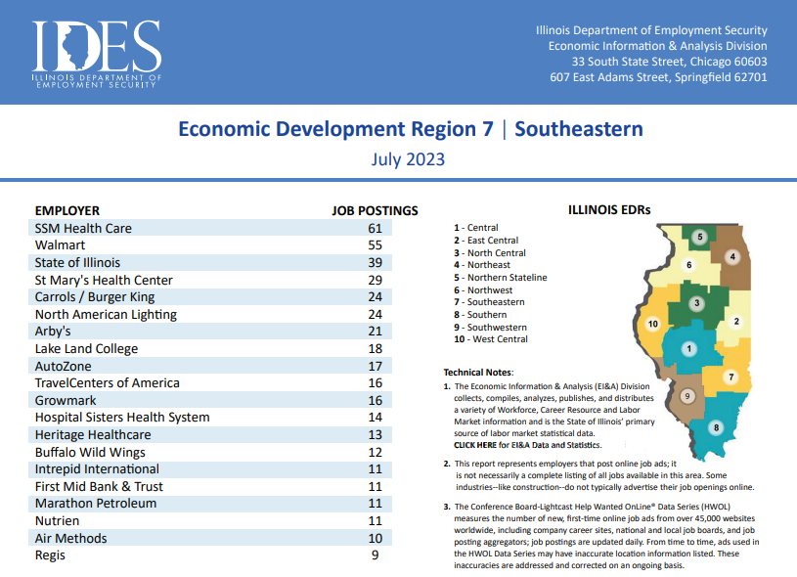
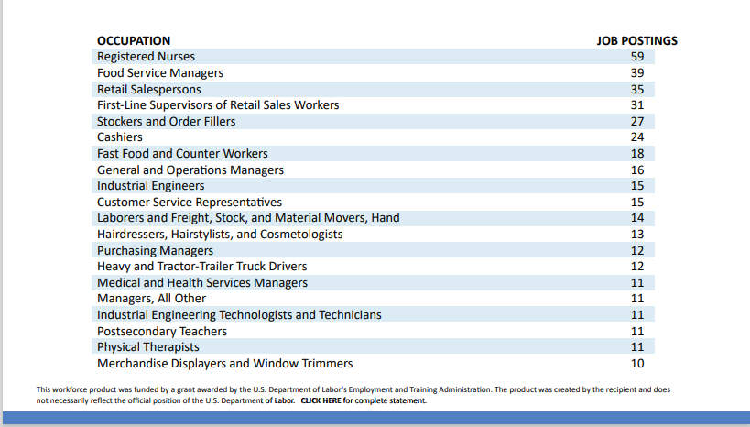

Slide 37

Employer Outreach Preparation
Identifying Occupations/Competencies
With the occupations provided to you by the employer, you can identify an existing apprenticeship template or Work Process Schedule that can be customized to fit their needs.
Over 1,300 occupations are already registered with DOL and have Work Process Schedules available at apprenticeship.gov
If approved (with revisions) by the employer, you have successfully determined the COMPETENCIES for the apprenticeship program.

Slide 38
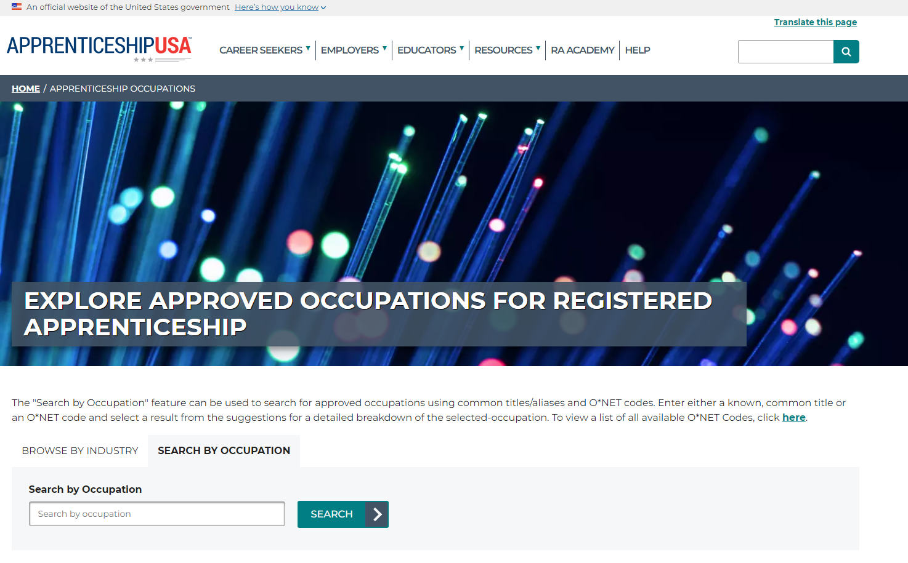

Slide 39
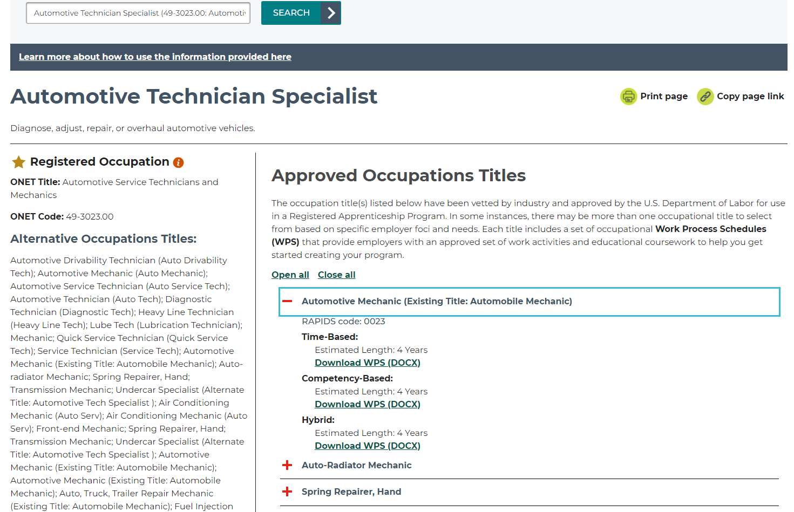

Slide 40
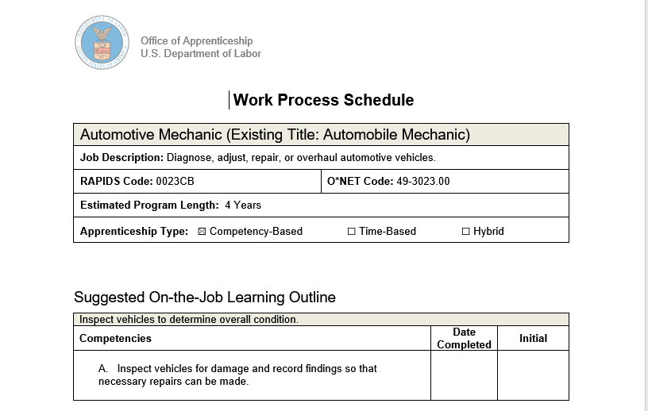
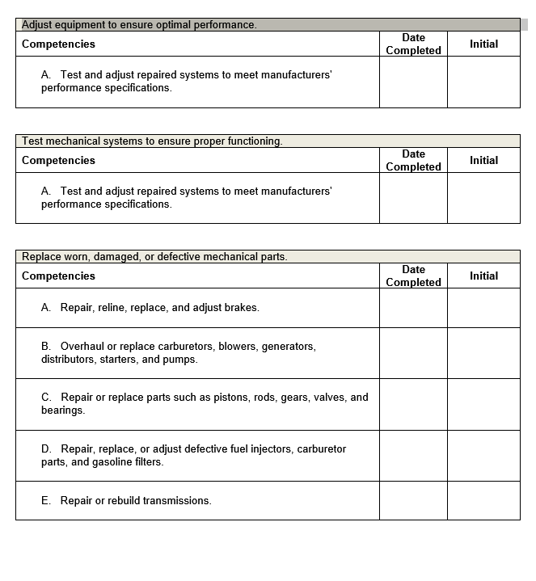

Slide 41
Employer Outreach
Identifying Available Training Curriculums
With the location information provided to you by the employer, you can determine which Illinois Community College Board district that the employer falls within, and partner with that community college OR if they are uninterested in active partnership, you can research and present their curricular offerings yourself.
Look at the certificate and degree programs offered by your community college and determine if any match the occupation you are building a program for.
If there are relevant programs, download/print its course descriptions, estimated total cost per student, and relevant scheduling options (online coursework, night classes, two-day per week scheduling, etc.)
If there are not relevant curricular offerings available at your community college, begin looking into industry/online training providers and collecting the same cost/time/coursework information on those programs as you would a college program

Slide 42
Employer Outreach
Presenting “The Full Package”
In one cohesive presentation:
The Seven DOL Components of Apprenticeship
Applicable WIOA Services, DCEO Tax Credit, CEJA Incentives, etc.
The Work Process Schedules and Curricular Offerings
Follow-Up Meetings may entail:
Revising the Competencies List
Finalizing Coursework Selections
Discussing/Finalizing Progressive Wage Schedule

Slide 43
Employer Outreach
Miscellaneous Info Required
Size of Company
Address
Complaint Contact
Hiring Procedures
Minimum Hiring Requirements
Interest in opening program to other employers?
Paid classroom time?*

Slide 44

virtual Office hours:
We’re Here to Help!
Open to all Illinois employers, apprenticeship stakeholders, and organizations in need of apprenticeship assistance.
One-on-One Trainings
Group Presentations
Employer Consultations
Program Development
Brainstorm/Strategy Sessions
Mondays & Wednesdays
10am-2pm
(Additional Availability by Appointment)
https://niu-edu.zoom.us/j/3254889090?pwd=TVk1YzUxY2VSamZxb3M0L0lzaFpDdz09&omn=85151811182

Slide 45
Q&A

Slide 46

Contact us:
  Nate Carlson ncarlson@niu.edu
  Jennifer Foil jfoil@niu.edu
  Jordan Johnson jtjohns@ilstu.edu

