Slide 1
APPRENTICESHIP EXPANSION
LWIA 15

Slide 2
Apprenticeship update
New Registered Apprenticeship Programs (RAP)
AirAce Heating & Cooling – HVAC Technician
Kinsel Trucking & Excavating – Construction Truck Driver & Operating Engineer
Messing Roofing – Roofer
Peoria Public Schools – Elementary Education
Potential RAP’s in Development
Quality Pools by Design – Operating Engineer
Village of Bartonville – CDL Truck Driver
JC Dillon Plumbing – CDL Truck Driver
Notes:
Explain that you provided technical assistance to AirAce Heating & Cooling, Kinsel Trucking, Messing Roofing and Peoria Public Schools to create 5 new RAPs.
Explain that you provided technical assistance to Quality Pools by Design and Village of Bartonville as well.

Slide 3
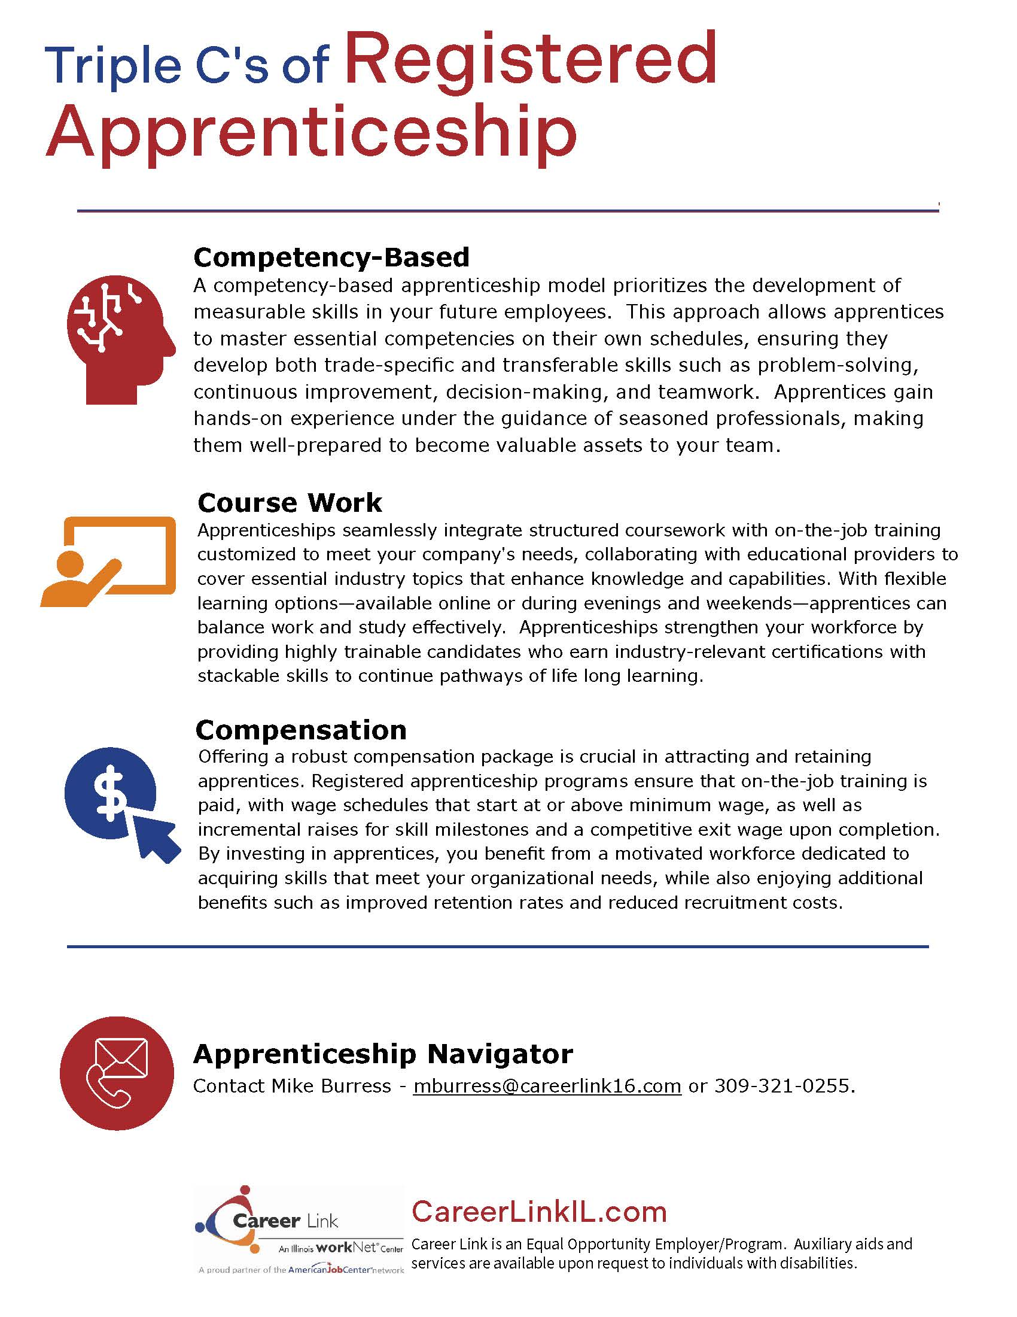
BEST PRACTICES
Incumbent Worker Training Assistance
Apprenticeship Technical Assistance
Integrated Business Service Team
RED Team

Slide 4
Key Workforce Partnerships

Slide 5
Effective Workforce Partnerships
Identify Key Stakeholders: Research and map out decision-makers such as HR leaders, department heads, and executives within targeted organizations.
Network and Build Relationships: Attend industry conferences, local business meetups, and professional events to initiate informal conversations and establish connections.
Utilize LinkedIn: Connect with stakeholders and engage in discussions that emphasize shared objectives related to workforce development.
Leverage Integrated Business Service Team: Present the team as a vital resource for addressing unique challenges in both growing and declining markets, capable of conducting thorough assessments.

Slide 6
Effective Workforce Partnerships
Develop Tailored Training Solutions: Offer customized training programs, apprenticeships, and leadership development initiatives that align with the specific needs and goals of the business.
Showcase Success Stories: Provide detailed case studies that demonstrate measurable improvements in employee performance, retention rates, and productivity from similar partnerships.
Focus on Adaptability: Emphasize how training programs can evolve in response to changing market conditions, reinforcing their long-term relevance.
Engage through Active Listening: Prioritize understanding the business's concerns and aspirations, incorporating feedback into proposals to foster ownership.

Slide 7
Effective Workforce Partnerships
Structured Follow-Up Plan: Propose regular follow-ups and evaluations of training initiatives, establishing clear metrics for success to track progress over time.
Forge Trust-Based Partnerships: Reinforce commitment to continuous improvement and investment in business success, creating sustainable collaborations that thrive in varying market environments.

Slide 8
To learn more:
www.CareerLinkIL.com
Integrated Business Services
Mike Burress – 309-321-0255 – mburress@careerlink16.com
.

