Slide 1
Regional Strategy Session #1:
Strengthening local partnerships
Nate Carlson, TA Program Director

Slide 2
What are our objectives?
Increase the viability and visibility of registered apprenticeships for high-demand occupations in the state of Illinois through intentional collaboration with state, local, and regional partners.
Create a robust local infrastructure to support the development and execution of high-quality registered apprenticeship programs.
Provide a consistent, end-to-end concierge service to Illinois employers looking to develop, register, or expand a registered apprenticeship program.

Slide 3
What are our obstacles?
Low employer awareness of registered apprenticeship as a workforce solution.
Lack of shared vision amongst local partners.
Individual organizational deliverables framed as being in contention with statewide goals.
Unengaged partners not invited to the table or allowed to hinder efforts through inaction.
Employer mindsets that prioritize avoiding short-term costs over long-term growth.
Ineffective outreach or referral processes that kill program momentum or employer enthusiasm.

Slide 4
What do we have?
A diverse array of state and local workforce stakeholders each offering their own business services, avenues for funding, and potential for innovative collaboration.
A formal organizational mechanism for developing and executing local workforce strategies (Integrated Business Services Teams!)
State and federal investments of time and funding to support apprenticeship expansion.

Slide 5
How do we improve?
Ensure that every IBST member understands what everyone else at the table does for businesses, prioritizes as an organization, and offers us as a collaborator.
Identify avenues for growth by analyzing current weak points in our partnerships as well as current champions.
Brainstorm, revise, and strategize on paths to completing our objectives as a unified local team.

Slide 6
Regional strategy session #1
As a table, you will work through your session packet, following the time parameters listed on the screen.
We will move through this session briskly!
This means…
All killer, no filler! This is bootcamp!
Make space for others and take space for yourself.
Be an active listener and avoid distracting conversations and technology use.
We’re not here to check a box…we’re here to think outside of it!

Slide 7
Regional strategy session #1
At the end of the session…
Everyone should have a completed session packet, and each table should have the following on their easel:
Your area’s visualized apprenticeship ecosystem
Three partnership strategies for improving the quality of your local collaborations
Three potential new apprenticeship outreach events to be co-hosted by two or more IBST members.
The brainstormed slogan for your area’s Integrated Business Services Team.

Slide 8
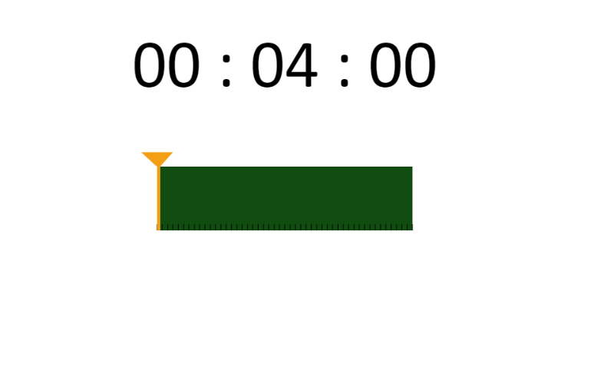
Regional strategy session #1

Slide 9
Rapid report out!
Each table select one individual to give a rapid report out for your group’s session.
In 90 seconds or less, they will share with the room…
Two strong partnerships your group identified
Two partnerships you will look to improve
One of your brainstormed collaboration strategies
One of your brainstormed events
Your area’s brainstormed IBST slogan

Slide 10
Room rotation feedback session
We will now rotate groups around the room to provide feedback on each group’s:
Strategies
Events
Visual Ecosystem
Slogan

