Slide 1


Pursuing Excellence in Local Apprenticeship Infrastructure
MAKEIT.
MINIMAL
Presentation
Your success starts with us.

Slide 2

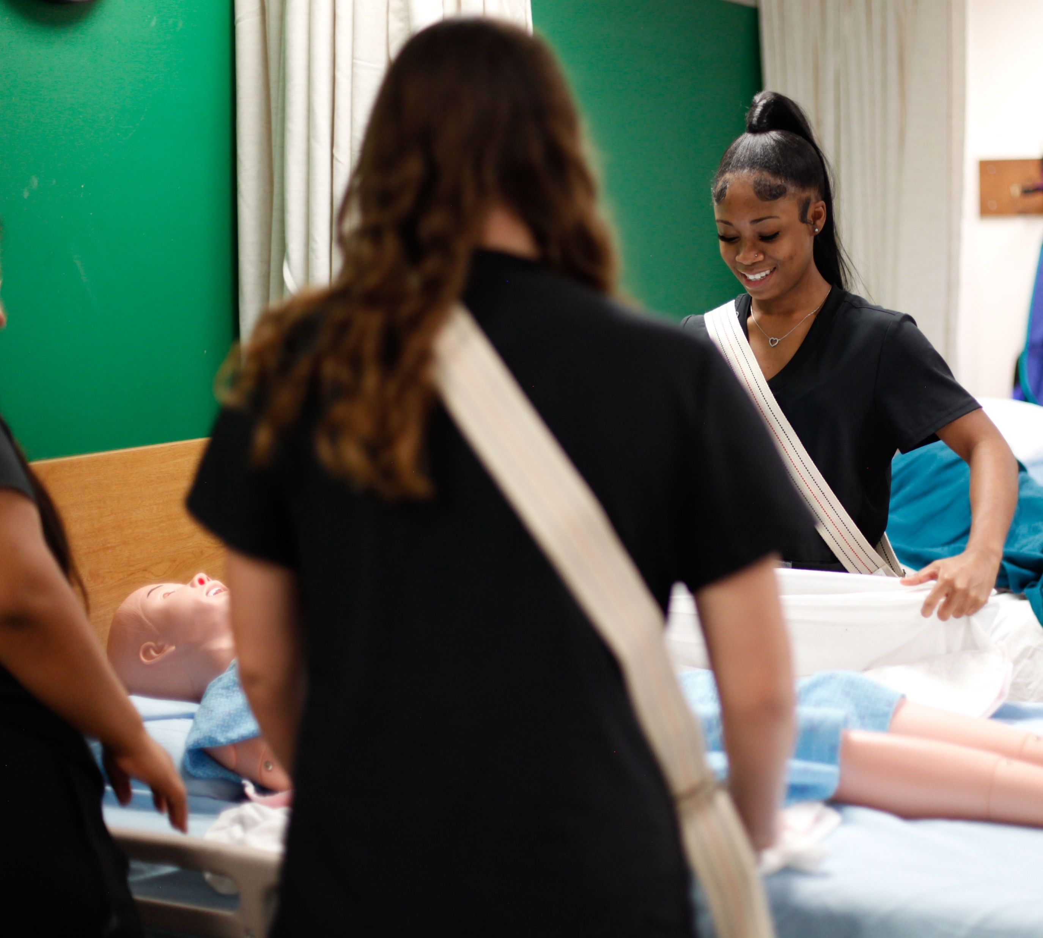
What is the Gateway
Apprenticeship Hub?
In the summer of 2022, the U.S. Department of Labor awarded Madison County and the St. Louis region workforce innovation areas the Apprenticeship Building America grant.
This is a four-year, $5.8 million initiative from which the Gateway Apprenticeship Hub was born.
The project aims to register at least 750 new apprentices across the region and represents the first joint initiative between Illinois and Missouri workforce areas, with a goal of at least 70% participation among underserved and underrepresented communities.
Target industries are:
Education | Healthcare | Bioscience

Slide 3
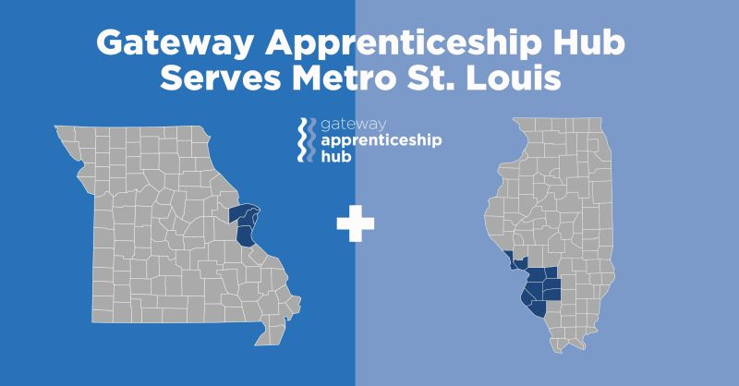

Slide 4

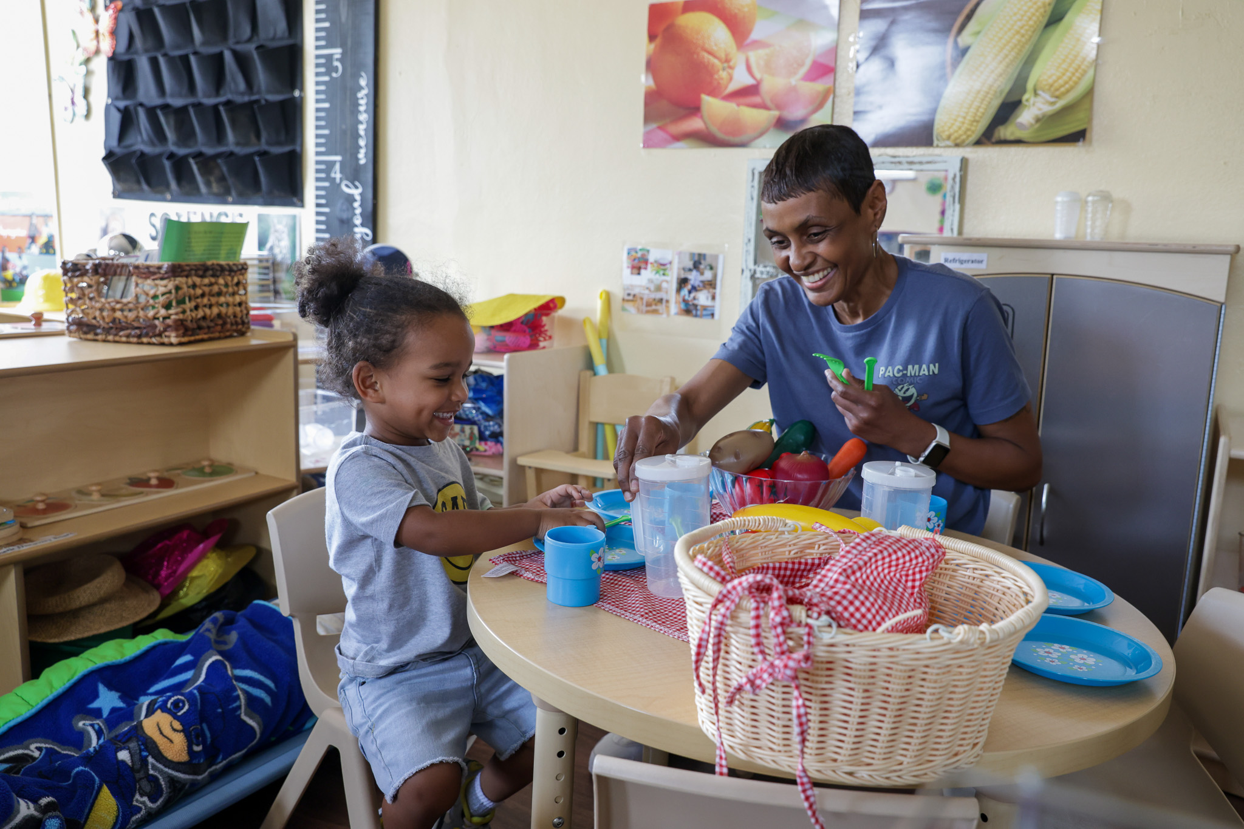
Participation
275 Newly Enrolled
Registered Apprentices
80 healthcare apprentices
73% from urban or rural communities
176 education apprentices
73% African American
19 bioscience apprentices
80% Female participants

Slide 5
Special School District of St Louis
Learning from a Successful Program
Mini Case Study #1
CNA Registered Apprenticeship Program – August 2018
Healthcare STARS Pre-apprenticeship program
  Career exploration
  Introduction into healthcare careers
  Supportive resources
Intermediary Sponsorship with multiple employer partners
  Bethesda Health Group
  Parc Provence
WIOA Partner – S.L.A.T.E
High completion and certification achievement rates

Slide 6

McKendree University
Trying Something New and Working With K-12
Mini Case Study #2
First Classroom Teacher RAP in Illinois – August 2023
Education Pre-apprenticeship program
  Introductory education courses at McKendree or community college
  Assistance in meeting minimum qualifications
Intermediary Sponsorship with multiple employer partners
  Over 30 school/district partners in Metro-East/Southern IL regions
  Over 70 school/district partners throughout Illinois
WIOA Partner – St Clair County (24) & Madison County (22)
Developed after surveying needs of school districts
Ongoing feedback from partners fueling growth and improvement
Development of Master Teacher Mentorship training program

Slide 7

Southern Illinois University Edwardsville
Navigating Setbacks
Mini Case Study #3
Laboratory Technician RAP – December 2023
Micro-credential pre-apprenticeship program
  Career exploration
  Introduction into lab skills
  Hands-on skills training
Challenge #1: Learning New Language
  Long technical assistance sessions
  Understanding administrative responsibilities
Challenge #2: Organizational Structure
  Where does apprenticeship live in greater university structure?
Challenge #3: Large Companies
  Low administrative capacity
  Hurdles with corporate legal teams
  Hiring processes

Slide 8


STAR Inc & LIV Recovery Sober Living
Connecting with Underserved Populations
Mini Case Study #4
STAR Inc: Early Childhood RAP – September 2023
  CDA Pre-Apprenticeship
LIV Sober Living: Peer Support Specialist RAP – January 2024
  Peer Pre-apprenticeship
Programs for Underserved Populations
  Digital literacy
  Emotional intelligence
  Financial literacy
  Career navigation
Higher education partners
Continued support and counseling through RAP completion
Engagement with small business owners and community organizations

Slide 9


SWIC & Kaskaskia Community College
Creating a Clean Package for Employers
Mini Case Study #5
RAP Intermediary Sponsors
Lists of apprenticeship programs across industries
  Healthcare Education
  Manufacturing Construction
Administrative and RTI function of apprenticeship
Funding packages through WIOA, other state and federal grants, tax credit programs
Participant recruitment

Slide 10
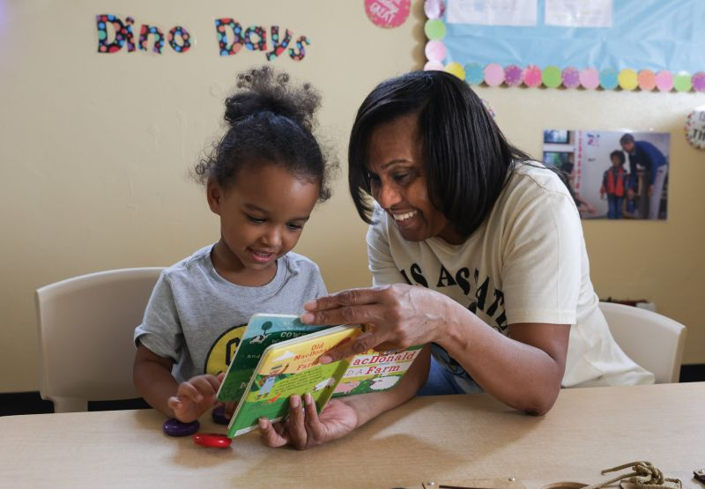
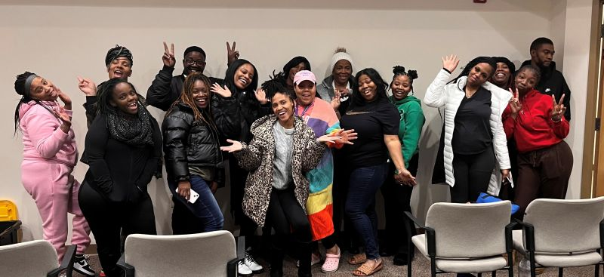
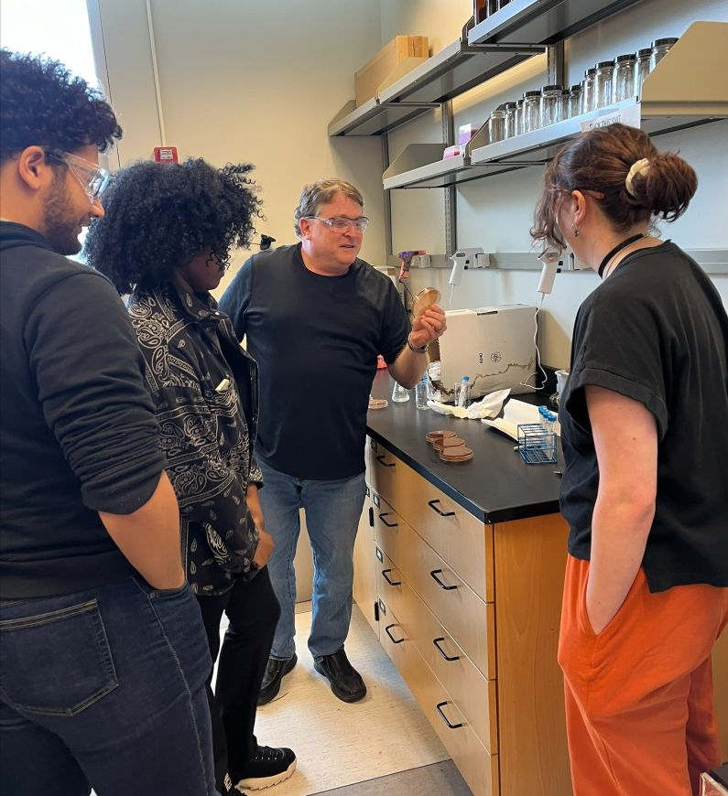
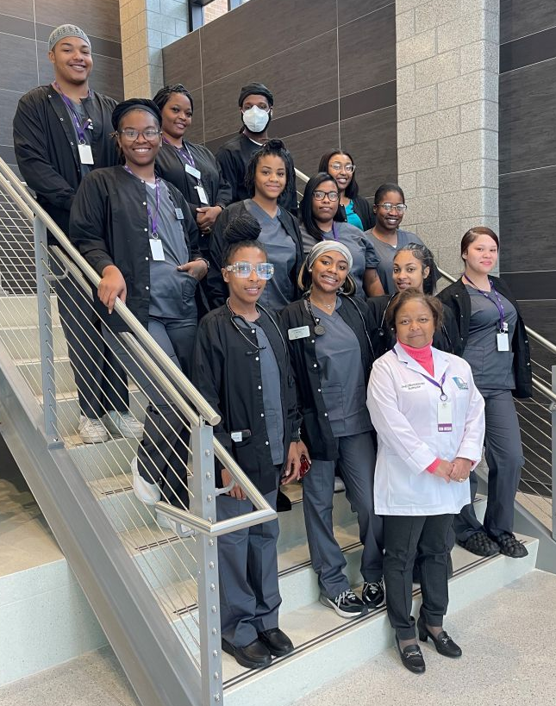
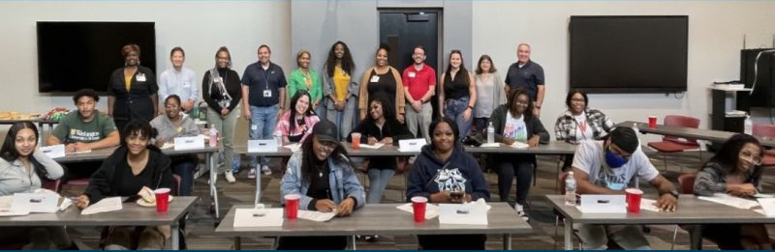

Slide 11
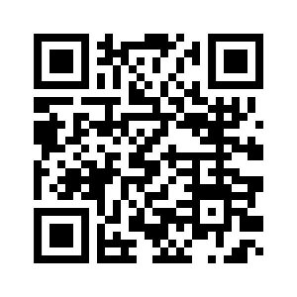
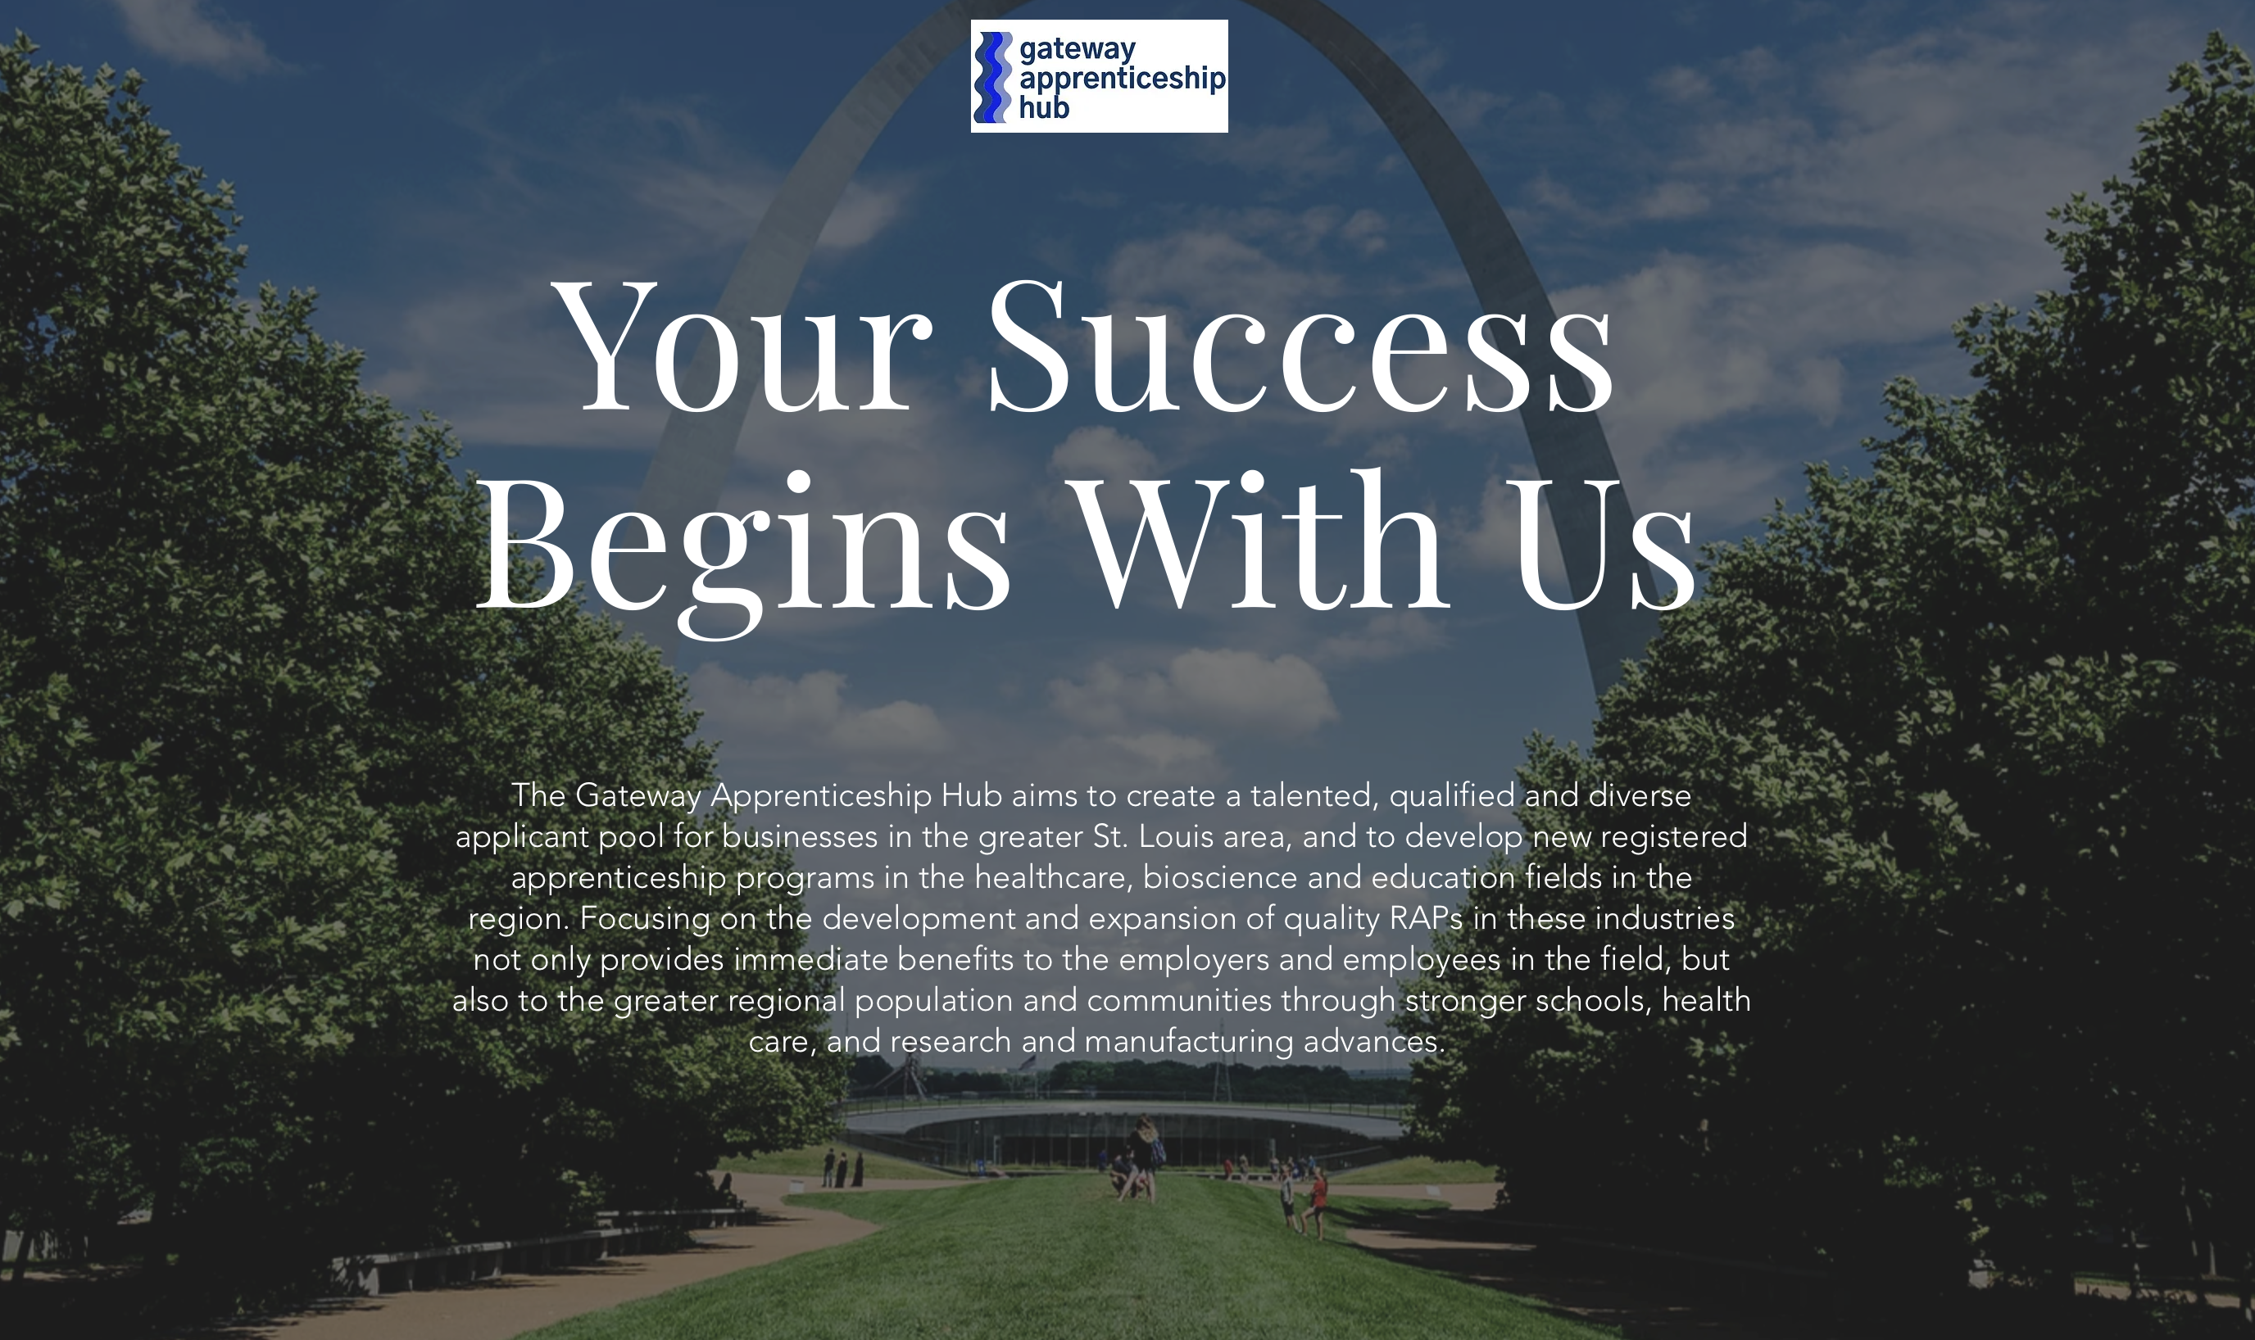
Contact Us!
GatewayApprenticeshipHub.com
Becca Ryan
Apprenticeship Grant Manager
Gateway Apprenticeship Hub
Madison County IL Employment & Training
rrryan@madisoncountyil.gov

