Slide 1
Engaging IBST Partners
Dr. Justin arnold
East central Illinois workforce board

Slide 2
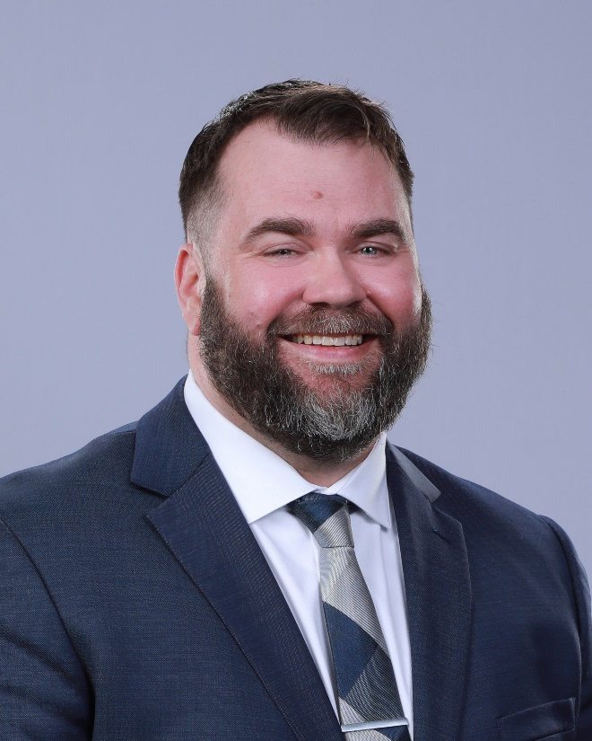
Dr. Justin Arnold, Executive Director

Slide 3
Learning Objectives
Using a shared framework
Facilitating planned change

Slide 4
Learning Objective 1:
Using a Shared Framework

Slide 5
using a shared framework
Different Perspectives
Geography
Places and built environments
Buildings, neighborhoods, cities, counties, districts
Sectors
Education, workforce development, human services, economic development
Norms, language, and goals are different in each sector

Slide 6
using a shared framework
Reference Points
Organization
Different types of organizations with different missions, sometimes in competition with each other
Different organizational structures and decision-making authority
Daily Lives
Differences in how we deliver services to employers and how we think about interacting with other entities
Not everyone is used to thinking about a regional ecology and systems

Slide 7
using a shared framework
Illinois Unified Plan
Core Partners
Workforce development, adult education and family literacy, employment services, and vocational rehab
Other Partners
Career and technical education, human services, education, economic development, business-serving
State Goals
Example of excellence in its approach to collaboration and customer service

Slide 8
using a shared framework
Illinois Workforce Board
Policymaking
“Through structured committees and task forces, IWIB representatives from private/public partner programs offer policy recommendations to strengthen Illinois' workforce system. All policies developed or commented upon include input from partners and the general public.”
Framework for Integrated Business Services
15-page document approved in 2017 that highlights how local areas can form and support local business services teams (Lee Reese)

Slide 9
using a shared framework
Apprenticeship Illinois
Local Workforce Areas
Invest in apprenticeship expansion through local areas by leveraging the existing infrastructure and plans
Apprenticeship Specialist
A subject-matter expert who would provide technical assistance and connect the local area to broader initiatives
Integrated Business Services Teams
An intentional attempt to integrate business services at the local level to better serve business customers

Slide 10
Learning Objective 2:
Facilitating Planned Change

Slide 11
Facilitating planned change
Investing in Key Relationships
Illinois Bootcamp 2023
Attended Apprenticeship Illinois Bootcamp with partners. Offered to pay for hotel, milage, food.
Monthly Meetings – “Planning Committee”
Set monthly meetings with the team.
Had an agenda.
Invited others.
Moved the meeting site.
Followed-up with summary emails.

Slide 12
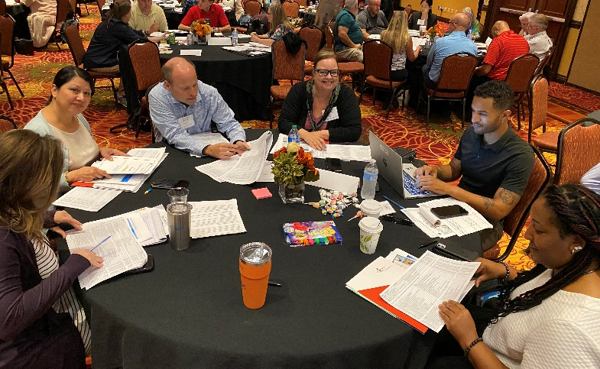
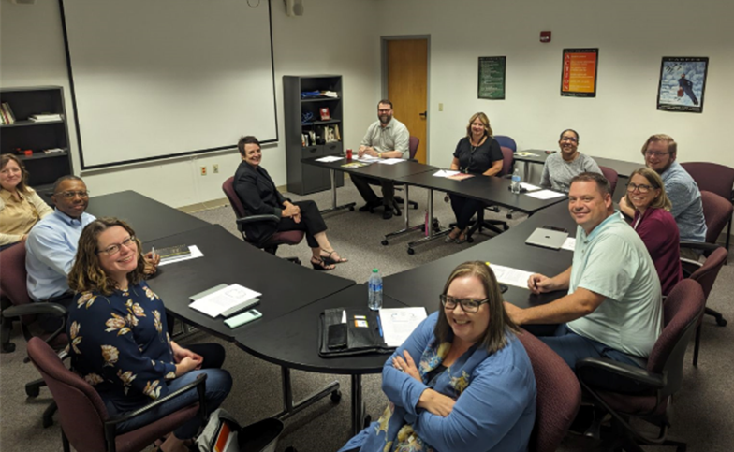
Apprenticeship Illinois Bootcamp (August 2023)
East Central Illinois Business Team (June 2024)

Slide 14
Facilitating planned change

Slide 15
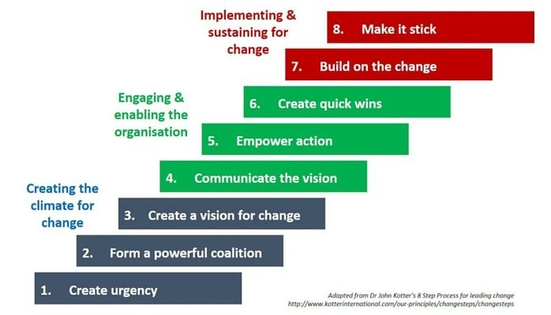
Facilitating planned change

Slide 16
Facilitating planned change
Kotter’s Leading Change
Create Urgency
Want people to feel like what they are doing is important and they aren’t wasting their time.
Form a Powerful Coalition
Can’t do it on your own. Need people who are excited, support, and bring others.

Slide 17
Facilitating planned change
Kotter’s Leading Change
Create a Vision for Change
Reviewed the State of Illinois’ Framework for IBST and thought about foundational elements and structural components.
Communicate the Vision
The foundational elements and structural components were our vision. Talked through them. Listened. Adjusted.

Slide 18
Facilitating planned change
Kotter’s Leading Change
Empower Action
Helping people at the table know they are contributing and can make decisions.
Had a team member present on “leading from the ground up.”
Create Quick Wins
Where we are now with a soft-launch: business visit form, quality referrals, shared visits, public events / promotion.

Slide 19
Facilitating planned change
Kotter’s Leading Change
Build on the Change
Easy to lose momentum if it gets too difficult and there are no wins.
Here is where people who have been silent or privately not buy-in will begin to share their concerns.
Make it Stick
Making change part of our regular work and normal environment.
This is difficult and requires ease of implementation, thinking about thinking, and the formation of new habits.

Slide 20
Learning Objectives
Building a shared framework
Facilitating planned change

Slide 21
Contact us:
Dr. Justin Arnold jarnold@ccrpc.org
Jennifer Foil jfoil@niu.edu
Jordan Johnson jtjohns@ilstu.edu

Slide 22
Questions?

