Slide 1
Working with High Impact Intermediaries
and Community Colleges
April 25, 2024
Dr. Gina De rosier-Cook, Elgin Community College
Veronica Inselmann, Heartland Community College
Danielle Kuglin Seago, College of DuPage
Notes:
Veronica

Slide 2



Introductions & Overview
DR. GINA DE ROSIER-COOK
Elgin Community College
DANIELLE KUGLIN SEAGO
College of DuPage
VERONICA INSELMANN
Heartland Community College

Slide 3
Introduction to Apprenticeship
The Apprenticeship Ecosystem

Slide 4
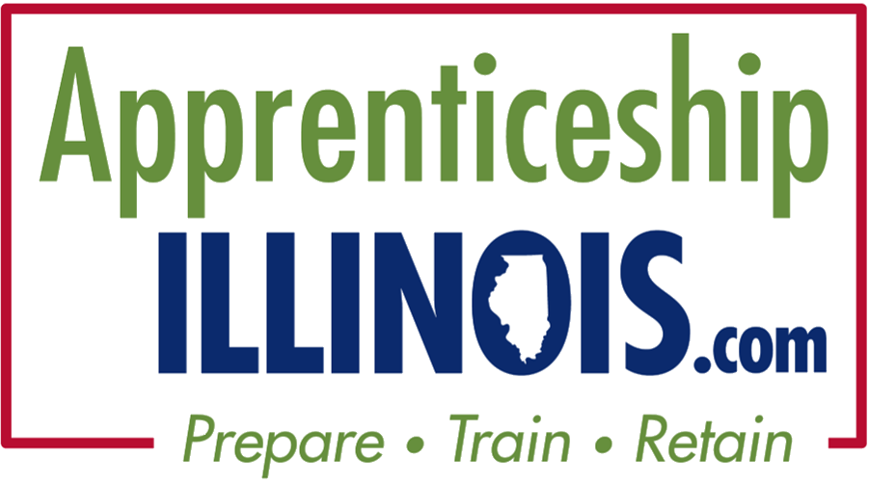
Definition of Apprenticeship
Apprenticeships are an industry-driven, high-quality career pathway in which employers develop and prepare their future workforce, and individuals obtain paid work experience, earn wages, and receive classroom instruction.
Notes:
Gina
State of Illinois Definition

Slide 5

Seven Hallmarks of
Apprenticeship
Notes:
Angela (15 min. Total; 8 slides)

Slide 6
Partners in Apprenticeships
Partners at Local, State, and Federal levels:
Apprenticeship Illinois - DCEO
Community Colleges
Department of Labor
Employer
Economic Development Councils
Illinois Community College Board
Illinois workNet Centers
Labor Organizations
Notes:
Gina

Slide 7
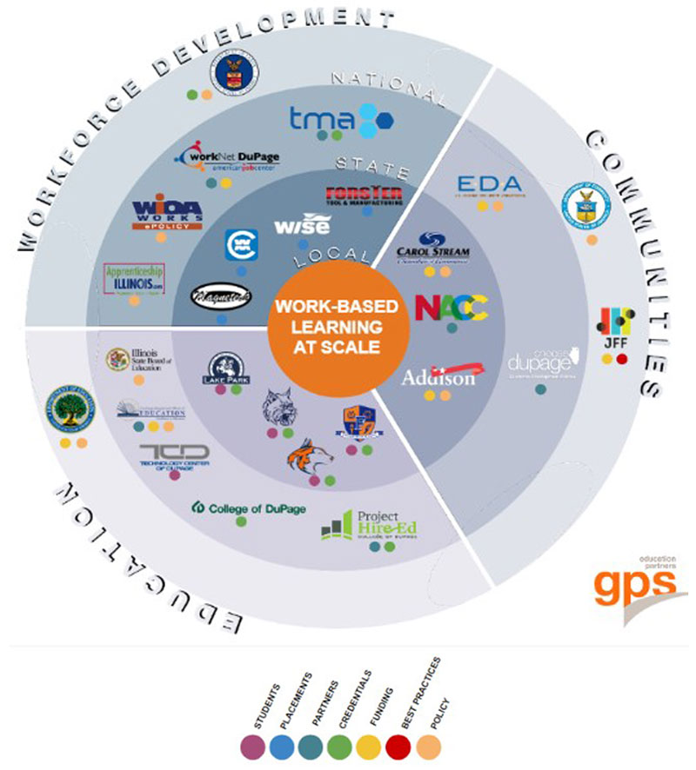
Apprenticeship Ecosystem
Notes:
Gina
Example of an Apprenticeship Ecosystem from DuPage County mapped out by various categories (workforce development, education, communitee), roles (funder, policy, best practice, etc.) and levels (federal, state, local).

Slide 8
The Role of Community Colleges in Apprenticeships
  Workforce alignment with industry
  Affordable, flexible training
  Access to diverse communities
  YOUR local community college
Notes:
Gina
Community colleges play a pivotal role in scaling apprenticeships across the U.S. by acting as critical intermediaries between students, employers, and the workforce development system.

Slide 9
Key Benefits of Partnering with Community Colleges
Key points from the recent Apprenticeships for America report;
Adaptable curriculum development in collaboration with employers
Opportunities for reskilling and upskilling in your community and offer local trainings
Integration of academic credentials with apprenticeship learning
High success rates with higher completion and employment rates compared to traditional academic pathways
Notes:
Gina
More to come ahead on this…
Here are key points from the recent Apprenticeships for America report and other sources on the role of community colleges in apprenticeship programs:
Education-Workforce Bridge: Community colleges serve as a bridge between education and high-demand careers, offering students a combination of technical instruction and paid work experience. Apprenticeships, facilitated by these institutions, provide a direct path to employment while reducing the time and cost typically associated with traditional academic programs​
Employer Partnerships: Many community colleges coordinate and manage apprenticeship programs in partnership with local employers, ensuring that the apprenticeships align with labor market needs and provide relevant, industry-specific training​
High Success Rates: Apprenticeship programs have been shown to lead to higher completion and employment rates compared to traditional academic pathways. This is especially significant given that over 55% of community colleges sponsor apprenticeship programs​
Flexibility and Customization: Community colleges have developed place-based and sector-specific approaches, tailoring apprenticeship programs to local industries, such as IT, cybersecurity, and healthcare. This adaptability allows community colleges to meet the unique needs of their communities while promoting economic growth​
Scaling Apprenticeship Nationwide: Through initiatives like the Expanding Community College Apprenticeship (ECCA), community colleges have been instrumental in registering thousands of apprentices across various states. This large-scale effort shows the potential of community colleges to play a leading role in expanding apprenticeships nationwide​
These roles highlight the importance of community colleges as a vital component in the U.S. apprenticeship ecosystem, especially in addressing skills gaps and fostering economic mobility

Slide 10
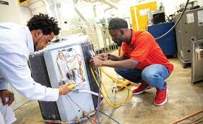
Case Study: Successful Collaboration
HVACR Apprenticeship
After 1 semester you have have a credential, wage increase, certificate from the college
Stackable into the Commercial side of HVACR
Registered with the DOL, competency-based program
Key outcomes: employer engagement, workforce skills development, learner success
Notes:
Gina

Slide 11
Role of High-Impact Intermediaries
Apprenticeship Success
Notes:
Veronica

Slide 12
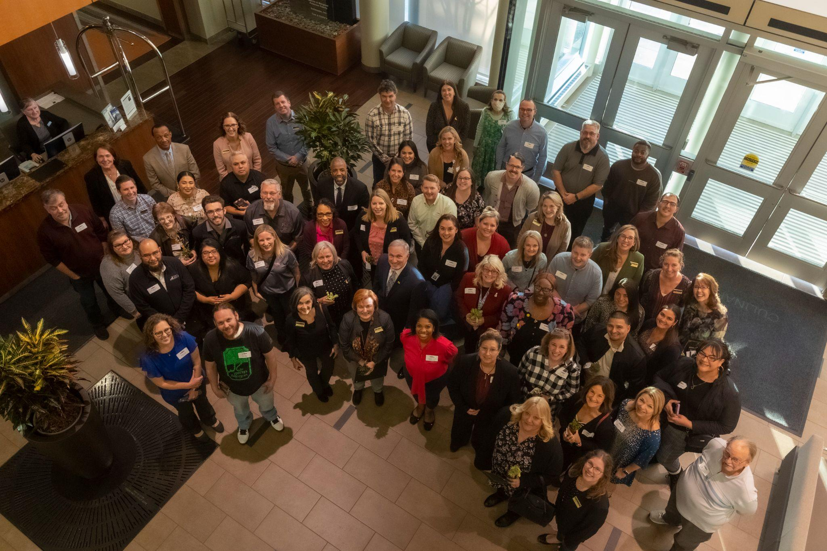
What is an Intermediary…
An organization that acts as a bridge between employers, apprentices and apprenticeship partners to build, launch, and run apprenticeship programs.
Notes:
Veronica
By: Iris Palmer, Michael Prebil, Rachel Rush-Marlowe
Community Colleges and Apprenticeship: The Promise, the Challenge
Last updated on November 6th, 2023

Slide 13
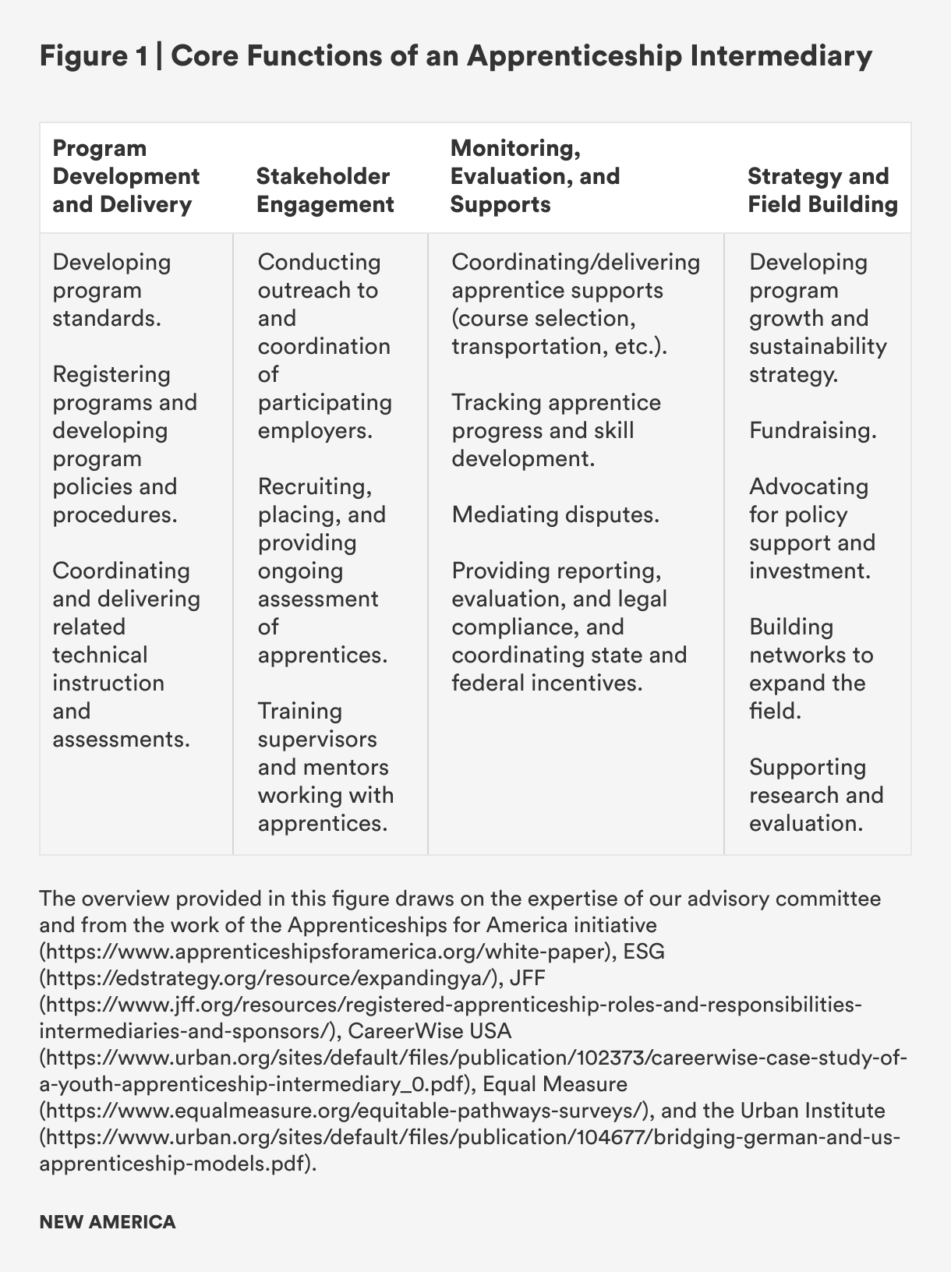
…and what do they do?
Program Development and Delivery
Stakeholder Engagement
Monitoring, Evaluation, and Supports
Strategy and Field Building
Notes:
Veronica
By: Iris Palmer, Michael Prebil, Rachel Rush-Marlowe
Community Colleges and Apprenticeship: The Promise, the Challenge
Last updated on November 6th, 2023

Slide 14
Collaboration for Successful Apprenticeships
Apprenticeship Illinois - DCEO: Grant funding to expand apprenticeships; Apprenticeship resources for Intermediaries, Employers, and Apprentices; Illinois Apprenticeship Education Expense Tax Credit Program
Illinois Community College Board: Apprenticeship Resources - Learning Communities for Community Colleges
Community Colleges: Community partnerships; Outreach to employers; Apprentice recruitment; Develop curriculum (RTI) to meet employer’s workforce needs; Schedule and deliver RTI; Provide wrap around support services for apprentices; Sponsor RA programs
Department of Labor: Registration of RA programs; Provide technical assistance with RAPIDS; RA program compliance
Notes:
Veronica

Slide 15
Collaboration for Successful Apprenticeships (cont.)
Employers: Employ apprentices; MOU with RA Sponsor; Pay up front for cost of RTI; Allow release time for apprentices to attend RTI; Sponsor RA programs
Economic Development Councils: Assist local businesses with expansion and recruitment; Identify community workforce needs
Illinois workNet Centers: Reimbursement funding to employers for workforce training costs; Workforce Innovation and Opportunity Act (WIOA) funding
Labor Organizations: Sponsor RA programs
Notes:
Veronica

Slide 16
Responsibilities of Intermediaries
Paperwork/Documentation
Streamline processes, ensure compliance, manage documentation.
Program Management & Placement
Match apprentices, monitor progress, adapt programs.
Recruitment
Attract employers and apprentices, conduct outreach, build relationships.
Funding Coordination
Identify sources, assist with financial aid, manage grants.
Notes:
Veronica
Per DOL, Intermediaries do the following:
Rapid Registered Program Development and Implementation Support
Technical Assistance and Partnership Building
Support a Diverse and Inclusive Apprenticeship Pipeline

Slide 17
Community Colleges
Driving Apprenticeship Success
Notes:
Veronica

Slide 18
Related Technical Instruction/Training
Value of the Community College
Facilitate training in a variety of times, structures and modalities.
Associate degrees, certificates or customized training.
Align faculty and employers to develop new workforce training programs.
Dual credit and secondary school connections.
Meets DOL training provider requirements.
Work with faculty to align training with job requirements and competencies.
Labs and training facilities.
Actively involved at each stage of WBL continuum
Notes:
Veronica

Slide 19
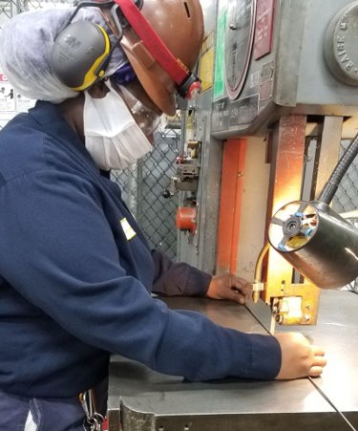
I chose apprenticeship because I wanted to change my life.
The technical skill that you learn from day to day through the trainers at work combined with the technical classes offered at the college with our faculty help us to accomplish our goals.
Dantielle
INCUMBENT WORKER
Industrial Maintenance Mechanic

Slide 20
Community College Wrap-Around Supports
Counseling
Tutoring
Advising
Case Management
Barrier Support
Built into many community colleges, counseling services are available directly at the college or through a referral.
Free tutoring is available to students to support their academic needs connected to their RTI.
Academic advisors are available for course advising and guidance. Referrals available to community resources.
Additional support from the apprenticeship community college staffing to serve as a conduit between OJT and RTI.
Referrals to community resources for barriers to successes such as food or housing insecurity, access & accommodations, transportation, laptops & internet access.
Notes:
Veronica
A key personal s is the case-managed wrap around supports we provide to apprentices. Many of these programs are baked into the fabric of community colleges already, which makes it easier for us to get apprentices connected to the right resources needed. This may include areas such as counseling, tutoring, advising, food-insecurities, transportation needs, technology needs, and other external resource referrals. In my area, we take it one step further by having a specific Apprentice Case Manager assigned to each apprentice whose sole responsibility is to serve as a conduit between the workplace and education. This person is a career coach by profession and is able to help apprentices navigate the workplace and their schooling with greater ease. We’ve seen positive completion numbers and retention of apprentices through the guidance of that case manager.

Slide 21

Olivia
INCUMBENT WORKER
Early Childhood Educator
Working full time and being a mother of three children, I can honestly say there was no time to think about advancing my career. But this program has taught me that I can do it, to believe in myself. At the beginning of the program, I was nervous and thought about dropping out. I don't have words to describe how much the staff at the college helped me with their encouragement and support to keep me going and successfully finishing the apprenticeship.

Slide 22
Accessibility to a Broad Demographic
Diverse Student Population: Community colleges often serve a more diverse demographic than four-year institutions, including underrepresented groups, non-traditional students, low-income individuals, and first-generation college-goers. This diversity means apprenticeship programs can reach a broader talent pool, helping to close equity gaps in the workforce.
Affordability: Community colleges offer an affordable pathway to higher education and career advancement, making apprenticeships more accessible to individuals who might not be able to afford other training options.
Example: Connecting employers to candidates that are reflective of the communities in which they reside, supporting accessibility to populations such as women in manufacturing and men in healthcare or education
Notes:
Veronica

Slide 23
Industry-Aligned Training and Curriculum
Collaboration with Employers: Community colleges are known for working closely with local industries and employers to develop relevant, hands-on curriculum that directly aligns with current workforce needs.
Customizable Curriculum: Community colleges can quickly adapt programs to the evolving needs of specific industries, ensuring that apprentices are trained in the most up-to-date practices.
Embedded Credentials: Community colleges often integrate industry-recognized credentials or certifications into apprenticeship programs, allowing apprentices to earn valuable qualifications while working.
Transcripted Education: Apprentices can take earned credit with them that leads to further education and/or training programs.
Real-World Experience with Academic Learning: The "earn-while-you-learn" model allows apprentices to directly apply classroom theory to practical, on-the-job experience. This synergy makes apprenticeships through community colleges highly effective.
Notes:
Veronica

Slide 24
Flexibility and Accessibility of Programs
Flexible Scheduling: Community colleges typically offer flexible class schedules, including night and weekend classes, which are crucial for working apprentices who are balancing their jobs and studies. Credit and non-credit options.
Online and In-person Learning Options: Especially post-pandemic, many community colleges have expanded their online and hybrid learning options. This flexibility enables more people to participate in apprenticeship programs, especially those with limited access to transportation or strict work schedules.
Stackable Credentials and Career Pathways: Community colleges are often designed to support lifelong learning, meaning apprentices can return later to upskill or complete advanced certifications, keeping pace with industry changes.
Notes:
Veronica

Slide 25
Connection to Local Workforce Development Initiatives
Economic and Workforce Development Hubs: Community colleges are often the central hubs for local economic and workforce development initiatives, working with state and local governments, workforce boards, and employers to provide tailored training and apprenticeships.
Regional Needs: They understand the unique needs of the region, making them ideal partners in creating apprenticeship programs that match the local economy’s demand.
Workforce Innovation and Opportunity Act (WIOA): Community colleges often work with Local Workforce Investment Areas (LWIAs) and workforce agencies to create apprenticeship programs that qualify for federal funding under WIOA, reducing costs for both employers and apprentices.
Northern Illinois Workforce Coalition (NIWC) - Formalized convening of Northern Illinois Community Colleges with the express purpose to increase collaboration across organizations for greater impact on workforce education, training and development.
Notes:
Veronica
Youth and Adult buckets; Amazing partners; use pipeline to help under/un employed in our regions

Slide 26
Work-Based Learning Continuum
AWARENESS
EXPLORATION
PREPARATION
TRAINING
EMPLOYEE
Gain exposure to careers and the skills required
Career fairs and field trips
Class Speakers
Service learning
Project-based learning
Achieve a deeper career understanding
Job shadowing
Client-connected projects
Interviews
Mentorships
Experience career-related tasks and coursework
Practicums
Volunteer activities
Dual-enrollment courses
Paid employment
Earn skills, certifications, credentials and degrees
Internships
Apprenticeships
Clinical experiences
Notes:
Veronica
A key personal s is the case-managed wrap around supports we provide to apprentices. Many of these programs are baked into the fabric of community colleges already, which makes it easier for us to get apprentices connected to the right resources needed. This may include areas such as counseling, tutoring, advising, food-insecurities, transportation needs, technology needs, and other external resource referrals. In my area, we take it one step further by having a specific Apprentice Case Manager assigned to each apprentice whose sole responsibility is to serve as a conduit between the workplace and education. This person is a career coach by profession and is able to help apprentices navigate the workplace and their schooling with greater ease. We’ve seen positive completion numbers and retention of apprentices through the guidance of that case manager.

Slide 27
Career Pathways for Apprentices
Career Services and Counseling: Many community colleges offer career services that apprentices can use, such as job placement support, resume-building workshops, and interview preparation, increasing their chances of securing long-term employment.
Pre-Apprenticeship: Pre-Apprenticeship programs are designed to prepare individuals to enter and succeed in an apprenticeship programs or in another career pathway approach. Pre-apprenticeship programs have 6 core elements: Inclusive Recruitment of Underrepresented Individuals, Industry-Focused Curriculum & Training, Hands-On Learning/Work Based Learning, Retention Services For Successful Participation and Completion, Partnerships with Employers and Connections to Apprenticeship Programs, & Strive for Credential Acquisition.
Youth Apprenticeships: ​Youth Apprenticeships provide opportunities for high school and postsecondary education students ages 16-24 with the foundation to choose among multiple pathways. Apprenticeships are employer-driven, “learn while you earn” models that combine structured paid on-the-job training (OJT) with job-related instruction in curricula that lead to attaining industry-recognized skill standards and an industry credential. Instruction and technical training related to the apprenticeship is provided by high schools, technical schools, community colleges, or other higher education institutions; on-the-job training occurs at a worksite. The goal is to provide students with advanced skill sets that meet specific employer needs. Often, employers hire full-time students who have been through their apprenticeship program upon graduation and cover additional training and certification expenses.
Notes:
Veronica

Slide 28
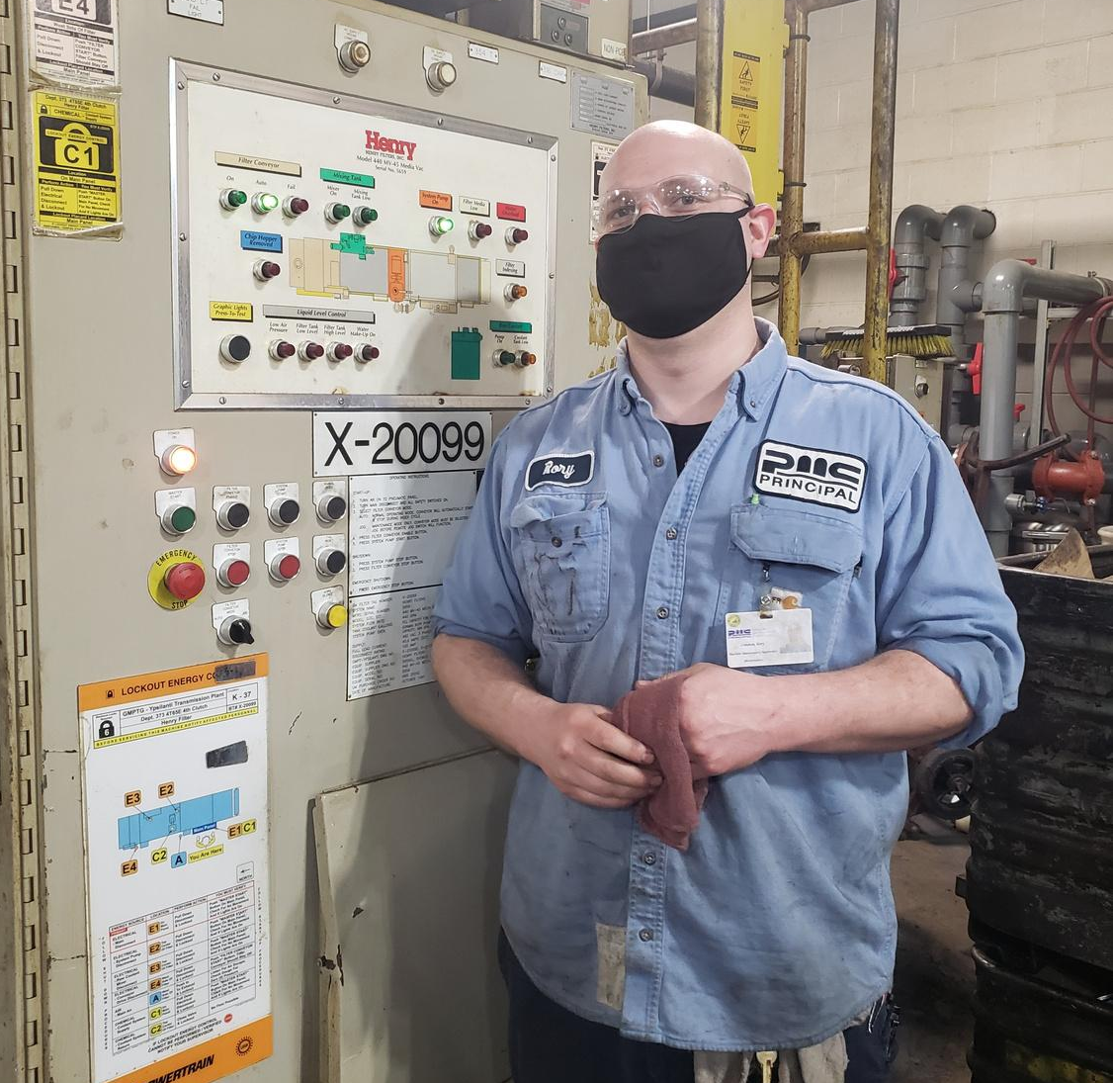
I struggled to find my way for years. I worked mostly dead-end jobs for over a decade and then I decided it was time for a change. I made the choice to go back to school to try to find an actual career that worked for me.
Being an apprentice has actually helped me build my confidence and given me a purpose that I was missing before. It’s more like I have a career now and I’m working towards something because I have definite goals.
Having this apprenticeship has been the greatest thing that I’ve done for my career and my life, so I would definitely say to others to go for it.
Rory
CAREER SEEKER
Industrial Maintenance Mechanic

Slide 29
Pathways to Further Education
Stackable Credentials: Apprenticeship programs at community colleges often allow students to earn stackable credentials that can lead to higher-level degrees or certifications. For example, apprentices may start with a certificate, move on to an associate’s degree, and even pursue a bachelor’s degree.
Pathway to Degrees: Community colleges often create pathways that enable apprentices to transition smoothly from technical certificates to degree programs without losing credits or training hours.
Articulation Agreements: Many community colleges have articulation agreements with four-year universities, allowing apprentices to continue their education if they choose to pursue advanced degrees while maintaining their career trajectory.
Notes:
Danielle

Slide 30
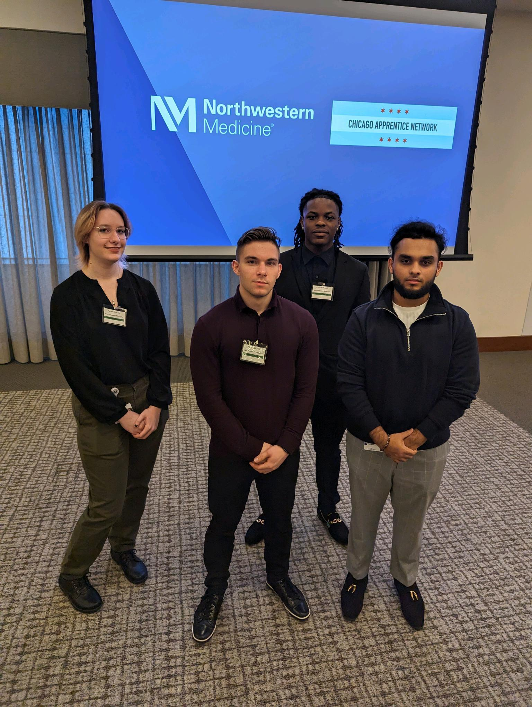
Christian
COLLEGE STUDENT HIRE
Information Technology in Healthcare
From the moment I started on my journey as an Apprentice, it became increasingly clear I made the right decision to choose this path. The idea of being an apprentice in such a high priority healthcare institution was not just about gaining technical skills but also about immersing myself in an environment that thrives on innovation, collaboration, and a commitment to patient care. My employer places a strong emphasis on hands-on experience, allowing apprentices like me to work directly with cutting-edge technologies and real-world challenges.

Slide 31
High Success & Retention Rates of Apprenticeship Programs
Completion and Employment Rates: Apprenticeships through community colleges tend to have high completion rates because students receive both academic and on-the-job support.
Retention: Apprentices who come through community college partnerships often stay with their employer's post-apprenticeship, as they’ve been trained specifically to fit the company’s needs and culture.
Employer Satisfaction: Employers frequently report high satisfaction with community college apprentices because they receive a well-rounded education that combines theory, practice, and workplace skills.
Notes:
Danielle
Focus on the retention rates of Apprenticeship Programs
Many programs track completion and support apprenticeship retention in and around 90% because of the additional support provided to these apprentices.

Slide 32
Funding and Grants Opportunities
Grant Programs: Community colleges are often eligible for federal, state, and local grants that can be used to support apprenticeship programs. For example, the U.S. Department of Labor has various grant initiatives to support apprenticeship expansion, and community colleges can access these to offset program costs.
Partnerships with Employers: Employers can partner with community colleges to apply for training grants or tax incentives, making apprenticeships more financially viable.
Partnerships with Workforce Investment Boards: Incumbent Worker Training funds (IWT), Apprenticeship Funding
Notes:
Danielle

Slide 33
Innovative Strategies
and Best Practices
High-Impact Intermediaries
Notes:
Danielle

Slide 34
Leveraging Unique Opportunities
Pre-Apprenticeship Programs
Assessing Business Culture for Readiness
Build Future Pipelines for Apprentices/Pre-Apprenticeship Programs
High School Partnerships/ Youth Apprenticeships & the Postsecondary and Workforce Readiness (PWR) Act
Mentorship Training for OJT Mentors
Notes:
Danielle
In our work, we’ve seen and adopted various apprenticeship unique opportunities. These are just a few of the many components added to apprenticeships to help enhance the experience for those engaged in an apprenticeship program. This isn’t an exhaustive list, and we acknowledge that these are areas we continue to work on improving in our own practice.
Pre apprenticeship - Elgin Community College
Assessing Business Culture for Readiness - Aimee
Mentorship Training - Danielle
Build Future Pipeline for Apprentices - Corey
(High School) Postsecondary and Workforce Readiness (PWR). - Danielle
Wrap Around Support - Danielle
NIWC Regional Collaboration - making it easier for employers to engage - Corey
ICCB Apprenticeship Learning Communities - bringing colleges together to build knowledge and programs - Corey

Slide 35
Leveraging Unique Opportunities (cont.)
Career Coaching
ICCB Apprenticeship Learning Communities (specific to community colleges)
Regional Collaboration
Awareness Building - National Apprenticeship Week partnerships
Notes:
Danielle
In our work, we’ve seen and adopted various apprenticeship unique opportunities. These are just a few of the many components added to apprenticeships to help enhance the experience for those engaged in an apprenticeship program. This isn’t an exhaustive list, and we acknowledge that these are areas we continue to work on improving in our own practice.
Pre apprenticeship - Elgin Community College
Assessing Business Culture for Readiness - Aimee
Mentorship Training - Danielle
Build Future Pipeline for Apprentices - Corey
(High School) Postsecondary and Workforce Readiness (PWR). - Danielle
Wrap Around Support - Danielle
NIWC Regional Collaboration - making it easier for employers to engage - Corey
ICCB Apprenticeship Learning Communities - bringing colleges together to build knowledge and programs - Corey

Slide 36
Navigating Challenges: Addressing Barriers in Apprenticeship Intermediary Partnerships
Finding the best fit for the region, industry & your employer’s needs in a complicated ecosystem
Differing levels of support, understanding and opportunities based on location
Developing new programs can take more time
Communication
Bureaucratic hurdles and political barriers
Notes:
Danielle
Not all community colleges have dedicated apprenticeship staff
Different models and approaches and levels of understanding
Communication - to the right people, with the right information, at the right time, with the right messaging
Complex administrative processes and shifting political landscapes can delay or complicate the development and scaling of apprenticeship programs.

Slide 37
Collaborating for Long-Term Apprenticeship Success
Future Alignment and
Strategic Alliances
Notes:
Gina

Slide 38
Future Alignment
We jointly “win” through collaboration and a continuous improvement mindset. Partnerships are even more crucial for future success and scale:
LWIA’s
Apprenticeship Illinois
Department of Labor
Illinois Community College Board (ICCB) Workgroup on Apprenticeship
Other Federal, State and Local Agencies
Notes:
Gina
The need for future alignment is stronger now than ever before. There are so many different players in this space and we all are focused on different but similar parts of the puzzle. Working together allows us to connect the dots between our work and better serve our constituents. We jointly “win” through collaboration and a continuous improvement mindset.
We know that there is potential new legislation we will need to work on together.
We acknowledge there are some barriers that we have as institutions of higher education. And we need to work on breaking down those barriers.
External: invite folks to our campuses, raise awareness of new programs
Internal work to do still: Being more flexible, using non-credit to move quicker
There is an ICCB Workgroup on Apprenticeship that supporting community colleges through apprenticeship learning communities, best practices, data collection and more.
We have to understand and sell the business value of apprenticeships. We know it is a longer-term, talent pipeline management solution and help our employers understand that.
We also know that the future of work is changing and we need to be able to anticipate those needs, including things like incorporate emerging technologies, emphasise transferable skills, promote lifelong learning, flexibility and modular structure, digital skills to better prepare individuals.
We know everyone has to be at the table to make it happen and hope you will be there to join us.

Slide 39
Strategic Alliances
The partnerships will differ community to community because:
  Each community and districts (LWIA, community college, etc.) are distinctly unique
  Resources vary by region
  The capacity and interests of each stakeholder
The stakeholders around the table are/should be ever-evolving based on:
  New programs, initiatives and funding sources (i.e. emergence of transformational clean energy, quantum projects)
  Changes in legislation
  Continuous improvement mindset
Notes:
Gina

Slide 40
Let's work together to build a sustainable, responsive apprenticeship system that provides opportunities for all.
Questions?
Thank you.

