Slide 1
Collaborating with K-12
on CTE and
Work-Based Learning

Slide 2



Presenters
Marci Johnson
Director of Career and Technical Education at the Illinois State Board of Education
Terry Stroh
Director of the Northern Kane County Regional Vocational System

Slide 3
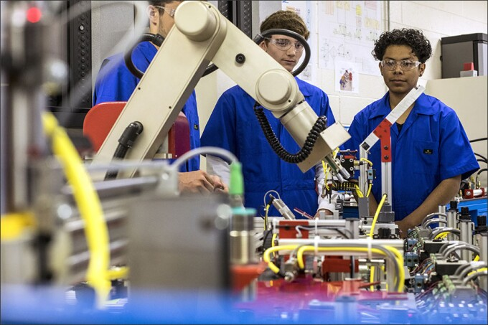
What is Career and Technical Education?
CTE refers to rigorous and relevant career and technical education (CTE) programs designed to focus on the academic and technical skills and knowledge necessary to prepare students for a wide range of high-wage, high-skill, in-demand careers.
Education Week

Slide 4

Career and Technical Education
Purpose of Career and Technical Education (CTE) is—​
A sequence of courses that includes rigorous academic content and relevant technical knowledge and skills that prepares secondary or postsecondary students for further education and careers in high-skill, high-wage, and in-demand occupations;​
Applied learning that supports the development of academic knowledge, higher-order reasoning and problem-solving skills, work attitudes, employability skills, occupation-specific technical skills, and knowledge of all aspects of an industry; ​
To the extent practicable, coordinated between secondary and postsecondary education programs through programs of study, which may include early college high school programs, dual credit, and other articulations; and ​
May include career exploration as early as the middle grades. ​

Slide 5

Perkins V State Plan
Goal 1: Increase the percentage of individuals who obtain a postsecondary certificate, degree, or industry-recognized credentials.
Goal 2: Strengthen CTE offerings by improving access, program quality, and transition points between education and workforce systems and programs.
Goal 3: Increase participation in CTE early college coursework.
Goal 4: Increase responsiveness to local, regional, and state workforce needs based on labor market information and employer input.
Goal 5: Recruit and retain a sustainable pipeline of CTE educators.
Goal 6: Expand access to quality work-based learning for all students.
https://www.isbe.net/perkinsv
Forbes

Slide 6

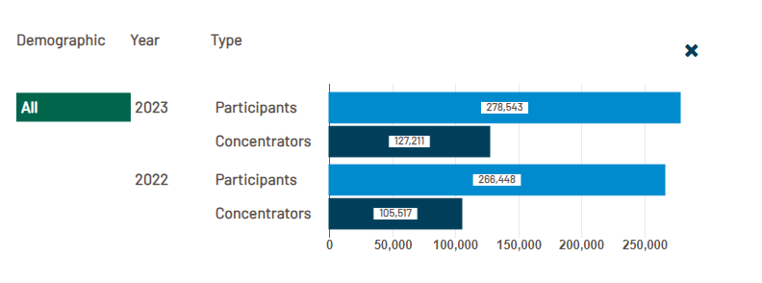
Iwww.llinoisreportcard.com

Slide 7
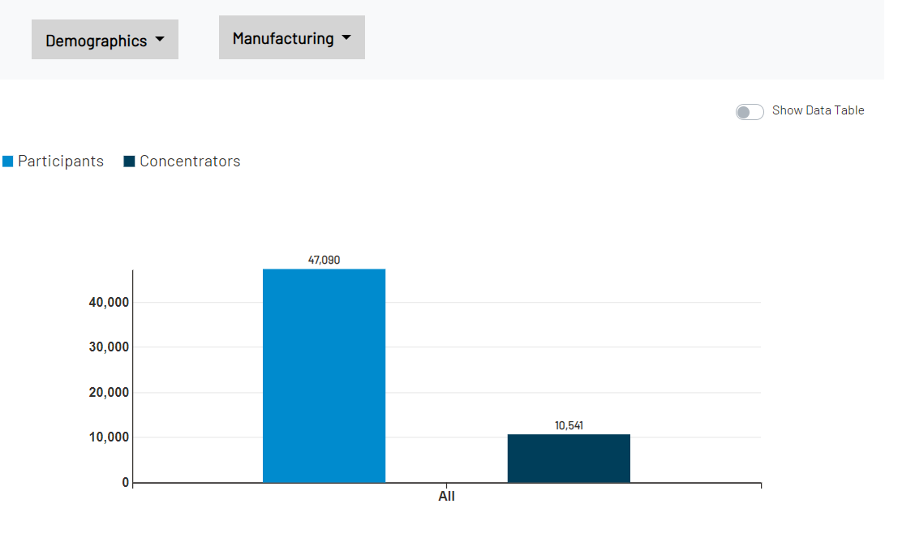
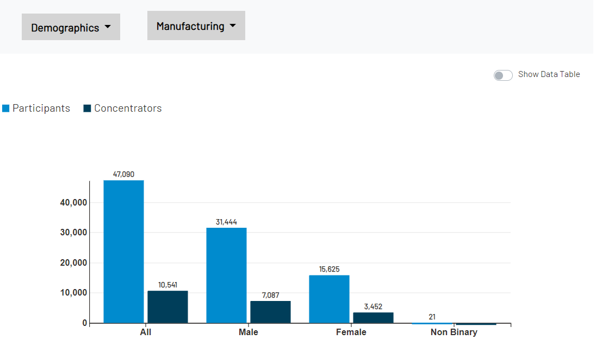
Example of Enrollment in Manufacturing

Slide 8
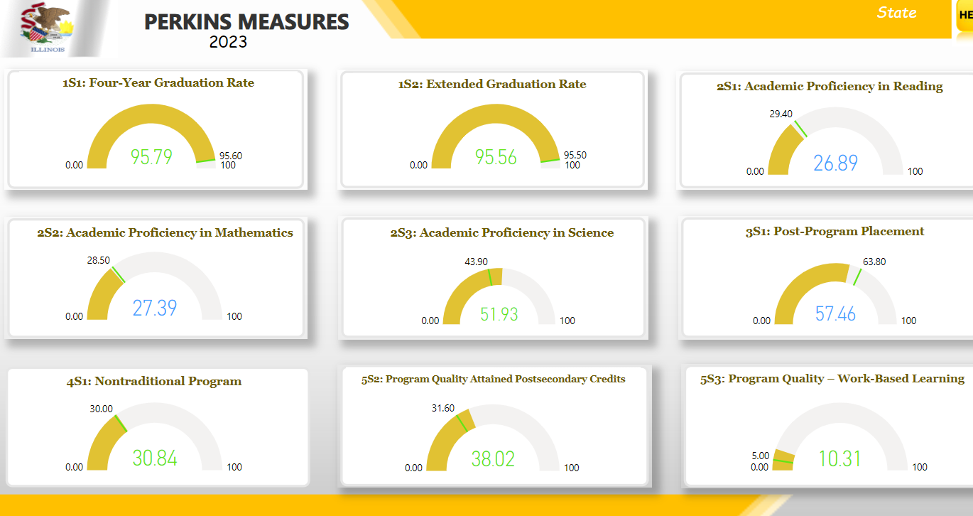
Performance Measures

Slide 9
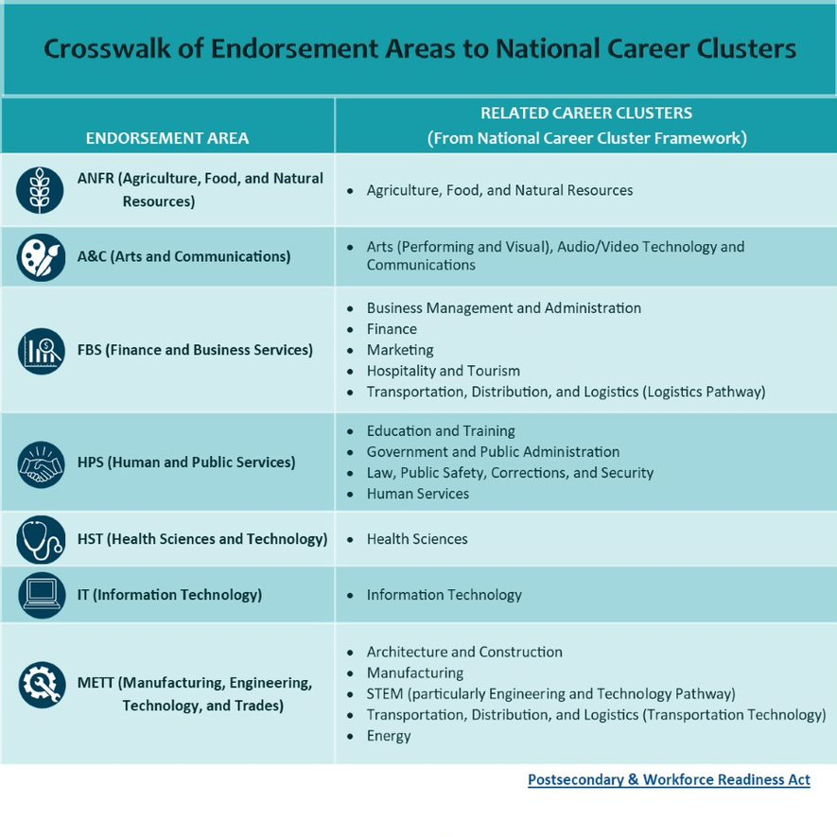








Slide 10

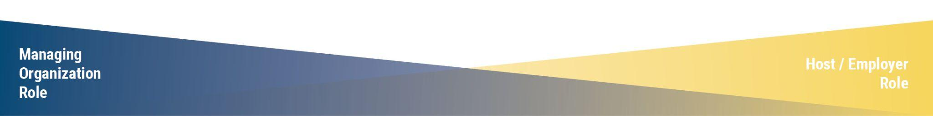
Work-Based Learning Continuum
Host Engagement Continuum
Definitions: Illinois Career Pathways Dictionary

Slide 11
Types of Workplace Experiences
Student-Led Enterprises
School-Based Enterprise
Immersion Supervised Agricultural Experience
Clinical Experiences
Internships
Youth Apprenticeships

Slide 12
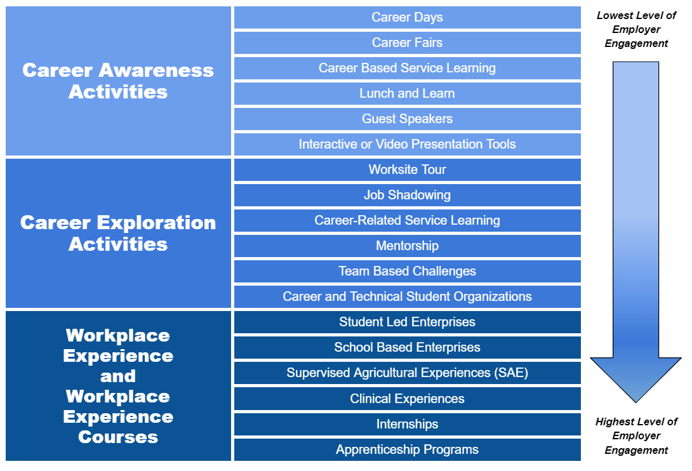
Notes:
The NIU-Illinois CTE Project has developed this graphic to help highlight a variety of Work-Based Learning activities and to illustrate where those activities fall within the continuum.
Career Awareness and Career Exploration are often already occurring and an easier lift so today’s focus will be Workplace Experience Courses as those typically come with the most questions surrounding requirement of educator-coordinator and implementation to make sure it is aligned with best practices.

Slide 13

Professional Learning: Team-Based Challenges
Report on two Team-Based Challenges that include these components:
Authentic problem or challenge
Students interact in a meaningful way with an adult mentor
Students demonstrate at least one Pathway specific Technical Competency and at least one Cross-Sector Essential Employability Competency (Essential Skill)
Students work in collaborative groups to solve the problem
Final product or a final presentation on the outcome of the Team-Based Challenge

Slide 14
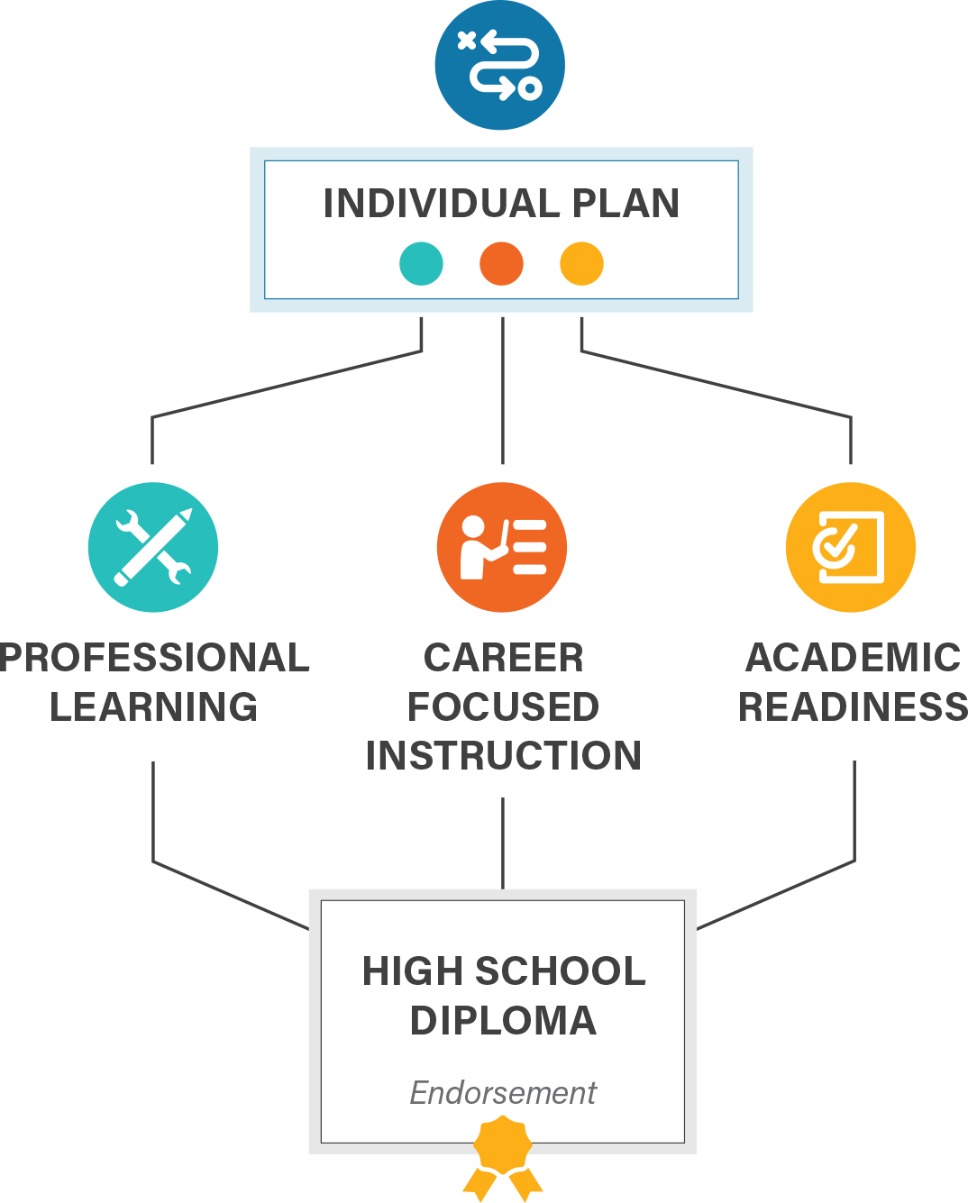
Pathway Endorsement Components
Individual Plan for Postsecondary and Career Readiness
Labor Market/Workforce Needs
Postsecondary Partner
Course Sequence
Academic Readiness
Professional Learning Experience

Slide 15
How can you benefit from Career Pathway Endorsements
Quality
Academics
Credentials
Knowledge
Technical Skills
Work-Based Learning
Experience

Slide 16
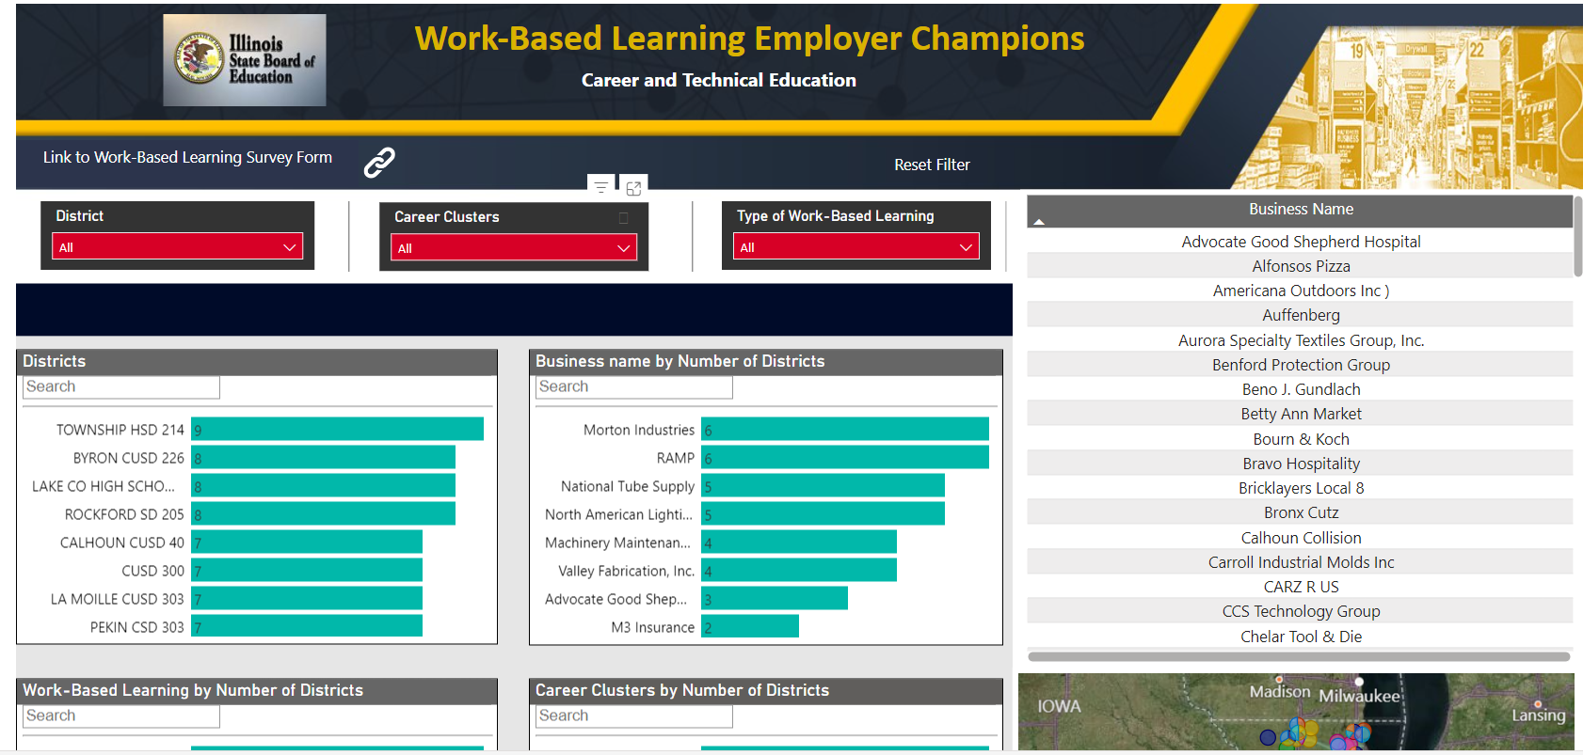

Slide 17
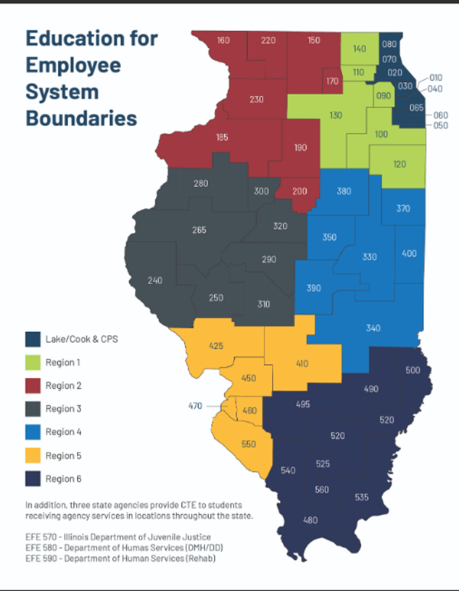
Education for Employment CTE
Funded by Federal Perkins V and State Line Item in the ISBE Budget

Slide 18


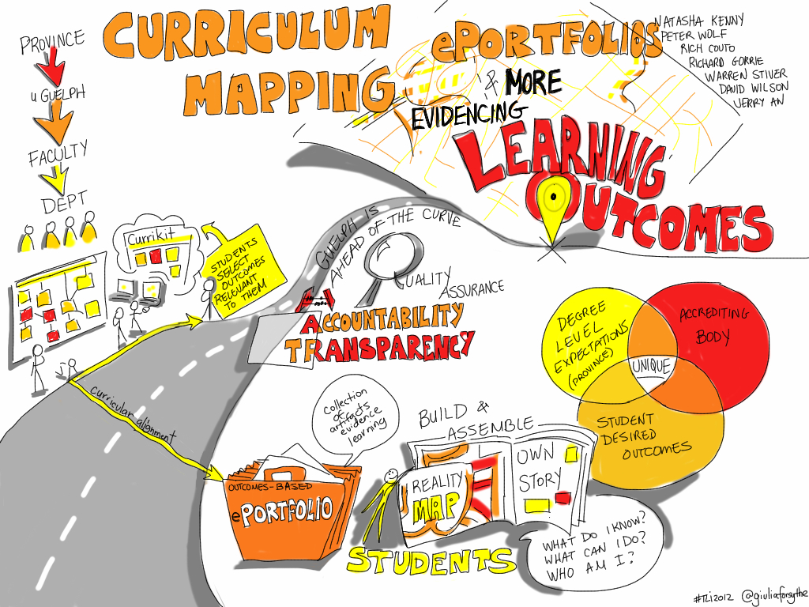
What is an EFE Director?
Regional CTE Director
  Curriculum
  Data
  Regional programming/Career Centers
Manager of grant funding
  State CTEI funds
  Perkins funds
  Other grant opportunities
Liaison with the community college
  Dual credit
Liaison between schools and industry
ThePhoto by PhotoAuthor is licensed under CCYYSA.

Slide 19
How does K-12 Education support Workforce Development?
Career Exploration
  Field Trips
  Guest Speakers
  Career Fairs
  Industry Tours
Career Development
  Career and Technical Education classes
  Advisory Boards
  Industry Certifications
Career Guidance
Staff Professional Development
  Counselor Field Trips
  Teacher PD
Student Competitions
Internships
Job Fairs

Slide 20
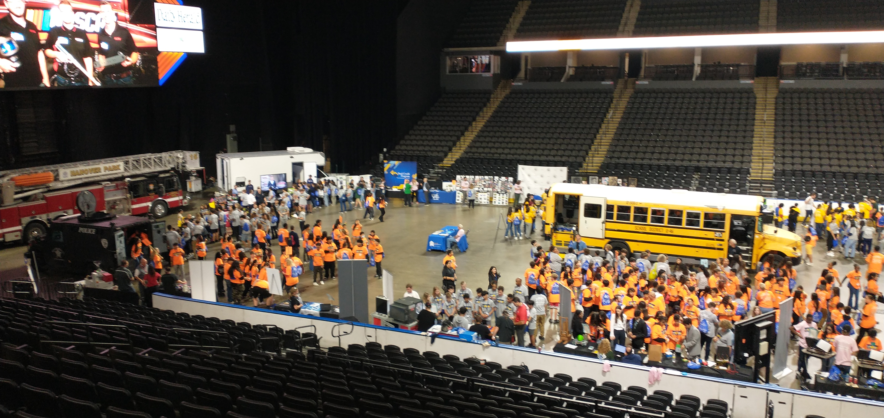
Job and Career Fair
Career Fairs
  Various grade levels
  Combinations of companies and colleges
    We would love to have more companies involved
Job Fairs
  Senior Job Fairs
  60+ companies and colleges
  On-site interviews

Slide 21
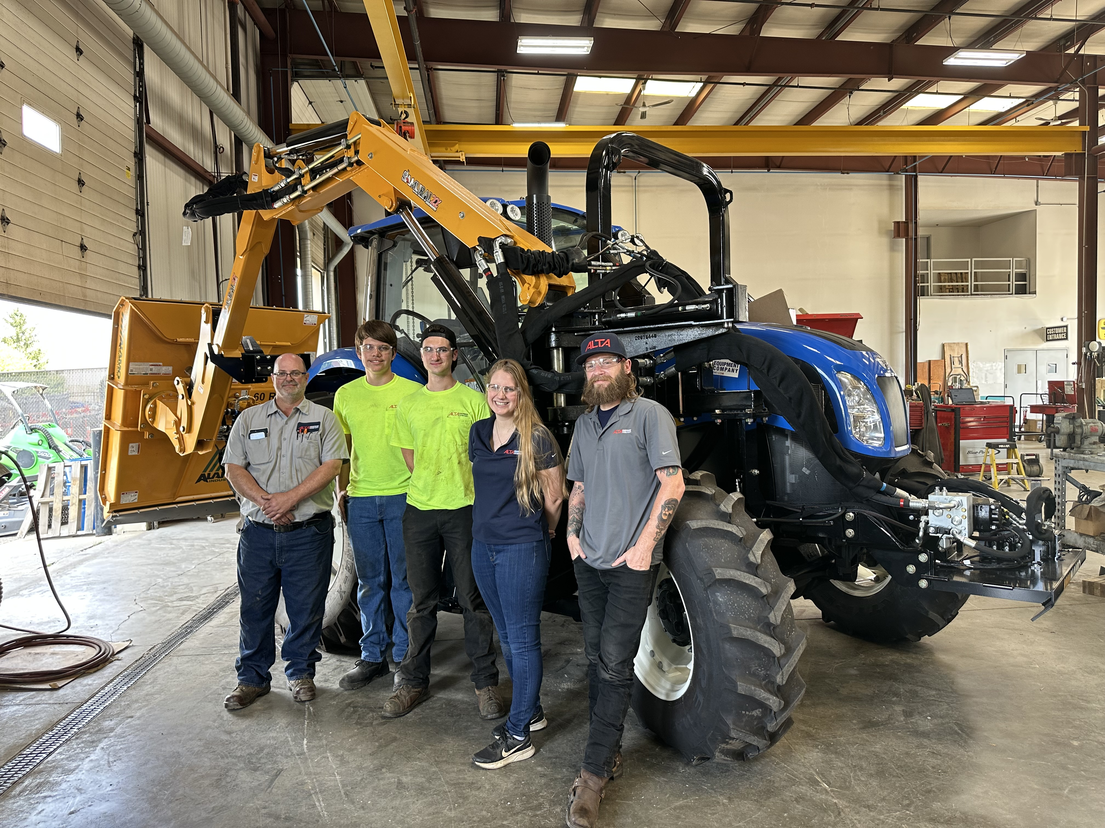
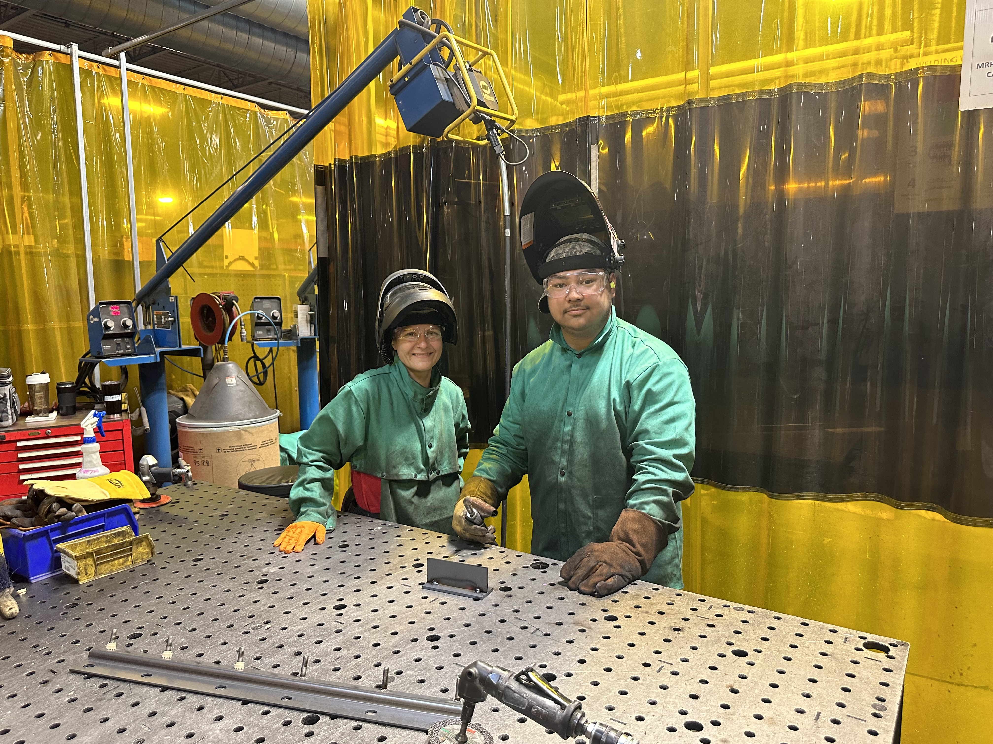
Internships
Shift from Co-Op to Internships
Requirements for internships
  Minimum of 60 hours
  Must be co-developed by schools and industry
During the school year
  Students get release time from school to complete hours
  There is a teacher of record that works with students
  Students must complete 1 hour per week with the teacher
Summer Internships
  Students complete these during summer break
How do we use these internships as a start to apprenticeships/employment?

Slide 22
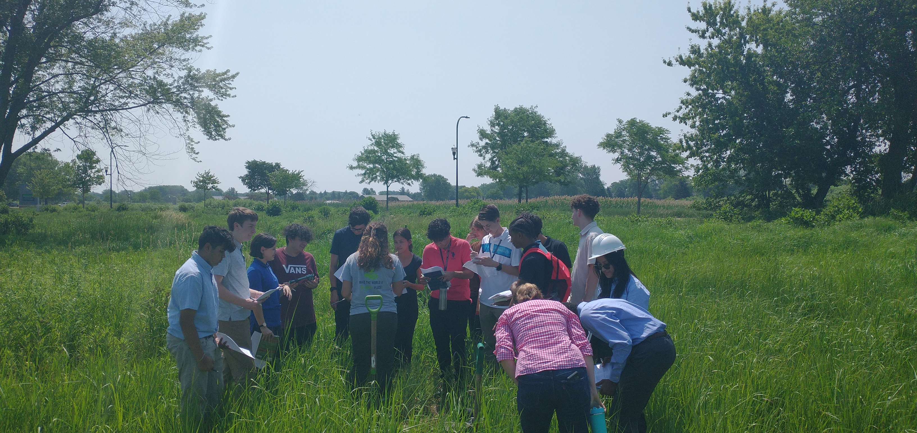
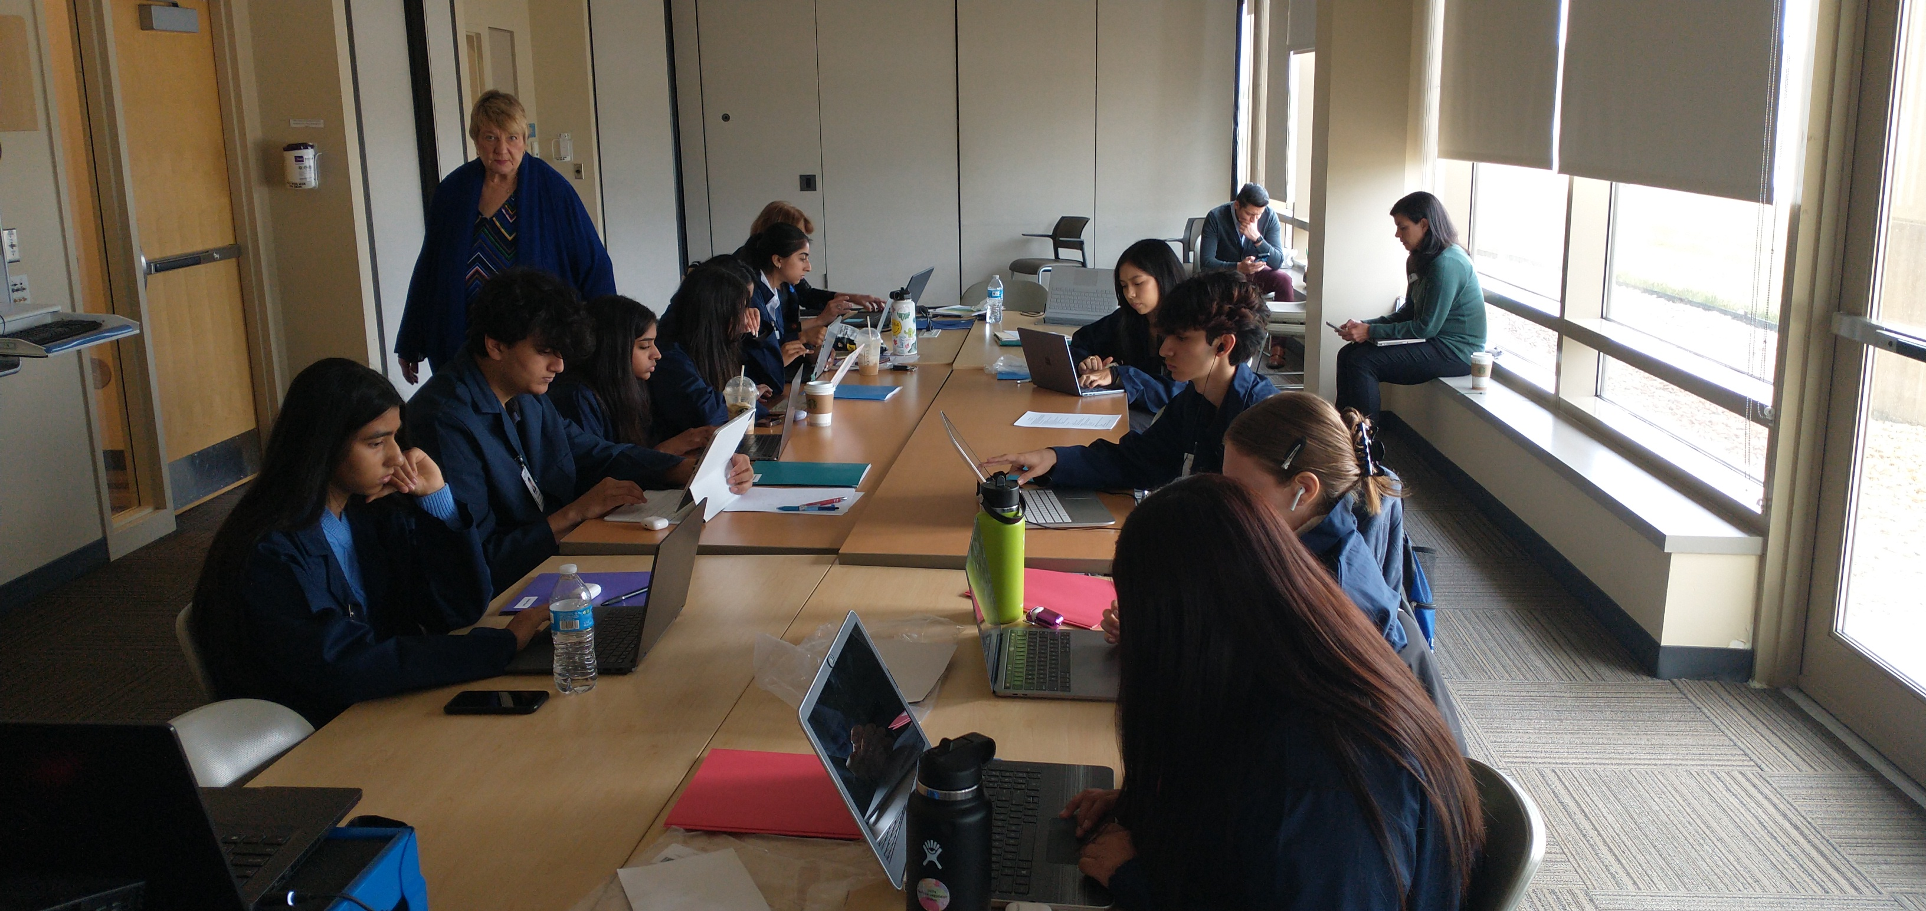
Internships continued
Company Agreements
Internship listings
Application process
  Application form
  Student Resume
Interviews
Placement
Follow-up

Slide 23
Questions and Contact Information
Marci Johnson – marjohns@isbe.net
Terry Stroh – terry.stroh@central301.net

