Slide 1


Phone lines will be muted for better sound quality
We will be recording this session
Please use chat box to ask questions
We will try to answer as many questions live as possible and will follow up with a FAQ if can’t get to all of them

Slide 2









Slide 3
What are we going to cover today?
IWIB Apprenticeship Committee and Work Groups
What is Apprenticeship?
Intermediary and Navigator Framework
Myths about Apprenticeship
How to find resources on ApprenticeshipIllinois.com
Time for Questions

Slide 4






Get to know your presenters
Patrick Campbell Illinois Department of Commerce and Economic Opportunity
Morgan Diamond Midwest Program Manager
Young Invincibles
Jennifer Foil Northern Illinois University
Center for Governmental Studies
Jim Nelson,
Vice President Education & Workforce Policy, Executive Director, Illinois Manufacturers’ Association Education Foundation
Manny Rodriguez Executive Director, Revolution Workshop
Paul Thompson, III
Executive Director,
Apprenticeship & Workforce Solutions
City Colleges of Chicago
Notes:
Patrick leads the welcome and introductions

Slide 5
IWIB Apprenticeship Committee
Illinois Workforce Innovation Board created a standing Apprenticeship Committee in Spring of 2016
Charge
  Fully integrate apprenticeship into state workforce development, education, and economic development strategies and programs;
  Support the rapid development of new apprenticeship programs and/or the significant expansion of existing programs;
  Support the development and recruitment of a diverse pipeline of apprentices; and
  Build state capacity to make it easier for businesses to start apprenticeship programs and for apprentices to access opportunities.
Work Groups
  Systems and Supports
  Marketing and Outreach
  Youth and Pre-Apprenticeships
Notes:
Jennifer Foil

Slide 6





What is apprenticeship?
Employer Involvement
Structured
On-the-Job Learning
Related Training and Instruction
Rewards for Skill Gains
National Occupational Credential
Five Core Components of Apprenticeship
Registered with the U.S. Department of Labor, Office of Apprenticeship and/or Federally Recognized State Apprenticeship Agencies
Notes:
Morgan Diamond
Five Core Components of Registered Apprenticeship
Employers are the foundation – providing input and guidance….. to build the program
Apprentices receive structured on-the-job learning from an experienced mentor/trainer
Related Instruction/Training-compliments the on-the-job learning
Apprentices receive increases in wages as they gain higher level skills
Registered Apprenticeship Programs result in a National Recognized Credential

Slide 7
What is Apprenticeship?
The Department of Labor considers an employer-worker relationship to be a qualified apprenticeship when:
The worker receives on-the-job learning (OJL) under the direction of the employer’s personnel (normally at least 2,000 hours);
The worker also receives theoretical and practical related instruction/training (a recommended minimum of 144 hours) outside of the OJL;
The worker earns a wage during his or her training, which increases as the apprentices develops more skills and experience; and*
The training results in an industry-recognized credential after one to six years.
*Two-Part Note:
The employer decides on the wage and the amount & timing of increased wages;
Some programs start with font-loaded, related training before OJL begins, where sometimes the participant is not yet hired, and therefore not receiving a wage and not yet an official apprentice.
Notes:
Morgan Diamond

Slide 8
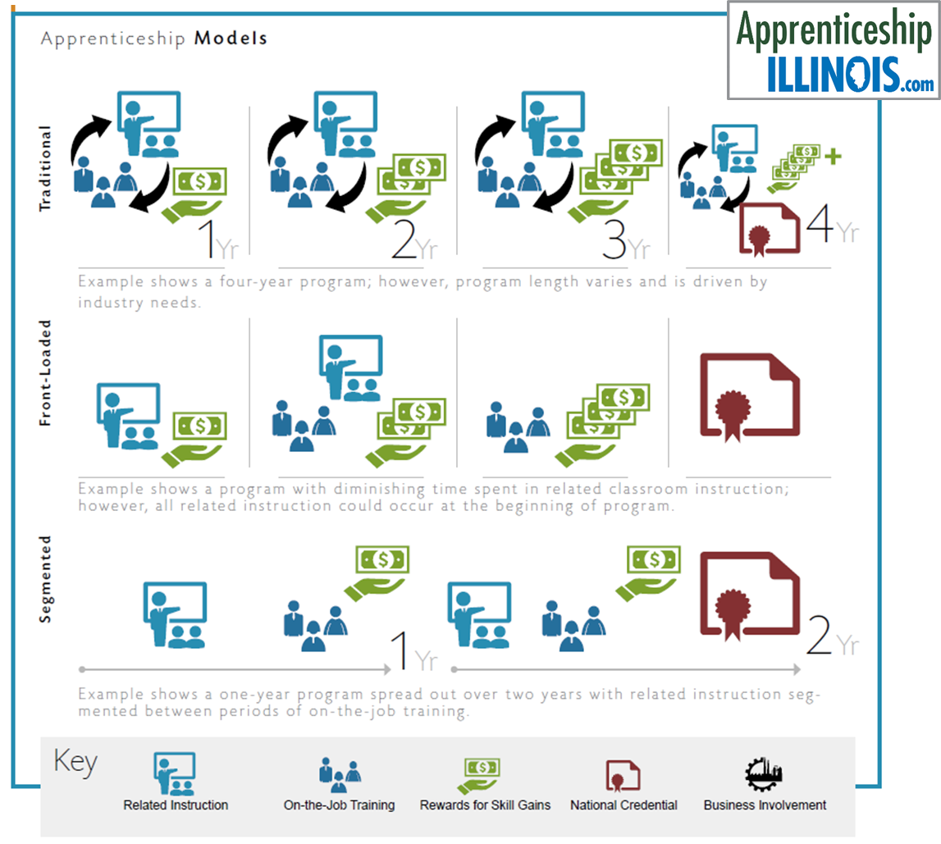
Apprenticeship Programs can be Flexible and Adaptable
Registered Apprenticeship is flexible and can adapt to employer needs.
Apprenticeship Models –
Traditional – Apprentices receive both related instruction and on-the-job learning throughout the program
Front loaded – Apprentices complete some related instruction before starting on-the-job learning
Segmented – Apprentices alternate between related and on-the-job learning
Programs can be time-based, competency-based, or a hybrid. The related instruction is flexible - can be online, in a conference room, in a classroom, or a combination.
Notes:
Morgan Diamond
Apprenticeship programs can be flexible to meet the needs of the employer and/or occupation. …….

Slide 9

Career Pathway
Pre-Apprenticeship
Pre-Apprenticeship
Youth Apprenticeship
Apprenticeship
Registered Apprenticeship
Non-Registered Apprenticeship Industry Recognized Credential Programs
Business Involvement • Structured-on-the-Job Training
• Related Instruction • Rewards for Skill Gains
• Industry Recognized Credential(s)
Notes:
Morgan Diamond

Slide 10
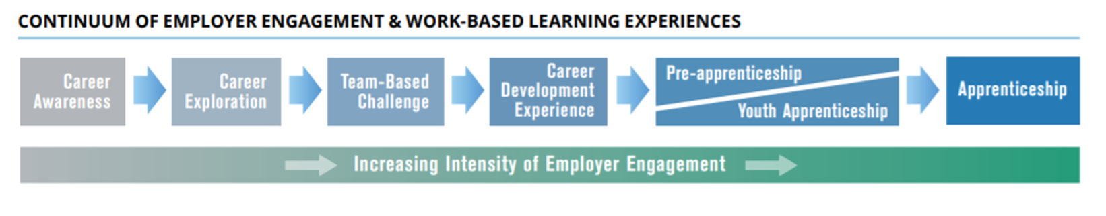
Apprenticeship as a Career Pathway
Career Pathways. A combination of rigorous and high-quality education, training, and other services that aligns both vertically and horizontally across Secondary Education, Adult Education, Workforce Training and Development, Career and Technical Education, and Postsecondary Education systems, pathways, and programs. Collaborative partnerships with these entities and business and industry, along with human service agencies, corrections, and other community stakeholders, serve as the foundational structure for high-quality and sustainable career pathways. A career pathway also includes multiple entry and exit points to facilitate individuals to build their skills as they progress along a continuum of education and training and advance in sector-specific employment.
For more information, refer to the Illinois Career Pathways Dictionary.
Notes:
Morgan Diamond
On the continuum of employer engagement and work-based learning experiences, Apprenticeship requires the most from employers. …..

Slide 11
Notes:
Morgan Diamond

Slide 12
Benefits of Apprenticeship
Helps to improve recruitment and develop a highly skilled workforce
Trains new workers or upgrades the skills of current employees
Newly hired apprentices receive a paycheck based on a training wage from day one – Pay rises incrementally as their knowledge and compentency increase
Provides employer opportunities for tax credits
Notes:
Jim Nelson

Slide 13
Value Proposition
Build a pipeline of workers
  Employers worry about their aging employees and how they will replace those retiring in the face of a contracting labor force
Gain workers with customized skills
  In addition to foundational industry standards, companies train to their own specific processes and procedures.
Boost retention
  94% of apprentices continue employment after completing an apprenticeship
  A survey of businesses with apprenticeship programs found that 97% would recommend apprenticeship to others
  Cost of turnover tool
Save money on wages
  Because apprentices start out earning less than a fully trained employee, businesses can reduce payroll costs by implementing an apprenticeship program
Notes:
Jim Nelson
https://www.americanprogress.org/issues/economy/news/2014/07/14/93768/the-bottom-line-apprenticeships-are-good-for-business/

Slide 14
Apprenticeship Education Tax Credit
SB 1591 – created to encourage employers with “skin in the game”
Available for expenditures on and after January 1, 2020, limited to $5,000,000 per calendar year (first-come, first-served basis)
Employers may receive up to $3,500 tax credit certificate for paying educational costs on behalf of a qualifying apprentice (can be for multiple apprentices working for the same company)
Additional $1,500 credit if (i) the qualifying apprentice resides in an underserved area as defined in the Economic Development for a Growing Economy Tax Credit Act or (ii) the employer's principal place of business is located in an underserved area.
Notes:
Jim Nelson

Slide 15
Apprenticeship Education Tax Credit
How does the credit work?
  Employers can take the credit against qualified education expenses they paid for during the apprentice(s)’ training program
How do firms become eligible to use this tax credit?
  Employers must apply to the Department for certification – see URL below
What are qualified education expenses?
  Tuition, book fees, and lab fees
Which employees are eligible?
  A qualifying apprentice must be: (a) an Illinois resident; (b) at least 16 at the close of the school year for which a credit is sought; (c) a full-time apprentice enrolled in an apprenticeship program registered with U.S. Department of Labor (USDOL), Office of Apprenticeship during the school year; and (d) employed by the taxpayer in Illinois
https://www2.illinois.gov/dceo/ExpandRelocate/Incentives/Pages/ILApprenticeshipTaxCredit.aspx
Notes:
Jim Nelson

Slide 16
Apprenticeship Illinois
Why Intermediaries and Navigators?
Notes:
Paul Thompson, III and Manny Rodriguez

Slide 17
The issue….
Braided Funding
Partnerships
LWAs
Turnover
Barriers
Employers
Workforce Needs
Skills Gap
WIOA
Credentials
Math & Literacy
Work-Based Learning
Data
Colleges
Training
Industry Trends
Goals
OJT
Quality Programs
DOL
Competencies
Retention
Targeted Populations
Career Pathways
Improvement
Productivity
High Schools
Wages
Mentoring
Notes:
Paul Thompson, III and Manny Rodriguez
Want to expand apprenticeships – new industries, new employers, more opportunities for workers - but there’s so much information…it’s overwhelming…need help making sense of it all and getting started.

Slide 18

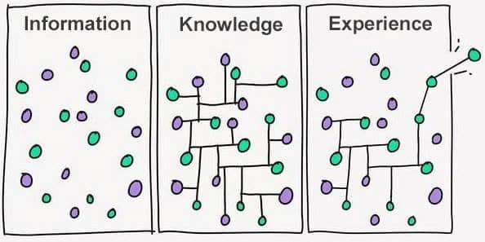
Connecting the Dots - Where to begin?
Regional workforce needs – present and future
Employers, Youth, Parents, Counselors, Adults
Career Pathways
Work-Based Learning /Apprenticeships
OJT/Mentoring
Perception
Training providers, Secondary & Post-Secondary Schools
Credentials
Quality & Standards
Braiding funds – WIOA & Private
Targeted populations
Supportive Services for Success
Reality
Notes:
Paul Thompson, III and Manny Rodriguez
Navigators & Intermediaries can do this! They are there to ease the burden on employers and to help connect the dots. ………..

Slide 19
“Theory” of creating more apprenticeships …
Role A – Regional Apprenticeship and Workforce Consultant, aka Apprenticeship Navigator
  Fosters the development of partnerships, get people to the starting line, “holds their hand” guiding them through the process
  Role A could connect Role C with a Role B or with DOL office of apprenticeship
  Helps create or foster Role Bs in region, as needed
Role B – Apprenticeship Intermediaries
  Aggregators providing more scale, with multiple employers and partners, they take on most of the “leg work” of implementing and managing apprenticeship programs
  Collaboration, all working together
Role C – “One-offs” – Individual Employers (although promoting first two scenarios for more rapid expansion of apprenticeship programs)
  An individual company that wants to have an apprenticeship program, may work with local training provider
  Is helped by Role A to begin a program
Notes:
Paul Thompson, III and Manny Rodriguez

Slide 20
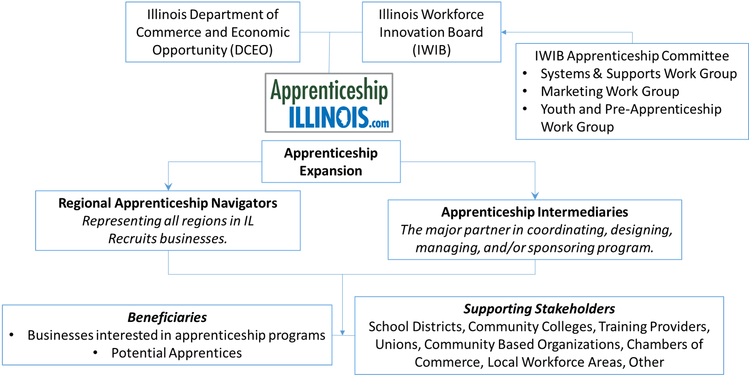
Apprenticeship Illinois Expansion
Notes:
Paul Thompson, III and Manny Rodriguez
The Apprenticeship Committee along with the help of DCEO have adopted the Navigator and Intermediary model to expand apprenticeships more quickly within all regions of the state and within different occupations……..

Slide 21
Overview of Roles
 | Navigator | Intermediary
Definition | Apprenticeship navigators serve as key points of contact in the region for outreach and partnership development to help expand apprenticeship programs. Navigators are also responsible for identifying intermediaries who can serve as supports (and at times sponsor) apprenticeship programs. | Intermediaries bundle the needs of small and medium-sized businesses and ensure that the employer and all supporting parties' have clearly defined roles and responsibilities. Intermediaries can sponsor/manage apprenticeship programs, but are not required to do so.
Service Area | Navigators are located in each of the economic development or local workforce area regions; they are primarily tasked with conducting recruitment and outreach activities to all employers regardless of the sector. | No geographic restriction; intermediaries are sector-specific, and may cover multiple sectors.
Role specifications | Navigators should remain unbiased on the apprenticeship strategy, RTI and community support partners for each employer client. Navigators should connect employers to all available funding streams. | An intermediary can employ one or more navigators but the navigator should never execute intermediary functions.
Key terms and useful descriptors | Marketing; making the field ripe; match making, & system building; they kick-start the program. | Make sure all of the activities and strategies are happening, but may not be doing “it” (e.g. sponsor)
Employer engagement/ recruitment | Using the US Chambers of Commerce’s Talent Pipeline Management’s approach to workforce development along with other business engagement best practices, navigators’ primary function is to engage employers and sell the idea of apprenticeship as a strategy for addressing talent pipeline challenges. | While they can also recruit employers as part of their normal business functions, intermediaries are not primarily responsible for recruiting employers.
Talent-facing engagement | Navigators recruit industry associations, business organizations, labor management partnerships and talent-serving institutions such as community and technical colleges, non-profit and community-based organizations and workforce development boards to serve as intermediaries. | Along with their internal talent pools (e.g.: in a community college setting or K-12 school district), intermediaries source for potential talent from community-based organizations and from the general labor market; employers have final approval for hiring the talent.
Notes:
Paul Thompson, III and Manny Rodriguez

Slide 22
Overview of Roles
 | Navigator | Intermediary
Identification of partners for RTI, wraparound supports | Navigators are primarily responsible for identifying organizations that support the training and retention of apprentices. They should have a database of local partners in their region. | Intermediaries are responsible for coordinating all organizations that support the training and retention of apprentices; they can play a secondary role in the identification and recruitment of partners.
Recruitment and training of OJL mentors | Navigators should not perform these functions. When an intermediary is needed to coordinate and/or implement a program, the navigator should identify the appropriate party that can serve as an intermediary or sponsor. | The intermediary should, in close partnership with the employer, identify and train mentors within the company who can provide structured on-the-job learning to apprentices.
Administration of apprenticeship program |  | The intermediary is responsible for ensuring this function is handled.
Holding standards of a program |  | The intermediary should execute this function.
Registration with DOL (when employer is interested) | When an intermediary is not needed and employer is interested in pursuing registration, the navigator should connect the employer to the DOL. | With the employer’s significant input, the intermediary can complete and submit registration documents to DOL.
Data collection | The navigator is responsible for collecting system-level data on their region in partnership with fellow navigators throughout the state. | The intermediary shares occupation-specific standards throughout the statewide apprenticeship navigator/intermediary network; the intermediary collects program and apprentice-level data.
Embedding diversity | Navigators are not accountable for enrollment of diverse populations into apprenticeships but should explain to their employer contacts the benefits of hiring apprentices from underrepresented groups (e.g.: increased tax credits, responsiveness to a wider range of consumers). Navigators should build relationships with employers and labor groups who may not have underrepresentation from women and people of color. Each navigator is also responsible for creating a list of community-based organizations that serve diverse and marginalized populations. | Intermediaries are responsible for ensuring diverse populations are enrolled in apprenticeship programs according to metrics that DCEO specifies.
Notes:
Paul Thompson, III and Manny Rodriguez

Slide 23
Apprenticeship Myth Busters
Myth: Only unions, community colleges, or large single employers can be “sponsors” or “hold the standards” NOT TRUE
Other examples of sponsors include committees, individual employers, consortiums, colleges & universities, workforce development boards/areas, industry associations, chambers of commerce, non-profits, community based organizations, and the military.
  If intermediary is the sponsor:
    Each employer can have different requirements for wage progression for skills gain
    Each employer signs a participation agreement
Notes:
Manny Rodriguez and Jim Nelson?

Slide 24
Apprenticeship Myth Busters
Myth: Registering an apprenticeship program is too bureaucratic, extensive, and difficult. NOT TRUE
Hundreds of existing Apprenticeable occupations
  Already vetted by industry
  Existing templates, core pieces, & 75% rule (can modify up to 25% of an existing registered program without having to reapprove)
    https://www.dropbox.com/sh/r6uucemwyhnywdn/AABYZ2Fi_nH1S9m7W8C2uL0xa
  If one doesn’t exist, use closely related occupations
New occupations
  ONet Code and outline
  Build OJL and Related Instruction
    Must be vetted and verified by 5 entities nationally
  Determine wage progression for skills gain
  Submit to national office
Notes:
Paul Thompson?

Slide 25
Apprenticeship Myth Busters
Myth: Apprenticeships and Internships are basically the same thing. NOT TRUE
APPRENTICESHIP
INTERNSHIP
Specific occupational training
High-level skills gained
Long-term (1-4 years)
Paid work
Expected to lead to continuous employment and career growth
Career Experience
More general skills gained
Short-term
Not necessarily paid work
Expected to last for a finite period of time
HANDS-ON EXPERIENCE
Notes:
Morgan Diamond?

Slide 26
Apprenticeship Myth Busters
Myth: All Apprenticeship programs take 4 years to complete. One size fits all. NOT TRUE
Time-based, competency-based, or hybrid
Increase or decrease a time-based by 25%
Minimum 2,000 hours of OJL to meet competencies
Credit for previous experience
Grandfathering
Registered Apprenticeship is flexible and can be customized to meet the needs of every type of business.
The training and education delivery as well as the length of the program can all be customized.
  For example, the on-the-job training component of the Registered Apprenticeship can be tailored to the specific skill requirements of a single company. This allows for training to be specific to the needs of that business.
Notes:
Morgan Diamond?

Slide 27
Apprenticeship Myth Busters
Myth: Apprenticeships are only for young people or recruiting new staff. It doesn’t apply to current employees. NOT TRUE
Apprenticeships are, in fact, open to all age groups and can be beneficial, career wise, even for an employee with years of experience.
A great model for upskilling current employees (incumbent workers).
Notes:
Manny Rodriguez?

Slide 28
Apprenticeship Myth Busters
Myth: Apprenticeship programs are costly. If I collaborate with other companies on an Apprenticeship program, my employees may go to one of those companies. NOT TRUE
Multiple studies have shown that apprentices are more loyal. Approximately, 91 percent of workers who complete a Registered Apprenticeship Program remain employed with the company. This investment leads to higher productivity, lower turnover, and less recruitment costs.
The risk of doing nothing is a far greater risk than possibly losing skilled workers to other companies. Building a larger pool of skilled workers is advantageous for all employers.
Employers who pay for the related training are eligible for the Illinois Apprenticeship Education Tax Credit.
Other resources may be available to pay for the related training and part of the OJL.
Notes:
Jim Nelson and Paul Thompson

Slide 29
Apprenticeship Myth Busters
Myth: Becoming an apprentice means choosing between work and college. NOT TRUE
Many apprentices earn two-year associates degrees during their apprenticeships and go on to earn four-year degrees (often free of debt).
Notes:
Paul Thompson and Jim Nelson?

Slide 30
Apprenticeship Myth Busters
Myth: Apprenticeship programs aren’t worth the investment.
NOT TRUE
There’s a perception among managers that taking on an apprentice will burden senior-level employees who will spend time on coaching rather than other tasks.
However, pairing entry-level apprentices with senior-level employees actually increases job satisfaction for senior team members, which could spell better long-term retention. After all, mentoring helps them feel invested in the company’s future. It also results in a smoother transition for apprentices and can significantly reduce onboarding time.
Notes:
Jim Nelson and Paul Thompson?

Slide 31
Apprenticeship Myth Busters
Myth: Designing an effective apprenticeship program requires too much legwork.
NOT TRUE
Businesses aren’t alone — Navigators and Intermediaries play a key role in supporting employers during the design process. Some programs are already designed, and employers can build on or use what is already in place. The navigators and intermediaries can help businesses through the registration process, making sure they take advantage of tax credits, and other financial incentives.
Companies can start by checking out the existing infrastructure. Visit www.ApprenticeshipIllinois.com
Notes:
Manny Rodriguez and Paul Thompson?

Slide 32
Apprenticeship Myth Busters
Myth: Stellar apprentices are few and far between.
NOT TRUE
Employers might not know where to find quality apprentices who have the drive to succeed and want skills-based learning opportunities. Because many companies hire based on older or outdated practices, this is especially true in industries such as tech, where many workers are self-taught or don’t have typical résumés. Fortunately, great apprentices aren’t difficult to find. For starters, intermediaries can assist companies in the search and hiring process. Beyond that, local workforce areas can support efforts in finding candidates, as well as supplemental funding for the training.
Notes:
Jim Nelson and Manny Rodriguez?

Slide 33

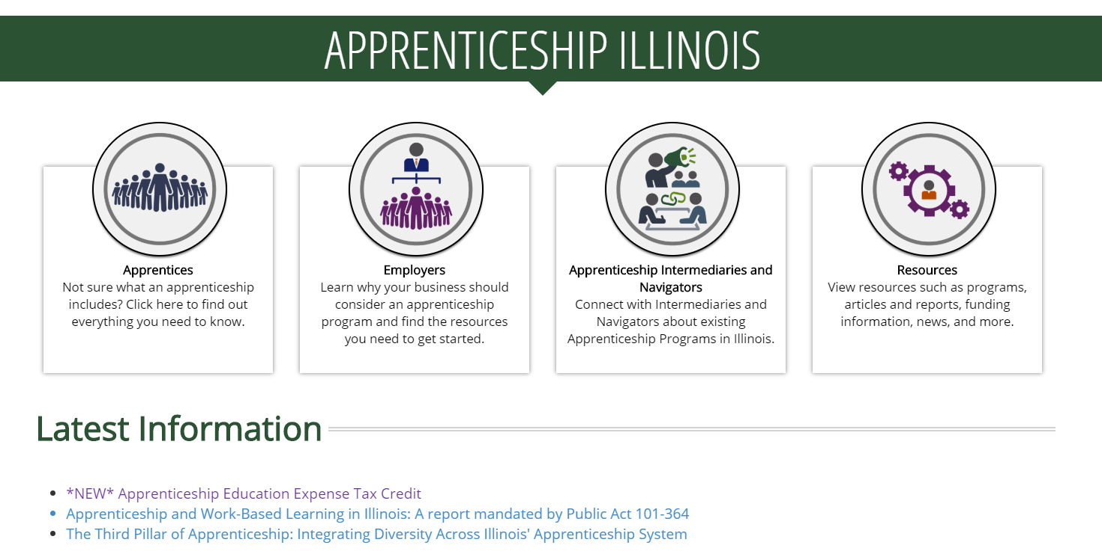
Apprenticeship Illinois Resources
Notes:
Patrick Campbell

Slide 34
Questions?
Notes:
ALL

